Slide 1

Computer Architecture ----A Quantitative Approach
陈文智
浙江大学计算机学院
chenwz@zju.edu.cn

Slide 2
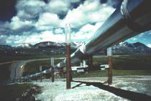
Lecture 2 for pipelining
The pipelining hazard
How to solve the structure hazard
How to solve the data hazard

Slide 3
What we knew about pipeline
Pipelining
implementation technique to execute instructions in a overlapped way to make fast CPUs (decrease CPUtime, improve throughput)
Ideal speedup of pipeline equal to Number of pipe stages
If the starting point is a multiple clock cycle per instruction machine then
pipelining decreases CPI.

Slide 4
Recall the MIPS 5 stage pipeline
IF (Instruction fetch cycle)
IR←Mem[PC];
NPC ←PC=PC+4;
ID (Instruction decode/register fetch cycle)
A ←Regs[rs];
B ←Regs[rt];
Imm ←sign-extended immediate field of IR;
Note: The first two stages of MIPS pipeline do the same functions for all kinds of instructions.

Slide 5
The third stage of MIPS pipeline
EX (Execution/effective address cycle)
Memory reference:
ALUoutput ←A+Imm
Register-Register ALU instruction:
ALUoutput ←A func B;
Register-Immediate ALU instruction:
ALUoutput ←A op Imm;
Branch:
ALUoutput ←NPC+(Imm <<2 );
Cond ←(A==0)

Slide 6
The last two stages of MIPS pipeline
MEM(Memory acces/branch completion cycle)
Memory reference:
LMD ←Mem[ALUoutput] or
Mem[ALUoutput] ←B
Branch:
If (cond) PC ←ALUoutput
WB (Write back cycle)
Register-Register ALU instruction
Regs[rd] ← ALUoutput;
Register-Immediate ALU instruction
Regs[rt] ←ALUoutput;
Load Instruction:
Regs[rt] ←LMD;

Slide 7
Table: Events on every stage
Stage | Any instruction
IF | IF/ID.IR←Mem[PC]; IF/ID.NPC, PC ←(if ((EX/MEM.opcode==branch)&EX/MEM.cond) { EX/MEM.ALUoutput} else {PC+4});
ID | ID/EX.A ←Regs[IF/ID.IR[rs]]; ID/EX.B ←Regs[IF/ID.IR[rt]]; ID/EX.NPC ←IF/ID.NPC; ID/EX.IR ←IF/ID.IR; ID/EX.Imm ←sign-extend(IF/ID.IR[immediate field]);
 | ALU instruction | Ld/st instruction | Branch instruction
EX | EX/MEM.IR ←ID/EX.IR; EX/MEM.ALUoutput ←ID/EX.A func ID/EX.B; or EX/MEM.ALUoutput ←ID/EX.A op ID/EX.Imm; | EX/MEM.IR ←ID/EX.IR; EX/MEM.ALUoutput ←ID/EX.A + ID/EX.Imm; EX/MEM.B ←ID/EX.B; | EX/MEM.ALUoutput ←ID/EX.NPC + (ID/EX.Imm<<2); EX/MEM.cond ←(ID/EX.A==0);
MEM | MEM/WB.IR ← EX/MEM.IR; MEM/WB.ALUoutput ←EX/MEM.ALUoutput; | MEM/WB.IR ← EX/MEM.IR; MEM/WB.LMD ←Mem[EX/MEM.ALUoutput]; Or Mem[EX/MEM.ALUoutput ←EX/MEM.B];
WB | Regs[MEM/WB.IR[rd]] ←MEM/WB.ALUoutput; or Regs[MEM/WB.IR[rt]] ←MEM/WB.ALUoutput; | For Load only; Regs[MEM/WB.IR[rt]] ←MEM/WB.LMD

Slide 8
The MIPS pipelining

Slide 9
Pipeline hazard: the major hurdle
A hazard is a condition that prevents an instruction in the pipe from executing its next scheduled pipe stage
Taxonomy of hazard
Structural hazards
These are conflicts over hardware resources.
Data hazards
Instruction depends on result of prior computation which is not ready (computed or stored) yet
Control hazards
branch condition and the branch PC are not available in time to fetch an instruction on the next clock

Slide 10
Hazards can always be resolved by Stall
The simplest way to "fix" hazards is to stall the pipeline.
Stall means suspending the pipeline for some instructions by one or more clock cycles.
The stall delays all instructions issued after the instruction that was stalled, while other instructions in the pipeline go on proceeding.
A pipeline stall is also called a pipeline bubble or simply bubble.
No new instructions are fetched during a stall .

Slide 11

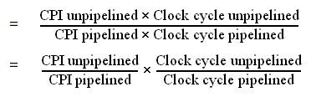
Performance of pipeline with stalls
Pipeline stalls decrease performance from the ideal
Recall the speedup formula:

Slide 12

Case of multi-cycle implementation
The ideal CPI on a pipelined processor is almost always 1. (may less than or greater that )
So
Ignore the overhead of pipelining clock cycle.
Pipe stages are ideal balanced.

Slide 13


Case of multi-cycle implementation
So: Clock cycle unpipelined = Clock cycle pipelining
CPl unpipelined = pipeline depth

Slide 14
Case of single-cycle implementation
CPI unpipelined = 1
Clock cycle unpipelined
pipeline depth
• Clock cycle pipelined =

Slide 15
Structural hazard: Pipe Stage Contention
Structural hazards
Occurs when two or more instructions want to use the same hardware resource in the same cycle
Causes bubble (stall) in pipelined machines
Overcome by replicating hardware resources
Multiple accesses to the register file
Multiple accesses to memory
some functional unit is not fully pipelined.
Not pipelined functional units

Slide 16
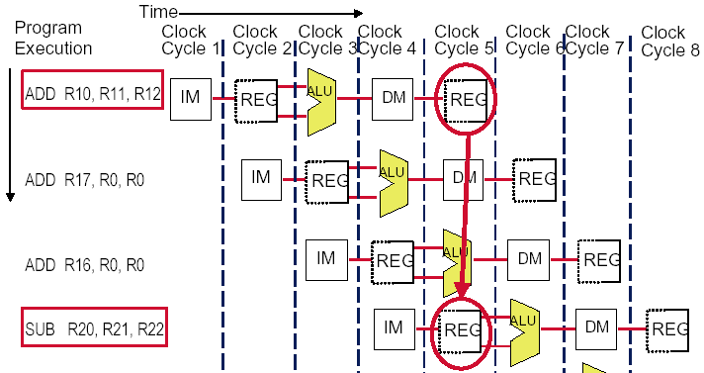
Multi access to the register file
Simply insert a stall , speedup will be decreased.
We have resolved it with “ double bump”

Slide 17
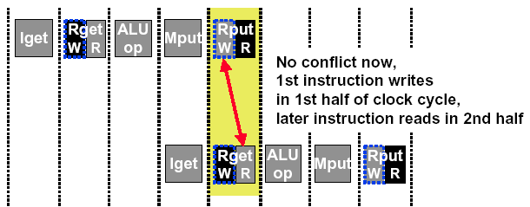
Double Bump Works !

Slide 18
Multi access to Single Memory Port
Time (clock cycles)
I
n
s
t
r.
O
r
d
e
r
Ld/St
Mem
Reg
ALU
Mem
Reg
Instr 1
Mem
Reg
ALU
Mem
Reg
Instr 2
Mem
Reg
ALU
Mem
Reg
Instr 3
Mem
Reg
ALU
Mem
Reg
Insert stall
provide another memory port
split instruction memory and data memory
use instruction buffer

Slide 19
Insert Stall
Time (clock cycles)
I
n
s
t
r.
O
r
d
e
r
Ld/St
Mem
Reg
ALU
Mem
Reg
Instr 1
Mem
Reg
ALU
Mem
Reg
Instr 2
Mem
Reg
ALU
Mem
Reg
Stall
Bubble
Bubble
Bubble
Bubble
Bubble
Instr 3
Mem
Reg
ALU
Mem
Reg

Slide 20
Split instruction and data memory
Time (clock cycles)
I
n
s
t
r.
O
r
d
e
r
Ld/St
IM
Reg
ALU
DM
Reg
Instr 1
IM
Reg
ALU
DM
Reg
Instr 2
IM
Reg
ALU
DM
Reg
Instr 3
IM
Reg
ALU
DM
Reg
Split instruction and data memory / multiple memory port / instruction buffer means:
fetch the instruction and data inference using different hardware resources.

Slide 21
Not fully pipelined function unit : may cause structural hazard

Slide 22
Machine without structural hazards will always have a lower CPI
Example (pA-14)
Data reference constitute 40% of the mix
Ideal CPI ignoring the structural hazard is 1
The processor with the structural hazard has a clock rate that is 1.05 times higher than that of a processor without structural hazard.
Answer
Average instruction time = CPI×Clock cycle time
=(1+0.4 ×1) ×CCideal/1.05
= 1.3 × Ccideal
Clearly, the processor without the structural hazard is faster.

Slide 23
Why allow machine with structural hazard ?
To reduce cost .
i.e. adding split caches, requires twice the memory bandwidth.
also fully pipelined floating point units costs lots of gates.
It is not worth the cost if the hazard does not occur very often.
To reduce latency of the unit.
Making functional units pipelined adds delay
(pipeline overhead -> registers.)
An unpipelined version may require fewer clocks per operation.
Reducing latency has other performance benefits, as we will see.

Slide 24
Example: impact of structural hazard to performance
Example
Many machines have unpipelined float-point multiplier.
The function unit time of FP multiplier is 6 clock cycles
FP multiply has a frequency of 14% in a SPECfp benchmark
Will the structural hzard have a large performance impact on the SPECfp benchmark?

Slide 25
Answer to the example
In the best case: FP multiplies are distributed uniformly.
There is one multiply in every 7 clock. 1/14%
Then there will be no structural hazard,then there is no performance penalty at all.
In the worst case: the multiplies are all clustered with no intervening instructions.
Then every multiply instruction have to stall 5 clock cycles to wait for the multiplier be released.
The CPI will increase 70% to 1.7, if the ideal CPI is 1.
Experiment result:
This structural hazard increase execution time by less than 3%.

Slide 26
Summary of Structural hazard
Taxonomy of Hazards
Structural hazards
These are conflicts over hardware resources.
OK, maybe add extra hardware resources;
or full pipelined the functional units;
otherwise still have to stall
Data hazards
Instruction depends on result of prior computation which is not ready (computed or stored) yet
Control hazards
branch condition and the branch PC are not available in time to fetch an instruction on the next clock

Slide 27
Data hazard
Data hazards occur when the pipeline changes the order of read/write accesses to operands comparing with that in sequential executing .
Let’s see an Example
DADD R1, R1, R3
DSUB R4, R1, R5
AND R6, R1, R7
OR R8, R1, R9
XOR R10, R1, R11

Slide 28
Data hazard
Basic structure
An instruction in flight wants to use a data value that’s not “done” yet
“Done” means “it’s been computed” and “it’s located where I would normally expect to go look in the pipe hardware to find it”
Basic cause
You are used to assuming a purely sequential model of instruction execution
Instruction N finishes before instruction N+k, for k >= 1
There are dependencies now between “nearby” instructions (“near” in sequential order of fetch from memory)
Consequence+
Data hazards -- instructions want data values that are not done yet, or in the right place yet

Slide 29
Coping with data hazards:example

Slide 30
Somecases “Double Bump” can do !

Slide 31
Proposed solution
Proposed solution
Don’t let them overlap like this…?
Mechanics
Don’t let the instruction flow through the pipe
In particular, don’t let it WRITE any bits anywhere in the pipe hardware that represents REAL CPU state (e.g., register file, memory)
Let the instruction wait until the hazard resolved.
Name for this operation: PIPELINE STALL

Slide 32
How do we stall ? --Insert nop by compiler
Bubble
Bubble
Bubble
Bubble
Bubble
Bubble
Bubble
Bubble
Bubble

Slide 33
How do we stall? --Add hardware Interlock !
Add extra hardware to detect stall situations
Watches the instruction field bits
Looks for “read versus write” conflicts in particular pipe stages
Basically, a bunch of careful “case logic”
Add extra hardware to push bubbles thru pipe
Actually, relatively easy
Can just let the instruction you want to stall GO FORWARD through the pipe…
…but, TURN OFF the bits that allow any results to get written into the machine state
So, the instruction “executes” (it does the work), but doesn’t “save”

Slide 34
Interlock: insert stalls
Bubble
Bubble
Empty slots in the
pipe called bubbles;
means no real
instruction work
getting saved here
How the interlock is implementated ?

Slide 35
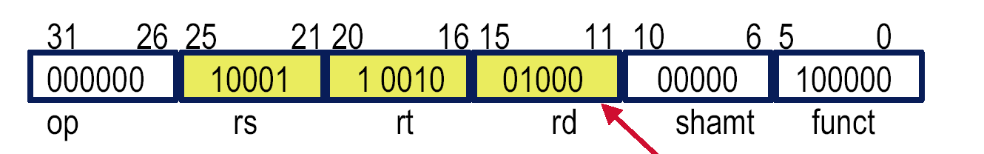
Recall MIPS Instruction format
add R8, R17, R18
is stored in binary format as
00000010 00110010 01000000 00100000
MIPS lays out instructions into “fields”
op operation of the instruction
rs first register source operand
rt second register source operand
rd register destination operand
shamt shift amount
funct function (select type of operation)

Slide 36
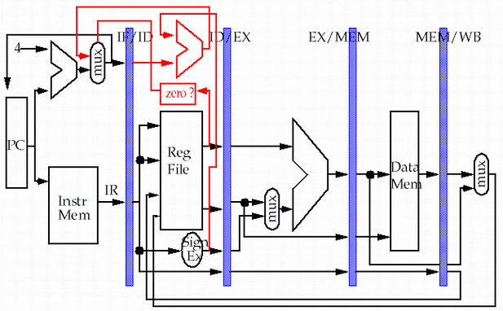
Detect: Data Hazard Logic

Slide 37
Detect: Data Hazard Logic
Rs =? Rd
Rt =? Rd
between IF/ID and
ID/EX, EX/MEM Stages
Rs
Rt
Rd
Rd
Rd

Slide 38
Example
DSUB R2, R1, R3 Rd = R2 Rs = R1 Rt = R3
AND R12, R2, R5 Rd = R12 Rs = R2 Rt = R5
OR R13, R6, R2 Rd = R13 Rs = R6 Rt = R2
DADD R14, R2, R2 Rd = R14 Rs = R2 Rt = R2
SW R15, 100(R2) Rd = R15 Rs = R2 Rt = XX
SUB-AND Hazard
ID/EX.RegRd(sub) == IF/ID. RegRs(and) == R2
SUB-OR Hazard
EX/MEM.RegRd(sub) == IF/ID. RegRt(or) == R2
AND-OR: No Hazard
ID/EX.RegRd(and)==R12 ≠ IF/ID.RegRt Or IF/ID.RegRs

Slide 39
How to delay the instruction ?
The Interlock can simulate the NOP:
Once it is detected need to add a stall, then
Clear the ID/EX.IR to be the instruction of NOP.
Reserve the IF/ID.IR unchanged for one more clock cycle.

Slide 40
Hardware simulates NOP
Bubble
Bubble
Bubble
Bubble
Bubble
Bubble
Bubble

Slide 41
Forwarding: reduce data hazard stalls
If the result you need does not exist AT ALL yet,
you are out of luck, sorry.
But, what if the result exists, but is not stored back yet?
Instead of stalling until the result is stored back in its “natural” home…
grab the result “on the fly” from “inside” the pipe, and send it to the other instruction (another pipe stage) that wants to use it

Slide 42
Forwarding
Generic name: forwarding ( bypass, short-circuiting)
Instead of waiting to store the result, we forward it immediately (more or less) to the instruction that wants it
Mechanically, we add buses to the datapath to move these values around, and these buses always “point backwards” in the datapath, from later stages to earlier stages

Slide 43
Forwarding: reduce data hazard stalls
Data may be already computed - just not in the Register File
EX/MEM.ALUoutput → ALU input port
MEM/WB.ALUoutput → ALU input port

Slide 44
Hardware Change for Forwarding
NextPC
ID/EX
EX/MEM
MEM/WR
Registers
mux
ALU
Data
Memory
mux
mux
Immediate

Slide 45
Hardware Change for Forwarding
NextPC
ID/EX
EX/MEM
MEM/WR
Registers
mux
ALU
Data
Memory
mux
mux
Immediate
EX/Mem.ALUoutput → ALU input
MEM/WB.ALUoutput → ALU input
MEM/WB.LMD → ALU input

Slide 46
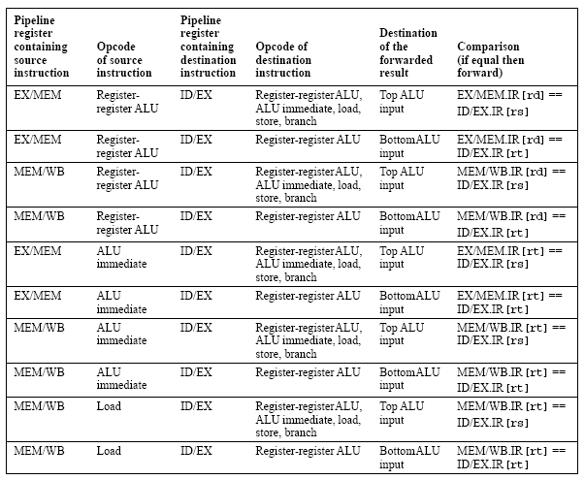
How to select the forwarding path: the forwarding logic
P161 in Edition 2; PA-36 in Edition 3

Slide 47
Forwarding path to other input entry
store
load
MEM/WB.LMD → DM input LMD: load memory data

Slide 48
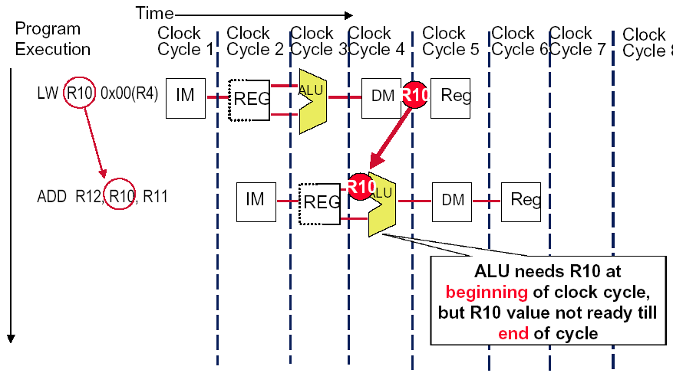
Forwarding Doesn’t Always Work

Slide 49
So we have to insert stall: Load stall
Time (clock cycles)
I
n
s
t
r.
O
r
d
e
r
lw r1, 0(r2)
Ifetch
Reg
ALU
DMem
Reg
Bubble
sub r4,r1,r6
Ifetch
Reg
ALU
DMem
Reg
Bubble
and r6,r1,r7
Ifetch
Reg
ALU
DMem
Reg
or r8,r1,r9
Bubble
Ifetch
Reg
ALU
DMem

Slide 50
How to implement Load Interlock
Detect when should use Load Interlock
situation | Example code sequence | Action
No dependence | LD R1, 45(R2) DADD R5,R6,R7 DSUB R8,R6,R7 OR R9,R6,R7 | No hazard possible because of no dependence
Dependence requiring stall | LD R1, 45(R2) DADD R5,R1,R7 DSUB R8,R6,R7 OR R9,R6,R7 | Comparators detect the use of R1 in the DADD and stall the DADD (and DSUB and OR ) before the DADD begins EX
Dependence overcome by forwarding | LD R1, 45(R2) DADD R5,R6,R7 DSUB R8,R1,R7 OR R9,R6,R7 | Comparators detect the use of R1 in DSUB and forward result of load to ALU in time for DSUB to begin EX
Dependence with accesses in order | LD R1, 45(R2) DADD R5,R6,R7 DSUB R8,R6,R7 OR R9,R1,R7 | No action required because read of R1 by OR occurs in the second half of the ID phase, while the write of the loaded data occurred in the first half.

Slide 51
The logic to detect for Load interlock
Opcode field of ID/EX | Opcode Field of IF/ID | Matching operand fields
Load | Reg-Reg ALU | ID/EX.IR[rt]==IF/ID.IR[rs]
Load | Reg-Reg ALU | ID/EX.IR[rt]==IF/ID.IR[rt]
Load | Load,store, ALU immediate, branch | ID/EX.IR[rt]==IF/ID.IR[rs]

Slide 52
Example of Forwarding and Load Delay
Why forwarding?
ADD R4, R5, R2
LW R15, 0(R4)
SW R15, 4(R2)
Why load delay?
ADD R4, R5, R2
LW R15, 0(R4)
SW R15, 4(R2)

Slide 53
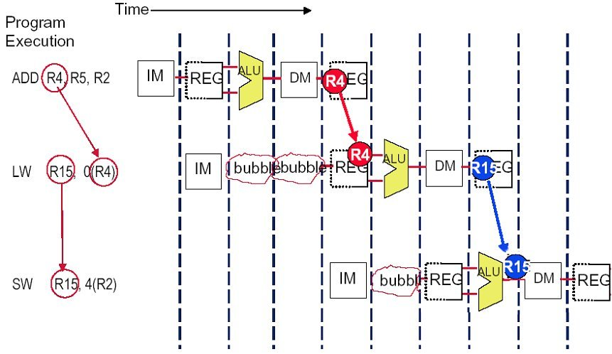
Solution (without forwarding)

Slide 54
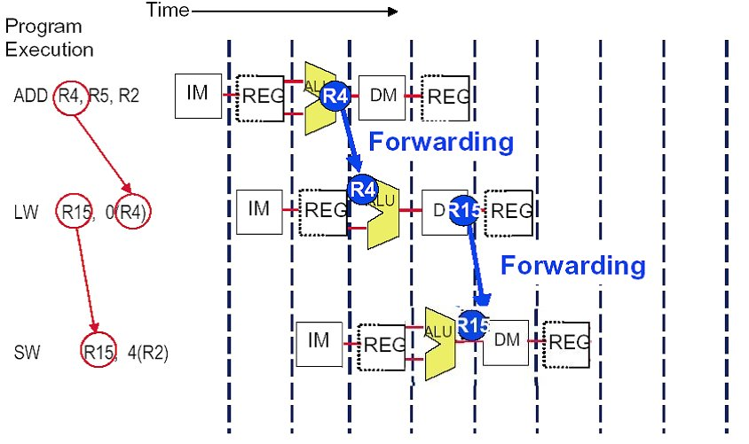
Solution (with forwarding)

Slide 55
The performance influence of load stall
Example
Assume 30% of the instructions are loads.
Half the time, instruction following a load instruction depends on the result of the load.
If hazard causes a single cycle delay, how much faster is the ideal pipeline ?
Answer
CPI = 1+30%×50% ×1=1.15
The performance decrease about 15% due to load stall.

Slide 56
Fraction of load that cause a stall

Slide 57
Instruction reordering by compiler to avoid load stall
Try producing fast code for
a = b + c;
d = e – f;
assuming a, b, c, d ,e, and f in memory.
Slow code:
LW Rb,b
LW Rc,c
ADD Ra,Rb,Rc
SW a,Ra
LW Re,e
LW Rf,f
SUB Rd,Re,Rf
SW d,Rd
Fast code:
LW Rb,b
LW Rc,c
LW Re,e
ADD Ra,Rb,Rc
LW Rf,f
SW a,Ra
SUB Rd,Re,Rf
SW d,Rd

Slide 58
Summary of Data Hazard
Taxonomy of Hazards
Structural hazards
These are conflicts over hardware resources.
Data hazards
Instruction depends on result of prior computation which is not ready (computed or stored) yet
OK, we did these, Double Bump, Forwarding path,
software scheduling, otherwise have to stall
Control hazards
branch condition and the branch PC are not available in time to fetch an instruction on the next clock

Slide 59

THANK YOU
THANK YOU

