Slide 1

Computer Architecture ----A Quantitative Approach
陈文智
浙江大学计算机学院
chenwz@zju.edu.cn

Slide 2
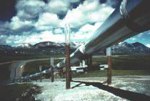
Lecture 3 for pipelining
The control hazard
How to solve the control hazard

Slide 3
Pipelining Hazards
Taxonomy of Hazards
Structural hazards
These are conflicts over hardware resources.
OK, maybe add extra hardware resources;
or full pipelined the functional units(split duble bump);
otherwise still have to stall
Data hazards
Instruction depends on result of prior computation which is not ready (computed or stored) yet
OK, we did these, Double Bump, Forwarding path,
software scheduling, otherwise have to stall
Control hazards
branch condition and the branch PC are not available in time to fetch an instruction on the next clock

Slide 4
The Control hazard
Cause
branch condition and the branch PC are not available in time to fetch an instruction on the next clock
The next PC takes time to compute
For conditional branches, the branch direction takes time to compute.
Control hazards can cause a greater greater performance loss for MIPS pipeline than do data hazards.

Slide 5
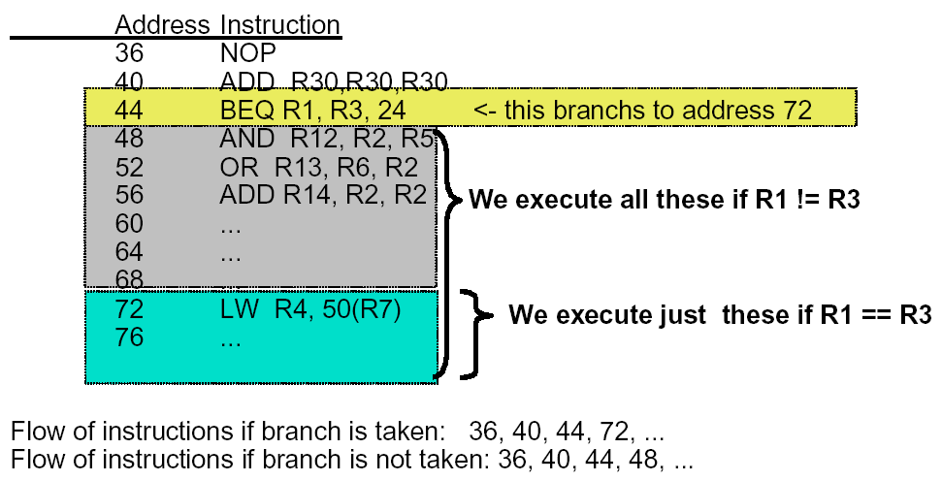
Example: Branches
24
R0
R0

Slide 6
Recall: Basic Pipelined Datapath

Slide 7
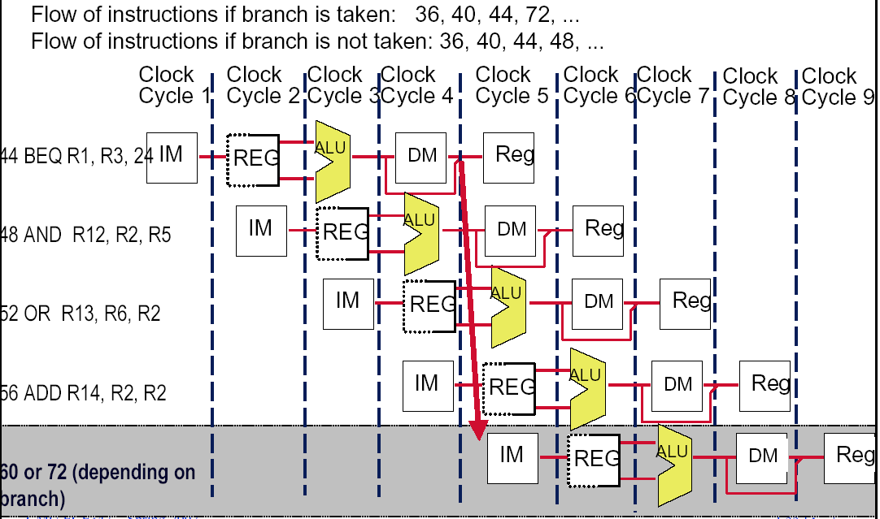
Control hazard
24

Slide 8
Dealing with the control hazard
Four simple solutions
Freeze or flush the pipeline
Predict-not-taken (Predict-untaken)
Treat every branch as not taken
Predict-taken
Treat every branch as taken
Delayed branch
Note:
Fixed hardware
Compile time scheme using knowledge of hardware scheme and of branch behavior

Slide 9
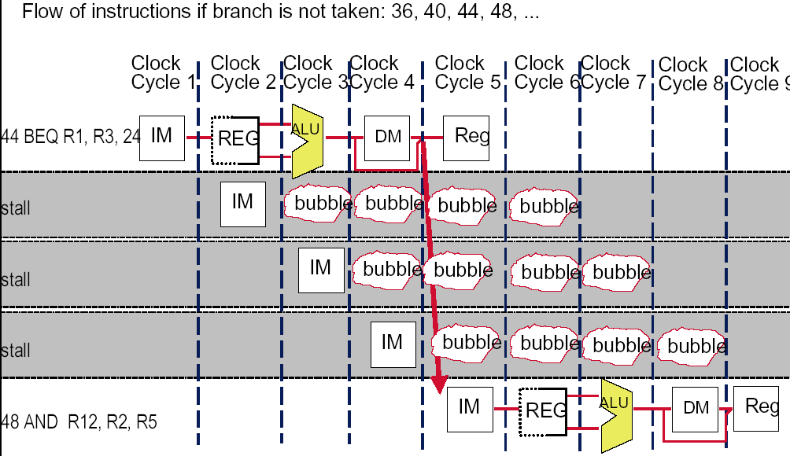
Recall: solve the hazard by inserting stalls
24
48 or 72

Slide 10
The pipeline status
Branch instruction | IF | ID | EX | MEM | WB
Branch Successor |  | IF | stall | stall | idle | idle
Branch successor+1 |  |  |  |  | IF | ID | EX
Branch successor+2 |  |  |  |  |  | IF | ID
Branch successor+3 |  |  |  |  |  |  | IF

Slide 11
Flushing the pipeline
Simplest hardware:
Holding or deleting any instruction after branch until the branch destination is know.
Penalty is fixed.
Can not be reduced by software.

Slide 12
Stalls greatly hurt the performance
Problem:
With a 30% branch frequency and an ideal CPI of 1, how much the performace is by inserting stalls ?
Answer:
CPI = 1+30%×３＝1.9
this simple solution achieves only about half of the ideal performance.

Slide 13
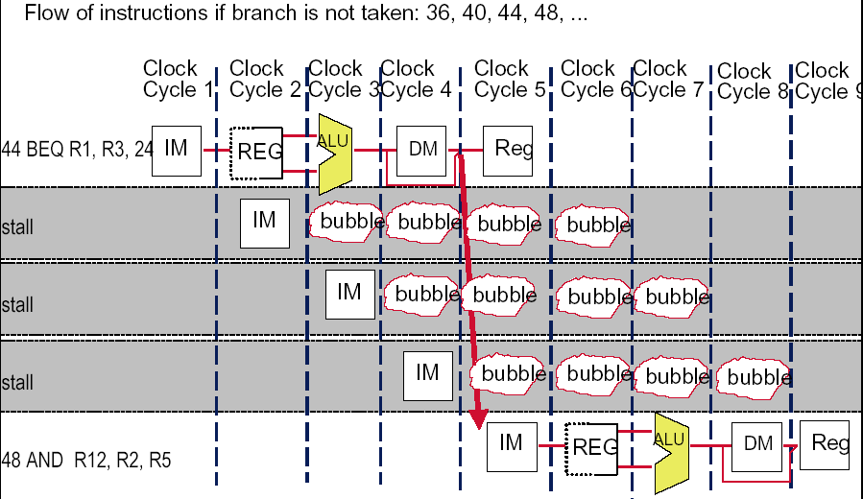
Always Stalling Hurts the Not- taken case

Slide 14
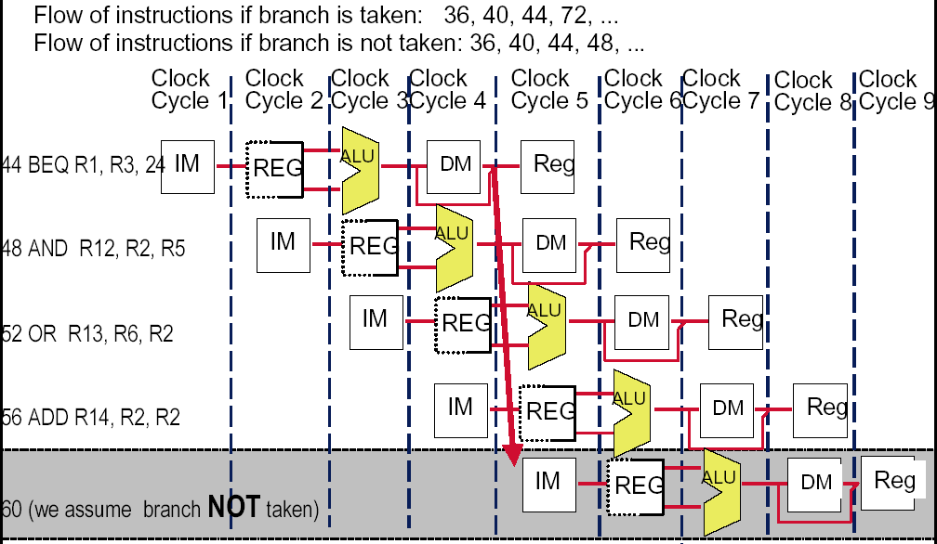
How about assume Branch Not Taken

Slide 15
Predict –not-taken
Hardware:
Treat every branch as not taken (or as the formal instruction)
When branch is not taken, the fetched instruction just continues to flow on. No stall
If the branch is taken, then restart the fetch at the branch target, which cause 3 stall.(should turn the fetched instruction into a no-op)
Compiler:
Can improve the performance by coding the most frequent case in the untaken path.

Slide 16
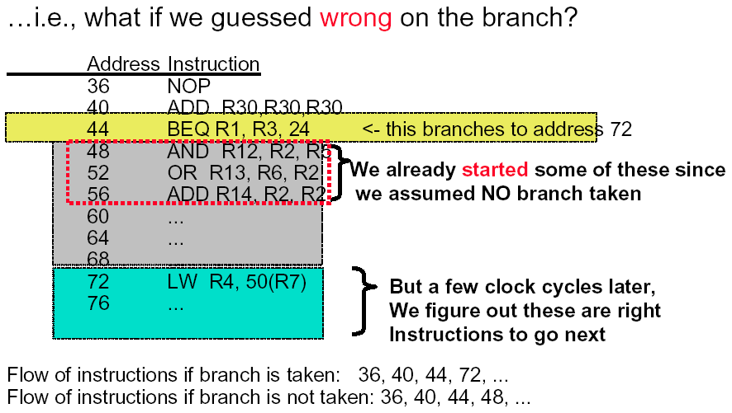
What If Branch Was Taken…?
24

Slide 17
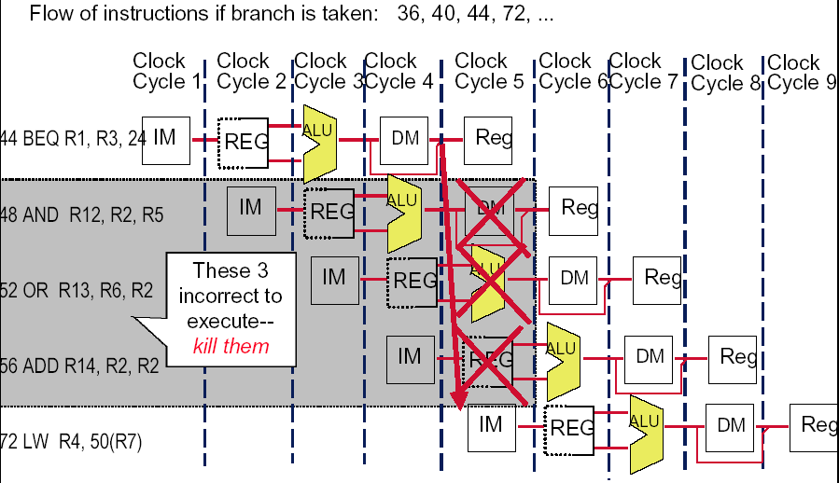
How to do with the branch taken ?
24

Slide 18
Alternative is assuming the branch always taken
Most branches(60%) are taken, so we should make the taken branch more faster. Why not try assuming the branch always taken?

Slide 19
Predict –taken
Hardware
Treat every branch as taken (evidence: more than 60% braches are taken)
As soon as the branch target address is computed, assume the branch to be taken and begin fetching and executing at the target.
Only useful when the target is known before the branch outcome.
No advantage at all for MIPS 5-stage pipeline.
Compiler
Can improve the performance by coding the most frequent case in the taken path.

Slide 20
Pipeline status for predict-taken
Branch is taken: 1 stall
44 BEQ R1, 24 | IF | ID | EX | MEM | WB
48 AND R12, R2, R5 |  | IF | idle | idle | idle | idle
72 LW R4, 50(R7) |  |  | IF | ID | EX | MEM | WB
76 |  |  |  | IF | ID | EX | MEM
80 |  |  |  |  | IF | ID | EX
Branch is not taken: 3 stall
44 BEQ R1, 24 | IF | ID | EX | MEM | WB
48 AND R12, R2, R5 |  | IF | idle | idle | idle | idle
72 LW R4, 50(R7) |  |  | IF | ID | idle | idle | idle
76 |  |  |  | IF | idle | idle | idle
48 AND R12, R2, R5 |  |  |  |  | IF | ID | EX

Slide 21
Common Side-Effect in Pipelines
Sometimes, you just have to guess what will execute
Often, we can do it right, and this saves cycles
But, occasionally, we are wrong
Consequences
We mistakenly start executing the wrong instructions
To repair this, must make sure that they DO NOT really execute
In particular, must ensure they do not incorrectly corrupt machine state

Slide 22
Move the Branch Computation Forward

Slide 23
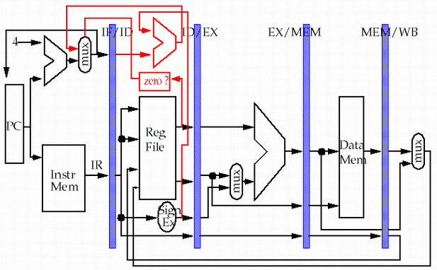
Move the Branch Computation more Forward
store
load

Slide 24
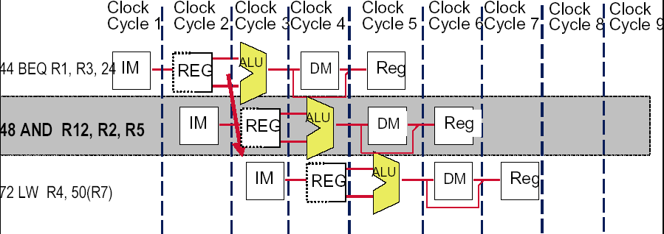
Result: New & Improved MIPS Datapath
Need just 1 extra cycle after the BEQ branch to know right address
On MIPS, its called - the branch delay slot
24
48 or 72

Slide 25

Flushing : need only to insert one stall to resolve control hazard
48 or 72
40 ADD R30,R30,R30 | IF | ID | EX | MEM | WB
44 BEQ R1, 24 |  | IF | ID | EX | MEM | WB
48 AND R12, R2, R5 |  |  | IF | idle | idle | idle | idle
48 or 72 |  |  |  | IF | ID | EX | MEM

Slide 26
Why “waste” the fetched instruction ?
48 or 72
We have fetched the instruction 48, why we fetch the second time if the branch not taken at last ?

Slide 27
The pipeline status for predict-not-taken
Branch is not taken: No stall
40 ADD R30,R30,R30 | IF | ID | EX | MEM | WB
44 BEQ R1, 24 |  | IF | ID | EX | MEM | WB
48 AND R12, R2, R5 |  |  | IF | ID | EX | MEM | WB
52 OR R13, R6, R2 |  |  |  | IF | ID | EX | MEM
Branch is taken: 1 stall
40 ADD R30,R30,R30 | IF | ID | EX | MEM | WB
44 BEQ R1, 24 |  | IF | ID | EX | MEM | WB
48 AND R12, R2, R5 |  |  | IF | idle | idle | idle | idle
72 LW R4, 50(R7) |  |  |  | IF | ID | EX | MEM
76 |  |  |  |  | IF | ID | EX

Slide 28
Delayed branch
Good news
Just 1 cycle to figure out what the right branch address is
So, not 2 or 3 cycles of potential NOP or stall
Strange news
OK, it’s always 1 cycle, and we always have to wait
And on MIPS, this instruction always executes, no matter whether the branch taken or not taken. (hardware scheme)

Slide 29
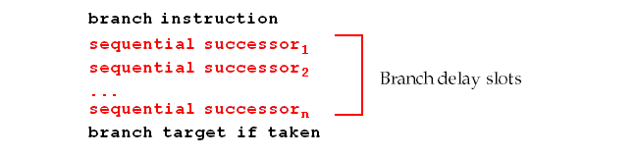
Branch delay slot
Hence the name: branch delay slot
The instruction cycle after the branch is used for address calculation , 1 cycle delay necessary
SO…we regard this as a free instruction cycle, and we just DO IT
Consequence
You (or your compiler) will need to adjust your code to put some useful work in that “slot”, since just putting in a NOP is wasteful (compiler scheme)

Slide 30
How to adjust the codes?

Slide 31
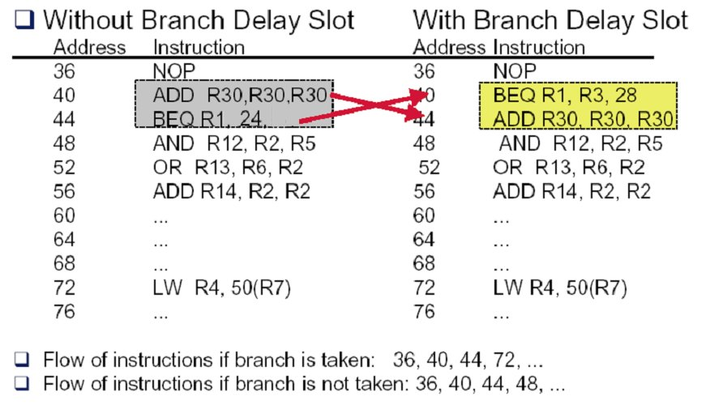
Example: rewrite the code (a)

Slide 32
Example: rewrite the code (b-1)
Loop: LW R2, 0(R1)
ADD R3, R2, R4
SW R3, 0(R1)
……
SUB R1, R1, #4
BNEZ R1, Loop
LW R2, 0(R1)
Loop: ADD R3, R2, R4
SW R3, 0(R1)
……
SUB R1,R1, #4
BNEZ R1, Loop
LW R2, 0(R1)

Slide 33
Example: rewrite the code (b-2)
Loop: LW R2, 0(R1)
ADD R3, R2, R4
SW R3, 0(R1)
DIV …..
……
SUB R1, R1, #4
BNEZ R1, Loop
Loop: LW R2, 0(R1)
ADD R3, R2, R4
DIV …...
…...
SUB R1, R1, #4
BNEZ R1, Loop
SW R3, +4(R1)

Slide 34
Schedualing strategy vs. performance improvement

Slide 35
Constrains of the delayed branch
There are restrictions on the instructions that are scheduled into the delay slots
The compiler's ability to predict accurately whether or not a branch is taken determines how much useful work is actually done.
For scheduling scheme b and c,
It must be O.K. to execute the SUB instruction if the prediction is wrong.
Or the hardware must provide a way of cancelling the instruction.

Slide 36
Cancelling function
Includes the direction that the branch is predicted to go.
If branch is predicted incorrectly , CPU turns the instruction in the branch delay slot into a no-op.
Can reduce the complexity for compiler to select useful instructions into delay slot.

Slide 37
Delayed branch with cancelling (of case b)

Slide 38
Efficiency of delayed branch

Slide 39
About delayed branch
Delayed branch are adopted in most RISC processors.
In general, the length of branch delay is more than 1 . However, always just one slot is used due to the compiler complexity.

Slide 40
Performance comparison for four schemes
MIPS R4000, deeper pipeline
Takes at least three pipeline stages before the branch target address is known
An additional cycle before the branch condition is evaluated.
Assuming branch frequencies as followed
Unconditional branch 4%
Conditional branch, untaken 6%
Conditional branch, taken 10%

Slide 41
Pipeline status for various schemes
uncond. L1 L2 L3 L4 L5 L6 2 stall
L1 s L1(branch target)
Stall pipeline: L1 L2 L3 L4 L5 L6 3 stall
L1 s s L1(branch target/i+1)
Predict taken:
L1 L2 L3 L4 L5 L6
taken: L1 s L1 L2 L3 2 stall
untaken: L1 s L1 idle 3 stall
L1(i+1)
Predict untaken:
L1 L2 L3 L4 L5 L6
untaken: L1 L2 L3 L4 L5 0 stall
taken: L1 L2 L3 idle 3 stall
L1 L2 idle
L1 idle
L1(branch target)

Slide 42
Resolution

Slide 43
Pipeline hazards
Taxonomy of Hazards
Structural hazards
These are conflicts over hardware resources.
Data hazards
Instruction depends on result of prior computation which is not ready (computed or stored) yet
Control hazards
branch condition and the branch PC are not available in time to fetch an instruction on the next clock
OK, we did these: calculate the destination address and condition ASAP., Flushing the pipeline, predict-not-taken, predict-taken, delayed branch ( with/without cancelling)

Slide 44
Summary for control hazard
Control hazards can cause a greater performance loss than do data hazards.
In general, the deeper the pipeline, the worse the branch penalty in clock cycles.
A higher CPI processor can afford to have more expensive branches.
The efficiency of the three schemes greatly depends on the branch prediction.

Slide 45
Branch prediction
There are many different schemes
static branch prediction
Assume taken
This is surprisingly effective since 85% of backward branches and 60% of forward branches are taken.
Assume not taken
Predict by using profile information from previous run
dynamic branch prediction by hardware
1-bit Branch Prediction
2-bit Branch Prediction
N-bit Branch Prediction
Table-based Branch Prediction

Slide 46
Accuracy of prediction based on profile

Slide 47
0：不转移
1：转移
转移指令
低位地址
0/1
预测行为
预测失败取反

Slide 48
T
NT
Predict Taken
11
10
Predict Taken
T
T
NT
NT
Predict Not
Taken
01
00
Predict Not
Taken
T

Slide 49
If (d==0)
d=1;
if (d==1){
…...
}
设Reg[R1] = d
BNEZ R1, L1 ; br b1, (d!=0)
DADDIU R1, R0, #1 ; d==0, so d=1
L1: DADDIU R3, R1, # -1 ;
BNEZ R3, L2 ; br b2, (d!=1)
……
L2:

Slide 52
四种组合的含义：
注意：
这里体现了相关性
虽然上一次Br指令，并非一定是本次br指令，但在简单的loop中是可能的，如简单loop中不含其它br指令。

Slide 53
用这种相关预测器来预测上述例子。初值为NT/NT. （第一次迭代预测错，其余均正确）
粗体字表示本次预测
预测出错 b1动作与b2预测值选用关系
预测正确 b2动作与b1预测值选用关系
新预测值

Slide 54

THANK YOU
THANK YOU

