Slide 1

Computer Architecture ----A Quantitative Approach
陈文智
浙江大学计算机学院
chenwz@zju.edu.cn

Slide 2

Lecture 4 for pipelining
What makes pipelining hard to implement ?
(execptions)
Extending the MIPS Pipeline to Handle Multicycle Operations
MIPS R4000 integer pipeline

Slide 3
What Makes Pipelines Hard to Implement?
Detecting and resolving hazards
OK. We have solved this problem.
Exceptions and Interrupts
Instruction Set complications
Very complex multicycle instructions are difficult to pipeline
Example:
stringMov from 0x1234, to 0x4000, 0x1000 bytes

Slide 4
Exception causes
I/O device requests
User OS service requests
Breakpoints
Integer arithmetic overflow/underflow
FP arithmetic anomaly
Page fault
Misaligned memory accesses
Memory protection violations
Hardware malfunctions
Undefined instructions

Slide 5
Exceptions and Interrupts
Exceptions are exceptional events that disrupt the normal flow of a program
Terminology varies between different machines
Examples of Interrupts
User hitting the keyboard
Disk drive asking for attention
Arrival of a network packet
Examples of Exceptions
Divide by zero
Overflow
Page fault

Slide 6
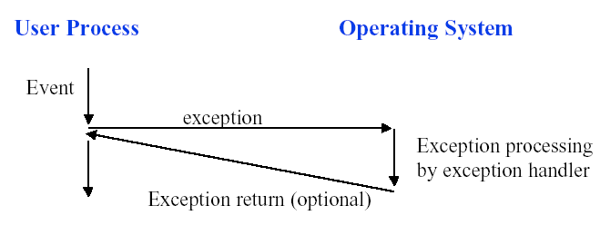
Exception Flow
When an exception (or interrupt) occurs, control is transferred to the OS

Slide 7
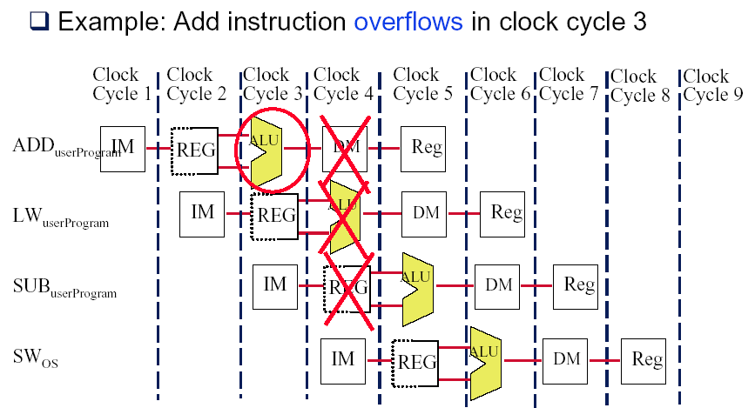
Flow of Instructions During Exception

Slide 8
Characterizing Exceptions and Interrupts
Synchronous vs asynchronous events
Synchronous events occur at the same place every time a program executes
Asynchronous events are caused by external devices such as a keyboard, disk drive or mouse
Asynchronous events can usually be handled after the completion of the current instruction, making them easier to handle
User requested vs. coerced
If a user asks for it, it is user requested
Coerced are hardware events not under user control
Coerced exceptions are harder to implement since they are not predictable.

Slide 9
Characterizing Exceptions and Interrupts (continued)
User maskable vs nonmaskable
Can a user disable an exception from being detected?
Within vs. between instructions
Does the event prevent the current instruction from completing?
Exceptions occurring within instructions are usually synchronous, since the instruction triggers the exception.
Within is more difficult to implement than between since the former must be restarted.
Resume vs. terminate
Can the event be handled (corrected) or must the program be terminated?
Restarting is harder (obviously), and is the more common case.

Slide 10
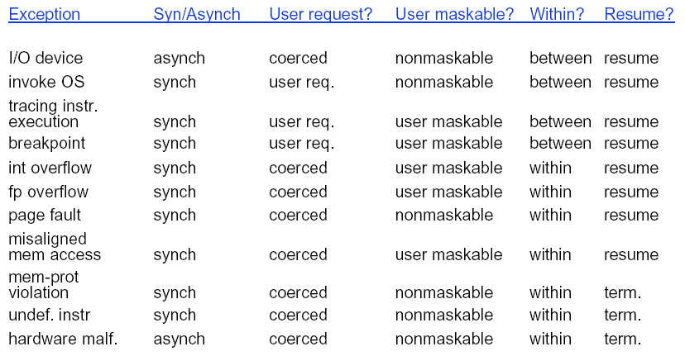
Types of Exceptions

Slide 11
How to do when exception occurs ?
Often, exception occurs while many instructions are in flight
Example: a page fault on a load instruction will occur in stage 4 of the MIPS pipe
Pipeline must be safely shutdown when exception occurs and then restarted at the offending instruction

Slide 12
Stopping and Restarting Execution
Force a trap instruction into the pipeline
Until the trap is taken, turn off all writes for the faulting instruction and any instruction that issued after the faulting instruction
This prevents instructions from changing the state of the machine
When the trap is taken, invoking the OS, the OS saves the PC of the offending instruction
The OS fixes the exception (if possible) and then restarts the machine
Restarting usually means setting PC <-- offending instruction address
Replays instruction(s)

Slide 13
Precise Exceptions
If the pipeline can be stopped so that the instructions issued before the faulting instruction complete and those after it can be restarted, then the pipeline is said to implement precise exceptions
All instructions before the faulting instruction complete
And instructions following the faulting instruction, including the faulting instruction, do not change the state of the machine.
Under this model, restarting is easy:
Simply re-execute the original faulting instruction.
Or, if it is not a resumable instruction, start with the next instruction.

Slide 14
Imprecise Exceptions
Difficult to do when some instructions take multiple cycles to complete
Some instructions may complete before an exception is detected
Example
Multiply r1, r2, r3 ; multiply takes 10 cycles
Add r10,r11,r12 ; takes 5 cycles
Add will complete before multiply is done. If multiply overflows, then
an exception will be raised AFTER the add has updated the value in R10.
This is an imprecise exception.

Slide 15
Precise vs. Imprecise Exceptions
Some machines implement both modes: imprecise and precise exceptions
Special software instructions to guarantee precise exceptions
Machine runs slower when one needs precise exceptions
In general, integer exceptions are precise, while FP exceptions may not be.

Slide 16
Exceptions and the MIPS Architecture
Which stage can exceptions occur in?
Stage Problem exceptions occurring
IF page fault on instruction fetch;
misaligned memory access;
memory protection violation
ID undefined or illegal opcode
EX arithmetic exception
MEM page fault on data fetch;
misaligned memory access;
memory-protection violation
WB none

Slide 17
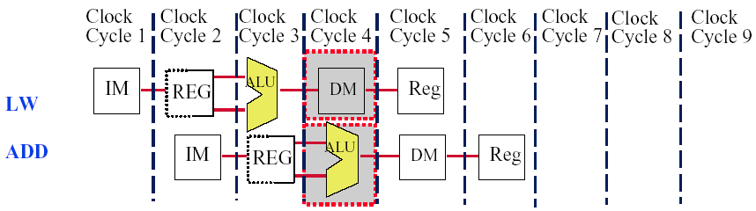
Multiple Exceptions in one clock cycle
In Clock Cycle 4, LW can have a data page fault while the ADD has an arithmetic exception
Handled by servicing the page fault and then restarting the LW instruction
The ADD’s arithmetic exception will occur again because the ADD instruction is restarted after the exception is handled

Slide 18
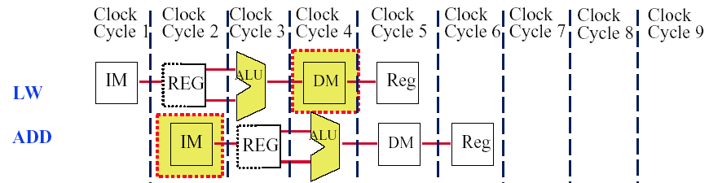
Multiple Exceptions out-of-order
ADD causes an exception in the instruction fetch stage while LW causes an exception in the memory access stage
If we implement precise exceptions, LW exception must be handled first
This is done by having hardware post exceptions by order of instruction

Slide 19
Exception ordering
When the instruction is about to exit the pipeline (MEM/WB), any pending exceptions for the instruction are examined.
If an instruction generates multiple exceptions, the exception occurring in the earliest stage takes precedence.
This is done by keeping an exception status vector for each instruction:
If an exception is posted, it is added to the vector and all writes that affect system state are disabled.

Slide 20
About Exceptions
One of the single messiest parts of designing a modern CPU
It isn’t pretty, it’s easy to get wrong
It’s often not too elegant
It usually takes huge wads of special logic
Further complicated by modern CPU mechanisms
Deep pipes
Superscalar --lots of instructions in flight in parallel
Out-of-order execution
time order of exceptions ≠ program order of the instructions on which the exceptions happened
Maintaining illusion of “sequential instruction execution” gets really complicated.

Slide 21
What Makes Pipelines Hard to Implement?
Detecting and resolving hazards
OK. We have solved this problem.
Exceptions and Interrupts
Instruction Set complications
Very complex multicycle instructions are difficult to pipeline
Example:
String Mov from 0x1234, to 0x4000, 0x1000 bytes

Slide 22
Instruction set complications-1
An instruction is committed when it is guaranteed to complete.
On MIPS, all instructions are committed at the end of MEM.
Since no updates occur before instructions commit, precise interrupts are straightforward.
In most RISC systems, each instruction writes only one result.
This means that the instruction can be cancelled any time before the instruction is committed, with no harm to the system state.

Slide 23
Instruction Set Complications-2
This is not true for many CISC machines, i.e. VAX
On these machines, the system state may be modified well before the instruction or its predecessors are committed.
For example, if an instruction using autoincrement mode is aborted because of an exception, then the machine state may have been altered.
This leads to an imprecise exception making it difficult to restart the instruction.

Slide 24
Instruction Set Complications-3
The situation is worse for instructions that access and write memory in multiple places.
These instructions can generate multiple faults.
Therefore, it becomes difficult to know where to resume.
This is usually solved by using general purpose registers as work registers (that are saved and restored.)

Slide 25
Instruction Set Complications-4
Odd bits of state that may create additional pipeline hazards or may require extra hardware to save and restore.
Example: conditional codes
Multicycle operation
The general solution used by more complex instruction set machines is to pipeline the microcode.
In 1990s, all companies moved to simpler ISA.

Slide 26
Extending the MIPS pipeline to handle MultiCycle Operations
Alternative resolutions to handle floating-point operations
Complete operation in 1 or 2 clock cycles,
Which means using a slow clock,
or/and using enormous amounts of logic in FP units.
Allow for a longer latency for operations
The EX cycle may be repeated as many times as needed to complete the operation
There may be multiple FP units

Slide 27
MIPS pipeline with FP units

Slide 28
Pipelining some of the FP units
Two terminologies
Latency---the number of intervening cycles between an instruction that produces a result and an instruction that uses the result.
Initiation interval---the number of cycles that must elapse between instructions issue to the same unit.
For full pipelined units, initiation interval is 1
For unpipelined units, initiation interval is always the latency plus 1.

Slide 29
Latencies and initiation intervals for functional units

Slide 30
Pipeline supports multiple outstanding FP operations

Slide 31
Specifications
Memory bandwidth: double words/one cycle
New pipeline latches are required:
M1/M2, M2/M3, M3/M4, M4/M5, M5/M6, M6/M7
A1/A2, A2/A3, A3/A4
New connection registers are required:
ID/EX, ID/M1, ID/A1, ID/DIV
EX/MEM, M7/MEM, A4/MEM, DIV/MEM
Because the divider unit is unpipelined, structural hazards can occur.
Because the instructions have varying running times, the number of register writes required in a cycle can be larger than 1
New data hazards: WAW is possible due to disorder WBs
Due to longer latency of operations, stalls for RAW hazards will be more frequent.
Problems with exceptions resulting from disorder completion

Slide 32
Issuing in order and completion out of order

Slide 33
Structural Hazards for the FP register write port

Slide 34
How to solve the write port conflict ?
Increase the number of write ports
Unattractive at all !
No worthy since steady state usage is close to 1.
Detect and insert stalls by serializing the writes
Track the use of the write port in the ID stage and to stall an instruction before it issues
Additional Hardware: a shift register+ write conflict logic
The shift register tracks when already-issued instructions will use the register file, and right shift 1 bit each clock.
The stalls might aggravate the data hazards
All interlock detection and stall insertion occurs in ID stage
To stall a conflicting instruction when it tries to enter the MEM or WB stage.
Easy to detect the conflict at this point
Complicates pipeline control since stalls can now occur in two places.

Slide 35
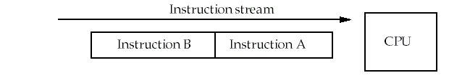
Types of data hazards
Consider two instructions, A and B. A occurs before B.
RAW( Read after write) true dependence
Instruction A writes Rx，instruction B reads Rx
WAW(Write after write) output dependence
Instruction A writes Rx，instruction B writes Rx
WAR( Write after read) anti-denpendence
Instruction A reads Rx，instruction B writes Rx
Hazards are named according to the ordering that MUST be preserved by the pipeline

Slide 36
RAW dependence
B tries to read a register before A has written it and gets the old value.
This is common, and forwarding helps to solve it.
Time
S(A)
D(A)
S(B)
D(B)
No hazard
S(A)
D(A)
If D(A)=S(B), hazard occur.
S(B)
D(B)

Slide 37
WAW dependence
B tries to write an operand before A has written it.
After instruction B has executed, the value of the register should be B's result, but A's result is stored instead.
This can only happen with pipelines that write values in more than one stage, or in variable-length pipelines (i.e. FP pipelines).
Time
S(A)
D(A)
S(B)
D(B)
No hazard
S(A)
D(A)
S(B)
D(B)
If D(A)=D(B), hazard occur.

Slide 38
WAR dependence
B tries to write a register before A has read it.
In this case, A uses the new (incorrect) value.
This type of hazard is rare because most pipelines read values early and write results late.
However, it might happen for a CPU that had complex addressing modes. i.e. autoincrement.
Time
S(A)
D(A)
S(B)
D(B)
No hazard
S(A)
D(A)
S(B)
D(B)
If S(A)=D(B), hazard occur.

Slide 39
Stalls arising from RAW hazards

Slide 40
The WAW hazards

Slide 41
Solving the WAW hazard
Stall an instruction that would "pass" another until after the earlier instruction reaches the MEM phase.
Cancel the WB phase of the earlier instruction
Both of these can be done in ID, i.e. when LD is about to issue.
Since pure WAW hazards are not common, either method works.
Pick the one that simplest to implement.
The simplest solution for the MIPS pipeline is to hold the instruction in ID if it writes the same register as an instruction already issued.

Slide 42
What other hazards are possible ?
Hazards among FP instructions.
Hazards between an FP instruction and an integer instruction.
Since two register files exist, only FP loads and stores and FP register moves to integer registers involve hazards.

Slide 43
Checks are required in ID
Check for structural hazards .
The divide unit and Register write port.
Check for RAW hazards
The CPU simply stalls the instruction at ID stage until:
Its source registers are no longer listed as destinations in any of the execution pipeline registers (registers between stages of M and A) OR
Its source registers are no longer listed as the destination of a load in the EX/MEM register.
Check for WAW hazards
Check instructions in A1, ..., A4, Divide, or M1, ...,M7 for the same destination register (check pipeline registers.)
Stall instruction in ID if necessary.

Slide 44
Performance of MIPS FP pipeline

Slide 45
Performance of MIPS FP pipeline

Slide 46
Maintaining precise Exception
Exceptions are difficult because instructions may now finish out of order .
Example:
DIVF F0, F2, F4
ADDF F10, F10, F8
SUBF F12, F12, F14
ADDF and SUBF are expected to complete before DIVF .----Out-of-order completion.
Suppose SUBF caused an arithmetic exception at a point where ADDF completed but DIVF has not.
The result is an imprecise exception . Fix here is to let pipeline drain.

Slide 47
The worse case
Worse, suppose DIVF had an exception after ADDF completed.
Since ADDF destroys one of its operands, we can not restore the state to what it was before the DIVF instruction, even with software !

Slide 48
Handling exceptions -- first solution
Ignore the problem (imprecise exceptions):
This may be fast and easy, but it's difficult to debug programs without precise exceptions.
Many modern CPUs, i.e. DEC Alpha 21064, IBM Power-1 and MIPS R800, provide a precise mode that allows only a single outstanding FP instruction at any time.
This mode is much slower than the imprecise mode, but it makes debugging possible

Slide 49
Handling exceptions -- Second solution
Buffer the results and delay commitment
In this case, the CPU doesn't actually make any state (register or memory) changes until the instruction is guaranteed to finish.
This becomes difficult when the difference in running time among operations is large.
Lots of intermediate results have to be buffered (and forwarded, if necessary).

Slide 50
Variations of the second solution-1
History file:
This technique saves the original values of the registers that have been changed recently.
If an exception occurs, the original values can be retrieved from this cache .
Note that the file has to have enough entries for one register modification per cycle for the longest possible instruction.
Similar to the solution used for the VAX for autoincrement and autodecrement addressing.

Slide 51
Variations of the second solution-2
Future file:
This method stores the newer values for registers.
When all earlier instructions have completed, the main register file is updated from the future file.
On an exception, the main register file has the precise values for the interrupted state.

Slide 52
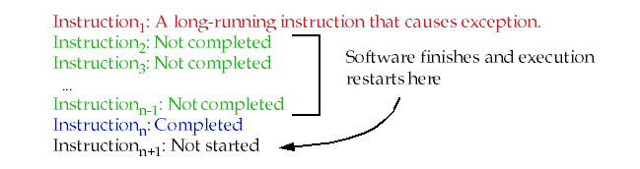
Handling exceptions, third solution
Keep enough information for the trap handler to create a precise sequence for the exception:
The instructions in the pipeline and the corresponding PCs must be saved.
After the exception, the software finishes any instructions that precede the latest instruction completed.
Technique is used in the SPARC architecture.

Slide 53
Handling exceptions, fourth solution
Allow instruction issue only if it is known that all previous instructions will complete without causing an exception.
The floating point function units must determine if an exception is possible early in the EX stage, first couple clocks,
In order to prevent the following instructions from completing.
Sometimes it requires stalling the pipeline in order to maintain precise interrupts.
The R4000 and Pentium solution.

Slide 54
Guidelines for designing instruction sets for pipelining-1
Avoid variable instruction lengths and running times whenever possible :
Variable length instructions complicate hazard detection and precise exception handling.
Sometimes it is worth it because of performance adv., i.e., caches .
Cause instruction running times to vary, when they miss.
Many times, the added complexity is delt with by freezing the pipeline.

Slide 55
Guidelines for designing instruction sets for pipelining-2
Avoid sophisticated addressing modes :
Addressing modes that update registers (post-autoincrement) complicates exceptions and hazard detection.
It also makes it harder to restart instructions.
Allowing addressing modes with multiple memory accesses also complicates pipelining.

Slide 56
Guidelines for designing instruction sets for pipelining-3
Don't allow self-modifying code
Since it is possible that the instruction being modified is already in the pipeline, the address being written must constantly be checked.
If it is found, then the pipeline must be flushed or the instruction updated !
Even if it's not in the pipeline, it could be in the instruction cache.

Slide 57
Guidelines for designing instruction sets for pipelining-4
Avoid implicitly setting CCs in instructions
This makes it harder to avoid control hazards since it's impossible to determine if CCs are set on purpose or as a side effect.
For implementations that set the CC almost unconditionally :
Makes instruction reordering difficult since it is hard to find instructions that can be scheduled between the condition evaluation and the branch.

Slide 58
The MIPS R4000 pipeline
IF－First half of instruction fetch. PC selection occurs. Cache access is initiated.
IS－Second half of instruction fetch.
－This allows the cache access to take two cycles.
RF－Decode and register fetch, hazard checking, I-cache hit detection.
EX－Execution: address calculation, ALU Ops, branch target calculation and condition evaluation.
DF/DS/TC
－ Data fetched from cache in the first two cycles.
－ The third cycle involves checking a tag check to determine if the cache access was a hit.
WB－Write back result for loads and R-R operations.

Slide 59
Possible stalls and delays
Load delay: two cycles
The delay might seem to be three cycles, since the tag isn't checked until the end of the TC cycle.
However, if TC indicates a miss, the data must be fetched from main memory and the pipeline is backed up to get the real value.

Slide 60
Load stalls

Slide 61
Example：load stalls

Slide 62
Branch delay: three cycles
Branch delay: three cycles (including one branch delay slot)
The branch is resolved during EX, giving a 3 cycle delay.
The first cycle may be a regular branch delay slot (instruction always executed) or a branch-likely slot (instruction cancelled if branch not taken).
MIPS uses a predict-not-taken method presumably because it requires the least hardware.

Slide 63
Branch Delays： 3 stalls

Slide 64
Pipeline status for branch latency

Slide 65
The FP 8-stage operational pipeline

Slide 66
Latency and initiation intervals

Slide 67
Structural hazards-1

Slide 68
Structural hazards-2

Slide 69
Structural hazards-3

Slide 70
Structural hazards-4

Slide 71
Effects and Benefits of longer pipeline
Effects of longer pipeline:
In addition to the longer (and possibly more frequent) stalls just mentioned, the longer pipeline requires additional forwarding hardware.
It also requires more complex hazard detection to find dependencies in the additional stages.
Benefits of longer pipeline
The major benefit to a longer pipeline is that each stage may be shorter.
This means that the clock cycle can be shorter, allowing more instructions to be issued in a fixed time.
Of course, the added stalls might eat up this benefit, but the hope is that at least some speedup will be left.

Slide 72
Performance issues (integer only)
The ideal CPI for the pipelined CPU is 1.
The biggest contributor to stalls is branch stalls.
Load stalls contribute very little.
This is probably because the compiler can usually reorganize code to avoid stalling on loads.
Since load latency is two cycles, though, the job is harder than it might be on processors with a single-cycle latency.

Slide 73
Performance loss measurements

Slide 74

THANK YOU
THANK YOU

