Slide 1
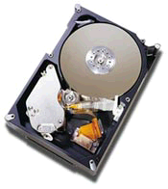
Lecture for Storage System
Type of Storage Devices
Buses—Connecting I/O Devices to CPU/Memory
Reliability,Availability,and Dependability
RAID: Redundant Arrays of Inexpensive Disks
Error and Failures in Real Systems
I/O Performance Measures
A Little Queuing Theory
1

Slide 2
7.1 Introduction
The prejudice
Historically neglected by CPU enthusiasts
CPU time which by definition ignores I/O
Citizenship of I/O is even apparent in the label peripheral applied to I/O devices.
The fact
A computer without I/O devices is like a car without wheels
You can’t get very far without them.
response time
The time between when the user types a command and when results appear—is surely a better measure of performance.
2

Slide 3
Does I/O Performance Matter?
One argument : I/O speed doesn’t matter
If a process waits for a peripheral, run another task
Throughput does not descend
I/O performance doesn’t matter in a multiprogrammed environment.
Several points to make in reply
if users didn’t care about response time
Interactive software never would have been invented
Be no workstations or personal computers today;
Expensive to rely on running other processes
Paging traffic from process switching might actually increase I/O.
Mobile devices and desktop computing, there is only one person per computer and thus fewer processes than in timesharing.
Many times the only waiting process is the human being!
3

Slide 4
I/O’s Revenge is at hand
Amdahl's Law: system speed-up limited by the slowest part!
10% IO & 10x CPU => (lose 50%)
10% IO & 100x CPU => (lose 90%)
I/O bottleneck:
Diminishing fraction of time in CPU
Diminishing value of faster CPUs
I/O performance increasingly limits system performance and effectiveness
CPU Performance: 55% per year and I/O did not improve
Every task would become I/O bound.
There would be no reason to buy faster CPUs—and no jobs for CPU designers.
1
Speedup=
0.1+0.09
=5
1
Speedup=
0.1+0.009
=10
Notes:
Ancestor of Java had no I/O
CPU vs. Peripheral
Primary vs. Secondary
What maks portable, PDA exciting?

Slide 5
Does CPU Performance Matter?
Why still important to keep CPUs busy vs. IO devices ("CPU time"), as CPUs not costly?
Moore's Law leads to both large, fast CPUs but also to very small, cheap CPUs
2001 Hypothesis: 600 MHz PC is fast enough for Office Tools?
PC slowdown since fast enough unless games, new apps?
People care more about storing information and communicating information than calculating
"Information Technology" vs. "Computer Science"
1960s and 1980s: Computing Revolution
1990s and 2000s: Information Age
This shift in focus from computation to communication and storage of information
emphasizes reliability, availability and scalability as well as cost-performance.

Slide 6
Types of Storage Devices-1
Device Providing Information
Sensor Key CRT
1~1000B/S 10B/S 2000B/S
Printer Communication Cable
1800B/S 30~200000B/S
Multimedia Data Device
high speed graphics video display Audio frequency
1MB/S 100MB/S 64KB/S
Network Communication
DIX ( Ethernet network standard Digital, Intel, Xerox)、TB2、RJ45

Slide 7
Types of Storage Devices-2
Device Behavior Partner Data Rate (KB/sec)
Keyboard Input Human 0.01
Mouse Input Human 0.02
Printer Output Human 3.00
Floppy disk Storage Machine 50.00
Laser Printer Output Human 100.00
Optical Disk Storage Machine 500.00
Magnetic Disk Storage Machine 5,000.00
Network-LAN Input or Output Machine 20 --1,000.00
Graphics Display Output Human 30,000.00

Slide 8
Storage Technology Drivers
Driven by the prevailing computing paradigm
1950s: migration from batch to on-line processing
1990s: migration to ubiquitous computing
computers in phones, books, cars, video cameras, …
nationwide fiber optical network with wireless tails
Effects on storage industry:
Embedded storage
smaller, cheaper, more reliable, lower power
Data utilities
high capacity, hierarchically managed storage

Slide 9
I/O Systems
interrupts
Processor
Cache
Memory - I/O Bus
Main
Memory
I/O
Controller
I/O
Controller
I/O
Controller
Disk
Disk
Graphics
Network

Slide 10
Disk Device Terminology
Inner
Track
Arm
Outer
Track
Head
Sector
Actuator
Platter
Several platters, with information recorded magnetically on both surfaces (usually)

Slide 11

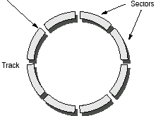
Disk Device Terminology
Bits recorded in tracks, which in turn divided into sectors (e.g., 512 Bytes)
Actuator moves head (end of arm,1/surface) over track (“seek”), select surface, wait for sector rotate under head, then read or write “Cylinder”: all tracks under heads

Slide 12
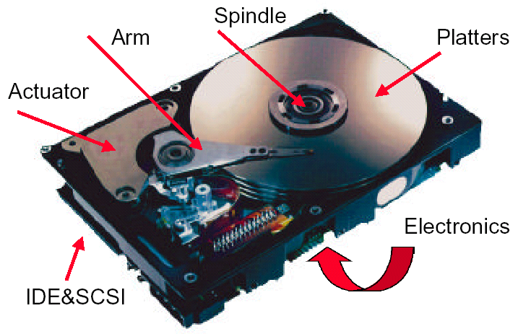
What’s Inside A Disk Drive?

Slide 13
Disk Device Performance
Disk Latency = Seek Time + Rotation Time + Transfer Time + Controller Overhead
Seek time: move head to the desired track
today’s drives - 5 to 15 ms
average seek = time for all possible seeks/no. of possible seeks
actual average seek = 25% to 33% due to locality
Rotational latency
today’s drives - 5,400 to 12,000 RPM ;
approximately 12 ms to 5 ms
average rotational latency = (0.5)(rotational latency)
Transfer time
time to transfer a sector (1 KB/sector)
function of rotation speed, recording density
today’s drives - 10 to 40 MBytes/second
Controller time
overhead on drive electronics adds to manage drive
but also gives prefetching and caching

Slide 14
Disk Device Performance-2 Average access time = (seek time) + (rotational latency) + (transfer) + (controller time)
Track and cylinder skew
cylinder switch time
delay to change from one cylinder to the next
may have to wait an extra rotation
solution - drives incorporate skew
offset sectors between cylinders to account for switch time
head switch time
change heads to go from one track to next on same cylinder
incur additional settling time
Prefetching
disks usually read an entire track at a time
assumes that request for the next sector will come soon
Caching
limited amount of caching across requests, but prefetching is preferred

Slide 15
Disk Device Performance-3
Average distance sector from head?
1/2 time of a rotation
10000 Revolutions Per Minute  166.67 Rev/sec
1 revolution = 1/ 166.67 sec  6.00 milliseconds
1/2 rotation (revolution)  3.00 ms
Average no. tracks move arm?
Sum all possible seek distances from all possible tracks / # possible
Assumes average seek distance is random
Disk industry standard benchmark

Slide 16
Data Rate: Inner vs. Outer Tracks
To keep things simple, originally kept same number of sectors per track
Since outer track longer, lower bits per inch
Competition decided to keep BPI the same for all tracks (“constant bit density”)
More capacity per disk
More of sectors per track towards edge
Since disk spins at constant speed, outer tracks have faster data rate
Bandwidth outer track 1.7X inner track!
Inner track highest density, outer track lowest, so not really constant
2.1X length of track outer / inner, 1.7X bits outer / inner

Slide 17
Devices: Magnetic Disks
Purpose:
Long-term, nonvolatile storage
Large, inexpensive, slow level in the storage hierarchy
Characteristics:
Seek Time (~8 ms avg)
positional latency
rotational latency
Transfer rate
10-40 MByte/sec
Blocks
Capacity
Gigabytes
Quadruples every 2 years (aerodynamics)
Response time
= Queue + Controller + Seek + Rot + Xfer
Service time

Slide 18
State of the Art: Barracuda 180
Track
181.6 GB, 3.5 inch disk
12 platters, 24 surfaces
24,247 cylinders
7,200 RPM; (4.2 ms avg. latency)
7.4/8.2 ms avg. seek (r/w)
64 to 35 MB/s (internal)
0.1 ms controller time
10.3 watts (idle)
Sector
Cylinder
Arm
Platter
Head
Track Buffer
Latency =
Queuing Time +
Controller time +
Seek Time + Rotation Time +
Size / Bandwidth
{
per access
+
per byte
source: www.seagate.com
Notes:
47 to 26 MB/s (external)

Slide 19
Disk Performance Example
Disk characteristics
512 byte sector, rotate at 5400 RPM, advertised seeks is 5 ms,
transfer rate is 40 MB/sec, it rotates at 10,000RPM, controller overhead is 0.1 ms, queue idle so no service time.
Answer
Access Time = Seek time + Rotational Latency + Transfer time + Controller Time + Queuing Delay
0.5
0.5KB
＝5ms ＋
＋
＋ 0.1ms
10,000PRM
40MB/sec
＝5ms ＋ 3.0 ＋ 0.013 ＋ 0.1 ＝8.11ms

Slide 20
Disk Performance Example(cont.)
Assuming the measured seek time is 33% of the calculated average, the answer is
Access Time ＝33%×5ms ＋ 3.0 ms＋ 0.013ms ＋ 0.1ms ＝4.783ms
Note that only 0.013 /4.783 or 0.3% of the time is the disk transferring data in this example. Even page-sized transfers often take less than 5%, so disks normally spend most of their time waiting for the head to get over the data rather than reading or writing the data.

Slide 21

The Future of Magnetic Disks
Bits recorded along a track
Metric is Bits Per Inch (BPI)
Number of tracks per surface
Metric is Tracks Per Inch (TPI)
Disk Designs Brag about bit density per unit area
Metric is Bits Per Square Inch
Called Areal Density
Areal Density = BPI x TPI

Slide 22
Areal Density
Areal Density = BPI x TPI
Change slope 29%/yr to 60%/yr about 1996

Slide 23

1 inch disk drive!
2000 IBM MicroDrive:
1.7” x 1.4” x 0.2”
1 GB, 3600 RPM, 5 MB/s, 15 ms seek
Digital camera, PalmPC?
2006 MicroDrive?
9 GB, 50 MB/s!
Assuming it finds a niche in a successful product
Assuming past trends continue

Slide 24
Optical Disks
One challenger
High capacity、Low cost
Read-only→Write once→ReWritable
CD-DA、CD-ROM、CD-I、CD-R、VCD、DVD
Pits(0.5μm)、lands、

Slide 25
Magnetic Tapes vs. Disk
Longitudinal tape uses same technology as hard disk; tracks its density improvements
Disk head flies above surface, tape head lies on surface
Disk fixed, tape removable
Inherent cost-performance based on geometries:
fixed rotating platters with gaps
(random access, limited area, 1 media / reader)
removable long strips wound on spool
(sequential access, "unlimited" length, multiple / reader)
Helical Scan (VCR, Camcoder, DAT)
Spins head at angle to tape to improve density

Slide 26
Current Drawbacks to Tape
Tape wear out:
Helical 100s of passes to 1000s for longitudinal
Head wear out:
2000 hours for helical
Both must be accounted for in economic / reliability model
Bits stretch
Readers must be compatible with multiple generations of media
Long rewind, eject, load, spin-up times; not inherent, just no need in marketplace
Designed for archival

Slide 27
Automated Tape Libraries StorageTek Powderhorn 9310
7.7 feet
8200 pounds, 1.1 kilowatts
10.7 feet
6000 x 50 GB 9830 tapes = 300 TBytes in 2000 (uncompressed)
Library of Congress: all information in the world; in 1992, ASCII of all books = 30 TB
Exchange up to 450 tapes per hour (8 secs/tape)
1.7 to 7.7 Mbyte/sec per reader, up to 10 readers

Slide 28
Library vs. Storage
Getting books today as quaint as the way I learned to program
punch cards, batch processing
wander thru shelves, anticipatory purchasing
Cost $1 per book to check out
$30 for a catalogue entry
30% of all books never checked out
Write only journals?
Digital library can transform campuses

Slide 29
Whither tape?
Investment in research:
90% of disks shipped in PCs; 100% of PCs have disks
~0% of tape readers shipped in PCs; ~0% of PCs have disks
Before, N disks / tape; today, N tapes / disk
40 GB/DLT tape (uncompressed)
80 to 192 GB/3.5" disk (uncompressed)
Cost per GB:
In past, 10X to 100X tape cartridge vs. disk
Jan 2001: 40 GB for $53 (DLT cartridge), $2800 for reader
$1.33/GB cartridge, $2.03/GB 100 cartridges + 1 reader
($10995 for 1 reader + 15 tape autoloader, $10.50/GB)
Jan 2001: 80 GB for $244 (IDE,5400 RPM), $3.05/GB
Will $/GB tape v. disk cross in 2001? 2002? 2003?
Storage field is based on tape backup; what should we do? Discussion if time permits?

Slide 30
What about FLASH
Compact Flash Cards
Intel Strata Flash
16 Mb in 1 square cm. (.6 mm thick)
100,000 write/erase cycles.
Standby current = 100uA, write = 45mA
Compact Flash 256MB~=$120 512MB~=$542
Transfer @ 3.5MB/s
IBM Microdrive 1G~370
Standby current = 20mA, write = 250mA
Efficiency advertised in wats/MB
Disks
Nearly instant standby wake-up time
Random access to data stored
Tolerant to shock and vibration (1000G of operating shock)

Slide 31
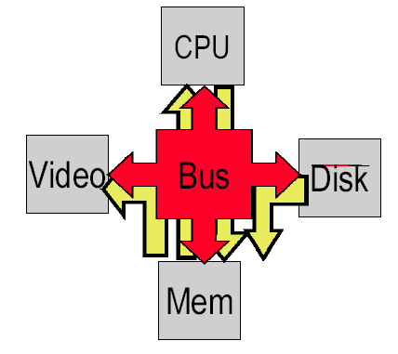
7.3 Buses--Connecting I/O Devices to CPU/Memory
Lots of sub-systems need to communicate
Busses: Shared wires for common communication

Slide 32
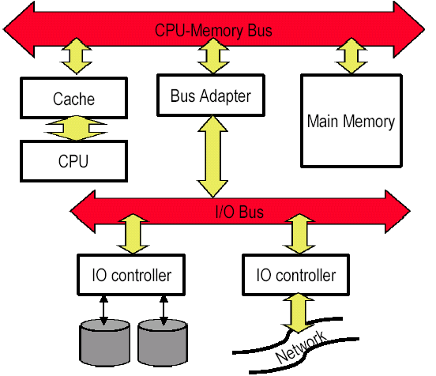
Bus Classifications
CPU-memory busses
Fast
Proprietary
Closed and controlled
Support only memory transactions
IO busses
Standardized (SCSI, PCI, AGP)
More diversity
More length
Bus Bridges/Adapter
Standardized (RS-232, )
Cross from one bus to another

Slide 33
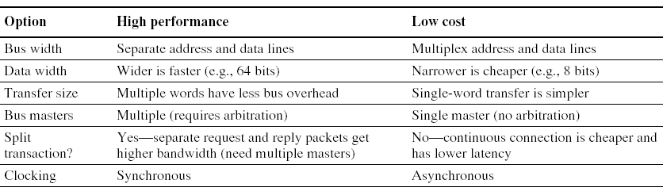
Bus Design Decisions
goals
decisions depend on cost and performance
higher performance at more cost.
The first three options in the figure are clear
separate address and data lines,
wider data lines, and multiple
word transfers

Slide 34
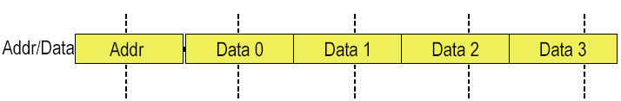
Structure, Width, and Transfer Length
Separate vs. Multiplexed Address/Data
Multiplexed: save wires
Separate: more performance
Wide words: higher throughput, less control per transfer
On-chip cache to CPU busses: 256 bits wide
Serial Busses
Data Transfer Length
More data per address/control transfer
Example: Multiplexed Addr/Data with Data transfer of 4

Slide 35
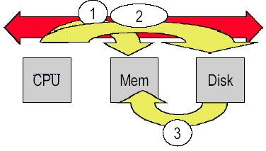
Bus Mastering
Bus Master: a device that can initiate a bus transfer
1. CPU makes memory request
2. Page Fault in VM requires disk access to load page
3. Mover data from disk to memory
If the CPU is master, does it have to check to see if the disk is ready to transfer?

Slide 36
Multiple Bus Masters
What if multiple devices could initiate transfers?
Update might take place in background while CPU operates
Multiple CPUs on shared memory systems
Challenge: Arbitration
If two or more masters want the bus at the same time, who gets it?

Slide 37
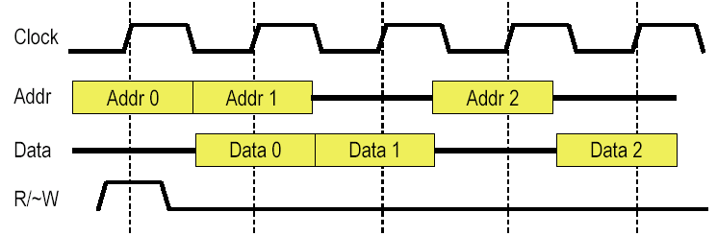
Bus Clocking: Synchronous
Synchronous
Sample the control signals at edge of clock
Pro: Fast and High Performance
Con:
Can’t be long (skew) or fast at same time
All bus members must run at the right speed

Slide 38
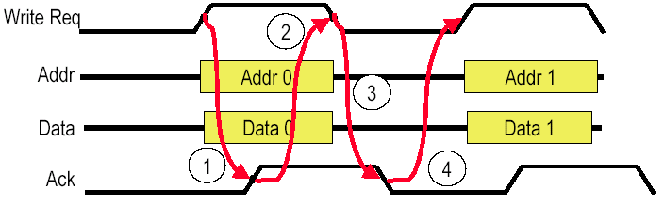
Bus Clocking: Asynchronous
Asynchronous
Edge of control signals determines communication
“Handshake Protocol”
Pros:
No clock
Slow and fast components on the same bus
Con:
Inefficient: two round trips
Like somebody who always repeats what was said to them
1. Request (with actual transaction)
2. Acknowledge causes de-assert of Request
3. De-assert of Request causes de-assert of Ack
4. De-assert of Ack allows re-assertion of Request

Slide 39
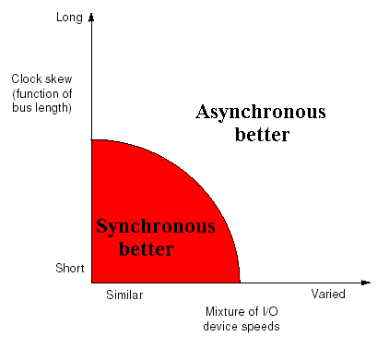
Synchronous vs Asynchronous
Preferred bus type as a function of length/clock skew and variation in I/O device speed.
Synchronous is best when the distance is short and the I/O devices on the bus all transfer at similar speeds.

Slide 40
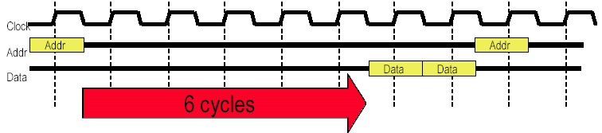
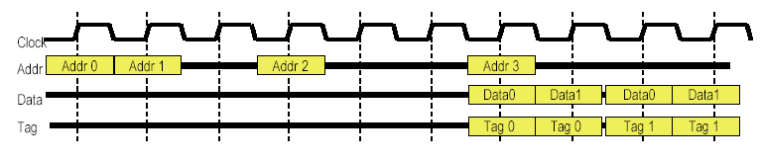
Split Transactions
Problem: Long wait times
Solution: Split Transaction Bus

Slide 41
Bus Standards
I/O bus --- interface---devices
Standards
let the computer designer and I/O-device designer work independently play a large role in buses.
Any I/O device can connect to any computer.
Document
Defines how to connect devices to computers
De facto standards
Machines sometimes grow to be so popular that their I/O buses become de facto standards
PDP-11 Unibus、IBM PC-AT

Slide 42
Examples of Buses
Buses in common use
Common desktop I/O buses,
I/O buses found in embedded devices,
CPU-memory interconnects found in servers
Summary of parallel I/O buses.
Summary of serial I/O buses ( Embedded computers)
Summary of CPU-memory interconnects found in 2000 servers.

Slide 43
Summary of parallel I/O buses
IDE---Integrated Drive Electronics
Early disk standard that connects two disks to a PC.
It has been extended by AT-bus Attachment (ATA), to be both wider and faster.
SCSI---Small Computer System Interconnect
connects up to 7 devices for 8-bit busses and up to 15 devices for 16-bit busses.
They can even be different speeds, but they run at the rate of the slowest device.
The peak bandwidth of a SCIS bus is the width (1 or 2 bytes) times the clock rate (10 to 160 MHz). Most SCSI buses today are 16-bits.
PCI---Peripheral Component Interconnect
PCI-X ,PCI Extended
Connect main memory to peripheral devices

Slide 44
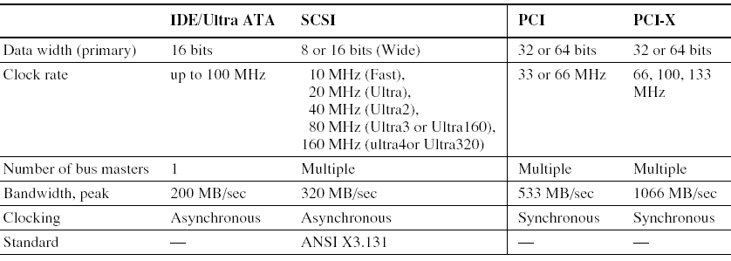
Summary of parallel I/O buses

Slide 45
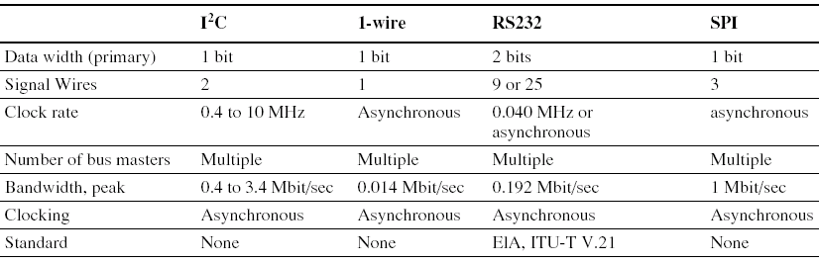
Summary of serial I/O buses
Often used in embedded computers.
I²C ----- invented by Phillips in the early 1980s.
1-wire -- developed by Dallas Semiconductor.
RS-232 -introduced in 1962.
SPI ----- created by Motorola in the early 1980s.

Slide 46
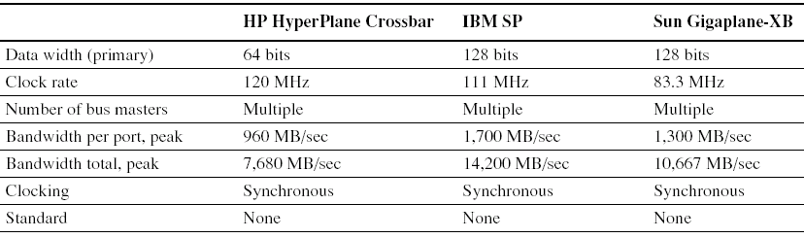
Summary of CPU-memory interconnects found in 2000 servers
Shared bus
crossbars switches
Each bus connects up to four processors and memory controllers, and then the crossbar connects the busses together.
The number of slots in the crossbar is 16, 8, and 16, respectively.
These servers use crossbars switches to connect nodes processors together instead of a shared bus interconnect.

Slide 47
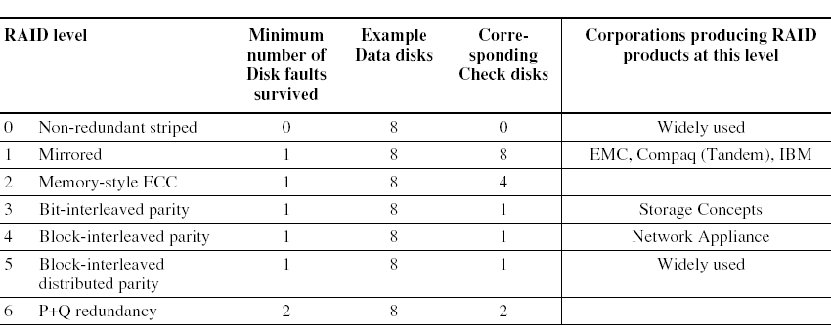
7.5 RAID: Redundant Arrays of Inexpensive Disks
A disk arrays replace larger disk

Slide 48
David patterson, Garth Gibson, and Randy Katz, A Case for Redundant Arrays of Inexpensive Disks (RAID), ACM SIGMOD conference, 1988

Slide 49
Use Arrays of Small Disks?
Katz and Patterson asked in 1987:
Can smaller disks be used to close gap in performance between disks and CPUs?
Conventional: 4 disk designs
3.5”
5.25”
10”
14”
Low End
High End
Disk Array: 1 disk design
3.5”

Slide 50
Replace Small Number of Large Disks with Large Number of Small Disks! (1988 Disks)
IBM 3390K
20 GBytes
97 cu. ft.
3 KW
15 MB/s
600 I/Os/s
250 KHrs
$250K
IBM 3.5" 0061
320 MBytes
0.1 cu. ft.
11 W
1.5 MB/s
55 I/Os/s
50 KHrs
$2K
x70
23 GBytes
11 cu. ft.
1 KW
120 MB/s
3900 IOs/s
??? Hrs
$150K
Capacity
Volume
Power
Data Rate
I/O Rate
MTTF
Cost
9X
3X
8X
6X
Disk Arrays have potential for large data and I/O rates, high MB per cu. ft., high MB per KW, but what about reliability?

Slide 51
Array Reliability
Reliability of N disks = Reliability of 1 Disk ÷ N
50,000 Hours ÷ 70 disks = 700 hours
Disk system MTTF: Drops from 6 years to 1 month!
• Arrays (without redundancy) too unreliable to be useful!
Hot spares support reconstruction in parallel with access: very high media availability can be achieved

Slide 52
Redundant Arrays of (Inexpensive) Disks
Files are "striped" across multiple disks
Redundancy yields high data availability
Availability: service still provided to user, even if some components failed
Disks will still fail
Contents reconstructed from data redundantly stored in the array
⇒ Capacity penalty to store redundant info
⇒ Bandwidth penalty to update redundant info

Slide 53
RAID 0: No Redundancy
Data is striped across a disk array but there is no redundancy to tolerate disk failure
It also improves performance for large accesses, since many diskscan operate at once.
RAID 0 something of a misnomer as there is no redundancy,

Slide 54
RAID 1: Disk Mirroring/Shadowing
recovery
group
• Each disk is fully duplicated onto its “mirror”
Very high availability can be achieved
• Bandwidth sacrifice on write:
Logical write = two physical writes
• Reads may be optimized
• Most expensive solution: 100% capacity overhead
(RAID 2 not interesting, so skip)

Slide 55
RAID 3: Bit-Interleaved Parity Disk
10010011
11001101
10010011
. . .
P
logical record
1
0
1
0
0
0
1
1
1
1
0
0
1
1
0
1
1
0
1
0
0
0
1
1
1
1
0
0
1
1
0
1
Striped physical
records
P contains sum of
other disks per stripe mod 2 (“parity”)
If disk fails, subtract
P from sum of other disks to find missing information

Slide 56
RAID 3
Sum computed across recovery group to protect against hard disk failures, stored in P disk
Logically, a single high capacity, high transfer rate disk: good for large transfers
Wider arrays reduce capacity costs, but decreases availability
33% capacity cost for parity in this configuration

Slide 57
Inspiration for RAID 4
RAID 3 relies on parity disk to discover errors on Read
But every sector has an error detection field
Rely on error detection field to catch errors on read, not on the parity disk
Allows independent reads to different disks simultaneously

Slide 58
RAID 4: High I/O Rate Parity
Increasing
Logical
Disk
Address
D0
D1
D2
D3
P
Insides of 5 disks
D4
D5
D6
D7
P
D8
D9
D10
D11
P
Example:
small read D0 & D5, large write D12-D15
D12
D13
D14
D15
P
Stripe
D16
D17
D18
D19
P
D20
D21
D22
D23
P
.
.
.
.
.
.
.
.
.
.
.
.
.
.
.
Disk Columns

Slide 59
Inspiration for RAID 5
RAID 4 works well for small reads
Small writes (write to one disk):
Option 1: read other data disks, create new sum and write to Parity Disk
Option 2: since P has old sum, compare old data to new data, add the difference to P
Small writes are limited by Parity Disk: Write to D0, D5 both also write to P disk
D0
D1
D2
D3
P
D4
D5
D6
D7
P

Slide 60
RAID 5: High I/O Rate Interleaved Parity
D0
D1
D2
D3
P
Increasing
Logical
Disk
Addresses
Independent writes
possible because of
interleaved parity
D4
D5
D6
P
D7
D8
D9
P
D10
D11
D12
P
D13
D14
D15
Example: write to D0, D5 uses disks 0, 1, 3, 4
P
D16
D17
D18
D19
D20
D21
D22
D23
P
.
.
.
.
.
.
.
.
.
.
.
.
.
.
.
Disk Columns

Slide 61
Problems of Disk Arrays: Small Writes
RAID-5: Small Write Algorithm
1 Logical Write = 2 Physical Reads + 2 Physical Writes
D0'
D0
D1
D2
D3
P
new
data
old
data
old
parity
(1. Read)
(2. Read)
+
XOR
+
XOR
(3. Write)
(4. Write)
D0'
D1
D2
D3
P'

Slide 62
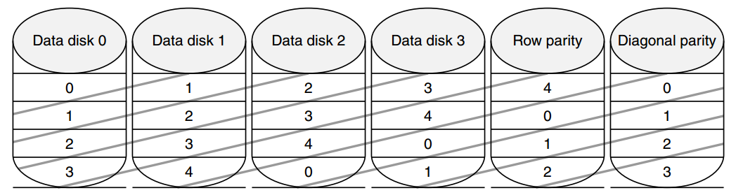
RAID-DP: P365 in 4th Edition
Protect against double failure
Row parity: one parity for per-stripe in red
Diagonal parity: showed in blue.
Row-Diagonal for p=5
P-1 dada disk, 1 row parity, 1 diagonal parity, total P+1 disk
-

Slide 63
Case: Recovery of double failure
Recovery solution 1:
→ D3-0(from Diagonal parity)
→ D1-3( from Row parity)
→ D3-3(Diagonal Parity)
→ D1-1(Row parity )
→ D2-2(Diagonal Parity)
→ D3-4(Row Parity )
→ D3-1 (Diagonal Parity)
→ D1-4 (Row Parity)

Slide 64
System Availability: Orthogonal RAIDs
Array
Controller
String
Controller
. . .
String
Controller
. . .
String
Controller
. . .
String
Controller
. . .
String
Controller
. . .
String
Controller
. . .
Data Recovery Group: unit of data redundancy
Redundant Support Components: fans, power supplies, controller, cables
End to End Data Integrity: internal parity protected data paths

Slide 65
System-Level Availability
host
host
I/O Controller
Fully dual redundant
I/O Controller
Array Controller
Array Controller
. . .
. . .
. . .
Goal: No Single
Points of
Failure
. . .
. . .
.
.
.
with duplicated paths, higher performance can be
obtained when there are no failures
Recovery
Group

Slide 66
Summary: RAID Techniques: Goal was performance, popularity due to reliability of storage
• Disk Mirroring, Shadowing (RAID 1)
1
0
0
1
0
0
1
1
1
0
0
1
0
0
1
1
Each disk is fully duplicated onto its "shadow"
Logical write = two physical writes
100% capacity overhead
• Parity Data Bandwidth Array (RAID 3)
1
0
0
1
0
0
1
1
1
1
0
0
1
1
0
1
1
0
0
1
0
0
1
1
0
0
1
1
0
0
1
0
Parity computed horizontally
Logically a single high data bw disk
• High I/O Rate Parity Array (RAID 5)
Interleaved parity blocks
Independent reads and writes
Logical write = 2 reads + 2 writes

Slide 67
7.7 I/O Performance Measures
I/O System performance depends on many aspects of the system (‘limited by weakest link in the chain’)
The CPU
The memory system:
Internal and external caches
Main Memory
The underlying interconnection (buses)
The I/O controller
The I/O device
The speed of the I/O software (Operating System)
The efficiency of the software¡¯s use of the I/O devices
Two common performance metrics:
Throughput: I/O bandwidth
Response time: Latency

Slide 68
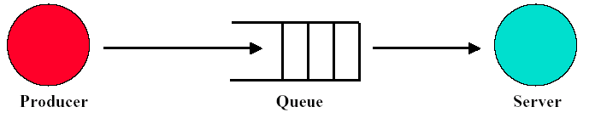
Simple Producer-Server Model
Throughput
The number of tasks completed by the server in unit time
In order to get the highest possible throughput:
The server should never be idle
The queue should never be empty
Response time
Begins when a task is placed in the queue
Ends when it is completed by the server
In order to minimize the response time:
The queue should be empty
The server will be idle

Slide 69
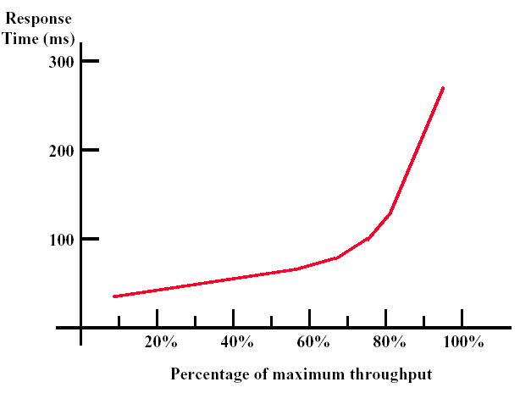
Throughput versus Respond Time

Slide 70
Response time relate to Interaction
An interaction, or transaction, with a computer is divided into three parts:
1. Entry time---The time for the user to enter the command.
The graphics system required 0.25 seconds on average to enter a command versus 4.0 seconds for the keyboard system.
2. System response time---The time between when the user enters the command and the complete response is displayed.
3. Think time---The time from the reception of the response until the user begins to enter the next command.

Slide 71
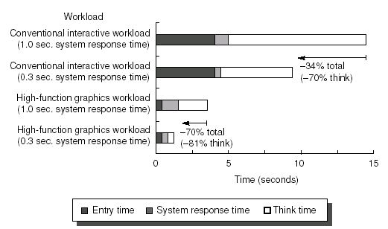
Response time relate to Interaction

Slide 72
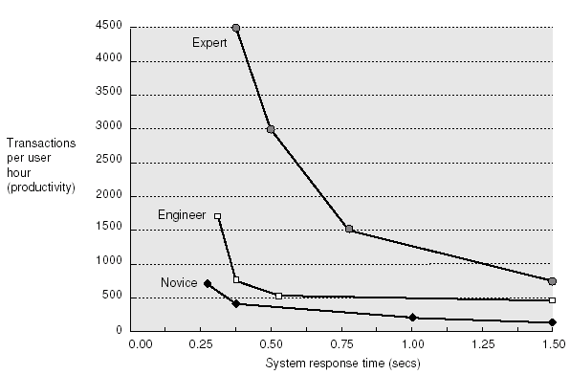
Response time vs Manipulator

Slide 73
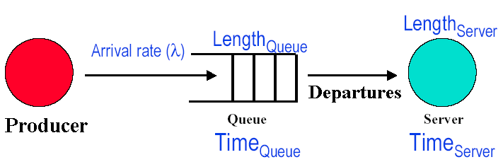
7.8 A Little Queuing Theory
Assumption: steady state characteristics, FIFO
Little’s Law:
Length_{System} = Arrival rate x Time_{System}
(Length_{Queue} + Length_{Server}) = l x (Time_{Queue} + Time_{Server})

Slide 74
How busy a system is !
Arrival rate
Server Utilization (U)
U = l x Time_{Server}
(Arrival Rate < Service Rate)
Example:
Single disk (server) gets 10 requests per second
Avg time to service a request: 50 ms
What is the utilization?
Arrival rate: 10 IOPS
Service rate: 1/50ms = 20 IOPS
How many requests at the disk on average?
Length_{Server} = Arrival rate x Time_{Server} = 10 IOPS x 0.05s
= 0.5 in disk at any one time
Server Utilization = -------------------
Service rate
10
Server Utilization = ------- =50%
20

Slide 75
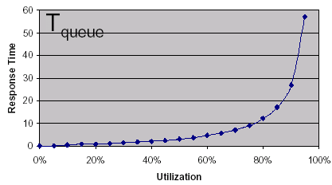
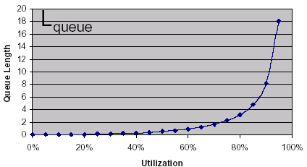
For I/O systems
(making some assumptions + doing a little algebra)
Tqueue = T_{server} x U / (1-U)
Lqueue= U² / (1-U)

Slide 76
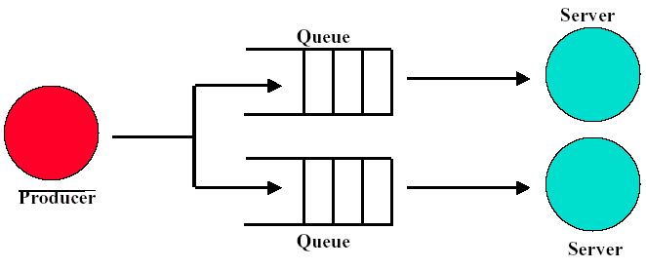
Throughput Enhancement-1
In general throughput can be improved by:
Throwing more hardware at the problem
Parallel Queues
Increases system throughput
Problem: One queue is full while other is empty

Slide 77
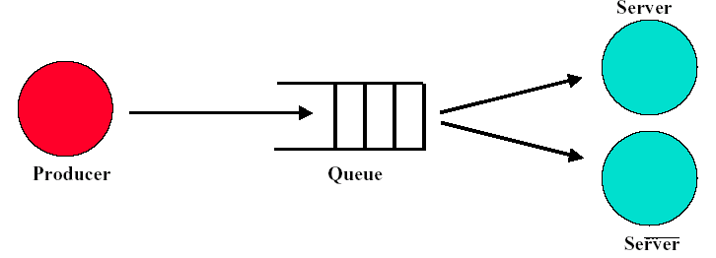
Throughput Enhancement-2
Little’s Law still holds
Server utilization could be greater than 1.0
Response time is much harder to reduce
Minimum: 1/T_{server}

