Slide 1
Lecture 15
Multiprocessors

Slide 2
Why Multiprocessors?
Application requirements
Uniprocessor speed improving fast
But there are things that need even more speed
Microprocessors as the fastest CPUs
Collecting several much easier than redesigning one
Complexity of current microprocessors
Do we have enough ideas to sustain 1.5X/yr?
Can we deliver such complexity on schedule?
Slow (but steady) improvement in parallel software
(scientific apps, databases, OS)

Slide 3
Opportunities for Applications
Scientific computing
Nearly unlimited demand (Grand challenge)
App Perf(GFLOPS) Memory (GB)
72 hour weather 3 1
Pharmaceutical design 100 10
Global Change,Genome 1000 1000
Successes in some real industries:
Petroleum reservoir modeling
Automotive: crash simulation, drag analysis, engine
Aeronautics: airflow analysis, engine, structural mechanics
Pharmaceuticals: molecular modeling
Entertainment: full length movies (“Toy Story”)
Commercial application
Transaction processing, file servers, electronic CAD simulation,search engine
Examples: IBM RS6000, Tandem (Compaq) Himilaya

Slide 4
Parallel Processing
Multiple processors working cooperatively on problems: not the same as multiprogramming
Goals/Motivation
Performance: limits of uniprocessors
ILP (branch prediction, RAW dependencies, memory)
Cost Efficiency: build big systems with commodity parts
(uniprocessors)
Scalability: just add more processors to get more performance
Fault tolerance: One processor fails you still can continue processing

Slide 5
Parallel Computers
Definition: “A parallel computer is a collection of processiong elements that cooperate and communicate to solve large problems fast.”
Almasi and Gottlieb, Highly Parallel Computing ,1989
Questions about parallel computers:
How large a collection?
How powerful are processing elements?
How do they cooperate and communicate?
How are data transmitted?
What type of interconnection?
What are HW and SW primitives for programmer?
Does it translate into performance?

Slide 6
Popular Flynn Taxonomy
Flynn’s Taxonomy of Parallel Machines
How many Instruction streams?
How many Data streams?
SISD (Single Instruction Single Data) ----Uniprocessors
MISD (Multiple Instruction Single Data) ---- Not used much
SIMD (Single Instruction Multiple Data)
Each “processor” works on its own data, but execute the same instr.
Examples: connection machine 2：65535个 1bit processors;
Illiac IV： 64个 64bit processors;
Ad: Simple programming model; Low overhead; Flexibility;
MIMD (Multiple Instruction Multiple Data)
Each processor executes its own instr. and operates on its own data
Examples: Sun Enterprise 5000, Cray T3D, SGI Origin
Ad: Flexible; Use off-the-shelf microprocessors;
Not superscalar, each node is superscalar, lessons will apply to multi-core

Slide 7
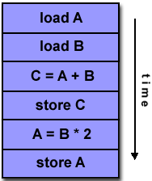
Program execute on SISD

Slide 8
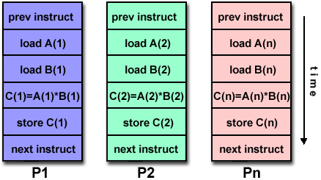
Program execute on SIMD

Slide 9
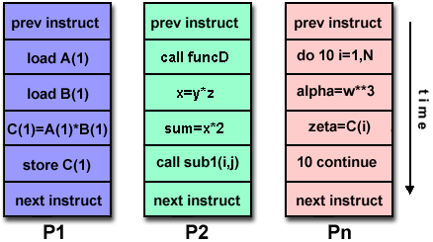
Program execute on MIMD

Slide 10
Catalogue the Parallel (MIMD) processors
Center on organization of main memory
Shared vs. Distributed
Appearance of memory to hardware
Q1: Memory access latency uniform?
Shared : yes, doesn’t matter where data goes
Distributed: no, makes a big difference
Appearance of memory to software
Q2: Can processors communicate directly via memory?
Shared (shared memory): yes, communicate via load/store
Distributed (message passing): no, communicate via messages
Dimensions are orthogonal
e.g. DSM: (physically) distributed, (logically) shared memory

Slide 11
Dimensions are orthogonal
(SMP)/UMA
(DSM)/ NUMA

Slide 12
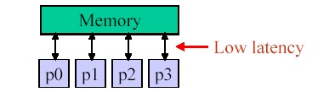
UMA vs. NUMA: Why it matters
Ideal model:
Perfect (single-cycle) memory latency
Perfect (infinite) memory bandwidth
Real systems:
Latencies are long and grow with system size
Bandwidth is limited
Add memory banks, interconnect to hook up (latency goes up)

Slide 13
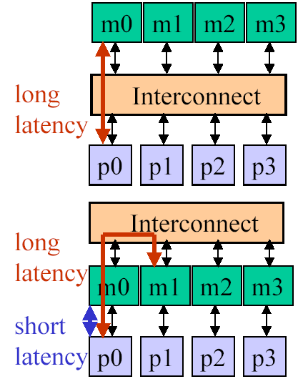
UMA vs. NUMA
UMA: uniform memory access
From p0 same latency to m0-m3
Data placement doesn’t matter
Latency worse as system scales
Interconnect contention restricts bandwidth
Small multiprocessors only
NUMA: non-uniform memory access
From p0 faster to m0 than m1-m3
Low latency to local memory helps performance
Data placement important (software!)
Less contention => more scalable
Large multiprocessor systems

Slide 14
Major MIMD Styles
Centralized shared memory ("Uniform Memory Access" time or "Shared Memory Processor")
Decentralized memory (memory module with CPU)
get more memory bandwidth, lower memory latency
Drawback: Longer communication latency
Drawback: Software model more complex

Slide 15
Structure of centralized shared-memory multiprocessor
< 100 processor nodes in 2006, normal few dozen

Slide 16
Structure of distributed-memory multiprocessor

Slide 17
Comparison in graph
Uniprocessor
Pipelined
Superscalar
VLIW
SMP(Symmetric)
or CSM(Centralized)
Distributed
P
M
P
M
M
P
M
P
M
N
E
T
P
M
M

Slide 18
Distributed-memory multiprocessor(1)
Distributed shared memory
（DSM or scalable shared memory)
logical uniform address space but physical distributed memory, so any one of the processors can access any one of the memories.
Shared memory means sharing the address space, which is different from centralized shared memory.

Slide 19
Distributed-memory multiprocessor(2)
multiple computers
Address space consists of multiple private (separate) address spaces。A processor can NOT access the remote memory node directly.
Every node (processor-memory pair）is a independent computer.
NOW(Network of Workstation)is consisted of multiple node( PC or workstation) connected by LAN
PC cluster

Slide 20
Parallel Architecture
Parallel Architecture extends traditional computer architecture with a communication architecture
abstractions (HW/SW interface)
organizational structure to realize abstraction efficiently

Slide 21
Parallel Framework
Programming Model:
Multiprogramming : lots of jobs, no communication
Shared address space: communicate via memory
Message passing: send and recieve messages
Data Parallel: several agents operate on several data sets simultaneously and then exchange information globally and simultaneously (shared or message passing)
Communication Abstraction:
Shared address space: e.g., load, store, atomic swap
Message passing: e.g., send, receive library calls

Slide 22
Shared Address Model-1
Each processor can name every physical location in the machine
Each process can name all data that shares with other processes
Data transfer via load and store
Data size: byte, word, ... or cache blocks
Uses virtual memory to map virtual space to local or remote physical space
Memory hierarchy model applies: now communication moves data to local processor cache (as load moves data from memory to cache)
Latency, Bandwidth, scalability when communicate?
For distributed memory architecture, a layer (software or hardware) is generally added to allow transparent address mapping􀂉

Slide 23
Shared Address Model-2
Significant research has been conducted to make the translation transparent and scalable for many node􀂉
Handling data consistency and protection is typically a challenge
For multi-computer systems, address mapping has to be performed by software modules, typically added as part of the operating system􀂉
Latency depends on the underlined hardware architecture (bus bandwidth, memory access time and support for address translation)􀂉
Scalability is limited given that the communication model is so tightly coupled with process address space*

Slide 24
Message Passing Model-1
Whole computers (CPU, memory, I/O devices) communicate as explicit I/O operations
Essentially NUMA but integrated at I/O devices vs. memory system
Send specifies local buffer + receiving process on remote computer
Receive specifies sending process on remote computer + local buffer to place data
Usually send includes process tag and receive has rule on tag: match 1, match any
Synch: when send completes, when buffer free, when request accepted, receive wait for send
Send + receive => memory-memory copy, where each supplies local address, AND does pairwise sychronization!

Slide 25
Message Passing Model-2
History of message passing:
Network topology important because could only send to immediate neighbor
Typically synchronous, blocking send & receive
Later DMA with non-blocking sends, DMA for receive into buffer until processor does receive, and then data is transferred to local memory
Later SW libraries to allow arbitrary communication
Example:
IBM SP-2, RS6000 workstations in racks
Network Interface Card has Intel 960
8X8 Crossbar switch as communication building block
40 MByte/sec per link

Slide 26
Shared Memory vs. Message Passing
Shared Memory (multiprocessors)
One shared address space
Processors use conventional load/stores to access shared data
Communication can be complex/dynamic
Simpler programming model (compatible with uniprocessors)
Hardware controlled caching is useful to reduce latency contention
Has drawbacks
Synchronization (discussed later)
More complex hardware needed

Slide 27
Shared Memory vs. Message Passing
MIMD (appearance of memory to software)
Message Passing (multicomputers)
Each processor has its own address space
Processors send and receive messages to and from each
other
Communication patterns explicit and precise
Explicit messaging forces programmer to optimize this
Used for scientific codes (explicit communication)
Message passing systems: PVM, MPI, OpenMP
Simple Hardware
Difficult programming Model

Slide 28
Communication Models
Shared Memory
Processors communicate with shared address space
Easy on small-scale machines
Advantages:
Model of choice for uniprocessors, small-scale MPs
Ease of programming
Lower latency
Easier to use hardware controlled caching
Message passing
Processors have private memories, communicate via messages
Advantages:
Less hardware, easier to design
Focuses attention on costly non-local operations
Can support either SW model on either HW base

Slide 29
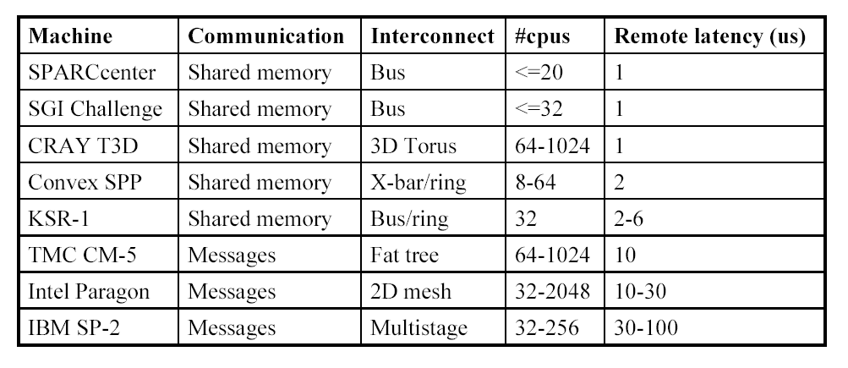
Parallel Systems (80s and 90s)

Slide 30
Multiprocessor Trends
Shared Memory
Easier, more dynamic programming model
Can do more to optimize the hardware
Small-to-medium size UMA systems (2-8 processors)
Processor + memory + switch on single board (4x pentium)
Single-chip multiprocessors (POWER4)
Commodity parts soon – glueless MP systems
Larger NUMAs built from smaller UMAs
Use commodity small UMAs with commodity interconnects (ethernet, myrinet)
NUMA clusters

Slide 31
Fundamental Issues_1
Naming: how to solve large problem fast
what data is shared
how it is addressed
what operations can access data
how processes refer to each other
Choice of naming affects code produced by a compiler; via load where just remember address or keep track of processor number and local virtual address for message passing
Choice of naming affects replication of data; via load in cache memory hierarchy or via SW replication and consistency

Slide 32
Fundamental Issues_2
Global physical address space: any processor can generate, address and access it in a single operation
Global virtual address space: if the address space of each process can be configured to contain all shared data of the parallel program
memory can be anywhere: virtual address translation handles it
Segmented shared address space: locations are named <process number, address>
uniformly for all processes of the parallel program

Slide 33
Fundamntal Issues_3
Synchronization:
To cooperate, processes must coordinate
Message passing is implicit coordination with transmission or arrival of data
Shared address => additional operations to explicitly coordinate: e.g., write a flag, awaken a thread, interrupt a processor􀁰

Slide 34
Fundamntal Issues_4 Latency and Bandwidth
Bandwidth
Need high bandwidth in communication
Match limits in network, memory, and processor
Challenge is link speed of network interface vs. bisection bandwidth of network
Latency
Affects performance, since processor may have to wait
Affects ease of programming, since requires more thought to overlap communication and computation
Overhead to communicate is a problem in many machines
Latency Hiding
How can a mechanism help hide latency?
Increases programming system burdern
Examples: overlap message send with computation, prefetch data, switch to other tasks

Slide 35
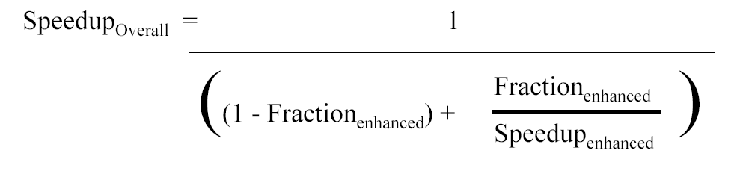
Challenge: limited program parallism
Example: Achieve speedup of 80 x using 100 processors
80 = 1/[Fracparallel/100+1-Fracparallel]
Frac parallel = 0.9975
==> only 0.25% of the work can be serial!
Can parallized part be imporved to 100 times considering the overheads ?

Slide 36
Challenge : long communication latency
Given： (P203)
32-processor machine, with each processor cycle time=0.5ns (2GHz );
remote reference time= 200ns;
all references except those involving communication hit in local memory;
base CPI=0.5 (all reference hit in the cache);
Processors are stalled on a remote request.
0.2% of the instructions involve a remote reference.
Answer:
CPI = Base CPI + Remote request rate × Remote request cost =0.5 + 0.2% × Remote request cost
The remote request cost is:
CPI=0.5 + 0.8 = 1.3
The multiprocessor with all local references is 1.3/0.5 = 2.6 times faster.
Remote access cost
200ns
=400cycles
=
Cycle time
0.5ns

Slide 37
What can we do ?
Limited program parallelism
New algorithm
Long communication latency
HW: caching shared data to lower the remote access frequency
Problem: cache coherence,
cache consistence
SW:
restructuring the data to make more accesses local
Synchronization
latency hiding techniques

Slide 38
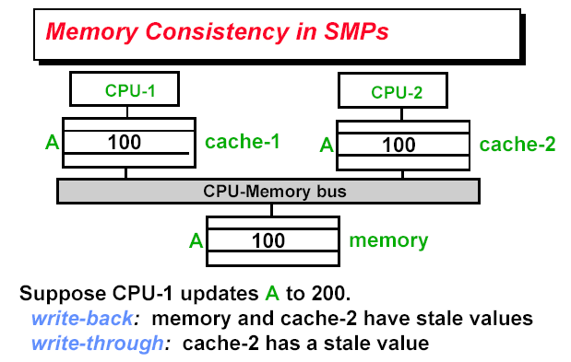
Cache Coherence in Multiprocessor

Slide 39
HW Coherence Protocols
Snooping Solution (Snoopy Bus):
Send all requests for data to all processors
Processors snoop to see if they have a copy and respond accordingly
Requires broadcast, since caching information is at processors
Works well with bus (natural broadcast medium)
Dominates for small scale machines (most of the market)
Directory-Based Schemes (discuss later)
Keep track of what is being shared in 1 centralized place (logically)
Distributed memory => distributed directory for scalability (avoids bottlenecks)
Send point-to-point requests to processors via network
Scales better than Snooping
Actually existed BEFORE Snooping-based schemes

Slide 40
Basic Snoopy Protocols
Write Invalidate Protocol:
Multiple readers, single writer
Write to shared data: an invalidate is sent to all caches which snoop and invalidate any copies
Read Miss:
Write-through: memory is always up-to-date
Write-back: snoop in caches to find most recent copy
Write Broadcast Protocol (typically write through):
Write to shared data: broadcast on bus, processors snoop, and update any copies
Read miss: memory is always up-to-date
Write serialization: bus serializes requests!
Bus is single point of arbitration

Slide 41
EX: write back Cache, write invalidate
Mechanics
Broadcast address of cache line to invalidate
All processor snoop, then invalidate if in local cache
policy can be used to service cache misses in write-back caches

Slide 42
Ex: Write back Cache, update(Broadcast)

Slide 43
Simple write-invalidate protocol
Three states
Invalid, Shared, exclusive
Events
CPU-R, CPU-W
BUS-R, BUS-W

Slide 44
Snoopy-Cache State Machine-I
State machine for CPU requests for each cache block
CPU Read hit
CPU Read
Shared
(read/only)
Invalid
Place read miss
on bus
CPU Write
Place Write Miss on bus
CPU read miss
Write back block,
Place read miss
on bus
CPU Read miss
Place read miss
on bus
CPU Write
Place Write Miss on Bus
Cache Block
State
Exclusive
(read/write)
CPU read hit
CPU write hit
CPU Write Miss
Write back cache block
Place write miss on bus
Notes:
Invalid:
read => shared
write => dirty
shared looks the same

Slide 45
Snoopy-Cache State Machine-III
CPU Read hit
State machine for CPU requests for each cache block and for bus requests for each cache block
Write miss for this block
CPU Read
Shared
(read/only)
Invalid
Place read miss
on bus
CPU Write
Place Write Miss on bus
Write miss for this block
CPU read miss
Write back block,
Place read miss
on bus
CPU Read miss
Place read miss
on bus
Write Back
Block; (abort
memory access)
CPU Write
Place Write Miss on Bus
Read miss for this block
Write Back
Block; (abort
memory access)
Cache Block
State
Exclusive
(read/write)
CPU read hit
CPU write hit
CPU Write Miss
Write back cache block
Place write miss on bus
Notes:
Invalid:
read => shared
write => dirty
shared looks the same

Slide 46
Distributed Directory MPs
Nov. 12 2008
Notes:
46

Slide 47
Directory protocol
Directory: track state of every block in memory, and change the state of block in cache according to directory.
Information in directory
Status of Every block: shared/uncached/exclusive
Which processors have copies of the block: bit vector
Whether the block is dirty or clean
Directory protocol can be implemented with a distributed memory
Directory protocol can be applied to a centralized memory organized into banks

Slide 48
Directory protocol implementation
Block status
Shared: ≥ 1 processors have data, memory up-to-date
Uncached (no processor hasit; not valid in any cache)
Exclusive: 1 processor (owner) has data; memory out-of-date
Directory size = f (entry number * entry size)
Each memory block has an entry in directory / only keep the entries for cached blocks
Every processor has one bit / Limited processor bits in bit vector
Directory can be distributed along with the memory to avoid becoming the bottleneck
Assumptions to Keep it simple:
Writes to non-exclusive data => write miss
Processor blocks until access completes
Assume messages received and acted upon in order as sent
Nov. 12 2008

Slide 49
Directory Protocol
No bus and don’t want to broadcast:
Interconnect means no longer single arbitration point
all messages have explicit responses
Terms: typically 3 processors involved
Local node where a request originates
Home node where the memory location of an address resides
Remote node has a copy of a cache block, whether exclusive or shared
Example messages on next slide: P = processor number, A = address
Nov. 12 2008
Notes:
49

Slide 50
Message type Source Destination Msg Content
Read miss Local cache Home directory P, A
Processor P reads data at address A; make P a read sharer and arrange to send data back
Write miss Local cache Home directory P, A
Processor P has a write miss at address A; make P the exclusive owner and arrange to send data back
Invalidate Local cache Home directory A
Request to send invalidates to all remote caches that are caching the block at address A
Invalidate Home directory Remote caches A
Invalidate a shared copy at address A.
Fetch Home directory Remote cache A
Fetch the block at address A and send it to its home directory
Fetch/Invalidate Home directory Remote cache A
Fetch the block at address A and send it to its home directory; invalidate the block in the cache
Data value reply Home directory Local cache Data
Return a data value from the home memory (read miss response)
Data write-back Remote cache Home directory A, Data
Write-back a data value for address A (invalidate response)
Notes:
50

Slide 51
The End.

