Slide 1
Pipeline Hazards
Structure hazard & Data hazard

Slide 2
Pipeline hazard: the major hurdle
A hazard is a condition that prevents an instruction in the pipe from executing its next scheduled pipe stage
Taxonomy of hazard
  Structural hazards
    These are conflicts over hardware resources.
  Data hazards
    Instruction depends on result of prior computation which is not ready (computed or stored) yet
  Control hazards
    branch condition and the branch PC are not available in time to fetch an instruction on the next clock

Slide 3
Hazards can always be resolved by Stall
The simplest way to "fix" hazards is to stall the pipeline.
Stall means suspending the pipeline for some instructions by one or more clock cycles.
The stall delays all instructions issued after the instruction that was stalled, while other instructions in the pipeline go on proceeding.
A pipeline stall is also called a pipeline bubble or simply bubble.
No new instructions are fetched during a stall .

Slide 4
Insert Stall—simplest way
Time (clock cycles)
I
n
s
t
r.
O
r
d
e
r
Ld/St
Mem
Reg
ALU
Mem
Reg
Instr 1
Mem
Reg
ALU
Mem
Reg
Instr 2
Mem
Reg
ALU
Mem
Reg
Stall
Bubble
Bubble
Bubble
Bubble
Bubble
Instr 3
Mem
Reg
ALU
Mem
Reg
In general it can be drawn in another way.

Slide 5
Insert Stall—simplest way
Bad perf. !
Time (clock cycles)
I
n
s
t
r.
O
r
d
e
r
Add R10, R11, R12
Mem
Reg
ALU
Mem
Reg
Add R17, R0, R0
Mem
Reg
ALU
Mem
Reg
Add R16, R0, R0
Mem
Reg
ALU
Mem
Reg
Stall
Bubble
Bubble
Bubble
Bubble
Bubble
Add R20, R21, R22
Mem
Reg
ALU
Mem
Reg

Slide 6
How bad is the performance ?
If given:
  ALU op 50%
  Load /store 25%
  Branch 25%
Solution:
  CPI = 1 + (50%+25%)*1 = 1.75
  Without considering data hazard, control hazard

Slide 7

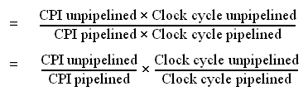
Performance of pipeline with stalls
Pipeline stalls decrease performance from the ideal
Recall the speedup formula:

Slide 8

Assumptions for calculation
The ideal CPI on a pipelined processor is almost always 1. (may less than or greater that )
So
Ignore the overhead of pipelining clock cycle.
Pipe stages are ideal balanced.
Two different implementation
  single-cycle implementation
  multi-cycle implementation

Slide 9

Case of single-cycle implementation
CPI unpipelined = 1
Clock cycle unpipelined
pipeline depth
• Clock cycle pipelined =

Slide 10

Case of multi-cycle implementation
Clock cycle unpipelined = Clock cycle pipelining
CPl unpipelined = pipeline depth
So comes the approaches to decrease the stalls !

Slide 11
Structural hazard:
Pipe Stage Contention
Structural hazards
  Occurs when two or more instructions want to use the same hardware resource in the same cycle
  Causes bubble (stall) in pipelined machines
  Overcome by replicating hardware resources
    Multiple accesses to memory
    Multiple accesses to the register file
    Not fully pipelined functional units

Slide 12
Multi access to Single Memory Port
Time (clock cycles)
I
n
s
t
r.
O
r
d
e
r
Ld/St
Mem
Reg
ALU
Mem
Reg
Instr 1
Mem
Reg
ALU
Mem
Reg
Instr 2
Mem
Reg
ALU
Mem
Reg
Instr 3
Mem
Reg
ALU
Mem
Reg

Slide 13
Split instruction and data memory
Is it enough to use split instruction/data cache?
Time (clock cycles)
I
n
s
t
r.
O
r
d
e
r
Ld/St
IM
Reg
ALU
DM
Reg
Instr 1
IM
Reg
ALU
DM
Reg
Instr 2
IM
Reg
ALU
DM
Reg
Instr 3
IM
Reg
ALU
DM
Reg
Split instruction and data memory / multiple memory port / instruction buffer means:
fetch the instruction and data inference using different hardware resources.

Slide 14
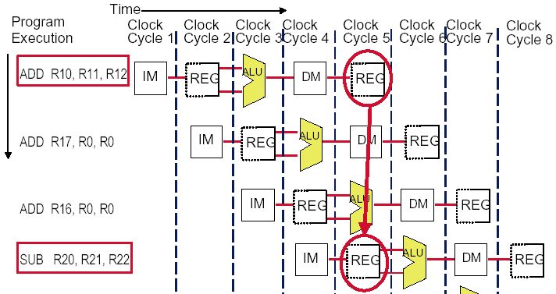
Multi access to the register file
Simply insert a stall , speedup will be decreased.

Slide 15
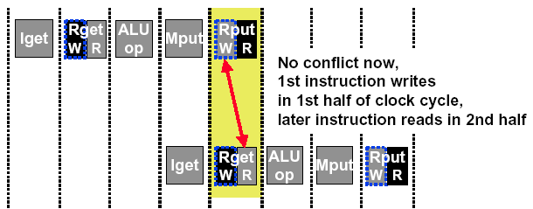
double bump(双重触发) works
allow WRITE-then-READ in one clock cycle (double bump)

Slide 16
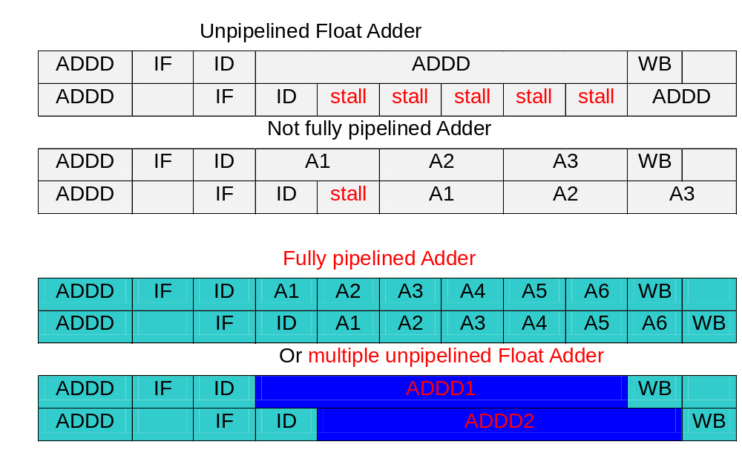
Not fully pipelined function unit : may cause structural hazard

Slide 17
Machine without structural hazards will always have a lower CPI
Example
  Data reference constitute 40% of the mix
  Ideal CPI ignoring the structural hazard is 1
  The processor with the structural hazard has a clock rate that is 1.05 times higher than that of a processor without structural hazard.
Answer
  Average instruction time = CPI×Clock cycle time
  =(1+0.4 ×1) ×CC_{ideal}/1.05
  = 1.3 × Cc_{ideal}
  Clearly, the processor without the structural hazard is faster.

Slide 18
Why allow machine with structural hazard ?
To reduce cost .
  i.e. adding split caches, requires twice the memory bandwidth.
  also fully pipelined floating point units costs lots of gates.
  It is not worth the cost if the hazard does not occur very often.
To reduce latency of the unit.
  Making functional units pipelined adds delay
  (pipeline overhead -> registers.)
  An unpipelined version may require fewer clocks per operation.
  Reducing latency has other performance benefits, as we will see.

Slide 19
Example: impact of structural hazard to performance
Example
  Many machines have unpipelined float-point multiplier.
  The function unit time of FP multiplier is 6 clock cycles
  FP multiply has a frequency of 14% in a SPECfp benchmark
  Will the structural hzard have a large performance impact on the SPECfp benchmark?

Slide 20
Answer to the example
In the best case: FP multiplies are distributed uniformly.
  There is one multiply in every 7 clock. 1/14%
  Then there will be no structural hazard,then there is no performance penalty at all.
In the worst case: the multiplies are all clustered with no intervening instructions.
  Then every multiply instruction have to stall 5 clock cycles to wait for the multiplier be released.
  The CPI will increase 70% to 1.7, if the ideal CPI is 1.
Experiment result:
  This structural hazard increase execution time by less than 3%.

Slide 21
Summary: solutions for structural hazard
Multiple accesses to memory
  Split instruction and data memory / multiple memory port / instruction buffer
  Memory bandwidth need to be imporved by 5 folds.
Multiple accesses to the register file
  Double bump
Not fully pipelined functional units
  Fully pipeline the functional unit
  Using multiple functional unites
Real machine often with structural hazards.

Slide 22
Summary of Structural hazard
Taxonomy of Hazards
  Structural hazards
    These are conflicts over hardware resources.
    OK, maybe add extra hardware resources;
    or full pipelined the functional units;
    otherwise still have to stall
    Allow machine with Structural hazard, since it happens not so often
  Data hazards
    Instruction depends on result of prior computation which is not ready (computed or stored) yet
  Control hazards
    branch condition and the branch PC are not available in time to fetch an instruction on the next clock

Slide 23
Pipeline Hazards
Taxonomy of Hazards
  Structural hazards
    These are conflicts over hardware resources.
  Data hazards
    Instruction depends on result of prior computation which is not ready (computed or stored) yet
  Control hazards
    branch condition and the branch PC are not available in time to fetch an instruction on the next clock

Slide 24
Data hazard
Data hazards occur when the pipeline changes the order of read/write accesses to operands comparing with that in sequential executing .
Let’s see an Example
  DADD R1, R1, R3
  DSUB R4, R1, R5
  AND R6, R1, R7
  OR R8, R1, R9
  XOR R10, R1, R11

Slide 25
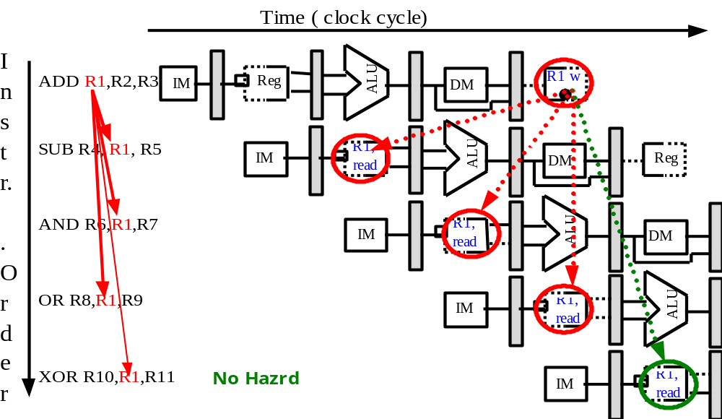
Coping with data hazards:example

Slide 26
Data hazard
Basic structure
  An instruction in flight wants to use a data value that’s not “done” yet
  “Done” means “it’s been computed” and “it’s located where I would normally expect to go look in the pipe hardware to find it”
Basic cause
  You are used to assuming a purely sequential model of instruction execution
  Instruction N finishes before instruction N+k, for k >= 1
  There are dependencies now between “nearby” instructions (“near” in sequential order of fetch from memory)
Consequence+
  Data hazards -- instructions want data values that are not done yet, or not in the right place yet

Slide 27
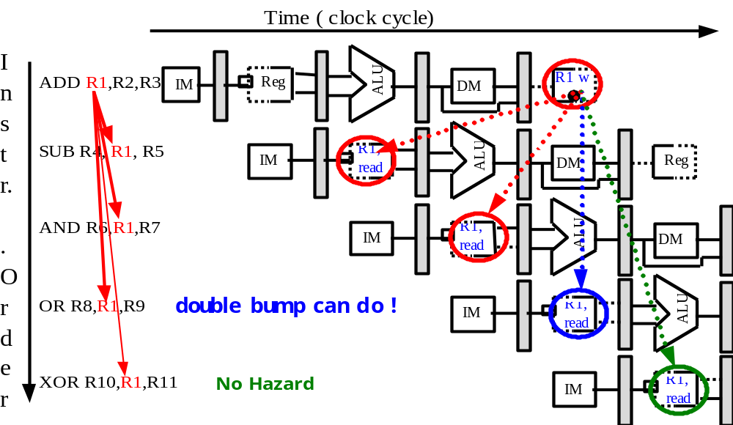
Somecases “Double Bump” can do !

Slide 28
Proposed solution
Proposed solution
  Don’t let them overlap like this…?
Mechanics
  Don’t let the instruction flow through the pipe
  In particular, don’t let it WRITE any bits anywhere in the pipe hardware that represents REAL CPU state (e.g., register file, memory)
  Let the instruction wait until the hazard resolved.
  Name for this operation: PIPELINE STALL

Slide 29
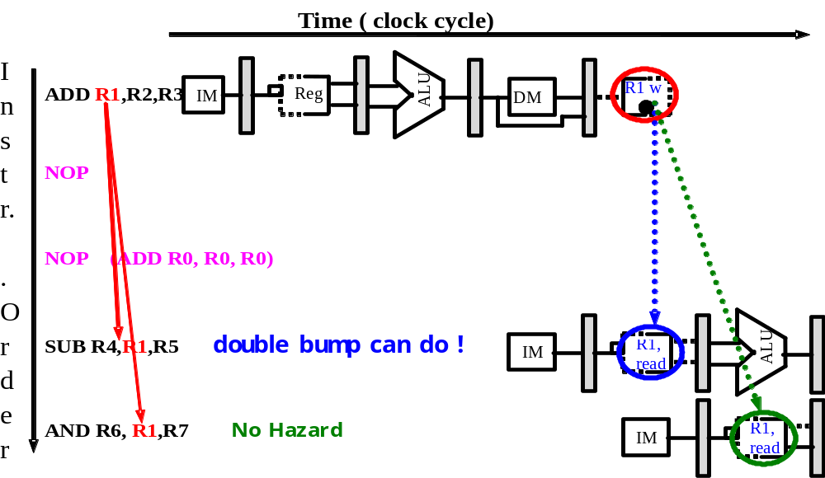
How do we stall ?
Insert nop by compiler
Bubble
Bubble
Bubble
Bubble
Bubble
Bubble
Bubble
Bubble
Bubble

Slide 30
How do we stall?
Add hardware Interlock !
Add extra hardware to detect stall situations
  Watches the instruction field bits
  Looks for “read versus write” conflicts in particular pipe stages
  Basically, a bunch of careful “case logic”
Add extra hardware to push bubbles thru pipe
  Actually, relatively easy
  Can just let the instruction you want to stall GO FORWARD through the pipe…
  …but, TURN OFF the bits that allow any results to get written into the machine state
  So, the instruction “executes” (it does the work), but doesn’t “save”

Slide 31
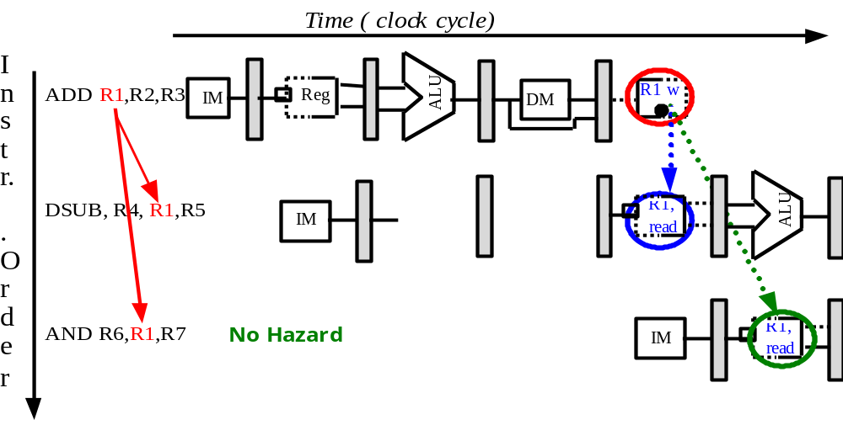
Interlock: insert stalls
Bubble
Bubble
Empty slots in the
pipe called bubbles;
means no real
instruction work
getting saved here
How the interlock is implementated ?

Slide 32
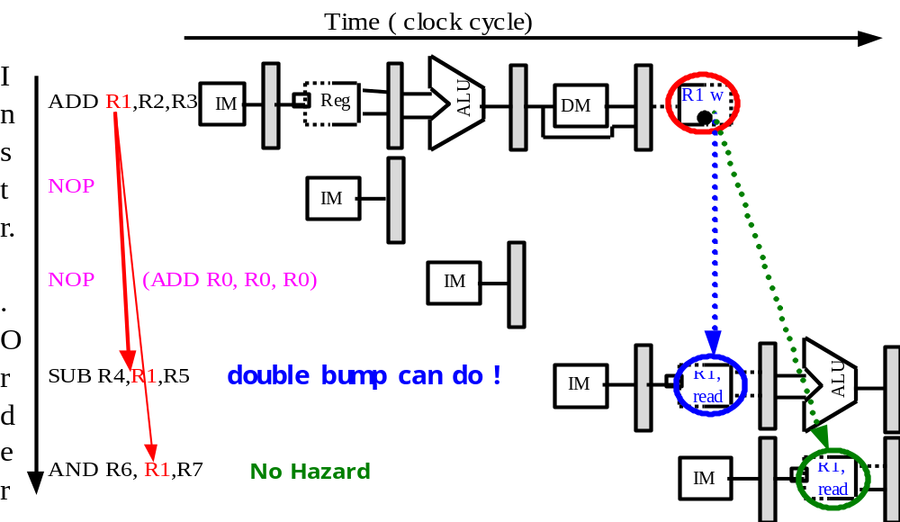
Hardware simulates NOP
Bubble
Bubble
Bubble
Bubble
Bubble
Bubble
Bubble

Slide 33
How to delay the instruction ?
The Interlock can simulate the NOP:
  Once it is detected need to add a stall, then
  Clear the ID/EX.IR to be the instruction of NOP.
    disable the write signal: “wreg, wmem”.
  Reserve the IF/ID. IR unchanged for one more clock cycle.
    Disable the write signal: “WritePC, WriteIR”.

Slide 34
How to Stall ? Add a stall control logic !
PC IF/ID ID/EX EX/MEM MEM/WB
M.Inst
D.Inst
E.Inst
F.Inst
Bubble
Bubble
Branch
Branch
Wreg
Wreg
Rd
Rd
Stall control logic
Rs
Rt
stall
To produce a stall signal. If stall ==1 then
Use stall to disable writing PC write and IF/ID latch.
Push a bubble into next stage.
  Bubble = 1 and disable control signal Wreg and Wmem.
  Puch a nop forward into ID/EX

Slide 35
Forwarding: reduce data hazard stalls
If the result you need does not exist AT ALL yet,
  you are out of luck, sorry.
But, what if the result exists, but is not stored back yet?
  Instead of stalling until the result is stored back in its “natural” home…
  grab the result “on the fly” from “inside” the pipe, and send it to the other instruction (another pipe stage) that wants to use it

Slide 36
Forwarding
Generic name: forwarding ( bypass, short-circuiting)
  Instead of waiting to store the result, we forward it immediately (more or less) to the instruction that wants it
  Mechanically, we add buses to the datapath to move these values
  around, and these buses always “point backwards” in the datapath, from later stages to earlier stages

Slide 37
Forwarding:reduce data hazard stalls
Data may be already computed - just not in the Register File
Time
( clock cycle)
I
n
ADD
R1
,R2,R3
ALU
R1
R
1 w
s
IM
Reg
R1
D
M
t
r.
.
SUB R4,
R1
,
R5
IM
R
1,
ALU
Reg
read
DM
O
r
d
e
AND R6
,
R1
,R7
IM
R
1,
ALU
r
read
DM
EX/MEM.ALUoutput → ALU input port
MEM/WB.ALUoutput → ALU input port

Slide 38
Hardware Change for Forwarding
NextPC
ID/EX
EX/MEM
MEM/WR
When to use the red. Blue
purple forwording path ?
Registers
mux
ALU
Data
Memory
mux
mux
Immediate
Source → sink
EX/Mem.ALUoutput → ALU input
MEM/WB.ALUoutput → ALU input
MEM/WB.LMD → ALU input

Slide 39
When to use the forwarding path ?
EX/Mem.ALUoutput → ALU input
    The previous instruction in EX/MEM is ALU
    The instruction in ID/EX has Rs or Rt source register
    EX/MEM.Rd == ID/EX.Rs or EX/MEM.Rd ==ID/EX.Rt
MEM/WB.ALUoutput → ALU input
    The previous instruction in MEM/WB is ALU
    The instruction in ID/EX has Rs or Rt source register
    MEM/WB.Rd == ID/EX.Rs or MEM/WB.Rd == IF/ID.Rt
MEM/WB.LMD → ALU input
    The previous instruction in MEM/WB is Load
    The instruction in ID/EX has Rs or Rt source register
    MEM/WB.Rd == ID/EX.Rs or MEM/WB.Rd == ID/EX.Rt

Slide 40
How to know if it’s ALU or Load ?
ALU:
  Wreg == 1 && W2Reg == 0
Load:
  Wreg ==1 && W2Reg == 1
Rd
  If ALU reg-reg, then Rd = Rd
  If Load or ALU reg-imm, then Rd = Rt
Rs or Rt
  If it’s Not JMP then it has Rs
  If it’s ALU reg-reg or Store or Branch then it has Rt

Slide 41
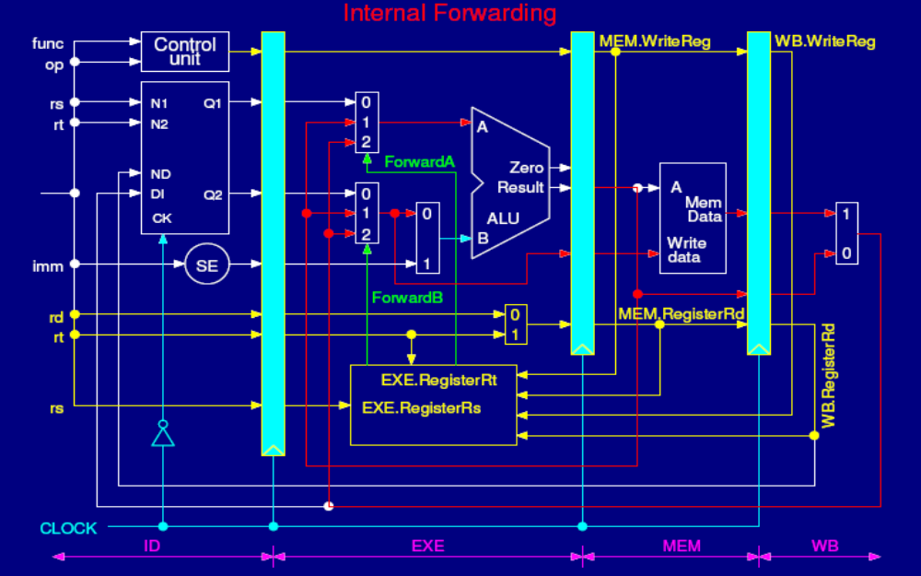

How we implement forwarding in Lab ?
EX/MEM.ALUoutput → ALU input port
3 Forwarding paths: MEM/WB.ALUoutput → ALU input port (0)
MEM/WB.LDMR → ALU input port(1)

Slide 42
Internal forwarding Logic
If (Mem.WriteReg
and(Mem.RegisterRD≠0)
and(Mem.RegisterRd ==Exe.RegisterRS)) ForwardA = 01
If (Mem.WriteReg
and(Mem.RegisterRD≠0)
and(Mem.RegisterRd ==Exe.RegisterRt)) ForwardB = 01
If (WB.WriteReg
and(WB.RegisterRD≠0)
and(Mem.RegisterRd ≠ Exe.RegisterRS))
and(WB.RegisterRd == Exe.RegisterRs)) ForwardA = 10
If (WB.WriteReg
and(WB.RegisterRD≠0)
and(Mem.RegisterRd ≠ Exe.RegisterRt))
and(WB.RegisterRd == Exe.RegisterRt)) ForwardB = 10

Slide 43
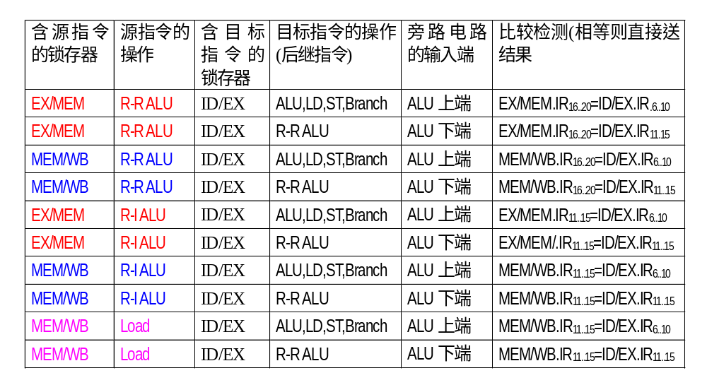
How to select the forwarding path: the forwarding logic
PA-36 in Edition 3th and Edition 4th
EX/MEM.Rd == ID/EX.rs or rt
What’s the difference with
ID/EX.Rd == IF/ID.rs or rt ?

Slide 44
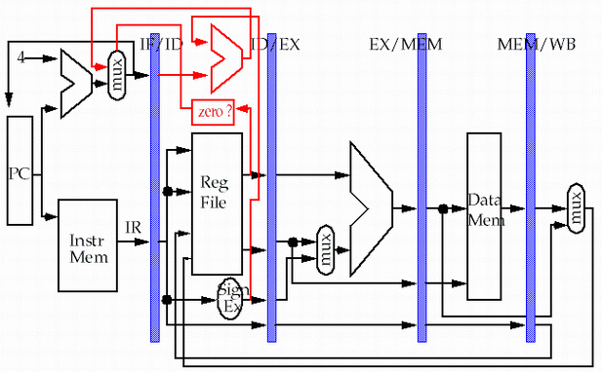
Forwarding path to other input entry
store
load
*** MEM/WB.LMD → DM input

Slide 45
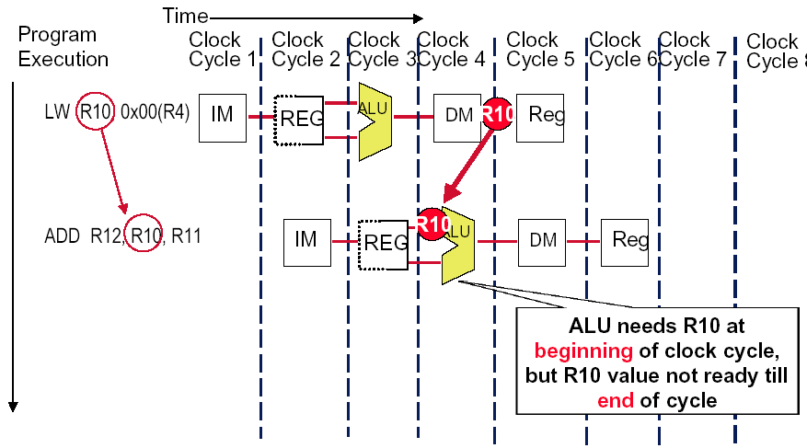
Forwarding Doesn’t Always Work

Slide 46
So we have to insert stall:
Load stall
Time (clock cycles)
I
n
s
t
r.
O
r
d
e
r
lw r1, 0(r2)
Ifetch
Reg
ALU
DMem
Reg
Bubble
sub r4,r1,r6
Ifetch
Reg
ALU
DMem
Reg
Bubble
and r6,r1,r7
Ifetch
Reg
ALU
DMem
Reg
or r8,r1,r9
Bubble
Ifetch
Reg
ALU
DMem

Slide 47
How to implement Load Interlock
Detect when should use Load Interlock PA34
situation | Example code sequence | Action
No dependence | LD R1, 45(R2) DADD R5,R6,R7 DSUB R8,R6,R7 OR R9,R6,R7 | No hazard possible because of no dependence
Dependence requiring stall | LD R1, 45(R2) DADD R5,R1,R7 DSUB R8,R6,R7 OR R9,R6,R7 | Comparators detect the use of R1 in the DADD and stall the DADD (and DSUB and OR ) before the DADD begins EX
Dependence overcome by forwarding | LD R1, 45(R2) DADD R5,R6,R7 DSUB R8,R1,R7 OR R9,R6,R7 | Comparators detect the use of R1 in DSUB and forward result of load to ALU in time for DSUB to begin EX
Dependence with accesses in order | LD R1, 45(R2) DADD R5,R6,R7 DSUB R8,R6,R7 OR R9,R1,R7 | No action required because read of R1 by OR occurs in the second half of the ID phase, while the write of the loaded data occurred in the first half.

Slide 48
The logic to detect for Load interlock
Opcode field of ID/EX | Opcode Field of IF/ID | Matching operand fields
Load | Reg-Reg ALU | ID/EX.IR[rt]==IF/ID.IR[rs]
Load | Reg-Reg ALU | ID/EX.IR[rt]==IF/ID.IR[rt]
Load | Load,store, ALU immediate, branch | ID/EX.IR[rt]==IF/ID.IR[rs]

Slide 49
Example of
Forwarding and Load Delay
Why forwarding?
  ADD R4, R5, R2
  LW R15, 0(R4)
  SW R15, 4(R2)
Why load delay?
  ADD R4, R5, R2
  LW R15, 0(R4)
  SW R15, 4(R2)

Slide 50
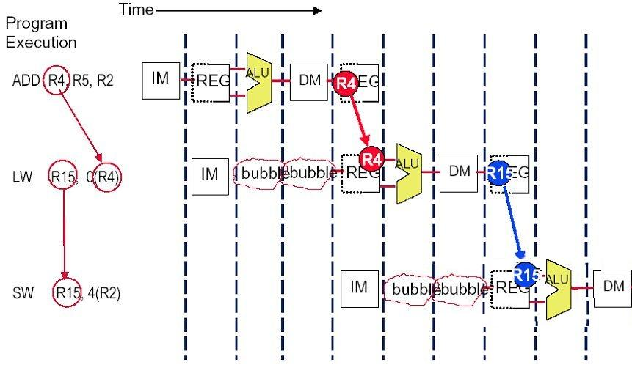
Solution (without forwarding)

Slide 51
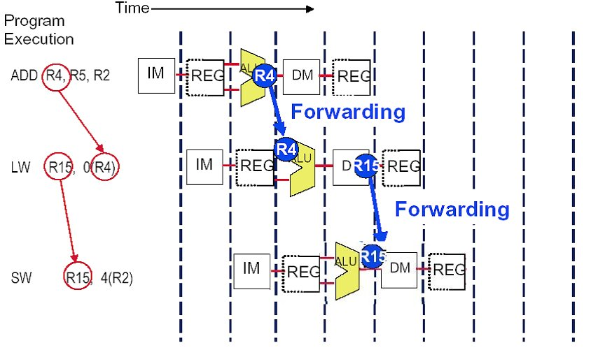
Solution (with forwarding)
EX/MEM.ALUoutput → ALU input port
MEM/WB.LDMR→ DM data write port

Slide 52
The performance influence of load stall
Example
  Assume 30% of the instructions are loads.
  Half the time, instruction following a load instruction depends on the result of the load.
  If hazard causes a single cycle delay, how much faster is the ideal pipeline ?
Answer
  CPI = 1+30%×50% ×1=1.15
  The performance decrease about 15% due to load stall.

Slide 53
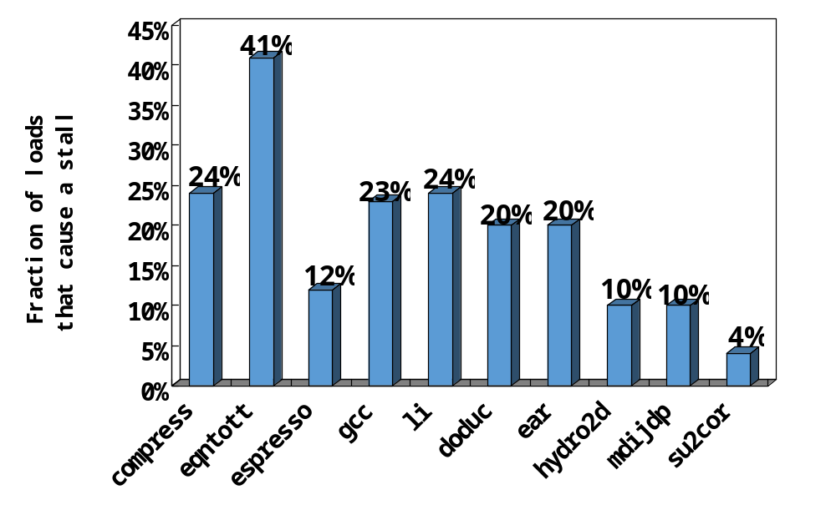
Fraction of load that cause a stall

Slide 54
Instruction reordering by compiler to avoid load stall
Try producing fast code for
a = b + c;
d = e – f;
assuming a, b, c, d ,e, and f in memory.
Slow code:
LW Rb,b
LW Rc,c
ADD Ra,Rb,Rc
SW a,Ra
LW Re,e
LW Rf,f
SUB Rd,Re,Rf
SW d,Rd
Fast code:
LW Rb,b
LW Rc,c
LW Re,e
ADD Ra,Rb,Rc
LW Rf,f
SW a,Ra
SUB Rd,Re,Rf
SW d,Rd

Slide 55
Another case: has stall even with forwarding path
alu r1, r2, R3
Ifetch
Reg
ALU
DMem
Reg
Bubble
BNE r4,r1,L1
Ifetch
Reg
ALU
DMem
Reg
Assume branch is
resolved in ID stage.

Slide 56
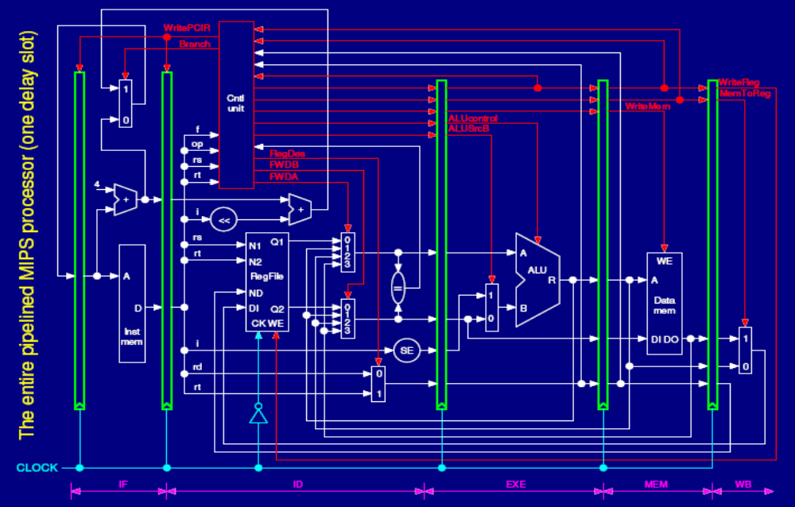
What we can do ?
Move the Forwarding path to ID stage
Move the forwarding control logic to ID stage

Slide 57
How to implement forwarding ?
PC IF/ID ID/EX EX/MEM MEM/WB
M.Inst
D.Inst
E.Inst
F.Inst
Bubble
Bubble
FwdA FwdB
Branch
Branch
Wreg
Wreg
Rd
Rd
Forwarding
logic
Stall
logic
Rs
Rt
stall
Think about Where is the logic function unit ?
  If FwdA, FwdB are used in ID, then …
  If FwdA, FwdB are used in EXE, then …
2) When to stall ? Load stall, control stall

Slide 58
Summary of Data Hazard
Taxonomy of Hazards
  Structural hazards
    These are conflicts over hardware resources.
  Data hazards
    Instruction depends on result of prior computation which is not ready (computed or stored) yet
    OK, we did these, Double Bump, Forwarding path, compiler scheduling, otherwise have to stall
  Control hazards
    branch condition and the branch PC are not available in time to fetch an instruction on the next clock

Slide 59
Related materials
an overview of pipelining computer processors
  http://granite.sru.edu/~venkatra/pipelining1.html
pipelining: a summery
  http://www-ee.eng.hawaii.edu/~tep/EE461/Notes/Pipeline/summary.html

