Slide 1


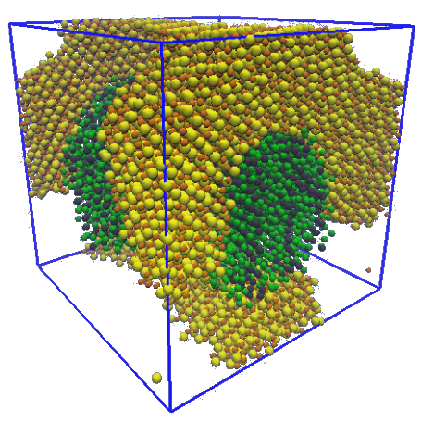

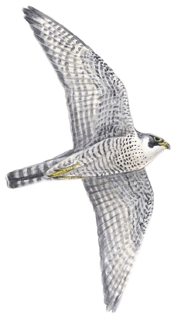

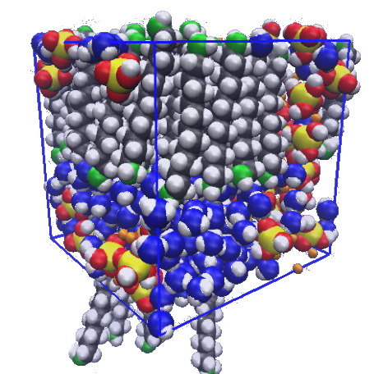
Computer-aided Design of
Bio-inspired Nanoporous
Silica Materials
By André Crescenzo
Miguel Jorge
Supervisor
Department of Chemical and Process Engineering
Alessia Centi
Supervisor
Department of Chemical and Process Engineering
Carlos F. Rangel
Supervisor
Department of Chemical and Process Engineering
MagiC

Slide 2

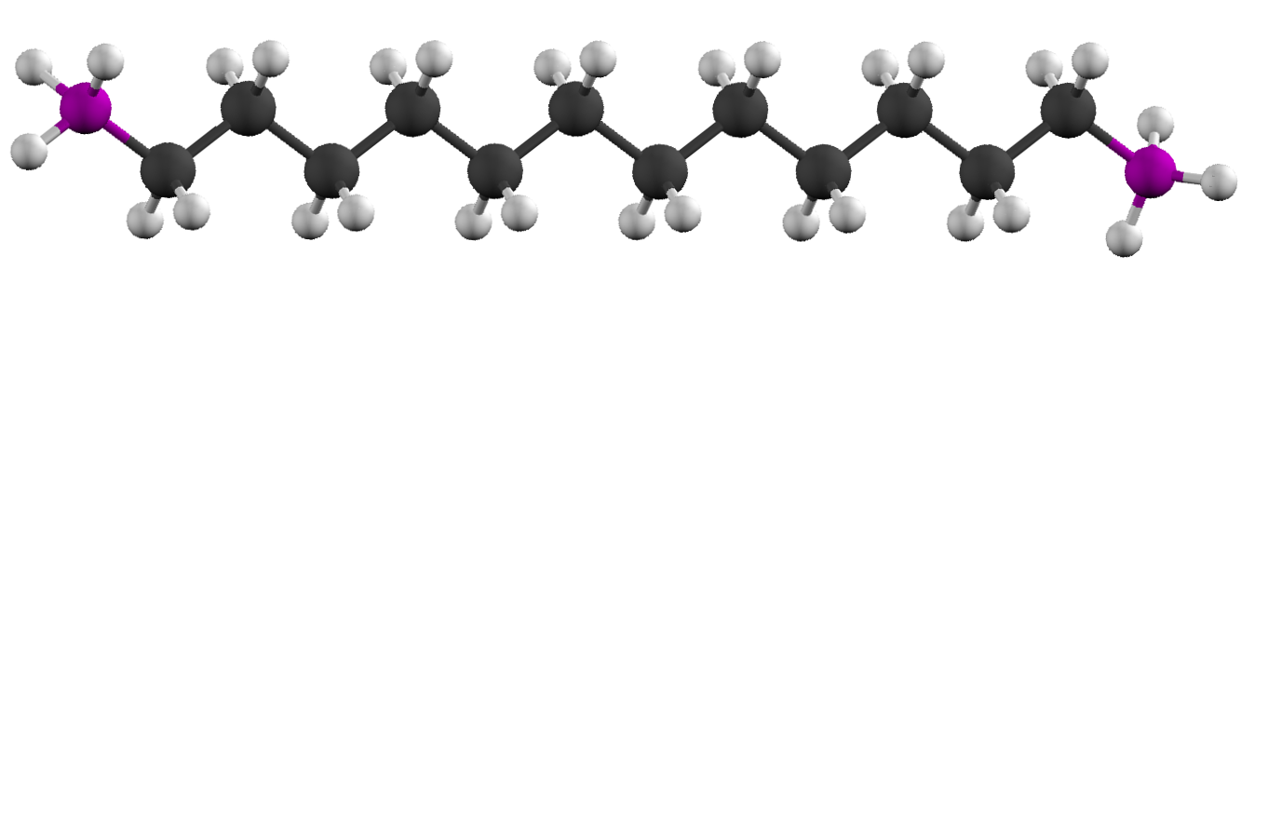
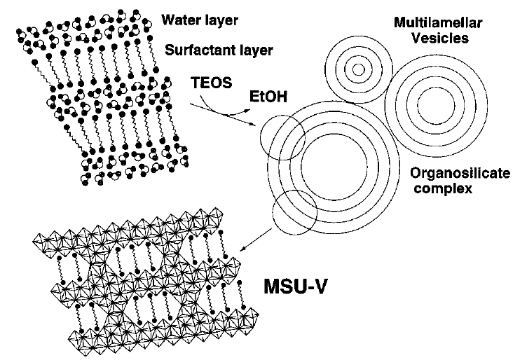

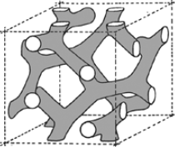
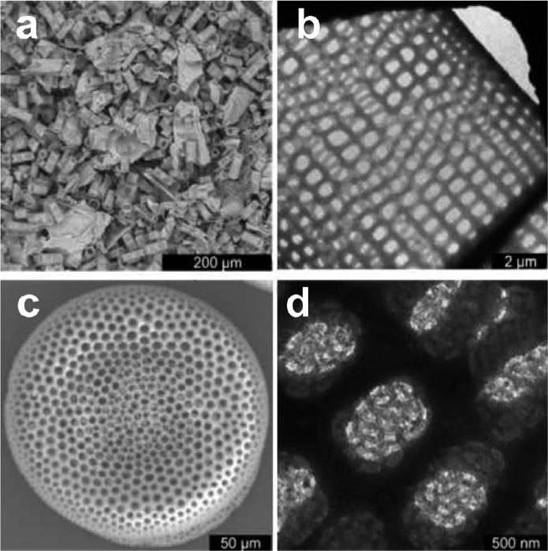
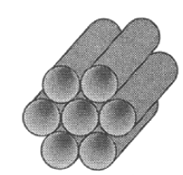
Silica-surfactant materials
MSU-V
  1,2-diaminododecane
Highly Structured Materials
High Porosity
High Surface area
Generated by
Nature
Self-Assembly structure
Synthesis
MCM-50
MCM-48
MCM-41
DOI:10.1039/C3CS60016E
DOI:10.1039/C0CC05648K
DOI:10.1021/ja970228v

Slide 3

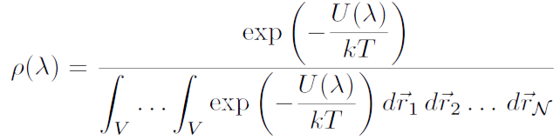

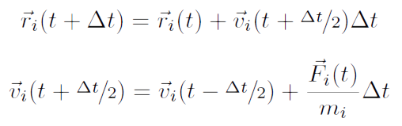
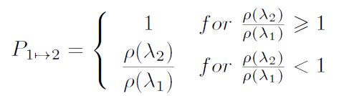
Molecular simulation
Molecular Dynamics
Monte Carlo Simulations
Newton's Law
Probability distribution function
“Leap-frog” Algorithm
Metropolis Method

Slide 4
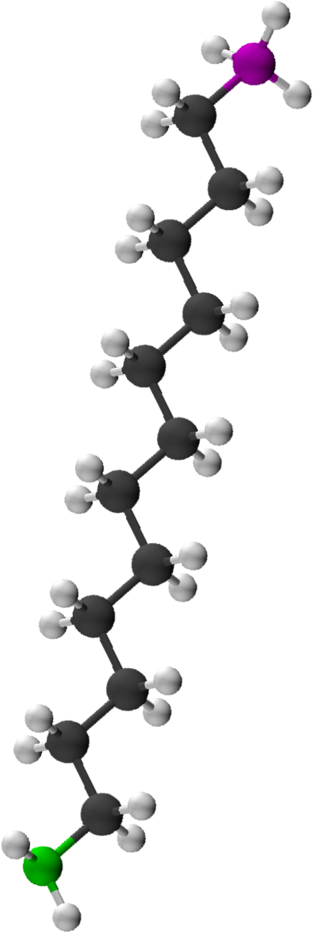

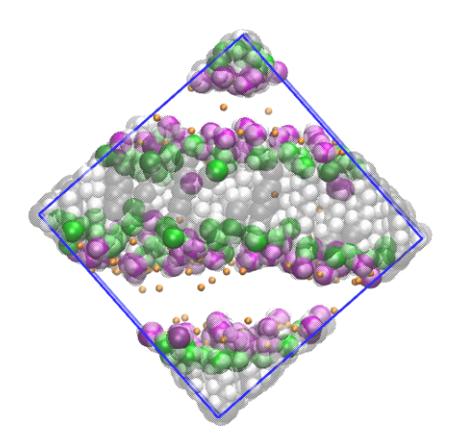
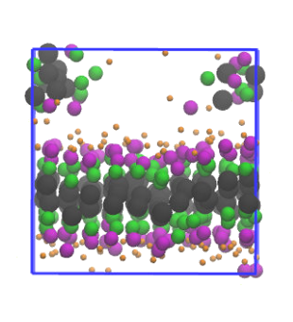
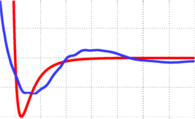
Coarse-graining
What is
coarse-grain?
Simulation Time
x
Computational limits
Tailored Potentials
Coarse-grain
Atomistic (L-J)
Time = ~1,5 days
Time = ~10 minutes

Slide 5
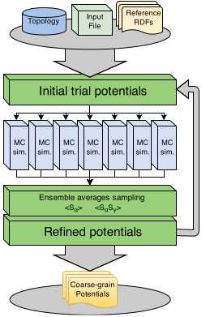
MagiC: a systematic method
Boltzmann inversion
  Low no. Monte Carlo steps
  Great to initial potentials
  No cross-correlations
Inverse Monte Carlo
  More reliable potentials
  Cross-correlations
  High no. Monte Carlo steps

Slide 6
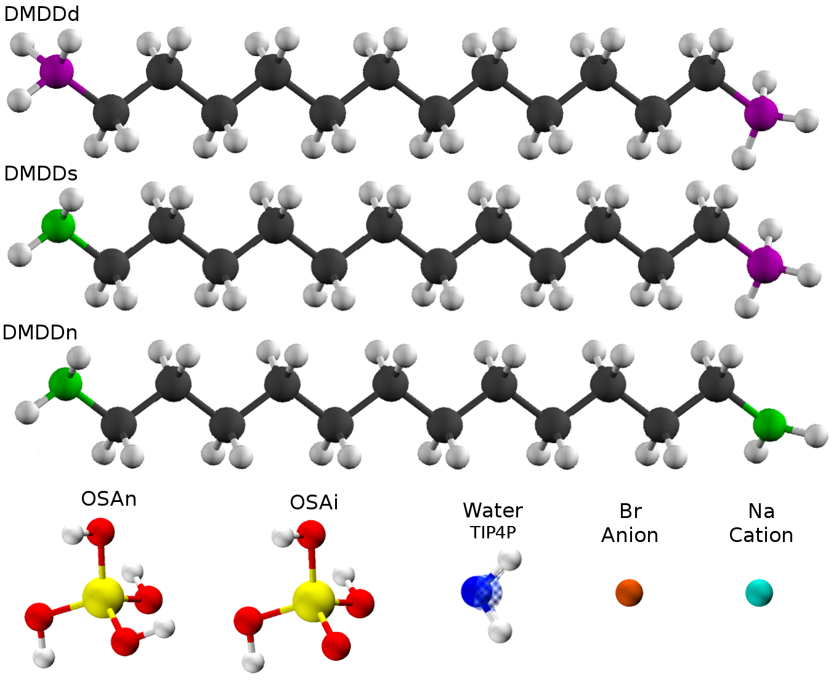

Atomistic Model
Analysis Objectives
  Box size
  Concentration
  pH
Atomistic Simulations
  NPT ensemble
  Over 100 ns

Slide 7
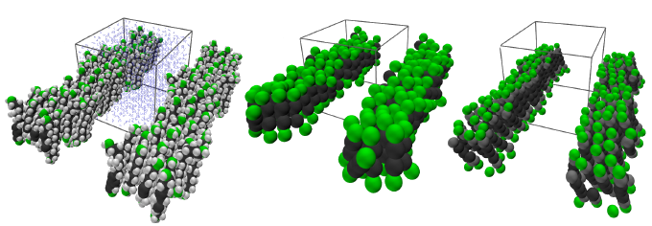
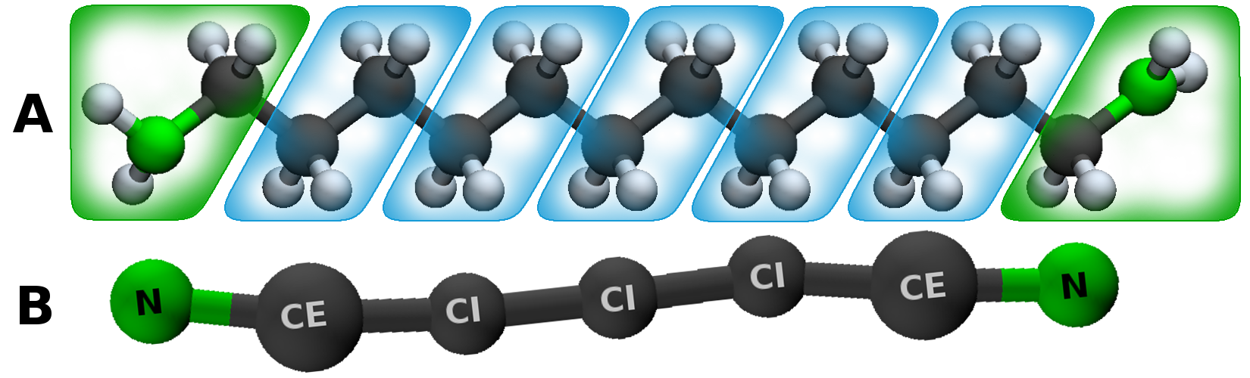
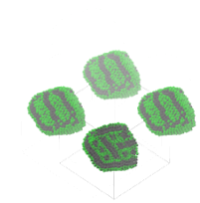
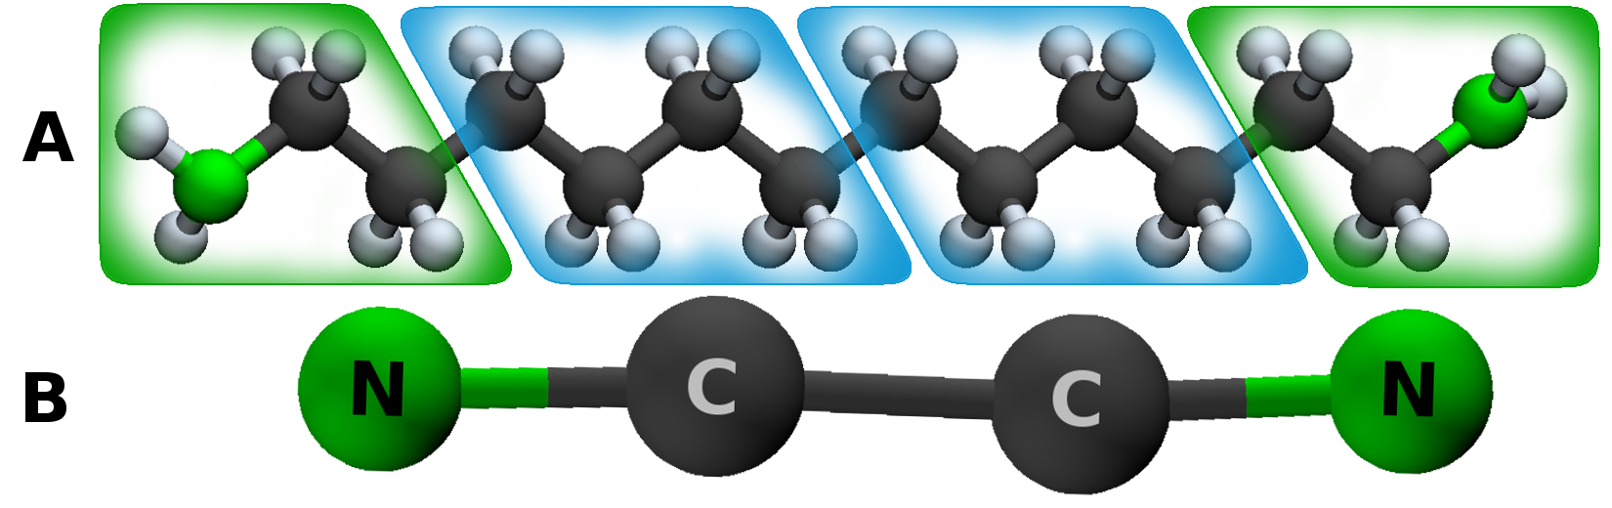
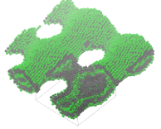
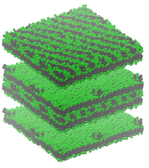
CG: Bead Size and Concentration
Multiple Models
  Model 1:
  Model 2:
  Reproduction test:
Multiple Concentrations
  Low: 0.89 mM
  Medium: 1.62 mM
  High: 3.3 mM

Slide 8
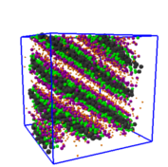
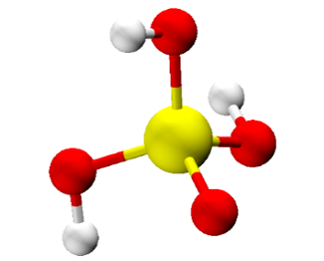
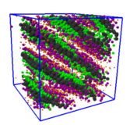
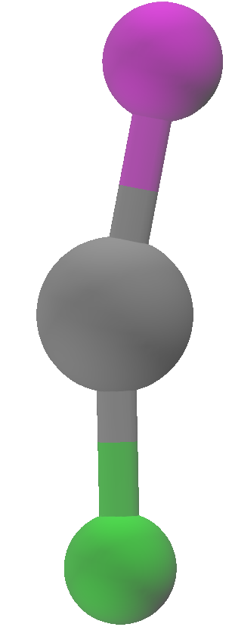

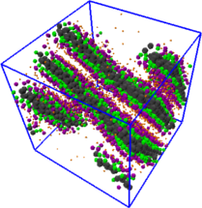
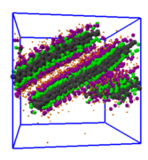




CG: Charged Systems
New Techniques for process efficiency
  Simplified model
  Multi-states reference
  Short range reference: ~30 nm box
  Long range reference: > 42 nm box
  Changes on MagiC inputs
Influence of Electrostatic forces
  Integrated Short-range
  Nc
  Nn
  Si
  C
  Long-range
  PME
Short
Range
Inital
Potentials
Pre-
Assembled
Layer

Slide 9
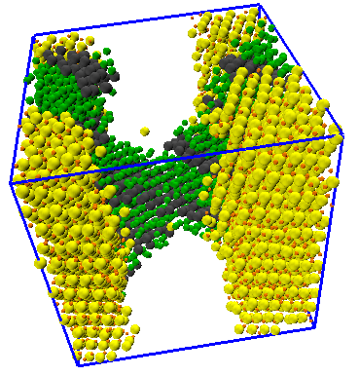
CG: Silica surfactant system
Ionic silica (OSAi) with neutral surfactant (DMDDn): Very High pH

Slide 10
Conclusion
CG potentials are a feasible option
Silica model still need improvements
MagiC technique is very flexible
Atomistic reference has deep influence in CG model
Ideas for the future
  Mixed CG model
  Multi-state potentials
  More focus in pH value

Slide 11
Any Questions?
Thank You!

