Slide 1
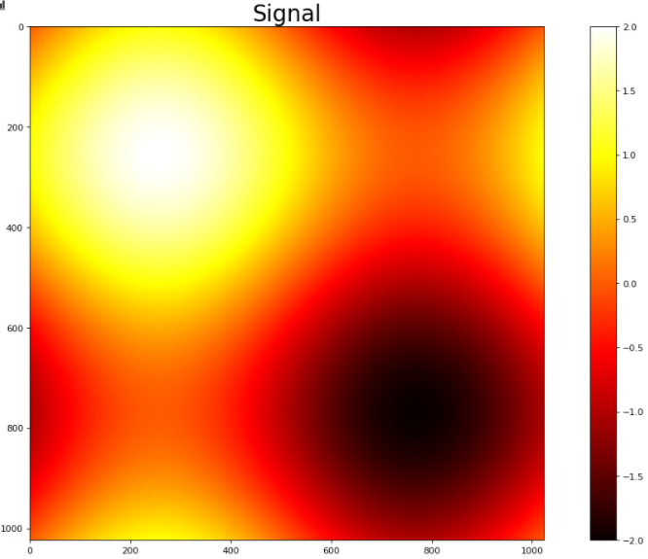
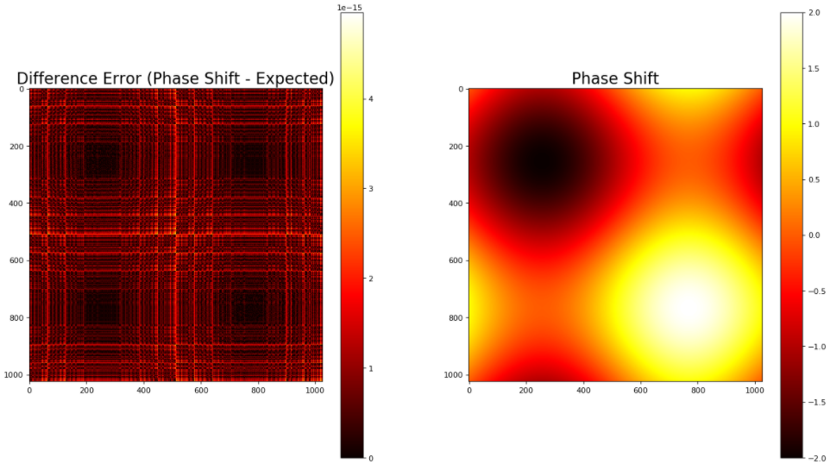


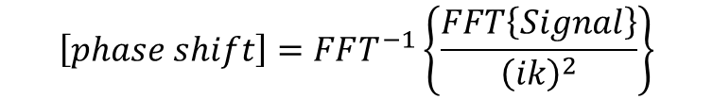
Phase retrieval and calculation of error (error around 10^-15)
FFT derivative
$$\left[phase shift\right]=FFT^{−1}\left\{\frac{FFT\left\{Signal\right\}}{{\left(ik\right)}^{2}}\right\}$$
$$\frac{d^{2}f}{dx^{2}}=FFT^{−1}\left\{{\left(ik\right)}^{2}FFT\left\{f\right\}\right\}$$
$$\frac{d^{2}}{{dx}^{2}}\sin\left(x\right)=\sin\left(x+π\right)=−sin⁡(x)$$
To compare to FFT result

