Slide 1

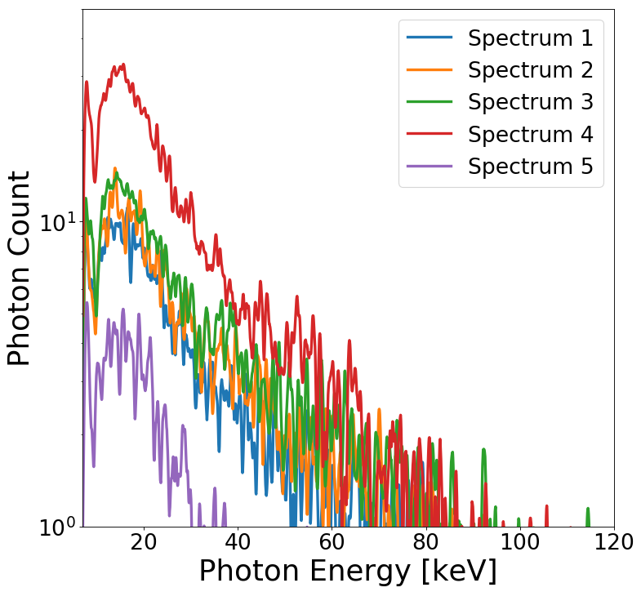
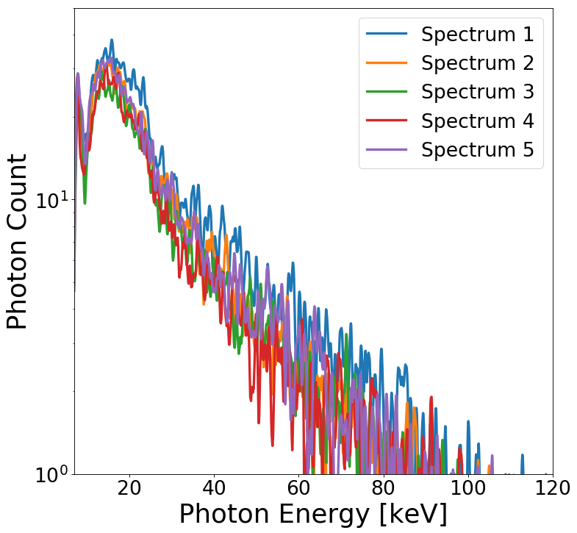
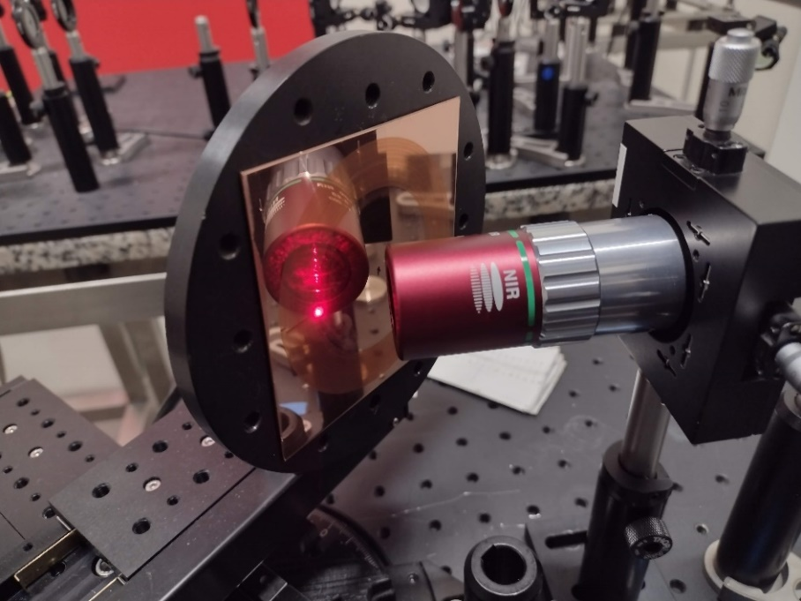
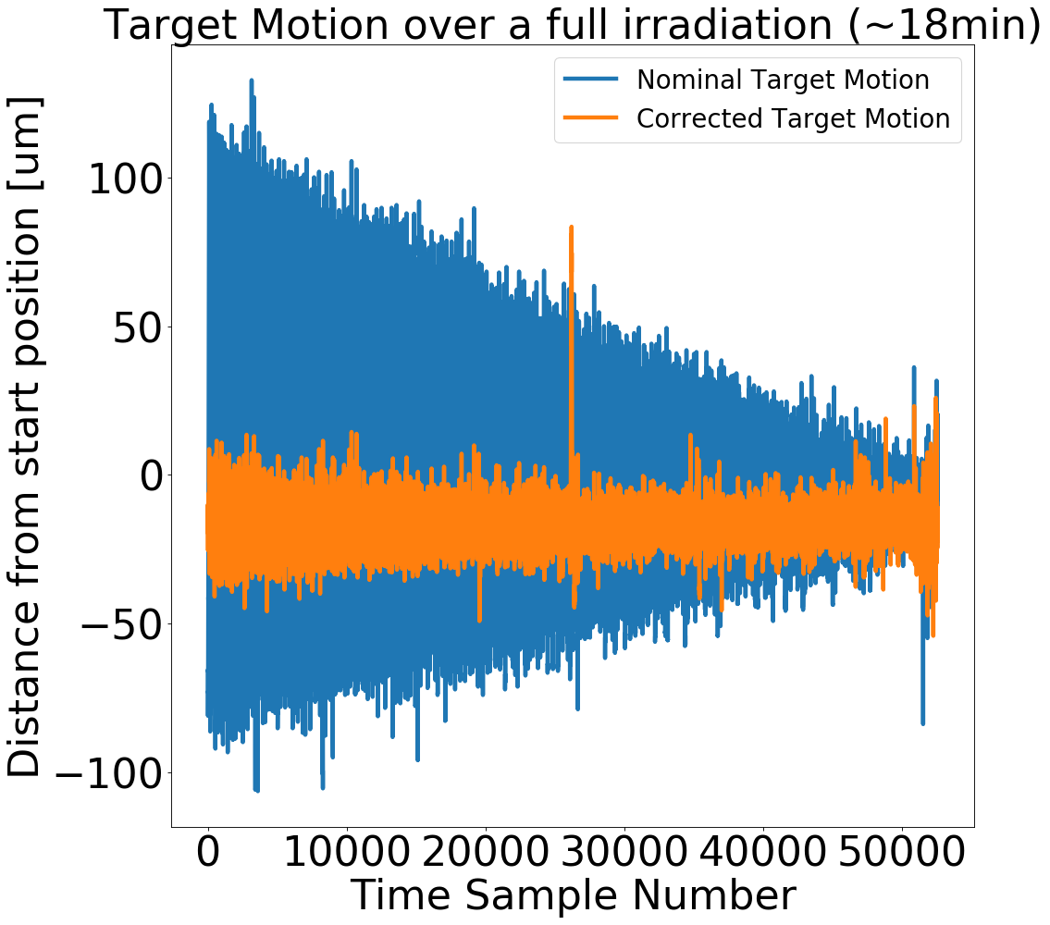
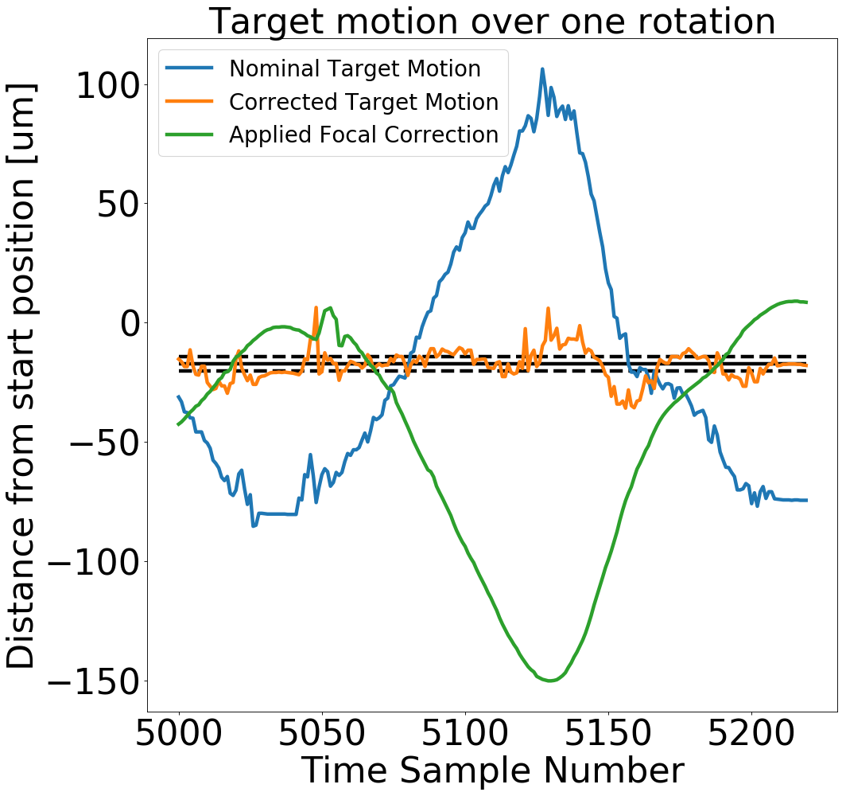



High-precision stabilization of copper rotary target motion for application in a laser-driven x-ray source
Andrew Coathup¹, Ramiro Contreras Martínez², Juan Peñas¹, Camilo Ruíz² and Jose Benlliure¹
¹IGFAE, Universidade de Santiago de Compostela, 15782 Santiago de Compostela, Spain
² Instituto Universitario de Física Fundamental y Matemáticas y Dpto. de Didáctica de la Matemática y de las Ciencias Experimentales, Universidad de Salamanca, Patio de Escuelas s/n, Salamanca, Spain
Introduction
Laser-based x-ray sources have unique properties and a promising range of applications however are very sensitive to small movements in the position of the target surface with respect to the laser focus
A 700µJ laser with a 32fs pulse duration at 1kHz repetition rate is focused through a microscope objective onto a copper target
Factors such as the wobble in the rotational motion of the target and small curvatures in the target material are sufficient to move the target surface outside the Rayleigh length (13µm) of the laser by at least an order of magnitude
In order to make the x-ray source viable, a focal correction is applied to maintain the position of the target surface within the Rayleigh length of the laser pulses
Figure 2: The copper target is mounted on a rotary stage. A microscope objective focusses the high intensity laser pulses onto the target producing x-ray radiation
Figure 3: (Left) Five spectra without focal correction (Right) Five spectra with focal correction
Focal-corrected spectra
More consistent spectral shape and photon flux
Standard deviation in hot temperature reduced from 3.8keV to 2.9keV (24% reduction)
Standard deviation in cold temperature reduced from 3.8keV to 0.5keV (87% reduction)
Target Stabilization
Standard deviation in target focal motion of 37.5µm without correction
Standard deviation in target focal motion of 6.2µm with correction
The majority of the laser shots therefore impact the target surface within the Rayleigh length
Conclusions
This work has demonstrated the stability of a laser-generated x-ray source, through both position sensor measurements as well as spectral measurements
Its stability allows us to exploit its unique properties for applications in phase contrast imaging
Funding
Action co-financed by IDIFEDER/2018/022 and IDIFEDER/2021/004 and the proyect “Nueva generación de equipos de imagen por rayos X con contraste de fase y fuente LÁSER (XPHASE-LASER)” No. RTC2019-007112-1.
Figure 1: (Left) The variation in the target surface motion without focal correction and with focal correction. (Right) Target surface motion over a single rotation of the target. The solid and dashed black lines show the mean and standard deviation of the corrected motion

Slide 2
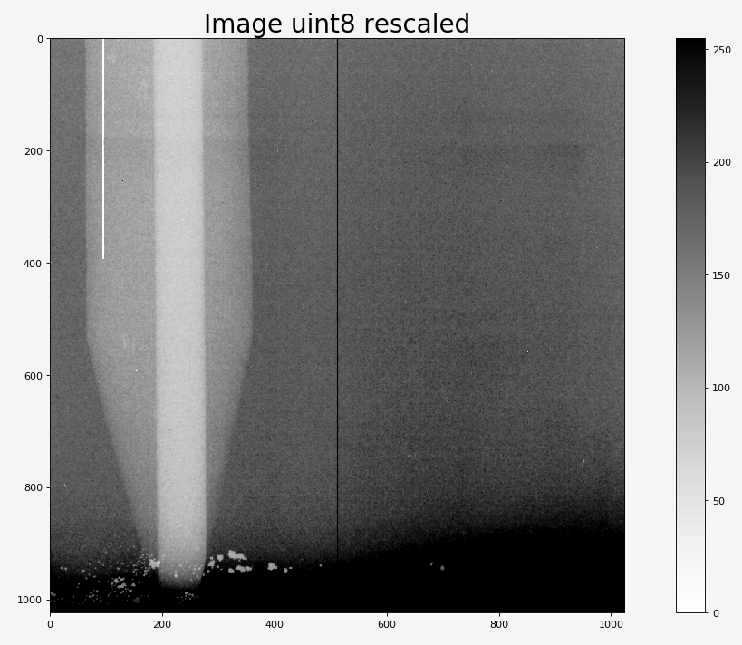
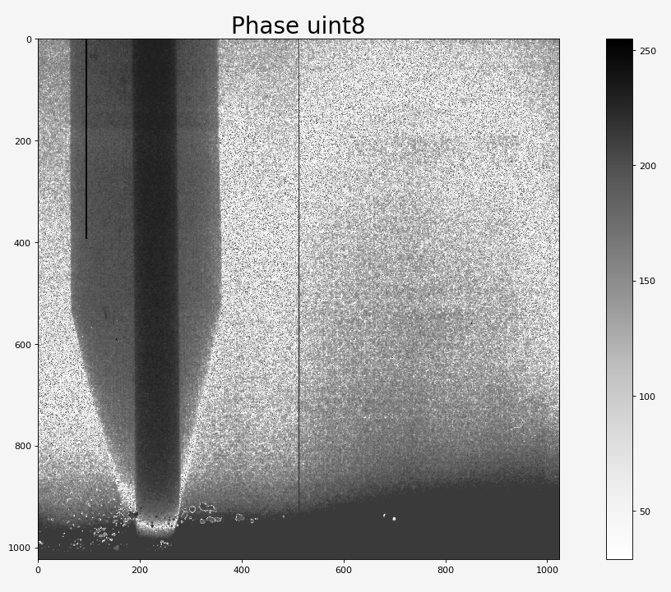
Example of program:
Pencil_R1_10_R2_10_run2
Pencil
R1 = 10cm
R2 = 10cm
deltaBetaRatio = 400 (approx. cellulose @ 8.3 keV)

Slide 3
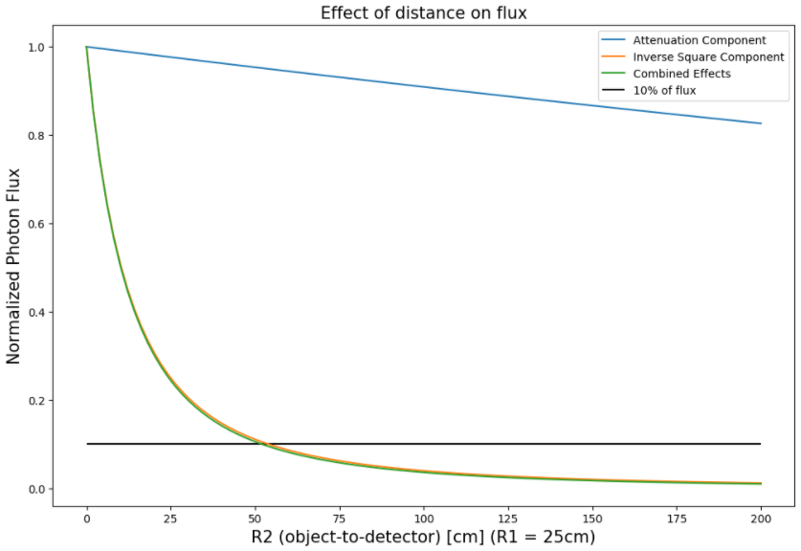
Attenuation caused by presence of air
Photon energy = 20keV
Loss of flux caused by geometry

Slide 4
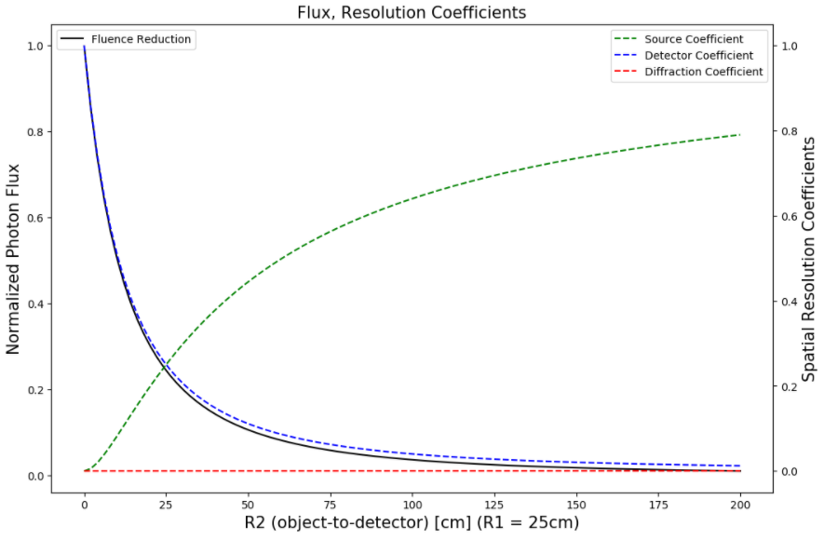


Slide 5
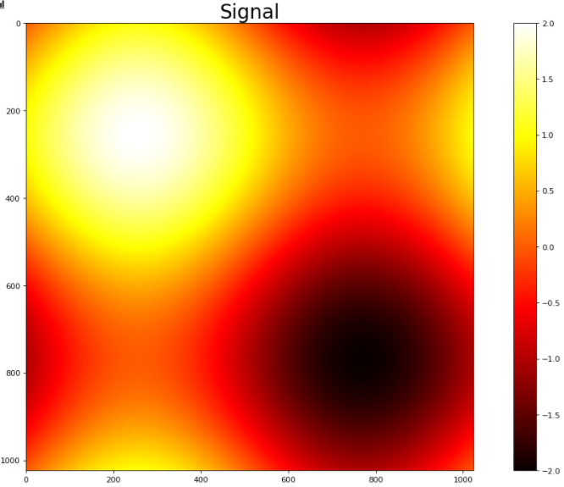
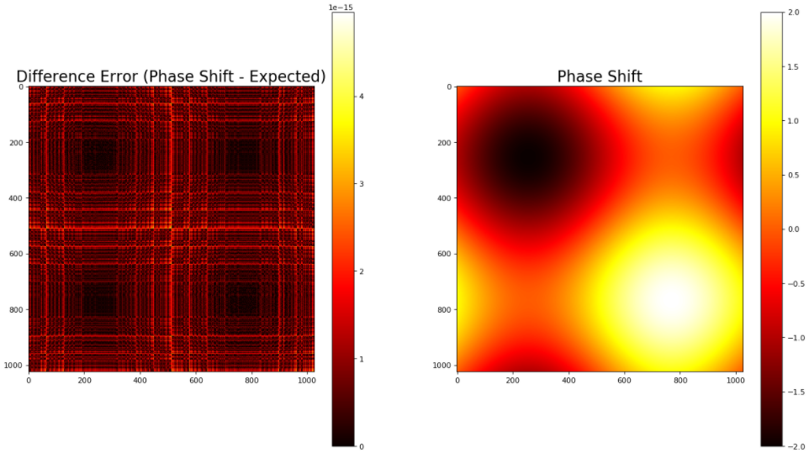


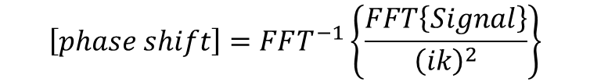
Phase retrieval and calculation of error (error around 10^-15)
FFT derivative
$$\left[phase shift\right]=FFT^{−1}\left\{\frac{FFT\left\{Signal\right\}}{{\left(ik\right)}^{2}}\right\}$$
$$\frac{d^{2}f}{dx^{2}}=FFT^{−1}\left\{{\left(ik\right)}^{2}FFT\left\{f\right\}\right\}$$
$$\frac{d^{2}}{{dx}^{2}}\sin\left(x\right)=\sin\left(x+π\right)=−sin⁡(x)$$
To compare to FFT result

Slide 6
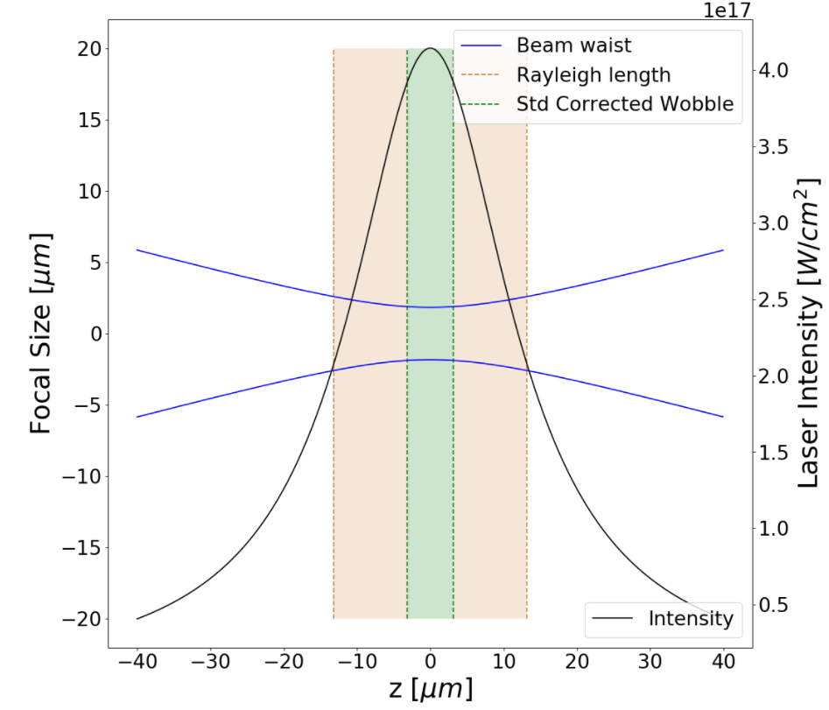

Slide 7
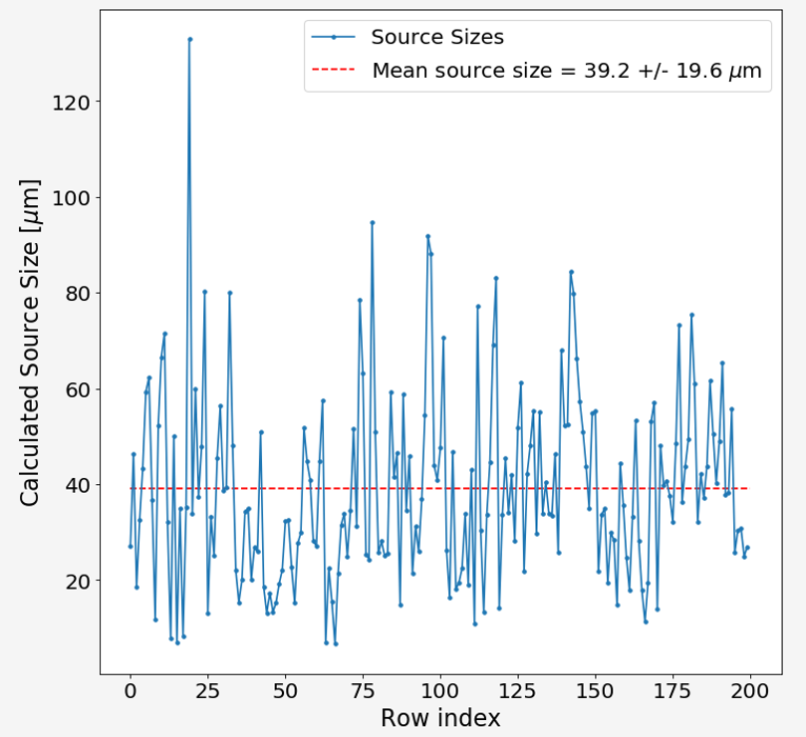

Slide 8
