Slide 1
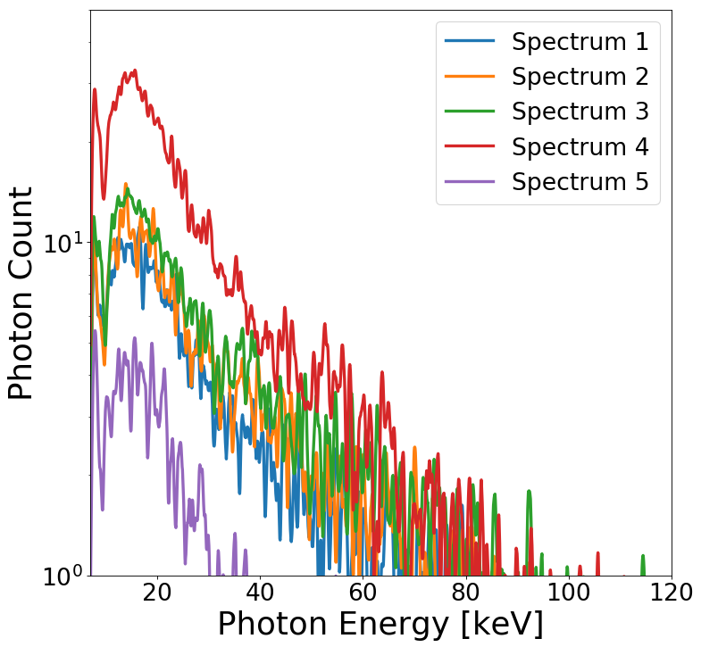
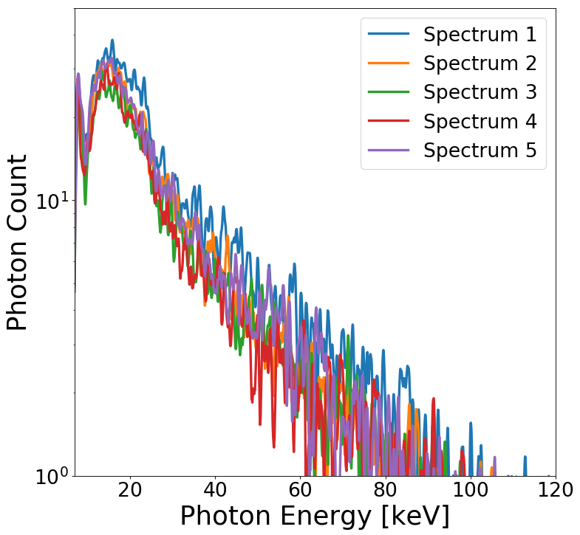
Figure 2: (Left) Five spectra without focal correction applied. (Right) Five spectra with focal correction applied.

