Slide 1
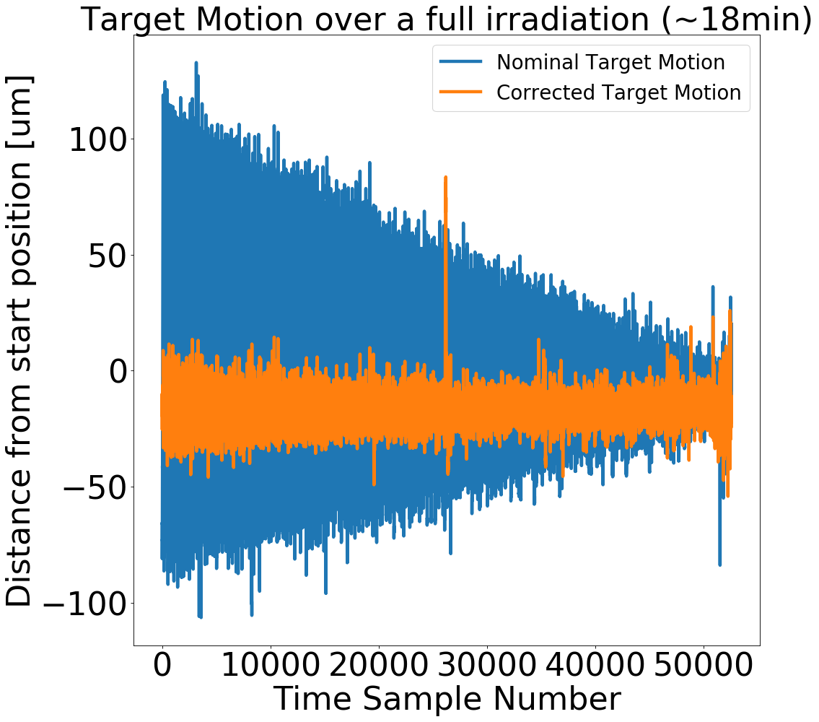
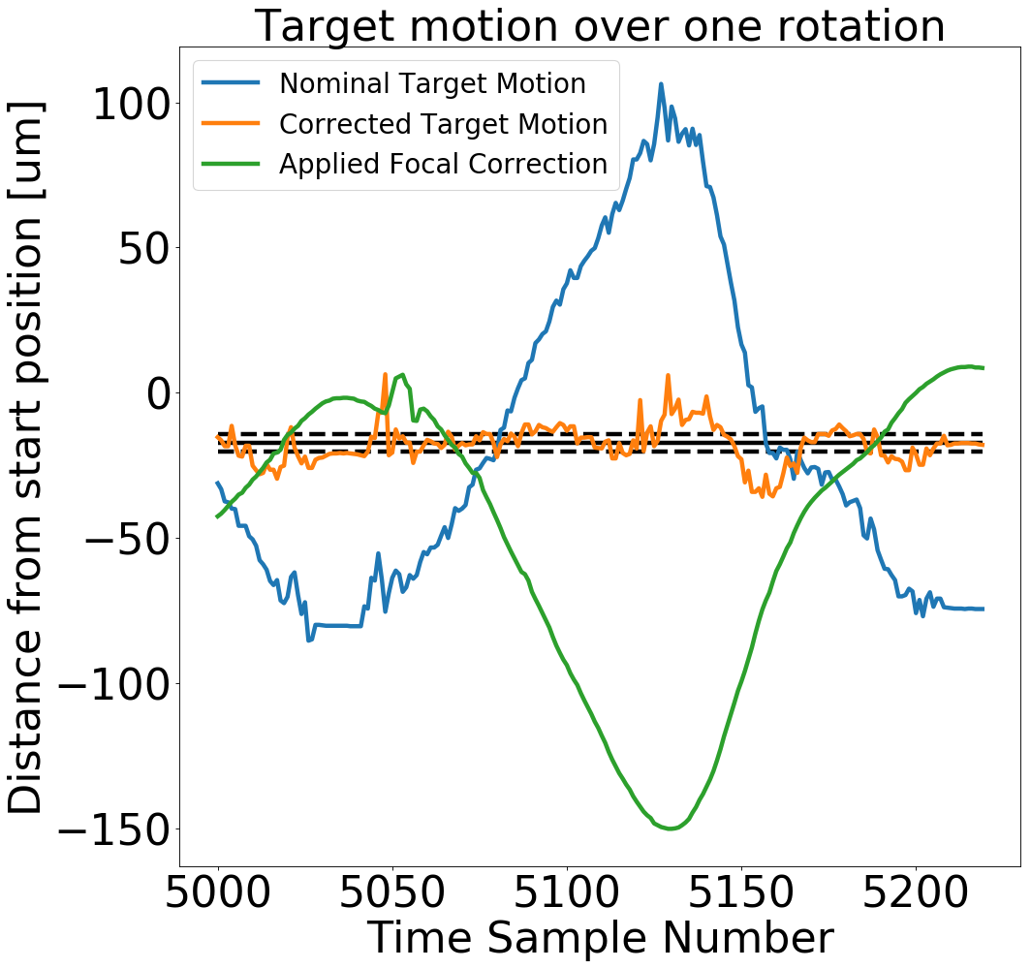
Figure 1: (Left) The variation in the target surface motion without correction and with correction. (Right) Target surface motion over a single rotation of the target. The solid and dashed black lines show the mean and standard deviation of the corrected motion

