Slide 1
Visualization 1
PSY 541: Advanced Psychological Statistics and Methods II
01/22/2025
Notes:
We're listening to "Lay-by" by Tennyson (submitted by Anmol)

Slide 2
Visualization

Slide 3
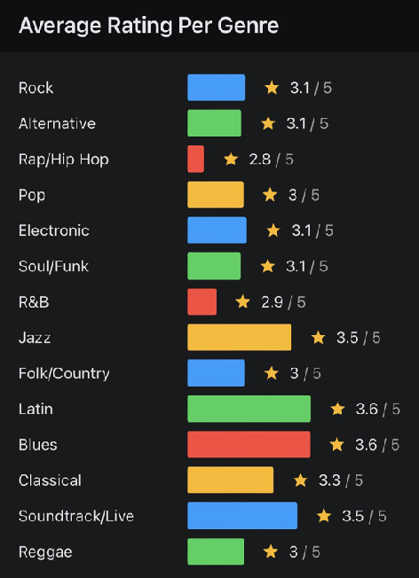
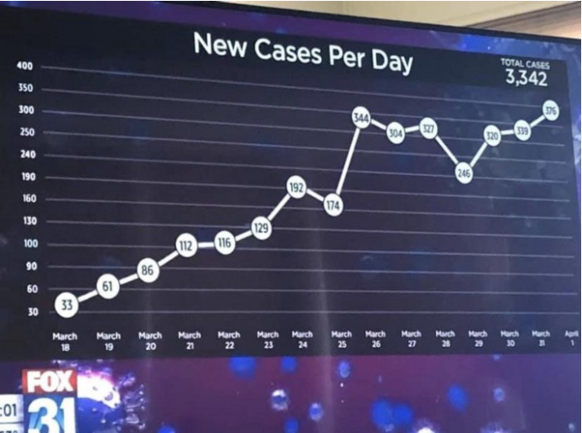
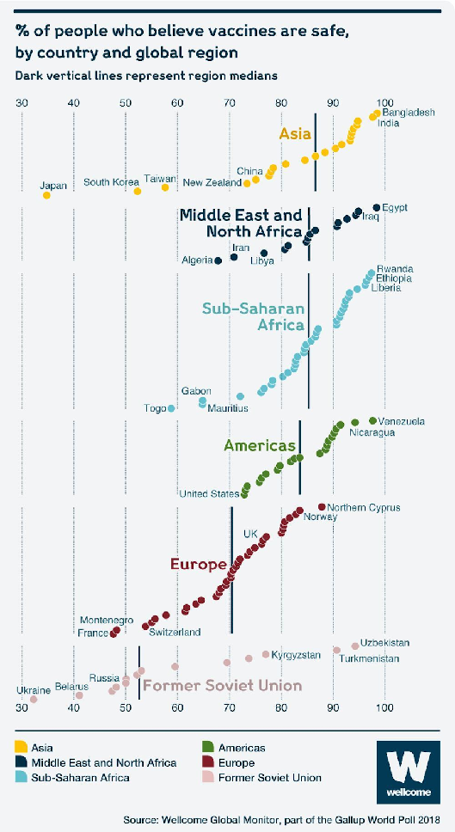
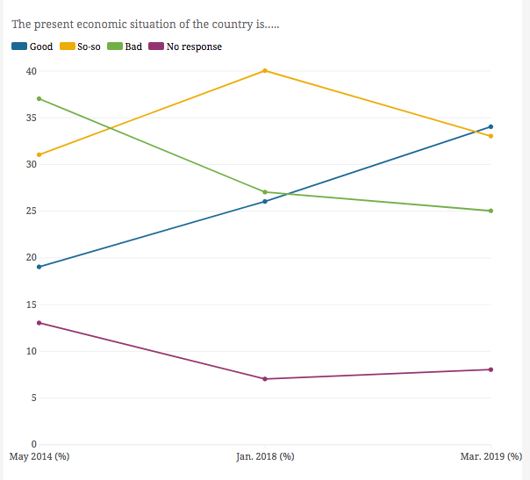
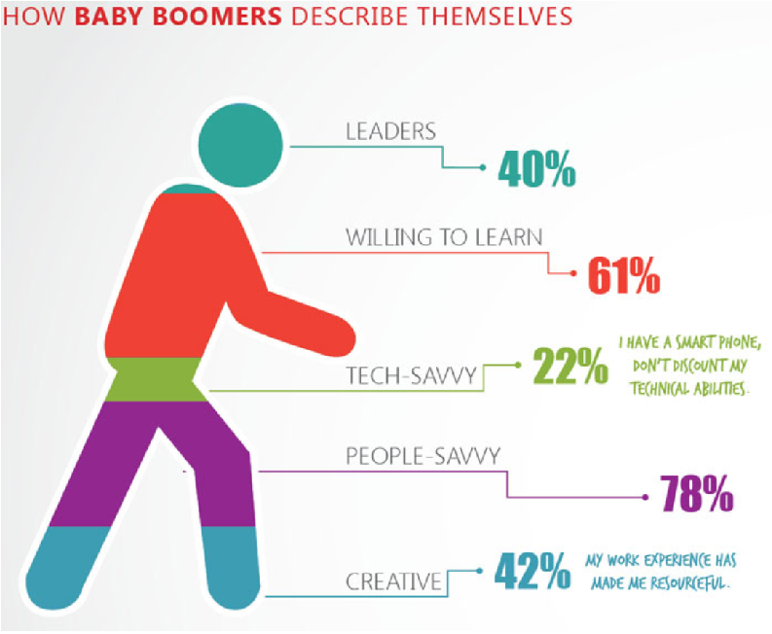
What’s wrong with these graphs? How would you improve them?

Slide 4
Logistics

Slide 6


What is RMarkdown?
+
Markdown

Slide 7
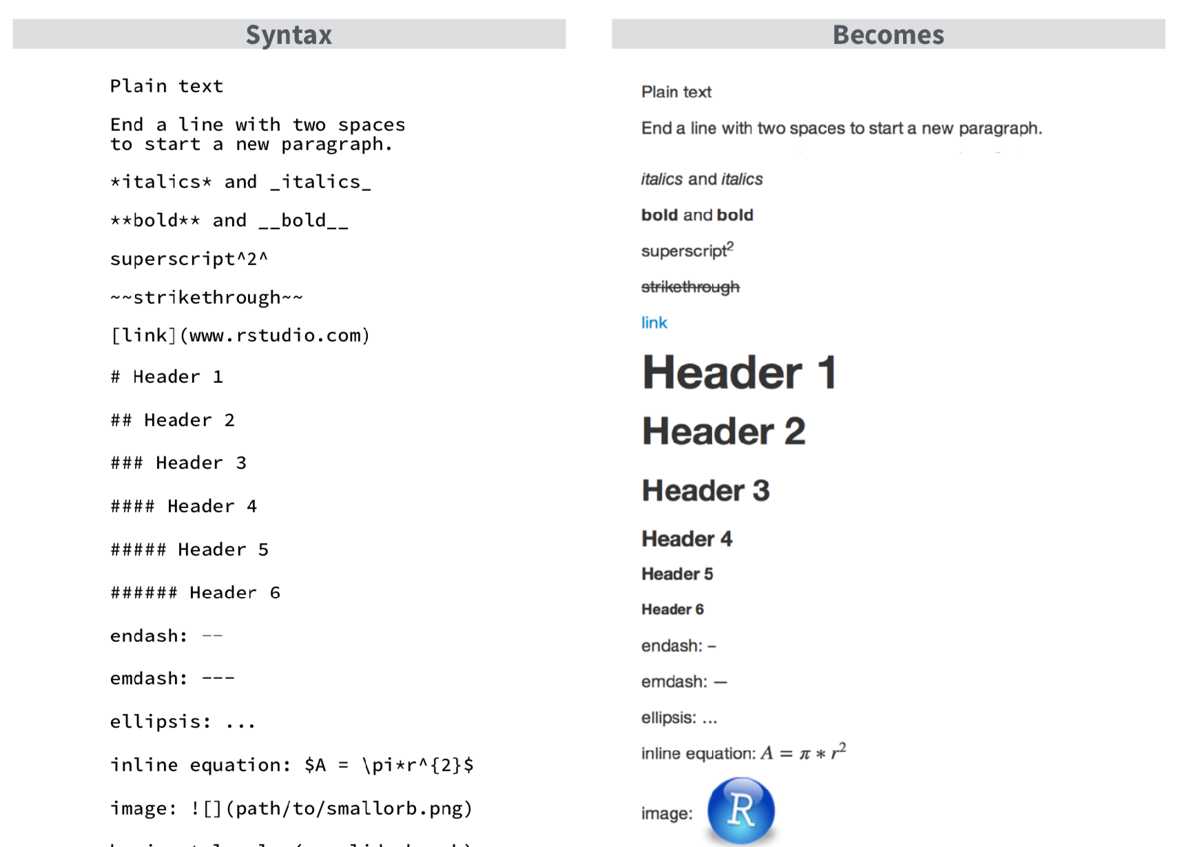
What is Markdown?
check out the file rmarkdown-reference.pdf

Slide 8
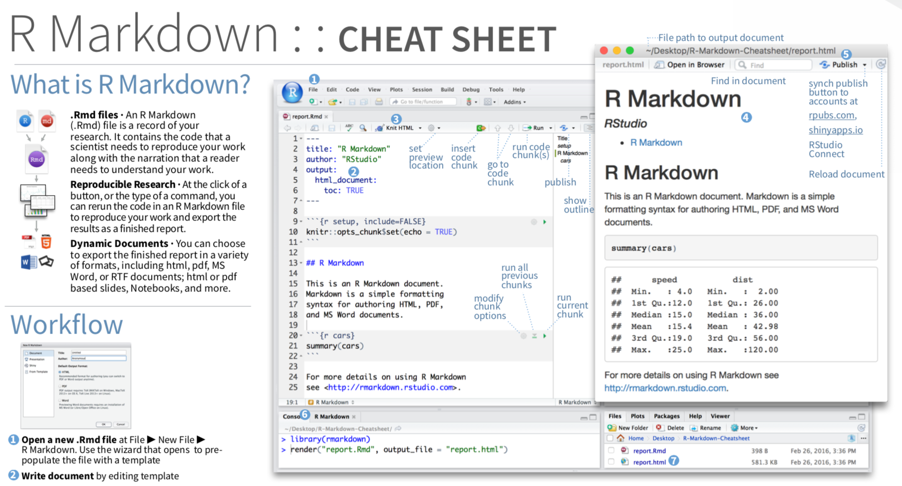
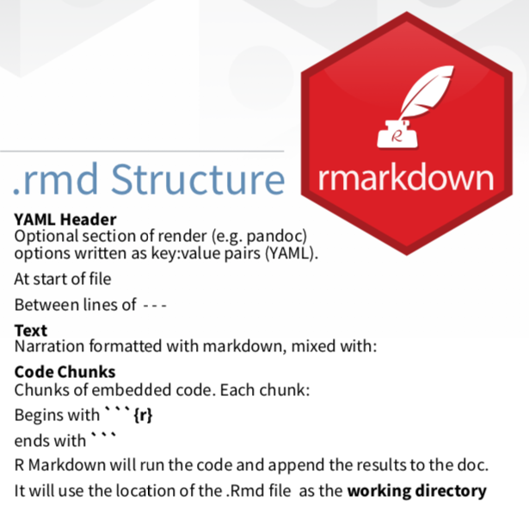
What is RMarkdown?
check out the file rmarkdown.pdf

Slide 9

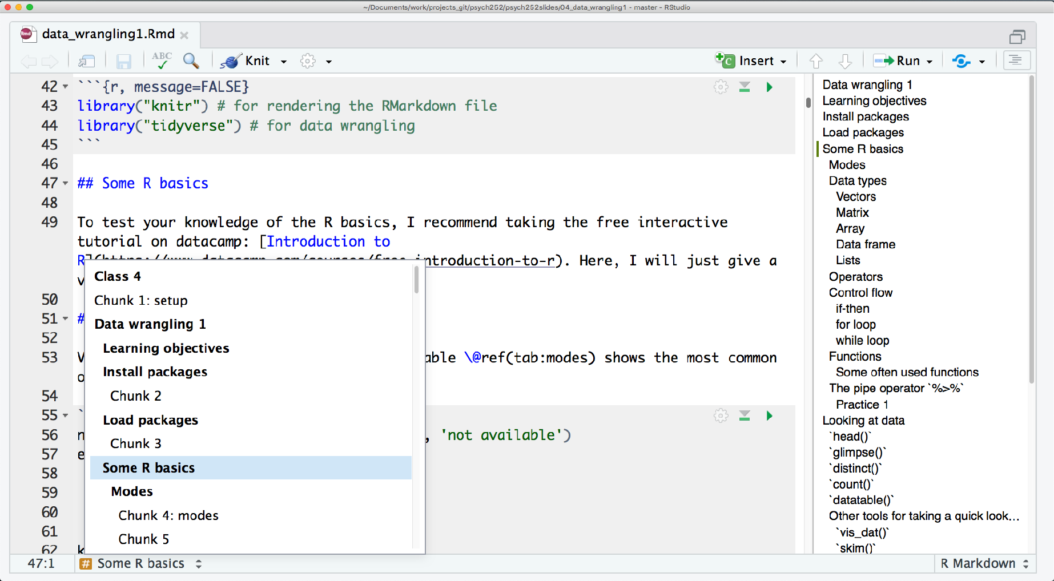

Follow me
Document outline
Code chunk viewer

