Slide 1
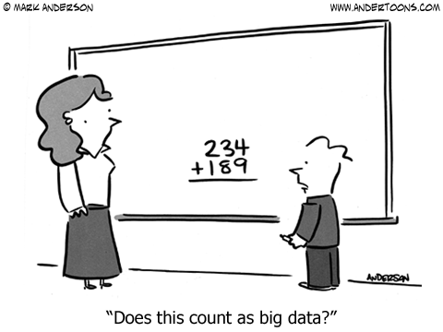
Wrangling data 1
PSY 541: Advanced Psychological Statistics and Methods II
02/12/2025
Notes:
we're listening to "Valentine" by "atlas"
submitted by Auguste!

Slide 2
Logistics

Slide 3



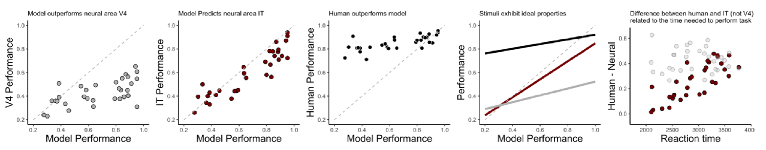
cool experiment
messy dataset
neat plot!

Slide 4
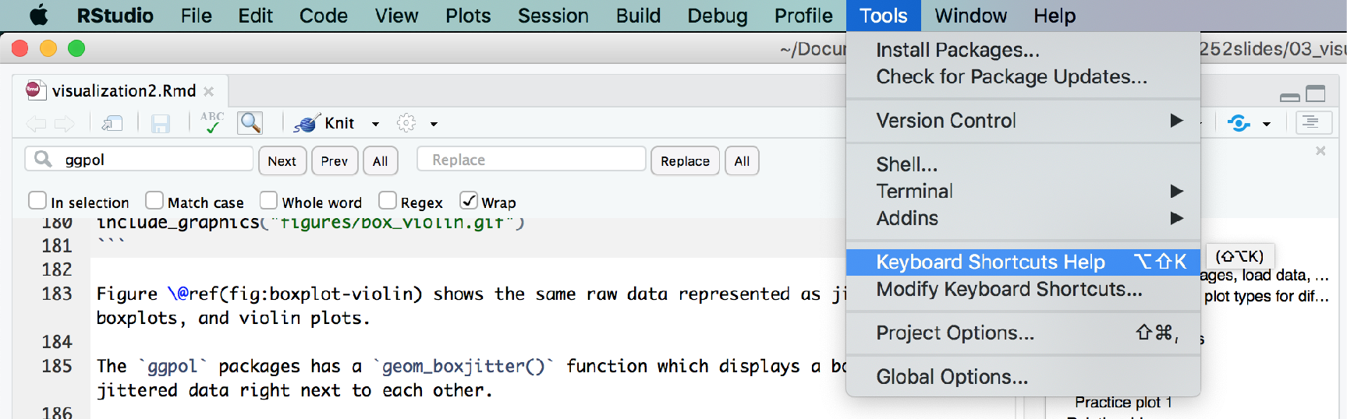
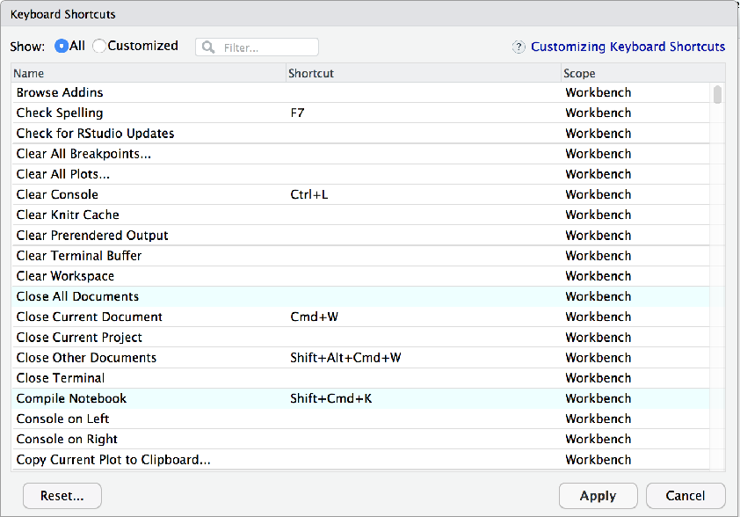
Learn the keyboard shortcuts!
... and make your own

Slide 5
Reformatting code
1 ggplot(data = df.diamonds[1:150,], mapping = aes(x = color, y = price)) +
2 # individual data points (jittered horizontally)
3 geom_point(alpha = 0.2,
4 position = position_jitter(width = 0.1, height = 0),
5 size = 2) +
6 # error bars
7 stat_summary(fun.data = "mean_cl_boot",
8 geom = "linerange",
9 color = "black",
10 size = 1) +
11 # means
12 stat_summary(fun.y = "mean",
13 geom = "point",
14 shape = 21,
15 fill = "red",
16 color = "black",
17 size = 4)
highlight code and press
cmd + i
1 ggplot(data = df.diamonds[1:150,], mapping = aes(x = color, y = price)) +
2 # individual data points (jittered horizontally)
3 geom_point(alpha = 0.2,
4 position = position_jitter(width = 0.1, height = 0),
5 size = 2) +
6 # error bars
7 stat_summary(fun.data = "mean_cl_boot",
8 geom = "linerange",
9 color = "black",
10 size = 1) +
11 # means
12 stat_summary(fun.y = "mean",
13 geom = "point",
14 shape = 21,
15 fill = "red",
16 color = "black",
17 size = 4)

Slide 6
Commenting code
1 ggplot(data = df.diamonds,
2 mapping = aes(x = color, y = price)) +
3 stat_summary(fun.y = "mean", geom = "bar")
highlight code and press
cmd + shift + c
1 # ggplot(data = df.diamonds,
2 # mapping = aes(x = color, y = price)) +
3 # stat_summary(fun.y = "mean", geom = "bar")

Slide 7
Data wrangling 1

Slide 8


Assignment operator
assignment operator
x <- 1
x = 1
identical
(except for some obscure cases)

Slide 9
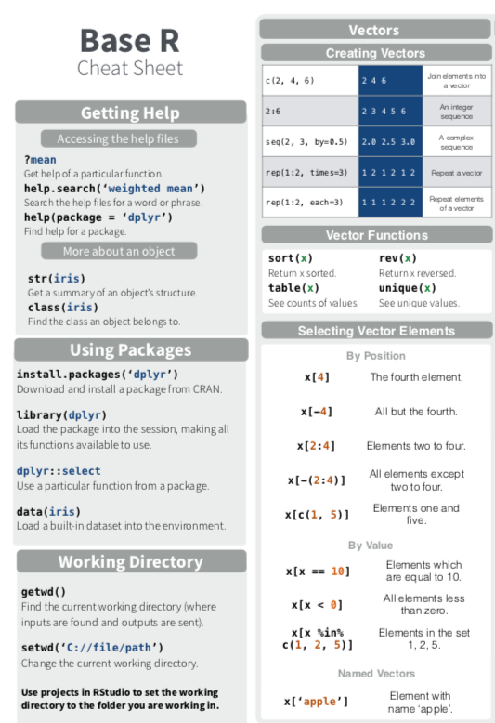
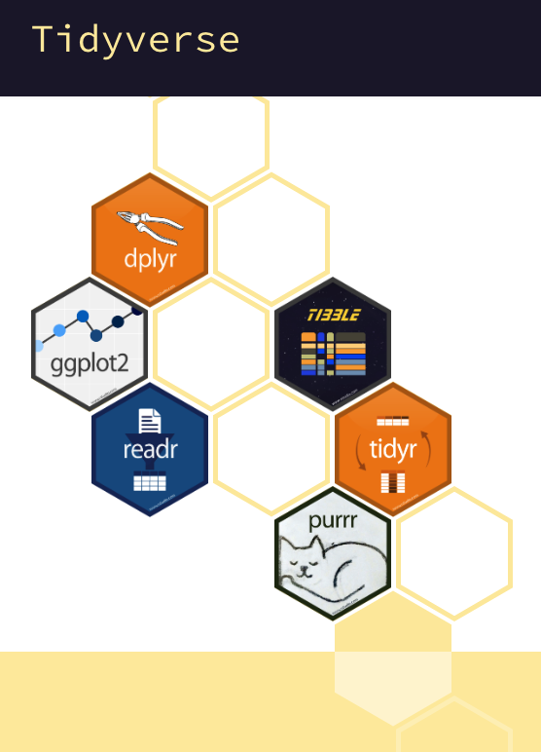
Two styles of coding in R

Slide 10
Making Data Wrangling Less Awful

Slide 11

RStudio time

Slide 12
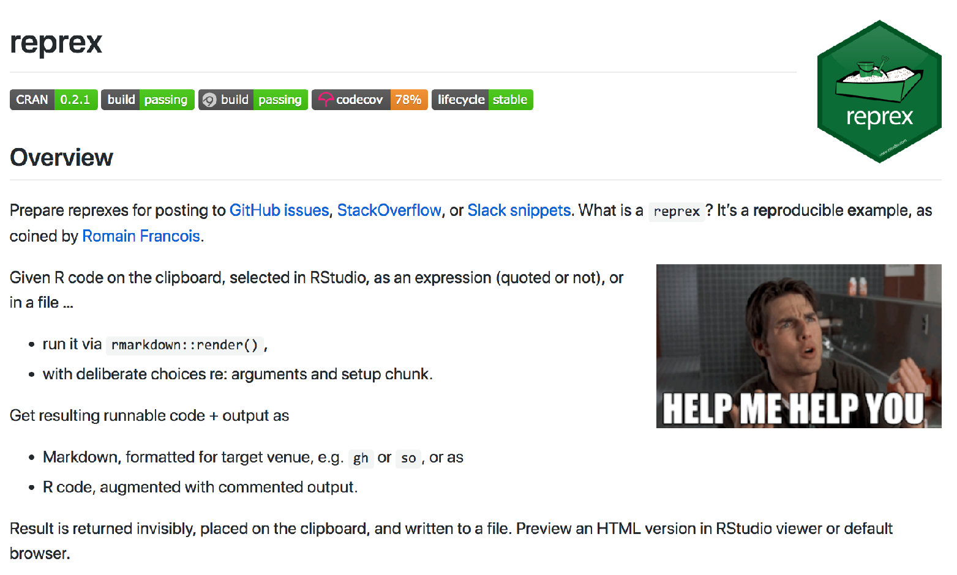
Reprex
best way to get help is by posting a reprex
reprex = reproducible example

Slide 13
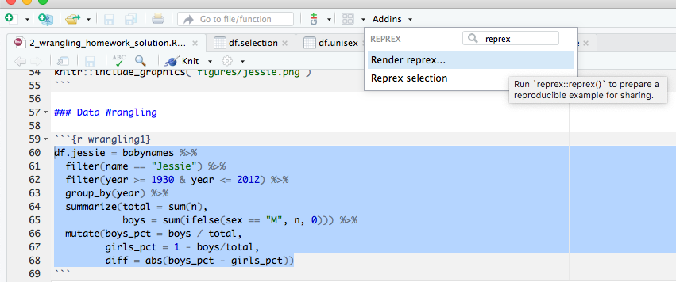
Reprex
install.package("reprex")
2. click on Addins
3. Render reprex
1. select the text

Slide 14
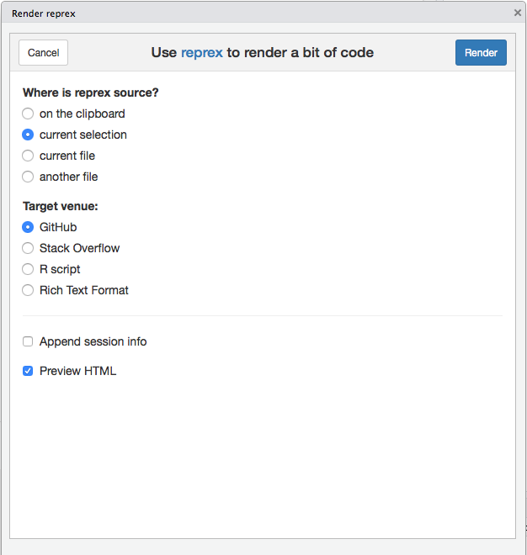
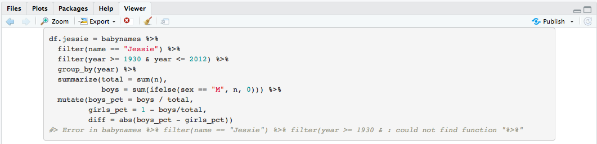
Reprex
5. click render
4. select this option
6. copy and paste from the viewer

Slide 15
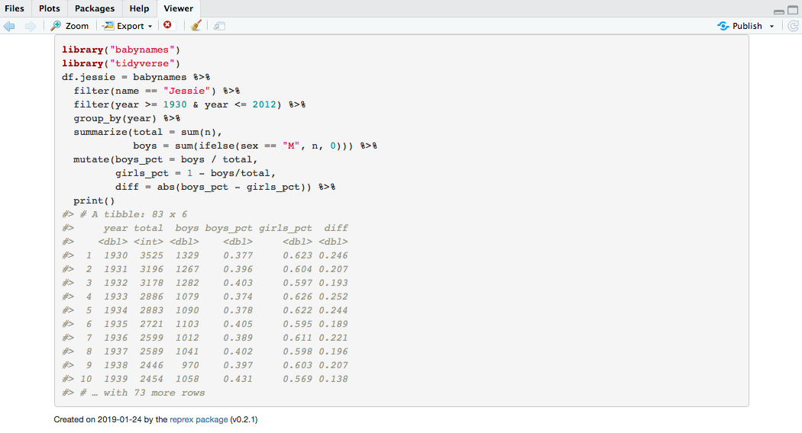
Reprex
7. make sure to load necessary packages in your reprex

Slide 16
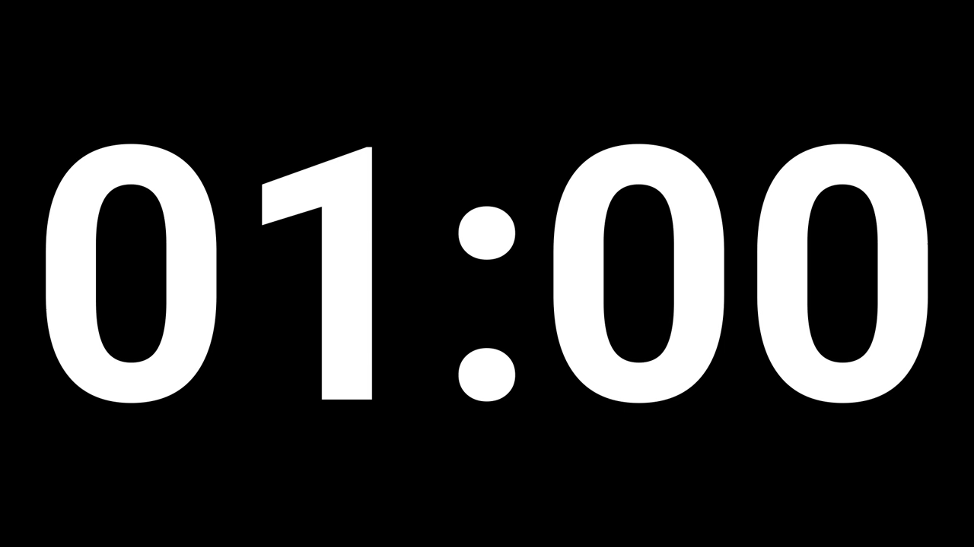

stretch break!
Notes:
we're listening to "Cold Heart - PNAU Remix" by "Elton John, Dua Lipa, PNAU"
submitted by Bella Fascendini

Slide 17



Using functions with tidyverse verbs
1 df.starwars %>%
2 select(where(fn = is.numeric))
my recommendation
fn = is.numeric
fn = "is.numeric"
fn = function(x){is.numeric(x)}
fn = ~ is.numeric(.)
flexible, short, works well with other verbs we'll learn about later
fn = ~ !is.numeric(.)
select all variables that are not numeric

