Slide 1
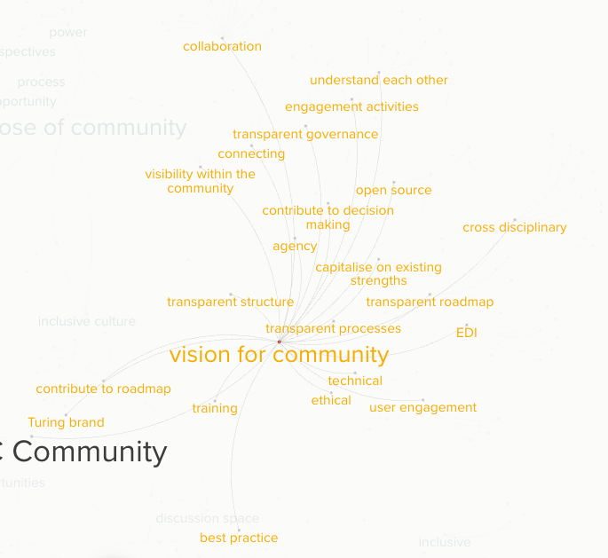
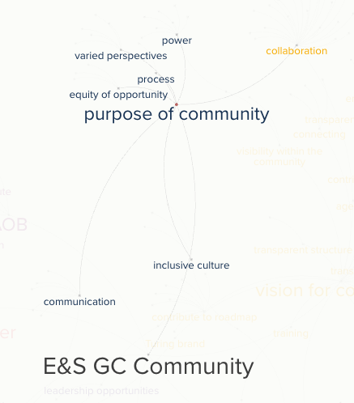

Slide 2
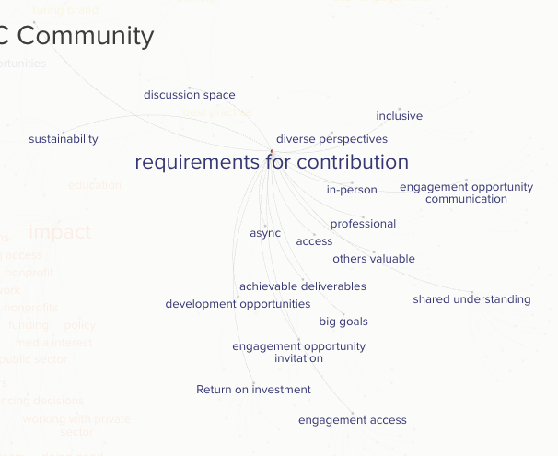

Slide 3
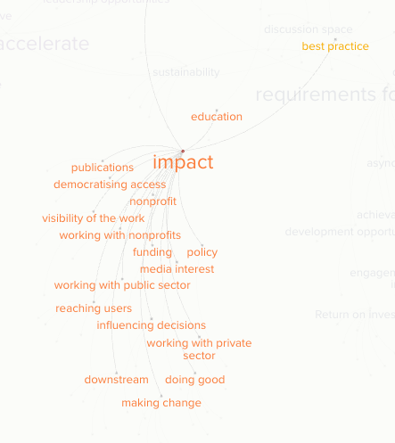
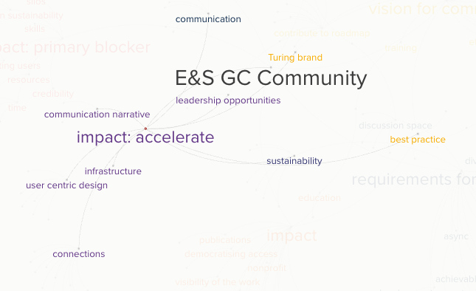
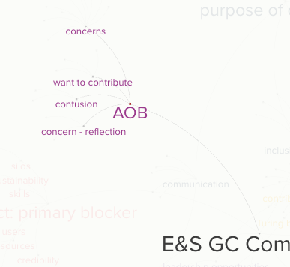
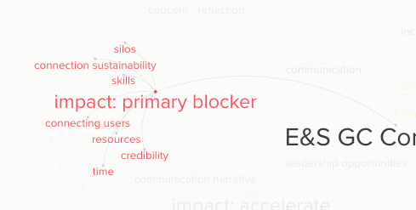

Slide 4
Question | Theme | n. occurances
1. purpose of com. | collaboration | 11
 | communication | 4
 | equity of opportunity | 3
 | inclusive culture | 5
 | power | 8
 | process | 1
 | varied perspectives | 5
2. vision for community | agency | 2
 | best practice | 4
 | capitalise on existing strengths | 3
 | collaboration | 16
 | connecting | 4
 | contribute to decision making | 2
 | contribute to roadmap | 9
 | cross disciplinary | 12
 | EDI | 6
 | engagement activities | 4
 | ethical | 2
 | open source | 4
 | technical | 2
 | training | 1
 | transparent governance | 3
 | transparent processes | 1
 | transparent roadmap | 5
 | transparent structure | 1
 | Turing brand | 2
 | understand each other | 5
 | user engagement | 5
 | visibility within the community | 2
3. requirements for contribution | access | 1
 | achievable deliverables | 3
 | async | 1
 | big goals | 4
 | development opportunities | 2
 | discussion space | 5
 | diverse perspective | 1
 | engagement access | 15
 | engagement opportunity communication | 9
 | engagement opportunity invitation | 5
 | in person | 2
 | inclusive | 5
 | others valuable | 4
 | professional | 3
 | Return on investment | 8
 | shared understanding | 18
 | sustainability | 2
4. what is impact | democratising access | 1
 | doing good | 3
 | downstream | 4
 | education | 2
 | funding | 1
 | impact best practice | 1
 | influencing decisions | 2
 | making change | 4
 | media interest | 1
 | policy | 7
 | publications | 1
 | reaching users | 5
 | visibility of the work | 2
 | working with nonprofits | 1
 | working with private sector | 2
 | working with public sector | 2
5. impact: accelerate | best practice | 1
 | communication | 1
 | communication narrative | 2
 | connections | 11
 | infrastructure | 1
 | leadership opportunities | 1
 | sustainability | 4
 | Turing brand | 2
 | user centric design | 6
6. impact: blocker | connecting users | 3
 | connection sustainability | 3
 | credibility | 1
 | resources | 1
 | silos | 1
 | skills | 1
 | time | 3
7. AOB | concern - reflection | 2
 | concerns | 10
 | confusion | 2
 | want to contribute | 3
Purpose of community
Vision for community
Requirements for contribution
What is impact
How could community accelerate impact
What is blocking impact
AOB

Slide 5
theme
Purpose of community
Vision for community
Requirements for contribution
What is impact
How could community accelerate impact
What is blocking impact
AOB

Slide 6
Theme
Purpose of community
Vision for community
Requirements for contribution
What is impact
How could community accelerate impact
What is blocking impact
AOB

