Slide 1







Metrics Findings Presentation
Alexandria (Ali) Cohen
Nov 26, 2023

Slide 2



OUTLINE
Executive Summary
Introduction
Methodology
Results
Visualization – Charts
Dashboard
Discussion
Findings & Implications
Conclusion
Appendix

Slide 3

EXECUTIVE SUMMARY
Review of Programming Languages revealed Trends:
Top 3 are changing from: Bash/Shell/PowerShell, HTML/CSS, C#
Trend towards: JavaScript, HTML/CSS, Python
Review of Platforms revealed:
Windows, Linux and Docker are popular
AWS is growing in popularity
Review of Databases revealed:
Top 3 changing from: ElasticSearch, DynamoDB, MongoDB
Trend towards: PostgreSQL, MongoDB, Redis
Review of Demographics showed:
Vast majority are Male (96.7%) with a Bachelor’s Degree
Majority are located in the US and Canada
Majority are between 24-32 years old
Review of Jobs and Salaries per Programming Language showed:
Language C has more jobs than all languages combined
Swift programmers make the highest salary

Slide 4

INTRODUCTION
Objective was to gather data from multiple sources and analyze for trends using visualization
Tools used included:
Python, SQL, Webscraping, Jupyter Notebooks, IBM Cognos Analytics, Microsoft Excel, Stack Overflow
Data reviewed included:
Programming Language Trends
Database Usage Trends
Platform Usage Trends
Webframe Usage Trends
Respondents Gender
Respondents location by Country
Respondents Age
Respondents Education Level
Job Postings per Programming Language
Annual Salaries per Programming Language

Slide 5

METHODOLOGY
Data Gathering and Wrangling
Sourced From Coursera IBM Data Analyst course. Dataset sources:
url = https://cf-courses-data.s3.us.cloud-object-storage.appdomain.cloud/IBM-DA0321EN-SkillsNetwork/labs/datasets/Programming_Languages.html
https://www.kaggle.com/promptcloud/jobs-on-naukricom
API requests
GitHub
BeautifulSoup used for Webscraping
Python code using Pandas, Requests, Flask, SQL
Data Cleaning
Imputing values
Adjusting data types
Data Calculations
Data Visualization
Using Microsoft Excel and IBM Cognos Analytics Dashboard
Data Presentation
Using Microsoft PowerPoint and Google Slides

Slide 6
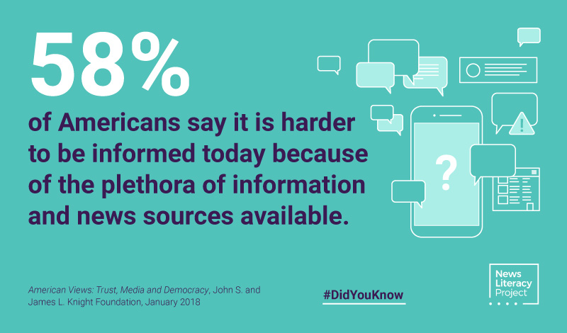
RESULTS
Source: https://newslit.org/tips-tools/did-you-know-harder-to-be-informed/

Slide 7
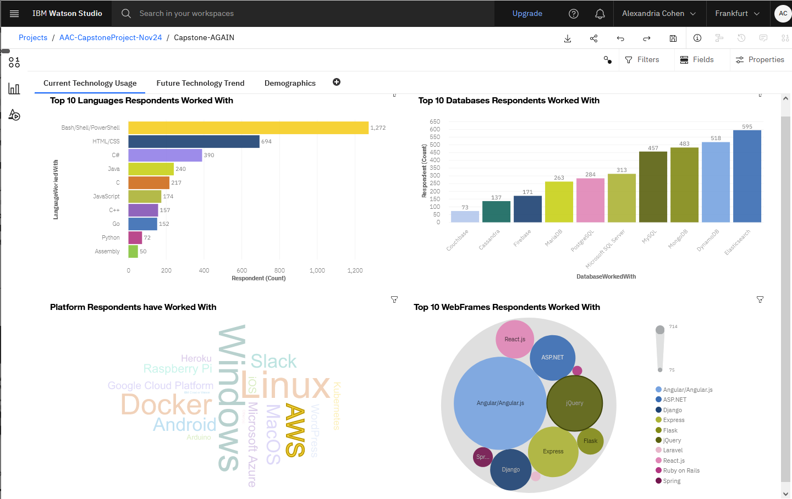
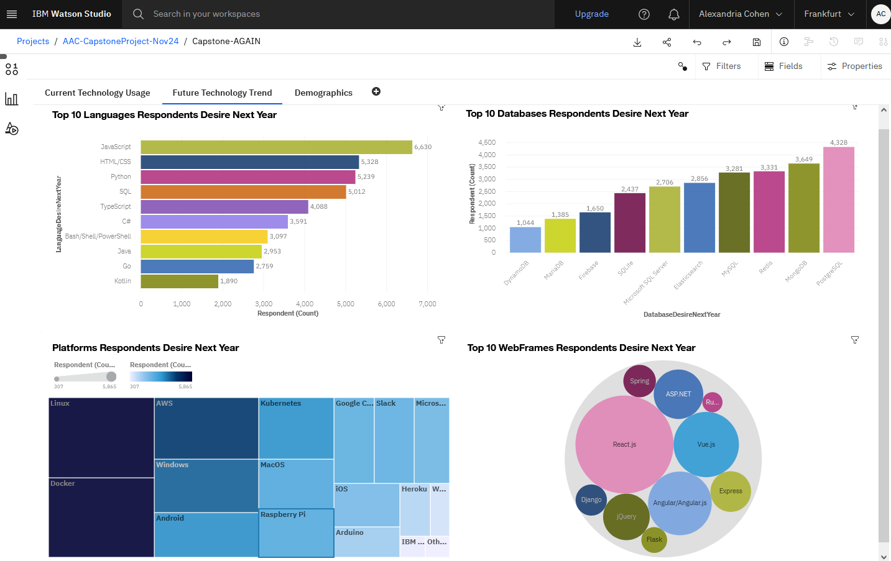
PROGRAMMING LANGUAGE TRENDS
Current Year
Next Year
<Bar chart of top 10 programming languages for the current year goes here.>
< Bar chart of top 10 programming languages for the next year goes here.>

Slide 8
PROGRAMMING LANGUAGE TRENDS - FINDINGS & IMPLICATIONS
Findings:
Top 3 Current Languages
Bash / Shell / PowerShell
HTML / CSS
C#
Implications:
From Current to Future trends
Bash / Shell / PowerShell drops from 1st to 7th place
HTML / CSS holds 2nd place
C# drops from 3rd to 6th
JavaScript is highly favored as the #1 future language
Python ranks as 3rd

Slide 9
DATABASE TRENDS
Current Year
Next Year
< Bar chart of top 10 databases for the current year goes here >
< Bar chart of top 10 databases for the next year goes here.>

Slide 10
DATABASE TRENDS - FINDINGS & IMPLICATIONS
Findings:
Top 3 Database Trends
ElasticSearch
DynamoDB
MongoDB
(with MySQL closely behind)
Implications:
From Current to Future trends
ElasticSearch falls 1st to 5th place
Dynamo DB falls 2nd to 10th place
MongoDB rises from 3rd to 2nd
Redis rises to 3rd place
(with MySQL closely behind
in 4th place again)

Slide 11

DASHBOARD
<Link to View
Cognos dashboard>

Slide 12
DASHBOARD TAB 1 – Current Technology Usage

Slide 13
DASHBOARD TAB 2 – Future Technology Trend

Slide 14
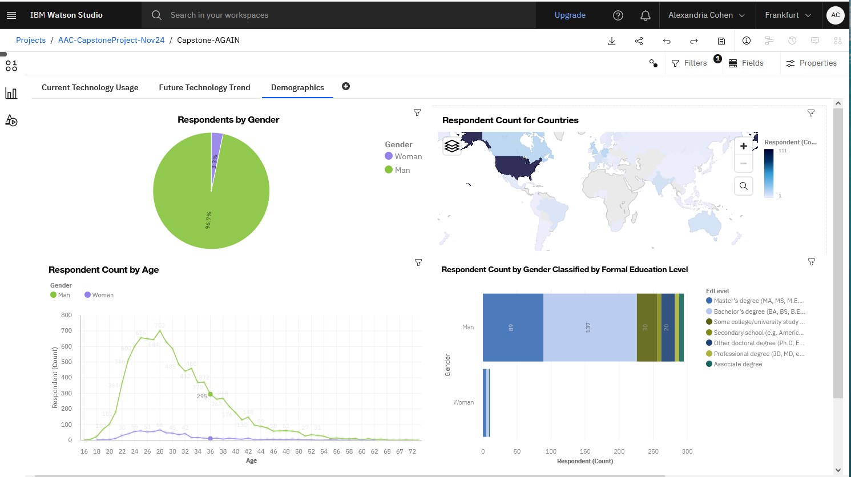
DASHBOARD TAB 3 – Demographics

Slide 15
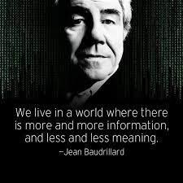
DISCUSSION

Slide 16
OVERALL FINDINGS & IMPLICATIONS
Findings:
Top 3 Programming Languages are changing:
From: Bash/Shell/PowerShell, HTML/CSS, C#;
Trending towards: JavaScript, HTML/CSS, Python
Analysis of Platform data revealed:
Windows, Linux and Docker are popular
AWS is growing in popularity
Analysis of Database data revealed Top 3 changing:
From: ElasticSearch, DynamoDB, MongoDB
Trending towards: PostgreSQL, MongoDB, Redis
Analysis of Demographics revealed:
Male Majority (96.7%) with a Bachelor’s Degree
Majority located in the US, then Canada
Majority are between 24-32 years old
Analysis of Jobs and Salaries showed:
Language C had more jobs than all languages combined
Swift programmers make the highest salary
Implications:
Trend seen away from the Front-End programming languages as A.I. tools assist that knowledge
Python, JavaScript, PostgreSQL, Mongo DB, Redis and AWS are all growing in popularity
Hiring will most likely focus on Women
C Programmers have highest demand with the most job opportunities

Slide 17

CONCLUSION
A.I. Tools (eg. Chat GPT) are changing the landscape and future trends in programming by making it easier to learn the front-end developer languages. This is causing a shift in the languages that programmers are desiring to learn next.
Hiring of females is lagging in the Programming industry
Most Programmers are in the US and Canada with a Bachelor’s Degree

Slide 18

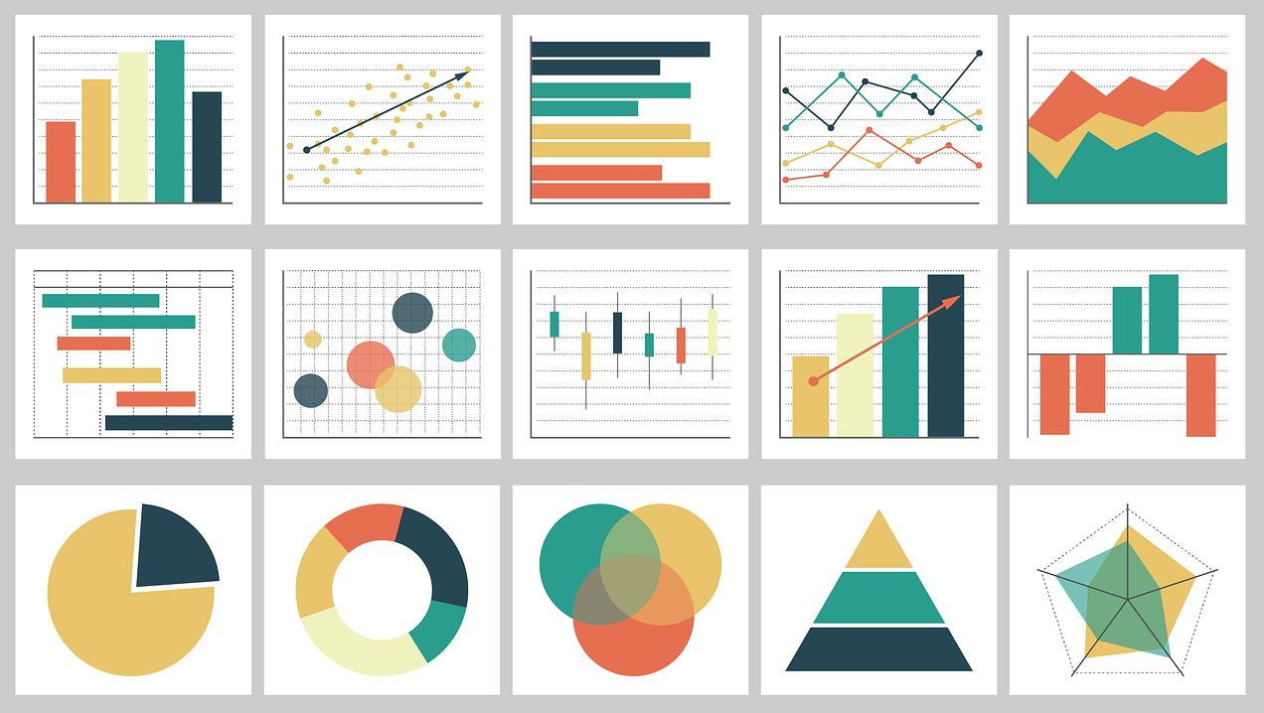
APPENDIX
The following slides are relevant additional charts, or tables created during the analysis phase.

Slide 19
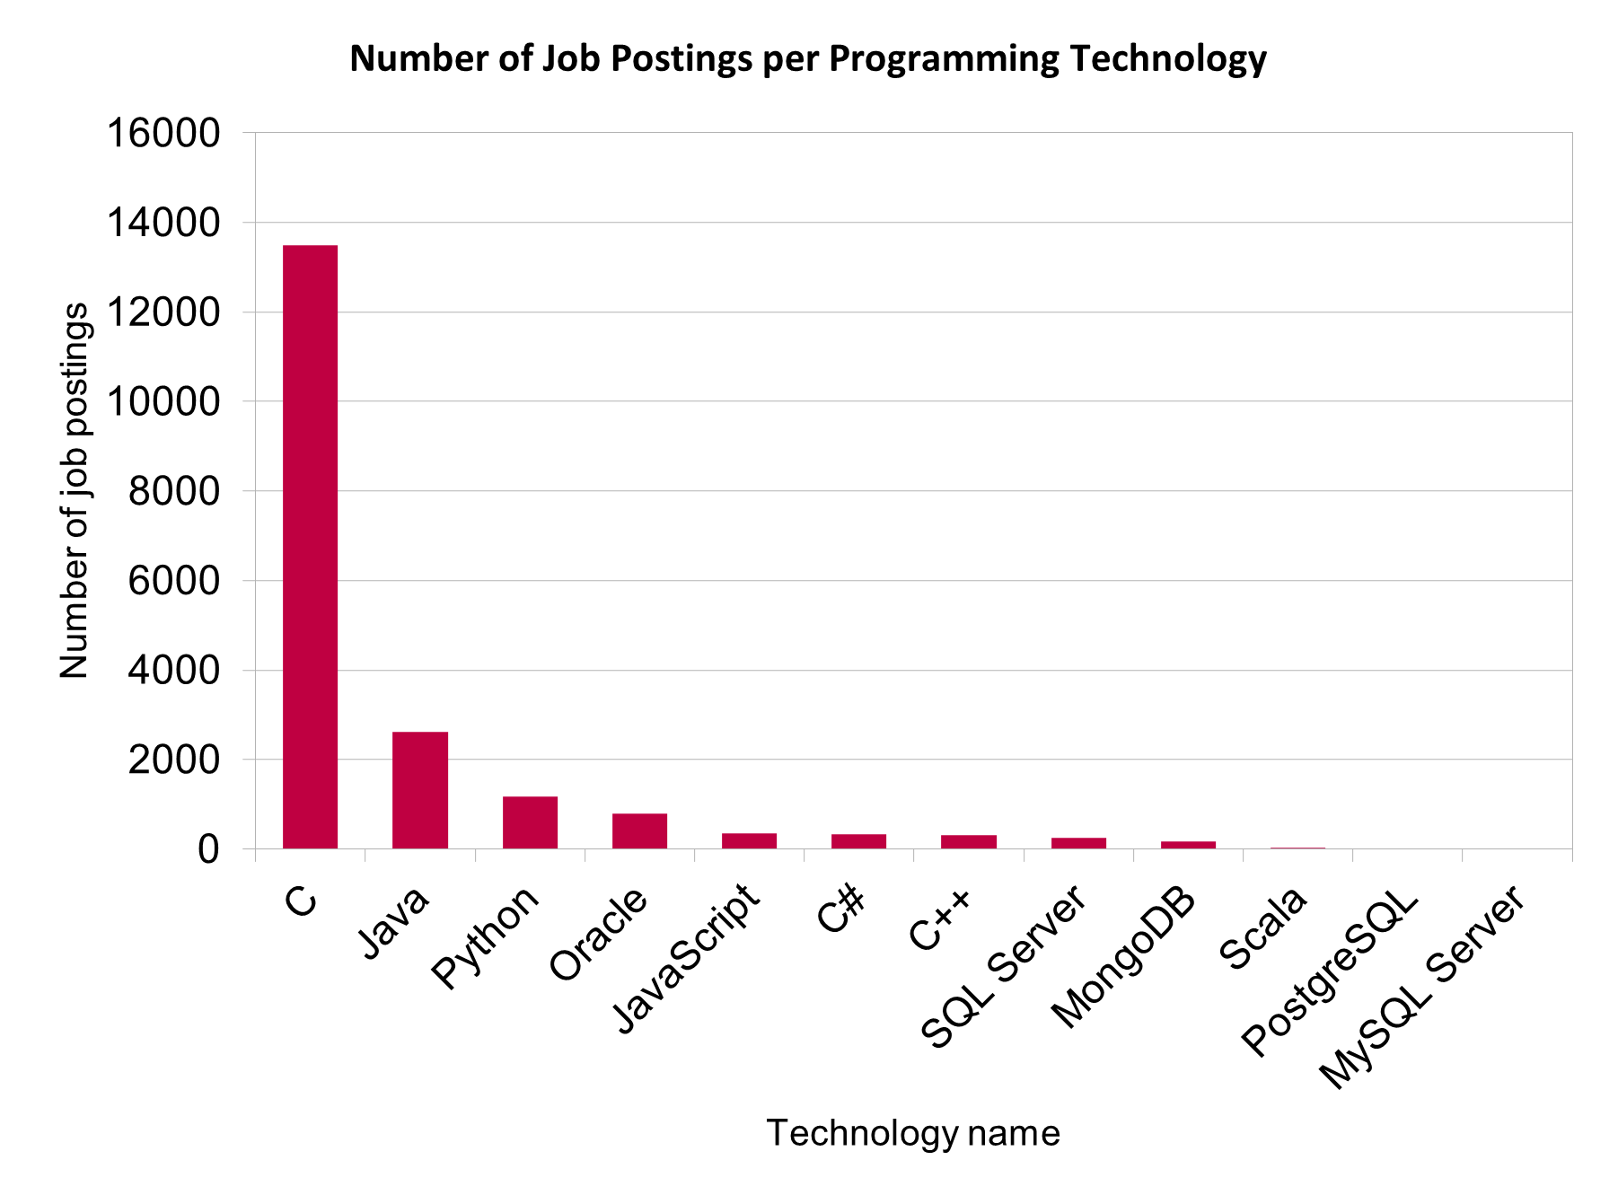
JOB POSTINGS
Module 1: Collected job posting data.
Bar Chart in descending order of number of job postings found per Technology.

Slide 20
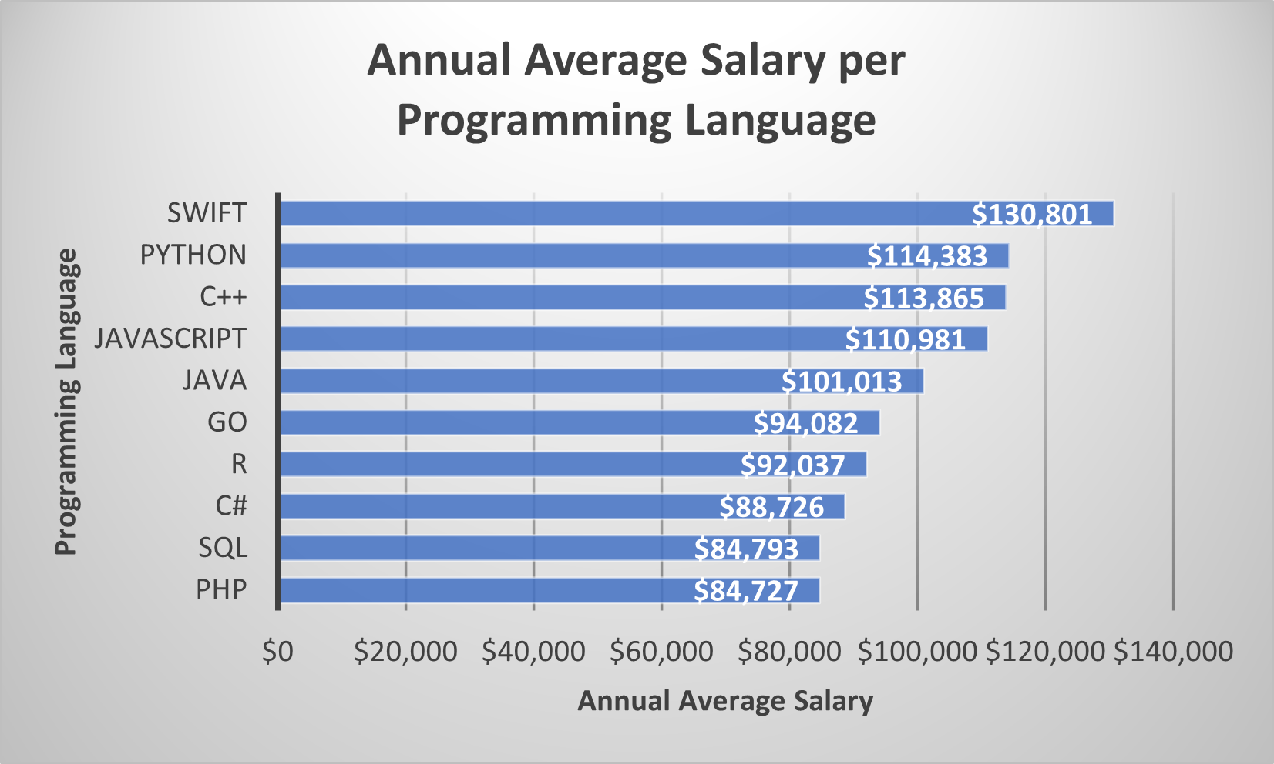
POPULAR LANGUAGES
Module 1: Collected job posting data.
Bar Chart in descending order of Salary per Language.

