Slide 1
Wumpus World
Mike Silva-Breen
Alex Cole
Trevor Boone

Slide 2



Wumpus World
Notes:
Description of

Slide 3

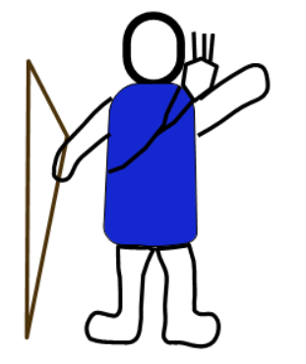

Cell by Cell
Never explore a cell twice
Unexplored nodes are children
Notes:
Description of how the hero moves around, adding children of new cells to the open list, adding cells previously visited to the closed list

Slide 4
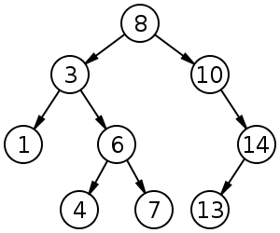
Search Patterns
DFS
BFS
Heuristic

Slide 5

Heuristic Search

Slide 6

Heuristic Search cont.
Danger: 0
Danger: 1
Danger: 1
Danger: 0
Danger: 1

Slide 7
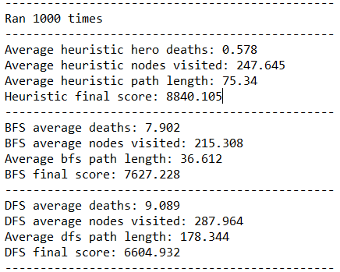
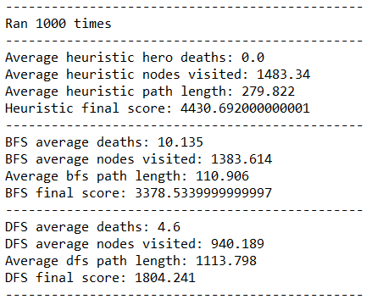
Results

Slide 8

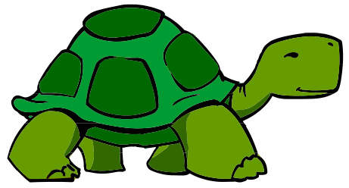
Knowledge vs Speed

Slide 9
Conclusions
Inference
Knowledge
Calculated Risk
Notes:
Admit defeat. Our heuristic is interesting, but a knowledge base based approach encapsulates all of our information, and also intelligently updates past squares based on future inference.

Slide 10
Any Questions?

