Slide 1
Introduction to RST
Rhetorical Structure Theory
Maite Taboada and Manfred Stede
Simon Fraser University / Universität Potsdam
Contact: mtaboada@sfu.ca
May 2009

Slide 2
Preface
The following is a set of slides from courses taught by Maite Taboada and Manfred Stede
It is distributed as a starting point for anyone who wants to present an introduction to RST
You are free to use and modify the slides, but we would appreciate an acknowledgement
For any comments and suggestions, please contact Maite Taboada: mtaboada@sfu.ca

Slide 3
Rhetorical Structure Theory
Created as part of a project on Natural Language Generation at the Information Sciences Institute (www.isi.edu)
Central publication
  Mann, William C. and Sandra A. Thompson. (1988). Rhetorical Structure Theory: Toward a functional theory of text organization. Text, 8 (3), 243-281.
Recent overview
  Taboada, Maite and William C. Mann. (2006). Rhetorical Structure Theory: Looking back and moving ahead. Discourse Studies, 8 (3), 423-459.
For many more publications and applications, visit the bibliography on the RST web site
  http://www.sfu.ca/rst/
  http://www.sfu.ca/rst/05bibliographies/

Slide 4
Principles
Coherent texts consist of minimal units, which are linked to each other, recursively, through rhetorical relations
  Rhetorical relations also known, in other theories, as coherence or discourse relations
Coherent texts do not show gaps or non-sequiturs
  Therefore, there must be some relation holding among the different parts of the text

Slide 5
Components
Units of discourse
  Texts can be segmented into minimal units, or spans
Nuclearity
  Some spans are more central to the text’s purpose (nuclei), whereas others are secondary (satellites)
  Based on hypotactic and paratactic relations in language
Relations among spans
  Spans are joined into discourse relations
Hierarchy/recursion
  Spans that are in a discourse relation may enter into new relations

Slide 6
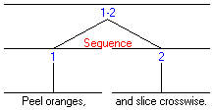
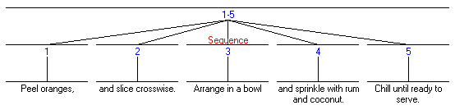
Paratactic (coordinate)
At the sub-sentential level (traditional coordinated clauses)
  Peel oranges, and slice crosswise.
But also across sentences
  1. Peel oranges, 2. and slice crosswise. 3. Arrange in a bowl 4. and sprinkle with rum and coconut. 5. Chill until ready to serve.

Slide 7
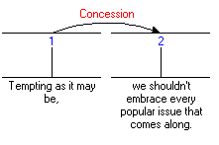
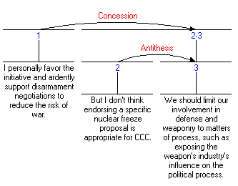
Hypotactic (subordinate)
Sub-sentential Concession relation
Concession across sentences
  Nucleus (spans 2-3) made up of two spans in an Antithesis relation

Slide 8
Relations
They hold between two non-overlapping text spans
Most of the relations hold between a nucleus and a satellite, although there are also multi-nuclear relations
A relation consists of:
  1. Constraints on the Nucleus,
  2. Constraints on the Satellite,
  3. Constraints on the combination of Nucleus and Satellite,
  4. The Effect.

Slide 9
Example: Evidence
Constraints on the Nucleus
  The reader may not believe N to a degree satisfactory to the writer
Constraints on the Satellite
  The reader believes S or will find it credible
Constraints on the combination of N+S
  The reader’s comprehending S increases their belief of N
Effect (the intention of the writer)
  The reader’s belief of N is increased
Assuming a written text and readers and writers; extensions of RST to spoken language discussed later
Definitions of most common relations are available from the RST web site (www.sfu.ca/rst)

Slide 10
Relation types
Relations are of different types
  Subject matter: they relate the content of the text spans
    Cause, Purpose, Condition, Summary
  Presentational: more rhetorical in nature. They are meant to achieve some effect on the reader
    Motivation, Antithesis, Background, Evidence

Slide 11
Other possible classifications
Relations that hold outside the text
  Condition, Cause, Result
vs. those that are only internal to the text
  Summary, Elaboration
Relations frequently marked by a discourse marker
  Concession (although, however); Condition (if, in case)
vs. relations that are rarely, or never, marked
  Background, Restatement, Interpretation
Preferred order of spans: nucleus before satellite
  Elaboration – usually first the nucleus (material being elaborated on) and then satellite (extra information)
vs. satellite-nucleus
  Concession – usually the satellite (the although-type clause or span) before the nucleus

Slide 12
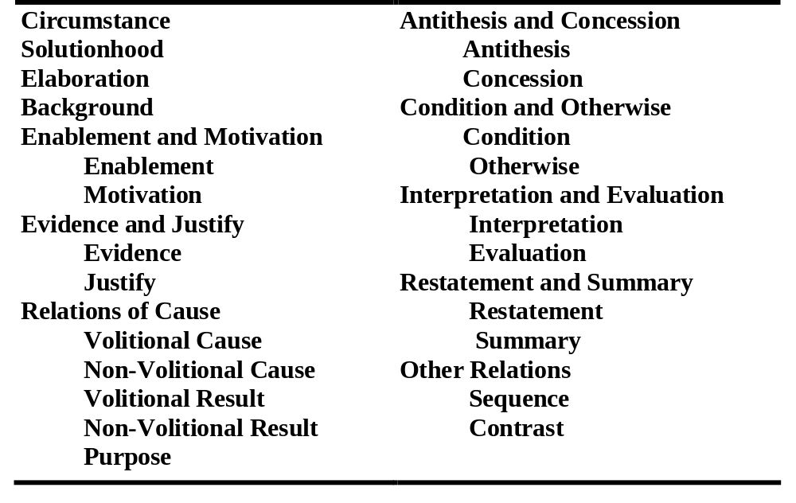
Relation names (in M&T 1988)
Other classifications are possible, and longer and shorter lists have been proposed

Slide 13
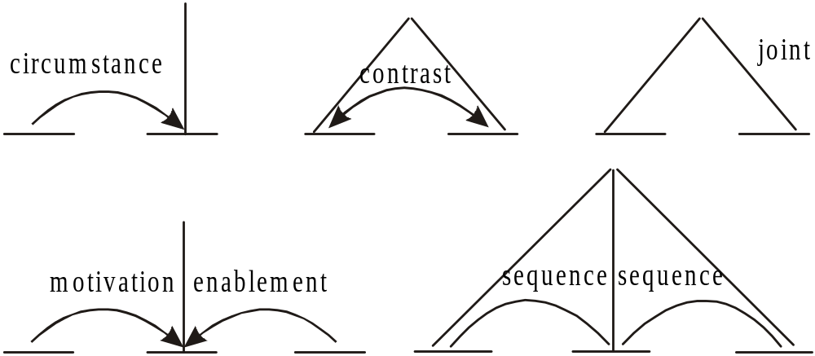
Schemas
They specify how spans of text can co-occur, determining possible RST text structures

Slide 14
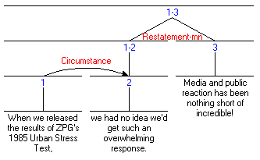
Graphical representation
A horizontal line covers a span of text (possibly made up of further spans
A vertical line signals the nucleus or nuclei
A curve represents a relation, and the direction of the arrow, the direction of satellite towards nucleus

Slide 15
How to do an RST analysis
Divide the text into units
  Unit size may vary, depending on the goals of the analysis
  Typically, units are clauses (but not complement clauses)
Examine each unit, and its neighbours. Is there a clear relation holding between them?
If yes, then mark that relation (e.g., Condition)
If not, the unit might be at the boundary of a higher-level relation. Look at relations holding between larger units (spans)
Continue until all the units in the text are accounted for
Remember, marking a relation involves satisfying all 4 fields (especially the Effect). The Effect is the plausible intention that the text creator had.

Slide 16
Some issues
Problems in identifying relations
  Judgments are plausibility judgments. Two analysts might differ in their analyses
Definitions of units
  Vary from researcher to researcher, depending on the level of granularity needed
Relations inventory
  Many available
  Each researcher tends to create their own, but large ones tend to be unmanageable
A theory purely of intentions
  In contrast with Grosz and Sidner’s (1986), it does not relate structure of discourse to attentional state. On the other hand, it provides a much richer set of relations.

Slide 17
Applications
Writing research
  How are coherent texts created
  RST as a training tool to write effective texts
Natural Language Generation
  Input: communicative goals and semantic representation
  Output: text
Rhetorical/discourse parsing
  Rendering of a text in terms of rhetorical relations
  Using signals, mostly discourse markers
Corpus analysis
  Annotation of text with discourse relations (Carlson et al. 2002)
  Application to spoken language (Taboada 2004, and references in Taboada and Mann 2006)
Relationship to other discourse phenomena
  Between nuclei and co-reference
For more applications (up to 2005 or so):
  Taboada, Maite and William C. Mann. (2006). Applications of Rhetorical Structure Theory. Discourse Studies, 8 (4), 567-588.

Slide 18
Resources
RST web page
  www.sfu.ca/rst
RST tool (for drawing diagrams)
  http://www.wagsoft.com/RSTTool/

Slide 19
Selected references (see RST web site for full bibliographies)
Carlson, Lynn, Daniel Marcu and Mary Ellen Okurowski. (2002). RST Discourse Treebank, LDC2002T07 [Corpus]. Philadelphia, PA: Linguistic Data Consortium.
Grosz, Barbara J. and Candace L. Sidner. (1986). Attention, intentions, and the structure of discourse. Computational Linguistics, 12 (3), 175-204.
Mann, William C. and Sandra A. Thompson. (1988). Rhetorical Structure Theory: Toward a functional theory of text organization. Text, 8 (3), 243-281.
Taboada, Maite. (2004). Building Coherence and Cohesion: Task-Oriented Dialogue in English and Spanish. Amsterdam and Philadelphia: John Benjamins.
Taboada, Maite and William C. Mann. (2006a). Applications of Rhetorical Structure Theory. Discourse Studies, 8 (4), 567-588.
Taboada, Maite and William C. Mann. (2006b). Rhetorical Structure Theory: Looking back and moving ahead. Discourse Studies, 8 (3), 423-459.

