Slide 1
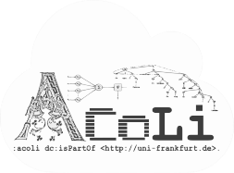
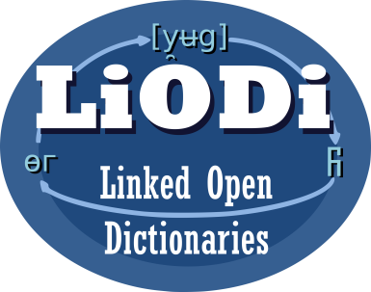

Linking Discourse Marker Inventories
LDK-2021, Zaragoza, Spain, Sep 2, 2021
Christian Chiarcos & Max Ionov
Applied Computational Linguistics (ACoLi)
chiarcos@informatik.uni-frankfurt.de
Notes:
30 min incl. disc.

Slide 2
Linking Discourse Marker Inventories
Introduction
Conversion
Linking
Conclusions

Slide 3
Discourse Markers
Make explicit how an utterance (clause, sentence, etc.) is linked to its discourse context
lexical expressions, mostly conjunctions, adverbs and PPs
John can‘t go. ...
And Mary can‘t go either.
Therefore, Mary can‘t go either.
However, Mary can‘t go either.
Mary can‘t go either.
additive
causal
relation
contrastive
implicit
(unmarked)

Slide 4
Discourse Relations (Coherence Relations)
Semantic, pragmatic or conversational relation holding between an utterance and its discourse context.
different theories and annotation frameworks
Coherence relations (Hobbs, 1979)
RST (Mann and Thompson, 1987)
SDRT (Asher & Lascarides, 2003)
PDTB (Prasad et al., 2008)
overlapping in intent and content, but not compatible with each other

Slide 5
Discourse Relations (Coherence Relations)
Semantic, pragmatic or conversational relation holding between an utterance and its discourse context.
different theories and annotation frameworks
general agreement that discourse relations can be made explicit by discourse markers
however, the use of discourse markers is optional and their meaning is context-dependent

Slide 6
Discourse Parsing
Mostly based on Rhetorical Structure Theory (RST) or Penn Discourse Treebank (PDTB)
identify arguments of discourse relations and the type of relationship
..., if the offense deals with one part of the business,
you don‘t attempt to seize the whole buiness; ... (WSJ 1365)
RST: CONDITON (Carlson et al. 2003)
PDTB: CONTIGENCY.Condition (Prasad et al. 2006)

Slide 7
Discourse Parsing
Mostly based on Rhetorical Structure Theory (RST) or Penn Discourse Treebank (PDTB)
identify arguments of discourse relations and the type of relationship
practically relevant for
natural language understanding (Mann & Thompson 1987)
text summarization (Marcu 1998)
machine translation (Smith 2017)
Notes:
Smith, Karin Sim. "On integrating discourse in machine translation." Proceedings of the Third Workshop on Discourse in Machine Translation. 2017.

Slide 8
Discourse Parsing
Mostly based on Rhetorical Structure Theory (RST) or Penn Discourse Treebank (PDTB)
identify arguments of discourse relations and the type of relationship
involves clarifying both implicit (unmarked) and explicit (marked) discourse relations
explicit: detect and disambiguate discourse markers
discourse marker analysis as a practical approximation/necessary pre-requisite of discourse parsing

Slide 9
Discourse Marker Inventories
For a considerable number of languages, discourse marker inventories have been developed
to facilitate discourse parsing and downstream tasks
map discourse markers to (possible) functions
Different formats, different theoretical frameworks
Our contribution: consolidation and integration

Slide 10
Goals: Consolidation and Integration
across languages
link discourse relation inventories
across frameworks
RST, PDTB, etc.
across formats
various CSV, XML and special-purpose formats
machine-readable semantics

Slide 11
Related Research: Framework-specific
RST
originally for English
adaptations of RST to other languages
PDTB
originally for English
adaptations of PDTB to other languages

Slide 12
Related Research: Across Frameworks
CCR
generalization over discourse theories
reduction to four primary dimensions
generalizes over different theories, with loss of detail
limited native data
ISO SemAF
generalization over theories and annotation frameworks
n:m mappings with other frameworks, some loss of detail
limited native data

Slide 13
Related Research: Across Languages
TextLink
Cost Action Structuring Discourse in Multilingual Europe (2014-2018)
multilingual discourse marker inventories
(mostly) providing PDTB relations as senses
(mostly) following a consistent XML format (DimLex, Stede & Umbach 1998)
http://connective-lex.info/
Notes:
https://www.cost.eu/actions/IS1312/

Slide 14
Beyond TextLink: We Aim to Improve
coverage
extend the range of languages and resources
semantics
provide machine-readable semantics
preserve the original sense definitions
usability
enable cross-framework comparison and search
link and query across languages

Slide 15
Beyond TextLink
An OntoLex edition of TextLink and other discourse marker inventories
Maintain original sense
definitions (discourse relations)
Link these with an overarching
ontology (reference model)
Ground the reference model in
SemAF and CCR

Slide 16
Beyond TextLink
An OntoLex edition of TextLink and other discourse marker inventories
Maintain original sense
definitions (discourse relations)
Link these with an overarching
ontology (reference model)
Ground the reference model in
SemAF and CCR
OLiA Discourse
Extensions
(Chiarcos 2014)

Slide 17
Conversion
From discourse marker inventories to OntoLex

Slide 18
Conversion
11+ languages
7 formats
4 frameworks
DimLex German, Arabic, Bangla DimLex-XML PDTB 3.0
DisCoDict Dutch DimLex-XML PDTB 3.0
PDTB English PDTB/PDF PDTB 2.0
LICO Italian mod. DimLex PDTB 2.0/3.0
LDM-PT Portuguese mod. DimLex PDTB 3.0
LexConn French mod. DimLex SDRT
CzeDLex Czech PML-XML PDiT 2.0
DiscMar English, Spanish, Catalan TSV/HTML DiscMar
TED-MDB 7 languages* PDTB format PDTB 3.0
* corpus extracts, low coverage, extendable to Hindi and Chinese

Slide 19
Example: German DimLex
Originally published by Stede & Umbach 1998
Scheffler & Stede (2016): PDTB relations as senses
CC-BY-NC-SA 4.0
https://github.com/discourse-lab/dimlex
274 entries
763 forms
432 sense links (28 discourse relations)

Slide 20
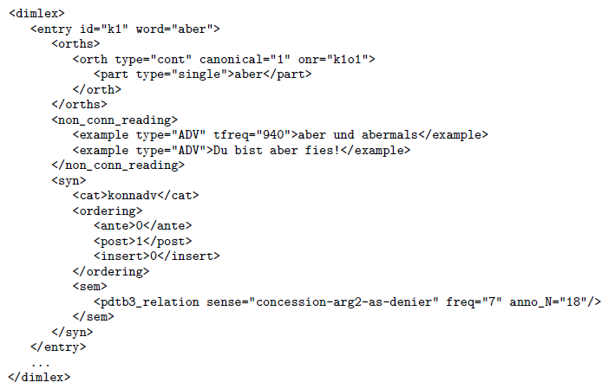
Example: German DimLex
Format: DimLex-XML
Notes:
Most other formats required extensive preprocessing, we generally converted via DimLex-XML

Slide 21
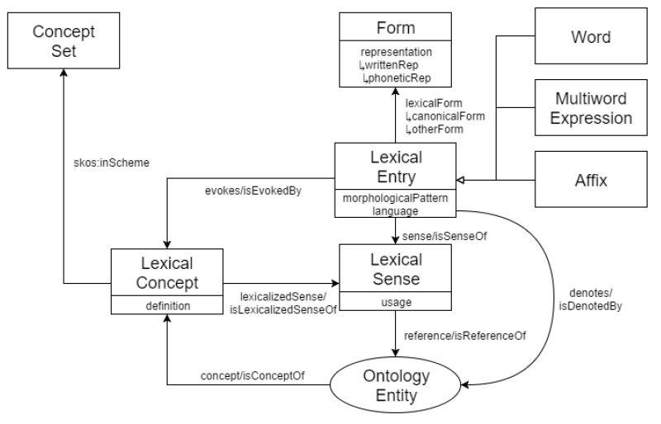

Example: German DimLex
Format: DimLex-XML $⇒_{XSLT}$ OntoLex
Notes:
Most other formats required extensive preprocessing, we generally converted via DimLex-XML

Slide 22

Example: German DimLex
Format: DimLex-XML $⇒_{XSLT}$ OntoLex + custom properties
(namespace dimlex:)
custom properties
correspond 1:1 to
DimLex elements
and attributes
different dialects
represented in a
lossless fashion
Notes:
Most other formats required extensive preprocessing, we generally converted via DimLex-XML

Slide 23
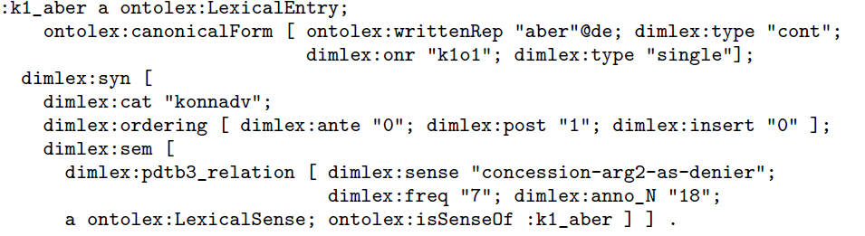

Example: German DimLex
$$_{XSLT}$$
Full DimLex-RDF
OntoLex concepts
original structure
lossless encoding
Notes:
Most other formats required extensive preprocessing, we generally converted via DimLex-XML

Slide 24
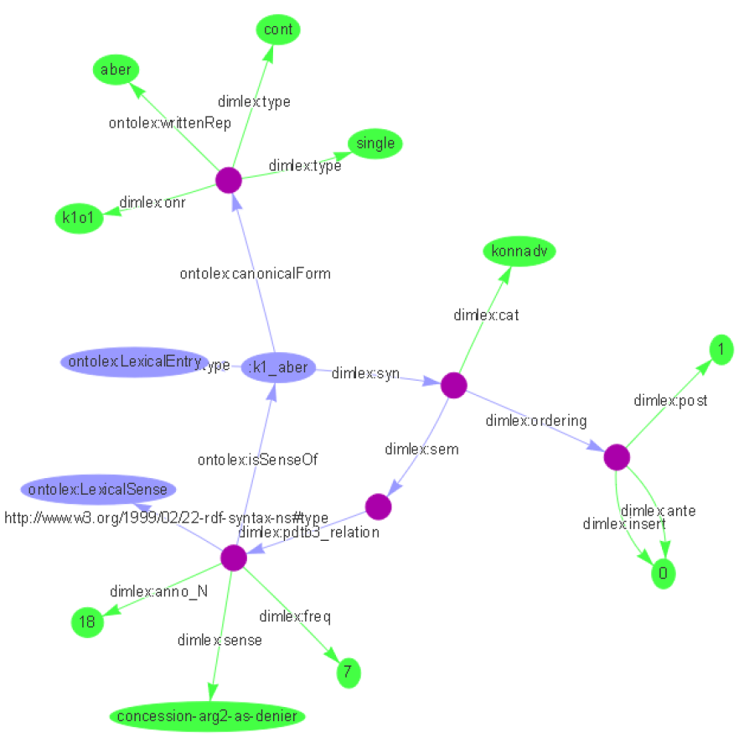
Example: German DimLex
Full DimLex-RDF
OntoLex concepts
original structure
lossless encoding

Slide 25
Other Discourse Marker Inventories
most inventories required massive restructuring
4 data sets conformant with DimLex DTD
3 data sets with modified DimLex markup
e.g., translated element and attribute names (French)
4 data sets in semistructured formats (DiscMar, PDTB)
2 data sets (TED-MDB, Czech) with different formats
separate preprocessor scripts normalize to DimLex-XML; then, regular conversion

Slide 26
Linking

Slide 27
Ontologies of Linguistic Annotation (OLiA)
http://purl.org/olia
Chiarcos and Sukhareva (2015)
one ontology per annotation schema
OLiA Annotation Model
one ontology that defines common terminology
OLiA Reference Model
one RDF file with rdfs:subClassOf statements
OLiA Linking Model: Annotation Model => Reference Model

Slide 28
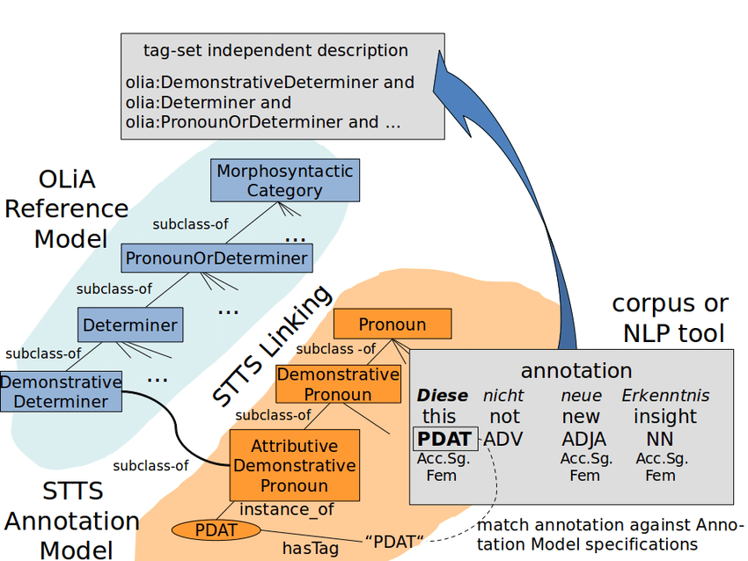
Ontologies of Linguistic Annotation (OLiA)
http://purl.org/olia
German POS

Slide 29
Ontologies of Linguistic Annotation (OLiA)
http://purl.org/olia
German POS
other schemas
are linked, too
we can map or
merge

Slide 30
Ontologies of Linguistic Annotation (OLiA)
http://purl.org/olia
annotation schemas for 100+ languages
morphosyntax
parts of speech
inflectional morphology
syntax
node labels
grammatical relations / dependency labels
aspects of semantics

Slide 31
OLiA Discourse Extensions
http://purl.org/olia/discourse
Chiarcos (2014)
reference model fragment for
anaphora
information status
information structure
discourse relations
discourse structure
annotation models, e.g., PDTB, RST-DTB, PDGB, Knott

Slide 32
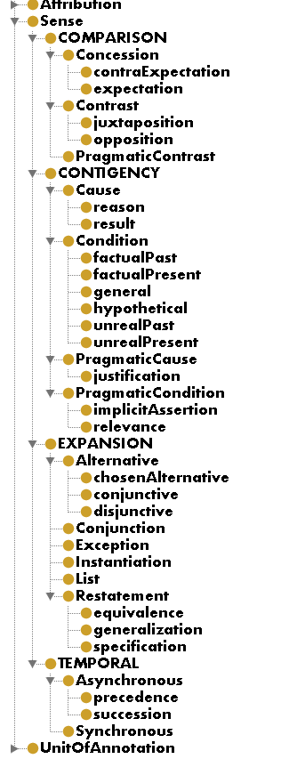
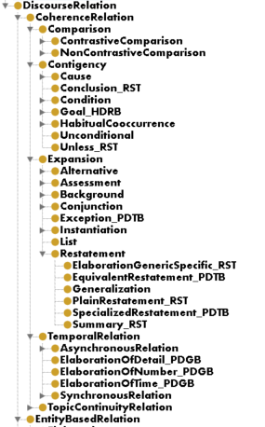
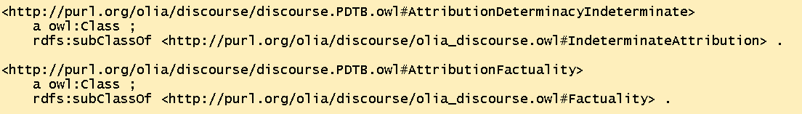
OLiA discourse relations
PDTB
ontology
Reference
Model
(fragment)
top-level structure based on PDTB
enriched to cover RST, RST-DTB, PDGB, LUNA, HDRB, CCR, ISO SemAF Core DRs
PDTB
linking model

Slide 33
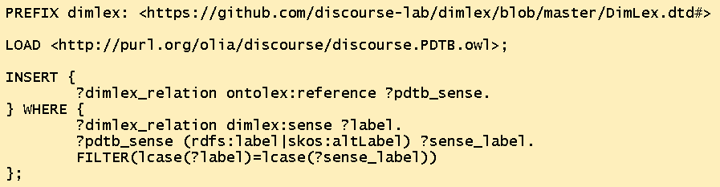
Linking
Just use one trivial SPARQL Update

Slide 34
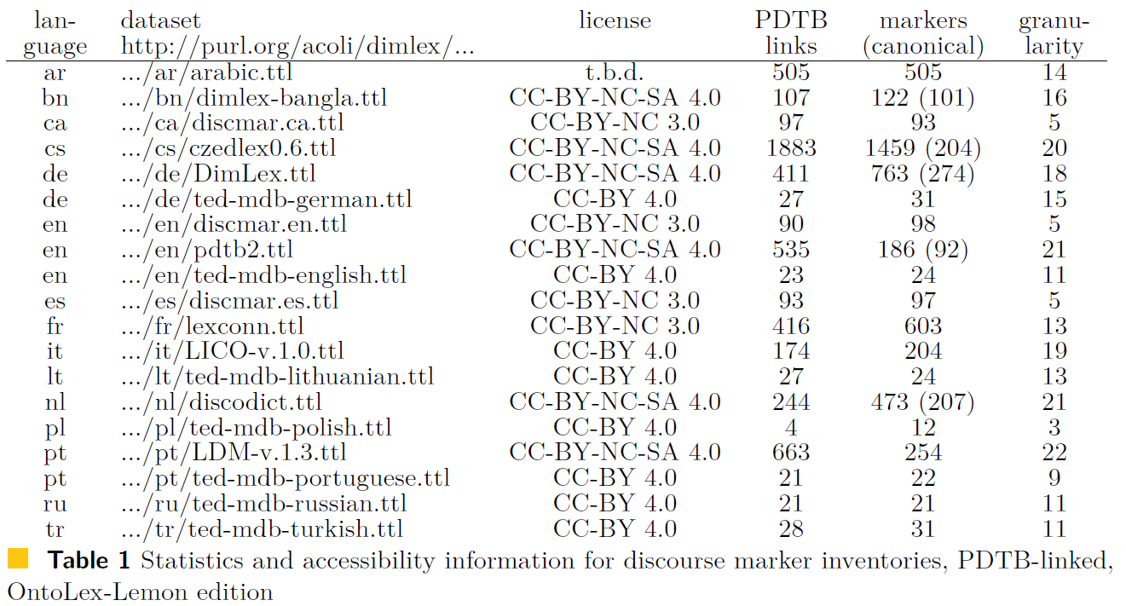
Conversion results

Slide 35
Querying
discourse marker → PDTB concept → discourse marker
from a given discourse marker, retrieve PDTB-equivalent discourse markers (e.g., in another language)

Slide 36
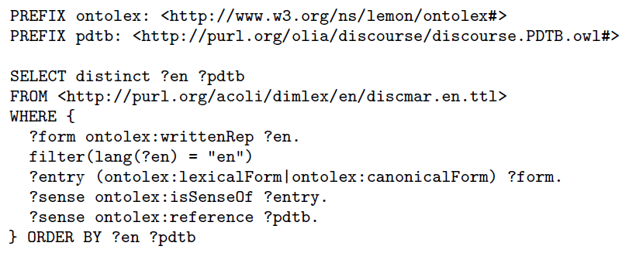
Query: Relations for English DiscMar markers

Slide 37
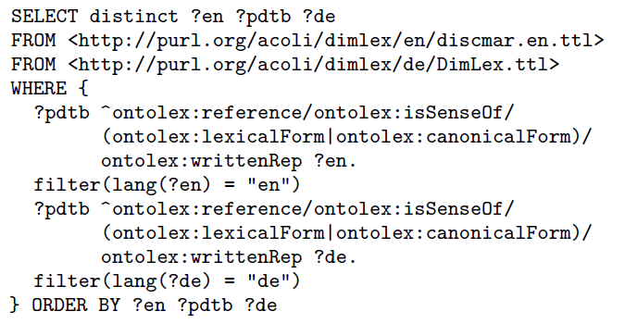
Query: Translate Discourse Markers
English DiscMar
German DimLex

Slide 38
Query: Granularity Differences
DiscMar and German DimLex have limited 1:1 correspondences wrt. discourse relations
English DiscMar: 5 discourse relations
German DimLex: 18 discourse relations
=> extend the search to PDTB subclasses

Slide 39
Querying
discourse marker → PDTB ontology → discourse marker
use the PDTB ontology for imprecise matches, i.e., more general/more specific senses

Slide 40
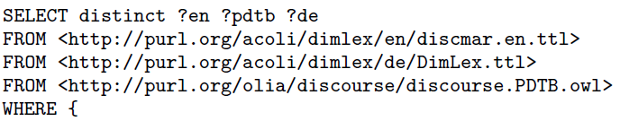
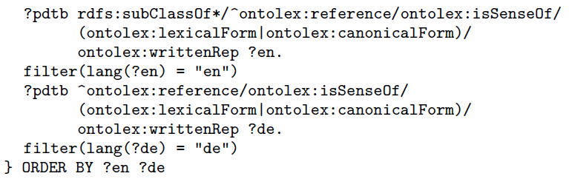
Query: Translate with Subsumption Inference
everything else stays as is

Slide 41
Query with Subsumption Inference
Analoguously, we can extend the query to retrieve results wrt. other discourse theories and frameworks

Slide 42
Querying
discourse marker → PDTB ontology → OLiA → other schemas
use the OLiA Discourse Extensions to retrieve RST (rather than PDTB) relations (etc.)

Slide 43
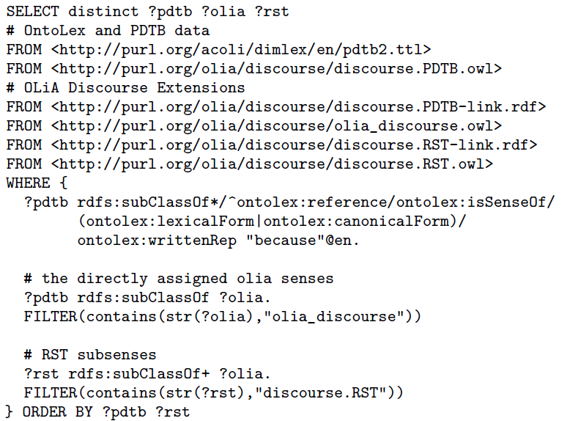
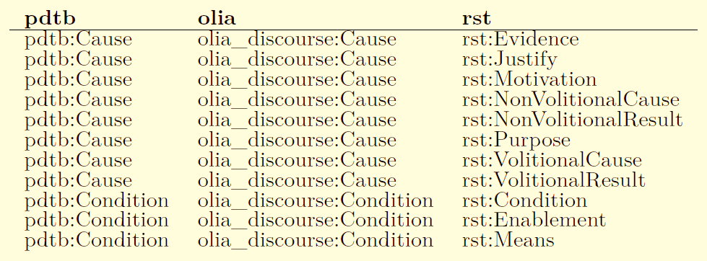
Query: Return (possible) RST relations for English discourse markers
Going through the details is left as an excercise ;)

Slide 44
Summary

Slide 45
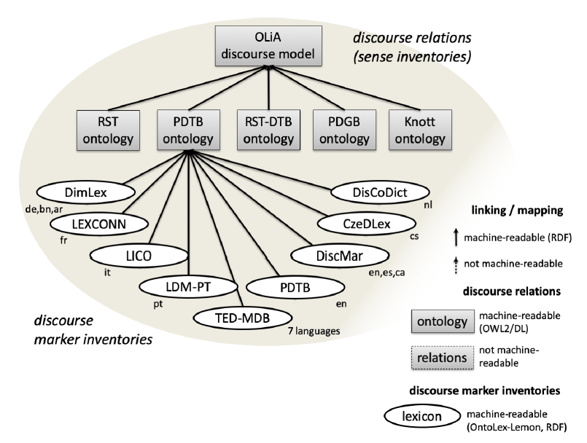
Linking and querying discourse marker inventories
Related research
http://connective-lex.info/
outcome of TextLink
designed for human consumption
no machine-readable semantics
based on structured XML data
PDTB senses only
no crosslingual integration
https://github.com/acoli-repo/rdf4discourse

Slide 46
Linking and querying discourse marker inventories
Thank you for your attention!
https://github.com/acoli-repo/rdf4discourse

