Slide 1
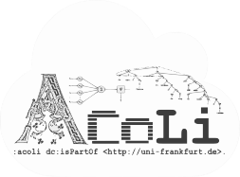
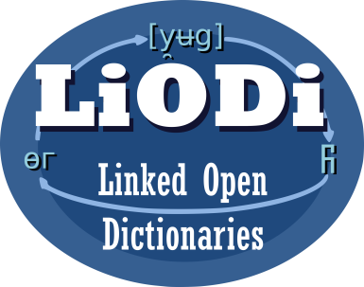

Linking Discourse Marker Inventories
LDK-2021, Zaragoza, Spain, Sep 2, 2021
Christian Chiarcos & Max Ionov
Applied Computational Linguistics (ACoLi)
chiarcos@informatik.uni-frankfurt.de
Notes:
30 min incl. disc.

Slide 2
Discourse Markers
Make explicit how an utterance (clause, sentence, etc.) is linked to its discourse context
lexical expressions, mostly conjunctions, adverbs and PPs; indicate discourse relations (coherence relations)
John can‘t go. ...
And Mary can‘t go either.
Therefore, Mary can‘t go either.
However, Mary can‘t go either.
Mary can‘t go either.
additive
causal
relation
contrastive
implicit
(unmarked)

Slide 3
Discourse Marker Inventories
For a considerable number of languages, discourse marker inventories have been developed
to facilitate discourse parsing and downstream tasks
map discourse markers to (possible) functions
Different formats, different theories
Our contribution: consolidation and integration

Slide 4
Goals: Consolidation and Integration
across languages
link discourse relation inventories
across theoretical frameworks
RST, PDTB, etc.
across formats
various CSV, XML and special-purpose formats
machine-readable semantics

Slide 5
Related Research: Across Languages
TextLink
Cost Action Structuring Discourse in Multilingual Europe (2014-2018)
multilingual discourse marker inventories
(mostly) providing PDTB relations as senses
(partially) following a consistent XML format (DimLex, Stede & Umbach 1998)
http://connective-lex.info/
Notes:
https://www.cost.eu/actions/IS1312/

Slide 6
Beyond TextLink: We Aim to Improve
coverage
extend the range of languages and resources
semantics
provide machine-readable semantics
preserve the original sense definitions
usability
enable cross-framework comparison and search
link and query across languages

Slide 7
Beyond TextLink
An OntoLex edition of TextLink and other discourse marker inventories
Maintain original sense
definitions (discourse relations)
Link these with an overarching
ontology (reference model)
Ground the reference model in
SemAF and CCR (cross-theory generalizations)

Slide 8
Beyond TextLink
An OntoLex edition of TextLink and other discourse marker inventories
Maintain original sense
definitions (discourse relations)
Link these with an overarching
ontology (reference model)
Ground the reference model in
SemAF and CCR
OLiA Discourse
Extensions
(Chiarcos 2014)

Slide 9
Conversion
From discourse marker inventories to OntoLex

Slide 10
Conversion
11+ languages
7 formats
4 frameworks
DimLex German, Arabic, Bangla DimLex-XML PDTB 3.0
DisCoDict Dutch DimLex-XML PDTB 3.0
PDTB English PDTB/PDF PDTB 2.0
LICO Italian mod. DimLex PDTB 2.0/3.0
LDM-PT Portuguese mod. DimLex PDTB 3.0
LexConn French mod. DimLex SDRT
CzeDLex Czech PML-XML PDiT 2.0
DiscMar English, Spanish, Catalan TSV/HTML DiscMar
TED-MDB 7 languages* PDTB format PDTB 3.0
* corpus extracts, low coverage, extendable to Hindi and Chinese

Slide 11
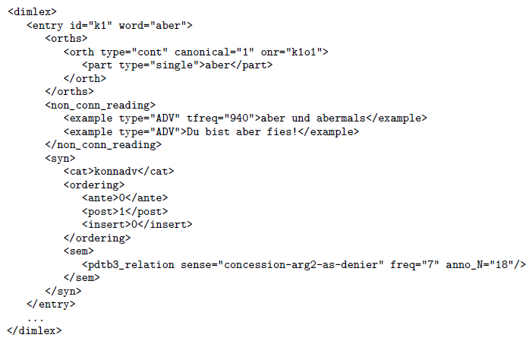
Example: German DimLex
DimLex-XML excerpt
Stede & Umbach 1998
PDTB relations as senses Scheffler & Stede (2016)
CC-BY-NC-SA 4.0
https://github.com/discourse-lab/dimlex
Notes:
Most other formats required extensive preprocessing, we generally converted via DimLex-XML

Slide 12
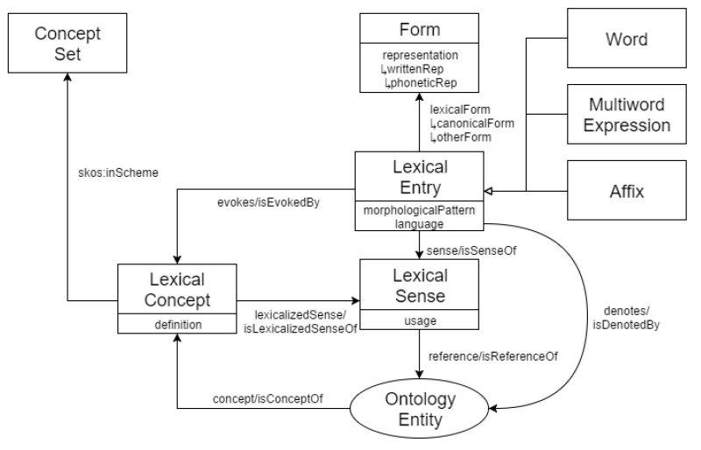

Example: German DimLex
DimLex-XML $⇒_{XSLT}$ OntoLex
Notes:
Most other formats required extensive preprocessing, we generally converted via DimLex-XML

Slide 13

Example: German DimLex
DimLex-XML $⇒_{XSLT}$ OntoLex + custom properties
(namespace dimlex:)
custom properties
correspond 1:1 to
DimLex elements
and attributes
different dialects
represented in a
lossless fashion
Notes:
Most other formats required extensive preprocessing, we generally converted via DimLex-XML

Slide 14
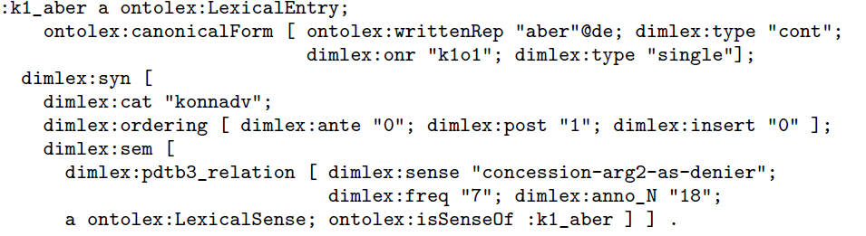

Example: German DimLex
$$_{XSLT}$$
DimLex-RDF
OntoLex concepts
original structure
lossless encoding
Notes:
Most other formats required extensive preprocessing, we generally converted via DimLex-XML

Slide 15
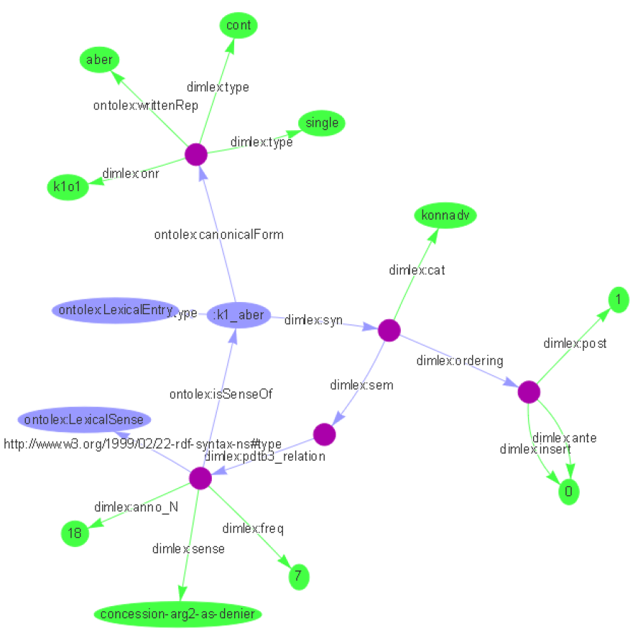
Example: German DimLex
DimLex-RDF
OntoLex concepts
original structure
lossless encoding

Slide 16
Other Discourse Marker Inventories
most inventories required massive restructuring
4 data sets conformant with DimLex DTD
3 data sets with modified DimLex markup
e.g., translated element and attribute names (French)
4 data sets in semistructured formats (DiscMar, PDTB)
2 data sets (TED-MDB, Czech) with different formats
separate preprocessor scripts normalize to DimLex-XML; then, regular conversion

Slide 17
Linking

Slide 18
Ontologies of Linguistic Annotation (OLiA)
http://purl.org/olia
Chiarcos and Sukhareva (2015): syntax, morphosyntax
one ontology per annotation schema
OLiA Annotation Model
one ontology that defines common terminology
OLiA Reference Model
one RDF file with rdfs:subClassOf statements
OLiA Linking Model: Annotation Model => Reference Model

Slide 19
OLiA Discourse Extensions
http://purl.org/olia/discourse
Chiarcos (2014): Reference Model for Discourse
anaphora
information status
information structure
discourse relations
discourse structure
annotation models, e.g., PDTB, RST-DTB, PDGB

Slide 20
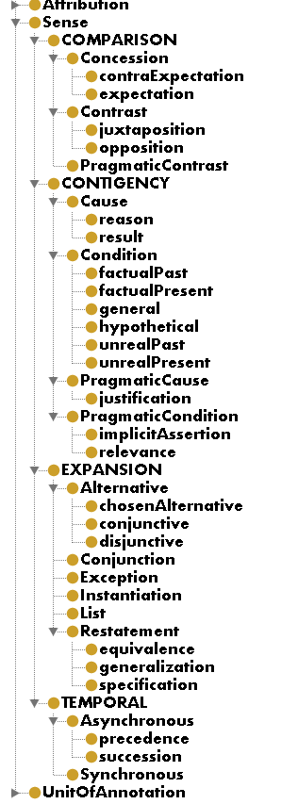
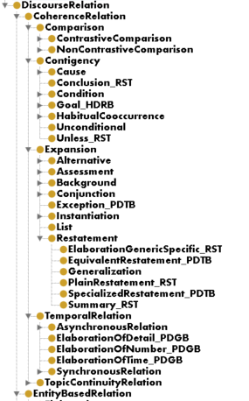
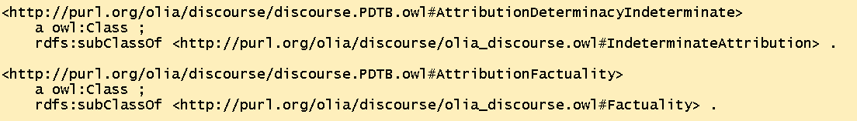
OLiA discourse relations
PDTB
ontology
Reference
Model
(fragment)
top-level structure based on PDTB
enriched to cover RST, RST-DTB, PDGB, LUNA, HDRB, CCR, ISO SemAF Core DRs
PDTB
linking model

Slide 21
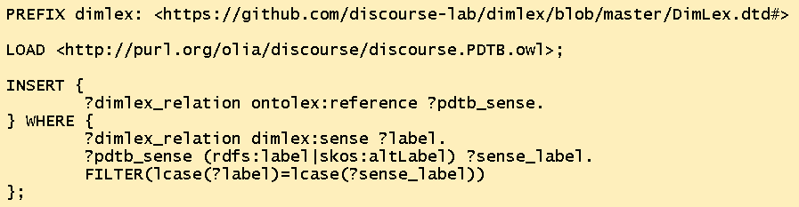
Linking
Just use one trivial SPARQL Update

Slide 22
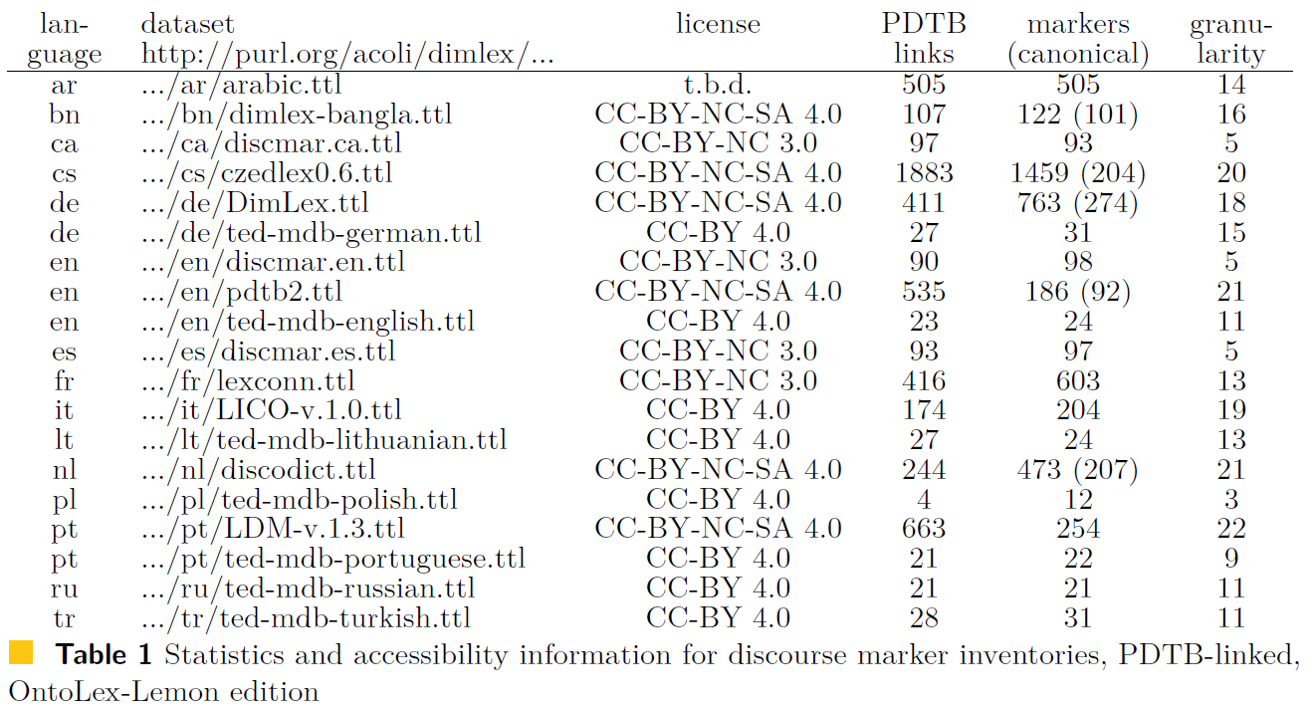
Conversion results

Slide 23
Querying
discourse marker → PDTB concept → discourse marker
from a given discourse marker, retrieve PDTB-equivalent discourse markers (e.g., in another language)

Slide 24
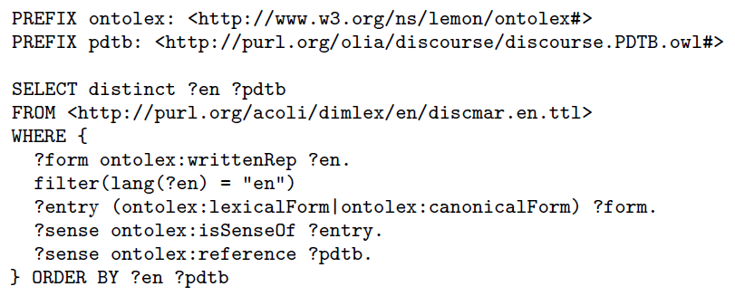
Query: Relations for English DiscMar markers

Slide 25
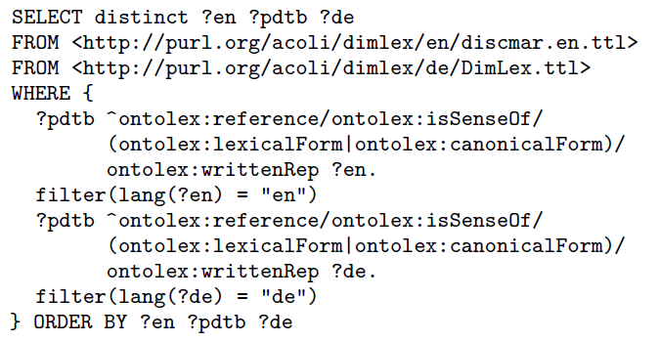
Query: Translate Discourse Markers
English DiscMar
German DimLex

Slide 26
Query: Granularity Differences
DiscMar and German DimLex have limited 1:1 correspondences wrt. discourse relations
English DiscMar: 5 discourse relations
German DimLex: 18 discourse relations
=> extend the search to PDTB subclasses

Slide 27
Querying
discourse marker → PDTB ontology → discourse marker
use the PDTB ontology for imprecise matches, i.e., more general/more specific senses

Slide 28
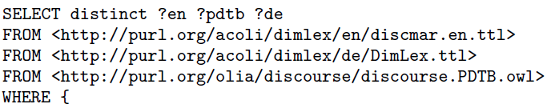
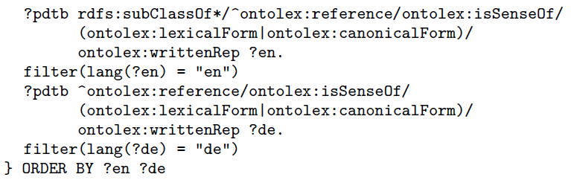
Query: Translate with Subsumption Inference
everything else stays as is

Slide 29
Query with Subsumption Inference
Analoguously, we can extend the query to retrieve results wrt. other discourse theories and frameworks

Slide 30
Querying
discourse marker → PDTB ontology → OLiA → other schemas
use the OLiA Discourse Extensions to retrieve RST (rather than PDTB) relations (etc.)

Slide 31
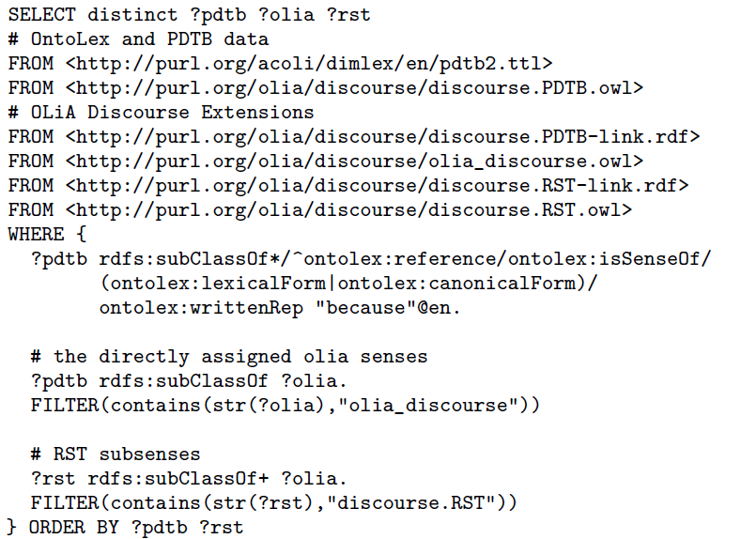
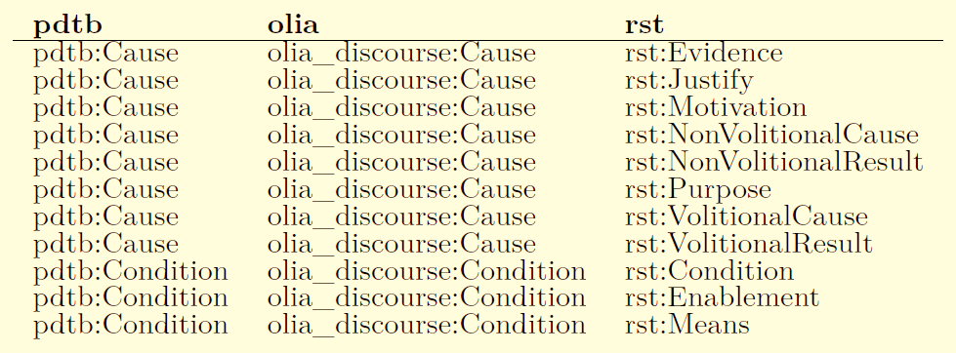
Query: Return (possible) RST relations for English discourse markers
Going through the details is left as an excercise ;)

Slide 32
Summary

Slide 33
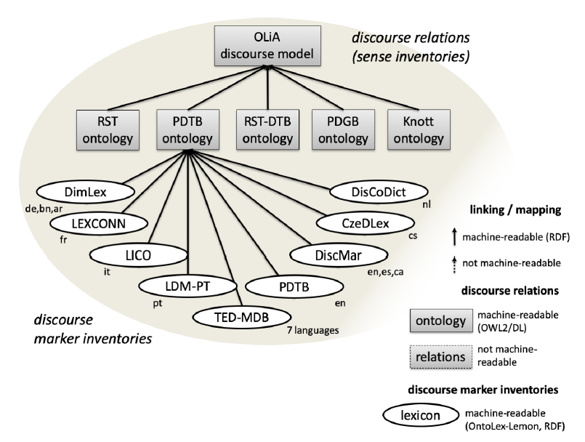
Linking and querying discourse marker inventories
Related research
http://connective-lex.info/
outcome of TextLink
designed for human consumption
no machine-readable semantics
based on structured XML data
PDTB senses only
no crosslingual integration
https://github.com/acoli-repo/rdf4discourse

Slide 34
Linking and querying discourse marker inventories
Thank you for your attention!
https://github.com/acoli-repo/rdf4discourse

