Slide 1
Dark Matter Detection
Experimental Quantum Physics, UU 2015
A.P.Colijn, C. Tunnell, A. Brown

Slide 2
Topics
Why Dark Matter? Particle physics hypothesis.
Dark Matter interaction rate
Phonons & Photons & Ionization
Xenon detectors. Workshop @ Nikhef

Slide 3
What to expect
3 x 2 hours lecture
2 x 4 hours exercise session
1 x 4 hours labcourse + exercise
last day @ Nikhef
tour of our DM lab
hands-on XENON data analysis

Slide 4
Week 1: lecture
Astronomical observations pointing to a “problem”
galactic rotation curves
bullet cluster
large scale structures
Particle physics explanation
Axions, MACHO’s, others
WIMPs
The early Universe and thermal freeze-out
Strategy for discovery

Slide 5
Week1: exercises
Exercises
Labcourse: NaI + BGO detectors and radioactive backgrounds

Slide 6
Week 2: lecture
WIMP interaction rate
Rough calculation
Estimate flux
Scattering
Spectrum
WIMP-nucleus cross-section
WIMP-nucleon cross-section

Slide 7
Week 2: lab course
Exercises
Work on report for NaI + BGO labcourse

Slide 8
Week 3
What materials can you use for a detector
Intrinsically suited or not?
High atomic mass
radioactive isotopes?
Photon detectors
Crystals – Luminescence, Scintillation
Phonon detectors
Debye theory – Heat capacity @ low T

Slide 9
Week 3: werkcollege
All knowledge to read state-of-the-art DM papers should now be there
We distribute a set of papers
You study & present. We will have a “public” discussion of the results.

Slide 10
Week 4
Lecture on Noble gas dark matter detectors
Tour of Nikhef – see the institute & DM lab
Workshop on XENON data analysis by Chris

Slide 11
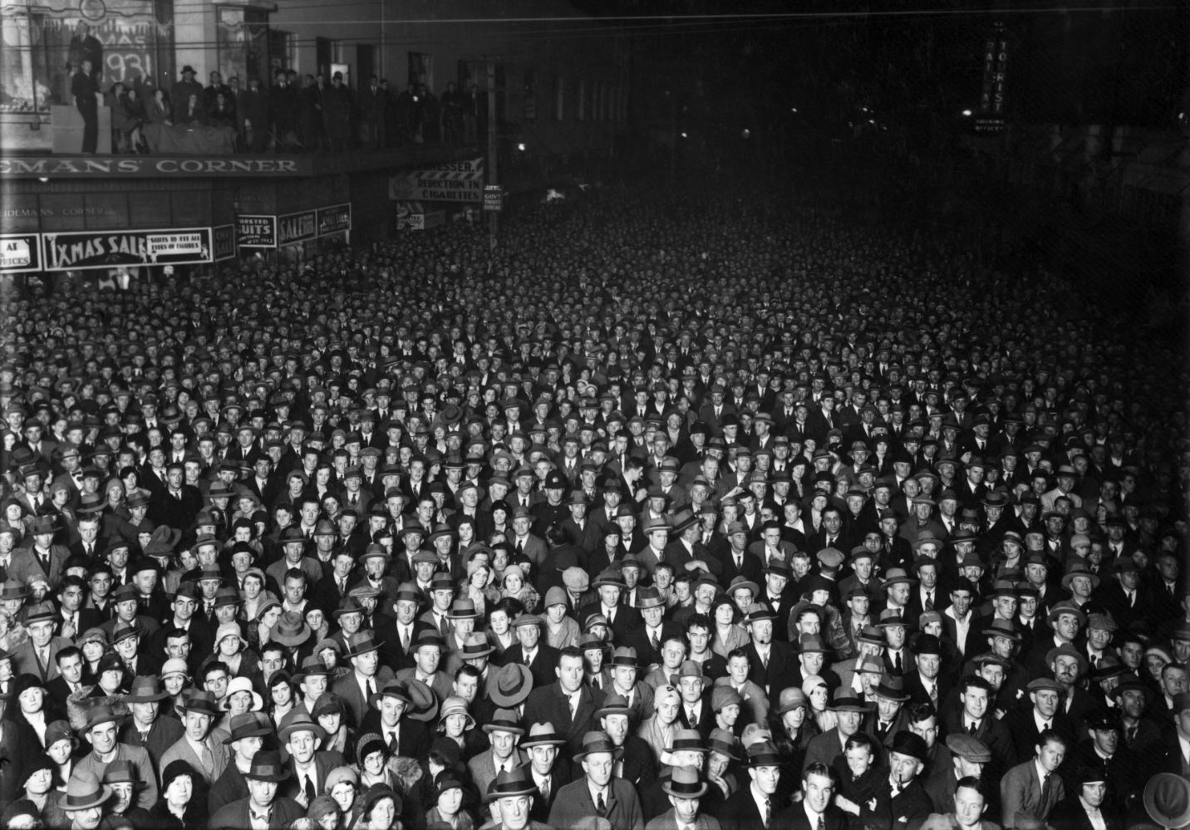

DM zichtbaar?

Slide 12

Liu Bolin
Of onzichtbaar?

Slide 13

Liu Bolin

