Slide 1
Real Estate Investing Options in Texas Metro Areas
Presented by: Austin Collins

Slide 2
Goals for Tom Jones
Diversify investment portfolio with residential real estate
Achieve growth (home values increasing over time)
Find opportunities near existing business

Slide 3
The Data
Zillow
Mean Price of homes, broken down by zipcode
Price Data Since January 2010
Included 587 possible zipcodes
Narrowed Down to 5 Metro Areas:
Dallas – Fort Worth
Austin
Houston
San Antonio
McAllen

Slide 4
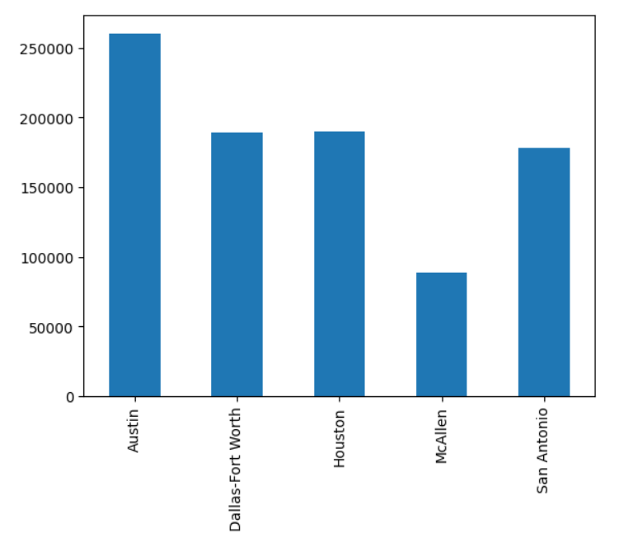
City Living
More expensive areas require more capital concentration
Mean Home Price Since 2013 ($)
Metro

Slide 5
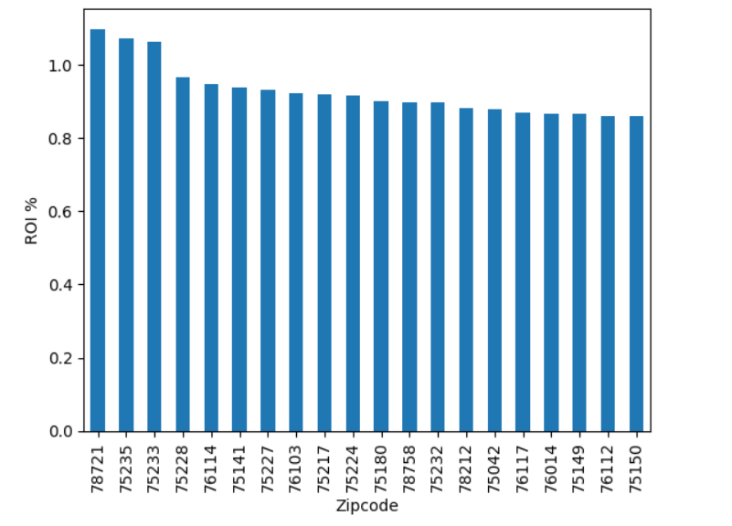
Promising Zipcodes
Where maximum recent growth has occured
We’re seeing real signs of opportunity!
20 Zipcodes with Highest ROI Over the Last 5 Years

Slide 6
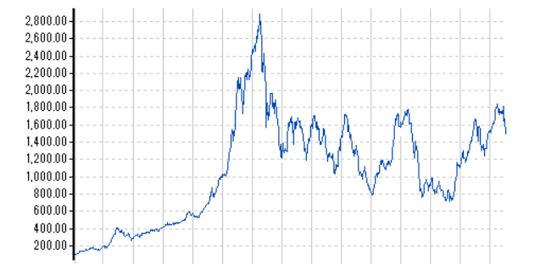
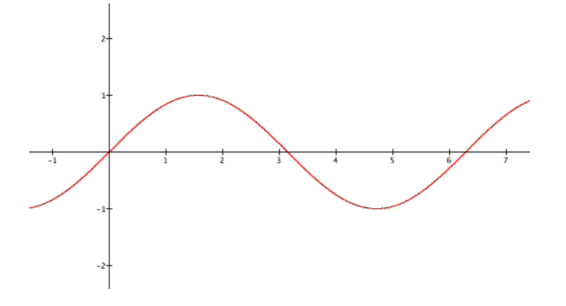
The Model
SARIMA
Seasonal Autoregressive Integrated Moving Average
Forecasts 24 months into the future

Slide 7
The Results – Invest Here!
Dallas – Fort Worth
75141 - Hutchins
75150 - Mesquite
75217 - Dallas
75224 - Dallas
75228 - Garland
75233 - Dallas
76112 - Arlington
76114 – Fort Worth
76117 – North Richland Hills
Austin
78758

Slide 8
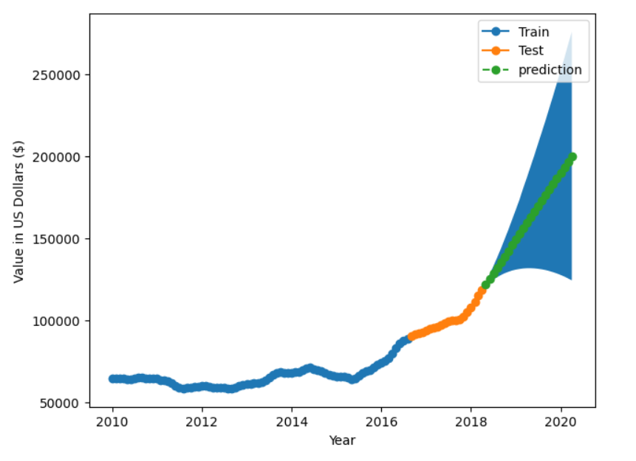
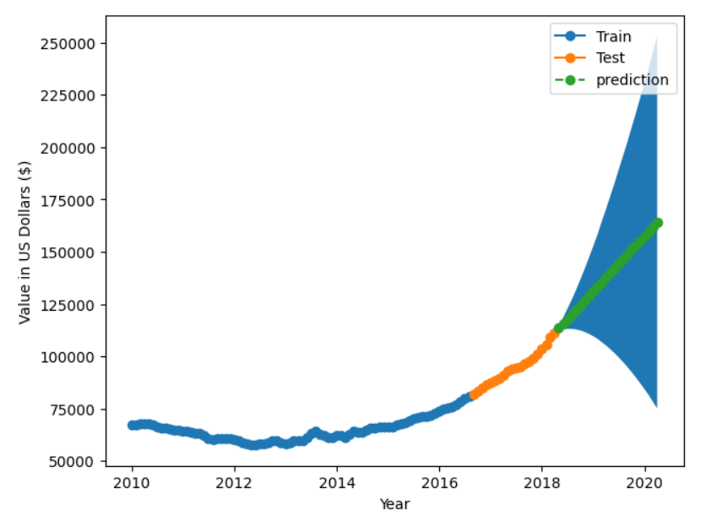
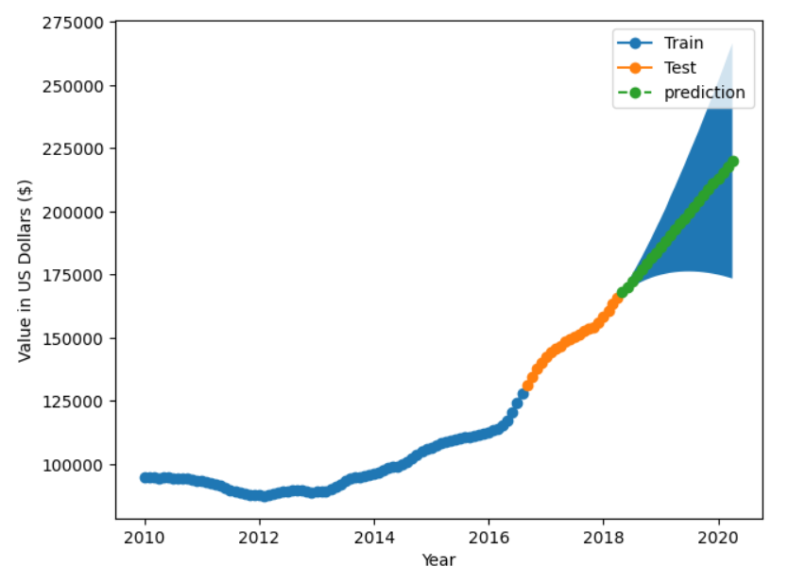
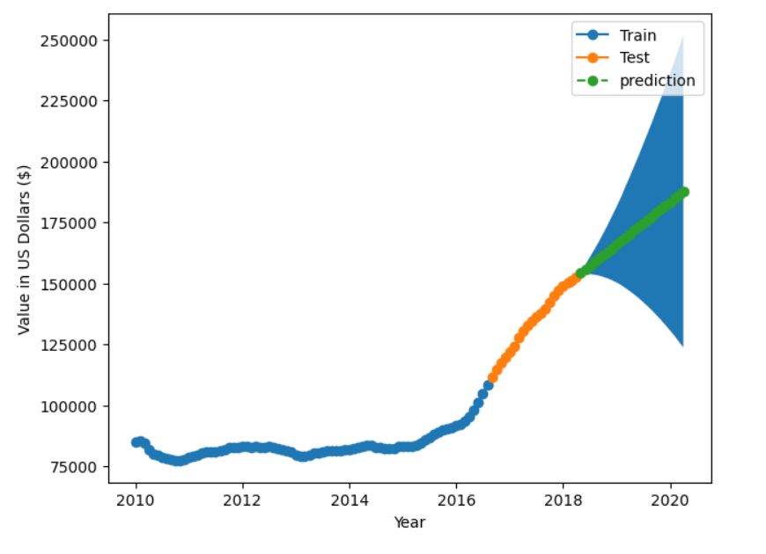
Risk Assessment
75141
75217
*models can be off by 10-50%
75150
75224

Slide 9
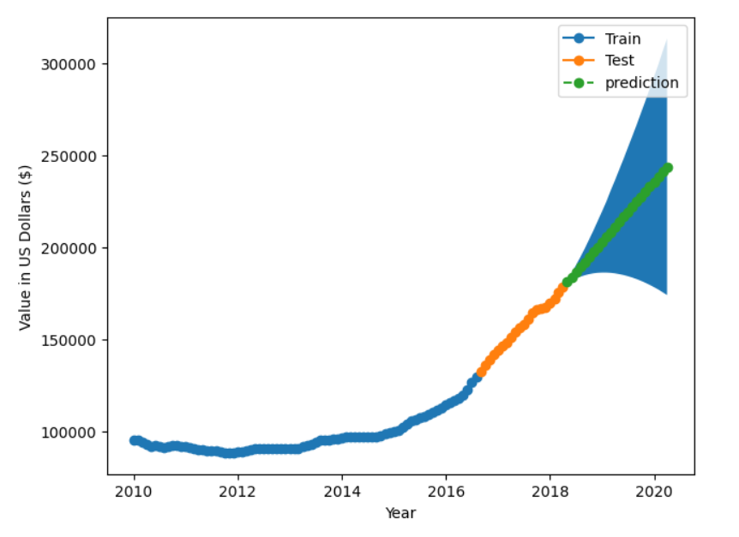
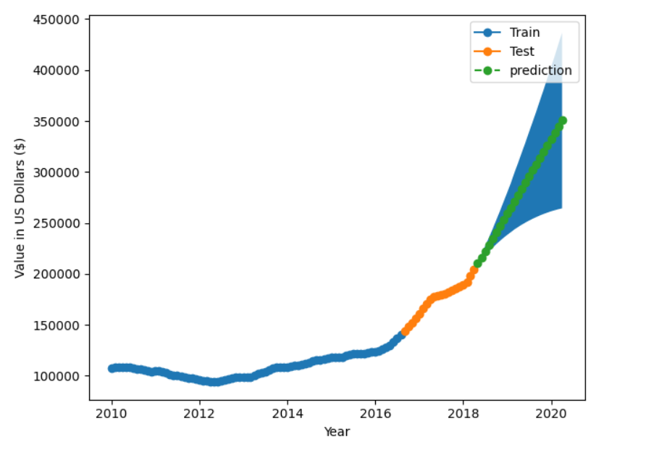
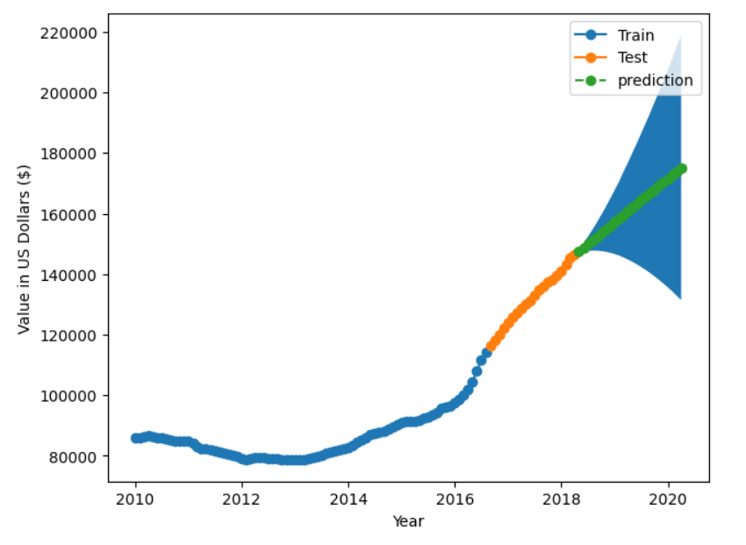
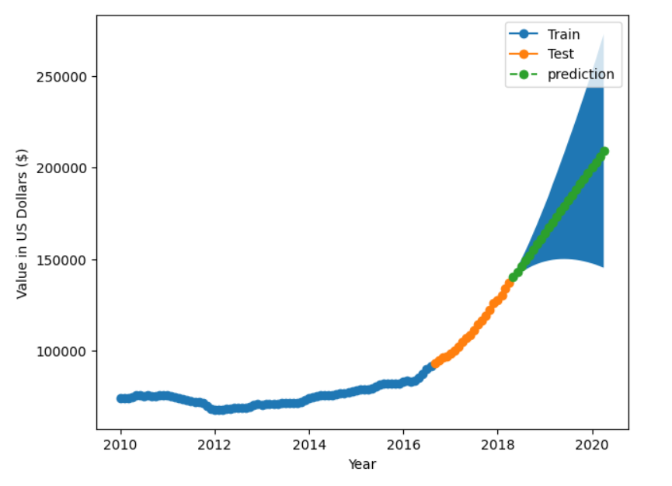
Risk Assessment
75228
75233
*models can be off by 10-50%
76112
76114

Slide 10
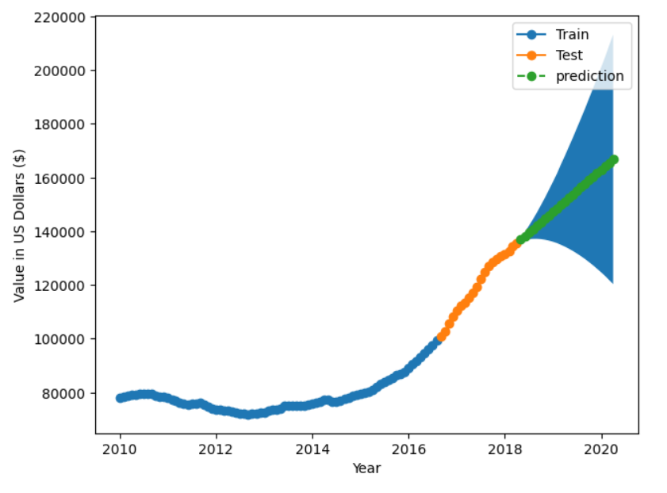
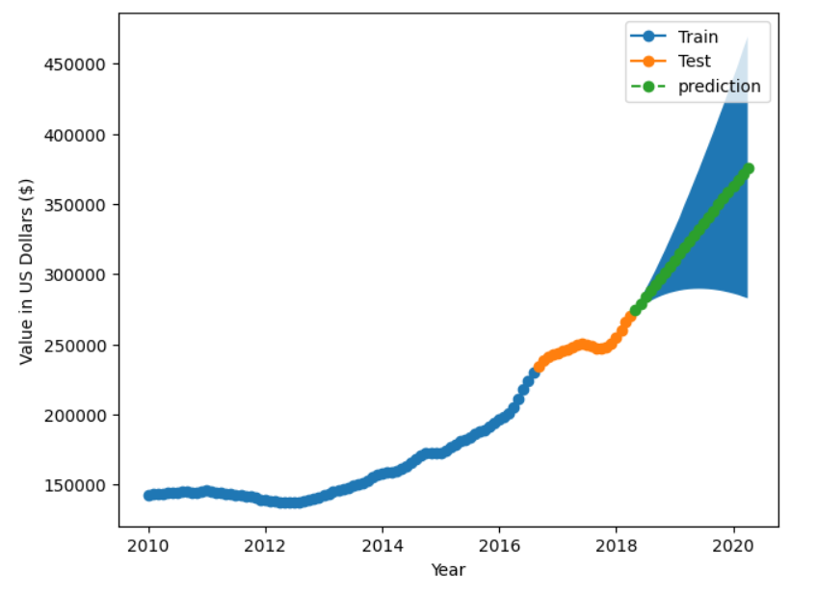
Risk Assessment
76117
78758
*models can be off by 10-50%

Slide 11
Key Takeaways
Most opportunity is in DFW
Invest in the 10 zipcodes outlined above
More expensive areas require more capital concentration
Downside risk can be mitigated by rental income and renovations

Slide 12
Thank you!
austincollins767@gmail.com

