Slide 1
Real Estate Investing Options in Texas Metro Areas
Presented by: Austin Collins

Slide 2
The Goal
Diversify investing portfolio
Achieve growth
Be close to existing business

Slide 3
The Data
Zillow
Mean Home Price per Zipcode
Price Data Since January 2010
Narrowed Down to 5 Metro Areas:
Dallas – Fort Worth
Austin
Houston
San Antonio
McAllen

Slide 4
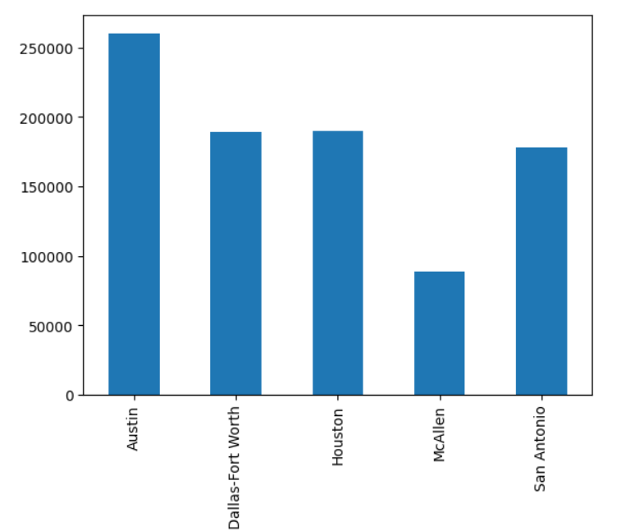
City Living
Mean Home Price Since 2013 ($)
Metro

Slide 5
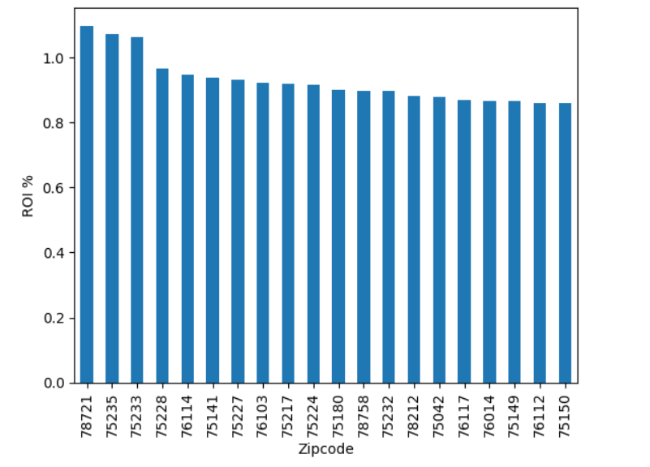
Promising Zipcodes
20 Zipcodes with Highest ROI Over the Last 5 Years

Slide 6
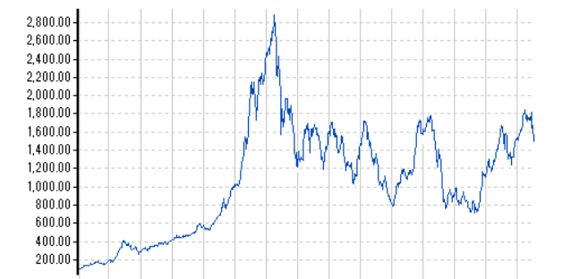
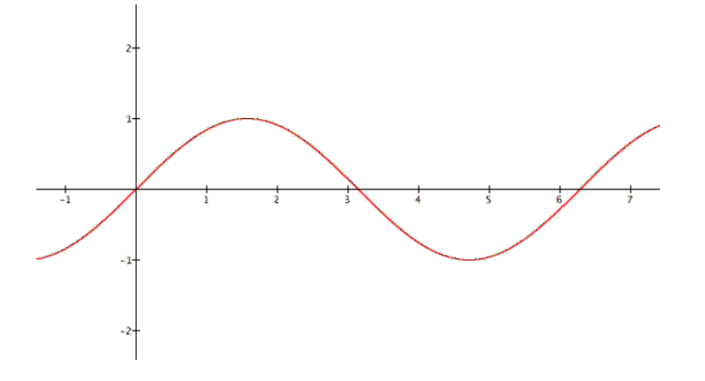
The Model
SARIMA
Seasonal Autoregressive Integrated Moving Average
Forecasts 24 months into the future

Slide 7
The Results
Dallas – Fort Worth
75141 - Hutchins
75150 - Mesquite
75217 - Dallas
75224 - Dallas
75228 - Garland
75233 - Dallas
76112 - Arlington
76114 – Fort Worth
76117 – North Richland Hills
Austin
78758

Slide 8
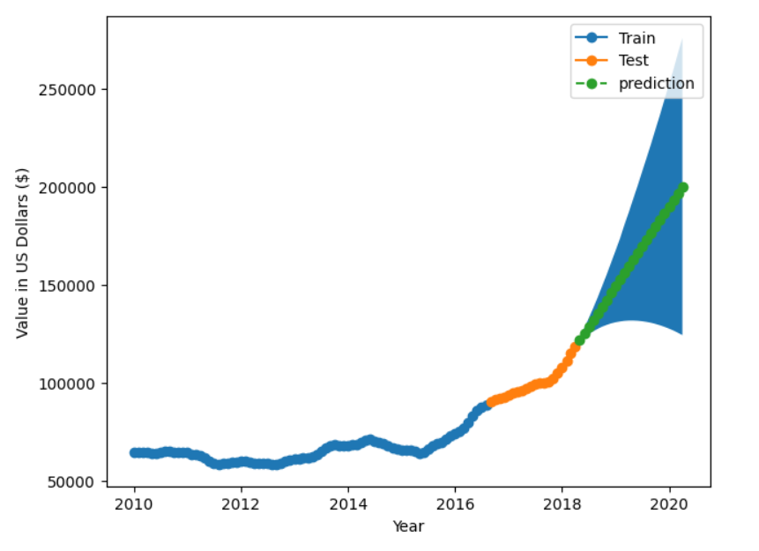
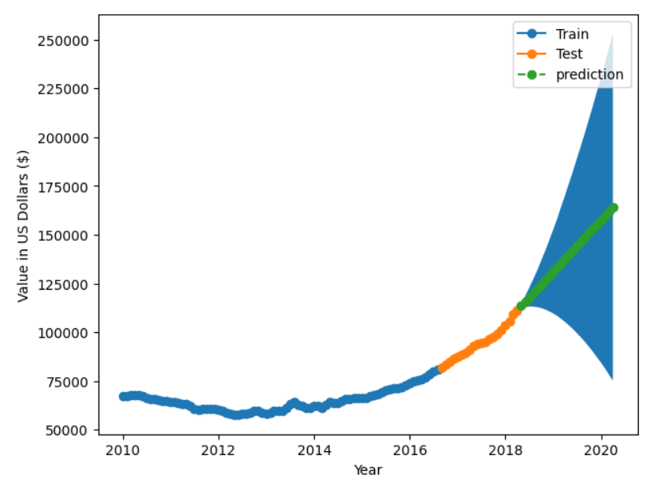
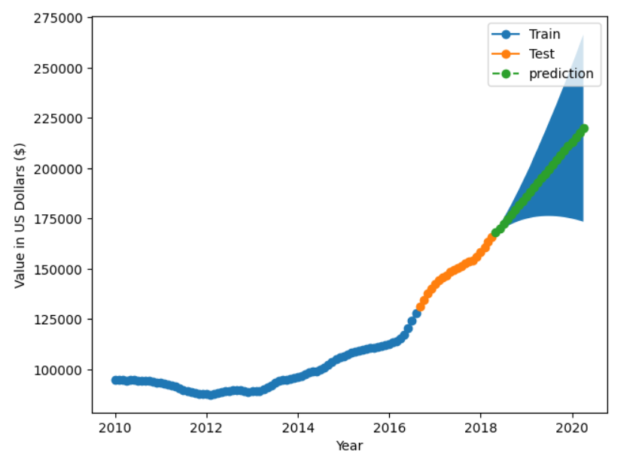
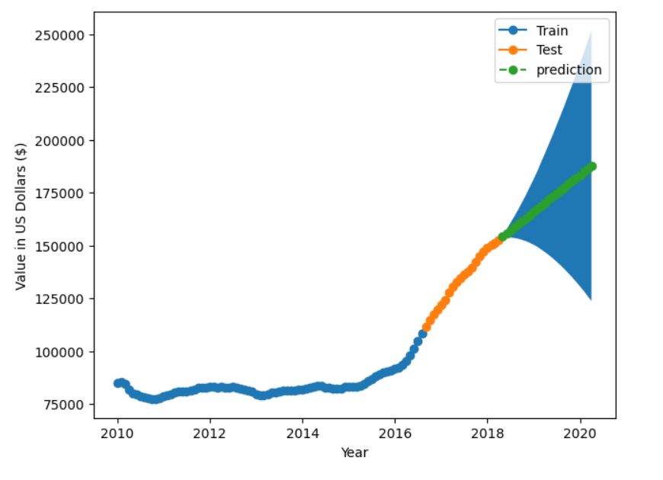
Risk Assessment
75141
75217
75150
75224

Slide 9
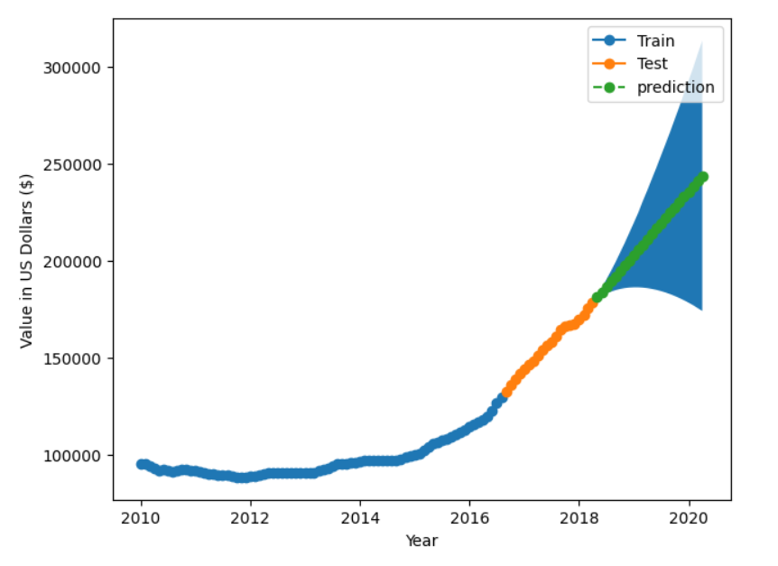
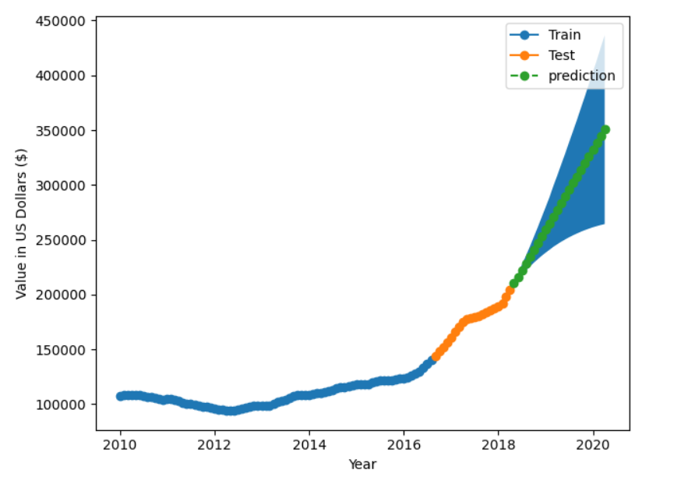
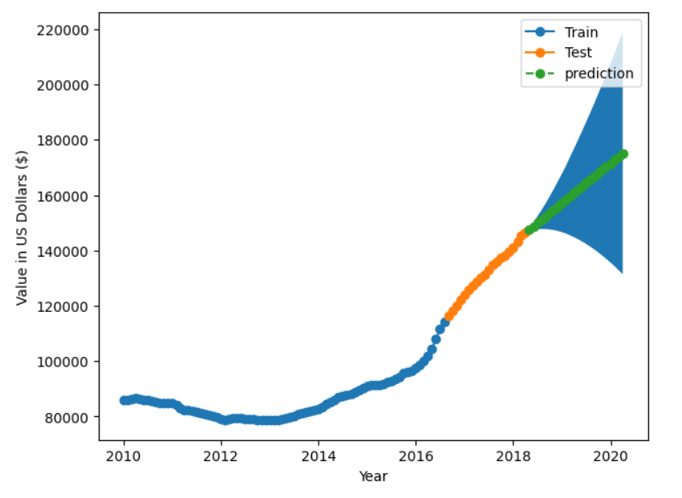
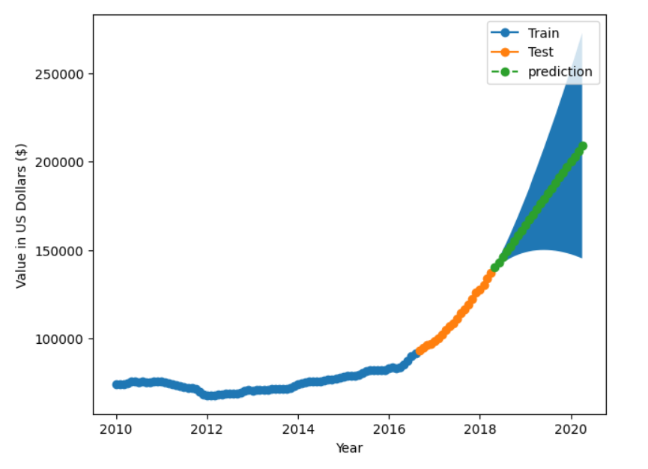
Risk Assessment
75228
75233
76112
76114

Slide 10
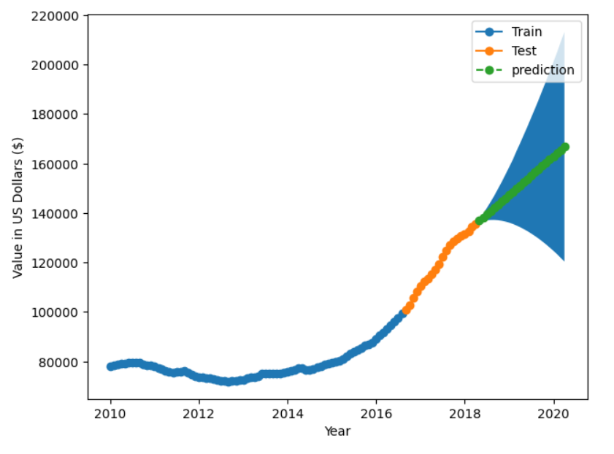
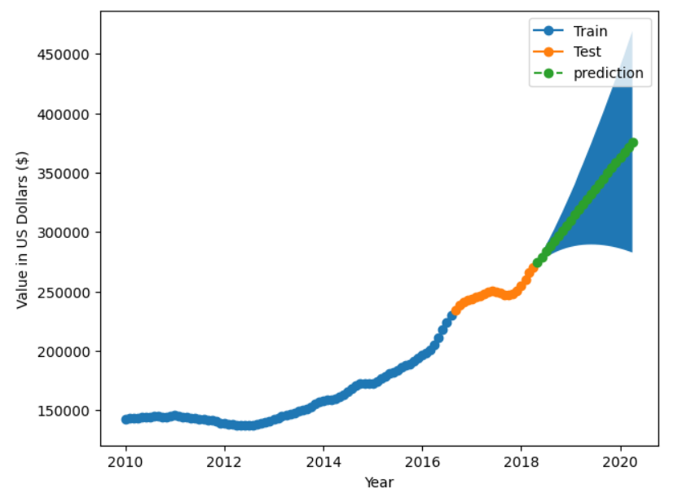
Risk Assessment
76117
78758

