Slide 1

Optimizing Truist Bank’s Term Deposits Marketing Campaign
Presented by: Austin Collins

Slide 2
Background
Promoting term deposit accounts to existing customers
Term Deposits are similar to CDs and HYSAs
Calling with account offers
Subscription rate is lower than expected
Stakeholders:
Director of Marketing
Truist Sales Team

Slide 3
Our Goals
Use existing marketing data to predict subscription outcomes
Determine what’s driving subscription outcomes
Alter targeting/approach to optimize for those factors

Slide 4
The Data
Over 45,000 existing customers Truist has marketed to
11.7% subscribed
Demographic Information
Age, Education, Marital Status, etc.
Account Information
Account balance, personal loans, home loans, credit default
Marketing Information
Length of calls, when we call them, frequency of calls, etc.

Slide 5
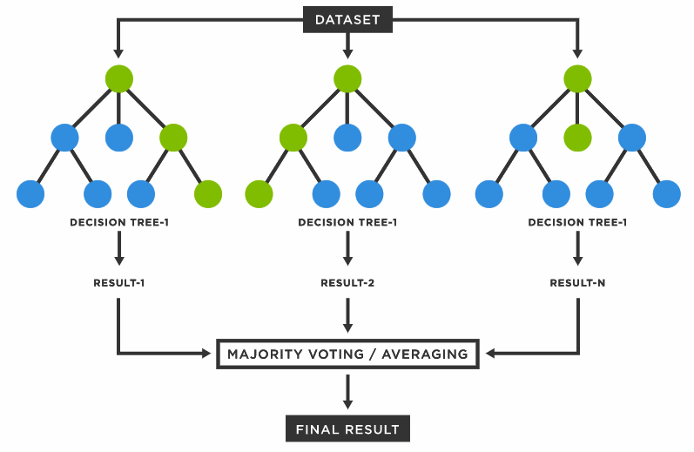
The Model
Random Forest
Aggregated Decision Trees

Slide 6
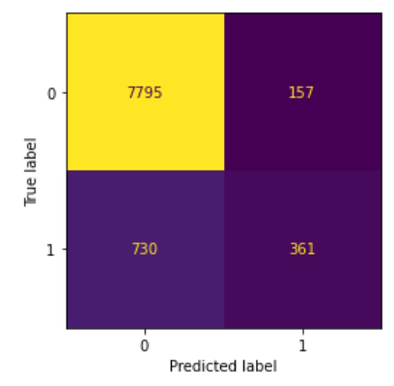
The Model
Conservative predictions
90.2% accuracy
Test outcomes ->

Slide 7
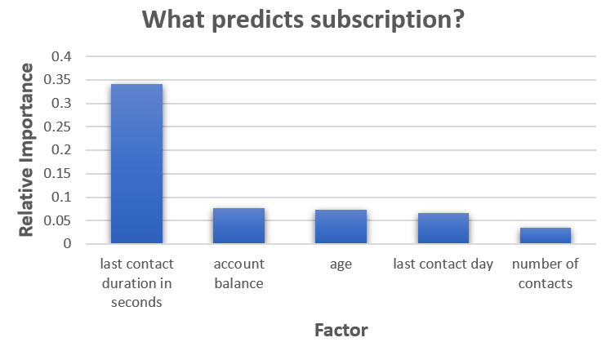
The Results
These are the factors that best predict subscription
Positive correlation with call duration

Slide 8
Action Items
Take your time with the calls
Introductions, Screener Questions, Scripts
> 7.1 minutes
Target customers with higher existing balances
> $1,800
Target customers who are older
38 or older
Call more frequently

Slide 9
Thank you!
Email me for follow-up questions
austincollins767@gmail.com

