Slide 1

Helping Homeowners Increase Home Value
Austin Collins
July 12, 2022

Slide 2
Summary
Goal: Give real estate agents (you) advice to pass on to homeowners to increase home value
The Data
The Model
The Factors
What owners can do

Slide 3
The Data
21, 597 homes in King County, Oregon
Sold in 2014-2015
Included information about size, bedrooms and bathrooms, quality of materials, sales comparable, view, etc.

Slide 4
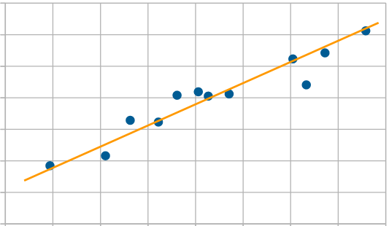
The Model
Ordinary Least Squares regression
Included 12 factors
Ruled out unreliable/confounding variables
Explained 70% of the variance

Slide 5
The Factors
Positive
Grade
Livable Area (Bedrooms x bathrooms x living sq. ft.)
Latitude
Waterfront
Living sq. ft. of 15 nearest homes
View
Condition
Year renovated
Sq. ft. of lot
Negative
Year built
Longitude
Lot size of 15 nearest homes

Slide 6
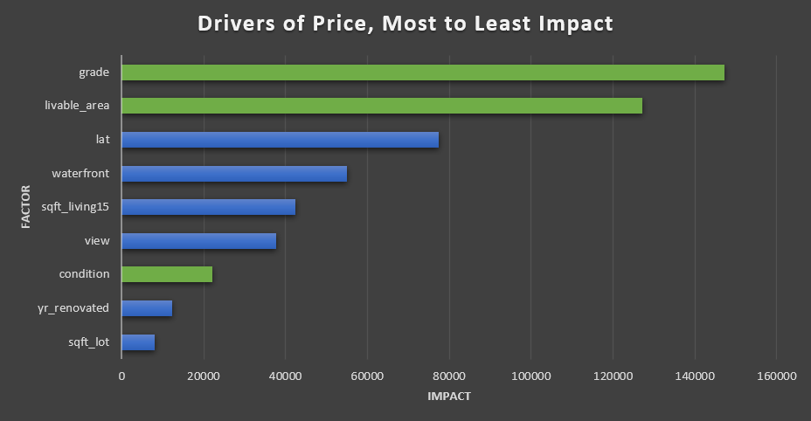

Slide 7
What Owners Can Do
Improve grade
Wood finishes, new tile, updated plumbing, countertops, insulation
Can also impact “year renovated” factor
Add livable square footage
Add a bedroom, bathroom, enclose a patio*
Improve condition
Clean the house, fix small repairs, touch up paint

Slide 8
Questions?

