Slide 1

Risk in a human life, counted in hours
80 years = 80 × 365.25 × 24 ≈ 701 000 hours (≈ 7 × 10⁵ h)
Sleep 33 %
Work 10 %
Home, leisure, sport, care … 50 %
Travel 5 %, study 2 %: indicative shares of a European life
Average mortality ≈ 10⁻⁶ /h → 7 × 10⁵ h × 10⁻⁶ ≈ 0.7
Sports
Medical
Car
Train
Aviation
Objects: skis and bindings, helmets, harnesses, regulators
Objects: stents, hip and knee prostheses
Car occupant, road vehicle
Rail passenger
Airline passenger
Risk per hour
Risk per hour
Risk per hour
Risk per hour
Risk per hour
10⁻⁷ – 10⁻⁵
≈ 10⁻⁶
1 – 3 × 10⁻⁷
2 – 3 × 10⁻⁸
3 × 10⁻⁸ – 4 × 10⁻⁷
Hours in a life
Hours in a life
Hours in a life
Hours in a life
Hours in a life
Ski 1 500 h
Scuba 600 h
≈ 130 000 h
(24 h/day, 15 y)
≈ 23 000 h
(1 h/day, 62 y)
≈ 8 000 h
(100 h/y, 80 y)
≈ 1 200 h
(20 h/y, 60 y)
Lifetime risk
Lifetime risk
Lifetime risk
Lifetime risk
Lifetime risk
Ski: 1 in 5 000
Scuba: 1 in 250
≈ 1 in 10 device events (not deaths)
1 in 150 –
1 in 350
≈ 1 in 5 000
1 in 2 000 –
1 in 30 000
EXED Polytechnique - Additive Manufacturing - 02 Technologies by Andrei Constantinescu 2027
Notes:
Risk is expressed per person and per hour of use (exposure). Lifetime risk = risk per hour x hours of exposure in a life.
Assumptions (orders of magnitude): skiing 1 week of 30 h per year for 50 years; scuba 20 one-hour dives per year for 30 years; an implant working 24 h a day for 15 years; car 1 h per day from 18 to 80; train 100 h per year; airline 20 h per year for 60 years.
Rates: ETSC (EU) and UK DfT figures per 10^8 or 10^9 person-hours; ski 0.7 micromort per ski day; scuba 5-10 micromorts per dive (BSAC); stent thrombosis 0.7 %/year (Xience, ABSORB III); hip revision about 5 % at 10 years (joint registries).
Check: average all-cause mortality is about 24 micromorts per day, i.e. 1e-6 per hour; over 7e5 hours this gives 0.7, consistent with a lifetime.
Medical devices: the numbers are device failure events (revision surgery, thrombosis), not deaths.

Slide 2
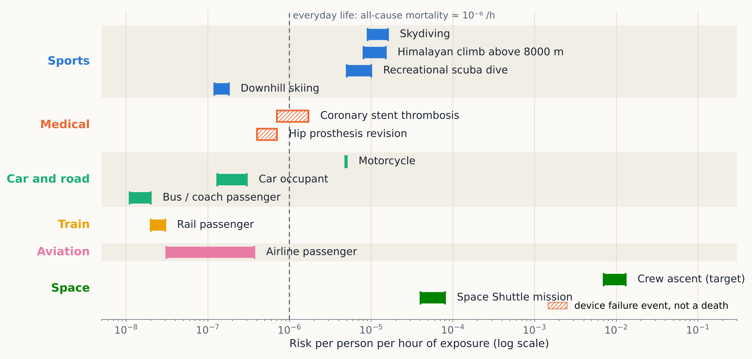
Risk per person and per hour of exposure
One unit for every activity
Micromort = a 10⁻⁶ chance of death
Divide by the hours of exposure to compare a dive, a drive and a flight
Per hour penalises short, intense exposures: take-off and landing, a jump, an ascent
Everyday baseline: ≈ 10⁻⁶ per hour, all causes
Bars show the spread between sources and countries: read them as orders of magnitude, not exact values.
Sources: ETSC (EU), UK DfT, BSAC, USPA, NASA, ABSORB III, joint registries — data in 04_industries/tables/04_risk_per_hour.csv
EXED Polytechnique - Additive Manufacturing - 02 Technologies by Andrei Constantinescu 2027
Notes:
The chart is generated by 04_industries/figures/04_risk_per_hour.py from tables/04_risk_per_hour.csv.
Hatched bars are device failure events for implants, not deaths. Aviation per hour hides that most of the risk is concentrated in take-off and landing; per journey, air looks worse than per hour.
Skydiving assumes about 0.5 h of exposure per jump; Himalayan climbs about 1000 h of expedition; Shuttle about 250 h per mission; crew ascent 1/500 over 10-15 minutes.

Slide 3
Aviation: four classes of parts, set by the effect of failure
Class | Effect of the part's failure | Failure condition | Allowed probability per flight hour | Typical parts
A High | Directly affects continued safe flight and landing; serious or fatal injuries | Catastrophic Hazardous | < 10⁻⁹ extremely improbable < 10⁻⁷ extremely remote | Engine discs and fan blades, wing spars, pressure bulkhead, flight-control actuators, landing-gear fittings
B Medium | Indirectly affects safe flight; minor injuries, large rise in crew workload | Major | < 10⁻⁵ remote | Secondary structure, fuel and hydraulic lines, brakes, pressure valves
C Low | No effect on safe flight; slight loss of function or comfort | Minor | < 10⁻³ probable | Cabin interior: bin latches, seat parts, ducts, non-structural brackets
D Negligible | No safety effect | No safety effect | No requirement | Decorative trim, covers, placard holders
Two rules for class A: below 10⁻⁹ per flight hour, and no single failure may lead to a catastrophe, however unlikely it is.
Targets apply to a failure condition of the system, not to one part. Structure is covered by safety factors, A/B-basis allowables and damage tolerance.
EXED Polytechnique - Additive Manufacturing - 02 Technologies by Andrei Constantinescu 2027
Notes:
Classes A to D: EASA Certification Memorandum CM-S-008 Issue 04 (2025), Table 1, derived from ASTM F3572-22.
Probabilities: CS-25 / FAR 25.1309 and AMC 25.1309 (AC 25.1309-1B) for large aeroplanes. CS-23 aircraft have looser targets (1e-6 to 1e-9 for catastrophic, by class).
Engine critical parts have their own rules: CS-E 515 / FAR 33.70 (life-limited parts).
Examples of incidents per class: A - United 232 (fan disc), Alaska 261 (jackscrew nut), JAL 123 (bulkhead repair), Southwest 1380 (fan blade); B - Air Transat 236 (fuel line chafed by a wrong part); C - overhead bins opening in turbulence.

Slide 4
Cars: ISO 26262 safety integrity levels
Each hazard is rated on three axes
ASIL | ≈ class | Random hardware failure target | Typical systems
D | A | < 10⁻⁸ /h | Electric power steering, brake-by-wire, ESC/ABS, airbag (no unwanted firing)
C | A/B | < 10⁻⁷ /h | Adaptive cruise control, engine torque control
B | B | < 10⁻⁷ /h | Headlights, brake lights, speedometer
A | C | no mandatory target (~10⁻⁶) | Rear lights, some driver-assist warnings
QM | D | quality management | Infotainment, comfort
S
Severity
S0 no injury … S3 fatal
E
Exposure
How often the driving situation occurs, E0 … E4
C
Controllability
Can the driver still avoid harm? C0 … C3
ISO 26262 covers electrical and electronic systems only. Wheels, brake discs and suspension arms go through UNECE type approval, FMEA and safety-critical part marking.
Why 10 × looser than aircraft: the driver can often recover and a crash involves few people. But 1.5 billion cars turn 10⁻⁸ into real events. Worst recalls were mechanical: GM ignition switch (2014), Takata inflators.
EXED Polytechnique - Additive Manufacturing - 02 Technologies by Andrei Constantinescu 2027
Notes:
ISO 26262 (road vehicles, functional safety). ASIL from the hazard analysis and risk assessment: S (S0-S3), E (E0-E4), C (C0-C3).
Random hardware failure targets (PMHF, ISO 26262-5): ASIL D < 1e-8/h, ASIL C < 1e-7/h, ASIL B < 1e-7/h, ASIL A none.
GM ignition switch: low switch torque let the key slip to accessory, cutting power steering and airbags; more than 100 deaths linked. Takata: ammonium-nitrate inflators rupturing; largest recall in history.
Road risk overall is about 1e-7 per vehicle-hour, mostly driver error rather than part failure.

Slide 5
Trains: EN 50126 / 50129 safety integrity levels
SIL | ≈ class | Tolerable hazard rate per hour | Typical functions
4 | A | 10⁻⁹ – 10⁻⁸ | Interlocking, train protection (ETCS on-board)
3 | B | 10⁻⁸ – 10⁻⁷ | Safety functions with a fallback (allocation is project-specific)
2 | C | 10⁻⁷ – 10⁻⁶ | Level-crossing and door functions, depending on the line
1 | C/D | 10⁻⁶ – 10⁻⁵ | Monitoring and diagnostic aids
Steel is not in the SIL table
SILs apply to signalling and control electronics
Wheels (EN 13979-1), axles (EN 13103/13104) and rails are designed for fatigue and kept safe by inspection
One wheel, one rail weld: a single load path, a Class A part
The two case studies that follow, Eschede and Adamuz, are both mechanical
Passenger risk is the lowest of all modes: ≈ 2 × 10⁻⁸ per hour, about 1 death per 30 billion passenger-km in the EU.
EXED Polytechnique - Additive Manufacturing - 02 Technologies by Andrei Constantinescu 2027
Notes:
SIL / THR bands follow IEC 61508 (high demand / continuous mode, probability of dangerous failure per hour), used by EN 50126 (RAMS), EN 50128 (software) and EN 50129 (hardware, safety case).
Example allocations vary between projects and published tables disagree; keep SIL 4 for interlocking and ATP/ETCS, the rest is indicative.
ERA Safety Overview 2021: about 0.033 passenger fatalities per billion passenger-km in the EU.

Slide 6
Medical devices: stents and prostheses
EU MDR class | ≈ class | Examples
III | A | Coronary stents; total and partial hip, knee, shoulder replacements; spinal cages
IIb | B | Other implants: bone plates, screws, pedicle screws and rods
IIa | C | Short-term invasive devices, airway stents (depending on use)
I | D | External limb prostheses, orthoses (self-certified)
≈ 5 %
of hip replacements revised within 10 years
≈ 6 × 10⁻⁷ per hour of use
0.7 %
stent thrombosis in the first year (Xience)
≈ 8 × 10⁻⁷ per hour, often a heart attack
No probability per hour in the rules. ISO 14971 asks to reduce risk as far as possible, then weigh it against the clinical benefit: the patient is already at risk without the device.
1.5 %
with the bioresorbable Absorb scaffold:
withdrawn in 2017 after 150 000 patients
Failures appear years later, in clinical registries, not in the lab: Class III devices need post-market clinical follow-up.
EXED Polytechnique - Additive Manufacturing - 02 Technologies by Andrei Constantinescu 2027
Notes:
EU MDR 2017/745 Annex VIII Rule 8: implantable devices are class IIb unless they are total or partial joint replacements (class III, except ancillary screws, wedges, plates and instruments) or in contact with the spinal column; Rules 6-8 put devices in contact with the heart or central circulatory system in class III. In the US many 3D-printed joint implants are FDA class II (510(k)) while coronary stents are class III (PMA).
ABSORB III: device thrombosis 1.5 % (Absorb) vs 0.7 % (Xience) at 12 months; Abbott withdrew Absorb worldwide in September 2017 after more than 150,000 implantations, following an FDA safety alert in March 2017.
Hip revision about 5 % at 10 years from national joint registries (order of magnitude). DePuy ASR metal-on-metal hip recall (2010) is another example of late failure found by registries.

Slide 7
One scale of four classes across domains
Class | Aviation (per flight hour) | Rail (SIL) | Car (ASIL) | Medical (EU MDR) | Space
A | Catastrophic < 10⁻⁹ Hazardous < 10⁻⁷ | SIL 4 10⁻⁹ – 10⁻⁸ /h | ASIL D < 10⁻⁸ /h | Class III stents, joint replacements | Crew: 1 in 270 per mission Payload class A (JWST)
B | Major < 10⁻⁵ | SIL 3 10⁻⁸ – 10⁻⁷ /h | ASIL C / B < 10⁻⁷ /h | Class IIb plates, screws | Payload class B (Mars Reconnaissance Orbiter)
C | Minor < 10⁻³ | SIL 2 / 1 10⁻⁷ – 10⁻⁵ /h | ASIL A | Class IIa | Payload class C
D | No safety effect | not safety-related | QM | Class I external prostheses | Payload class D (CubeSats)
Same logic everywhere: the consequence of failure sets the class, the class sets the target and the effort (redundancy, testing, inspection). The mapping between domains is indicative: each standard rates functions or devices its own way.
EXED Polytechnique - Additive Manufacturing - 02 Technologies by Andrei Constantinescu 2027
Notes:
Space: NASA Commercial Crew requires loss of crew below 1/500 for ascent and 1/500 for entry, 1/270 for the whole mission. NASA NPR 8705.4A defines payload risk classes A (very low risk, e.g. JWST, Hubble) to D (high risk tolerance, e.g. CYGNSS, CubeSats); these classes grade mission importance, not danger to people.

Slide 8
When Class A structures fail
Six fatal or near-fatal failures, and what each one changed
1986
1989
1998
2003
2010
2026
Challenger
Sioux City
Eschede
Columbia
Qantas 32
Adamuz
O-ring, booster joint
DC-10 fan disc
ICE wheel tyre
foam strike, wing
A380 turbine disc
rail weld
EXED Polytechnique - Additive Manufacturing - 02 Technologies by Andrei Constantinescu 2027
Notes:
Also mentioned: Gelida (Barcelona, 20 January 2026), retaining wall collapse onto a commuter train; Santiago de Compostela (2013), overspeed on a curve, a human-factor accident with no part failure.

Slide 9
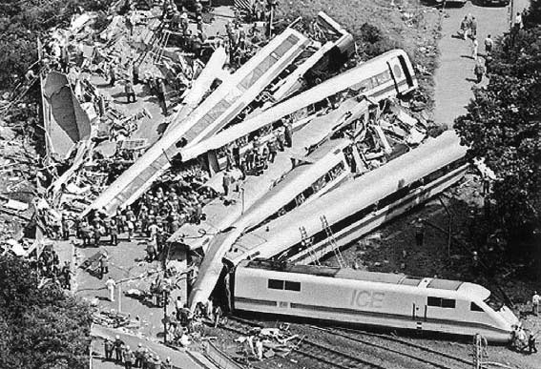
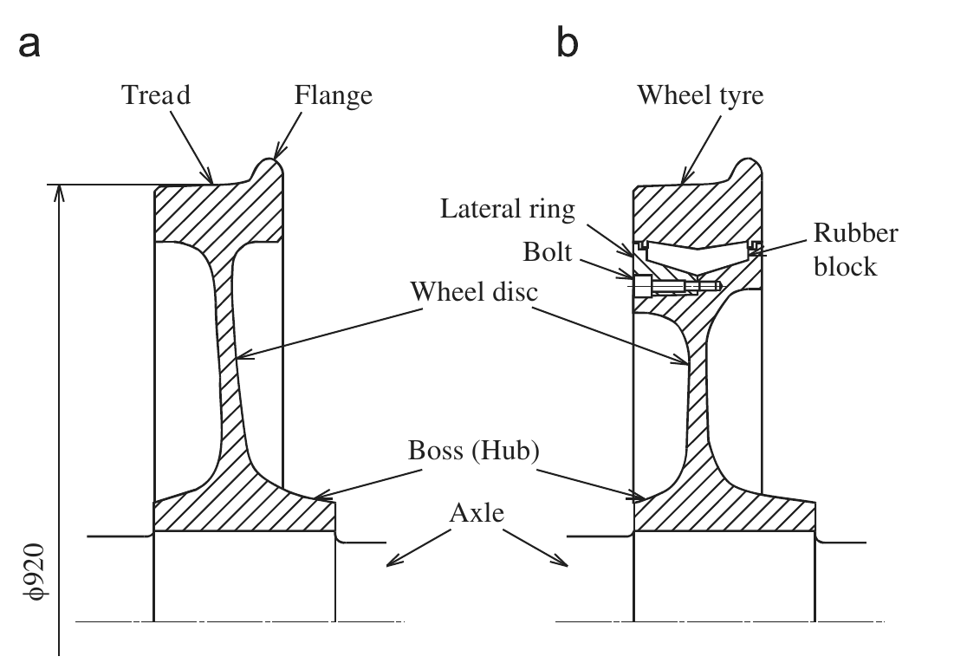
Eschede 1998: a wheel tyre breaks at 200 km/h
101
deaths, 88 seriously injured — the world's worst high-speed rail accident
3 June 1998, ICE 884 Munich → Hamburg
The steel tyre of a rubber-sprung wheel breaks by fatigue, peels off and pierces the floor
6 km later it catches a set of points: coaches derail and hit a road bridge, which collapses on the train
The accident site (Richard et al. 2005, fig. 1)
(a) monobloc wheel, (b) rubber-sprung wheel, Ø 920 mm (Kubota & Hirakawa 2009, fig. 1)
The rubber-sprung wheel BA 064
Steel tyre on 34 pre-compressed rubber blocks, bolted to the wheel disc by a lateral ring
Used for decades on trams and metros; admitted on ICE 1 trailer cars in autumn 1992 to cut vibration and noise
EXED Polytechnique - Additive Manufacturing - 02 Technologies by Andrei Constantinescu 2027
Notes:
Richard, Fulland, Sander, Kullmer, 'Fracture in a rubber-sprung railway wheel', Engineering Failure Analysis 12 (2005) 986-999: the wheel broke about 6 km before the switch near Eschede; ICE-type wheel = tyre, 34 rubber blocks, wheel rim in two parts (centre and detachable ring) and solid shaft; permitted by Deutsche Bahn for high-speed trains in autumn 1992.
Kubota and Hirakawa, 'The effect of rubber contact on the fretting fatigue strength of railway wheel tire', Tribology International 42 (2009) 1389-1398: rubber-sprung wheels on the trailer cars, 34 rubber pads between wheel disc and tyre.
Figures are reproduced from these Elsevier papers for teaching; check the publisher's permission before any public distribution of the slides.

Slide 10
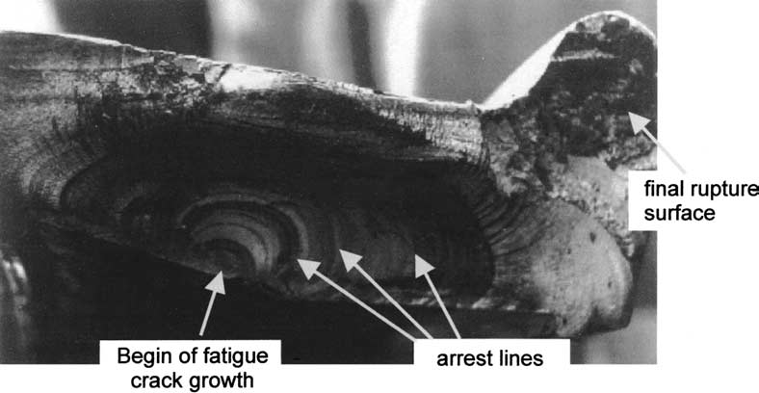
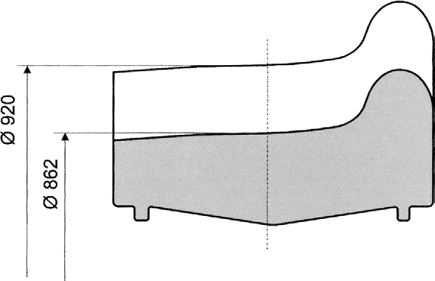
Eschede: a fatigue crack inside a worn tyre
Fracture surface of the broken tyre: origin on the inner face, arrest lines (Richard et al. 2005)
Re-profiling by wear: tyre diameter 920 → 862 mm (Richard et al. 2005)
Fracture mechanics (Richard 2005)
Full-scale tests (Kubota 2009)
Thickness 60 → 31 mm by wear; scrap limit Ø 854 mm
Highest hoop stress on the hidden inner face
A 1.5 mm crack grows slowly, with arrests, long before rupture
No fretting damage from the rubber contact
Fatigue safety factor > 3.5 at Ø 862 mm, 80 kN
Test crack starts at the centre of the inner face, as in service
Lesson: the design margin looked sufficient; the missing barrier was an inspection able to see the inner face.
EXED Polytechnique - Additive Manufacturing - 02 Technologies by Andrei Constantinescu 2027
Notes:
Richard et al. 2005: new tyre diameter 920 mm, broken wheel 862 mm, limit 854 mm; tyre thickness decreased from 60 to 31 mm; wheel contact force Q = 1.25 Q0 = 98 kN (Q0 = 78 kN static); highest circumferential stress at the inner side of the worn tyre for straight running; conclusion: calculated fatigue safety was sufficient for new and re-profiled tyres, crack initiation 'most likely an incidental event'; an initial crack of 1.5 mm depth grows; crack growth was discontinuous (arrests) and lasted a long time before final rupture. ADAPCRACK3D simulations agree with the fracture surface for Q = 98 kN.
Kubota and Hirakawa 2009: basic fretting tests with rubber pads show no typical fretting damage and only a slight decrease of fatigue strength; FEM: maximum hoop stress at the centre of the inner surface; safety factor above 3.5 for 862 mm under 80 kN; full-scale wheel failed at about 1.56 million cycles under 308 kN with the crack at the centre of the inner surface and no fretting trace; conclusion: rubber contact had no effect on fretting fatigue strength.
After Eschede, ICE 1 trains returned to monobloc wheels and wheel inspection moved to ultrasonic methods.

Slide 11
Spain, January 2026: two accidents in three days
Adamuz (Córdoba), 18 January — high-speed line
Gelida (Barcelona), 20 January
1
Rail broken at a weld before the train passed
Storm after months of drought: a motorway retaining wall collapses onto the R4 commuter line
It hits the cab as the train arrives: 1 trainee driver killed, 37 injured
The whole Rodalies network is stopped for inspection
Notches on the wheels of three earlier trains match the break
2
Iryo 6189 Málaga → Madrid: rear coaches derail
The rail tips outward under coach 5; coach 6 leaves the track
3
Alvia 2384 on the other track hits the coaches
46 deaths: Spain's worst high-speed accident
Lesson: infrastructure is a Class A structure shared by every train. A hidden rail defect was hit by several trains before one derailed. Final causes are still under investigation (CIAF).
EXED Polytechnique - Additive Manufacturing - 02 Technologies by Andrei Constantinescu 2027
Notes:
Adamuz: 18 January 2026, about 19:45, Madrid-Andalusia high-speed line. CIAF preliminary note of 23 January 2026: the rail broke at a weld between two rail sections; notches on the right wheels of coaches 2-5 of the Iryo train and on three trains that passed earlier (Renfe 130, Iryo 109-003 and 109-011); provisional hypothesis that the fracture predates the derailment; coach 6 derailed after the rail tipped outward. The note stresses the hypotheses are provisional. Death toll reported as 45 in January and 46 in March 2026 (Ara).
Gelida: 20 January 2026 about 21:00, R4 Rodalies between Gelida and Sant Sadurni d'Anoia; AP-7 retaining wall collapsed in heavy rain; a trainee driver in the cab was killed, 37 injured; CIAF first findings 23 January.
For contrast: Santiago de Compostela, 24 July 2013, Alvia derailed at about 179 km/h on a curve limited to 80 km/h, 80 deaths: no part failed.
Picture to add: photos from the CIAF note (rail fracture, wheel notches) once the final report is out; check reuse terms.

Slide 12
Space Shuttle: the real risk was far above the claim
1 in 100 000
≈ 1 in 100
2 in 135
loss of a flight, as claimed by management before Challenger
Feynman's estimate after Challenger, from engineers' data
missions actually lost: about 1 in 68
Challenger, 28 January 1986
Columbia, 1 February 2003
Cold launch: an O-ring in a booster field joint failed to seal
Hot gas reached the external tank 73 s after lift-off
7 crew lost
Foam from the external tank hit the left wing's carbon leading edge at launch
Hot plasma entered the wing during re-entry
7 crew lost
Lesson: both were known anomalies accepted flight after flight. A NASA review later put the first Shuttle flights at about 1 in 10.
EXED Polytechnique - Additive Manufacturing - 02 Technologies by Andrei Constantinescu 2027
Notes:
Feynman, appendix F of the Rogers Commission report (1986): management quoted about 1 in 100,000; engineers' data suggested roughly 1 in 100.
Hamlin et al., NASA JSC, 'Shuttle risk progression' (2011): retrospective PRA gives about 1 in 9 to 1 in 10 for the first flights; risk improved by steps after each accident, not gradually.
Benjamin, Dezfuli and Everett (PSAM 12, 2014): underappreciated scenarios in both accidents (O-ring blow-by; foam on the RCC).
Pictures to add: NASA photos (public domain), e.g. the STS-51-L plume or the foam impact test on an RCC panel at SwRI (2003).

Slide 13
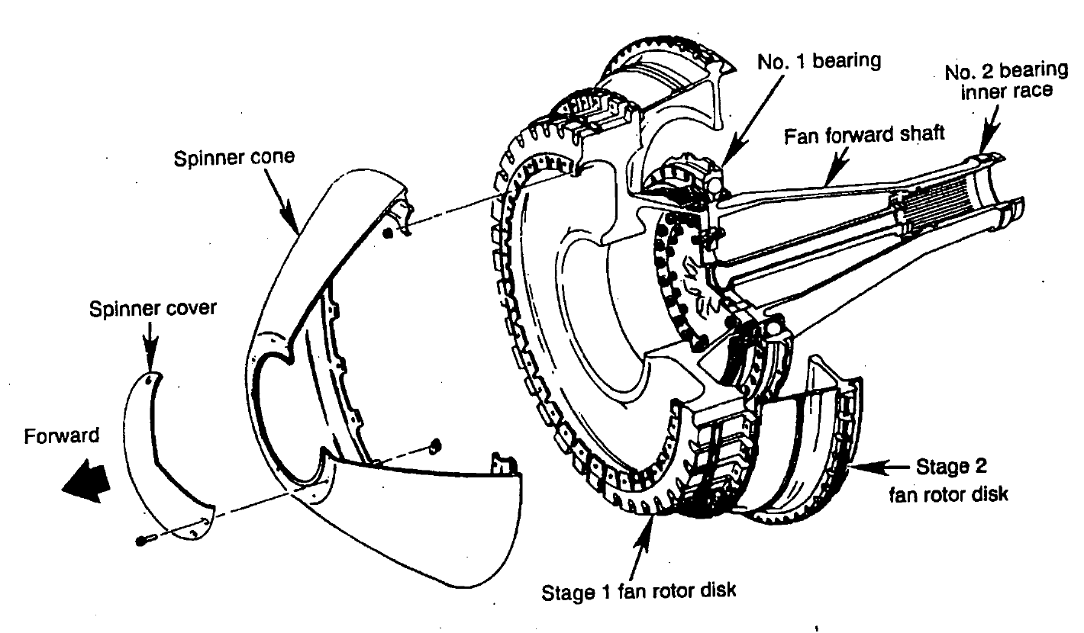
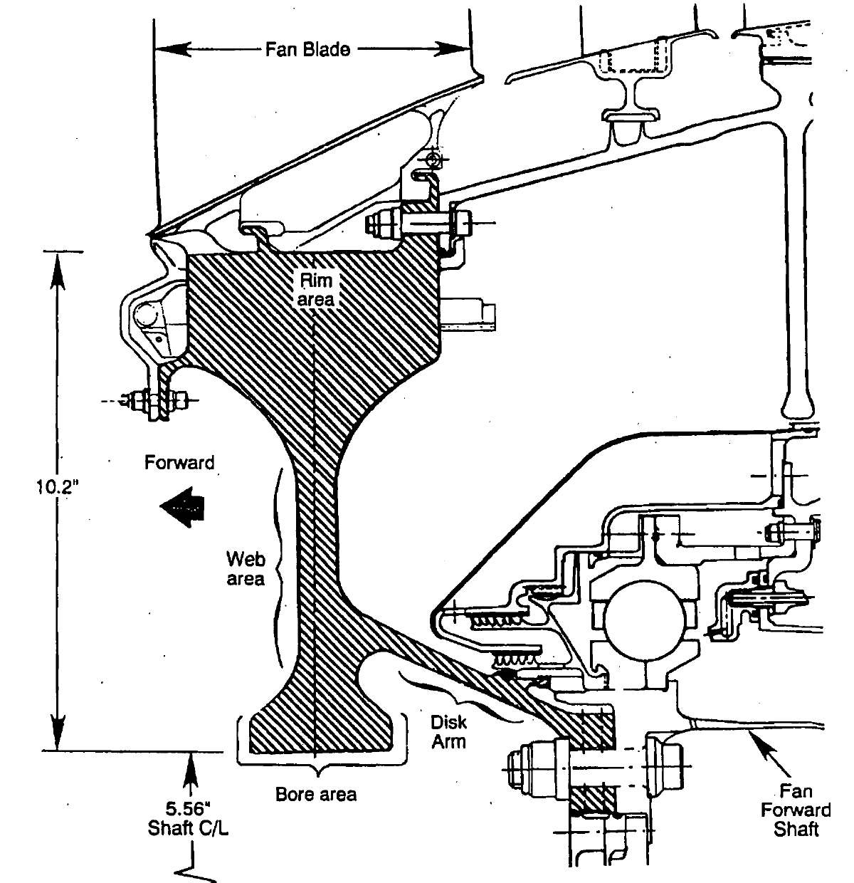
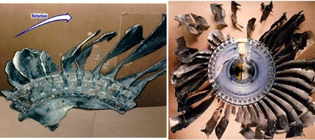
Sioux City 1989: one fan disc, three hydraulic systems lost
111
deaths among 296 on board; 185 survived
19 July 1989, United 232, cruise at 11 300 m
The 168 kg titanium stage 1 fan disc of the tail engine bursts
Debris cuts the lines of all three hydraulic systems: no flight controls
Crew steers with engine thrust alone and reaches Sioux City
CF6-6 fan rotor and stage 1 fan disc section; disc height 259 mm (10.2 in), bore radius 141 mm (NTSB AAR-90/06, fig. 5, 17)
Found 3 months later in farm fields near Alta, Iowa: two pieces making up nearly the whole disc, the small one thrown to the left, the rest to the right.
Lesson: three separate hydraulic systems, routed close together: one high-energy event defeated the redundancy.
Reconstructed No. 2 fan disc with blade segments (FAA Lessons Learned)
EXED Polytechnique - Additive Manufacturing - 02 Technologies by Andrei Constantinescu 2027
Notes:
NTSB AAR-90/06: 285 passengers and 11 crew; 110 passengers and 1 flight attendant fatally injured. Cruise at flight level 370 (37,000 ft = 11,300 m). The stage 1 fan disk weighs 370 lb (168 kg) and is machined from a titanium alloy (Ti-6Al-4V) forging.
Probable cause (NTSB): inadequate consideration of human factors limitations in the inspection and quality control procedures at the United engine overhaul facility, which failed to detect a fatigue crack from a previously undetected metallurgical defect in a critical area of the stage 1 fan disc made by GE; debris exceeded the protection of the hydraulic system design.
The NTSB drawings give dimensions in inches: 10.2 in = 259 mm, 5.56 in = 141 mm.
Reconstructed fan disc photo: FAA Lessons Learned N1819U (fan.jpg). NTSB: about 3 months after the accident, two sections making up nearly the entire disc, with fan blade segments attached, were found in farm fields near Alta, Iowa; the small segment departed to the left, the rest to the right. Other pictures on the FAA page (US Government, public domain unless stated): in-flight photo with damage highlighted (in_flight_1.jpg), right horizontal stabilizer damage (rhsrecon.jpg), hydraulic schematic (hydschem_lg.jpg). The main aircraft photo there is (c) Howard Chaloner. Save them under the same file names in figures/ and run xfab sync.

Slide 14
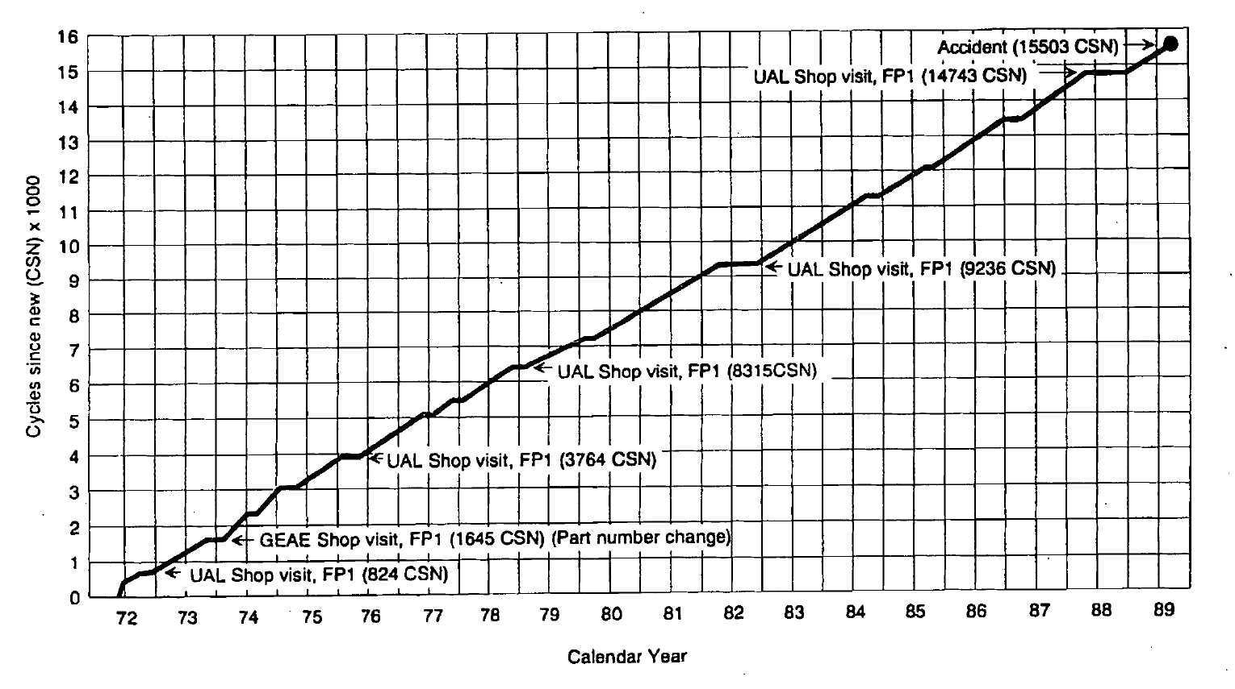
Sioux City: a melt defect, six inspections, one missed crack
1971: a nitrogen-rich hard alpha inclusion forms while melting the titanium (double vacuum melt)
A 1.4 × 0.4 mm cavity in the bore starts a fatigue crack, 31.5 mm long and 14.2 mm deep at failure
Six inspections accepted the disc, the last one 760 flights before the accident
Failure at 15 503 cycles, against a life limit of 18 000
Cycles since new of the accident disc and its six fluorescent penetrant inspections (NTSB AAR-90/06, fig. 9)
Why it was missed: a defect born at the melt shop, a safe-life rule that assumes defect-free material, and a manual inspection that depends on the inspector's eye. Safe life alone was not enough.
EXED Polytechnique - Additive Manufacturing - 02 Technologies by Andrei Constantinescu 2027
Notes:
NTSB AAR-90/06 sections 1.6 and 1.17: disc S/N MPO 00385 made at GE Evendale from September to December 1971 (heat K8283); inspected by FPI in 1972, 1973, 1976, 1978, 1982 and February 1988; 41,009 hours and 15,503 cycles at the accident.
Crack sizes from the report, converted: fatigue zone 1.24 in axial x 0.56 in radial = 31.5 x 14.2 mm; discoloured area 0.476 x 0.180 in = 12.1 x 4.6 mm; cavity 0.055 x 0.015 in = 1.4 x 0.4 mm. The FAA Lessons Learned page describes the missed crack as about half an inch (13 mm) at the bore surface.

Slide 15
Sioux City: from safe life to probabilistic damage tolerance
Ultrasonic inspection of CF6-6 fan discs (AD 89-20-01)
FAA–SwRI 'Turbine Rotor Material Design' programme with 4 engine makers
AC 33.14-1: damage tolerance for titanium rotors, target risk per flight cycle
AC 33.70-1 and 33.70-2 (hole features)
1989
1995
2001
2009
1990–91
1997
2007
2023
FAA Titanium Rotating Components Review Team: triple vacuum melting, damage tolerance
DARWIN code, version 1: probabilistic risk of fracture from hard alpha defects
14 CFR 33.70: damage tolerance assessment required for engine life-limited parts
AC 33.70-3 titanium anomalies, replaces AC 33.14-1
DARWIN (Design Assessment of Reliability With INspection): finite elements + fracture mechanics + inspection simulation + Monte Carlo, giving the probability of fracture of a disc with rare defects.
Airframe side: hydraulic fuses and shut-off valves on the DC-10 (AD 90-13-07, 95-14-06); AC 20-128A on uncontained rotor debris. In Europe: CS-E 515, engine critical parts.
EXED Polytechnique - Additive Manufacturing - 02 Technologies by Andrei Constantinescu 2027
Notes:
Sources: FAA Lessons Learned N1819U (ADs and ACs, review teams); SwRI DARWIN background: TRMD grant 95-G-041 (August 1995 - September 1999), DARWIN version 1 released 1997, version 2 1998, R&D 100 award 2000, formal licensing from 2001; FAA AC 33.14-1 (8 January 2001); 14 CFR 33.70 Engine life-limited parts, Amendment 33-22, 72 FR 50856 (4 September 2007), effective 5 November 2007, which removed 33.14 and requires damage tolerance assessments for material, manufacturing and service-induced anomalies; AC 33.70-1 (31 July 2009), AC 33.70-2 (28 August 2009), AC 33.70-3 (17 April 2023); later AC 33.70-4 (nickel powder, 2023) and 33.70-5 (blade slots).
SwRI presentations state a maximum allowable design risk around 1e-9 events per flight cycle for a titanium rotor component.
Research papers: Leverant et al., Turbine Rotor Material Design, DOT/FAA/AR-00/64 (2000); McClung et al., J. ASTM Int. 1(8) (2004); Wu et al. (2002) on probabilistic methods for rare anomalies.

Slide 16
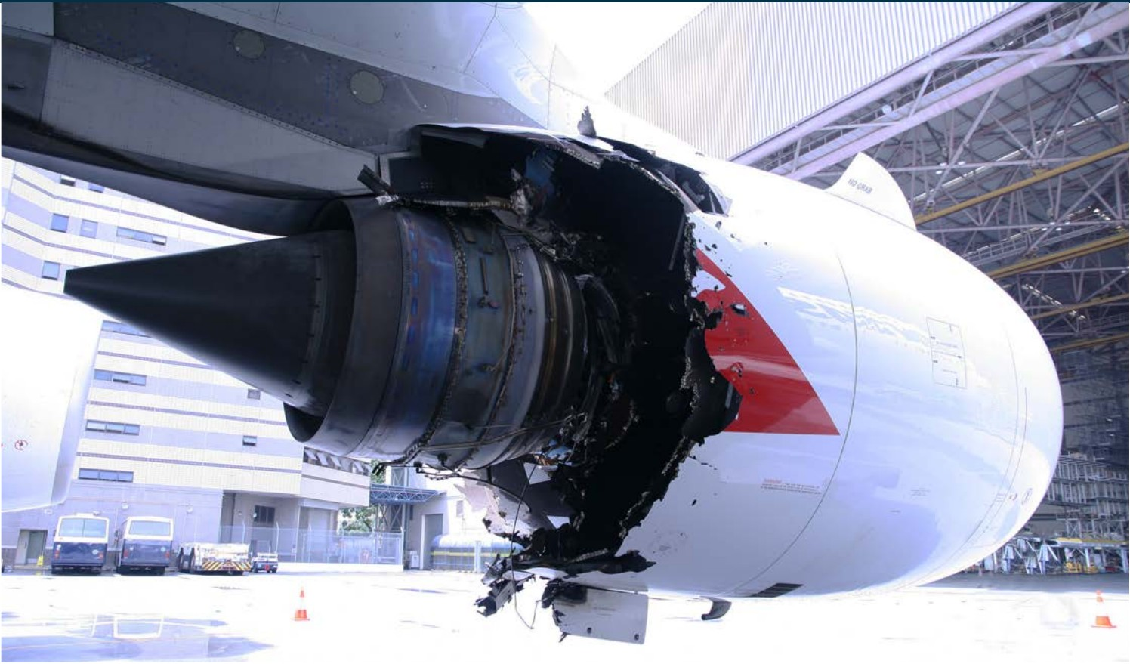
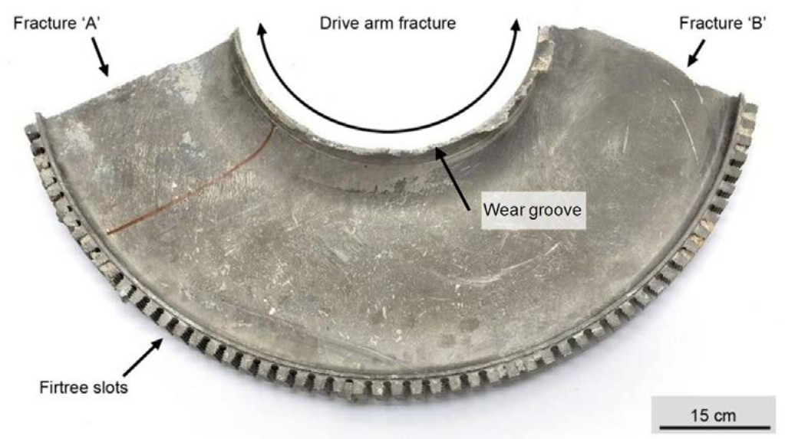
Qantas 32, 2010: an A380 turbine disc bursts after take-off
No. 2 engine, Rolls-Royce Trent 900 (ATSB AO-2010-089, cover; CC BY 3.0 AU)
Intermediate-pressure turbine disc: 43 % of the disc, about 70 kg, found on Batam Island, Indonesia (ATSB fig. 38)
469
2 100 m
≈ 50 min
The disc fragment fell on a property on Batam; other debris pierced the wing and fuel tanks and cut wiring.
on board, no injuries
climbing out of Singapore
to complete the initial ECAM procedures
EXED Polytechnique - Additive Manufacturing - 02 Technologies by Andrei Constantinescu 2027
Notes:
ATSB Transport Safety Report AO-2010-089 (final, 27 June 2013): 4 November 2010, VH-OQA, climbing through 7,000 ft (2,100 m) after departing Singapore Changi; 5 flight crew, 24 cabin crew, 440 passengers; uncontained failure of the intermediate pressure (IP) turbine disc of the No. 2 engine overhead Batam Island.
Disc: a section of about 40-43 % of the IP turbine disc, about 70 kg, was recovered from a property on Batam Island (ATSB fig. 12 shows the property damage); two radial fractures and a circumferential fracture in the drive arm, all overstress, no pre-existing material defect. No other significant fragment of the disc was found.
ATSB: it took about 50 minutes for the flight crew to complete all of the initial ECAM procedures; touchdown at 03:46:47 UTC.
Licence: ATSB material is CC BY 3.0 Australia, attribute 'Source: Australian Transport Safety Bureau'. Third-party photos in the report (passengers, Qantas crew, AAIB Singapore, Posmetro, Rolls-Royce, Airbus) are not used here.

Slide 17
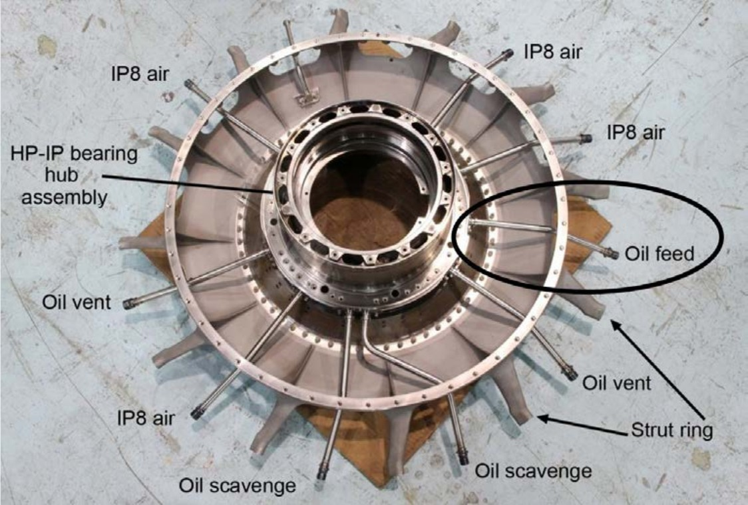
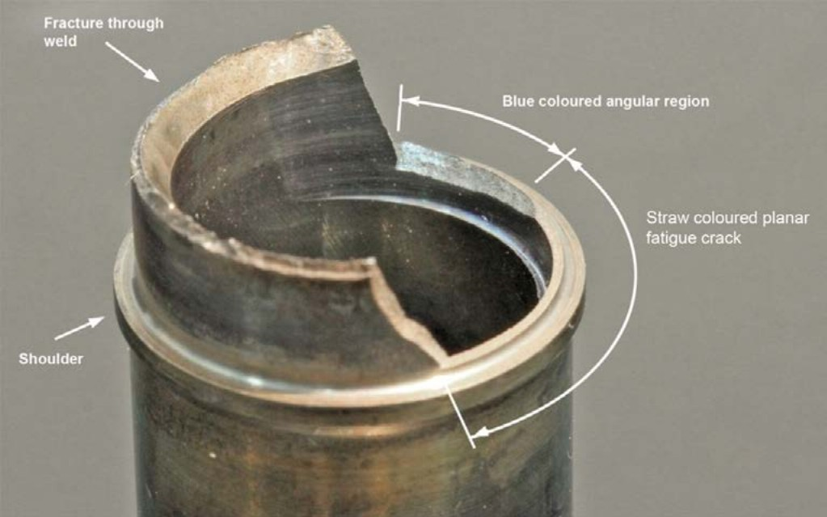
Qantas 32 root cause: a 0.35 mm wall instead of 0.82 mm
Counter bore machined off-centre during manufacturing
↓
Stub pipe wall 0.35 mm at its thinnest
↓
Fatigue crack, oil leak into a hot buffer space
HP/IP bearing support with its service pipes; oil feed circled (ATSB fig. 29)
Fractured oil feed stub pipe (ATSB fig. 43)
↓
Internal oil fire: IP turbine disc separates from its shaft
0.91 mm
0.82 mm
0.35 mm
↓
nominal wall of the stub pipe in the counter bore
minimum allowed, worst-case tolerances
measured at the crack, off-centre bore
Disc overspeeds and bursts: uncontained debris
The bearing hub moves about 6 mm at full thrust and bends the pipe at every flight.
EXED Polytechnique - Additive Manufacturing - 02 Technologies by Andrei Constantinescu 2027
Notes:
ATSB AO-2010-089: nominal wall thickness of the oil feed stub pipe in the counter bore 0.91 mm; minimum permissible with worst-case tolerances 0.82 mm; the fractured pipe varied from 1.42 mm down to 0.35 mm; the fatigue crack coincided with the thinnest wall section. Greatest hub movement at maximum thrust about 6 mm (used in the stress model).
Figure 29 shows the bearing chamber service pipes (oil feed, scavenge, vent, IP8 air) on the HP/IP support structure; the oil feed stub pipe is the short pipe welded in the hub at the inner end of the circled oil feed line.
The misalignment came from the machining datum and fixture; the wall thickness could not be seen by the inspector and a CMM report error statement was not acted on.

Slide 18
Qantas 32: a Class A disc lost through an unclassified pipe
Part | Manufacturer's class (FMECA) | Effect of its failure | ≈ class | Controls that follow
IP turbine disc | Critical part (engine critical / life-limited part, CS-E 515) | Hazardous: uncontained high-energy debris | A | Hazardous effects ≤ 10⁻⁸ per engine flight hour; life limit, special process and inspection controls
HP/IP bearing support with oil feed stub pipe | 'Unclassified' at certification; 'Reliability sensitive' after the event | Oil leak; foreseen in the FMECA to end, extremely rarely, in disc overspeed | D → B | No special controls: the wall thickness was not an explicit drawing feature
Lesson: the failure analysis assumed that every part conforms to its drawing. A low-class part made out of tolerance started a chain that ended at a Class A part. Classify parts along the whole failure chain, and match manufacturing control to that class.
EXED Polytechnique - Additive Manufacturing - 02 Technologies by Andrei Constantinescu 2027
Notes:
ATSB AO-2010-089 section 2.4.5-2.4.6: the engine manufacturer classified parts as Critical (primary failure likely to have hazardous effects, requiring special controls), Reliability sensitive, or Unclassified. The Trent 900 FMECA identified the HP/IP bearing support assembly as 'Unclassified'; the manufacturer's post-event review found it had been inappropriately classified and reclassified it as a Reliability Sensitive part.
The FMECA recorded a failure mode very similar to the stub pipe failure, ending in IP turbine drive failure and overspeed above burst speed; it was classified as a hazardous effect with the acceptable probability 'extremely remote' (JAR-E: not greater than 1e-8 per engine flying hour). The FMECA assumed all manufactured parts conformed to the design.
The class letters A to D are the course scale (EASA CM-S-008 style); the mapping of the manufacturer's classes onto it is indicative.

Slide 19
What the failures of Class A structures have in common
1
Hidden manufacturing defects
2
Inspection has limits
Hard alpha in a titanium disc, a misaligned counter bore, a rail weld: within tolerance on paper, not in the part.
Cracks missed six times, cracks on an invisible face, walls the inspector could not see.
Sioux City · Qantas 32 · Adamuz
Sioux City · Eschede · Qantas 32
3
One event defeats redundancy
4
Estimated risk ≠ real risk
High-energy debris cuts every hydraulic line or wire that runs close together.
1 in 100 000 claimed, 1 in 68 observed. Known anomalies become accepted.
Sioux City · Qantas 32
Challenger · Columbia
EXED Polytechnique - Additive Manufacturing - 02 Technologies by Andrei Constantinescu 2027
Notes:
Take-away for the next part of the course: the classification of a part (A to D) decides how much evidence is needed about its material, its manufacturing process and its inspection.

Slide 20
References
Classes and targets
EASA CM-S-008 Issue 04, Additive Manufacturing, 2025 (part classes A–D); ASTM F3572-22
EASA CS-25 / AMC 25.1309; FAA AC 25.1309-1B
ISO 26262 Road vehicles – Functional safety; IEC 61508; EN 50126, EN 50128, EN 50129
EU MDR 2017/745 Annex VIII; ISO 14971; NASA NPR 8705.4A; NASA human-rating, Commercial Crew loss-of-crew requirements
Risk data
ETSC, Transport safety performance in the EU (1999, 2003); ERA Safety Overview 2021; UK DfT via Wikipedia, Transport accident
Micromort data: BSAC, USPA, ski-injury.com; Ellis et al., ABSORB III, JACC 2017
Accident reports and studies
NTSB AAR-90/06, United Airlines Flight 232, DC-10-10, Sioux City, 1990
FAA Lessons Learned, N1819U; AC 33.14-1 (2001); 14 CFR 33.70 (2007); AC 33.70-1 to -3; Leverant et al., DOT/FAA/AR-00/64, 2000 (DARWIN)
McClung, Enright, Millwater, Leverant, Hudak, A software framework for probabilistic fatigue life assessment of gas turbine engine rotors, J. ASTM Int. 1(8), 2004
Chapel, Kemme (GE), Comparisons and lessons learned from UA232 and AA383, ISASI
ATSB AO-2010-089, In-flight uncontained engine failure, A380-842 VH-OQA, 2013
Richard, Fulland, Sander, Kullmer, Fracture in a rubber-sprung railway wheel, Eng. Fail. Anal. 12 (2005) 986–999; Kubota, Hirakawa, Tribol. Int. 42 (2009) 1389–1398
CIAF, Note on the Adamuz accident, 23 January 2026; Rogers Commission (1986), app. F (Feynman); CAIB report (2003); Hamlin et al., Shuttle risk progression, NASA (2011)
EXED Polytechnique - Additive Manufacturing - 02 Technologies by Andrei Constantinescu 2027
Notes:
Full URLs: EASA CM-S-008 https://www.easa.europa.eu/sites/default/files/dfu/cm-s-008_issue-04_final_0.pdf ; NTSB report mirrored by the FAA https://www.faa.gov/sites/faa.gov/files/2022-11/AccidentReportUAL232.pdf ; FAA Lessons Learned https://www.faa.gov/lessons_learned/transport_airplane/accidents/N1819U ; DOT/FAA/AR-00/64 https://rosap.ntl.bts.gov/view/dot/93997 ; AC 33.14-1 https://www.faa.gov/sites/faa.gov/files/2022-11/AC33.14-1.pdf ; ISASI paper https://isasi.org/Documents/Awards/ ; ETSC https://etsc.eu/transport-safety-performance-in-the-eu-a-statistical-overview/ ; CIAF note via Railway Gazette https://www.railwaygazette.com/download?ac=77177 ; NASA risk classification fact sheet https://www.nasa.gov/wp-content/uploads/2023/12/risk-classification-fact-sheet.pdf

