Slide 1
Printing the Path to Orbit
EXECUTIVE WORKSHOP · 2 HOURS
Additive manufacturing in the New Space small-launcher race
[Date] · [Venue] · [Facilitator name]
Notes:
Welcome. Two hours, three exercises, one question running through all of it: where does additive manufacturing create real strategic advantage for small launchers, and where is it just good engineering that everyone now has? We start with a world tour (USA, Canada, Europe, Russia, China, India, Pakistan and a few others) because the regional context explains most of the strategic choices. Facts in this deck are current as of 31 October 2026.

Slide 2
120 minutes: two lectures, three exercises
RUN OF SHOW
Time | Block | Format
0:00 – 0:08 | Welcome and three bets | Poll
0:08 – 0:35 | Part 1 · Global map, geography, cost per kg | Lecture
0:35 – 0:50 | Exercise 1 · Regional war room | Teams
0:50 – 0:55 | Break | —
0:55 – 1:30 | Part 2 · Engineering primer, Raptor, AM value | Lecture
1:30 – 1:50 | Exercise 2 · The board decision | Teams
1:50 – 1:56 | Exercise 3 · Pre-mortem | Plenary
1:56 – 2:00 | Takeaways and commitments | Plenary
Printing the Path to Orbit · Opening
EXED Polytechnique - Additive Manufacturing - 04 Industries by Andrei Constantinescu 2027
Notes:
Walk through the shape of the session quickly. Stress that two thirds of the time is them working, not us talking. Teams of 4 to 6 should already be seated together; if not, form them now so Exercise 1 starts without friction.

Slide 3
By 2:00 you will be able to…
OBJECTIVES
01
Read the race
Explain who is flying, who pays and why, region by region.
02
Price the lever
Say where additive manufacturing creates value — and where it does not.
03
Make the call
Take and stress-test a make-or-buy decision on printed engines.
Printing the Path to Orbit · Opening
EXED Polytechnique - Additive Manufacturing - 04 Industries by Andrei Constantinescu 2027
Notes:
Three outcomes. The first is about context, the second about the technology’s economics, the third about decisions. Executives do not need to know how to tune a laser; they need to know when owning that capability is worth the capital.

Slide 4
Place three bets
WARM-UP · 5 MINUTES · SHOW OF HANDS OR POLL APP
1
Which region flies the most private small-launcher missions in 2028? USA · China · Europe · India
2
By 2030, how much of a typical small-launcher engine will be printed? Under 25% · 25–50% · Over 50%
3
In three years, will your organisation make, partner for, or buy its AM capability?
Printing the Path to Orbit · Opening
EXED Polytechnique - Additive Manufacturing - 04 Industries by Andrei Constantinescu 2027
Notes:
Record the votes on a flip chart; we come back to them at the close. Do not comment on the answers yet. Bet 1 sets up the regional tour, bet 2 sets up Part 2, bet 3 sets up Exercise 2. If time is short, take bet 3 only.

Slide 5
The global map
PART 1 · 0:08 – 0:35
Geography, cost per kg, then USA · Canada · Europe · Russia · China · India · Pakistan
EXED Polytechnique - Additive Manufacturing - 04 Industries by Andrei Constantinescu 2027
Notes:
Twenty-seven minutes: two minutes on the geography map, two on cost per kg, then roughly three minutes per region. For each region we ask the same three questions: where do they stand, what is their additive-manufacturing signature, and what should an executive read into it. Status as of 31 October 2026.

Slide 6
Four regions have a private rocket in orbit
SCOREBOARD · OCTOBER 2026
Region | Private small launcher in orbit? | AM signature | Who pays
USA | Yes — Electron, Alpha | Rutherford, all primary parts printed | Private capital, DoD, NASA
China | Yes — Ceres-1 and others | Little public detail | Private funds, local governments
India | Yes — Vikram-1, July 2026 | Agnilet single-piece engine | Private, IN-SPACe, ISRO pads
Europe | Yes — Spectrum, Sept 2026 | Mixed; vertical integration | ESA and national budgets
Canada | Not yet — target 2028 | Too early to tell | Federal ‘Launch the North’
Russia | No ultralight in service | NK-3 parts planned in AM | State (Rostec)
Pakistan | No launcher | — | Buys Chinese launches
Part 1 · The global map · Sources at the end of the deck
EXED Polytechnique - Additive Manufacturing - 04 Industries by Andrei Constantinescu 2027
Notes:
One slide to anchor the tour. Read it top to bottom: the USA and China lead on volume; India joined the private-orbit club on 18 July 2026; Europe on 5 September 2026 with Isar Aerospace. Canada, Russia and Pakistan are at very different starting points, which is exactly what makes Exercise 1 interesting. Note that ‘AM signature’ for China says little public detail: be honest that open sources on Chinese AM use in launchers are thin.

Slide 7
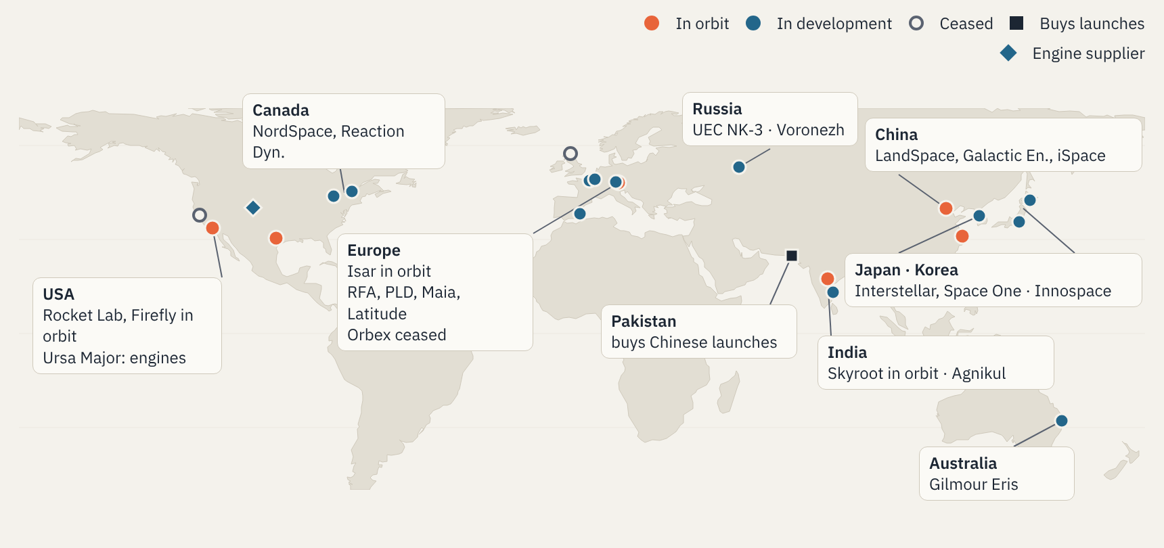
Where small launchers are built
GEOGRAPHY · HEADQUARTERS
Full map of 222 small launchers (updated 31 Jul 2026): newspace.im/launchers · Outline: Natural Earth via Basemap
EXED Polytechnique - Additive Manufacturing - 04 Industries by Andrei Constantinescu 2027
Notes:
This map shows only the headquarters discussed in the regional tour. For the full picture, open the interactive map at newspace.im/launchers during the session: Erik Kulu’s database tracks 222 small launchers (operational, in development and retired), last updated 31 July 2026. Point out the clusters: Beijing and the US West Coast dominate; Ursa Major in Colorado sells engines rather than rockets; Europe has four or five serious contenders after Orbex’s collapse, including France’s MaiaSpace and Latitude; India has two; Japan has Interstellar (Hokkaido) and Space One (Tokyo); Canada, Korea and Australia each have one or two challengers; Pakistan has chosen to buy launches. Ask the room: does clustering matter (supply chains, talent pools, test sites), or only launch sites?

Slide 8
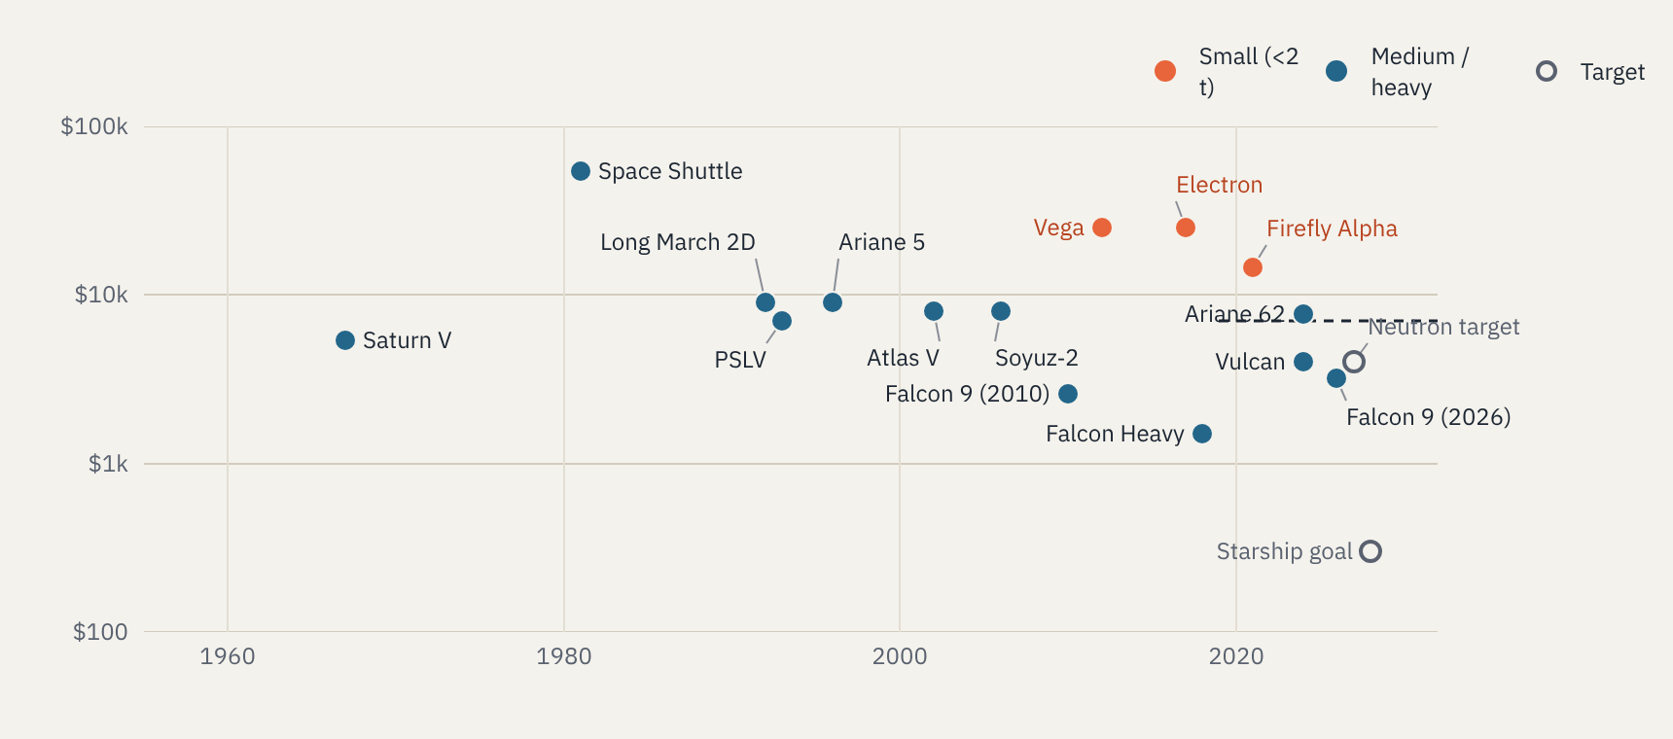
Small launchers pay 5–10× more per kilogram
ECONOMICS · PRICE PER KG TO LOW EARTH ORBIT
Approximate, US$/kg, first-flight year · Saturn V, Shuttle, Falcon 9 (2010), Falcon Heavy: CSIS (2021 $) · others: list price ÷ max LEO payload · dashed line: F9 rideshare ≈ $7k/kg (2026)
EXED Polytechnique - Additive Manufacturing - 04 Industries by Andrei Constantinescu 2027
Notes:
Read the chart as orders of magnitude, not precise prices. Four points are the figures CSIS publishes in 2021 dollars (Saturn V about $5,400/kg, Space Shuttle about $54,500, Falcon 9 in 2010 about $2,600, Falcon Heavy about $1,500). The others are our own approximations: public list price divided by maximum payload to low Earth orbit, in then-year dollars: Electron about $7.5M for 300 kg, Firefly Alpha about $15M for 1,030 kg, Falcon 9 in 2026 about $74M for 22.8 t. Long March 2D, Vega, Ariane 62, Atlas V and Soyuz-2 are estimates because prices are not published consistently. Neutron and Starship are targets, not prices. The dashed line is SpaceX’s rideshare price, about $350,000 for 50 kg plus $7,000 per extra kg to sun-synchronous orbit in February 2026. That line is the small launcher’s real competitor: a dedicated small launcher must sell schedule, orbit choice and sovereignty, because it cannot win on price per kg.

Slide 9
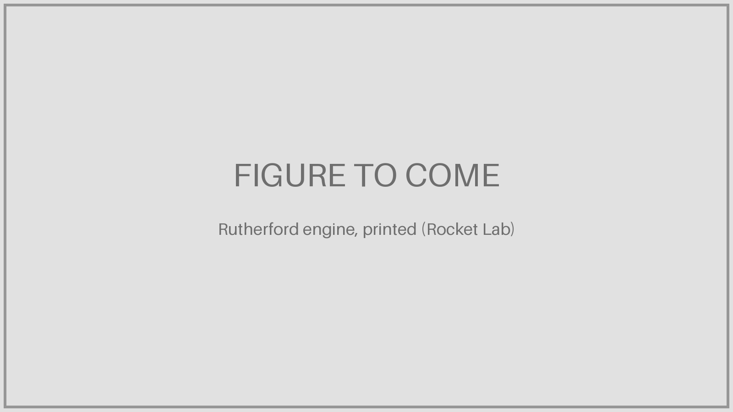
The reference case: printing at production rate
REGION · USA
Where they stand
• Electron: 75 successful missions through 2025
• Second most-launched orbital rocket of 2025
• Firefly Alpha back to flight, 11 Mar 2026
• Neutron (medium lift) slipped to 2027
AM signature
• Rutherford: chamber, injector, pumps, valves all printed
• ≈ 24 h claimed print time per engine
• Relativity: 85% printed Terran 1 → hybrid Terran R
• Ursa Major sells engines ≈ 80% printed
Executive read
Printing is mature and in-house. Neutron’s latest delay came from a carbon-composite tank dome, not a printed part. The bottleneck has moved to structures, integration and cadence.
Part 1 · The global map · Rocket Lab 10-K FY2025; Rocket Lab release 14 Oct 2026; Relativity Space
EXED Polytechnique - Additive Manufacturing - 04 Industries by Andrei Constantinescu 2027
Notes:
Rocket Lab is the proof that a printed engine can be produced at rate: the company has said it can print a Rutherford in about 24 hours, and it moved engine production into a dedicated Engine Development Center in Long Beach. Relativity is the cautionary counterpoint: it built its brand on printing almost the whole rocket, then moved to a hybrid of printed and conventionally made parts for Terran R, keeping powder-bed and wire-arc printing for engine parts where fast iteration matters. On Neutron: Rocket Lab announced on 14 October 2026 that the first launch moves to 2027 after air pockets were found in a composite forward dome. Ask the room: what does it tell you that the US leaders now talk less about printing and more about cadence? More detail: Rocket Lab prints Rutherford parts by electron-beam melting; it moved engine production to a dedicated Engine Development Center in Long Beach, which also builds Archimedes (about 730 kN, oxygen-rich staged combustion, methane) for Neutron. Electron is publicly priced at about $7.5M for roughly 300 kg. Ursa Major (Colorado, about 270 staff in 2023) is the US engine merchant: Hadley (22 kN) is about 80% printed by mass and flies on Stratolaunch’s Talon-A; Stratolaunch ordered 16 for $32.9M. Firefly’s Alpha flew 7 times by March 2026: 3 full successes, 2 partial, 2 failures.

Slide 10

Sovereignty first, hardware later
REGION · CANADA
Where they stand
• Only G7 nation without its own launcher
• Launch the North: C$8.3M each to 3 companies
• Target: light-lift orbit in 2028
• C$200M, 10-year pad lease, Spaceport Nova Scotia
AM signature
• Reaction Dynamics: printed hybrid engines
• Regeneratively cooled nozzle fired 30 s (Dec 2023)
• NordSpace unveiled orbital-class engine, Aug 2026
• No flight-proven printed engine yet
Executive read
Defence money buys time, not maturity. A late entrant can leapfrog by buying proven AM processes and partners rather than re-learning them, and by hosting foreign launchers in the meantime.
Part 1 · The global map · National Defence (Mar 2026); IEEE Spectrum; SpaceQ
EXED Polytechnique - Additive Manufacturing - 04 Industries by Andrei Constantinescu 2027
Notes:
Canada is the clearest case of launch as a sovereignty project. Budget 2025 set aside C$182.6M over three years for a sovereign launch programme, and the wider Launch the North envelope is reported at about C$305M. On 21 October 2026 Ottawa also signed a 10-year, C$20M agreement for access to NordSpace’s Atlantic Spaceport Complex in Newfoundland, and Canada joined NATO’s STARLIFT launch cooperation. The question for executives: when you start ten years behind, do you build engine know-how or license it? More detail: the three Launch the North companies are NordSpace (Markham, Ontario; Atlantic Spaceport Complex in Newfoundland), Canada Rocket Company and Reaction Dynamics (Quebec). Reaction Dynamics had 37 staff in 2022; its Aurora-8 uses eight RE-202B hybrid engines on the first stage and two on the second, burning a liquid oxidizer with pellets of recycled plastic; its first orbital attempt is planned around Q3 2028 from Spaceport Nova Scotia under a pathfinder agreement with Maritime Launch Services. Isar Aerospace signed a 10-year agreement in July 2026 to launch Spectrum from Nova Scotia from 2028.

Slide 11

One orbit, one collapse, a €544M bet
REGION · EUROPE
Where they stand
• Isar Spectrum in orbit, 5 Sep 2026 (flight 2)
• ESA Launcher Challenge: €543.6M to Isar, RFA, PLD
• France backs MaiaSpace (€179M); debut H2 2027
• Orbex ceased trading, Feb 2026
AM signature
• Isar prints Aquila thrust chambers in-house
• ArianeGroup: up to half of Prometheus printed
• Latitude prints its whole Navier engine
• Orbex: printed engines did not save it
Executive read
Technology is not the moat. A first success is: SEOPS booked five more Spectrum launches about ten days after Isar reached orbit. Capital and a funded manifest decide who survives.
Part 1 · The global map · SpaceNews; Isar Aerospace; Space Intel Report; FRP Advisory
EXED Polytechnique - Additive Manufacturing - 04 Industries by Andrei Constantinescu 2027
Notes:
ELC split as reported: about €197.8M to Isar and €186.9M to RFA, with Spain behind PLD and France committing about €179M to MaiaSpace at the Bremen ministerial. RFA One’s debut from SaxaVord slipped after a pad anomaly. MaiaSpace dropped its suborbital test and now targets an orbital debut in the second half of 2027, its third schedule revision. Orbex is the warning: printed engines, public money from the UK and ESA, a planned spaceport, and still insolvency once the Series D and the sale to The Exploration Company failed. Its manufacturing assets and IP were sold in October 2026. Ask: which European entrant would you fund today, and why? More detail: Isar prints the Aquila thrust chamber on EOS M 290 and AMCM M 450 machines, with cooling channels in the chamber wall; it reported 124 hot fires in 12 months and design loops of four weeks or less in 2023. RFA (Augsburg, OHB spin-off) uses the oxygen-rich staged-combustion Helix (100 kN, 100 bar); it lost a stage in August 2024, de-stacked its vehicle at SaxaVord in July 2026 and named a new CEO on 5 October 2026. MaiaSpace’s Maia uses three Prometheus engines on the first stage and one on the second (980 kN class, methane, €1M target cost). Latitude (Reims) flies seven Navier engines plus one, printed in Inconel 718, on a 100 kg Zephyr.

Slide 12
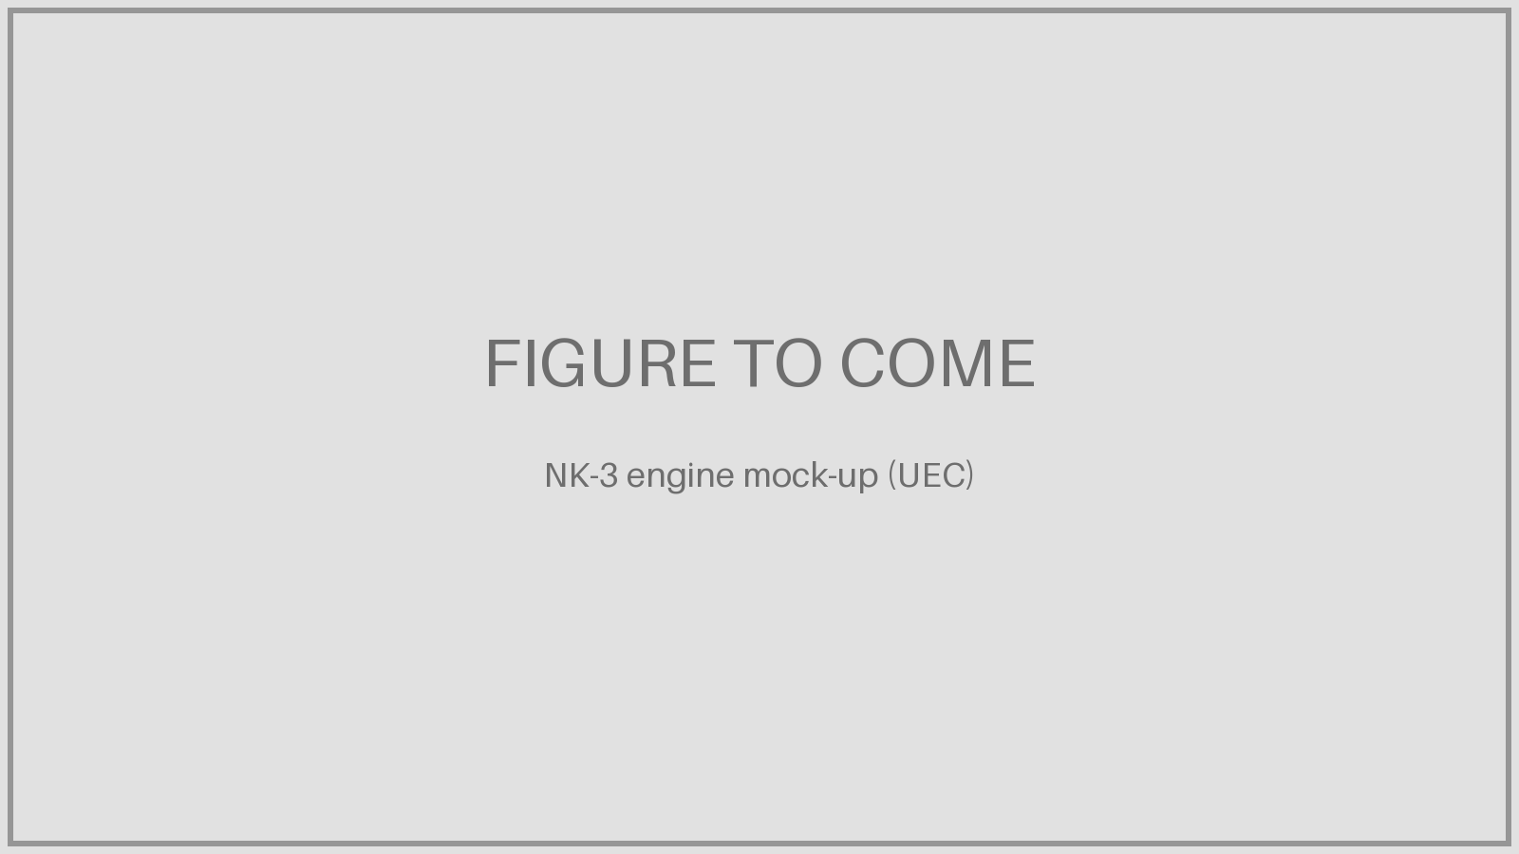
State-led catch-up in the ultralight class
REGION · RUSSIA
Where they stand
• No serial ultralight launcher or engine
• NK-3 (4.5 t thrust) for the Voronezh rocket
• 12 engines on stage 1, 1 restartable on stage 2
• Up to 250 kg to low orbit; no flight date
AM signature
• Printed gas generator and turbopump parts planned
• Chamber derived from Soyuz RD-107A steering chamber
• RD-191MR (heavy): ≈ 40% lower cost claimed
• Claims not independently verified
Executive read
AM here is an industrial catch-up tool inside state champions, not a startup play. Strong engine heritage; limited access to Western export markets and customers.
Part 1 · The global map · Rostec / UEC (Apr 2026); TASS; Frontier India
EXED Polytechnique - Additive Manufacturing - 04 Industries by Andrei Constantinescu 2027
Notes:
The NK-3 borrows its chamber design from the steering chamber of the RD-107A used on Soyuz, while pumps, turbine, gas generator and automation are being designed from scratch. Preliminary design was complete by spring 2026; no flight date has been published. The RD-191MR claims (about 40% cost reduction and manufacturing 2.5 times faster) come from the developer and have not been independently verified: present them as claims. Contrast with the startups: in Russia, AM sits inside engine primes with decades of heritage. More detail: UEC-Kuznetsov in Samara also builds the RD-107A/108A engines for Soyuz, so the NK-3 sits inside an established engine prime rather than a startup. A full-scale mock-up was shown in 2026 and the preliminary design phase is complete. Energomash’s RD-191MR for the Angara-A5M is the large-engine reference: the developer claims about 40% lower production cost and 2.5 times faster manufacturing from additive parts.

Slide 13
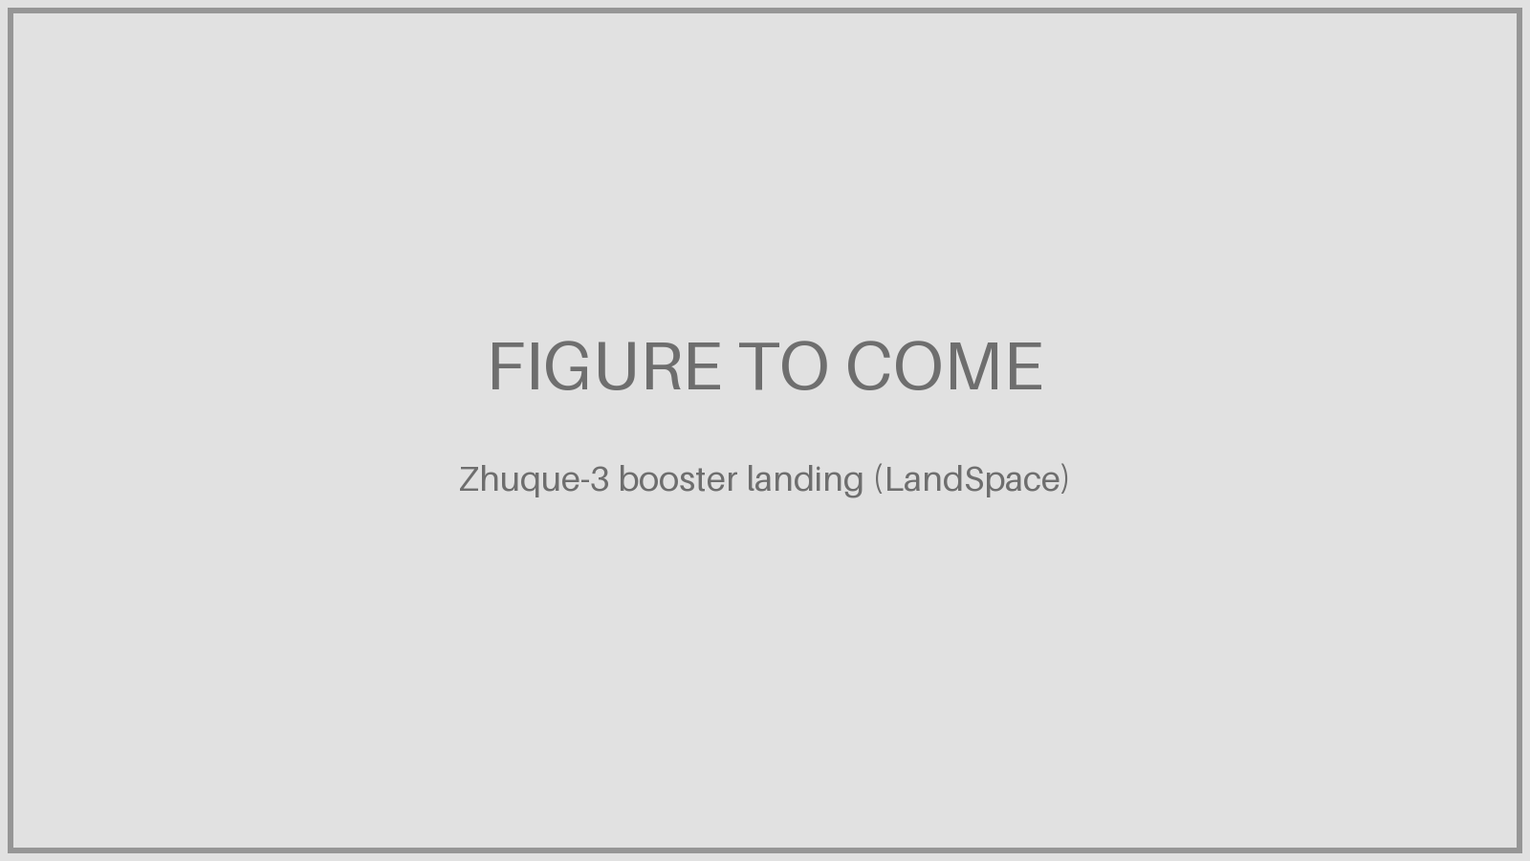
Volume and capital: small is a stepping stone
REGION · CHINA
Where they stand
• 2026 target: 100+ launches, 60+ commercial
• Ceres-1: the solid small-launch workhorse
• Ceres-2 debut failed, Jan 2026
• Zhuque-3 booster landed, 19 Aug 2026
Industrial model
• Engineers spun out of the state primes
• Local-government parks, land and subsidies
• Large rounds: iSpace ≈ $726M (Feb 2026)
• Public data on AM use: thin
Executive read
Constellation demand pulls Chinese firms toward reusable medium lift. Expect them to compete on price and cadence; small solid launchers become the training ground.
Part 1 · The global map · CislunarSpace / Beijing News (Apr 2026); Jiemian; Reuters; CB Insights
EXED Polytechnique - Additive Manufacturing - 04 Industries by Andrei Constantinescu 2027
Notes:
The launch projections come from Chinese industry and media sources and are targets, not results. Zhuque-3’s first flight in December 2025 reached orbit but lost the booster on landing; the second flight on 19 August 2026 landed it about 390 km downrange, making LandSpace the third company to land an orbital booster on legs. Constellations such as Qianfan and Guowang create a domestic demand pull that the rest of the world lacks. Be candid: we do not have reliable public data on how much of Chinese launcher engines is printed, so do not overclaim. More detail: Galactic Energy had completed 20 successful Ceres-1 missions carrying 85 satellites for 27 clients by its latest public count, including sea launches. LandSpace flew the world’s first methane rocket to orbit (Zhuque-2, July 2023) and is preparing a listing on Shanghai’s STAR Market. Other players to name: iSpace (Hyperbola), Space Pioneer (Tianlong-3), CAS Space (Kinetica/Lijian), Deep Blue Aerospace, Orienspace.

Slide 14
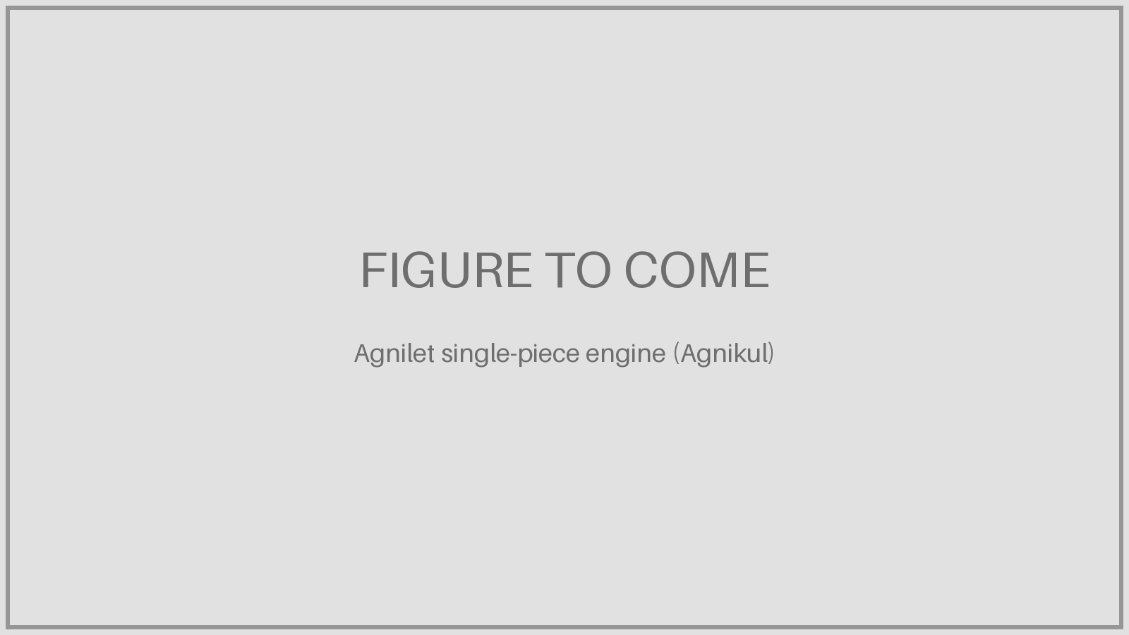
The printed engine as national champion
REGION · INDIA
Where they stand
• Skyroot Vikram-1 in orbit, 18 Jul 2026
• 350 kg to LEO; commercial service from 2027
• Agnikul fired a four-engine cluster, May 2026
• Agnibaan orbital attempt: late 2026–27
AM signature
• Agnilet: single-piece Inconel engine
• ≈ 72 h print; flew suborbitally May 2024
• 14 parts → 1, 19 weld joints avoided
• Skyroot: engine build from months to days
Executive read
Low cost base, an enabling regulator (IN-SPACe) and access to ISRO pads mean fast learning. AM lets a startup own its engine IP without a legacy supply chain.
Part 1 · The global map · SpaceNews; 3D Printing Industry; Agnikul; Space Odyssey Hub
EXED Polytechnique - Additive Manufacturing - 04 Industries by Andrei Constantinescu 2027
Notes:
India is the strongest story for AM as a strategic lever. Agnikul’s pitch is literally ‘print an engine, not assemble one’: its engine core replaces many parts and weld joints with one print, which removes inspection steps as well as machining. Skyroot uses printed engines across its Vikram family and calls the Vikram-1 engine India’s first fully 3D-printed orbital engine. With Vikram-1, India joined the USA and China as the only countries with a private company that has reached orbit (Europe joined in September). Ask: what would it take for a European or Canadian player to match India’s cost base? More detail: Agnikul built India’s first private launch pad at Sriharikota and runs Rocket Factory-1 at IIT Madras Research Park. Skyroot says it created more than 1,000 jobs, about 95% trained from scratch, and that its Vikram-1 engine is India’s first fully 3D-printed orbital engine. IN-SPACe authorised Vikram-1’s launch; ISRO provided the pad.

Slide 15
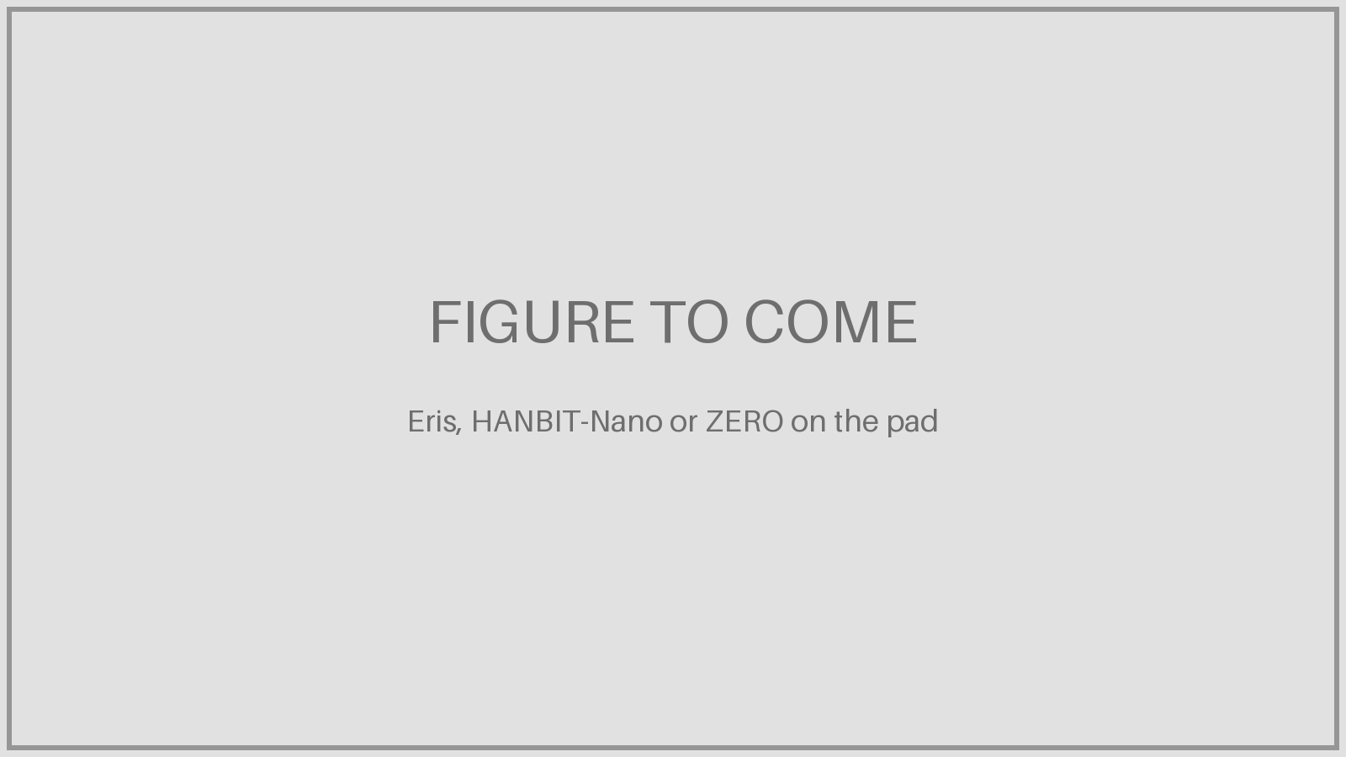
Buyers, challengers and near misses
REGION · PAKISTAN AND THE CHALLENGERS
Pakistan
• No indigenous orbital launcher
• 10 of 13 satellite launches on Chinese rockets
• PRSC-EO3 on a Long March 6, Apr 2026
• Invests in satellites, not rockets
Korea · Japan · Australia
• Innospace (KR): hybrid HANBIT-Nano, from Brazil
• Interstellar (JP): methane ZERO, 800 kg, 2027
• Space One (JP): solid KAIROS
• Gilmour Eris (AU): lost 14 s into 2025 debut
Executive read
Not every nation needs a launcher. For buyers, AM matters indirectly: it lowers suppliers’ costs and widens the choice beyond a single patron.
Part 1 · The global map · KeepTrack; Quwa; Next Spaceflight; Space Connect
EXED Polytechnique - Additive Manufacturing - 04 Industries by Andrei Constantinescu 2027
Notes:
Pakistan is the useful contrast case: it consciously chose not to build a launcher and to rely on Chinese launch services through China Great Wall Industry Corporation, putting its money into satellite design instead. That is a legitimate strategy and a reminder that launch sovereignty is a choice with a price. Korea and Australia show how hard the first flight is even with hybrid or simplified propulsion. Japan: Interstellar Technologies (Hokkaido, 200+ staff, more than $287M raised) has flown suborbital rockets and targets a first ZERO orbital flight in 2027; it prints injectors and turbine manifolds and casts its chamber in printed moulds (see the engine-bets slides). Space One (Tokyo) develops the solid KAIROS.

Slide 16
Four patterns across every region
WHAT THE MAP TELLS US
1 · Printed engines are table stakes
From Long Beach to Chennai to Samara, the engine is where printing lives. It no longer differentiates on its own.
2 · Sovereignty pays the bills
ESA’s Launcher Challenge, Canada’s Launch the North, Rostec, IN-SPACe: public money funds most new entrants.
3 · Winners move up
Rocket Lab to Neutron, LandSpace to reusable medium lift, Isar to a bigger Spectrum: small is a stepping stone.
4 · Failure is rarely the print
Orbex failed on capital; Neutron slipped on composites. Money, integration and cadence break programmes.
Part 1 · The global map
EXED Polytechnique - Additive Manufacturing - 04 Industries by Andrei Constantinescu 2027
Notes:
Pause here and ask the room which pattern surprised them. Pattern 4 is the one that matters for Part 2: if printing is not usually what breaks a programme, then the strategic question is not whether to print but how to own, source and qualify the capability without betting the company on it. Hand over to Exercise 1.

Slide 17
Regional war room
EXERCISE 1 · 15 MINUTES · TEAMS OF 4–6
You are the launch strategy council of your assigned region. Fill one canvas on a flip chart.
Teams: USA · Europe · China · India · Canada. Extra teams take Russia or Pakistan.
Timing: 9 min work, then a 60-second pitch per team, then 1 min wrap-up.
1 · Who flies by 2028? Name your two most credible players.
2 · Who pays? State, defence, private, foreign customers?
3 · Where does AM give you an edge? Or is it table stakes?
4 · Biggest risk to your region’s position.
5 · One move you would make on Monday.
Exercise 1 · Handout A in the facilitator guide
EXED Polytechnique - Additive Manufacturing - 04 Industries by Andrei Constantinescu 2027
Notes:
Assign regions so that each team argues for a region that is not their own, if possible: it removes home bias. Keep the scoreboard slide visible on a second screen if you have one. At minute 10, warn them they have two minutes. Pitches are strictly 90 seconds; the facilitator writes each team’s ‘one move’ on a shared flip chart. Wrap-up: point out where moves converge (usually: secure a manifest, partner for qualification) and where they diverge (build versus buy). That divergence is the bridge to Part 2.

Slide 18
Break
5:00
Back at 0:55 for Part 2: the engineering and what printing buys.
EXED Polytechnique - Additive Manufacturing - 04 Industries by Andrei Constantinescu 2027
Notes:
Five minutes only. Use it to collect the five ‘one move’ answers on one flip chart and to hand out the Exercise 2 case sheet face down on each table.

Slide 19
What printing actually buys
PART 2 · 0:55 – 1:30
Engineering primer · Raptor case · value, processes, limits · make or buy
EXED Polytechnique - Additive Manufacturing - 04 Industries by Andrei Constantinescu 2027
Notes:
Thirty-five minutes. First an engineering primer (Δv and propellant, anatomy and failure risk, engine cycles and thrust, development time and money), then the Raptor case study, then the four AM slides and the make-or-buy ladder that sets up Exercise 2. Budget about 2 minutes per primer slide. Keep the technical depth at board level: what each process is good for and what it costs you in qualification and post-processing.

Slide 20
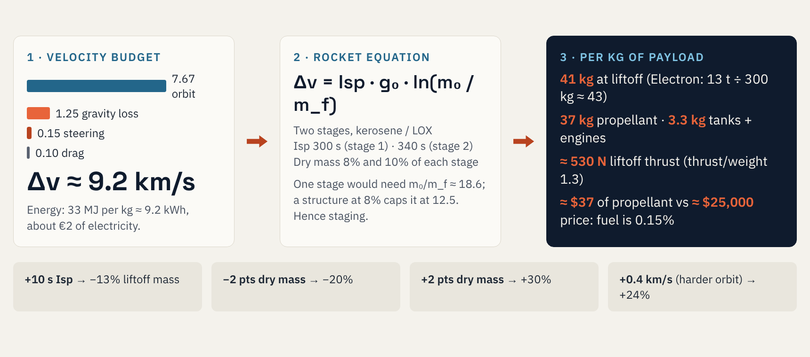
From one kilogram in orbit to propellant, thrust and money
PHYSICS · 1 KG TO A 400 KM ORBIT
Workshop model: two-stage rocket equation, optimal Δv split · propellant ≈ $1/kg blended LOX + RP-1 · Electron ≈ $7.5M for 300 kg
EXED Polytechnique - Additive Manufacturing - 04 Industries by Andrei Constantinescu 2027
Notes:
Walk left to right. A circular orbit at 400 km needs 7.67 km/s; climbing out of gravity costs about 1.25 km/s more, steering and drag about 0.25. Total about 9.2 km/s (an eastward launch gains about 0.4 km/s from Earth’s rotation; a sun-synchronous launch gains nothing). Put that into the rocket equation for a two-stage kerosene/LOX rocket and you get about 41 kg on the pad per kg delivered, which matches Electron (13 t for about 300 kg). The punchline is the last line: propellant costs tens of dollars per kilogram delivered; the price is tens of thousands. Launch cost is hardware and people, not fuel. That is why additive manufacturing targets the hardware: lighter engines and structures (the dry-mass sensitivities) and higher chamber pressure (Isp). A 2-point cut in dry mass fraction shrinks the whole rocket by about 20%.

Slide 21
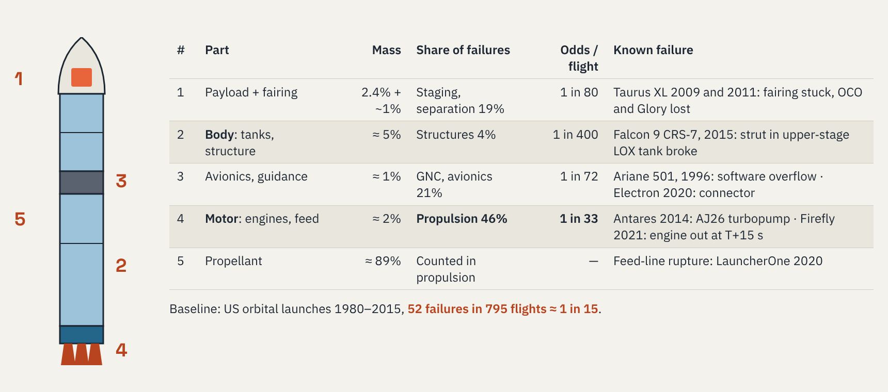
Engines are 2% of the mass and half of the failures
ANATOMY · MASS AND RISK
Mass: illustrative 300 kg-class two-stage launcher from the workshop model · Failure shares: NASA NTRS 20170009844 (US orbital launches 1980–2015)
EXED Polytechnique - Additive Manufacturing - 04 Industries by Andrei Constantinescu 2027
Notes:
The mass column comes from our rocket-equation model scaled to a 300 kg payload (liftoff about 12.4 t): about 89% propellant, 5% tanks and structure, 2% engines, 1% avionics and fairing, 2.4% payload. The failure columns come from a NASA study of 795 US orbital launches between 1980 and 2015: 52 failed, and propulsion caused 46% of them; guidance and avionics about 21%; staging and separation, including fairings, about 19%; structures about 4%; the rest unknown or thermal protection. ‘Odds per flight’ simply divides each count by 795. The message for engineers and executives alike: the motor is a tiny share of the mass and the dominant share of the risk, which is exactly where additive manufacturing concentrates. Printing removes welds and joints (fewer leak paths), but it adds new failure modes (porosity, powder contamination, unqualified parameter sets), so it shifts where you test, not whether you test.

Slide 22
New small launchers fail about one flight in two
TRACK RECORD · FAILURES PER LAUNCH
Vehicle | Flights | Success | Cause in | Failure (year): what broke
Electron | 79 | 75 | Avionics | 2020 stage-2 connector · 2017 ground software
Firefly Alpha | 7 | 3 | Motor | 2021: first-stage engine shut down at T+15 s
LauncherOne | 6 | 4 | Motor | 2020 LOX feed line rupture · 2023 fuel filter
Astra Rocket 3 | 7 | 2 | Motor | 2020 pogo oscillation · 2021 engine shutdown
Terran 1 | 1 | 0 | Motor | 2023: upper-stage engine short of full thrust
Spectrum | 2 | 1 | Body / GNC | 2025: bending modes → loss of attitude control
Eris | 1 | 0 | — | 2025: lost 14 s after liftoff
Vikram-1 | 1 | 1 | — | 2026: orbit on the first attempt
11 / 25
full successes for the 7 newcomers listed after Electron
7 / 8
maiden flights in this table failed
75 / 79
Electron through 2025: what a mature line looks like
Rocket Lab 10-K FY2025; Spaceflight Now; Gunter’s Space Page; Isar Aerospace; Wikipedia launch lists · Alpha: 2 failures + 2 partial · status 31 Oct 2026
EXED Polytechnique - Additive Manufacturing - 04 Industries by Andrei Constantinescu 2027
Notes:
Counts: Electron 75 successful missions through December 2025 plus 4 failures (2017 ground telemetry software triggered range safety; 2020 stage-2 electrical connector; 2021 and 2023 stage-2 anomalies). Firefly Alpha: 7 flights, 3 full successes, 2 partial (low orbits in 2022 and 2023) and 2 failures (2021, 2025). LauncherOne: 4 of 6 before Virgin Orbit closed. Astra Rocket 3: 2 of 7. Terran 1: one flight, upper stage failed. Spectrum: first flight lost at about 30 s in March 2025 because bending modes were not properly characterised; second flight reached orbit in September 2026. Eris: lost after 14 s in July 2025. Vikram-1: success on its first flight in July 2026. Where the cause is known, most of these first failures were in the motor or its feed system, consistent with the NASA figure of 46%. Catastrophic failures outside small launch to mention: Challenger 1986 (booster joint seal, a motor failure) and Columbia 2003 (foam strike on the wing’s heat shield, a body failure). Ask the room: what does a 1-in-2 maiden-flight success rate mean for insurance, customers and your second vehicle on the line?

Slide 23
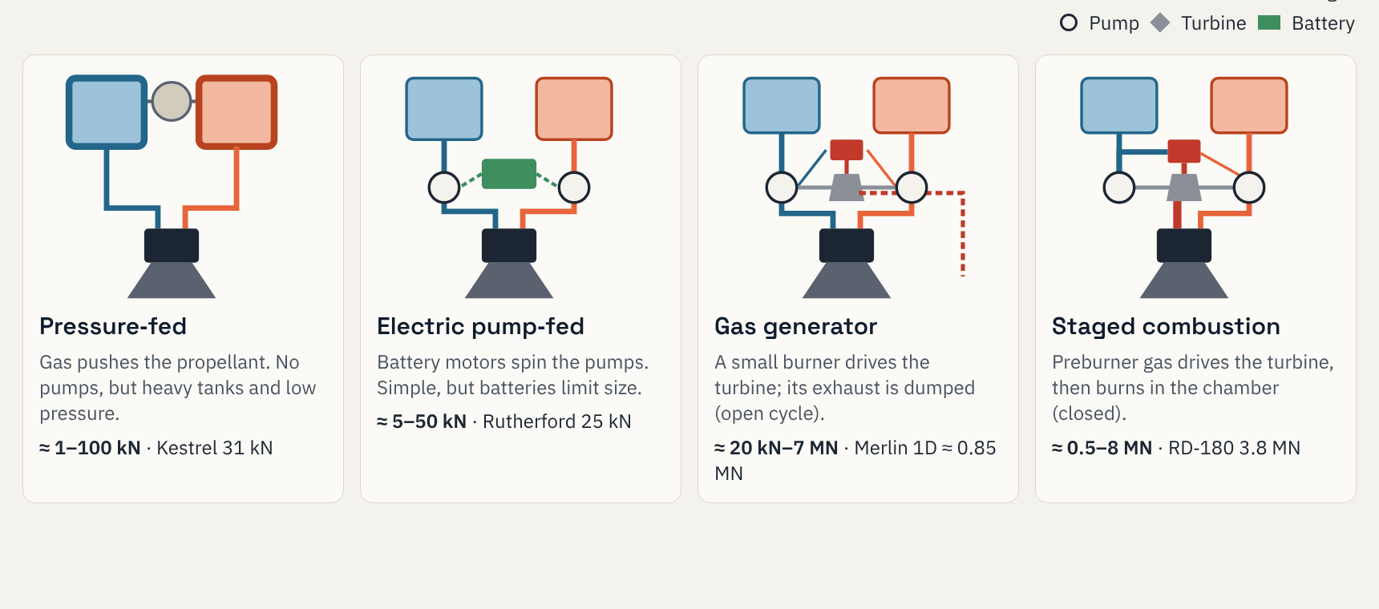
Four engine cycles, four thrust classes
PROPULSION · HOW LIQUID ENGINES FEED THEMSELVES
Thrust at sea level, approximate · Rutherford: Rocket Lab 10-K · others: manufacturer data via Wikipedia · schematics simplified (valves, cooling, igniters omitted)
EXED Polytechnique - Additive Manufacturing - 04 Industries by Andrei Constantinescu 2027
Notes:
Read each schematic top to bottom: tanks, feed, chamber. Pressure-fed: the simplest, but tank walls must hold the full feed pressure, so chamber pressure stays low (about 1–2.5 MPa) and the engine stays small. Electric pump-fed (Rocket Lab’s Rutherford): pumps replace pressure, so tanks are thin; but battery energy scales badly, which is why the cycle stays below about 50 kN. Gas generator (Merlin, Archimedes, Vulcain): a small burner drives the turbine and its exhaust is dumped, costing a few per cent of efficiency; it is the workhorse from tens of kN to the F-1’s 6.8 MN. Staged combustion (RD-180, BE-4, RS-25; Raptor in its full-flow version with two preburners): nothing is dumped, chamber pressure reaches 25–35 MPa, highest efficiency, hardest to build. Why it matters for additive manufacturing: preburners, injectors, turbine housings and regeneratively cooled chambers are exactly the complex, channel-filled parts printing is good at. The higher the cycle, the more AM pays.

Slide 24
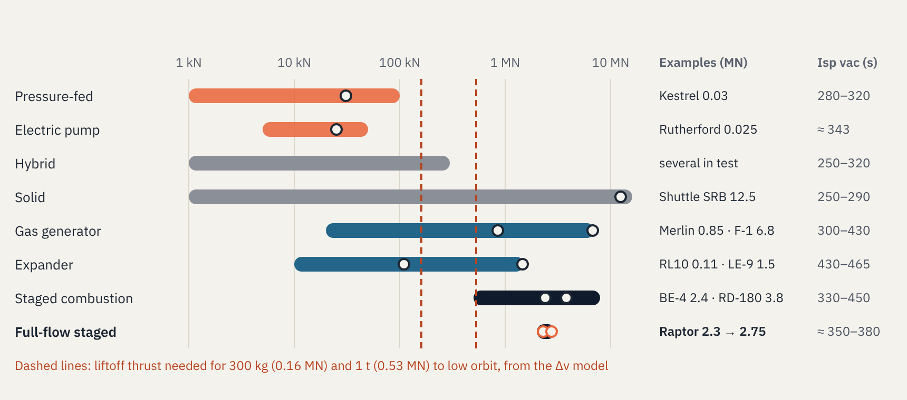
Small launchers need 0.2–0.5 MN: cluster engines
PROPULSION · THRUST PER ENGINE, LOG SCALE
Sea-level thrust, approximate · ranges indicative · Rutherford: Rocket Lab 10-K · Raptor 3: SpaceX 280 tf (≈ 2.75 MN) · others: manufacturer data via Wikipedia
EXED Polytechnique - Additive Manufacturing - 04 Industries by Andrei Constantinescu 2027
Notes:
Read across: each bar is the practical thrust range of one cycle, dots are named engines. The two dashed lines come from our Δv model: about 530 N of liftoff thrust per kilogram of payload, so a 300 kg launcher needs roughly 0.16 MN and a 1 tonne launcher roughly 0.53 MN. Small launchers therefore do not need a big engine; they need several small ones. Electron clusters nine 25 kN Rutherfords; Spectrum, Vikram-1 and Agnibaan also cluster. Clustering is where additive manufacturing shines: you print the same engine many times, so a short print-to-test loop pays back on every unit. Raptor sits alone in full-flow staged combustion: two preburners, one fuel-rich and one oxygen-rich, the highest-pressure production engine flying. Isp values are vacuum, typical ranges; expander and some gas-generator and staged engines reach the upper values because they burn hydrogen.

Slide 25
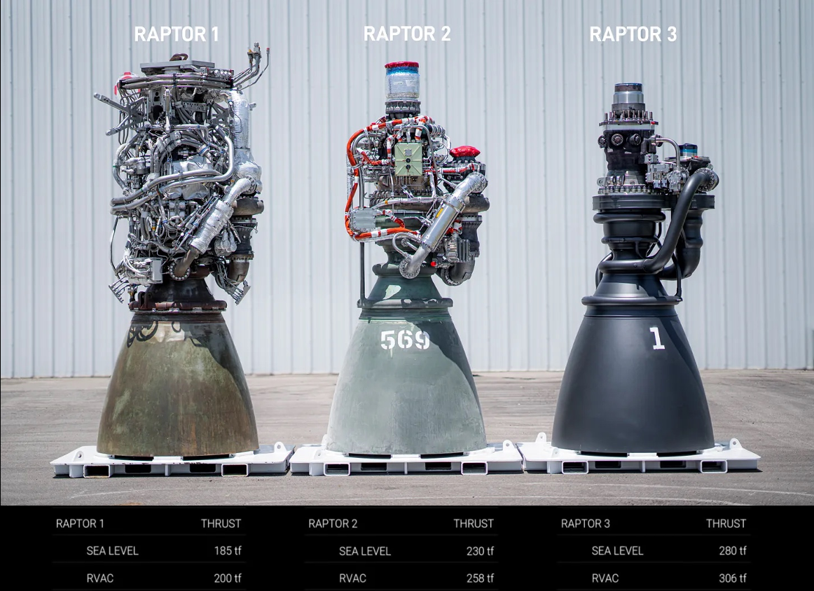
Raptor 1 → 3: +51% thrust, −27% mass
CASE STUDY · SPACEX RAPTOR
 | Raptor 1 | Raptor 2 | Raptor 3
Thrust, sea level (tf) | 185 | 230 | 280
Thrust, vacuum (tf) | 200 | 258 | 306
Mass (kg) | 2,080 | 1,630 | 1,525
Chamber pressure (bar) | 250–300 | 300 | 330–350
Thrust / weight | 89 | 141 | 184
First flight | 2019 | 2023 | 2026
Each generation moved plumbing inside the engine. Raptor 3 needs no heat shield and few bolted joints.
Image and thrust: SpaceX · mass, pressure: Wikipedia “SpaceX Raptor” · Raptor 3 nominal rating 250 tf (T/W 164); 280 tf reached in testing
EXED Polytechnique - Additive Manufacturing - 04 Industries by Andrei Constantinescu 2027
Notes:
Three generations in seven years. Raptor 1 (first flown on Starhopper in 2019) carried a visible nest of external lines and needed a heat shroud. Raptor 2 was a complete redesign: new turbomachinery, chamber and nozzle; flanges turned into welds; coaxial swirl injectors; production passed one engine per day by late 2022, at about half Raptor 1’s cost according to Musk. Raptor 3 moved plumbing and sensors into the main structure with integrated cooling and secondary flow circuits, removing the external shroud and heat shields. It first flew on Starship flight 12 on 22 May 2026. Thrust figures are SpaceX’s from the image; 280 tf is the highest reported test level, while the nominal rating is about 250 tf. Thrust-to-weight is thrust divided by mass. For engineers: thrust up 51%, mass down 27%, chamber pressure up about 15%. For executives: this is what iterating hardware fast looks like.

Slide 26
Print to learn fast, then integrate functions
CASE STUDY · ADDITIVE MANUFACTURING AT SPACEX
2013
SuperDraco chamber
Printed thrust chamber; concept to hot fire in just over 3 months, ~10× shorter lead time.
2014
Merlin 1D valve flies
Printed main oxidizer valve body: under 2 days vs months for a casting. Flew 6 Jan 2014.
2016
Raptor subscale
About 40% of parts by mass printed, including turbopump parts and injectors.
2019
In-house superalloys
SX300, then SX500, to survive hot oxygen-rich gas. Materials enable the cycle.
2021–23
Raptor 2 at rate
Over 1 engine a day; 50+ chambers melted and 20+ engines lost in testing.
2024–26
Raptor 3: functions inside
Cooling and secondary flows built into the structure; no heat shield. “Still has printed parts.”
Lesson: SpaceX does not print everything. It prints to shorten the test loop, then uses design for AM to merge parts, channels and joints.
Space.com (Aug 2014); Wikipedia “SpaceX Raptor”; 3Dnatives (Aug 2024) · colour: orange = printing milestones, blue = enablers
EXED Polytechnique - Additive Manufacturing - 04 Industries by Andrei Constantinescu 2027
Notes:
Six steps. 2013: the SuperDraco escape-engine chamber was printed; SpaceX said concept to first hot fire took just over three months, an order-of-magnitude lead-time reduction. January 2014: a printed main oxidizer valve body flew inside a Merlin 1D on the Thaicom 6 mission; printed in under two days instead of a months-long casting cycle. 2016: the subscale Raptor development engine had about 40% of its parts by mass printed, including turbopump and injector parts. 2019: SpaceX’s own superalloys (SX300, then SX500) for hot oxygen-rich gas: in a staged-combustion engine, materials are the gate. 2021–23: Raptor 2 production passed one engine per day, and testing destroyed more than 50 chambers and more than 20 engines; hardware-rich testing is the method, and printing makes it affordable. 2024–26: Raptor 3 integrates cooling and secondary flow circuits into the structure, removing heat shields and bolted joints; Musk said in 2024 it still has printed parts. The public record does not say which Raptor 3 parts are printed or by which process; do not overclaim. Ask the room: which of these six moves could your organisation copy without SpaceX’s budget?

Slide 27
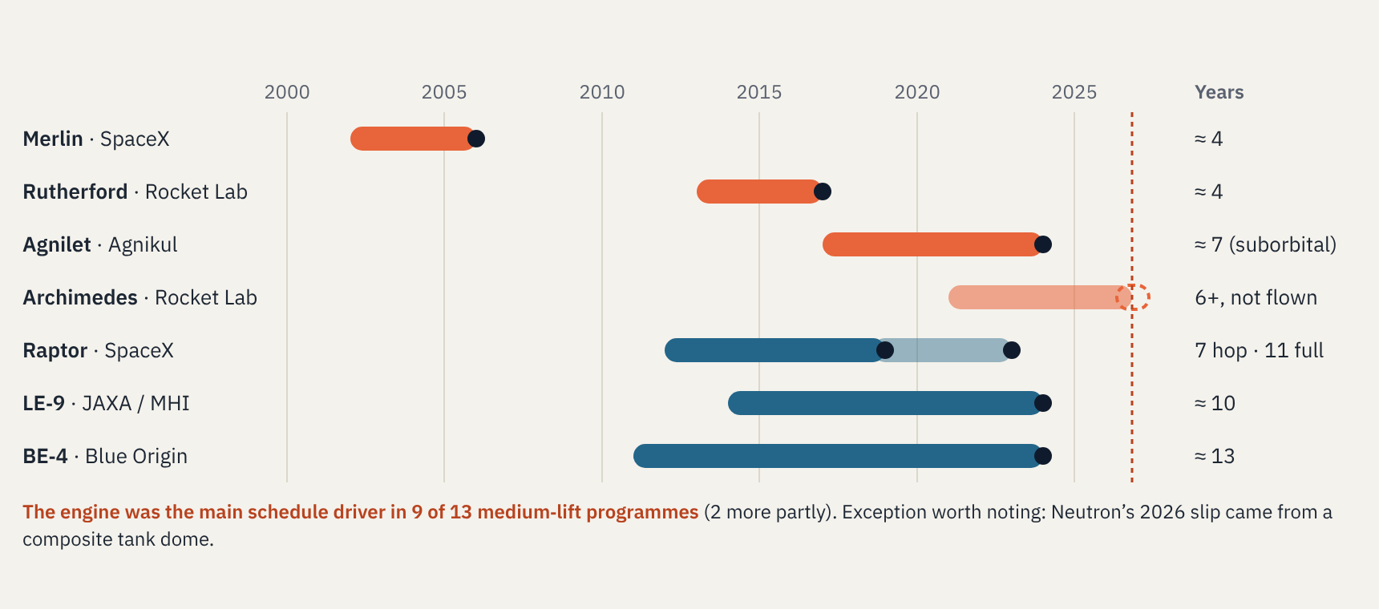
Engines take 4–13 years and set the schedule
DEVELOPMENT TIME · START TO FIRST FLIGHT
Orange = small-launcher engines · blue = larger engines · dot = first flight · dashed line = Oct 2026 · start years approximate · New Space Economy (Feb 2026); Wikipedia
EXED Polytechnique - Additive Manufacturing - 04 Industries by Andrei Constantinescu 2027
Notes:
Start dates are approximate: company founding or programme start where the engine start is not public. Merlin: SpaceX founded 2002, Falcon 1 first flew 2006. Rutherford: Electron programme from about 2013 to first flight 2017. Agnilet: Agnikul founded 2017, first suborbital flight May 2024; orbital flight still pending. Archimedes: announced with Neutron in 2021, not yet flown (Neutron now 2027). Raptor: concept 2012, component tests 2014, first hop 2019, full-scale flight 2023. LE-9: H3 programme from about 2014, first successful flight February 2024 after combustion-instability delays. BE-4: development from about 2011, first flight on Vulcan January 2024, the main cause of Vulcan’s slip. The New Space Economy review of 13 medium-lift programmes since 1987 found the engine was the main schedule driver in 9 and a partial driver in 2. Small, AM-heavy engines (Merlin, Rutherford) reached flight in about four years; large closed-cycle engines take a decade. Ask: where is your critical path, the engine or the body?

Slide 28
Small launchers: $100–400M and a few hundred people
DEVELOPMENT MONEY AND PEOPLE
Programme (first flight) | Development cost | People | Note
Falcon 1 (2006) | $90M | — | Reached orbit on flight 4, 2008
Falcon 9 (2010) | $390M incl. Falcon 1 | 1,180+ staff (2010) | NASA estimate, traditional way: $1.7–4B
Electron (2017) | ≈ $100M | — | Engine printed in-house
Spectrum (2025) | > €400M raised (company) | 400+ staff (2024) | Orbit on flight 2, Sept 2026
Vikram-1 (2026) | — | 1,000+ jobs created | 95% of staff trained from scratch
Orbex Prime (never) | > £70M public funding | ≈ 163 at collapse | Printed engines; ceased Feb 2026
Neutron (2027) | ≈ $300M (CFO target) | — | Slipped from 2024 to 2027
H3 (2024) | ≈ $1.5B | — | LE-9 instability drove delays
Ariane 6 (2024) | ≈ $4.4B | — | Upper stage and Vinci delays
Body vs motor: no company publishes its engineering hours by subsystem. Use the schedule as the proxy: the engine is the critical path, so it gets staffed and tested first.
Payload Research (development costs); SpaceX overview 2010; Wikipedia “Isar Aerospace”; ThePrint (Skyroot); Scotsman (Orbex) · then-year money
EXED Polytechnique - Additive Manufacturing - 04 Industries by Andrei Constantinescu 2027
Notes:
Development costs come from Payload Research’s compilation, which itself relies on company statements: Falcon 1 about $90M, Falcon 9 about $390M including Falcon 1, Electron about $100M, Neutron ‘remarkably close to $300M’ per Rocket Lab’s CFO, H3 about $1.5B, Ariane 6 about $4.4B. NASA’s 2011 cost-model exercise estimated Falcon 9 at $1.7B to $4B if developed the traditional way. People: SpaceX had over 1,180 staff in 2010; Isar Aerospace 400+ in 2024 and more than €400M raised; Skyroot says it created more than 1,000 jobs with about 95% of staff trained internally; Orbex had about 163 staff when it entered administration after more than £70M of public funding. On the split between body and motor: there is no reliable public breakdown of engineering hours. Do not invent one; ask participants from industry what they see. A useful data point: NASA’s FASTRAC engine went from authority to proceed (April 1996) to a delivered engine in about 28 months, then 57 tests in 14 months. Small, focused engine teams can move fast; integration is where headcount grows.

Slide 29
Same physics, nine engineering bets
ENGINE BETS · 1 / 2 · THE ENGINEERING NUMBERS
Company | Engines (1st + 2nd) | Cycle · propellants | Thrust | To LEO | Team · money
SpaceX (US) | 9 + 1 Merlin 1D | Gas generator · RP-1/LOX | ≈ 845 kN | 22.8 t | $390M (Falcon 9 dev.)
Ursa Major (US) | Hadley (supplier) | Ox-rich staged · RP-1/LOX | 22 kN | sells engines | ≈ 270 · $190M+
Isar (DE) | 9 + 1 Aquila | Gas generator · propane/LOX | 75 kN | 1,000 kg | 400+ · > €400M
RFA (DE) | 9 + 1 Helix | Ox-rich staged · RP-1/LOX | 100 kN | 1,300 kg | 300+ · ESA €187M
HyImpulse (DE) | Hybrid motors | Hybrid · paraffin/LOX | — | 600 kg | €45M (2025)
MaiaSpace (FR) | 3 + 1 Prometheus | Gas generator · methane/LOX | ≈ 980 kN | 0.5–1.5 t | France €179M
Latitude (FR) | 7 + 1 Navier | Turbopump-fed | — | 100 kg | ≈ $55M
Interstellar (JP) | ZERO · COSMOS | Gas generator · methane/LOX | — | 800 kg | 200+ · $287M+
Reaction Dyn. (CA) | 8 + 2 RE-202B | Hybrid · liquid ox. + plastic | 34 kN | not public | 37 · C$15M
Thrust per engine, sea level · team = staff · money = raised or public · Wikipedia; VoxelMatters; NASASpaceflight; newspace.im · — = not public
EXED Polytechnique - Additive Manufacturing - 04 Industries by Andrei Constantinescu 2027
Notes:
Nine bets on one table. Two Americans set the reference: SpaceX’s Merlin 1D (gas generator, about 845 kN, nine per Falcon 9) and Ursa Major, which sells engines rather than rockets: Hadley, an oxygen-rich staged-combustion engine of 22 kN that flies on Stratolaunch’s Talon-A hypersonic test vehicle, with Ripley (220 kN) and Arroway (890 kN, full-flow) in development. Germany: Isar (gas generator, propane), RFA (oxygen-rich staged), HyImpulse (paraffin hybrid). France: MaiaSpace with ArianeGroup’s Prometheus, a 980 kN methane gas-generator engine with a production-cost target of about €1M; Latitude (Reims) with seven turbopump-fed Navier engines on a 100 kg Zephyr, first flight targeted 2026–27. Japan: Interstellar Technologies’ ZERO, methane/LOX, 800 kg to LEO, first launch targeted 2027, more than $287M raised and over 200 staff. Canada: Reaction Dynamics’ hybrids. Ursa Major’s money is the sum of disclosed rounds ($8M 2017, $85M 2021, $100M Series E); its staff figure is from 2023. Use the next slide for what each one prints.

Slide 30
Everyone prints the chamber; few print the whole engine
ENGINE BETS · 2 / 2 · ADDITIVE MANUFACTURING AND STATUS
Company | What is printed | Machines · material | Status, Oct 2026
SpaceX (US) | Merlin valve, SuperDraco chamber, Raptor parts | In-house · SX500 alloy | Falcon 9, Raptor 3 flying
Ursa Major (US) | ≈ 80% of Hadley by mass: chamber, turbopumps | 9 powder-bed printers | Hadley flying; Draper 2026
Isar (DE) | Thrust chamber with cooling channels in the wall | EOS M 290, AMCM M 450 | In orbit, 5 Sep 2026
RFA (DE) | Major Helix components (planned) | not public | No launch date
HyImpulse (DE) | Nothing published | — | SL1 from 2027
MaiaSpace (FR) | Up to half of Prometheus; turbines printed by GKN | Target ≈ €1M per engine | First flight 2027
Latitude (FR) | Navier engine and most turbopump parts | Inconel 718 | First flight 2026–27
Interstellar (JP) | Injector, turbine manifold, chamber moulds | Inconel, stainless steel | ZERO first flight 2027
Reaction Dyn. (CA) | RE-101/102 engine hardware, cooled nozzle | not public | Orbit target Q3 2028
Space.com (2014); Wikipedia (Raptor, Prometheus, Ursa Major); VoxelMatters (Ursa Major, Isar); SpaceNews (GKN); NASASpaceflight (Latitude); 3Dnatives (Interstellar)
EXED Polytechnique - Additive Manufacturing - 04 Industries by Andrei Constantinescu 2027
Notes:
Three patterns. First, the thrust chamber with its regenerative cooling channels is the part almost everyone prints: it is the heaviest, longest-lead and most expensive part to make conventionally. Second, the companies that print the most (Ursa Major about 80% of Hadley by mass; Latitude the Navier engine and most turbopump parts; ArianeGroup up to half of Prometheus) are betting on many cheap engines. Third, printing does not guarantee schedule: RFA and HyImpulse are still waiting for orbit, Isar made it on its second flight. Interstellar is a nice nuance: it uses 3D-printed moulds to cast an Inconel chamber, a hybrid route that avoids large powder-bed machines. Next step, if wanted: turn these two tables into a visual comparison (engine thrust vs share printed vs status).

Slide 31
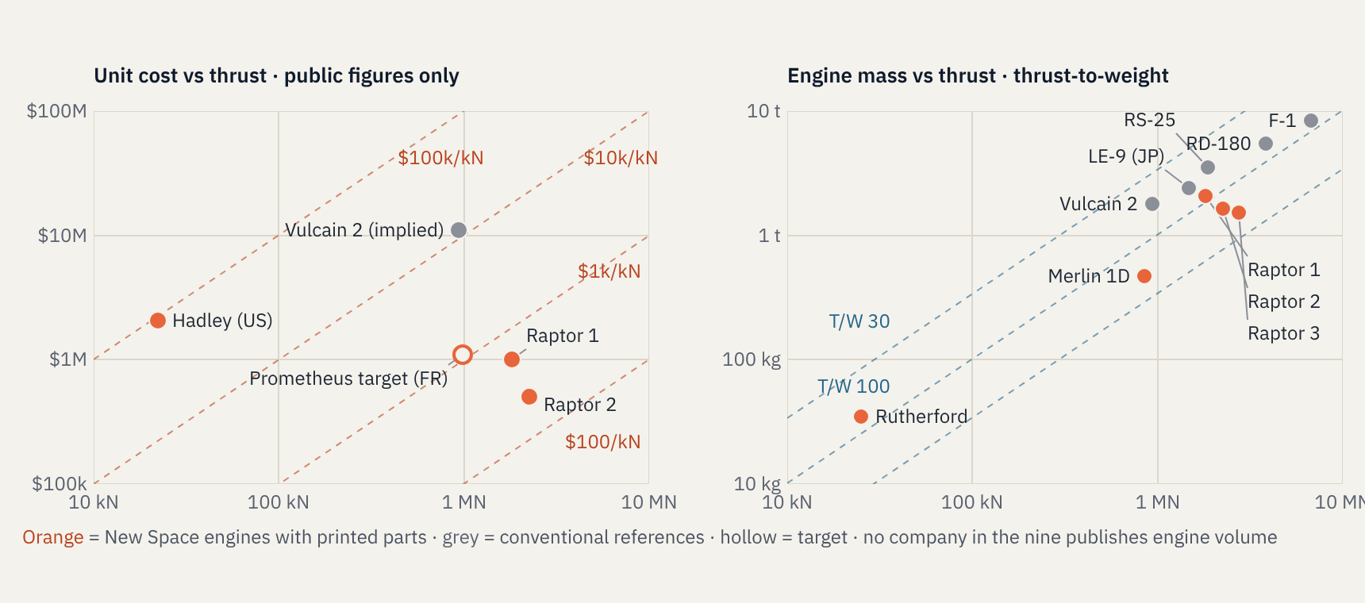
Per kN, small engines cost about 100× more
ENGINE BETS · COMPARED
Wikipedia (orbital engine comparison, Raptor, Prometheus); VoxelMatters (Hadley: $32.9M for 16) · costs mix prices, targets and statements
EXED Polytechnique - Additive Manufacturing - 04 Industries by Andrei Constantinescu 2027
Notes:
Left chart, unit cost against thrust, uses the only public figures we found: Ursa Major’s Hadley at about $2.1M each (Stratolaunch ordered 16 for $32.9M, so that figure may include support); ArianeGroup’s Prometheus target of about €1M for roughly 980 kN; Vulcain 2 implied at about ten times Prometheus (ESA’s stated goal is a tenfold cost cut); Raptor 1 at about $1M (Musk, 2019) and Raptor 2 at about half that (Musk, 2022). The dashed lines are dollars per kilonewton. The lesson: a small engine costs 100 times more per kN than a big one, which is why small launchers cluster cheap, identical engines and why printing them at volume matters. Right chart, mass against thrust, uses published sea-level thrust and mass; the dashed lines are thrust-to-weight ratios. Merlin 1D (about 183) and Raptor 3 (about 184) lead; Rutherford (about 73) pays for its batteries elsewhere. Raptor’s climb from about 89 to about 184 across three generations is the visible effect of integrating functions, which printing enabled. Most of the nine companies (Isar, RFA, HyImpulse, MaiaSpace, Latitude, Interstellar, Reaction Dynamics) publish neither engine mass nor unit cost, and none publishes engine volume, so we do not plot them rather than guess. If you obtain figures from industry contacts, they drop straight into these two charts.

Slide 32
Printing buys speed first, cost second
THE VALUE
2–10×
shorter lead times for rocket-engine parts
NASA Marshall
>50%
lower cost reported for printed propulsion parts
NASA Marshall
~24 h
claimed time to print a Rutherford engine
Rocket Lab
14 → 1
parts in Agnikul’s engine core, 19 weld joints avoided
Agnikul
All four are development and lead-time wins. Unit cost at rate still depends on post-processing, yield and cadence.
Part 2 · NASA MSFC, AIAA SciTech (2025); Rocket Lab; Manufactur3D
EXED Polytechnique - Additive Manufacturing - 04 Industries by Andrei Constantinescu 2027
Notes:
The NASA figures are ranges from Marshall Space Flight Center’s propulsion work; one Marshall example is a printed injector that cut cost by around 70%. Company claims (24 hours, 72 hours, 14 parts to 1) are marketing figures: real, but measured on the print step, not on the whole chain of heat treatment, machining and inspection. The executive point: printing compresses the design-build-test loop. That is why startups love it; it lets them iterate engines in weeks rather than quarters.

Slide 33
Four ways to print a rocket, one board-level map
THE PROCESSES
Process | How it works | Best for | Watch out for
Laser powder bed (L-PBF) | A laser melts metal powder layer by layer | Injectors, cooled chambers, valves, fine channels | Build size, powder handling, residual stress
Electron-beam bed (EB-PBF) | Same idea, electron beam in near vacuum | Reactive alloys; Rocket Lab’s Rutherford parts | Rougher surfaces, fewer suppliers
Directed energy / wire-arc (DED, WAAM) | Wire or powder fed into a moving melt pool | Large nozzles, domes, near-net blanks | Rough finish, heavy machining after
Hybrid | Print the complex parts, machine or weld the rest | Most flight engines today, incl. Terran R | Two process chains to qualify
Part 2 · NASA MSFC process overviews; Relativity Space (Mar 2025); Rocket Lab
EXED Polytechnique - Additive Manufacturing - 04 Industries by Andrei Constantinescu 2027
Notes:
Executives do not need the physics, but they do need to know that each process is a separate qualification effort, a separate machine market and a separate skill set. Powder bed is where most engine value sits today. Wire-arc and other directed-energy methods are how you print big. Relativity’s current approach for Terran R combines powder-bed and wire-arc printing with conventional manufacturing: that hybrid is now the industry norm, not the exception.

Slide 34
What printing does not fix
THE LIMITS
Qualification
Every machine, powder lot and parameter set is a process to qualify. NASA wrote dedicated standards for laser powder bed (MSFC-STD-3716, SPEC-3717).
Touch labour stays
Heat treatment, hot isostatic pressing, machining and CT inspection follow every print. Spent powder and failed builds are part of the cost.
Size and scale
Build envelopes cap part size. Relativity moved from a mostly printed Terran 1 to a hybrid Terran R to reach volume.
Supply chain and people
Large machines, qualified powders and skilled operators are scarce, and export controls can apply to all three.
Part 2 · NASA NTRS (MSFC AM training, process overviews); TechCrunch; NASASpaceflight
EXED Polytechnique - Additive Manufacturing - 04 Industries by Andrei Constantinescu 2027
Notes:
This is the honest slide. The print itself may take a day; the qualified, inspected, flight-ready part takes much longer. Executives should ask suppliers and teams for the full chain time, not the print time. On people: the scarce resource is often the materials and process engineer who can qualify a new machine, not the machine itself. On export controls: check both machine and powder sourcing early, especially for programmes with defence customers.

Slide 35
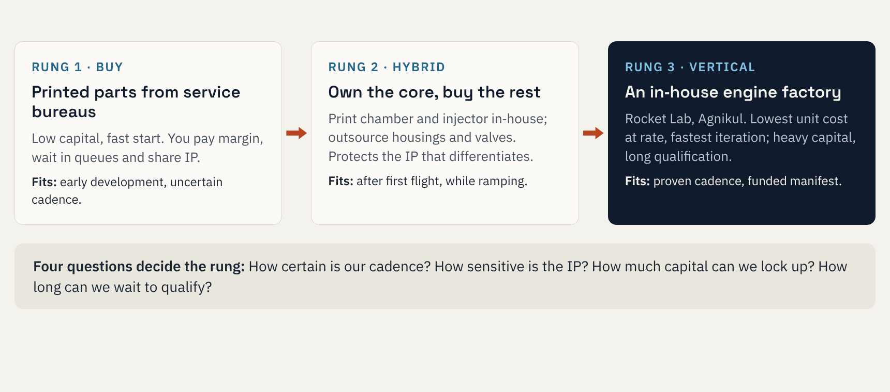
Make or buy: a three-rung ladder
THE DECISION
Part 2 · Framework for Exercise 2
EXED Polytechnique - Additive Manufacturing - 04 Industries by Andrei Constantinescu 2027
Notes:
Most successful companies climb the ladder rather than jump to the top. Rocket Lab built in-house once Electron had a market; Relativity jumped to the top rung for the whole rocket and had to step back down to hybrid for Terran R. The four questions are the ones teams will use in Exercise 2. Leave this slide up while you hand out the case.

Slide 36
Building and de-risking a printed engine
PART 3
Raptor scheme · materials · AM geometry limits · equipment · tests · design chain · cost · defects · loads · failure scenarios
EXED Polytechnique - Additive Manufacturing - 04 Industries by Andrei Constantinescu 2027
Notes:
Part 3 moves from strategy to engineering. It opens with the Raptor schematic, the material map and the geometric limits of printing, then asks what we need to buy, test and organise (equipment, test pyramid, design chain, cost, defects), and closes with Raptor as a worked example: the wall cross-section that derives the loads, the loads table, failure scenarios and reliability. All Raptor numbers are workshop estimates derived from public thrust and chamber-pressure figures, not SpaceX data: say so explicitly.

Slide 37
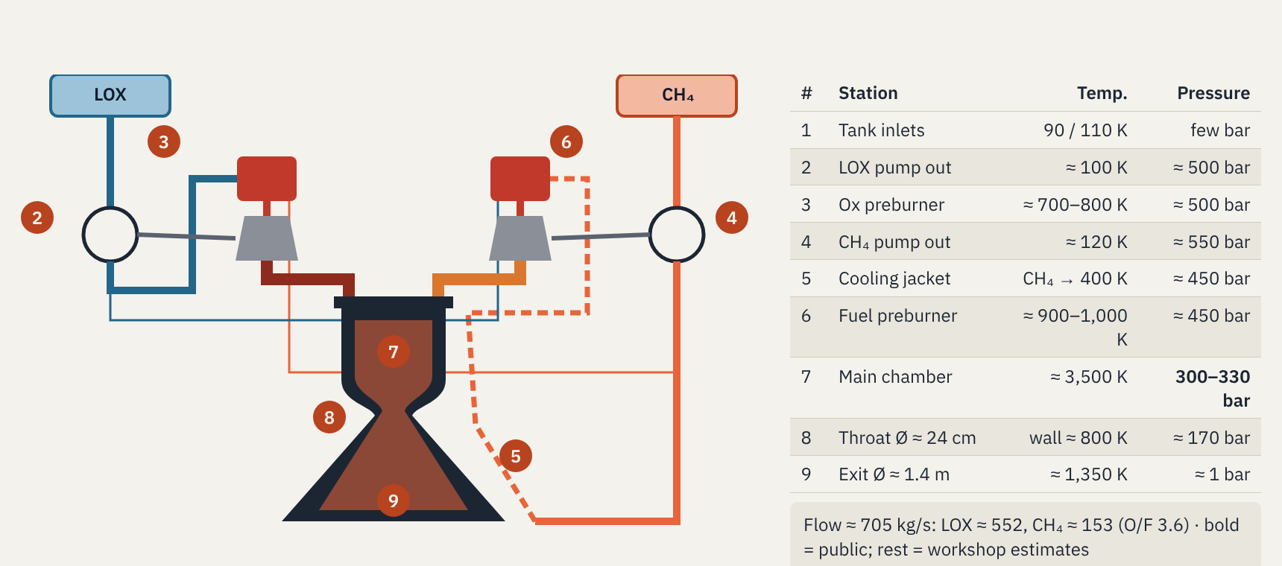
Two preburners, two turbines, all gas into the chamber
RAPTOR · HOW FULL-FLOW STAGED COMBUSTION WORKS
Schematic simplified · public inputs: thrust 230 tf, chamber 300–330 bar (Wikipedia “SpaceX Raptor”) · temperatures, pressures, diameters: workshop estimates, not SpaceX data
EXED Polytechnique - Additive Manufacturing - 04 Industries by Andrei Constantinescu 2027
Notes:
How to read it. Liquid oxygen (blue, station 1) enters top left and is pumped (2) to roughly 500 bar. All of it goes to the oxygen-rich preburner (3), which burns it with a little methane at a few hundred kelvin above ambient so the turbine survives; that turbine drives the oxygen pump, and its hot oxygen-rich gas then flows into the main injector. Methane (orange) enters top right, is pumped (4), then flows through the cooling channels of the nozzle and chamber wall (5, dashed) where it picks up heat, then into the fuel-rich preburner (6), whose turbine drives the methane pump; its hot methane-rich gas also flows into the main injector. Because both propellants arrive as hot gas, mixing is excellent and nothing is dumped overboard: that is ‘full-flow’. Main chamber (7): about 3,500 K at 300 bar (Raptor 2) to 330 bar (Raptor 3). Throat (8): from public thrust and pressure, a characteristic velocity of about 1,850 m/s gives a throat area of about 0.043 m², roughly 24 cm across; heat flux there is of order 100–160 MW/m² (the Space Shuttle main engine throat is about 160 MW/m² at lower pressure). Nozzle exit (9): assuming an area ratio of 35, about 1.4 m across and about 1,350 K. Temperatures and pressures at stations 2–6 are reasoned estimates, chosen to make the cycle close, and are labelled as such.

Slide 38
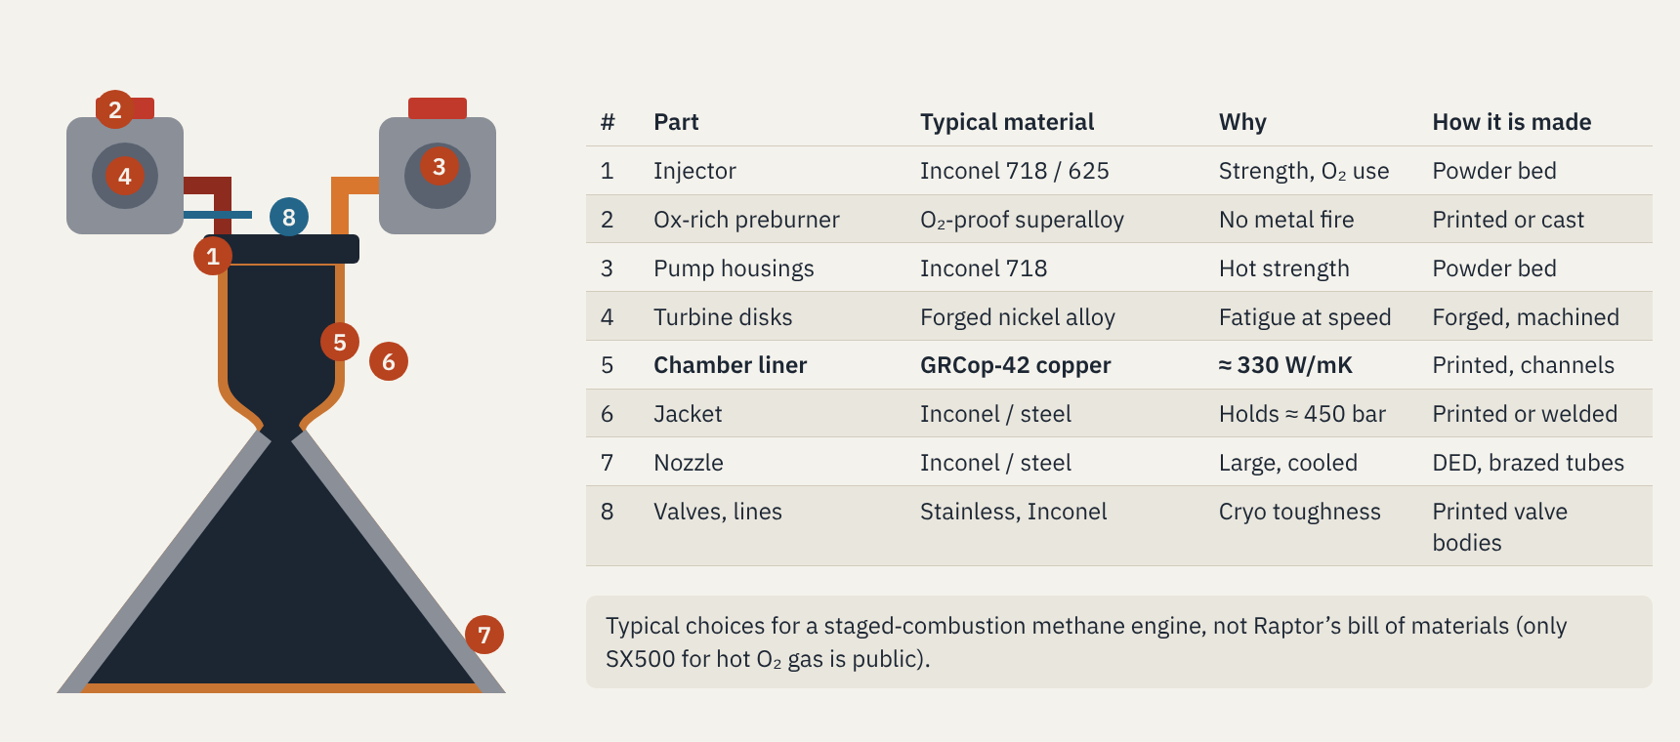
Copper to remove heat, nickel to hold pressure
BUILDING · WHICH MATERIAL WHERE
Velo3D (GRCop-42); Everyday Astronaut (SX500); Space.com (Merlin printed valve); NASA MSFC material overviews · copper = orange zone, nickel = grey
EXED Polytechnique - Additive Manufacturing - 04 Industries by Andrei Constantinescu 2027
Notes:
Walk the engine top to bottom. Hot sections need two opposite properties: carry heat away (copper) and hold pressure (nickel or steel). That is why a regeneratively cooled chamber is a sandwich: a thin copper alloy liner with cooling channels (GRCop-42 conducts about 320–350 W/mK after HIP but yields at only about 180–195 MPa) inside a structural nickel-alloy or steel jacket that carries the coolant pressure. Injectors and pump housings are classic Inconel 718 or 625 powder-bed parts: complex, many internal passages, moderate temperature. The oxygen-rich preburner and hot-gas manifold are the hardest material problem: hot oxygen at hundreds of bar makes most metals burn, which is why SpaceX developed its own superalloy (SX500) and why Russian oxygen-rich engines used special coatings. Rotating parts (turbine disks, impellers) are still usually forged and machined because fatigue is critical and printed microstructures are less proven there. Large nozzles are made by directed-energy deposition or brazed tube bundles. Valve bodies were among the first printed flight parts (Merlin 1D main oxidizer valve, 2014). Stress to the audience: this is a typical bill of materials, not Raptor’s, which is not public beyond SX500.

Slide 39
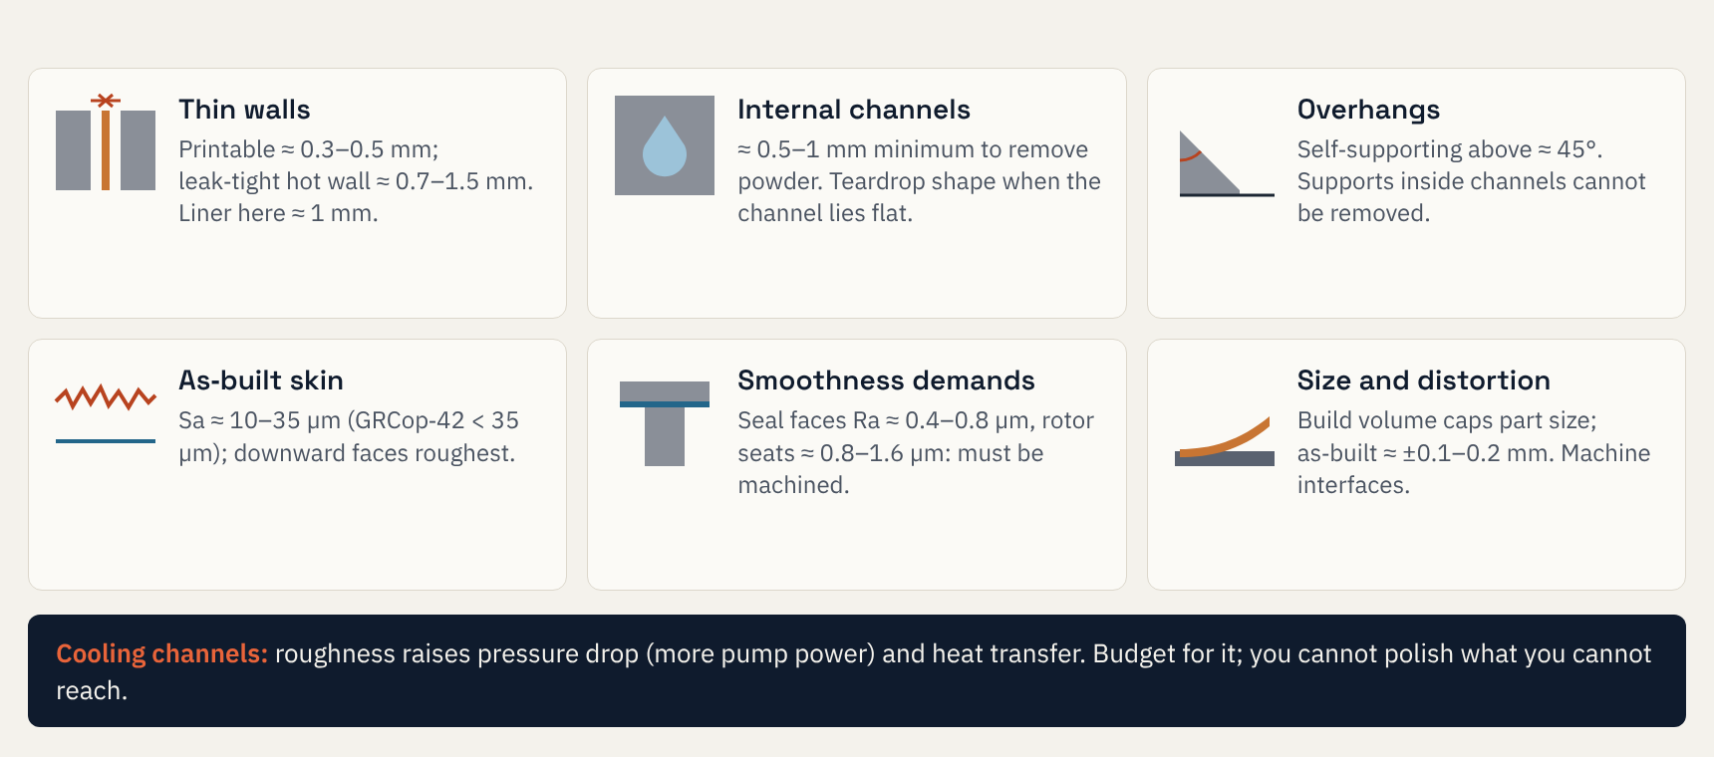
Thin walls, small channels, overhangs and rough skins
BUILDING · WHAT PRINTING FINDS HARD
Velo3D (GRCop-42 Sa); Materials & Design 2021 (IN718 channels 0.5–1 mm, droplet shape); other values typical design-guide ranges, check your machine
EXED Polytechnique - Additive Manufacturing - 04 Industries by Andrei Constantinescu 2027
Notes:
Six rules of thumb, each a drawing. Thin walls: a powder-bed machine can print walls of a few tenths of a millimetre, but a leak-tight hot wall that must survive pressure and thermal cycling is usually 0.7–1.5 mm; our Raptor-class liner estimate uses 1 mm. Internal channels: below roughly 0.5–1 mm, powder cannot be removed reliably; a 2021 study of Inconel 718 channels from 0.5 to 1 mm found a droplet (teardrop) cross-section, scaled with build inclination, gives the most accurate channels when they lie at less than 45°. Overhangs: surfaces flatter than about 45° need supports, and supports inside closed channels cannot be removed, so channel routing is a design constraint. As-built skin: typical areal roughness is about 10–35 µm (Velo3D quotes Sa below 35 µm for GRCop-42 after HIP), with downward-facing surfaces the roughest. Smoothness demands: sealing faces and rotor seats need about 0.4–1.6 µm, so they are always machined; turbine and pump flow paths are usually machined or polished. Size and distortion: the build volume limits part size, residual stress distorts long thin parts, and as-built tolerances of about a tenth to two tenths of a millimetre mean every interface is machined. The bar at the bottom is the engineering trade: rough cooling channels increase friction (pump power) but also heat transfer; size them with measured roughness, not drawing values. Values other than the cited ones are typical design-guide ranges and vary by machine and alloy.

Slide 40
The printer is one box in a four-box chain
WHAT YOU NEED · FROM POWDER TO FLIGHT PART
1 · Printers
• Laser powder bed: injectors, chambers, manifolds
• Multi-laser, large bed (Isar: AMCM M 450)
• Wire / powder DED for big nozzles, domes
• Inert gas, powder room, safety
≈ €0.5–4M per machine (indicative)
2 · Materials
• Copper GRCop-42: chamber liners, 323–351 W/mK
• Inconel 718 / 625: injectors, housings
• O₂-compatible superalloys for ox-rich gas
• Powder spec, lot tracking, reuse limits
GRCop-42: yield ≈ 180–195 MPa, UTS ≈ 365–390 MPa
3 · Post-processing
• Stress relief before removal
• Powder removal from channels
• HIP and heat treatment
• Machining of interfaces, channel finishing
Often the longest step in the chain
4 · Inspection, test
• CT scan, dye penetrant
• Flow test every cooling circuit
• Proof and leak test
• Witness coupons from every build
Then hot fire on your own stand
People: process and materials engineers, NDE specialists and test crews are the scarce resource, not machines.
Velo3D GRCop-42 data sheet (after HIP); VoxelMatters (Isar, Ursa Major); NASA MSFC AM overviews · machine prices indicative, ask vendors
EXED Polytechnique - Additive Manufacturing - 04 Industries by Andrei Constantinescu 2027
Notes:
Read left to right: printing is one step in a four-step chain, and the last two steps usually take longer and cost more than the print. Printers: laser powder bed fusion makes the precision parts with internal channels (injectors, regeneratively cooled chambers, manifolds, turbine housings); bigger multi-laser machines such as the AMCM M 450 Isar uses give the build volume for a full thrust chamber; directed-energy or wire-arc deposition makes large nozzles and domes. Machine prices span roughly half a million to several million euros depending on size and laser count; treat these as indicative and get quotes. Materials: copper alloys such as NASA’s GRCop-42 conduct heat well (about 323–351 W/mK after HIP) but are weak (yield about 180–195 MPa at room temperature), which is why chamber liners are life-limited; nickel superalloys such as Inconel 718 and 625 give strength for injectors and housings; hot oxygen-rich gas needs special oxygen-compatible alloys, which is why SpaceX developed SX500. Post-processing: stress relief, removal of trapped powder from channels, hot isostatic pressing, heat treatment and machining. Inspection: CT, flow tests of every cooling circuit, proof and leak tests, and witness coupons printed alongside every part. The people who qualify a new machine or parameter set are scarce.

Slide 41
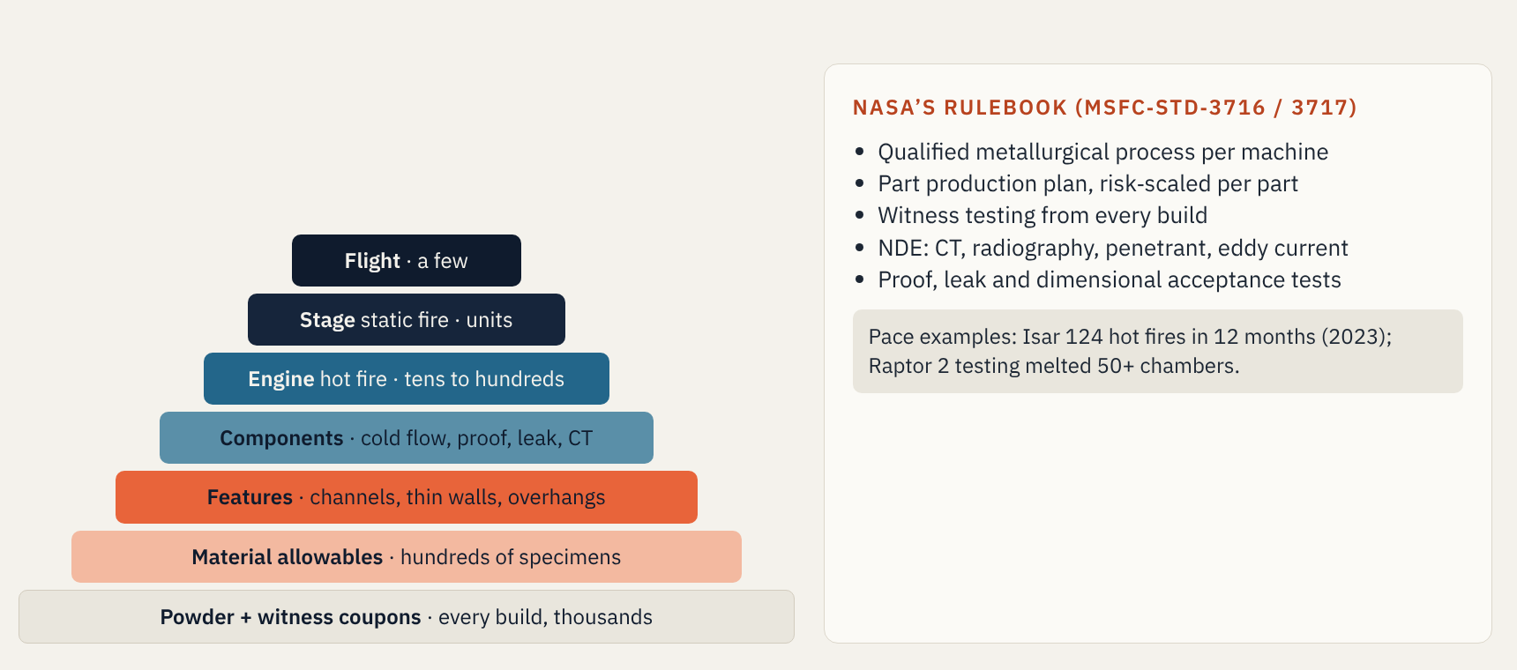
The test pyramid: thousands of coupons, a few flights
TESTS · BUILDING CONFIDENCE BOTTOM UP
NASA NTRS 20170012456 (MSFC-STD-3716 overview); Isar Aerospace (Mar 2023); Wikipedia “SpaceX Raptor” · counts indicative
EXED Polytechnique - Additive Manufacturing - 04 Industries by Andrei Constantinescu 2027
Notes:
The pyramid is how confidence is built: many cheap tests at the bottom, few expensive ones at the top. Every printed build carries witness coupons, small specimens printed beside the part, which are tensile- or fatigue-tested to prove that build behaved like the qualified process. Above that: material allowables (hundreds of specimens to get statistically valid design values), feature tests (can we print this channel, this wall thickness), component acceptance (cold flow, proof pressure, leak, CT), engine hot fire, stage static fire, flight. NASA’s MSFC-STD-3716 and MSFC-SPEC-3717 formalise this for laser powder bed fusion: a qualified metallurgical process for each machine, a part production plan scaled to each part’s risk, witness testing, non-destructive evaluation and acceptance tests. Two pace examples: Isar ran 124 hot fires in 12 months in 2023; SpaceX’s Raptor 2 programme melted more than 50 chambers and lost more than 20 engines in testing. Executive message: budget the pyramid, not just the printer, and fund the test stand early.

Slide 42
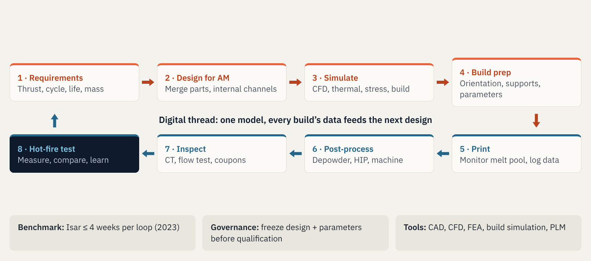
One loop, closed in weeks, not months
DESIGN CHAIN · THE DIGITAL THREAD
Isar Aerospace press (Mar 2023); NASA MSFC AM process flow · tool categories generic
EXED Polytechnique - Additive Manufacturing - 04 Industries by Andrei Constantinescu 2027
Notes:
Read clockwise from top left. Requirements set thrust, cycle, life and mass. Design for additive manufacturing merges parts and puts cooling and flow channels inside walls. Simulation covers fluid flow, heat transfer, structural margins and the build itself (distortion and residual stress). Build preparation fixes orientation, supports and laser parameters. Printing is monitored layer by layer. Post-processing removes powder, closes porosity by hot isostatic pressing and machines interfaces. Inspection uses CT, flow tests and witness coupons. Hot fire closes the loop, and its data flows back into the model: that is the digital thread. Isar reported design loops of four weeks or less in 2023. Governance point for executives: iterate freely in development, but freeze design and process parameters before qualification, because every change to the process restarts part of the test pyramid.

Slide 43
The print is a fifth of the cost; the rest is after it
ESTIMATING COST · PER PRINTED PART
The model
Cost per good part = (machine + material + post + inspection) ÷ yield
Machine = build hours × (capex ÷ (years × hours per year) + operating €/h)
Build hours = (part + support volume) ÷ (lasers × cm³/h per laser)
Material = mass × €/kg × (1 + scrap)
Plus once: qualification, fixtures, CT programmes, test stand
Worked example · copper chamber liner (illustrative)
Input | Assumption → result
Volume + supports | 4,800 cm³ → ≈ 42 kg copper alloy
Build | 4 lasers × 20 cm³/h → 60 h
Machine | €2M, 5 yr, 5,000 h/yr + €40/h → €7.2k
Powder | €100/kg + 10% scrap → €4.6k
Post-processing | HIP, heat treat, machining → €10k
Inspection | CT, flow, proof, coupons → €5k
Yield 80% | ≈ €34k per good part
Print 21%
Powder 14%
Post-processing 30%
Inspection 15%
Scrap (yield) 20%
All inputs illustrative · density 8.79 g/cm³ (GRCop-42, Velo3D) · replace with vendor quotes and your own yields
EXED Polytechnique - Additive Manufacturing - 04 Industries by Andrei Constantinescu 2027
Notes:
The model is deliberately simple so an executive can challenge each input. Machine cost per hour is capital spread over useful hours plus operating cost (gas, power, maintenance, operator share). Build time is volume including supports divided by deposition rate times number of lasers. Material is mass times powder price plus scrap. Post-processing and inspection are often quoted per part. Divide everything by yield, because a part that fails CT or proof testing still costs the full chain. Worked example, all assumptions illustrative: a copper chamber liner of about 4,000 cm³ plus 20% supports (about 42 kg at 8.79 g/cm³), printed on a four-laser machine at 20 cm³/h per laser (60 hours), machine €2M depreciated over 5 years at 5,000 hours per year plus €40/h operating (about €120/h, €7.2k), powder €100/kg plus 10% (about €4.6k), post-processing €10k, inspection €5k, yield 80%: about €34k per good part. The print itself is about a fifth; post-processing, inspection and scrap are more than half. Levers: yield (process control), post-processing (design for depowdering and fewer machined surfaces), utilisation (more hours per year). Non-recurring costs (qualification, fixtures, CT programmes, the test stand) usually dwarf the unit cost in the first years.

Slide 44
Six defects to hunt, and how to find them
RISK · DEFECTS IN PRINTED METAL
Defect · cause | How we find it | What it does | Mitigation
Lack of fusion: low energy | CT, witness coupons | Fatigue crack starter (worst) | Parameters, melt-pool monitoring
Gas porosity: keyholing | CT | Lower fatigue life | HIP closes internal pores
Rough surface: layering | Profilometry, CT | Fatigue strength can halve | Machine, polish, flow-finish
Trapped powder | Flow test, CT, weight | Blocked coolant → burn-through | Design to drain, flow test all
Residual stress | 3D scan, build simulation | Distortion, cracks, leaks | Supports, stress relief
Bad powder | Chemistry, coupons | Brittle; metal fire in O₂ | Powder control plan
HIP does not close surface-connected flaws
Polishing Ti-6Al-4V: 250 → 500 MPa fatigue strength
CT resolution falls as part size grows
NASA NTRS 20170012456 (MSFC-STD-3716 risks); review of AM fatigue, arXiv 2311.07046 (Ti-6Al-4V data)
EXED Polytechnique - Additive Manufacturing - 04 Industries by Andrei Constantinescu 2027
Notes:
Six defect families. Lack of fusion (unmelted regions from too little energy or spatter) is the most harmful because its sharp flat voids start fatigue cracks; NASA singles out vertical, horizontal and ‘zero-volume’ lack of fusion that survives HIP. Gas porosity (round pores from keyholing or gas in the powder) is less harmful and is mostly closed by hot isostatic pressing, but HIP cannot close pores connected to the surface. As-built surface roughness dominates fatigue: in one study polishing printed Ti-6Al-4V raised its fatigue strength at 10 million cycles from about 250 to 500 MPa; internal cooling channels cannot be polished easily, so they are designed with margin or flow-finished. Trapped powder in channels blocks coolant and causes burn-through, so every cooling circuit should be flow-tested. Residual stress from steep thermal gradients distorts and cracks parts; supports, stress relief and build simulation manage it. Contaminated or degraded powder makes parts brittle and, in oxygen-rich gas, can ignite: a powder control plan with lot tracking and reuse limits is mandatory. CT is the main detection tool, but its resolution falls as the part gets bigger and denser, so witness coupons and proof tests complement it. The quantitative fatigue figures quoted are for Ti-6Al-4V; for copper and nickel alloys use your own test data.

Slide 45
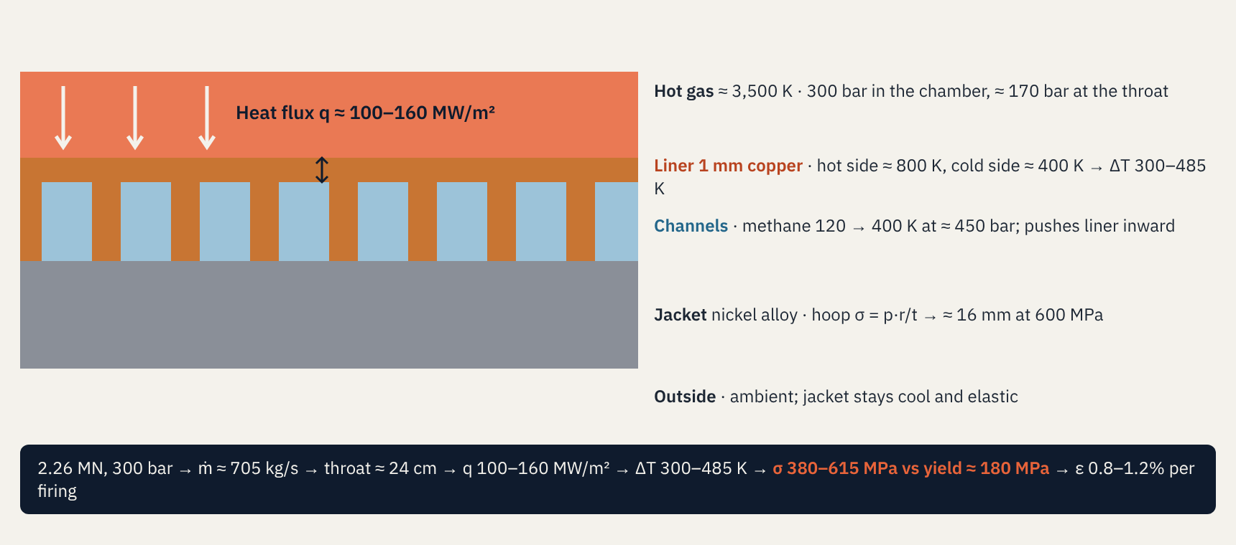
Where the numbers in the table come from
LOADS · THE COOLED WALL NEAR THE THROAT
Public: thrust, chamber pressure · assumed: c* 1,850 m/s, Isp 327 s, liner 1 mm, k 330 W/mK, E 100 GPa, α 17×10⁻⁶ /K · heat flux by analogy with SSME throat (≈ 160 MW/m²)
EXED Polytechnique - Additive Manufacturing - 04 Industries by Andrei Constantinescu 2027
Notes:
This slide is the derivation behind the loads table, drawn as a slice through the chamber wall near the throat. Step 1, mass flow: thrust divided by exhaust velocity, 2.26 MN ÷ (327 s × 9.81) ≈ 705 kg/s, of which about 552 kg/s oxygen and 153 kg/s methane at a mixture ratio of 3.6. Step 2, throat: area = characteristic velocity × mass flow ÷ chamber pressure = 1,850 × 705 ÷ 30 MPa ≈ 0.043 m², about 24 cm across; thrust coefficient check 2.26 MN ÷ (30 MPa × 0.043 m²) ≈ 1.73, a sensible value. Step 3, heat flux at the throat: of order 100–160 MW/m², by analogy with the Space Shuttle main engine throat (about 160 MW/m²). Step 4, temperature drop through 1 mm of copper conducting 330 W/mK: q·t/k ≈ 300–485 K, so the hot face sits near 800 K while the coolant side is near 400 K. Step 5, thermal stress for a plate held flat: E·α·ΔT ÷ 2(1−ν) ≈ 380–615 MPa, two to three times the copper’s room-temperature yield of about 180 MPa; strain α·ΔT ÷ (1−ν) ≈ 0.8–1.2%. Step 6, coolant at about 450 bar pushes the thin liner ligaments inward between ribs (small bending stress, tens of MPa) and the jacket must carry the hoop load: p·r/σ ≈ 16 mm of nickel alloy at 600 MPa. Step 7, the strain per firing feeds the fatigue-life estimate two slides later. All but thrust and chamber pressure are assumptions.

Slide 46
Temperatures, forces, stresses, strains in five minutes
RAPTOR · BACK-OF-ENVELOPE LOADS
Part · load | Quick formula | Estimate | So what
Liner, copper 1 mm · 100–160 MW/m² | ΔT = q·t/k · σ = EαΔT / 2(1−ν) | ΔT 300–485 K · σ 380–615 MPa | > yield every firing
Jacket, nickel alloy · 450 bar coolant | t = p·r / σ | ≈ 16 mm at 600 MPa hoop | Elastic: fine
Injector face · 300 bar on Ø 41 cm | F = Pc · A | ≈ 3.9 MN (1.7× thrust) | Joints carry it
Pumps · 705 kg/s to ≈ 500 bar | P = ṁ·Δp / (ρ·η) | ≈ 32 + 28 = 60 MW | ≈ 80,000 hp each
Turbine disk · tip ≈ 450 m/s | σ ≈ (3+ν)/8 · ρ · v² | ≈ 690 vs ≈ 900 MPa hot yield | Margin ≈ 1.3
Cluster · 33 × 2.26 MN | ΣF | ≈ 75 MN at liftoff | Thrust structure
The life limiter
The copper liner yields every firing: 0.8–1.2% strain per cycle. That sets engine life, and printing defects shorten it.
Geometry check
c* ≈ 1,850 m/s → throat 0.043 m², Ø ≈ 24 cm, Cf ≈ 1.73
Inputs: Raptor 2 thrust 2.26 MN, 300 bar (public) · copper k ≈ 330 W/mK, yield ≈ 180 MPa (Velo3D GRCop-42) · all else assumed · order of magnitude only
EXED Polytechnique - Additive Manufacturing - 04 Industries by Andrei Constantinescu 2027
Notes:
Each row is a one-line calculation an engineer can redo on a whiteboard. Inputs that are public: Raptor 2 sea-level thrust about 2.26 MN and chamber pressure about 300 bar. Assumptions: mixture ratio 3.6, characteristic velocity about 1,850 m/s, sea-level specific impulse about 327 s (mass flow about 705 kg/s), contraction ratio 3 (chamber about 41 cm across), copper liner 1 mm thick with conductivity about 330 W/mK, stiffness about 100 GPa hot, expansion 17 millionths per kelvin. Liner: heat flux at the throat of 100–160 MW/m² gives a 300–485 K drop across 1 mm, a thermal stress of 380–615 MPa and a strain of 0.8–1.2%, far above the copper’s yield (about 180 MPa at room temperature, less when hot): the liner yields in compression when hot and in tension when cooled, every firing. That is low-cycle fatigue, plus ratcheting that thins the wall between channels: the classic life limiter of regeneratively cooled chambers. Jacket: about 450 bar of coolant at a radius of 22 cm needs about 16 mm of nickel alloy at 600 MPa hoop stress. Injector face: 300 bar over the chamber cross-section is about 3.9 MN, more than the thrust itself. Pumps: raising 552 kg/s of oxygen and 153 kg/s of methane to about 500–550 bar takes about 32 and 28 MW, roughly 80,000 horsepower in an engine of about 1.6 t. Turbine disk: at an assumed 450 m/s tip speed, centrifugal stress is about 690 MPa against a hot yield of roughly 900 MPa for a nickel superalloy, so a margin near 1.3: an internal defect in a printed turbine part matters. Cluster: 33 engines give about 75 MN at liftoff.

Slide 47
One launch: sudden failures · many launches: wear-out
RAPTOR · FROM DEFECT TO FAILURE
One launch · defect → mechanism | Consequence | Catch it before flight
Lack of fusion at hot wall → hot spot | Liner burn-through, engine shut down | CT, proof test
Powder left in channel → coolant starved | Throat burn-through | Flow test every circuit
Rough turbine manifold → vibration crack | Uncontained turbopump, hits neighbours | Finishing, CT, spin test
Particle in O₂-rich gas → metal fire | Engine destroyed | O₂-compatible alloy, cleanliness
Distorted flange → methane leak | Fire in the engine bay | Leak test, build simulation
Many launches · how liner life shrinks (cycles per engine)
1,000–3,000 fatigue life at 0.8–1.2%
300–1,500 × 0.3–0.5 wall thinning
60–750 ÷ 2–5 for print defects
≈ 15–190 flights ÷ 4 safety factor on life
Scenarios illustrative · thinning factor: NASA NTRS 19850018554 (cyclic creep life ≈ 30–50% of LCF life) · Coffin–Manson with copper constants assumed · knockdown and safety factor assumed
EXED Polytechnique - Additive Manufacturing - 04 Industries by Andrei Constantinescu 2027
Notes:
Top: five single-flight scenarios, each a chain from a printing defect to a consequence, with the check that should catch it before flight. The two in bold are the dangerous ones in a cluster: an uncontained turbopump can destroy neighbouring engines, and a metal fire in oxygen-rich gas destroys the engine; both argue for shielding between engines and for oxygen-compatible alloys such as SpaceX’s SX500. Bottom: the multi-flight story, a chain of estimates for the chamber liner. Low-cycle fatigue for a copper alloy at 0.8–1.2% total strain (Coffin–Manson with assumed constants, ductility coefficient 0.3 and exponent −0.55) gives roughly 1,000–3,000 cycles. NASA analyses of cooled chambers found that cyclic creep and wall thinning cut life to about 30–50% of the pure fatigue life: 300–1,500. Printing defects near the hot wall plausibly cut that by a factor 2–5: 60–750. A life factor of 4, common for rocket-engine fatigue design, gives about 15–190 flights. SpaceX has publicly targeted dozens of flights per Raptor, which is consistent with the top of this range only if defects are tightly controlled. The point is not the exact number: it is that the defect knockdown is the biggest lever an AM organisation controls.

Slide 48
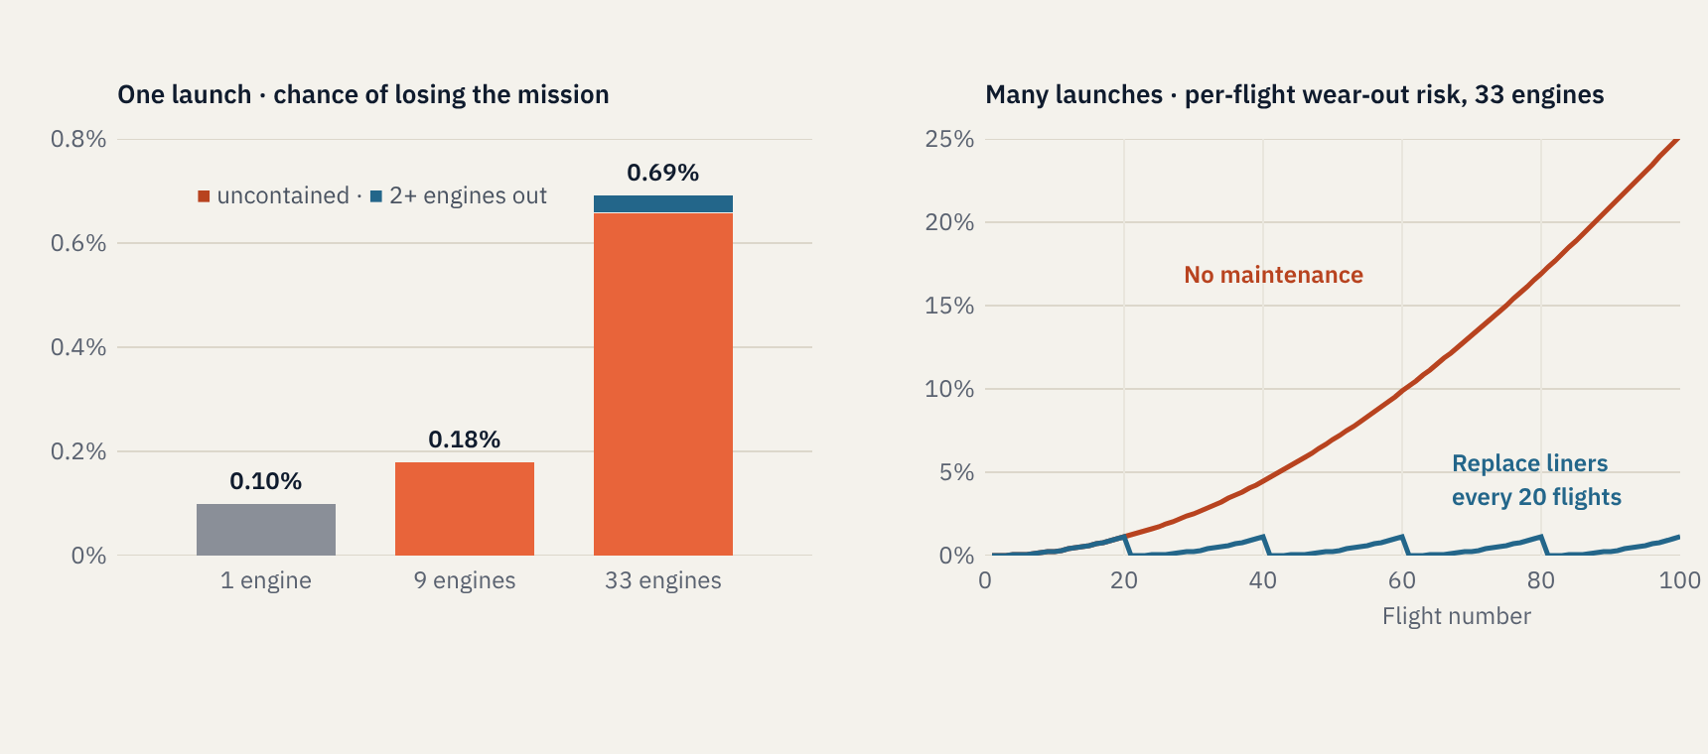
More engines, more exposure; more flights, more wear
RISK IN NUMBERS · ILLUSTRATIVE
Assumed: engine failure 1 in 1,000 per flight, 1 in 5 uncontained, 1 engine-out tolerated · wear-out Weibull β = 3, η = 150 flights per engine · not SpaceX data
EXED Polytechnique - Additive Manufacturing - 04 Industries by Andrei Constantinescu 2027
Notes:
Two simple models an executive can interrogate. Left, one launch: assume each engine fails one time in a thousand per flight, and one failure in five is uncontained (it damages neighbours or the stage), while the vehicle tolerates one contained engine-out. A single-engine rocket then loses the mission 0.10% of the time; a nine-engine cluster 0.18%; a 33-engine cluster 0.69%, almost entirely from uncontained failures (0.66%), because engine-out protection only covers failures that stay inside the engine. Lesson: with many engines, containment (shielding, fire suppression, fast shutdown) matters more than engine-out logic, and per-engine quality must be very high. Right, many launches: model liner wear-out with a Weibull distribution, shape 3 and characteristic life 150 flights per engine, consistent with the life chain on the previous slide. Without maintenance, the chance that at least one of 33 engines wears out on a given flight is about 1% at flight 20, 7% at flight 50 and 25% at flight 100. Replacing liners (or engines) every 20 flights keeps it below about 1%. Lesson: reusable engines need a life-limit and inspection policy, and every printing defect that shortens liner life moves the replacement interval and the cost per flight. All inputs are assumptions chosen for teaching; ask your engineers for their numbers.

Slide 49
The board decision: Boreal Launch
EXERCISE 2 · 20 MINUTES · SAME TEAMS
Boreal Launch is a fictional European small-launcher company: 1 tonne to low orbit, 10 engines per rocket, expendable. First flight succeeded. The plan is 4, 12 and 25 launches in 2027, 2028 and 2029: 410 engines.
Today the board must decide how engines are sourced for the next three years.
Your task
1 · Cost each option over 3 years, at plan and at half the plan.
2 · Choose A, B or C.
3 · Name your top risk and the trigger that makes you revisit.
4 · Pitch it in 60 seconds.
Exercise 2 · Handout B in the facilitator guide · All figures illustrative
EXED Polytechnique - Additive Manufacturing - 04 Industries by Andrei Constantinescu 2027
Notes:
Timing: 12 minutes in teams, 60 seconds per team to pitch, 3 minutes of debrief with the reveal slide. Insist that teams compute both scenarios; the whole learning is in the gap between plan and half-plan. If a team asks about reuse: Boreal is expendable for this period. If they ask about the bureau’s capacity: it is shared with defence customers, so queue time can stretch.

Slide 50
Three options on the table
EXERCISE 2 · CASE DATA
 | A · In-house factory | B · Service bureau | C · Hybrid
Up-front capital | €35M | €3M | €15M
Cost per engine | €110k | €260k | €170k
Lead time per engine | ~1 week print + 3 weeks post | 10–14 weeks | Core in-house; rest ~10 weeks
Time to qualify | 18 months | Already qualified | 12 months
IP control | Full | Low | Core IP protected
Engines needed | 40 in 2027 | 120 in 2028 | 250 in 2029 (410)
Until an in-house line is qualified, engines must come from the bureau at €260k. Ignore reuse, inflation and financing.
Exercise 2 · All figures illustrative, built for discussion
EXED Polytechnique - Additive Manufacturing - 04 Industries by Andrei Constantinescu 2027
Notes:
Leave this slide up for the full 15 minutes of team work. The last line is the hidden lever: A cannot produce its own engines in year 1 (18-month qualification) and C only partly. Teams that miss it will overstate A. Do not point it out unless asked; the debrief will.

Slide 51
Optimal on paper, robust in practice
EXERCISE 2 · DEBRIEF · SHOW AFTER THE PITCHES
3-year cost | On paper, at plan | Year-1 bridge, at plan | Year-1 bridge, half plan
A · In-house | €80.1M | €86.1M, lowest | €60.6M, highest
B · Bureau | €109.6M | €109.6M | €56.3M
C · Hybrid | €84.7M | €88.3M | €51.7M, lowest
At plan, A wins by only €2.2M once year 1 is bought from the bureau.
At half plan, C saves €8.9M against A, and A becomes the worst option.
Exercise 2 · Year-1 bridge = all 2027 engines bought from the bureau while lines qualify · Figures illustrative
EXED Polytechnique - Additive Manufacturing - 04 Industries by Andrei Constantinescu 2027
Notes:
Method: A = €35M + year-1 engines at €260k + years 2–3 at €110k. C = €15M + year-1 at €260k + years 2–3 at €170k. B = €3M + all engines at €260k. Half plan = 20, 60 and 125 engines. The lesson: in small launch, cadence is the most uncertain variable, so pick the option whose cost holds up when cadence disappoints. That is usually the hybrid rung, with a written trigger to climb to full in-house (for example, two consecutive quarters at or above plan and a signed manifest for the next 18 months). Ask teams who picked A: what would have to be true? Ask teams who picked B: what happens to your IP and your queue position when a defence customer arrives?

Slide 52
It is October 2029. Our AM programme failed. Why?
EXERCISE 3 · 6 MINUTES · WHOLE ROOM
2 min
Silent writing: one cause per sticky note, as many as you can.
3 min
Cluster on the wall: capital, qualification, supply chain, people, market.
1 min
Dot-vote the top two, and name one early warning signal for each.
Exercise 3 · Pre-mortem
EXED Polytechnique - Additive Manufacturing - 04 Industries by Andrei Constantinescu 2027
Notes:
A pre-mortem lowers the social cost of naming risks: people are explaining a failure that has already happened, not criticising a plan. Keep strict time. Typical top clusters: qualification took twice as long as planned; cadence never reached plan so the factory sat idle; the key process engineers left; a powder or machine supplier became unavailable. Write the two winning risks and their warning signals on the closing flip chart next to the ‘one move’ list from Exercise 1.

Slide 53
Five things to take back to your board
CLOSE · 1:56 – 2:00
1 Printed engines are now table stakes; differentiation has moved to cadence and integration.
2 Sovereignty money opens doors; a first orbital success and a manifest keep them open.
3 Ask for full-chain time and cost, never print time alone.
4 Climb the make-or-buy ladder; do not jump it. Write the trigger to climb.
5 Choose the option that survives half your cadence plan.
Before you leave, write down: one decision to revisit, one question to ask your team, one person to call.
Printing the Path to Orbit · Close
EXED Polytechnique - Additive Manufacturing - 04 Industries by Andrei Constantinescu 2027
Notes:
Go back to the three bets from the opening and ask whether anyone would change their vote. Bet 3 (make, partner or buy) usually moves toward partner or hybrid after Exercise 2. End on the commitment card: ninety seconds of silent writing, then close. Thank the room.

Slide 54
Where the facts come from
SOURCES · STATUS AS OF 31 OCTOBER 2026
Rocket Lab, Form 10-K FY2025
Rocket Lab, Neutron update, 14 Oct 2026
Relativity Space, Terran R milestones, Mar 2025
SpaceNews, Isar reaches orbit, Sept 2026
Space Intel Report, ESA Launcher Challenge awards
NASASpaceflight, Orbex collapse, Feb 2026
IEEE Spectrum, Canada’s launch push
TASS, NK-3 engine for Voronezh, Apr 2026
CislunarSpace, China 2026 launch outlook
Zhuque-3 flight history
3D Printing Industry, Vikram-1 reaches orbit
Space Odyssey Hub, Skyroot vs Agnikul
KeepTrack, Pakistan’s satellites, Oct 2026
NASA MSFC, Intro to AM for propulsion, 2025
Company figures are company claims · Exercise 2 figures are illustrative
EXED Polytechnique - Additive Manufacturing - 04 Industries by Andrei Constantinescu 2027
Notes:
Full source list with notes is in the facilitator guide. Refresh the regional slides the week before delivery: launch schedules in this sector move monthly.

