Slide 1
Technologies
From a shapeless material to a part: shaping, then adding, layer by layer
Notes:
FR : technologies de fabrication additive. DE: Fertigungstechnologien.

Slide 2
The path of this chapter
0
Materials and traditional technologies
1
AM as layer-wise primary shaping
2
A morphological box
what is made, how it is shaped, the kitchen and the machines
every AM process is an old primary-shaping process, made selective
material state × feedstock × agent × addressing
3
Clocks
4
The layer interface
5
From physics to potentials
how fast the material sets, how fast the next layer comes
what joins layer n to layer n − 1
detail, accuracy, surface, residual stress
Structure after Gebhardt & Hötter, Additive Manufacturing (Hanser 2016), ch. 2; figures in the style of M. F. Ashby.

Slide 3
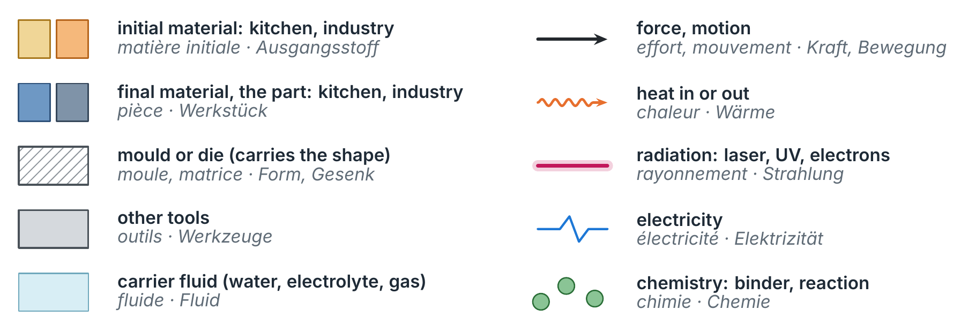
One colour convention for every schematic
Notes:
Kitchen figures: pale yellow → blue. Industrial figures: orange → slate. Moulds hatched, tools grey; heat orange waves, radiation magenta, electricity blue, chemistry green.

Slide 4
0 · Materials and traditional technologies
What we make things from, and the six ways of making them
Notes:
FR : matériaux et procédés traditionnels. DE: Werkstoffe und konventionelle Fertigungsverfahren.

Slide 5
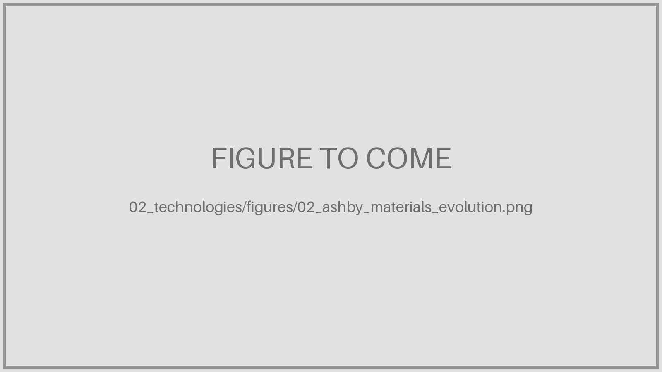
Materials through the ages
Four families
Metals
Polymers and elastomers
Ceramics and glasses
Composites
Relative importance changes with time: the age of steel, of polymers, of composites.
Every family has its own ways of being shaped.
M. F. Ashby, Materials Selection in Mechanical Design, Butterworth-Heinemann: evolution of engineering materials with time (picture to add: 02_ashby_materials_evolution.png, licence to check).
Notes:
FR : métaux, polymères et élastomères, céramiques et verres, composites. DE: Metalle, Polymere und Elastomere, Keramiken und Gläser, Verbundwerkstoffe.

Slide 6
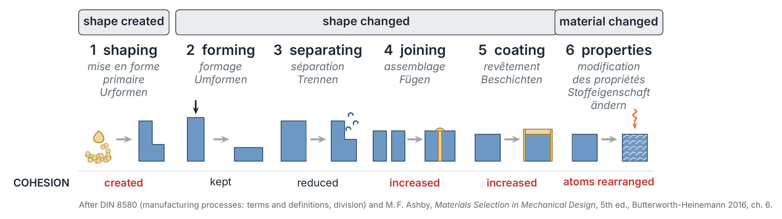
Shape created, shape changed, material changed
Notes:
DIN 8580 main groups. FR : mise en forme primaire, formage, séparation, assemblage, revêtement, modification des propriétés. DE: Urformen, Umformen, Trennen, Fügen, Beschichten, Stoffeigenschaft ändern.

Slide 7
What is what: the six groups and their cohesion
DIN 8580 | English | Français | Deutsch | Cohesion | Examples
1 | Primary shaping | Mise en forme primaire | Urformen | created | casting, injection moulding, sintering
2 | Forming | Formage | Umformen | kept | forging, rolling, deep drawing
3 | Separating | Séparation | Trennen | reduced | turning, milling, cutting
4 | Joining | Assemblage | Fügen | increased | welding, brazing, bonding
5 | Coating | Revêtement | Beschichten | increased | painting, plating, spraying
6 | Changing properties | Modification des propriétés | Stoffeigenschaft ändern | atoms rearranged | heat treatment, hardening, HIP
Additive manufacturing belongs to group 1
It creates the shape and the cohesion of the part from a shapeless material, like casting, but without a mould: the shape comes from a file, layer by layer.
DIN 8580, Fertigungsverfahren — Begriffe, Einteilung.

Slide 8
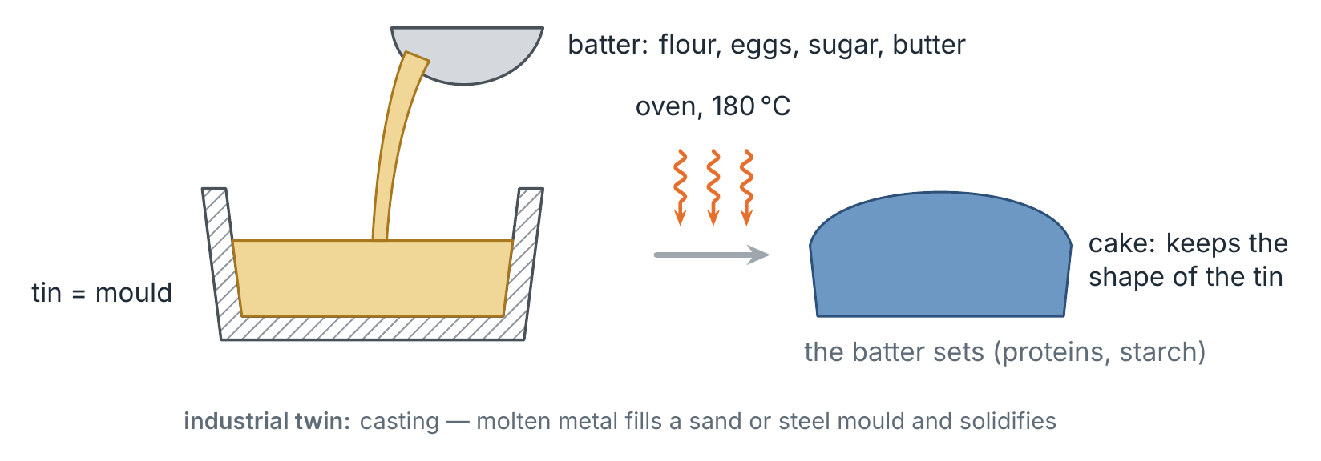
Kitchen · primary shaping: a cake takes its tin's shape
Notes:
FR : mise en forme primaire (moulage). DE: Urformen (Gießen).

Slide 9
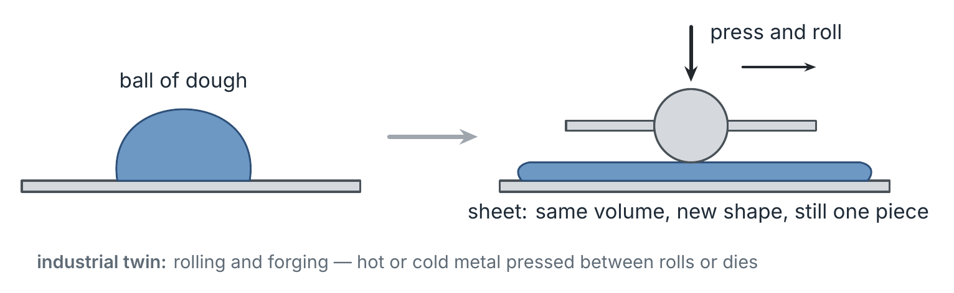
Kitchen · forming: same dough, new shape
Notes:
FR : formage, laminage. DE: Umformen, Walzen.

Slide 10
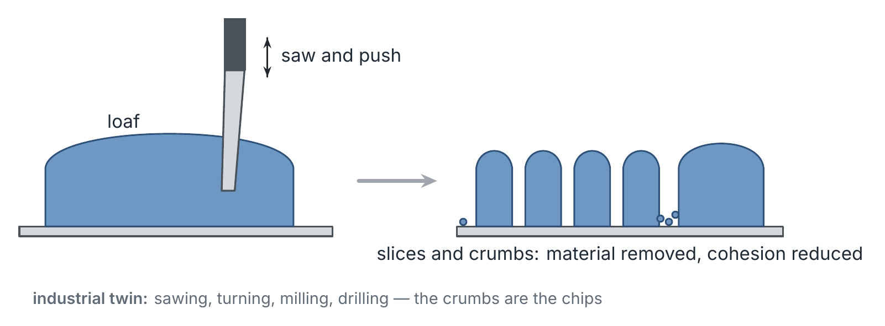
Kitchen · separating: slicing removes material
Notes:
FR : séparation, usinage, copeaux. DE: Trennen, Spanen, Späne.

Slide 11
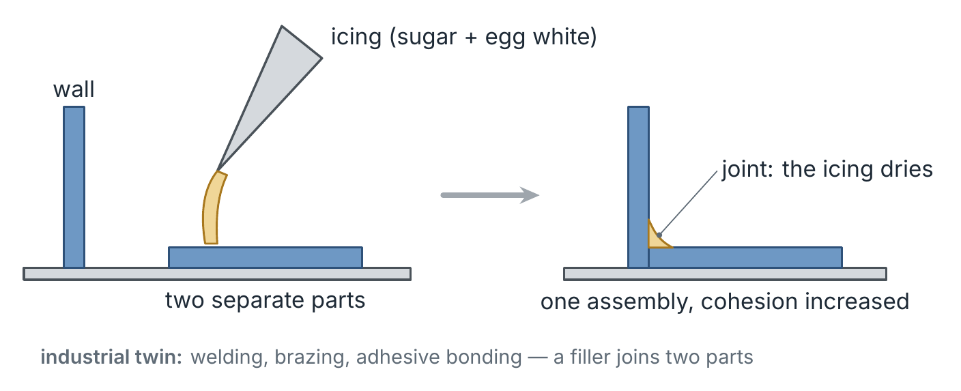
Kitchen · joining: icing glues two walls
Notes:
FR : assemblage, collage, soudage. DE: Fügen, Kleben, Schweißen.

Slide 12
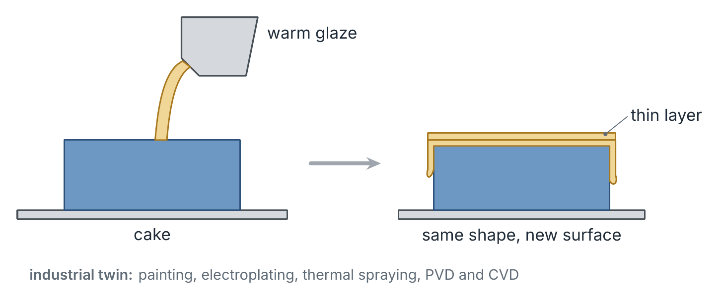
Kitchen · coating: a glaze, a new surface
Notes:
FR : revêtement. DE: Beschichten.

Slide 13
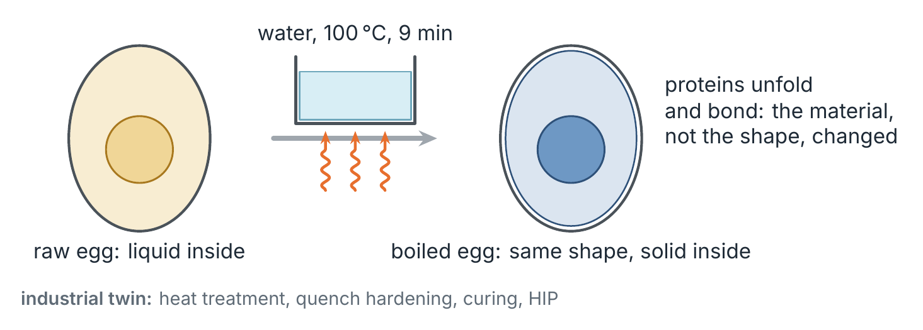
Kitchen · changing properties: the boiled egg
Notes:
FR : modification des propriétés, traitement thermique. DE: Stoffeigenschaft ändern, Wärmebehandlung. Later: the kitchen parallel extends to a material twin — heterogeneous, fibrous and crystalline materials.

Slide 14
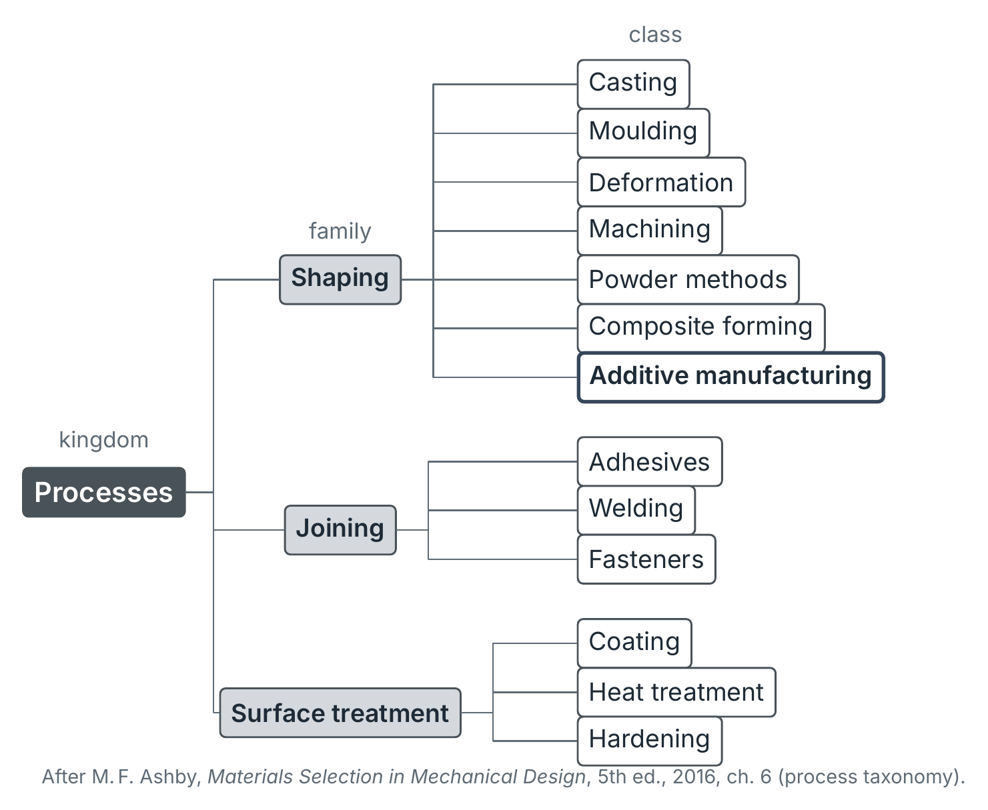
Processes, as Ashby classifies them
Kingdom, family, class
Ashby sorts processes like living things: kingdom → family → class → member → attributes.
Three families: shaping, joining, surface treatment.
Additive manufacturing is one class of shaping.
Each member is described by attributes: materials, size, tolerance, roughness, economic batch size.
M. F. Ashby, Materials Selection in Mechanical Design, 5th ed., 2016, ch. 6–7.
Notes:
FR : mise en forme, assemblage, traitement de surface. DE: Formgebung, Fügen, Oberflächenbehandlung.

Slide 15
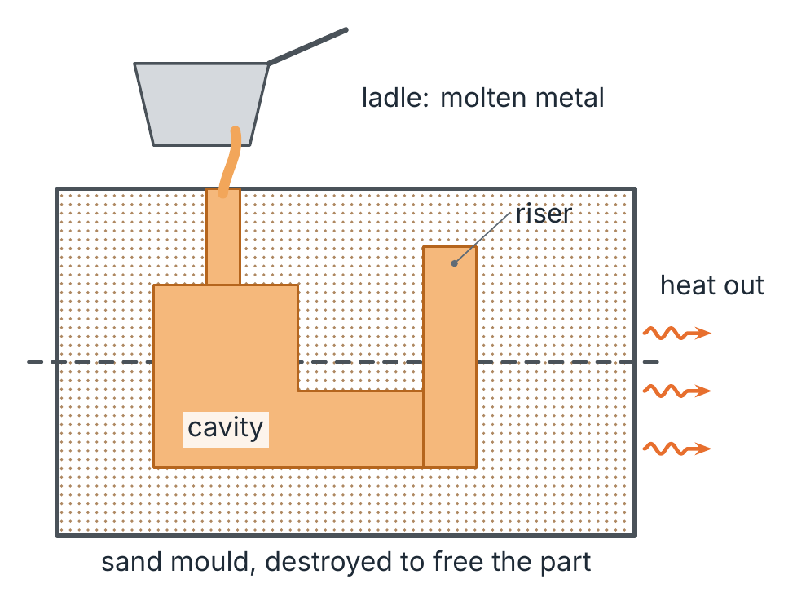
Casting: the mould holds the shape
Primary shaping from the liquid
Molten metal fills a cavity and solidifies.
Sand moulds: one part each; die casting: steel moulds, many parts.
Risers feed the shrinkage on solidification.
Twin in AM: powder bed fusion, DED (melt and solidify).
Notes:
FR : fonderie, moulage en sable, masselotte. DE: Gießen, Sandguss, Speiser.

Slide 16
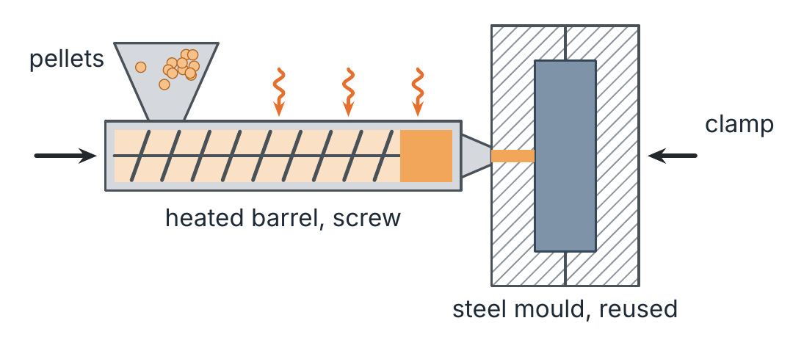
Injection moulding: plastic flow into a steel mould
Shaping from the plastic state
Pellets melt in a heated barrel, a screw pushes the melt.
The mould is clamped, cooled, opened: seconds per part.
Moulds cost 10⁴–10⁵ €: large batches only.
Twin in AM: material extrusion.
Notes:
FR : moulage par injection. DE: Spritzgießen.

Slide 17
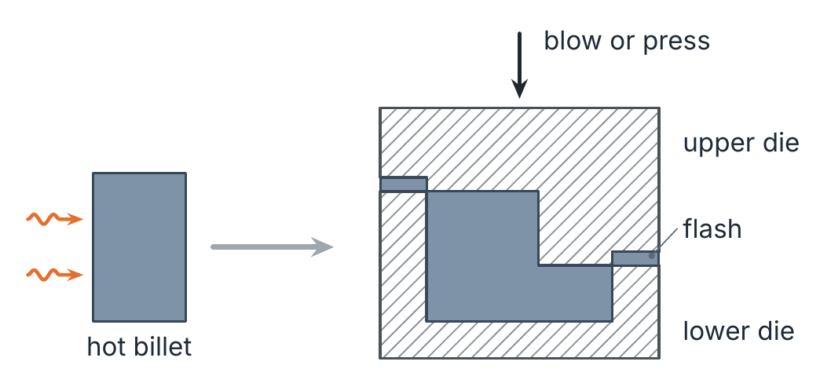
Forging: the dies hold the shape
Forming: cohesion kept
A hot billet is pressed or hammered between two dies.
The grain flows with the shape: strong parts.
The flash takes the excess metal.
No AM twin: AM parts are not deformed, hence different microstructures.
Notes:
FR : forgeage en matrice, bavure. DE: Gesenkschmieden, Grat.

Slide 18
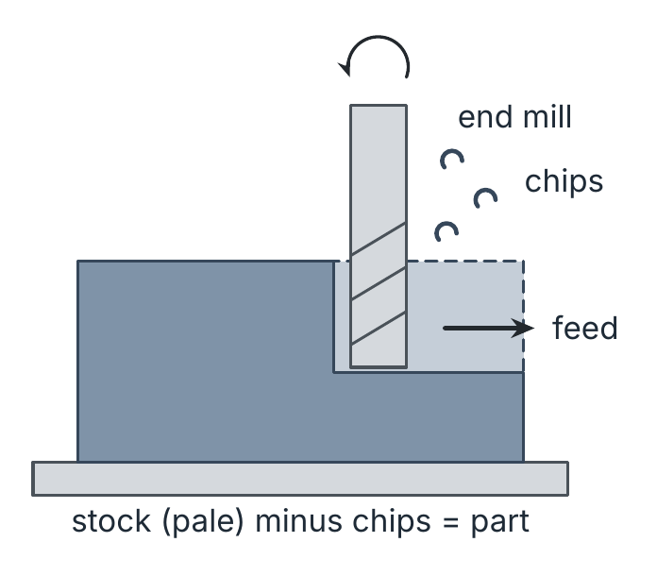
Machining: the tool path holds the shape
Separating: cohesion reduced
A rotating tool removes chips from a stock.
The geometry is stored in a program, as in AM.
Buy-to-fly of aerospace parts can reach 10–20.
In AM: finishing of functional faces, hybrid machines.
Notes:
FR : usinage, fraisage, copeaux. DE: Spanen, Fräsen, Späne.

Slide 19
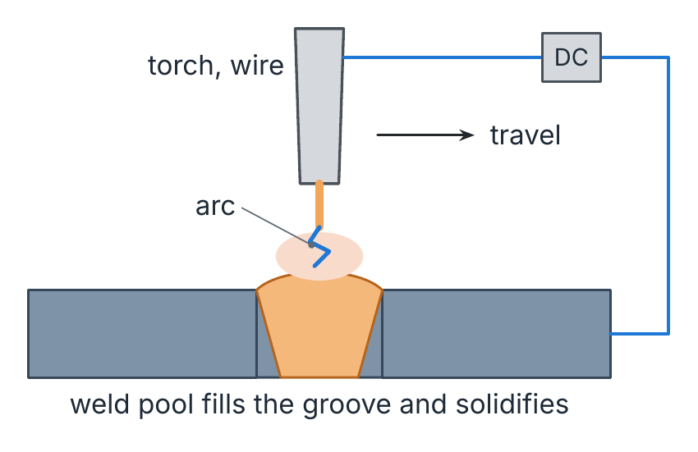
Welding: a moving melt pool joins two parts
Joining: cohesion increased
An arc melts the wire and the edges; the pool solidifies behind the torch.
Pool, heat-affected zone, residual stress: the same physics as in metal AM.
Twin in AM: wire-arc DED and laser DED, welding bead on bead.
Notes:
FR : soudage à l'arc, bain fondu. DE: Lichtbogenschweißen, Schmelzbad.

Slide 20
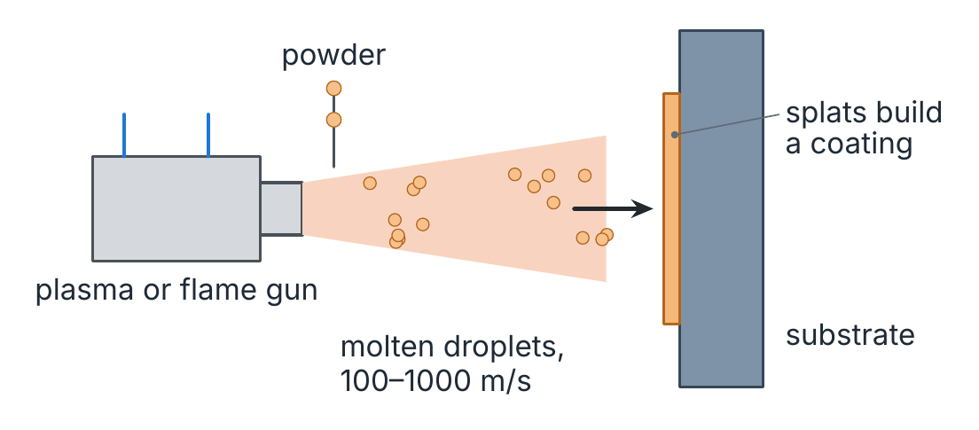
Thermal spraying: droplets build a coating
Coating
Powder melts in a plasma or flame and hits the part.
Each droplet flattens into a splat; splats build a layer.
Twin in AM: cold spray, where the particles stay solid and bond by impact.
Notes:
FR : projection thermique. DE: thermisches Spritzen.

Slide 21
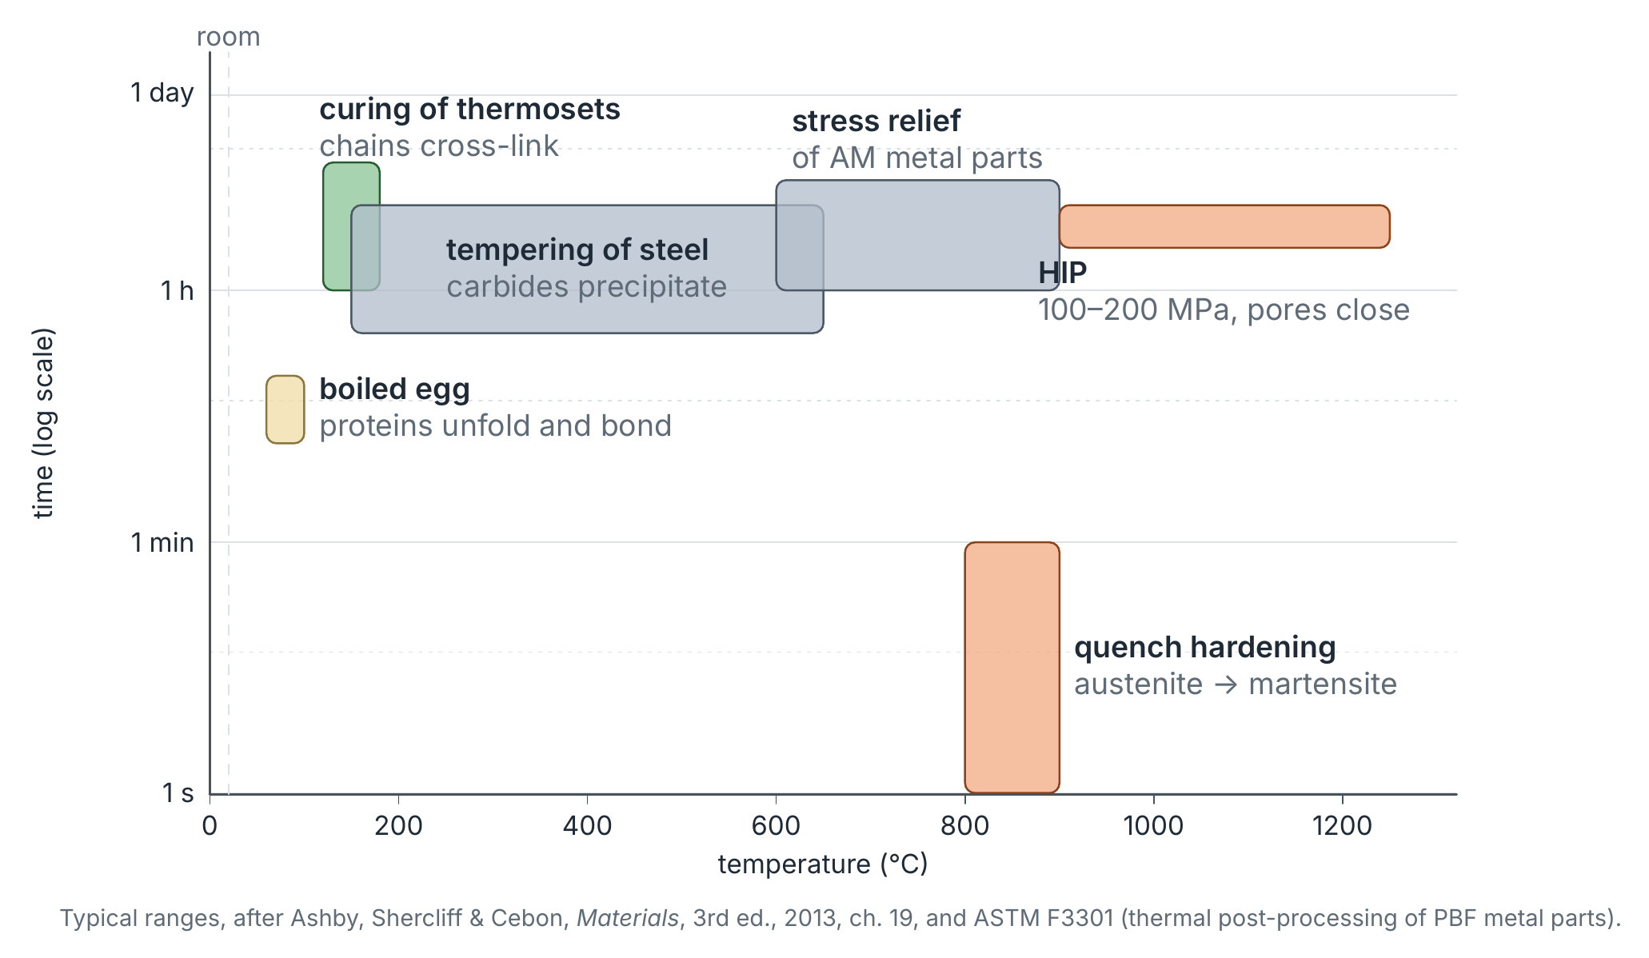
Changing properties: phenomena and temperatures
Notes:
Egg 60–100 °C, curing 120–180 °C, tempering, quench hardening, stress relief, HIP 900–1250 °C at 100–200 MPa. FR : trempe, revenu, détensionnement, compaction isostatique à chaud. DE: Härten, Anlassen, Spannungsarmglühen, heißisostatisches Pressen.

Slide 22
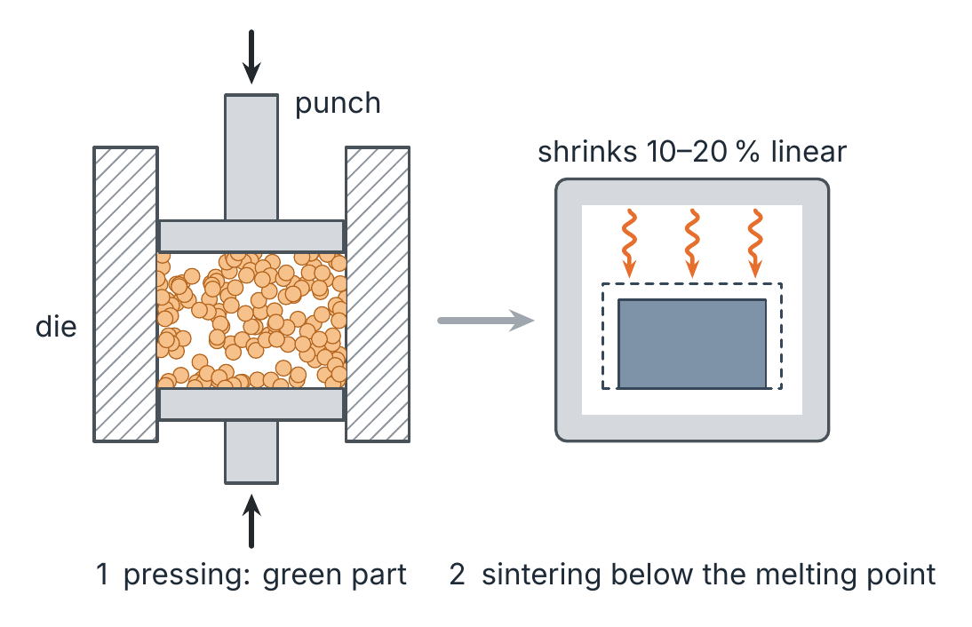
Powder metallurgy: press, then sinter
Primary shaping from powder
A die gives the shape to a green compact.
Sintering bonds the grains by diffusion below the melting point.
The part shrinks: tolerances must allow for it.
Twin in AM: binder jetting followed by sintering.
Notes:
FR : métallurgie des poudres, compactage, frittage. DE: Pulvermetallurgie, Pressen, Sintern.

Slide 23
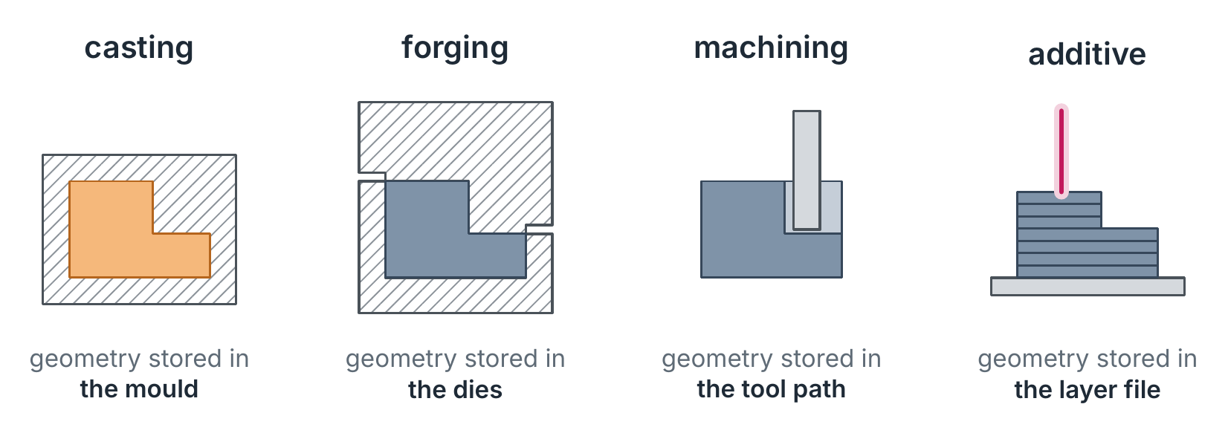
Where is the geometry stored?
From the tool to the file
Casting and forging store the shape in a mould or a die: expensive, so many identical parts. Machining and AM store it in a program: one part can differ from the next.
Notes:
FR : outillage, programme, fichier. DE: Werkzeug, Programm, Datei.

Slide 24
1 · AM as layer-wise primary shaping
Every AM process is an old primary-shaping process, made selective and layer by layer
Notes:
FR : la fabrication additive comme mise en forme primaire couche par couche. DE: additive Fertigung als schichtweises Urformen.

Slide 25
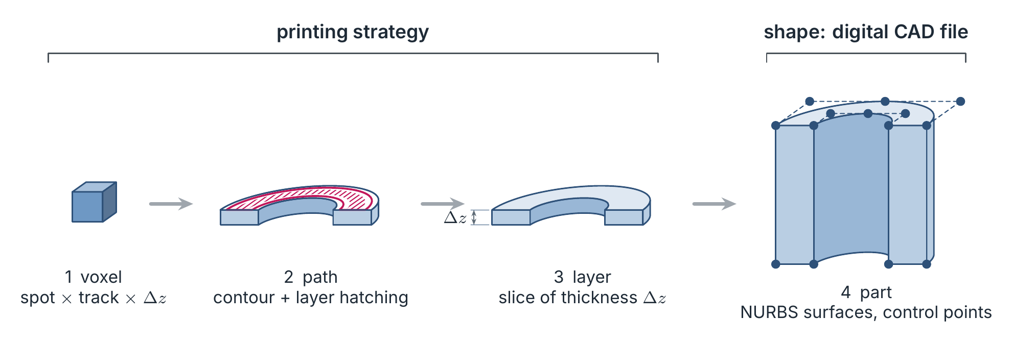
Adding material: file, layer, voxel
Notes:
FR : tranche, couche, voxel. DE: Schicht, Voxel.

Slide 26
Seven starting states, seven conventional twins
DIN 8580 | Starting state | Conventional twin | AM process | ISO/ASTM 52900
1.1 | liquid | casting, resin casting | vat photopolymerisation, material jetting | VPP, MJT
1.2 | plastic | injection moulding, extrusion | material extrusion (filament, pellets) | MEX
1.3 | pasty | slip casting, concrete casting | paste extrusion: ceramics, clay, concrete | MEX
1.4 | granular or powder | pressing and sintering; welding, casting | binder jetting; powder bed fusion, DED; cold spray | BJT, PBF, DED
1.5 | chips or fibres | board pressing, lamination | sheet lamination; continuous-fibre extrusion | SHL, MEX
1.6 | gas or vapour | CVD, PVD | laser CVD | —
1.7 | ionised | electroforming | electrochemical AM | —
DIN 8580 primary-shaping subgroups; ISO/ASTM 52900:2021 process categories.
Notes:
FR : liquide, plastique, pâteux, granulaire ou pulvérulent, copeaux ou fibres, gazeux, ionisé. DE: flüssig, plastisch, breiig, körnig oder pulverförmig, span- oder faserförmig, gas- oder dampfförmig, ionisiert.

Slide 27
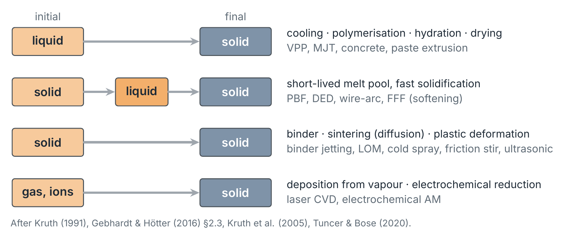
Four material paths to a solid
Notes:
Kruth's classification by the state of the material, completed by the binding mechanisms of Kruth et al. (2005) and the solid-state processes of Tuncer & Bose (2020).

Slide 28
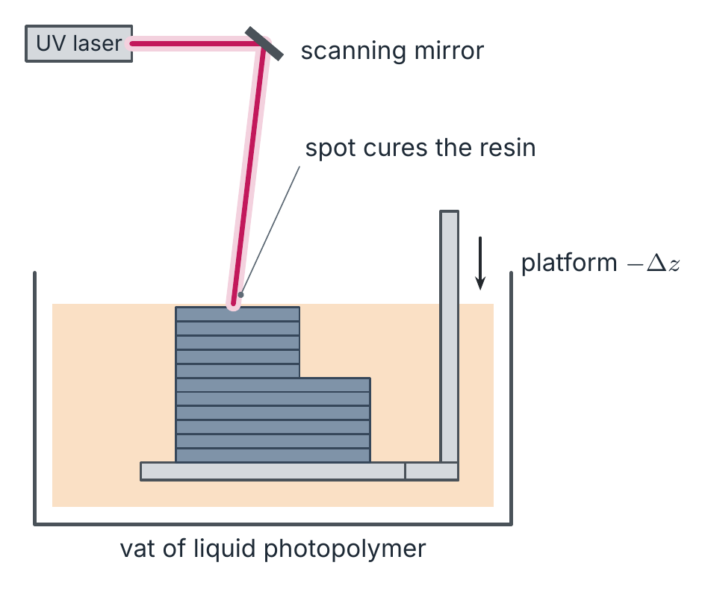
Vat photopolymerisation: resin casting, one spot at a time
Twin: resin casting
Liquid monomers polymerise under UV light.
Laser spot (SLA) or projected mask (DLP).
Layers 25–100 µm; fine detail and smooth surfaces.
Post-cure and support removal.
Notes:
FR : photopolymérisation en cuve. DE: Badbasierte Photopolymerisation.

Slide 29
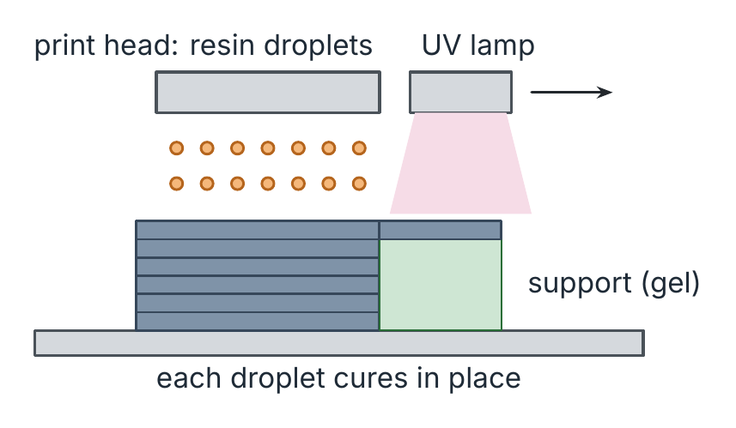
Material jetting: droplets that cure where they land
Twin: inkjet casting
A print head jets resin droplets, a lamp cures them.
Several materials and colours in one part.
A gel support fills the overhangs.
Notes:
FR : projection de matière. DE: Freistrahl-Materialauftrag.

Slide 30
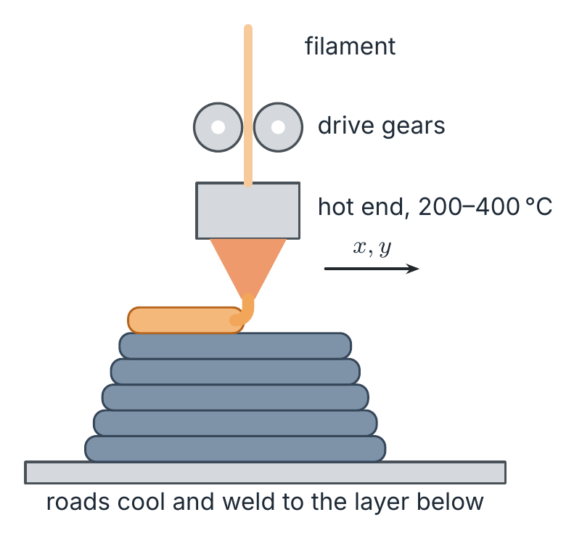
Material extrusion: injection moulding without a mould
Twin: injection moulding
A filament or pellets melt in a hot end.
The nozzle lays roads; each cools on the one below.
Cheap and simple; the weak point is the bond between layers.
Notes:
FR : extrusion de matière. DE: Materialextrusion.

Slide 31
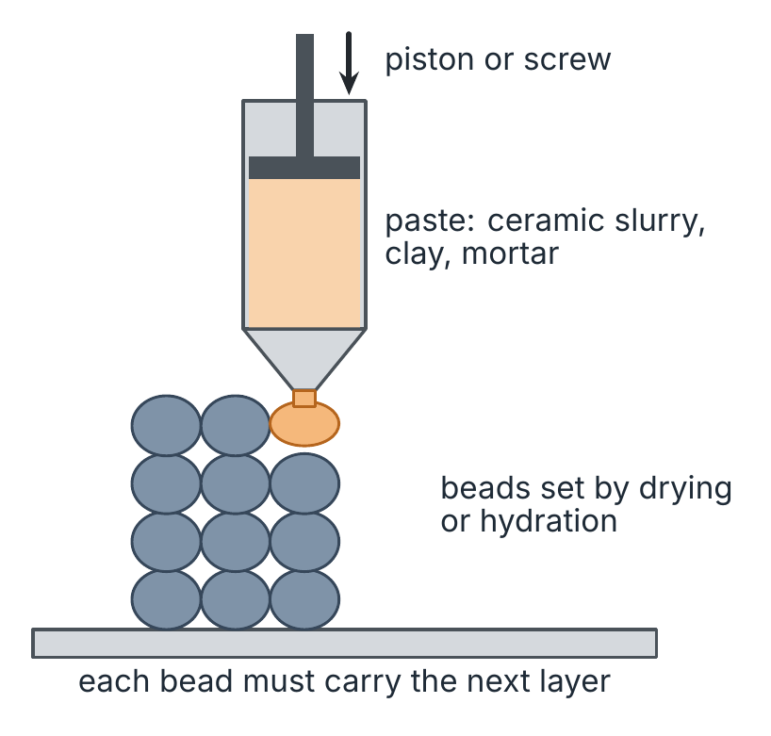
Paste extrusion: slip and concrete, bead by bead
Twin: slip and concrete casting
A paste is pushed through a nozzle.
It must flow in the nozzle and stand still on the stack.
Ceramics are dried and fired; concrete sets by hydration.
Notes:
FR : extrusion de pâte, impression béton. DE: Pastenextrusion, Betondruck.

Slide 32
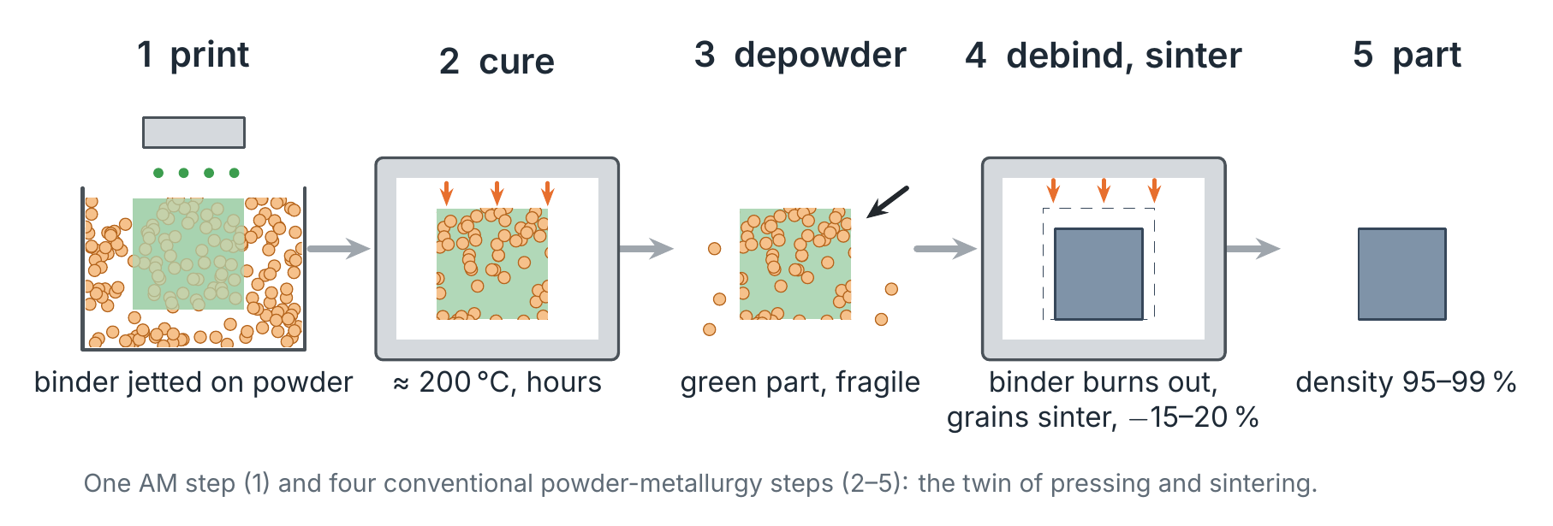
Binder jetting: one AM step, four powder-metallurgy steps
Twin: pressing and sintering
Consequences
The printer replaces the die; curing, depowdering, debinding and sintering are those of powder metallurgy.
No melt pool: no residual stress from printing. Shrinkage of 15–20 % must be built into the file.
Notes:
FR : projection de liant, déliantage, frittage. DE: Binder Jetting, Entbindern, Sintern.

Slide 33
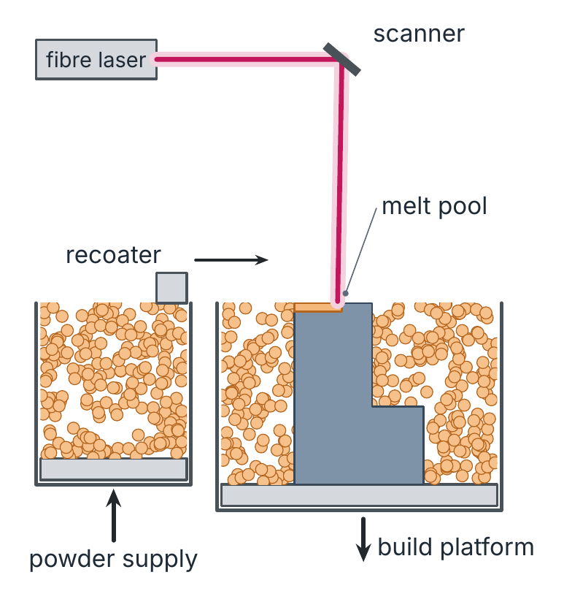
Powder bed fusion: welding and casting, layer by layer
Twin: welding, casting
A recoater spreads 20–100 µm of powder.
A laser or electron beam melts the cross-section.
Melt pool, fast solidification, residual stress: welding physics.
Platform down, next layer.
Notes:
FR : fusion sur lit de poudre. DE: Pulverbettbasiertes Schmelzen.

Slide 34
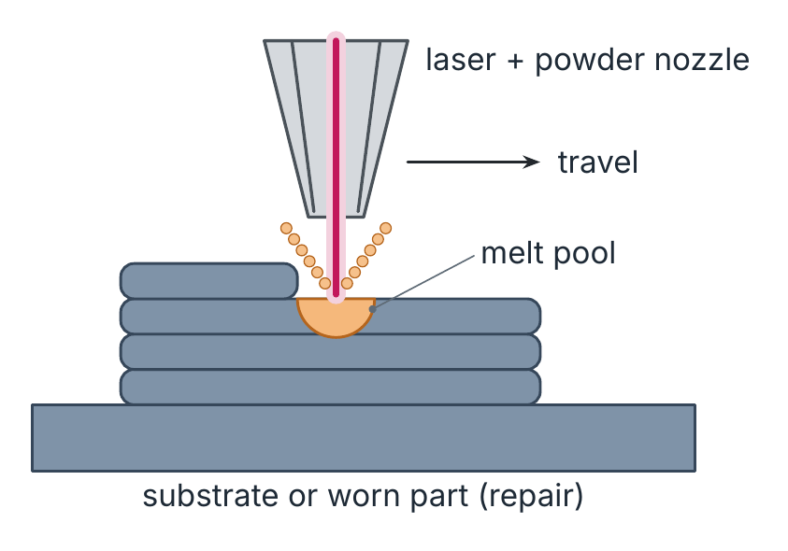
Directed energy deposition: a welding torch that builds
Twin: cladding, welding
Powder or wire is fed into a melt pool made by a laser, an arc or a beam.
Large parts, repair of worn parts.
Near-net shape: finish by machining.
Notes:
FR : dépôt de matière sous énergie concentrée. DE: Gerichtete Energieeinbringung.

Slide 35
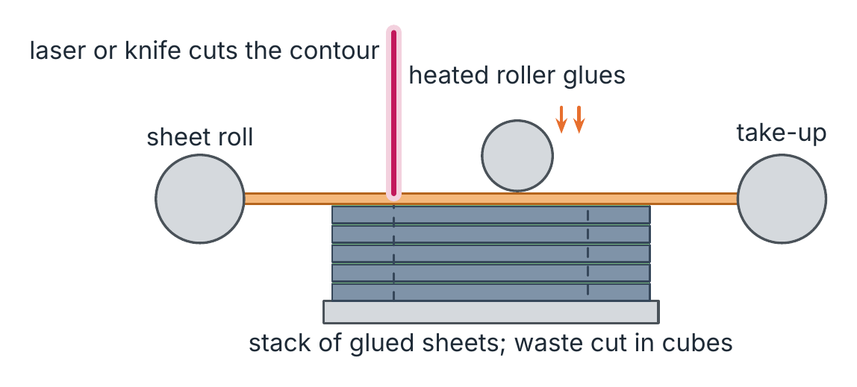
Sheet lamination: cut and glue
Twin: lamination, gluing
Sheets of paper, polymer or metal are glued or welded.
Each contour is cut by a laser or a knife.
Ultrasonic AM joins metal foils in the solid state.
Notes:
FR : stratification de couches. DE: Schichtlaminierung.

Slide 36
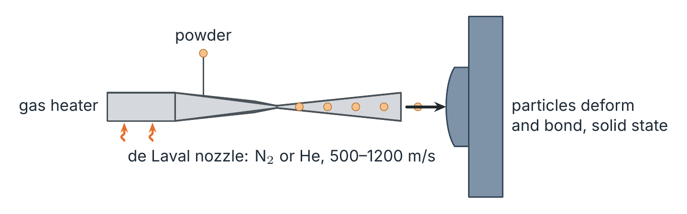
Cold spray: thermal spraying without melting
Twin: thermal spraying
Particles are accelerated in a supersonic gas jet.
They deform plastically at impact and bond in the solid state.
No melt pool: little oxidation, used for repair.
Notes:
FR : projection à froid. DE: Kaltgasspritzen.

Slide 37
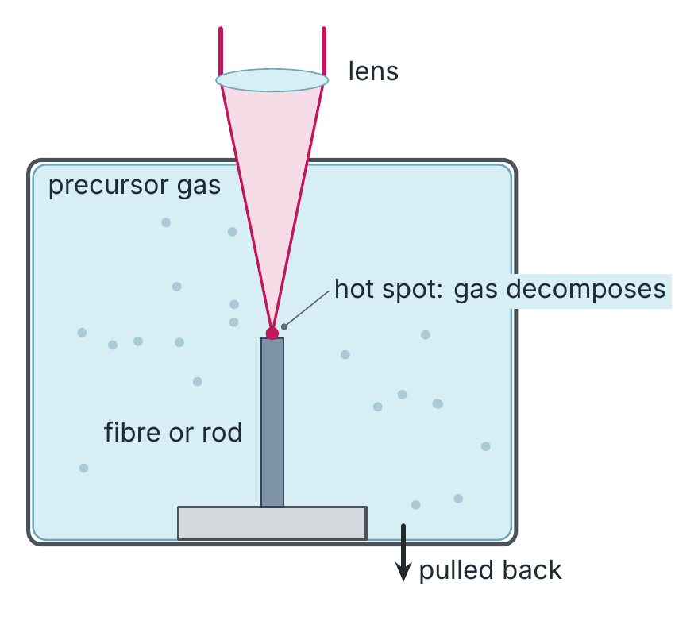
Laser CVD: CVD at one hot spot
Twin: CVD
A precursor gas decomposes on a hot surface.
A focused laser makes only one spot hot.
Fibres and rods of carbon, SiC, tungsten.
Notes:
FR : dépôt chimique en phase vapeur assisté par laser. DE: laserunterstützte Gasphasenabscheidung.

Slide 38
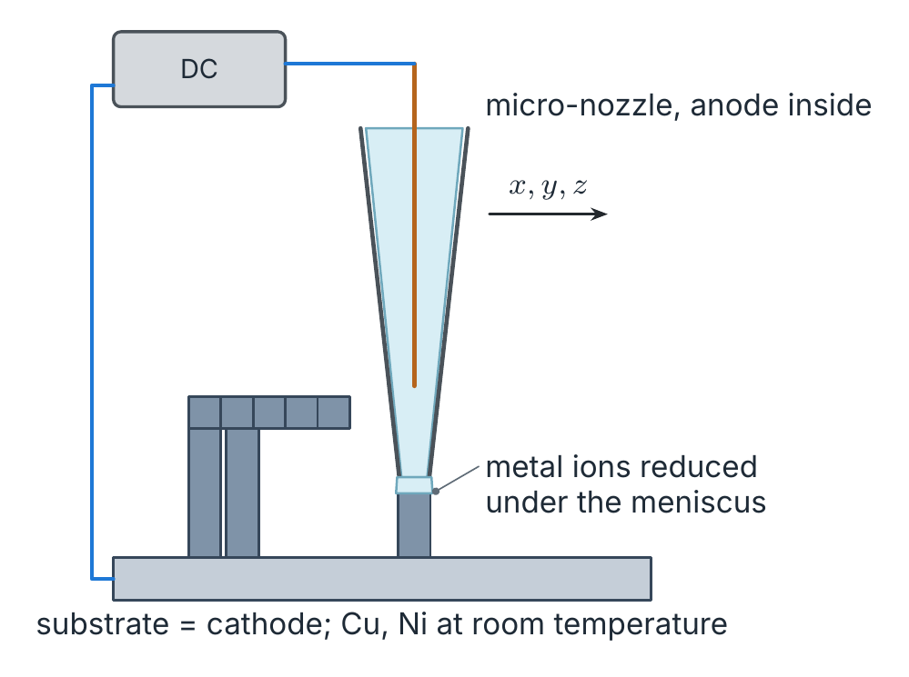
Electrochemical AM: electroforming under a nozzle
Twin: electroforming
Metal ions are reduced on a cathode.
A micro-nozzle confines the reaction to a meniscus.
Copper and nickel at room temperature, micrometre features.
Notes:
FR : fabrication additive électrochimique, électroformage. DE: elektrochemische additive Fertigung, Galvanoformung.

Slide 39
2 · A morphological box
Material state × feedstock form × agent × addressing
Notes:
FR : boîte morphologique (Zwicky). DE: morphologischer Kasten.

Slide 40
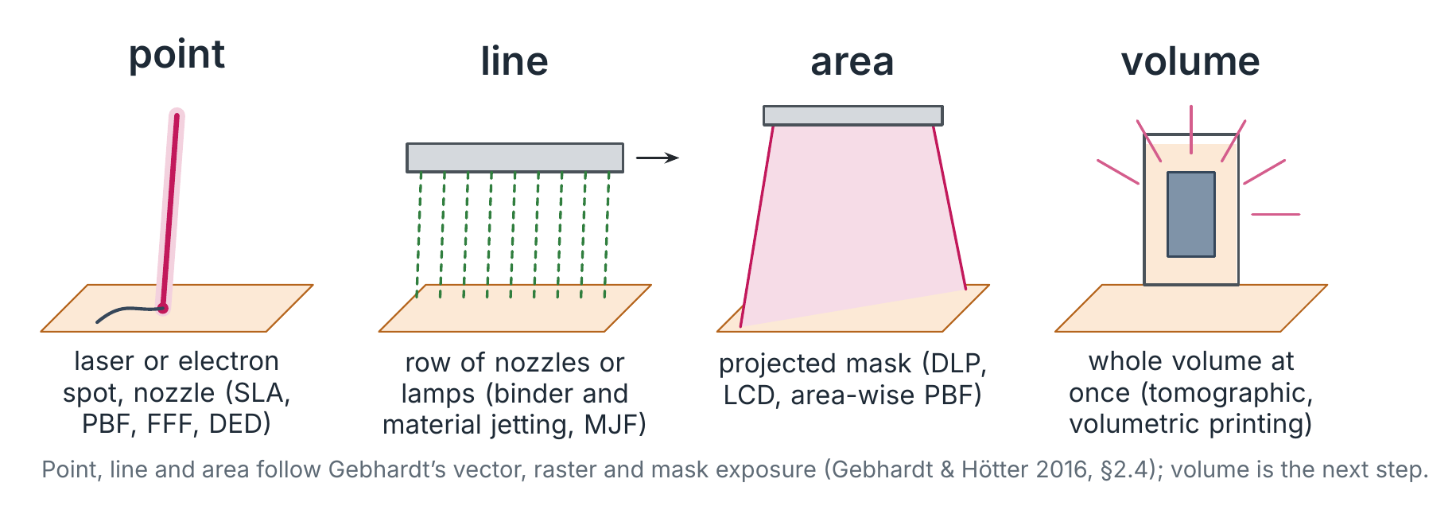
Point, line, area, volume
Notes:
Gebhardt: vector (contour traced continuously, most accurate, slowest), raster (line by line), mask (whole layer at once, time independent of layer complexity). Volume: tomographic and volumetric printing.

Slide 41
Every process is one path through the box
Process | Material state | Feedstock form | Agent | Addressing
SLA | liquid | vat | light | point
DLP | liquid | vat | light | area
Multi-jet fusion | powder | bed | agent + heat | line
Binder jetting | powder | bed | binder | line
Laser PBF | powder | bed | laser | point
Laser DED | powder or wire | jet | laser | point
FFF | plastic | filament | heat | point
Cold spray | powder | jet | kinetic energy | point
Volumetric printing | liquid | vat | light | volume
Exercise
Find the empty cells: area-wise metal PBF and volumetric printing appeared there.

Slide 42
3 · Clocks
A race between how fast the material sets and how fast the next layer comes
Notes:
FR : temps caractéristiques. DE: charakteristische Zeiten.

Slide 43
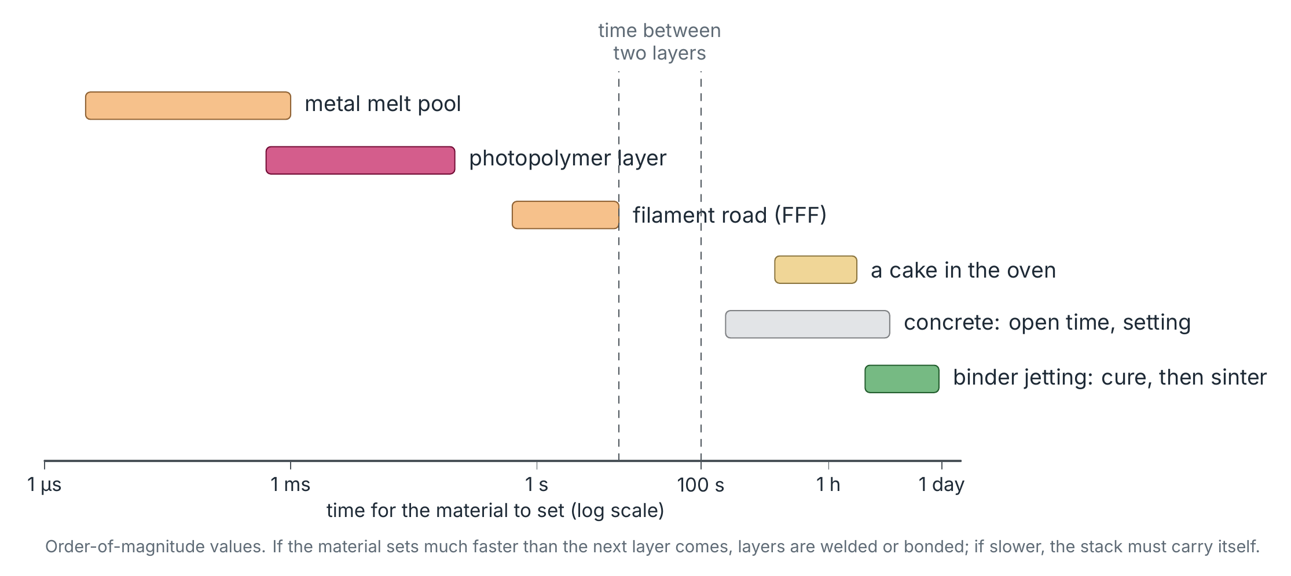
How fast does the material set?
Notes:
Explains build speed, why supports are needed, and the open-time problem of concrete.

Slide 44
4 · The layer interface
What joins layer n to layer n − 1?
Notes:
FR : interface entre couches, anisotropie. DE: Schichtgrenzfläche, Anisotropie.

Slide 45
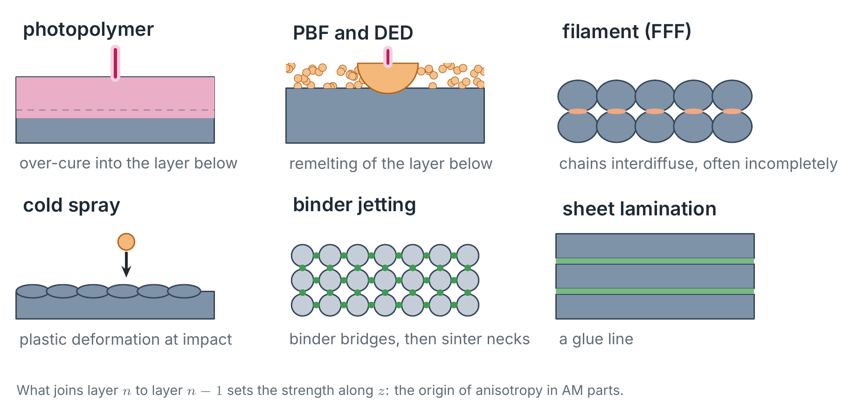
Six ways to join a layer to the one below
Notes:
Is it the same mechanism that formed the layer? This explains anisotropy, the weaker z direction, and why each path needs its own design rules.

Slide 46
5 · From physics to potentials
Gebhardt's theoretical potentials, derived from the material path
Notes:
FR : potentiels théoriques. DE: theoretische Potenziale.

Slide 47
From physics to design rules
Criterion | Set by | Orders of magnitude | Design rule
Smallest detail | spot, droplet or particle size | 0.1 µm (2PP) – 0.1 mm (PBF) – 1 mm (DED) | no feature below ≈ 2–3 voxels
Accuracy | shrinkage of the transformation | polymerisation, solidification; 15–20 % linear on sintering | scale the file, test parts
Surface | layer thickness + partly bonded particles | Ra ≈ 5–20 µm for metal PBF | machine functional faces
Residual stress | a liquid-to-solid step over a large temperature range | PBF, DED: high; binder jetting, cold spray: low | supports, stress relief, HIP
Anisotropy | the layer interface | z direction weakest in FFF | orient the load along the layers
After Gebhardt & Hötter (2016) §2.6; orders of magnitude are indicative.

Slide 48
Machines and prices
Build volumes, resolutions and investment
Notes:
FR : machines et prix. DE: Maschinen und Preise.

Slide 49
Metal laser powder bed fusion: investment
Manufacturer | Model | Price (USD) | Build volume (mm)
SLM Solutions | SLM 125 | 400 000 – 500 000 | 125 × 125 × 125
SLM Solutions | SLM 280 | 500 000 – 800 000 | 280 × 280 × 300
SLM Solutions | SLM 500 | 800 000 + | 500 × 500 × 500
EOS | M 290 | 600 000 – 1 000 000 | 290 × 290 × 400
EOS | M 400 | 1 000 000 + | 400 × 400 × 400
Renishaw | AM 400 | 600 000 – 1 000 000 | to check
TRUMPF | TruPrint 1000 | 170 000 | 100 × 100 × 100
Source: 03_Technologies deck (2025), after AMPOWER Insights. Table: tables/02_machines_lpbf_metal.csv.

Slide 50
Metal binder jetting: five systems
System | Maker | Build volume | Build speed | Resolution | Cost
X160PRO | ExOne (Desktop Metal) | 800 × 500 × 400 mm | ≤ 3 120 cm³/h | layers 30–200 µm | $$$$
Production System P-50 | Desktop Metal | 490 × 380 × 260 mm | ≤ 12 000 cm³/h | 1 200 dpi | $$$$$
Metal Jet S100 | HP | 430 × 309 × 200 mm | 1 990 cm³/h | 1 200 dpi | $$$
Series 3 | GE Additive | 500 × 500 × 500 mm | ≤ 100 × metal PBF | walls ≥ 400 µm | $$$$
PX100 | Markforged | 250 × 217 × ? mm | 1 000 cm³/h | 1 600 dpi | $$$
Source: voxelmatters.com, complete guide to binder-based metal 3D printing. Table: tables/02_machines_binder_jetting_metal.csv.

Slide 51
Microprinting: liquid, paste, powder and ions
Printer | Technology | State | Min. layer | Resolution | Price (USD)
BMF microArch | projection micro-SLA | liquid | 5 µm | 2 µm | 145 000 – 230 000
Nanoscribe Quantum X | two-photon polymerisation | liquid | 0.1 µm | 0.2 µm | 500 000
UpNano NanoOne | two-photon polymerisation | liquid | 0.17 µm | 0.01 µm | on request
Incus Hammer Lab35 | lithography-based metal | pasty | 10 µm | 35 µm | 250 000
Exaddon Ceres | electrochemical deposition | ionised | — | < 1 µm | 272 000
3D MicroPrint DMP | micro laser sintering | powder | 15 µm | 1 µm | on request
Microlight3D µFAB-3D | two-photon polymerisation | liquid | 0.6 µm | 0.2 µm | 120 000 – 180 000
Femtika Nanofactory | two-photon polymerisation | liquid | 0.2 µm | 0.3 µm | on request
Source: all3dp.com, micro 3D printing guide. Table: tables/02_machines_microprinting.csv.

Slide 52
References
Classification and processes
DIN 8580, Fertigungsverfahren — Begriffe, Einteilung. Beuth.
ISO/ASTM 52900:2021, Additive manufacturing — General principles — Fundamentals and vocabulary.
M. F. Ashby, Materials Selection in Mechanical Design, 5th ed., Butterworth-Heinemann, 2016.
M. F. Ashby, H. Shercliff, D. Cebon, Materials: Engineering, Science, Processing and Design, 3rd ed., 2013.
M. F. Ashby, K. Johnson, Materials and Design, 3rd ed., 2014.
Additive manufacturing
A. Gebhardt, J.-S. Hötter, Additive Manufacturing: 3D Printing for Prototyping and Manufacturing, Hanser, 2016.
I. Gibson, D. Rosen, B. Stucker, M. Khorasani, Additive Manufacturing Technologies, 3rd ed., Springer, 2021.
J.-P. Kruth, Material incress manufacturing by rapid prototyping techniques, CIRP Annals 40 (1991).
J.-P. Kruth, M. C. Leu, T. Nakagawa, Progress in additive manufacturing and rapid prototyping, CIRP Annals 47 (1998).
J.-P. Kruth et al., Binding mechanisms in SLS and SLM, Rapid Prototyping Journal 11 (2005).
N. Tuncer, A. Bose, Solid-state metal additive manufacturing: a review, JOM 72 (2020).

