Slide 1
AM for repair — figures test
One slide per figure of the 'AM for Repair — Projects' deck. Grey box = figure still missing. Refresh: xfab.py sync

Slide 2
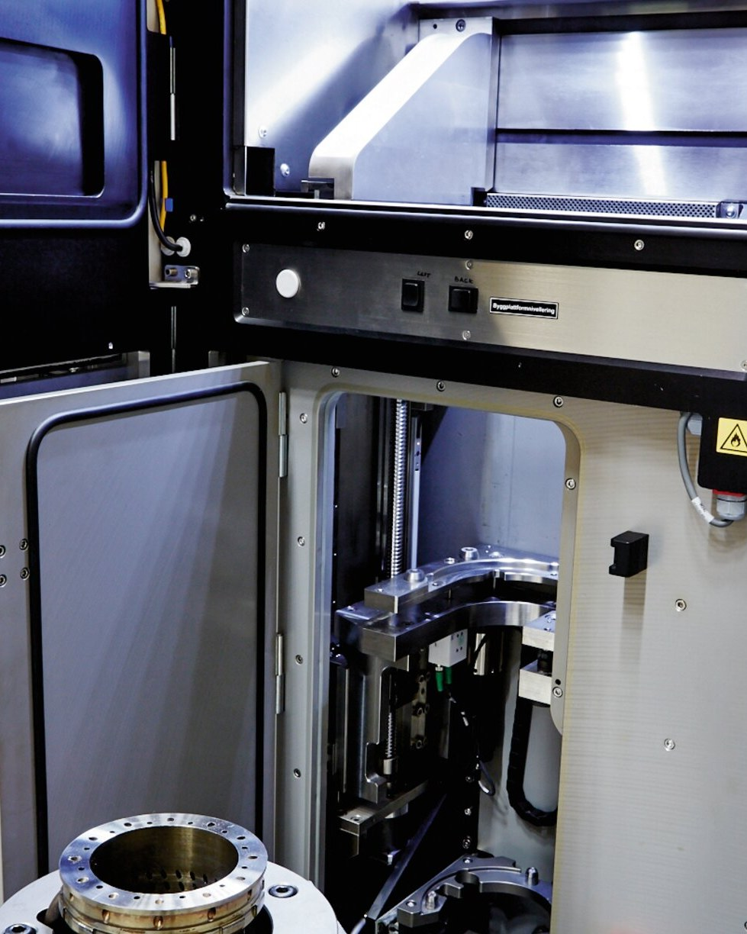
Cover: burner in the EOS M 280
04_am_repair_cover_ded_blade_tip.jpg
Notes:
Source: optomec.com - turbine repair pages - credit Optomec - press image - ask permission

Slide 3
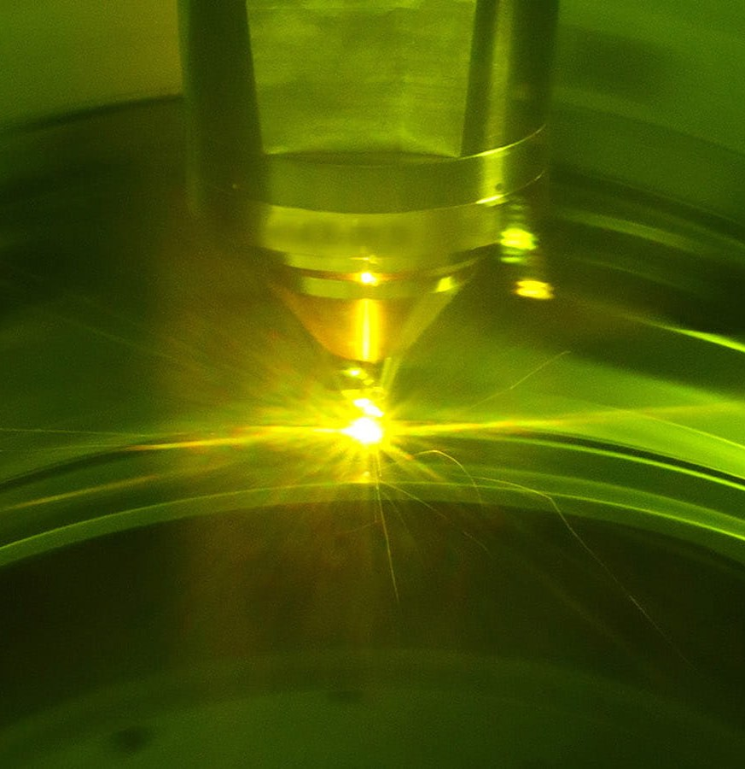
Pratt & Whitney: DED repair of GTF cases
04_pw_gtf_case_repair.jpg
Notes:
Source: prattwhitney.com newsroom; RTX press release 8 Apr 2025 - credit Pratt & Whitney - press image - credit Pratt & Whitney

Slide 4
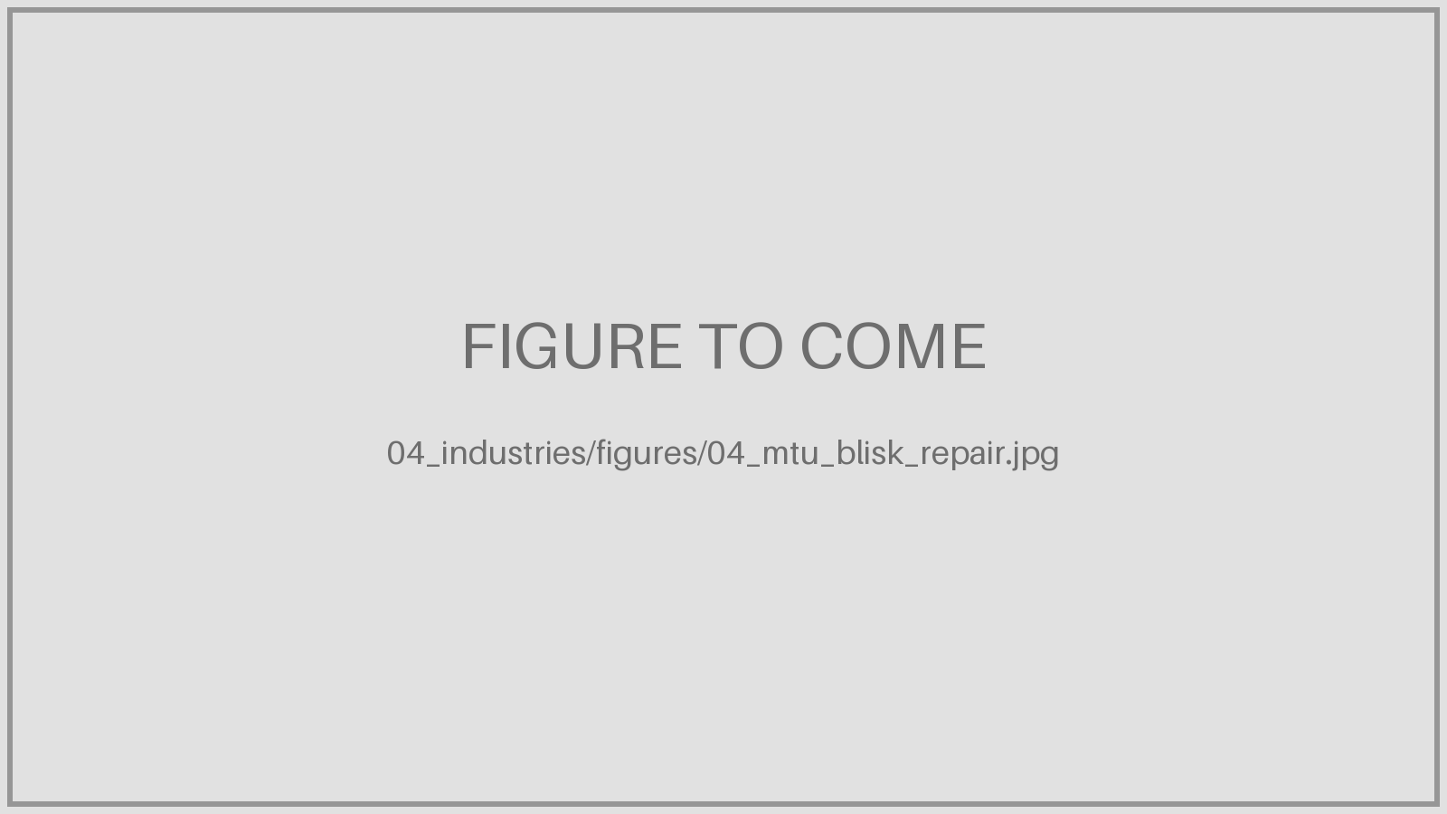
MTU: laser powder cladding of blade tips
04_mtu_blisk_repair.jpg
Notes:
Source: mtu.de press images - credit MTU Aero Engines - press image - credit MTU

Slide 5
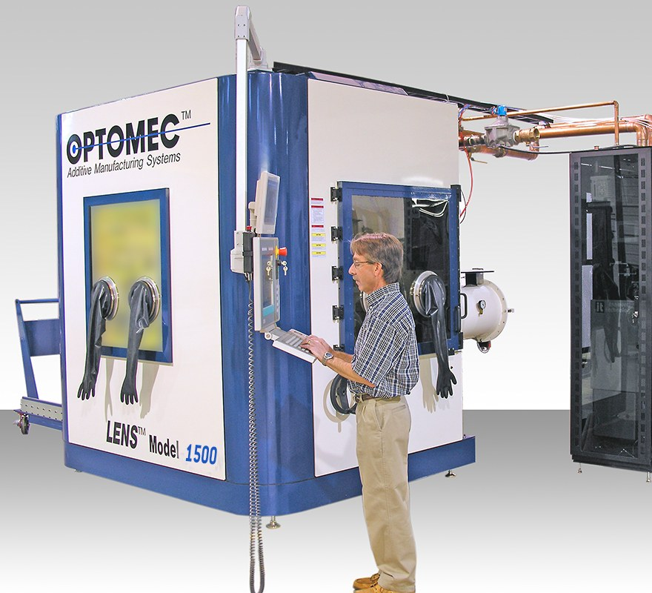
USAF Tinker: Optomec LENS DED
04_usaf_lens_blade_repair.jpg
Notes:
Source: optomec.com news Sept 2020 / June 2021 - credit Optomec - press image - credit Optomec

Slide 6
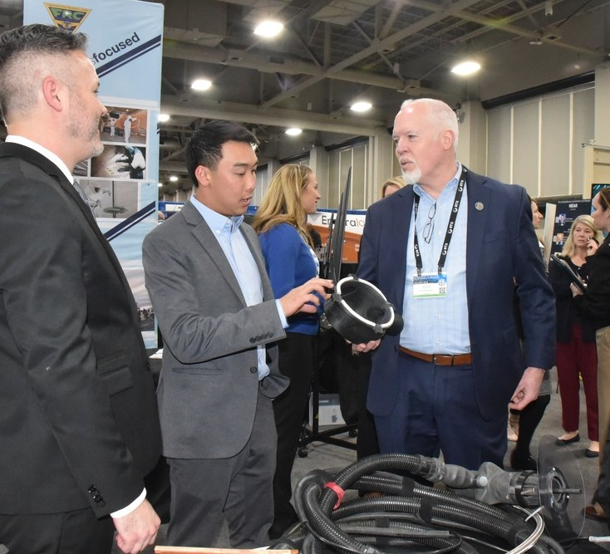
US Navy FRCSW: cold-sprayed parts
04_frcsw_amad_cold_spray.jpg
Notes:
Source: dvidshub.net (FRCSW cold spray) / navair.navy.mil - credit US Navy - US government work - usually public domain; check DVIDS record

Slide 7
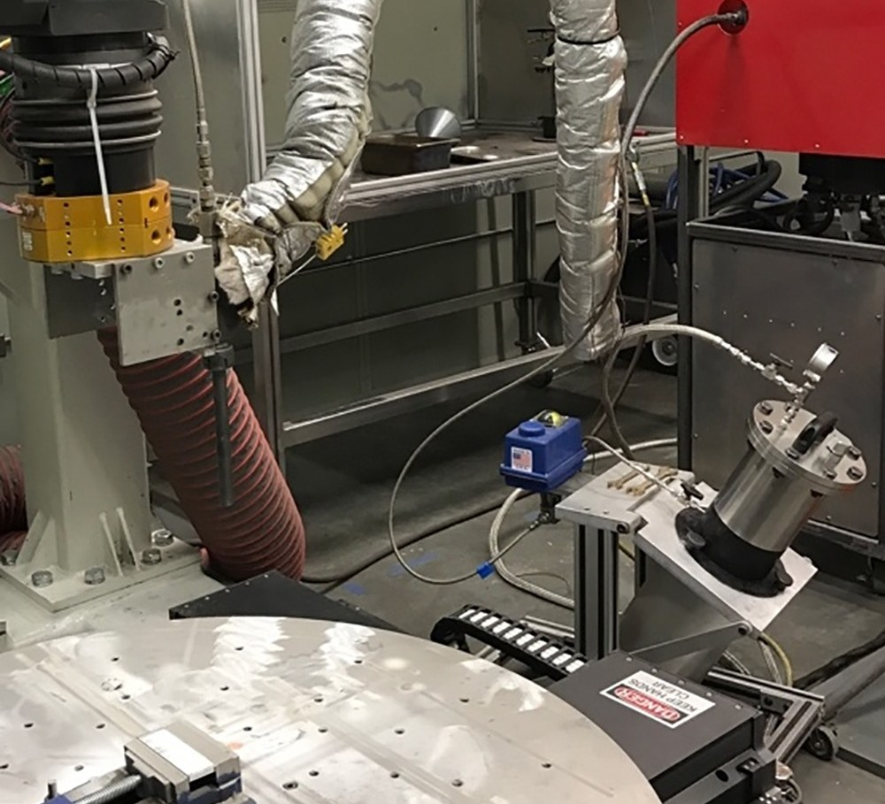
US Army ARL: cold spray cell
04_army_uh60_gearbox_cold_spray.jpg
Notes:
Source: serdp-estcp.mil / army.mil - credit US Army - US government work - usually public domain

Slide 8
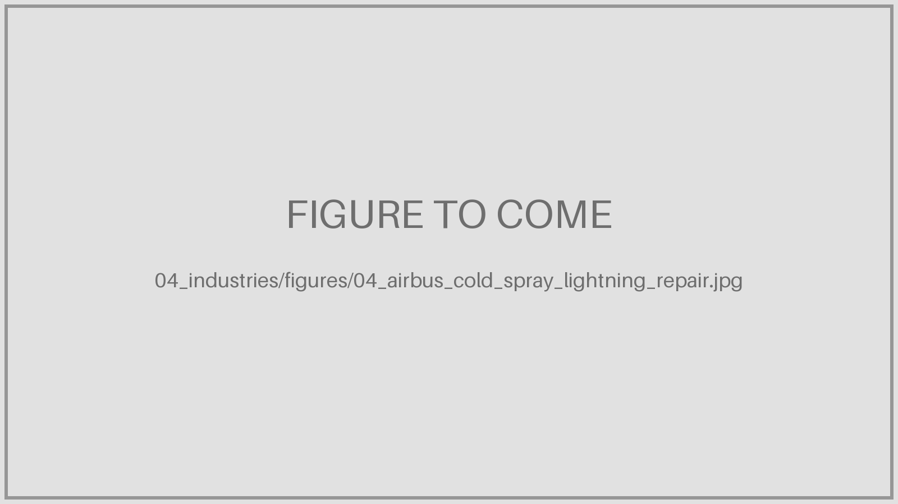
Airbus DS: N2 cold spray (not in repo)
04_airbus_cold_spray_lightning_repair.jpg
Notes:
Source: D. Schimbaeck, Airbus Defence and Space, Aluminium Cold Spray Repair, Oct 2025, p. 11 - credit Airbus Defence and Space - Airbus Amber - internal; check with author before public distribution

Slide 9
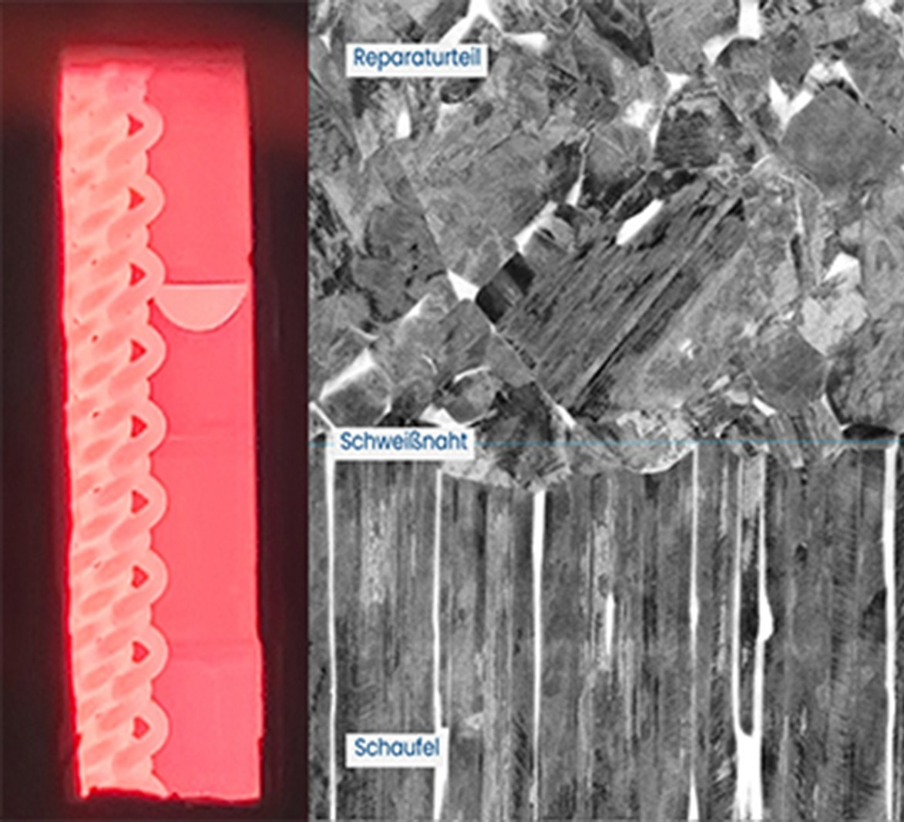
Hereon & Lufthansa Technik: TiAl repair
04_hereon_tial_blade_repair.jpg
Notes:
Source: hereon.de news 18 Feb 2022 - credit Hereon / Marcus Rackel - press image - credit Hereon

Slide 10
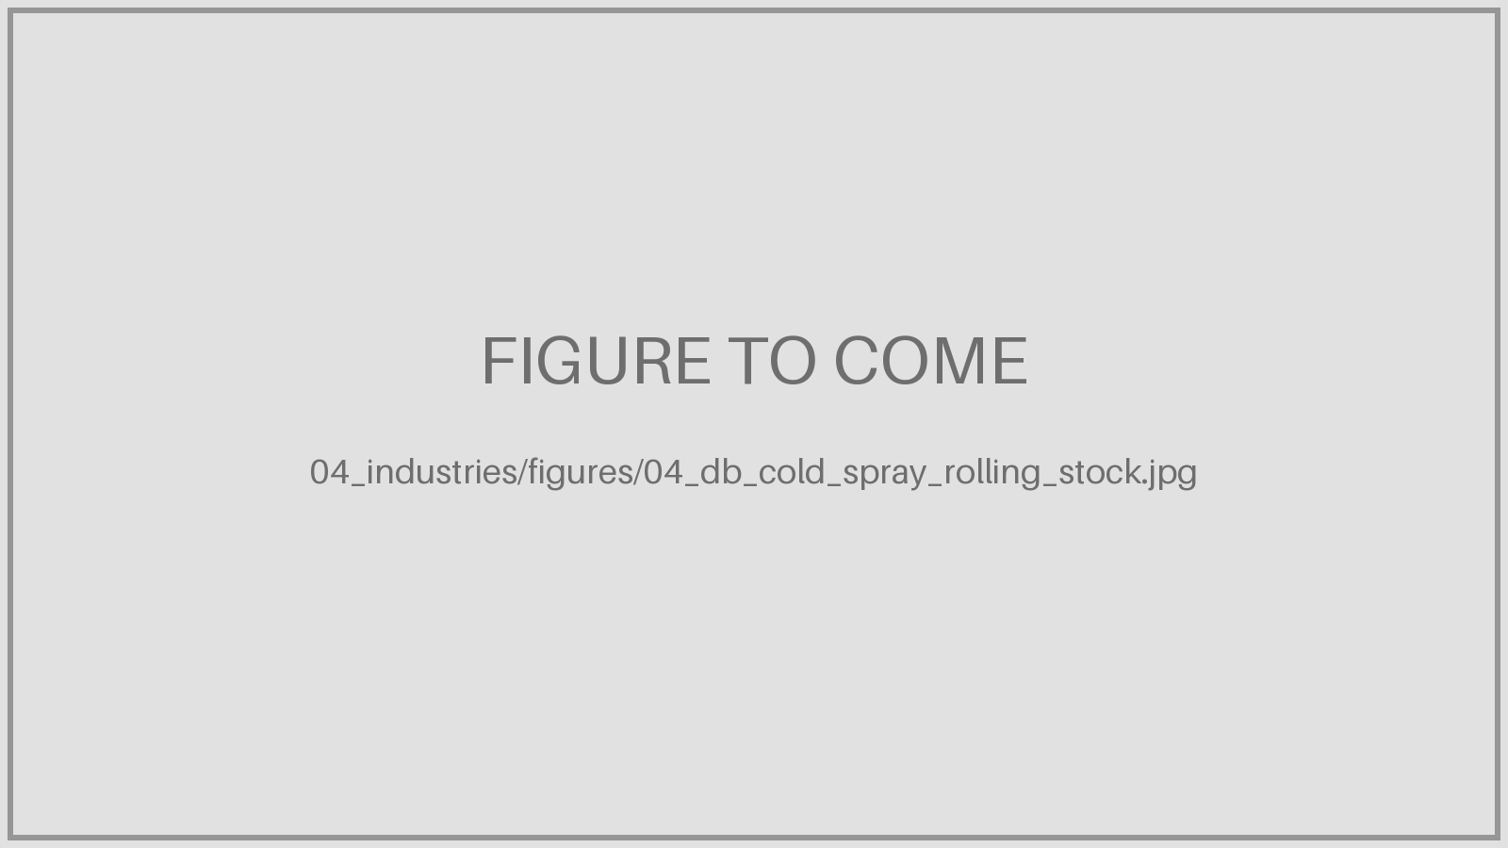
Deutsche Bahn: cold spray (Titomic)
04_db_cold_spray_rolling_stock.jpg
Notes:
Source: titomic.com news 27 Jan 2026 - credit Titomic - press image - credit Titomic

Slide 11
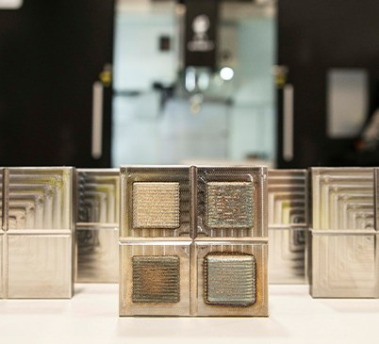
NMIS: LMD die remanufacture
04_nmis_forging_die_repair.jpg
Notes:
Source: nmis.scot / iom3.org Jan 2022 - credit NMIS - press image - credit NMIS

Slide 12
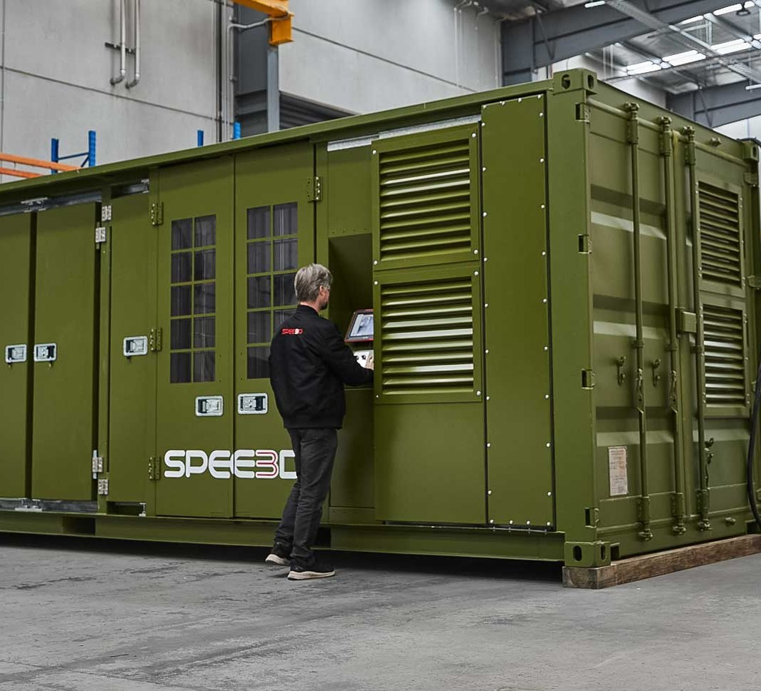
US Navy: XSPEE3D cold spray
04_navy_xspee3d_cold_spray.jpg
Notes:
Source: dvidshub.net (SPEE3D) / spee3d.com - credit US Navy / SPEE3D - DVIDS: US government work; spee3d.com: press image

Slide 13
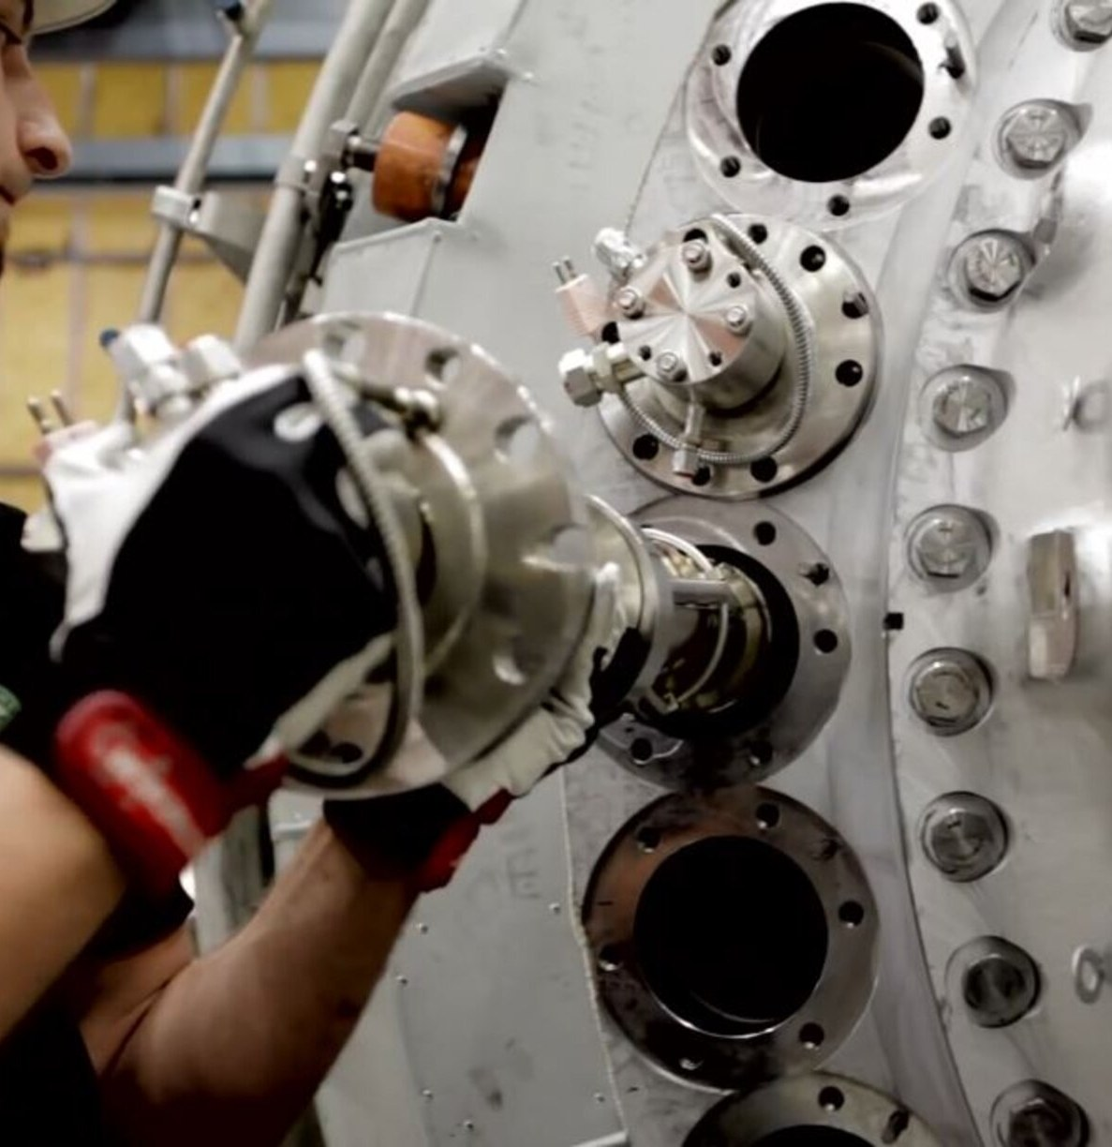
Siemens Energy: burner tip repair
04_siemens_burner_tip_repair.jpg
Notes:
Source: eos.info Siemens case study; laserfocusworld.com Fig. 2 - credit Siemens Energy / EOS - press image - credit Siemens Energy

Slide 14
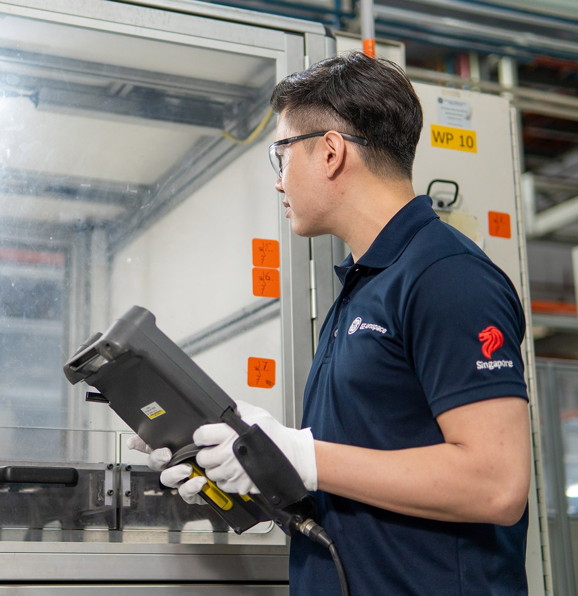
GE Aerospace Singapore: blade tips
04_ge_singapore_hpc_blade_tip.jpg
Notes:
Source: geaerospace.com Singapore site / news - credit GE Aerospace - press image - credit GE Aerospace

Slide 15
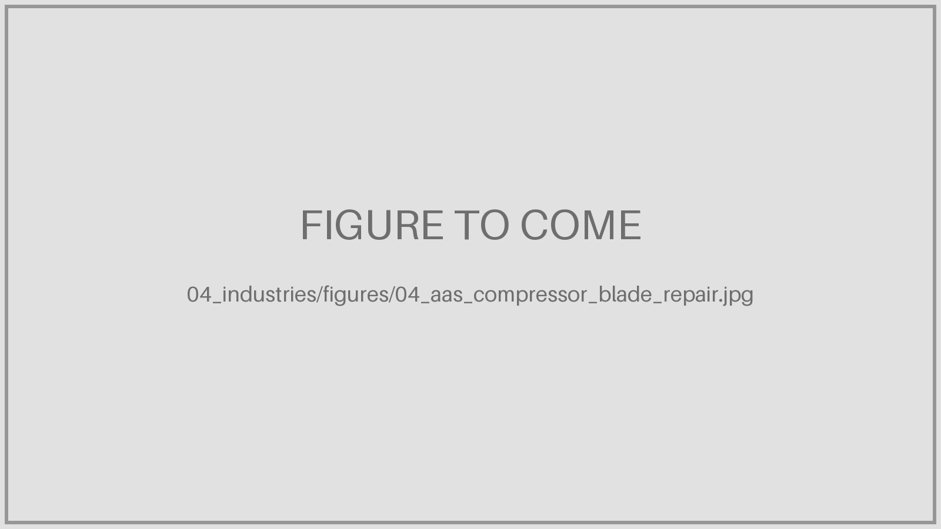
AAS (Safran, AF-KLM): compressor blades
04_aas_compressor_blade_repair.jpg
Notes:
Source: afiklmem.com joint ventures / safran-group.com implantations - credit Safran / AFI KLM E&M - press image

