Slide 1
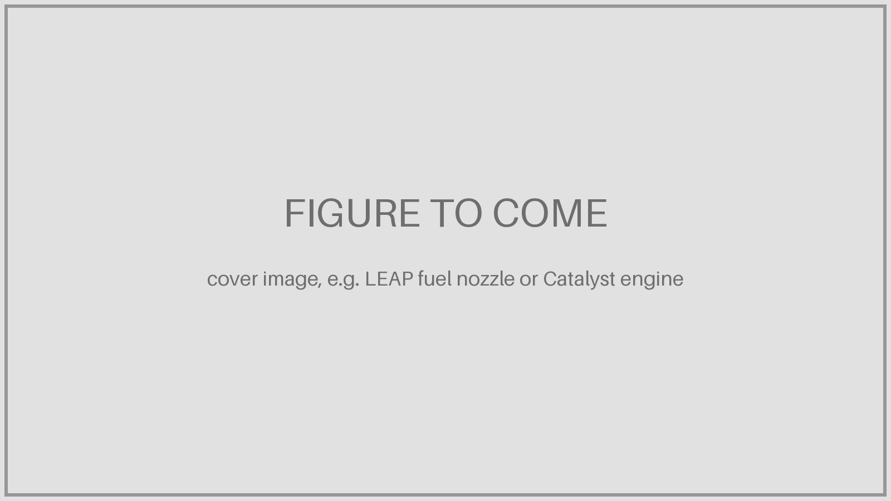
Additive manufacturing in aviation
ADDITIVE MANUFACTURING · APPLICATIONS
Why aviation prints parts, who prints them and where, the technologies and alloys, application examples, and two GE stories: the LEAP fuel nozzle and the Catalyst engine.
Draft · November 2026
geaerospace.com › newsroom / media
Notes:
Draft deck. Dashed boxes are picture placeholders with a suggested source page underneath.

Slide 2
Introduction
PART 1
Printed parts across industries, why aviation prints, and what a kilogram is worth.
• Printed parts across industries
• Why aviation prints parts
• What one kilogram is worth
EXED Polytechnique - Additive Manufacturing - 04 Industries by Andrei Constantinescu 2027

Slide 3
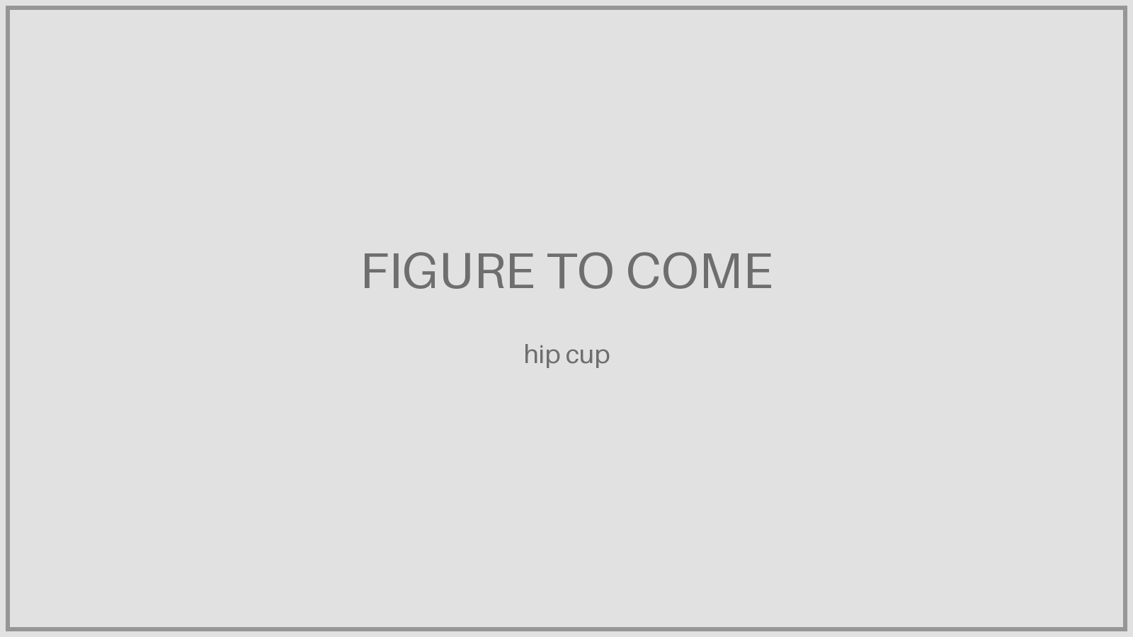

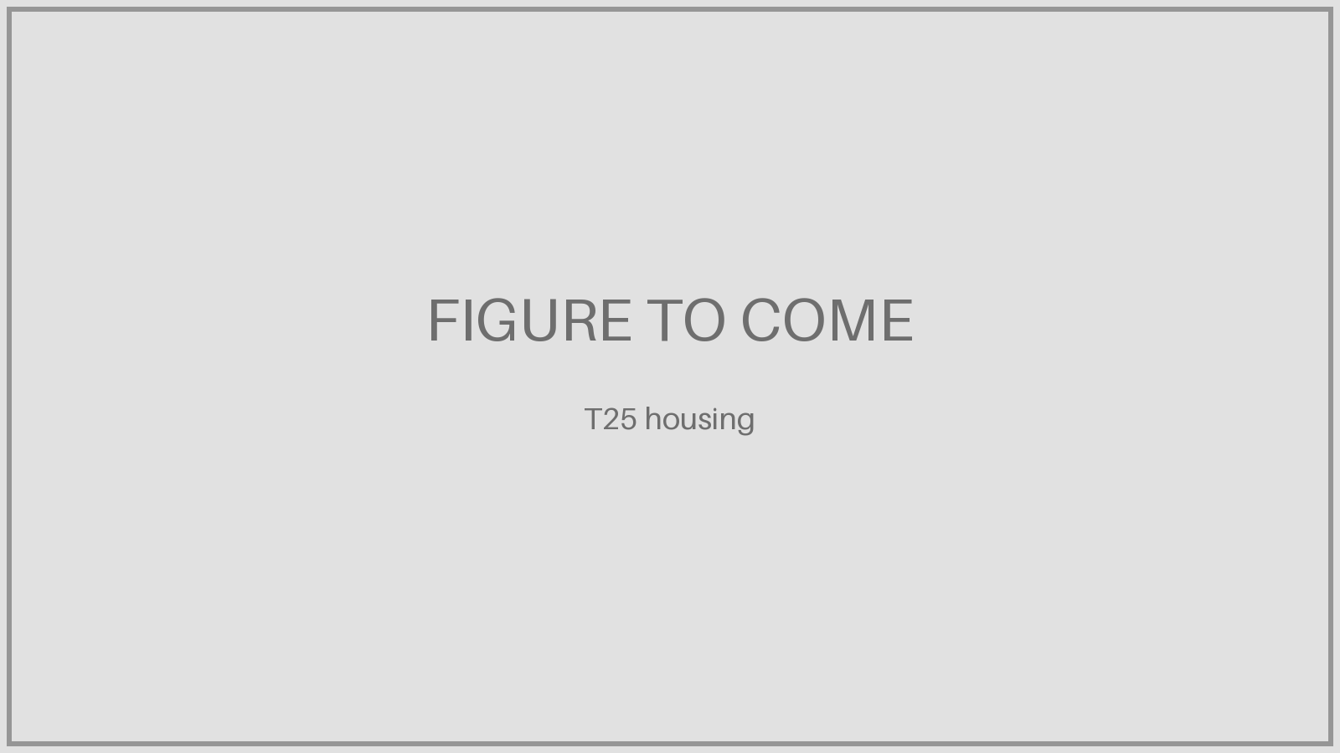

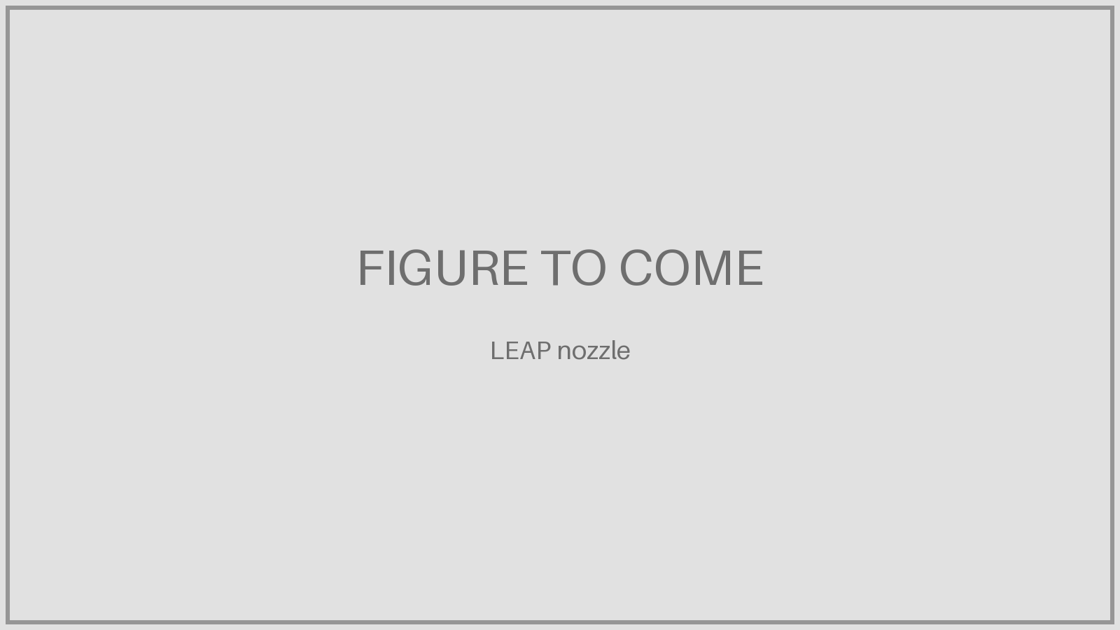
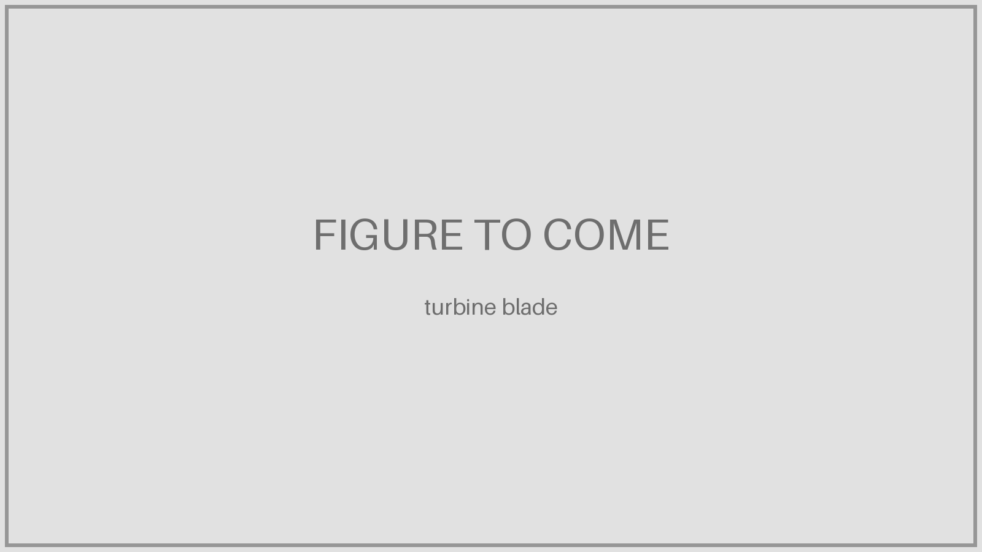
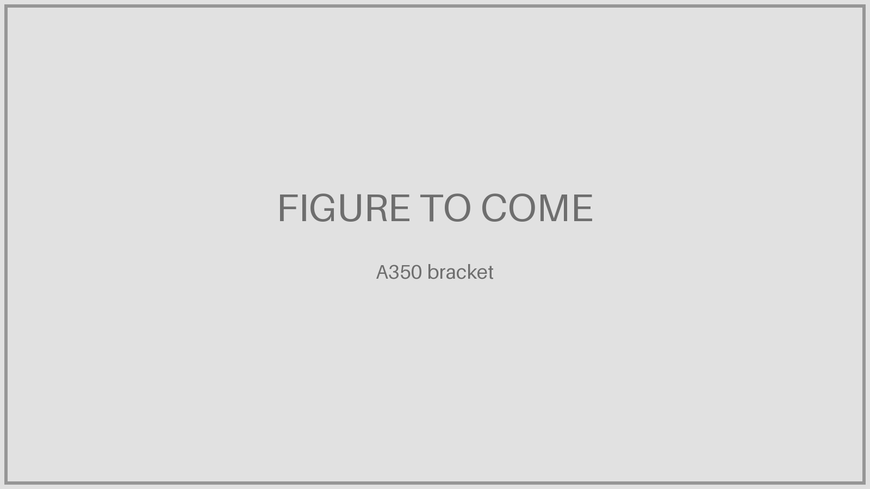



Printed parts in service across industries, 2007–2026
Medical Space Aviation Energy Automotive Defense
2007 · Medical
EBM titanium hip cups (Lima, Adler Ortho) get CE mark
2014 · Space
SpaceX SuperDraco: printed Inconel chamber qualified
2015 · Aviation
GE T25 sensor housing: first FAA-certified AM engine part
2015 · Aviation
Rolls-Royce 1.5 m titanium bearing housing flies
2016 · Aviation
CFM LEAP enters service with printed fuel nozzles
2017 · Energy
Siemens printed gas-turbine blades pass full-load test
2017 · Aviation
Airbus A350: first printed Ti bracket on a series aircraft
2018 · Automotive
Bugatti Chiron: printed Ti brake caliper, ~40% lighter
2025 · Aviation
GE Catalyst turboprop with 12 printed parts certified
2026 · Defense
US Navy depot prints its first flight-certified metal parts
EXED Polytechnique - Additive Manufacturing - 04 Industries by Andrei Constantinescu 2027
Notes:
Introduction: first-of-kind printed parts in real service or qualification across industries. Aviation goes from single certified parts (2015) to series production (2016–2017) to whole engines designed around AM (Catalyst, 2025). Bugatti caliper kept as the automotive example. Aviation-only timeline follows later.

Slide 4
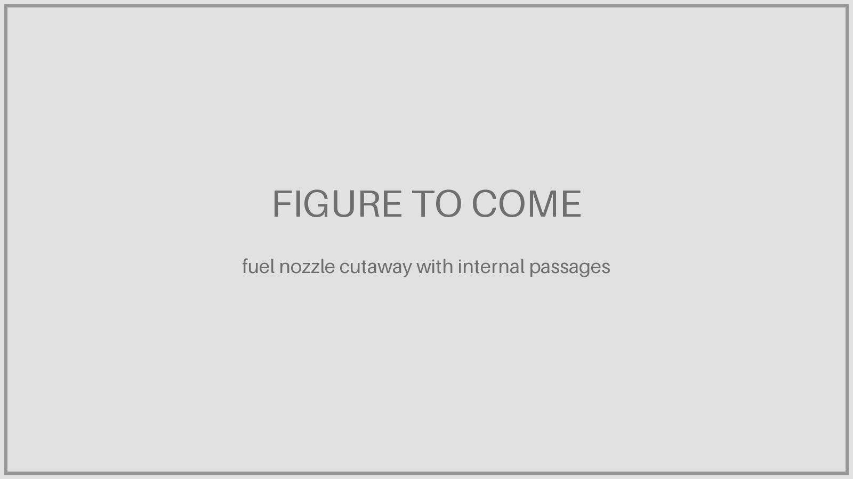

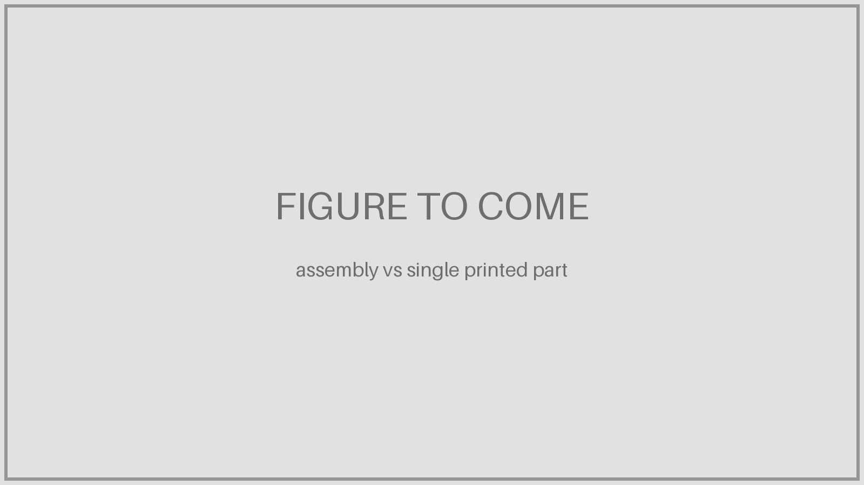
Engines: one part instead of many, lighter means less fuel burned
Proof points in this deck: LEAP nozzle · 20 → 1 parts, −25% Catalyst · 855 → 12 parts, −5% engine Bugatti caliper · −40% mass
Complex internal geometry
Cooling channels, fuel passages and lattices that no casting or machining can reach.
Lower weight
Material only where loads need it: topology-optimised brackets, thin-walled housings.
Fewer parts
Assemblies become single parts: no brazes, welds or bolts to make, inspect or fail.
EXED Polytechnique - Additive Manufacturing - 04 Industries by Andrei Constantinescu 2027
Notes:
The main draws are complex internal geometry, lower weight and fewer parts. AM lets engineers replace complex assemblies with single parts that are lighter than previous designs, saving weight and boosting a jet engine's fuel efficiency (GE, 2015). The next slide puts a euro value on each kilogram saved on an engine.

Slide 5
What one kilogram saved on an engine is worth
1 kg removed from each engine | A320neo / 737 MAX | A330neo / 787
Extra fuel to carry 1 kg per flight hour (any mass) | 3.0% | 3.5%
Block hours per year (assumed) | 3,500 h | 5,000 h
Engines per aircraft | 2 | 2
Fuel saved per aircraft per year | ≈210 kg | ≈350 kg
CO₂ avoided per year (3.16 kg / kg fuel) | ≈660 kg | ≈1.1 t
Per year, fuel at 2025 avg ($90/bbl) | ≈€130 | ≈€215
Per year, IATA 2026 forecast ($152/bbl) | ≈€220 | ≈€365
Per year, Oct 2026 weekly ($190/bbl) | ≈€275 | ≈€455
Over 25 years in service | €3,200–6,800 | €5,400–11,400
A kg is a kg
The 3%/h rule holds for any mass carried: passenger, structure or engine. Per aircraft it counts twice: two engines.
New designs: the snowball
1 kg less engine allows 1.5–4 kg less empty weight (pylon, wing, landing gear). Multiply the table by 1.5–4.
The bigger lever: fuel efficiency
A320neo ≈ 2,250 kg/h × 3,500 h ≈ 7,900 t fuel a year. 1% better SFC ≈ 79 t/yr ≈ €50–100k : worth ~750 kg of weight.
Assumptions: Jet A-1 0.8 kg/L, 159 L/bbl, €1 = $1.15 [check rate], undiscounted. Fuel: IATA ($90 2025, $152 2026 forecast, $190.18 week to 9 Oct 2026).
EXED Polytechnique - Additive Manufacturing - 04 Industries by Andrei Constantinescu 2027
Notes:
Answer to the per-passenger vs per-engine question: the cost-of-weight rule (≈3% per flight hour, Aircraft IT; 3.5%, OpenAirlines; IATA range 2.5–5%) applies to any extra kilogram regardless of where it sits (Scholz, HAW Hamburg: it does not matter whether the kg is operating empty mass or payload). An engine kilogram therefore costs the same fuel to carry as a passenger kilogram, but (1) a twin carries two engines, (2) in a new design each engine kg drives 1.5–4 kg of aircraft empty weight through supporting structure (IPCC Aviation report, ch. 7.4), and (3) for engine parts like the LEAP nozzle the main gain is efficiency, not mass: the LEAP is about 15% more fuel-efficient than the CFM56. A320neo average cruise burn ≈2,250 kg/h (Lufthansa figure via The Flying Engineer). Oct 2026: IATA weekly global average $190.18/bbl (Europe $202.61).

Slide 6
Aviation milestones and applications
PART 2
Aviation milestones by technology, and the five application areas.
• Milestones by technology
• Five application areas
EXED Polytechnique - Additive Manufacturing - 04 Industries by Andrei Constantinescu 2027

Slide 7
Aviation milestones by technology and application area
Year | Polymer | Laser powder bed | Electron beam | DED (wire / powder)
2014 | CABIN · A350 first delivery: 1,000+ ULTEM 9085 parts (Stratasys)
2015 |  | ENGINE · GE T25 housing: first FAA-certified printed engine part | ENGINE · Rolls-Royce XWB-97: 1.5 m Ti bearing housing flies
2016 |  | ENGINE · CFM LEAP enters service with printed CoCr fuel nozzles
2017 | MRO · Etihad: first airline MRO to certify and fly printed cabin parts (powder bed 2019) | AIRFRAME · A350 Ti bracket (Arconic); A380 spoiler valve block (Liebherr) |  | AIRFRAME · Norsk Titanium: first FAA-approved structural Ti parts, 787
2020 |  |  | ENGINE · GE9X certified with printed TiAl turbine blades
2022 |  | ENGINE · Safran AM Campus opens near Bordeaux
2025 |  | ENGINE · GE Catalyst certified: 855 parts → 12 printed
2026 |  |  |  | AIRFRAME · Airbus: wire-DED Ti parts in A350 cargo-door surround
EXED Polytechnique - Additive Manufacturing - 04 Industries by Andrei Constantinescu 2027
Notes:
Columns are the printing technologies, the coloured tag is the application area (engine, airframe, systems, cabin, MRO). Polymers entered aviation through cabin parts and MRO; laser powder bed dominates engines; electron beam is used for TiAl blades and large titanium; wire DED is now moving into primary airframe structure.

Slide 8
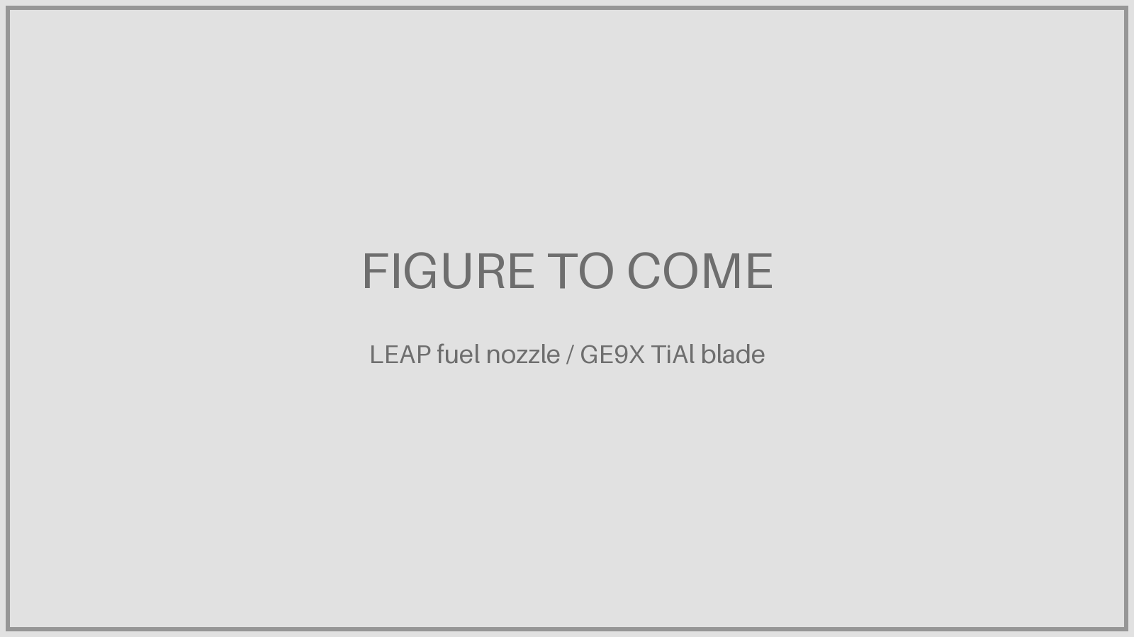
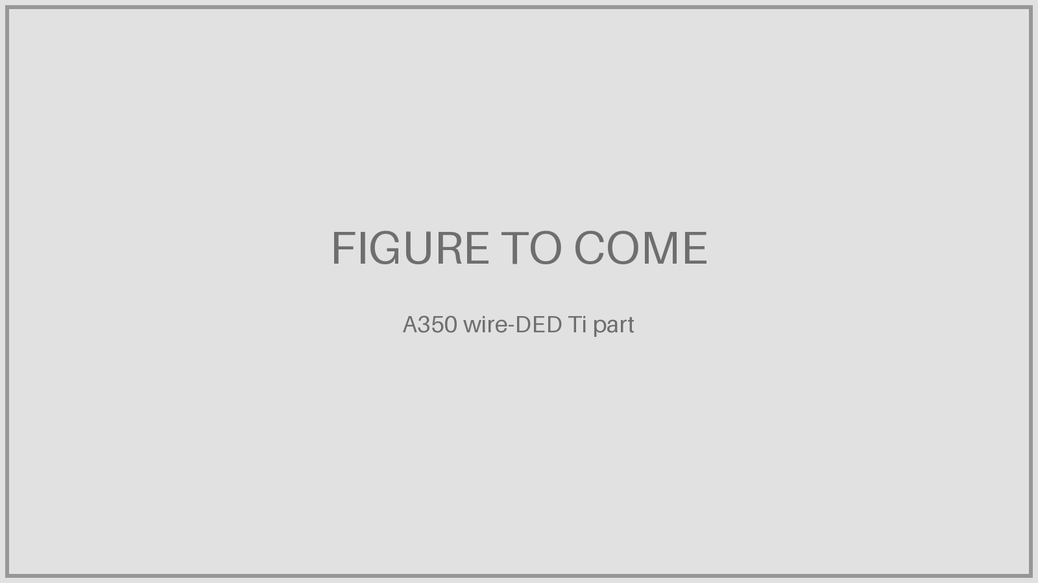
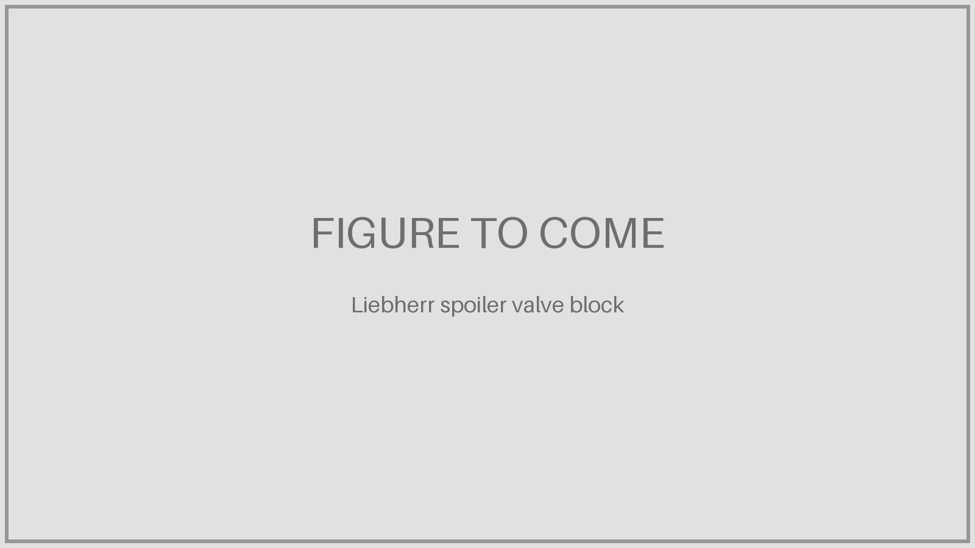
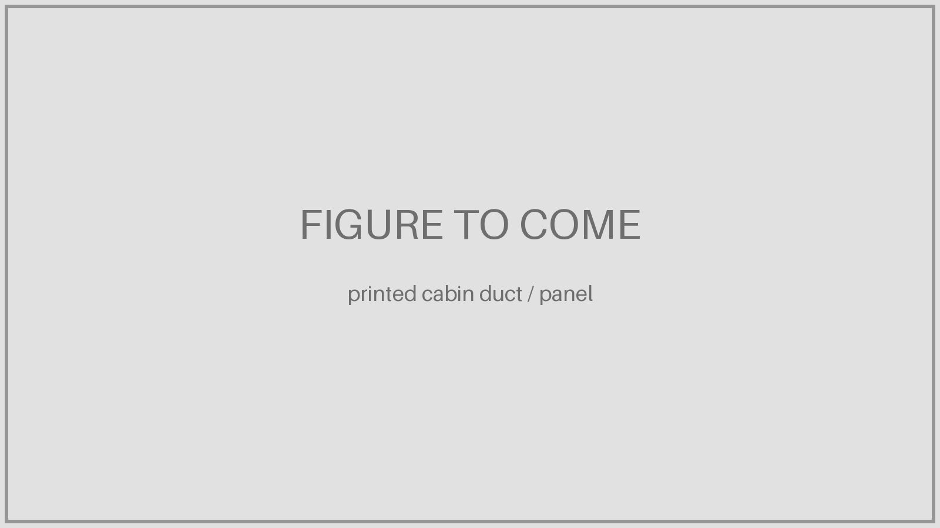
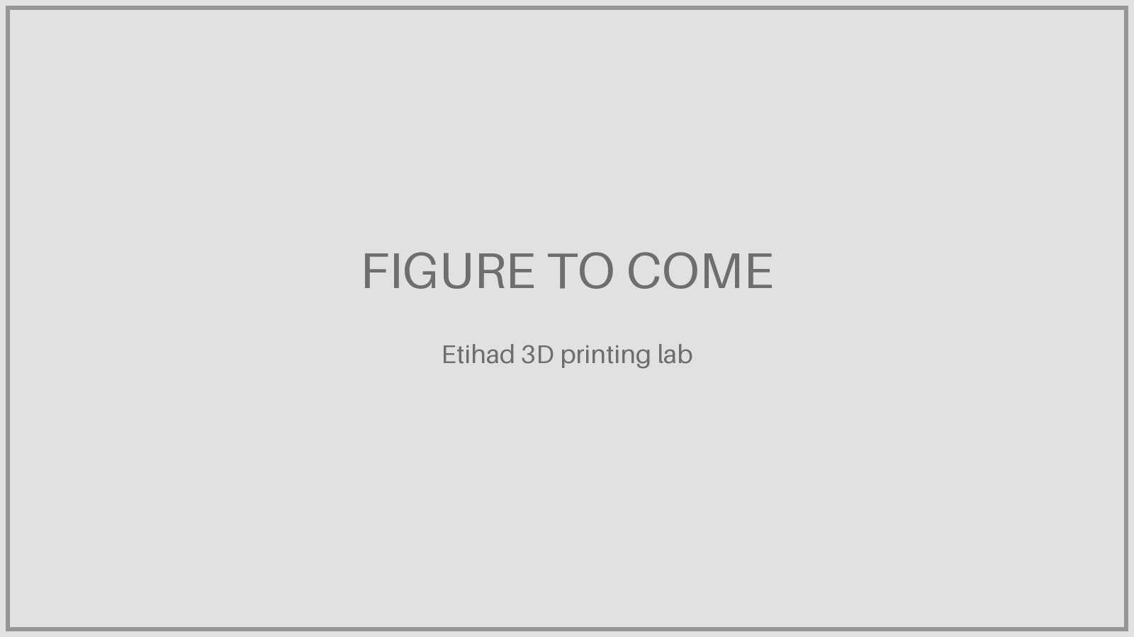
Five application areas
Engines
• Fuel nozzles, housings, heat exchangers
• TiAl turbine blades
• Whole engines (Catalyst)
Airframe
• Titanium brackets
• Large wire-DED structures
• 787 Ti fittings
Systems
• Hydraulic valve blocks
• Actuator housings
• 35% lighter (A380)
Cabin
• Ducts, panels, brackets
• ULTEM and PA12 polymers
• 25,000+ parts a year (Airbus)
MRO and tooling
• Spares on demand
• DED repair of worn parts
• Jigs, fixtures, moulds
EXED Polytechnique - Additive Manufacturing - 04 Industries by Andrei Constantinescu 2027
Notes:
Each area has an example page next: engines (T25, GE9X blades, Safran campus), systems (Liebherr), airframe (A350, 787, C919), cabin (Airbus/Stratasys), MRO (Etihad, US Navy FRCE).

Slide 9
Application examples
PART 3
One page per example: company, printer, gains and problems.
• Engines: T25, GE9X, UEC VK-1600V
• Systems and airframe: Liebherr, A350, 787, C919, BLT
• Cabin, MRO and space: Airbus, Etihad, Ariane 6
EXED Polytechnique - Additive Manufacturing - 04 Industries by Andrei Constantinescu 2027

Slide 10
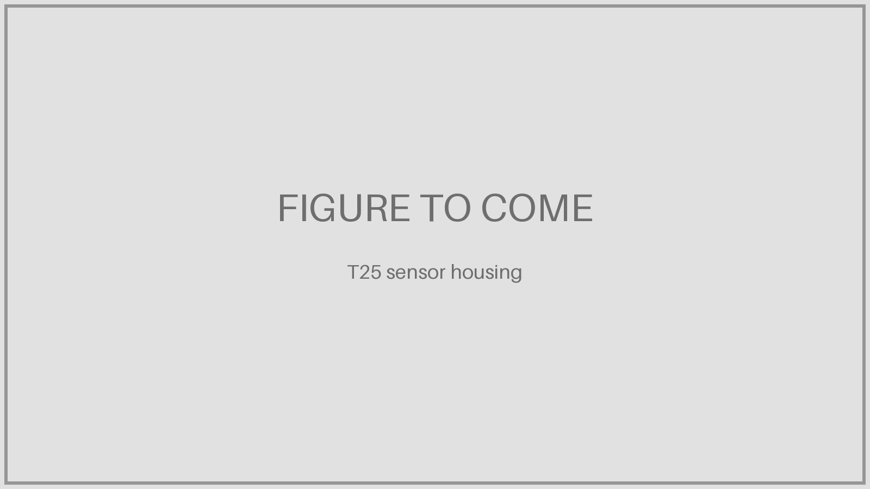
GE90 T25 sensor housing: the first certified printed engine part
• Housing for the compressor-inlet temperature and pressure sensor of the GE90-94B (Boeing 777)
• Protects the sensor electronics from icing and punishing airflow
• Retrofit approved by the FAA in 2015; opened the way for the LEAP nozzle
Company
GE Aviation (now GE Aerospace), Cincinnati
Printer / process
Laser powder bed, cobalt-chrome
Gains
Fast prototype-to-production; first certified printed engine part
Problems / challenges
First of its kind: new process specification and FAA acceptance
Source: GE Reports, 14 Apr 2015; introduction slides
EXED Polytechnique - Additive Manufacturing - 04 Industries by Andrei Constantinescu 2027
Notes:
From the introduction slides (2016 GE90-94 T25).

Slide 11
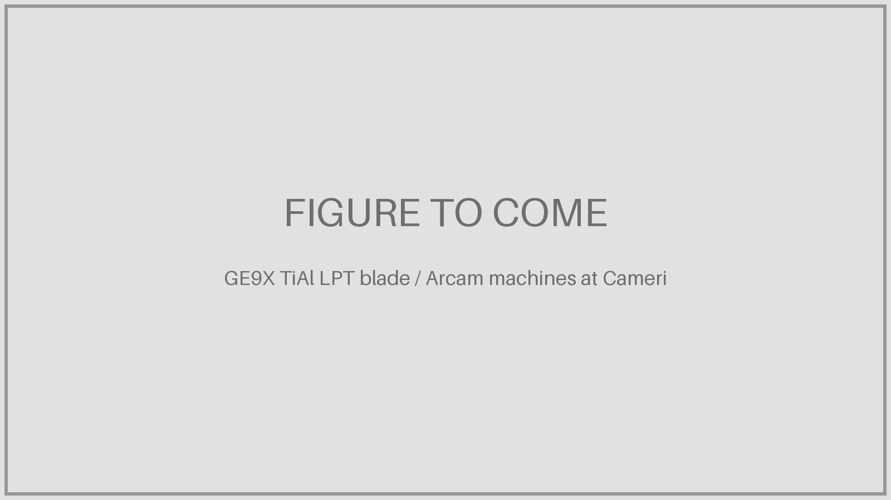
GE9X: printed TiAl low-pressure turbine blades
• Low-pressure turbine blades printed at Avio Aero, Cameri (Italy)
• 304 parts in 7 printed components on each GE9X
• Engine FAA-certified September 2020 (Boeing 777X)
Company
Avio Aero (GE Aerospace), Cameri, Italy
Printer / process
Arcam, now Colibrium: A2X (6 blades/batch), Spectra H (10)
Gains
Blades about half the weight of nickel; key to −10% fuel vs GE90
Problems / challenges
TiAl is brittle and fussy, EBM is demanding; 62 machines for rate
Source: GE Additive / Metal AM, June 2019; CompositesWorld; GE Aerospace, Sept 2020
EXED Polytechnique - Additive Manufacturing - 04 Industries by Andrei Constantinescu 2027
Notes:
The 10% fuel gain is for the whole engine vs GE90-115B; TiAl blades are a driving factor.

Slide 12
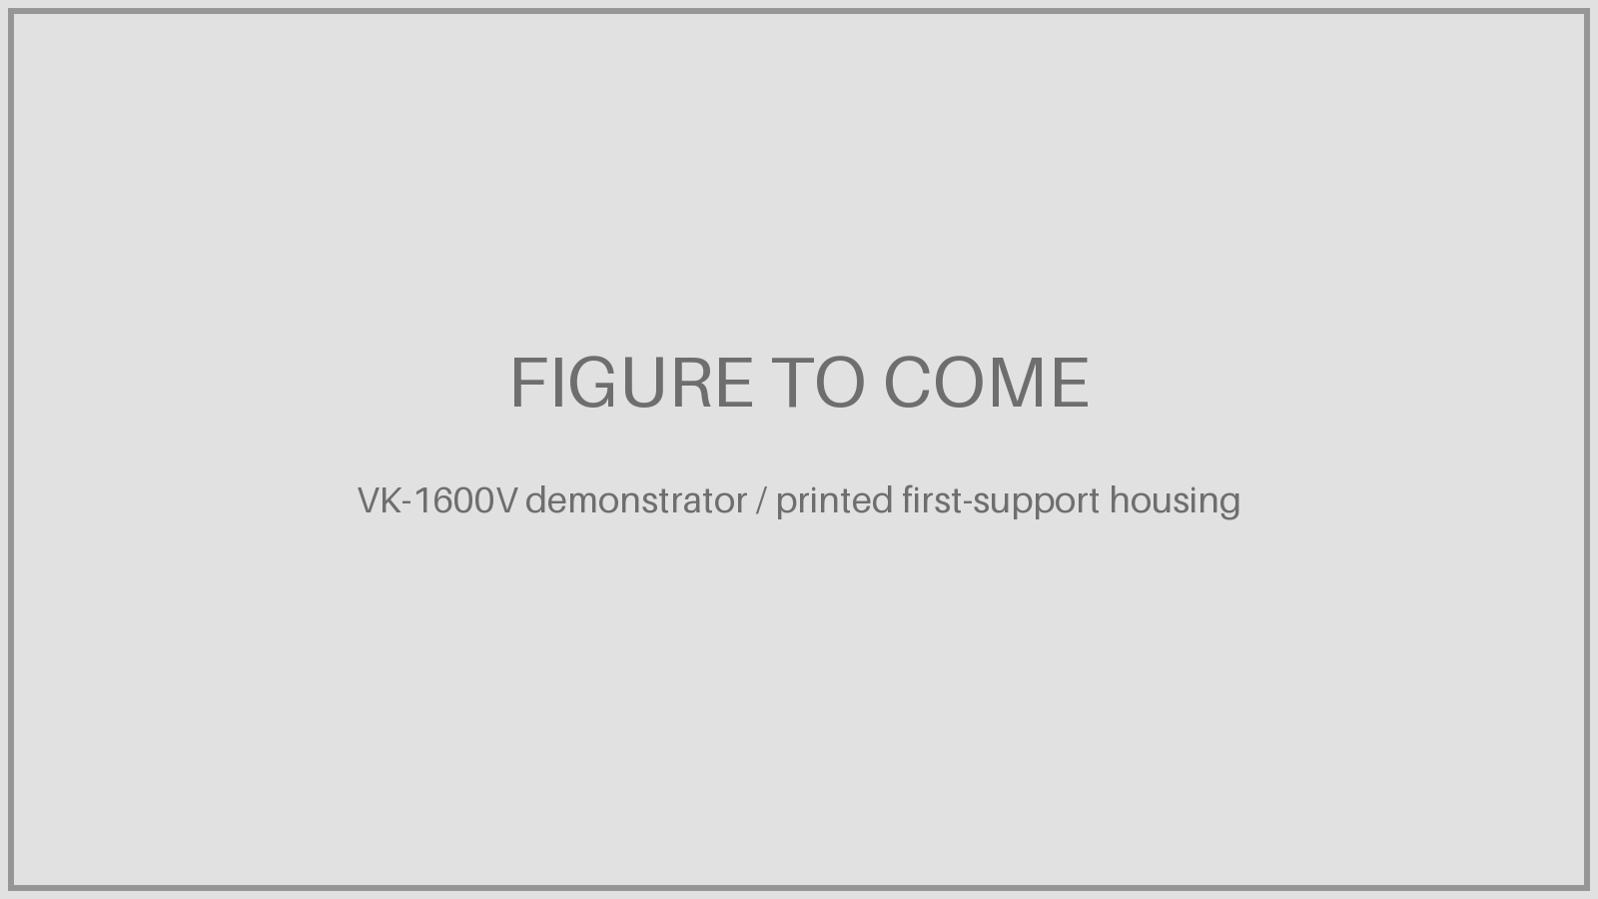
UEC VK-1600V: up to 70% of castings replaced by printed parts
• Helicopter engine for the Ka-62, designed entirely in 3D (no paper drawings) at UEC-Klimov
• Up to 70% of castings printed, incl. hot-section parts and the first-support housing (made with UEC’s Chernyshev plant, Moscow)
• 1,400 hp take-off, 210 kg dry weight; demonstrator 2021
Company
United Engine Corporation (Rostec): UEC-Klimov, Chernyshev (Moscow)
Printer / process
Rostec Additive Technologies Center: Russia’s largest laser machine, Russian materials
Gains
Lead time from 6 months to 3 weeks; lighter parts
Problems / challenges
Type certificate planned for 2023 and series for 2024: current status unclear
Source: Rostec/UEC, May 2021; Airframer; Rostec ATC, May 2021; www1.ru, Nov 2024
EXED Polytechnique - Additive Manufacturing - 04 Industries by Andrei Constantinescu 2027
Notes:
The 70% figure is the share of castings replaced in the demonstrator; Rostec also said more than 10% of the engine’s parts would be printed. Treat as a prototype programme; independent data are scarce.

Slide 13
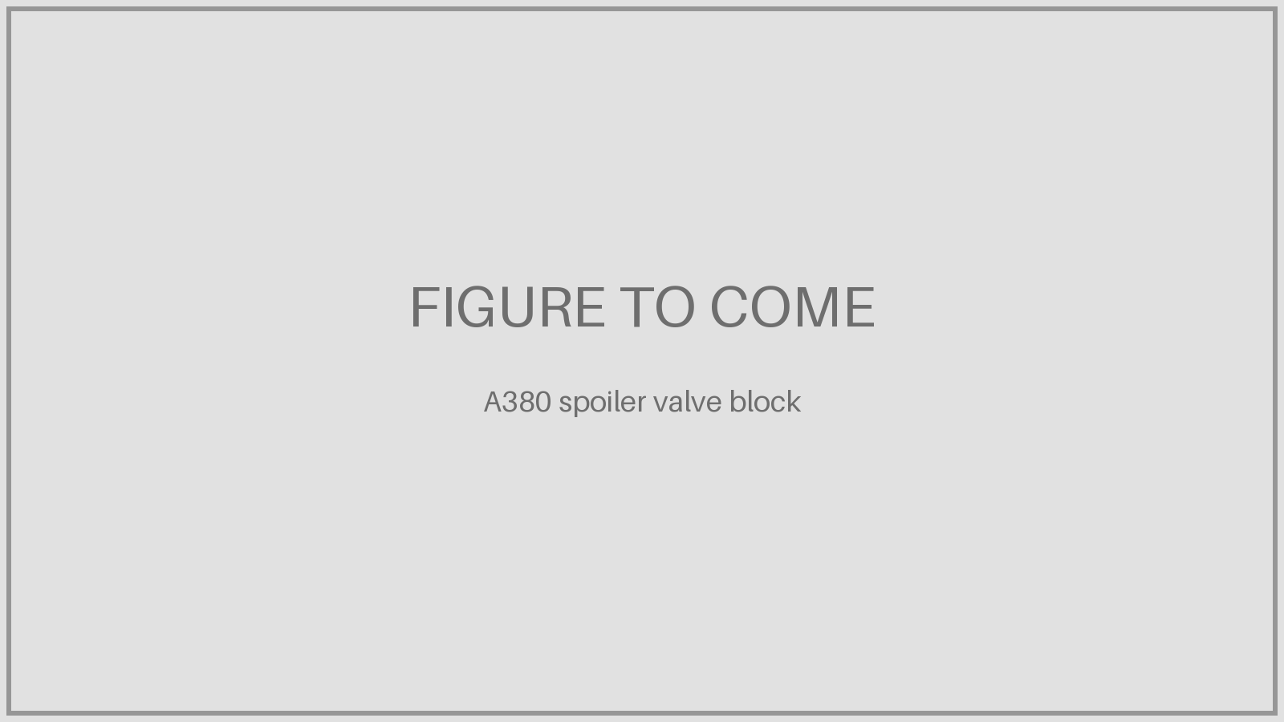
Liebherr-Aerospace: printed spoiler-actuator valve block
• First printed primary-flight-control hydraulic part flown on an Airbus (A380 test flight, 30 March 2017)
• Same performance as the forged titanium valve block
• Then serial A350 parts: nose-gear bracket (2019), cargo-door actuator and valve (2022), flex shaft
Company
Liebherr-Aerospace (Lindenberg, DE; HQ Toulouse) with TU Chemnitz
Printer / process
Laser powder bed, titanium powder
Gains
35% lighter, fewer parts, minimal titanium waste
Problems / challenges
Whole chain still to optimise: powder, laser parameters, post-processing
Source: Liebherr-Aerospace, Apr 2017; 3DPrint.com
EXED Polytechnique - Additive Manufacturing - 04 Industries by Andrei Constantinescu 2027
Notes:
Liebherr’s CTO said broad use would still take “quite a way” in 2017.

Slide 14
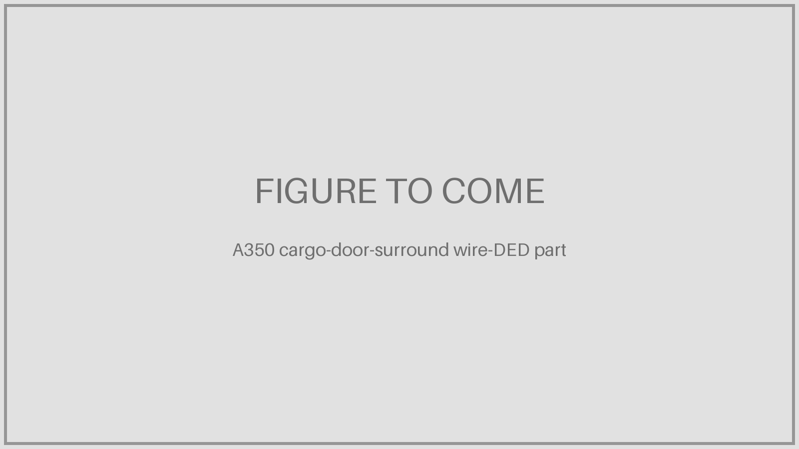
Airbus A350: from printed brackets to 7-metre titanium parts
• 2017: first printed titanium bracket on a series Airbus (Arconic, Austin)
• 2026: plasma wire-DED titanium parts in the A350 cargo-door surround
• Near-net-shape parts up to 7 m long, then machined
Company
Airbus with Arconic (now Howmet) and Norsk Titanium
Printer / process
Laser powder bed and e-beam (Arconic); plasma wire DED
Gains
Avoids recycling 80–95% of bought titanium; weeks instead of months
Problems / challenges
Ultrasonic inspection and machining still needed; energy sources still evaluated
Source: Howmet/Arconic, Sept 2017; Airbus newsroom and Metal AM, Jan 2026
EXED Polytechnique - Additive Manufacturing - 04 Industries by Andrei Constantinescu 2027
Notes:
Parts inspected by Testia Bremen, machined and installed in Airbus factories. Airbus aims at wings and landing gear in the longer term.

Slide 15
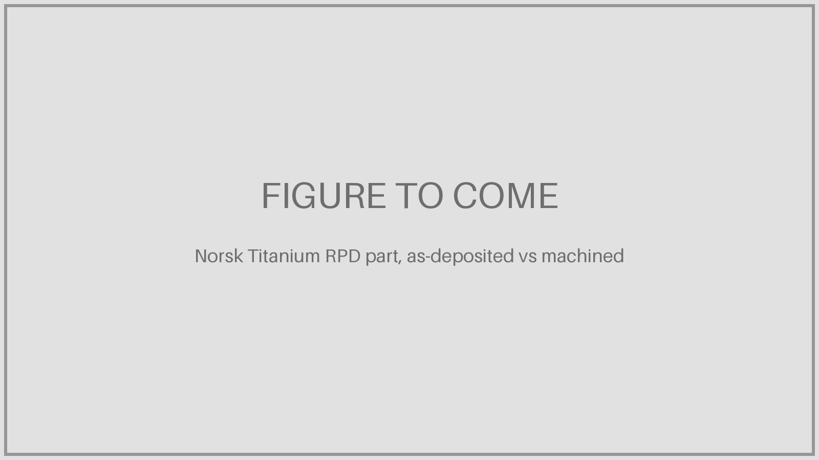
Boeing 787: Norsk Titanium structural parts
• Rapid Plasma Deposition: titanium wire melted by plasma torches
• First FAA-approved printed structural titanium parts (Feb 2017)
• Initial family of four parts near the rear of the cabin
Company
Norsk Titanium (Norway; Plattsburgh, NY) for Boeing
Printer / process
Own MERKE IV RPD machines
Gains
Boeing expected $2–3 M savings per 787
Problems / challenges
Preforms must be machined; parts approved one by one until the process is approved
Source: Norsk Titanium / Business Wire, Apr 2017; Engadget; Aero-Mag
EXED Polytechnique - Additive Manufacturing - 04 Industries by Andrei Constantinescu 2027
Notes:
Once the RPD process is approved, new parts would not need individual certification.

Slide 16
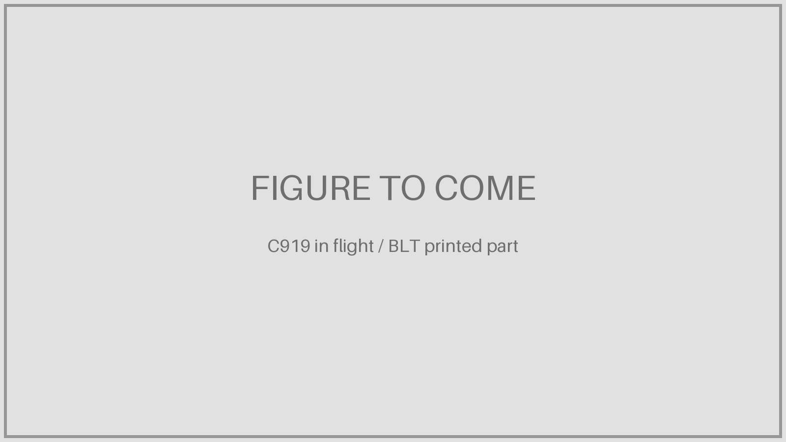
COMAC C919: printed titanium parts
• C919 first flight May 2017 with printed titanium parts
• 28 cabin-door parts and 2 fan-inlet structural parts
• FalconTech supplied 30 metal parts; BLT printed others
Company
COMAC (Shanghai); suppliers BLT (Xi’an) and FalconTech
Printer / process
Laser powder bed; FalconTech used foreign-brand machines
Gains
Lighter titanium parts, shorter lead times, domestic capability
Problems / challenges
Early reliance on imported machines; mostly secondary structure
Source: 3D Printing Industry, May 2017; 3DPrint.com
EXED Polytechnique - Additive Manufacturing - 04 Industries by Andrei Constantinescu 2027
Notes:
China has worked on laser titanium AM since 1995.

Slide 17
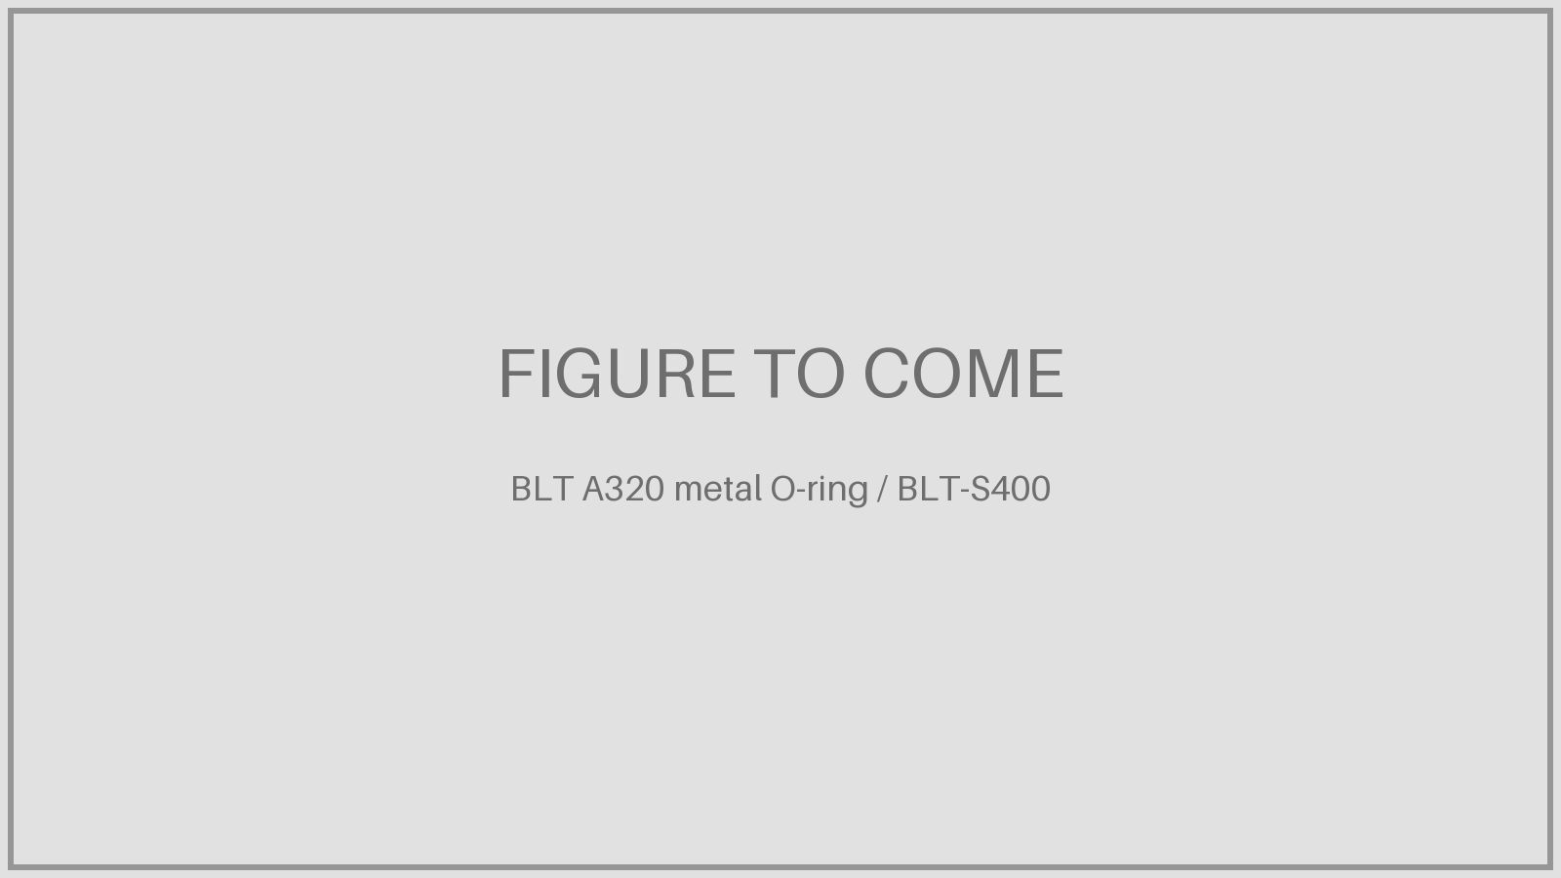
BLT: a Chinese printer maker in Airbus series production
• Nov 2024, Zhuhai Airshow: new A320 metal O-ring work package for Airbus Atlantic
• Printed in superalloy powder on BLT’s own S400 machine
• Airbus A330 production approval for AM parts since 2018; A350 large-part agreement 2018
Company
Xi’an Bright Laser Technologies (BLT), ~1,700 staff
Printer / process
Own BLT-S400 laser powder bed and own powders
Gains
Vertical integration: 20 machine models, 1,000+ t powder a year
Problems / challenges
Quantities, value and part criticality not disclosed
Source: Metal AM, 20 Nov 2024; VoxelMatters; 3DPrint.com; Metal AM (Formnext 2025)
EXED Polytechnique - Additive Manufacturing - 04 Industries by Andrei Constantinescu 2027
Notes:
BLT is listed on the Shanghai STAR market and passed its 1,000th LPBF machine in 2023.

Slide 18

Airbus cabin: polymer parts at industrial scale
• 1,000+ printed parts on the first A350 delivered (Qatar Airways, Dec 2014)
• Today 25,000+ flight parts a year for A320, A350 and A400M
• Started in 2013 to de-risk the A350 delivery schedule
Company
Airbus
Printer / process
Stratasys FDM, ULTEM 9085 Certified Grade
Gains
−43% weight, −85% lead time, no minimum order quantity
Problems / challenges
Flame, smoke and toxicity compliance; strict material traceability
Source: Stratasys, May 2015; Airframer, Dec 2025
EXED Polytechnique - Additive Manufacturing - 04 Industries by Andrei Constantinescu 2027

Slide 19
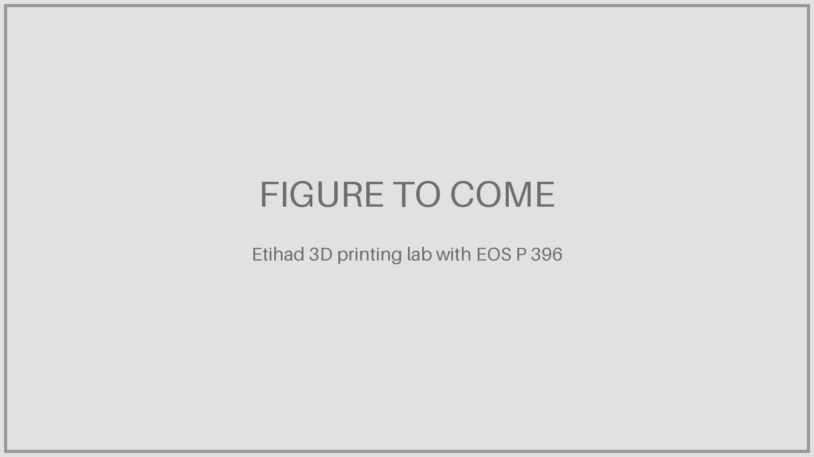
Etihad Engineering, Abu Dhabi: printing cabin parts in MRO
• 2017: first airline MRO to certify, print and fly 3D printed cabin parts (filament)
• 2019: EASA approval for powder-bed polymer parts
• Cabin defects fixed during line maintenance and C-checks
Company
Etihad Engineering, Abu Dhabi
Printer / process
EOS P 396 (PA 2241 FR, 340×340×600 mm); BigRep ONE
Gains
Parts on site and on demand; jigs, fixtures and moulds
Problems / challenges
Design and production approval needed per technology
Source: Etihad, 14 Nov 2019; Aircraft Interiors International
EXED Polytechnique - Additive Manufacturing - 04 Industries by Andrei Constantinescu 2027
Notes:
Region’s first AM facility with EASA design and production approval.

Slide 20
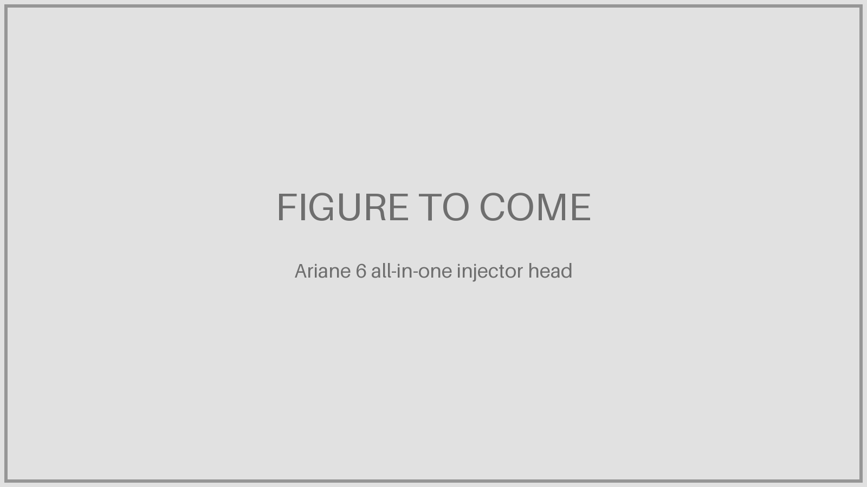
Ariane 6: a one-piece printed injector head
• Injector head with 122 injection elements printed as one part instead of 248
• Developed for the Vinci upper-stage engine of Ariane 6
• The Vulcain 2.1 main engine also flies a printed gas generator
Company
ArianeGroup (Airbus + Safran joint venture)
Printer / process
EOS M 400-4 (four lasers), EOS NickelAlloy IN718
Gains
−50% cost, build time ÷3, design iteration from ~6 months to days
Problems / challenges
Class-1 mission-critical part; internal cavities must stay clean in testing
Source: EOS / ArianeGroup case study; Develop3D; ArianeGroup; Cetim
EXED Polytechnique - Additive Manufacturing - 04 Industries by Andrei Constantinescu 2027
Notes:
Cetim developed a filtration system so test water would not clog the Vulcain 2.1 gas-generator injection head cavities.

Slide 21
Where aviation prints
PART 4
Machine makers and part makers worldwide, and two production sites.
• Machine makers worldwide
• Where flagship parts are made
• Safran campus, Bordeaux
• US Navy depot, Cherry Point
EXED Polytechnique - Additive Manufacturing - 04 Industries by Andrei Constantinescu 2027

Slide 22
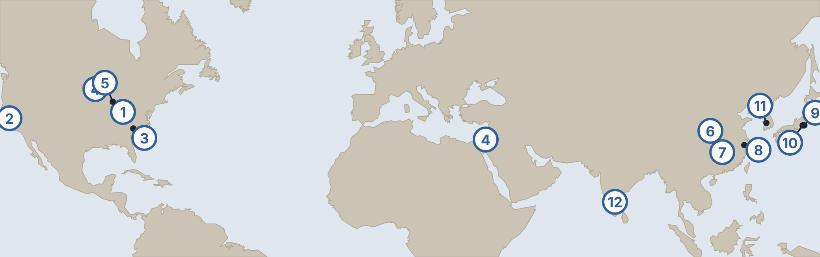
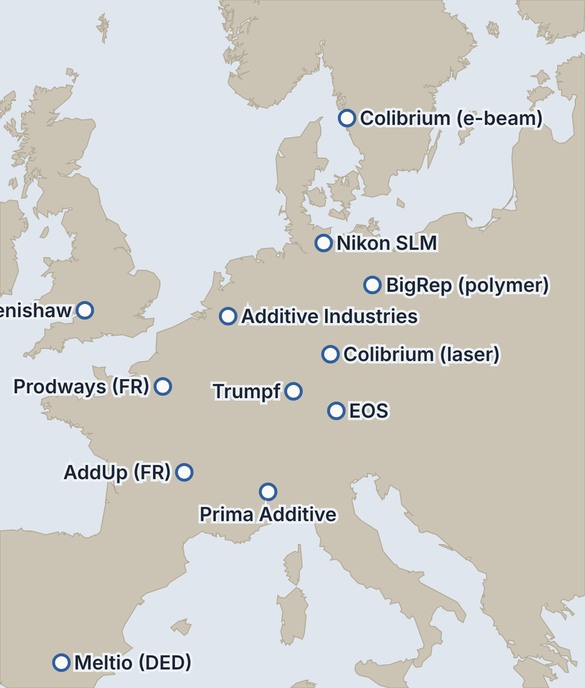
Machine makers worldwide
1 Colibrium Additive · West Chester, US · laser + e-beam
2 Velo3D · Fremont, US · laser powder bed
3 3D Systems · Rock Hill, US · metal and polymer
4 Stratasys · Eden Prairie, US / Rehovot, Israel · polymer
5 Sciaky · Chicago, US · electron-beam wire DED
6 BLT · Xi’an, China · large laser powder bed
7 Farsoon · Changsha, China · laser metal and polymer
8 Eplus3D · Hangzhou, China · laser powder bed
9 Nikon (owner of SLM) · Tokyo, Japan
10 JEOL · Tokyo, Japan · electron beam (JAM-5200EBM)
11 InssTek · Daejeon, Korea · DED
12 Wipro3D · Bengaluru, India · laser powder bed
Blue rings = machine makers. France: AddUp (Michelin + Fives, Cébazat) and Prodways (Les Mureaux).
EXED Polytechnique - Additive Manufacturing - 04 Industries by Andrei Constantinescu 2027
Notes:
GE’s own machines come from Colibrium Additive (ex-Concept Laser in Lichtenfels, ex-Arcam in Gothenburg). Germany is the largest cluster (EOS, Trumpf, Nikon SLM). China (BLT, Farsoon, Eplus3D) and Japan (Nikon, JEOL) are the main Asian makers; InssTek (Korea) specialises in DED; Stratasys is US–Israeli.

Slide 23
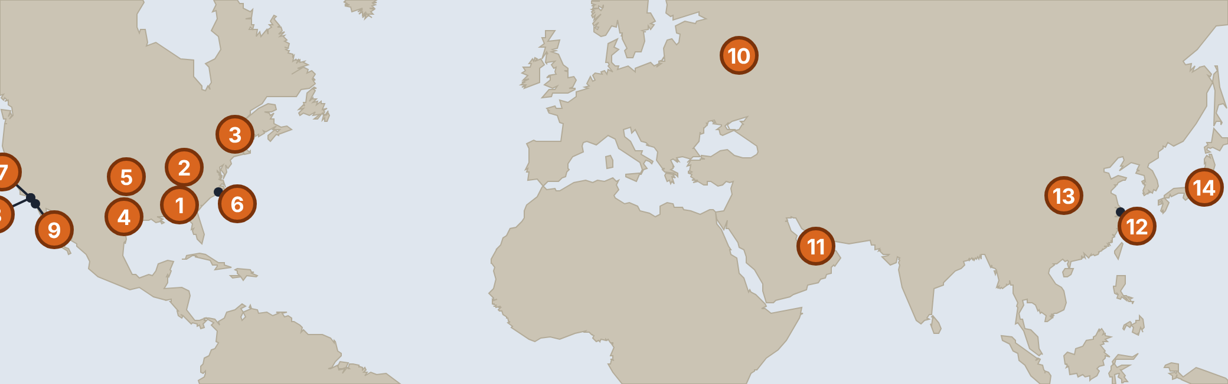
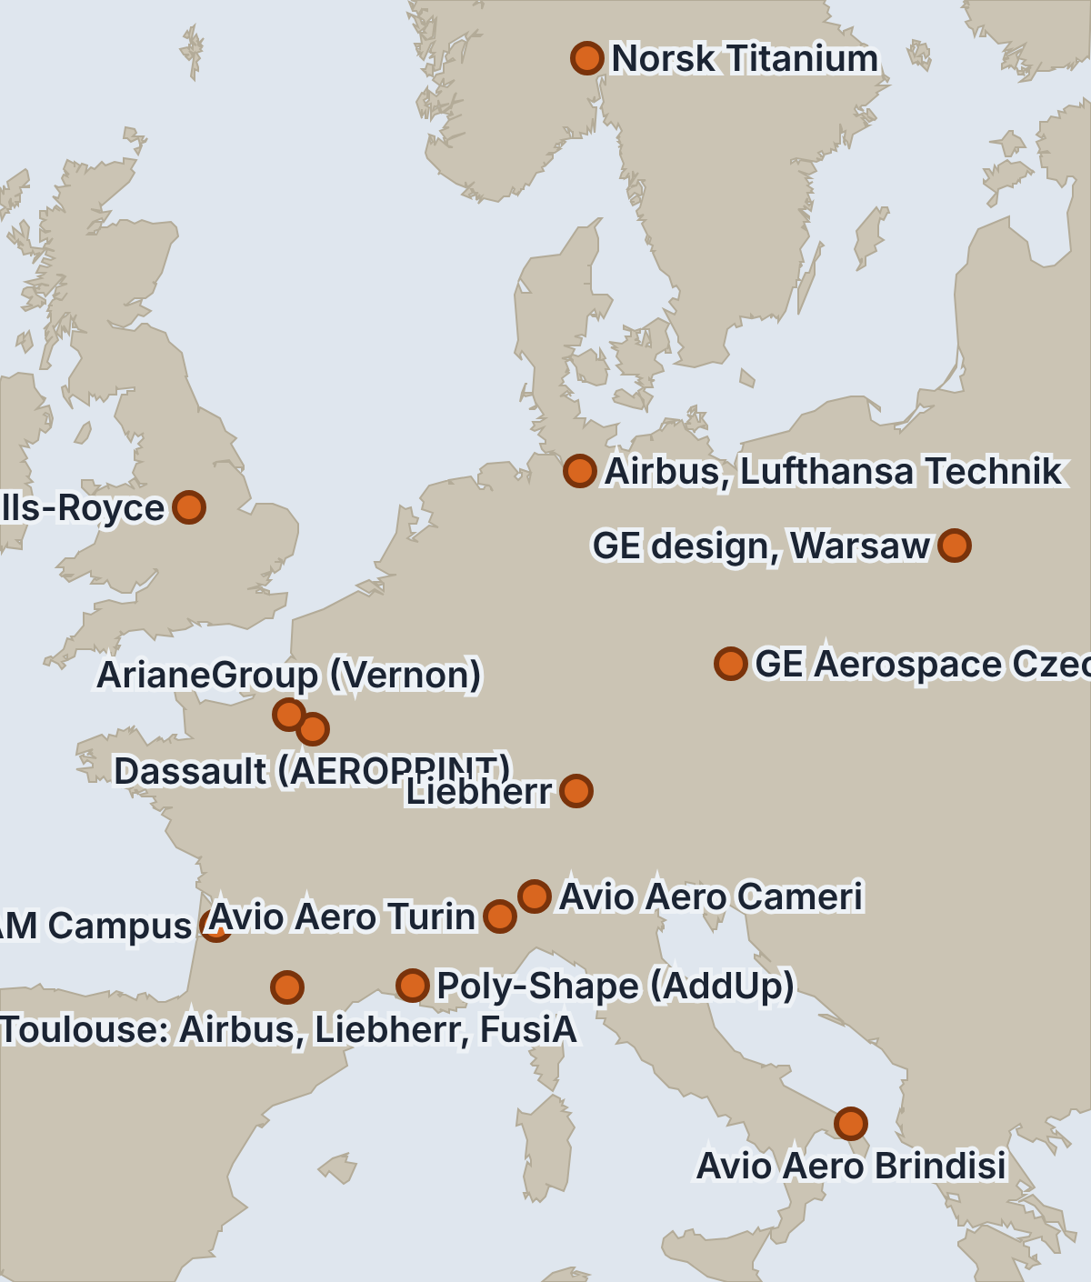
Where flagship parts are made and flown
1 GE · Auburn · LEAP nozzle tips
2 GE · Cincinnati · design, GE9X, Catalyst
3 Norsk Titanium · Plattsburgh · 787
4 Arconic · Austin · A350 bracket
5 Textron · Wichita · Denali
6 FRCE · Cherry Point · certified spares
7 SpaceX · Hawthorne · SuperDraco
8 Divergent · Torrance · DAPS structures
9 GA-ASI · San Diego · MQ-9B, drones
10 UEC · Moscow · VK-1600V
11 Etihad Engineering · Abu Dhabi
12 COMAC · Shanghai · C919
13 BLT · Xi’an · C919, Airbus A320
14 IHI Aerospace · Tokyo · GE9X partner
Orange = parts and programmes. France: Safran campus, Toulouse cluster, Dassault, ArianeGroup, Poly-Shape.
EXED Polytechnique - Additive Manufacturing - 04 Industries by Andrei Constantinescu 2027
Notes:
France: Safran AM Campus (Le Haillan) supplies Safran Helicopter Engines; Toulouse hosts Airbus, Liebherr-Aerospace HQ and FusiA Aeroadditive; Dassault works with AddUp (AEROPRINT); Poly-Shape (Salon-de-Provence) is AddUp’s parts subsidiary. Middle East: Etihad Engineering. Asia: COMAC/BLT (C919), IHI. Russia: UEC (VK-1600V). US west coast: SpaceX, Divergent, GA-ASI.

Slide 24

Safran Additive Manufacturing Campus, Le Haillan (Bordeaux)
• €80 M, 12,500 m² centre of excellence opened October 2022
• R&D, engineering and series production of metal parts on one site
• First 1,000 parts delivered to Safran Helicopter Engines within four months
Company
Safran Group
Printer / process
Laser powder bed incl. Renishaw RenAM 500Q; 8 printers at opening
Gains
4,000 parts in 2022, 8,000 in 2023, tens of thousands targeted in 2026
Problems / challenges
Much of the value lies in design and finishing, not only printing
Source: Safran, 7 Oct 2022; 3DPrint.com; Le Journal des Entreprises; TCT
EXED Polytechnique - Additive Manufacturing - 04 Industries by Andrei Constantinescu 2027
Notes:
Safran is GE’s partner in CFM (LEAP).

Slide 25
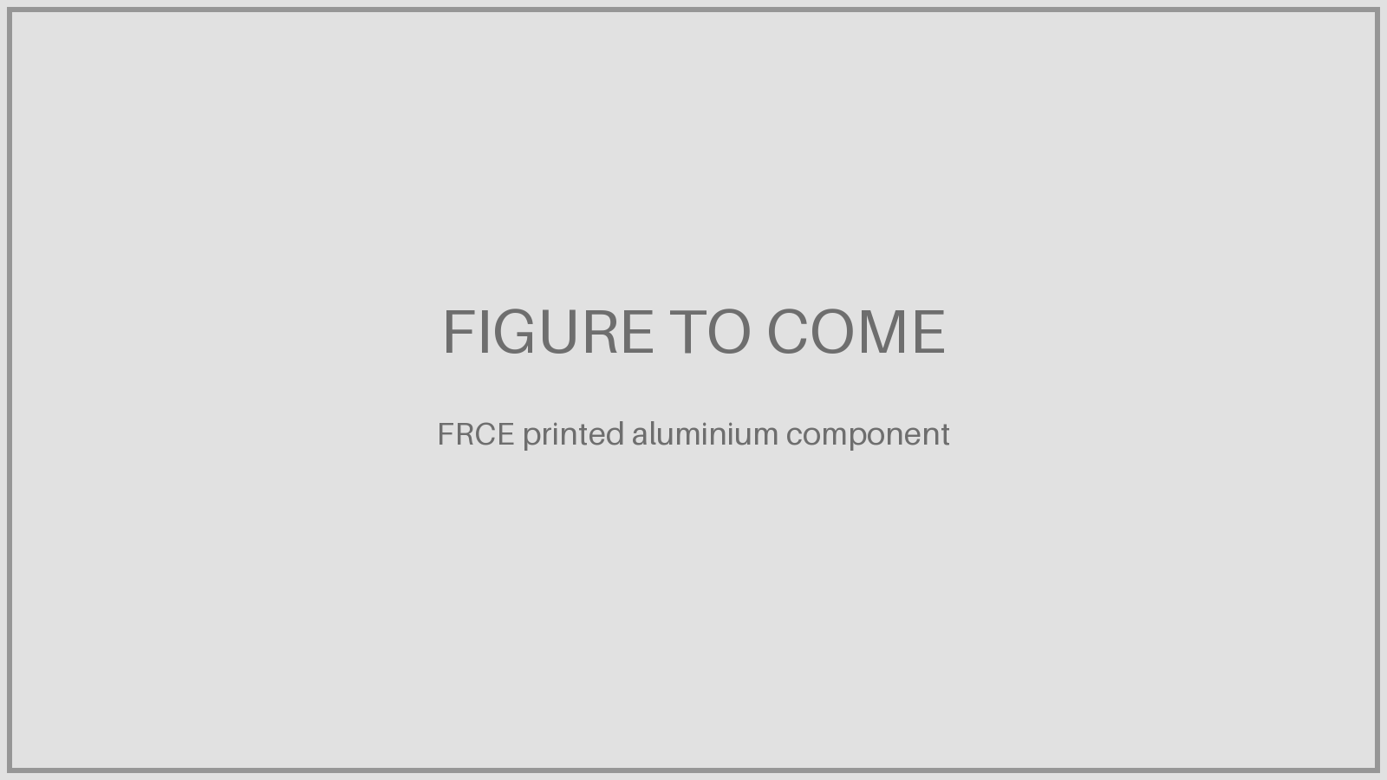
US Navy FRCE: printing certified spares at the depot
• Fleet Readiness Center East, at Marine Corps Air Station Cherry Point, NC
• First flight-certified metal parts printed in-house: three aluminium components
• Installed on AH-1Z and V-22 (Marine Corps) and C-130
Company
US Navy / NAVAIR depot
Printer / process
In-house metal printing (machine not named)
Gains
Certified in under six months, a NAVAIR record
Problems / challenges
Each part still needs its own qualification; only three parts so far
Source: 3D Printing Industry / Pulse, 30 Apr 2026; TrendHunter, May 2026
EXED Polytechnique - Additive Manufacturing - 04 Industries by Andrei Constantinescu 2027
Notes:
Shows the MRO case: shorter lead times for spares on ageing fleets.

Slide 26
Technologies
PART 5
Metals by alloy, the GE machine fleet, and polymers.
• Metals by alloy family
• GE / Colibrium machines
• Polymers
EXED Polytechnique - Additive Manufacturing - 04 Industries by Andrei Constantinescu 2027

Slide 27
Metal printing by alloy family
Alloy family | Printing process | Example machines | Aviation parts
Cobalt-chrome | Laser powder bed | Colibrium M2 / M Line, EOS M290 | LEAP fuel nozzle tip, T25 housing, most GE9X printed parts
Nickel superalloys (IN718, IN625) | Laser powder bed; DED for repair | EOS M400, Nikon SLM, Velo3D, AddUp | Combustor and heat-exchanger parts, SuperDraco chamber, turbine-part repair
Titanium Ti-6Al-4V | Laser powder bed, electron beam, wire DED | Trumpf, Renishaw, Colibrium A2X, Norsk RPD | A350 bracket, A380 valve block, 787 fittings, A350 cargo-door surround
Titanium aluminide (TiAl) | Electron beam only | Colibrium A2X (6 blades), Spectra H (10) | GE9X low-pressure turbine blades
Aluminium (AlSi10Mg, AlSi7Mg) | Laser powder bed | EOS M400, AddUp FormUp 350 | Heat exchangers, brackets, Navy depot spares
Steels (17-4PH, 15-5PH, maraging) | Laser powder bed, binder jet | BLT, AddUp, EOS | Tooling, moulds, jigs and fixtures
EXED Polytechnique - Additive Manufacturing - 04 Industries by Andrei Constantinescu 2027
Notes:
CoCr and nickel go into hot, complex engine parts; titanium into structures and systems; TiAl only by electron beam because the hot bed limits cracking. On the GE9X, 7 printed components (304 parts) are CoCr on Concept Laser M2 machines except the TiAl blades and the heat exchanger.

Slide 28
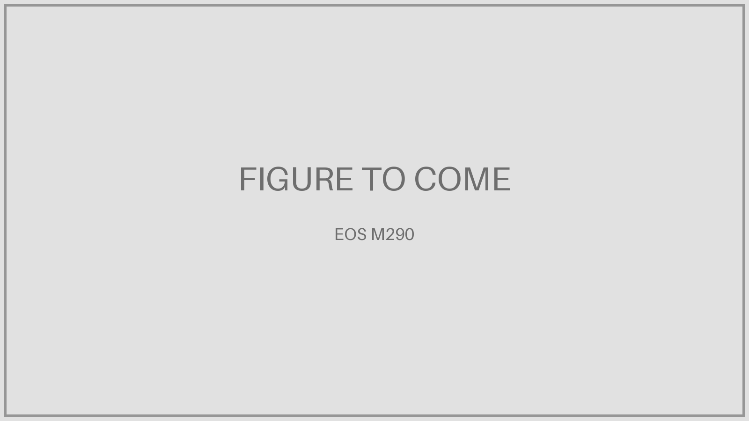

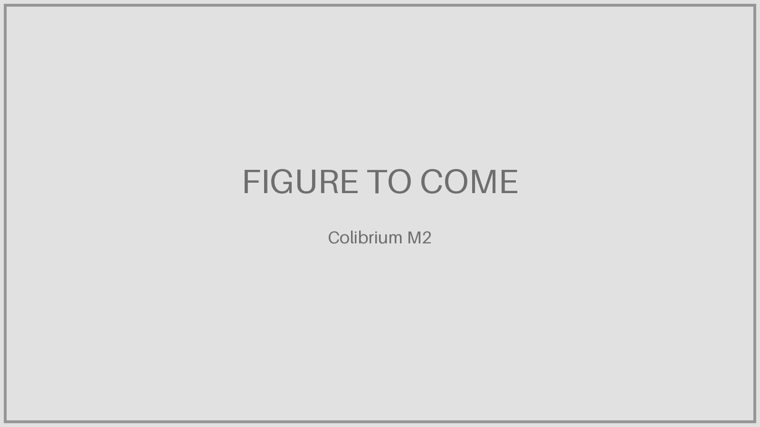
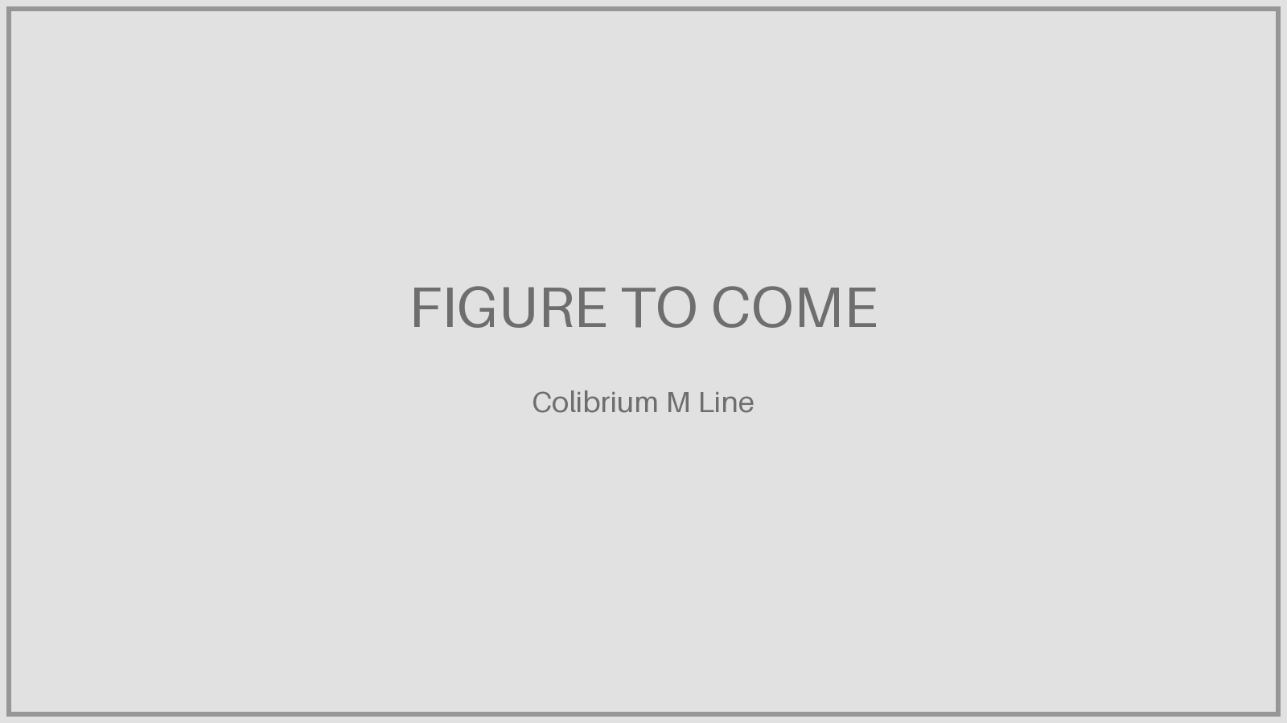
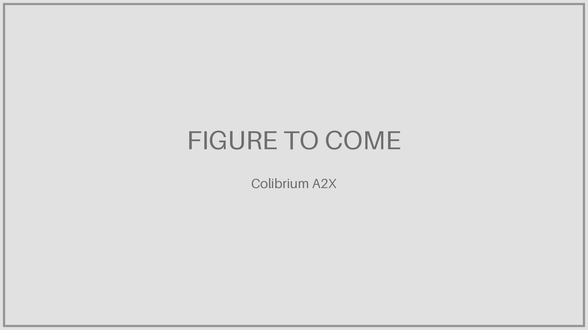

The GE Aerospace / Colibrium machine fleet
EOS M290
LASER
250 × 250 × 325 mm · 1 laser, 400 W
EOS M400
LASER
400 × 400 × 400 mm · 1 laser, 400 W
Colibrium M2
LASER
250 × 250 × 350 mm · 2 lasers, 400 W
Colibrium M Line
LASER
500 × 500 × 450 mm · 4 lasers, 400 W
Colibrium A2X
EBM
200 × 200 × 380 mm · 1 electron beam, 3 kW
Colibrium Spectra H
EBM
Ø250 × 430 mm · 1 electron beam, 6 kW
Specs from GE Aerospace / Colibrium capability slides. Materials: cobalt-chrome, nickel, aluminium, titanium.
EXED Polytechnique - Additive Manufacturing - 04 Industries by Andrei Constantinescu 2027
Notes:
Laser machines make most engine parts; EBM machines make TiAl blades.

Slide 29
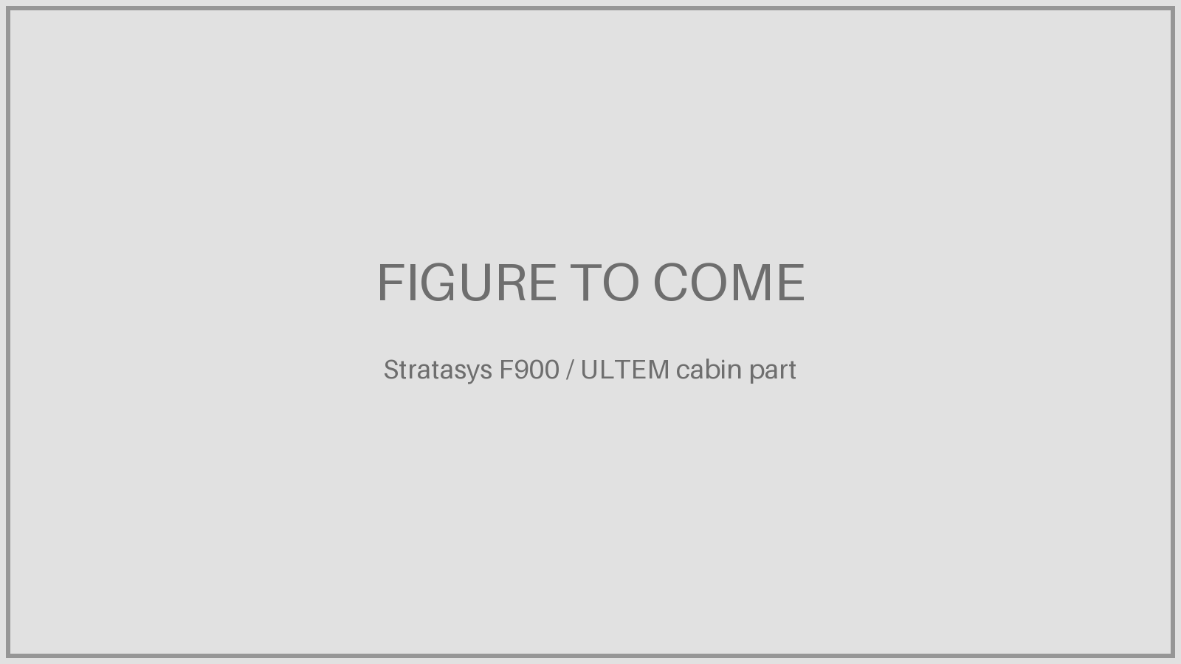
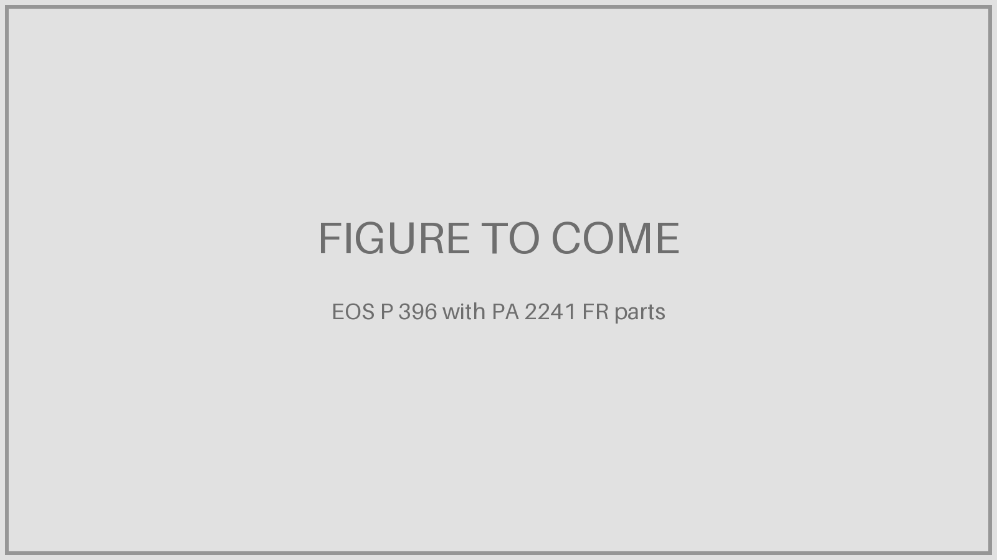
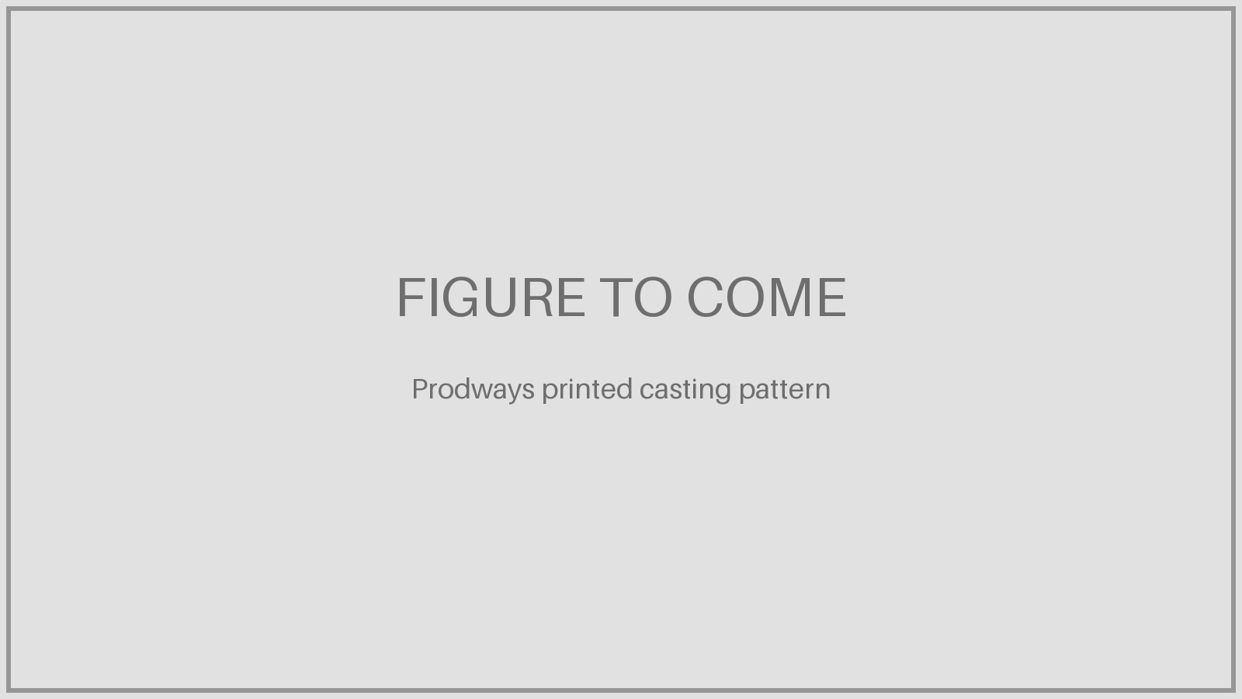
Polymer printing: cabin, MRO and indirect metal parts
Technology | Materials | Machines | Aviation parts
Extrusion (FDM / FFF) | ULTEM 9085 / 1010 (PEI): flame, smoke, toxicity compliant | Stratasys F900; BigRep ONE (large format) | A350 cabin parts, jigs, fixtures, moulds
Powder bed (SLS) | PA12, PA11, flame-retardant PA 2241 FR, PEKK | EOS P 396, 3D Systems, Farsoon, Prodways | Cabin parts made in MRO, ducts, covers
Vat photopolymer (SLA / DLP) | Resins, ceramic-filled pastes | Prodways MOVINGLight, 3D Systems | Casting patterns and ceramic moulds for turbine blades, wind-tunnel models
EXED Polytechnique - Additive Manufacturing - 04 Industries by Andrei Constantinescu 2027
Notes:
Polymers fly mainly in the cabin. Safran works with Prodways on printed casting patterns and ceramic moulds; about 30% of engine parts are cast, so indirect AM reaches parts that direct printing does not.

Slide 30
The GE success story
PART 6
Money, sites, parts, two stories and a complete in-house chain.
• Investment
• Global sites
• Parts timeline
• LEAP fuel nozzle
• Catalyst engine
• In-house chain
EXED Polytechnique - Additive Manufacturing - 04 Industries by Andrei Constantinescu 2027

Slide 31

Two decades of betting on additive: the money
2010–16 | ~$1.5 bn | invested by GE in manufacturing and additive technologies
2012 | n/d | buys Morris Technologies (Cincinnati), maker of the first LEAP nozzles
2013 | €3.3 bn | buys Avio Aero (Turin) incl. Cameri TiAl know-how; $1.1 bn more planned over 10 years
2015 | $50 M | Auburn, AL additive plant for LEAP fuel nozzles
2016 | $1.4 bn | bid for Arcam + SLM; buys Arcam and 75% of Concept Laser ($599 M) instead of SLM
2016 | $1 bn | target for the new additive business by 2020; $3–5 bn product cost-out over 10 years
2019 | +27 | EBM machines for GE9X blades, 62 in total
2024 | — | GE Additive renamed Colibrium Additive (GE Aerospace)
2026 | $115 M · €110 M | metal AM, test cells and capacity in Cincinnati; European plants (€77 M in Italy)
Amounts as announced by GE; acquisitions include more than additive. n/d = not disclosed.
EXED Polytechnique - Additive Manufacturing - 04 Industries by Andrei Constantinescu 2027
Notes:
Sources: GE (Avio acquisition 2013, €3.3 bn / $4.3 bn); Irish Times ($1.1 bn planned investment in Avio); The Engineer (Auburn $50 M); 3DPrint.com and American Machinist (2016 $1.4 bn bid, Concept Laser 75% for $599 M, $1 bn business target by 2020, $3–5 bn cost-out); Metal AM 2019 (27 EBM machines, 62 total); Dealroom (Colibrium 2024); 3Druck and 3D Printing Industry 2026 ($1 bn US incl. $115 M Cincinnati; €110 M Europe).

Slide 32
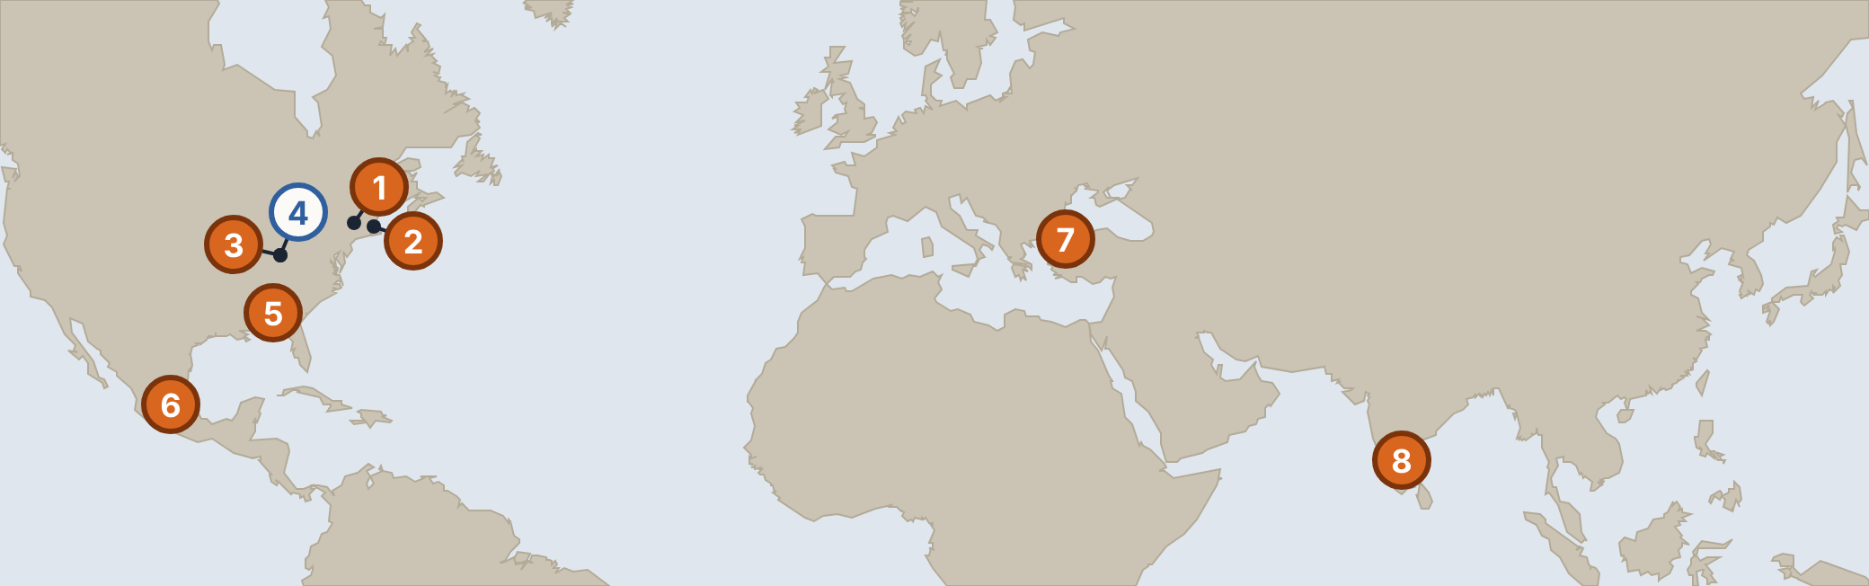
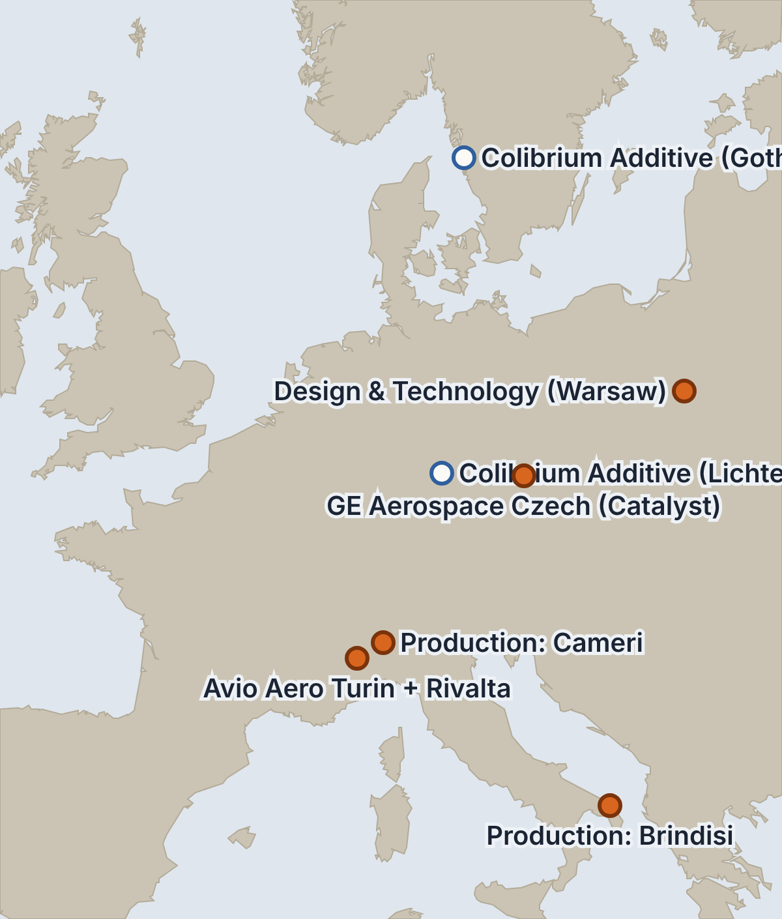
GE Aerospace, Colibrium and Avio Aero: global organisation
1 Global Research · Niskayuna, NY
2 Design · Lynn, MA
3 Design & Materials · Evendale, OH
4 Colibrium Additive + Additive Technology Center · West Chester, OH
5 Production · Auburn, AL (LEAP nozzles)
6 Design & Materials · Querétaro, Mexico
7 Design & Manufacturing · Turkey Technology Center, Istanbul
8 Design & Technology · Bangalore, India
Blue = Colibrium Additive machine sites; orange = research, design and production. From GE Aerospace / Colibrium capability slides.
EXED Polytechnique - Additive Manufacturing - 04 Industries by Andrei Constantinescu 2027
Notes:
Design and materials are spread across the US, Mexico, Poland, Italy, Turkey and India; machines come from Colibrium (West Chester, Lichtenfels, Gothenburg); series production of printed parts is in Auburn (LEAP nozzles), Cameri (GE9X TiAl blades) and Brindisi (Catalyst). Turin hosts Avio Aero HQ and the Turin Additive Lab; Rivalta does design and materials. Prague (Catalyst assembly and test) added from the Catalyst story.

Slide 33




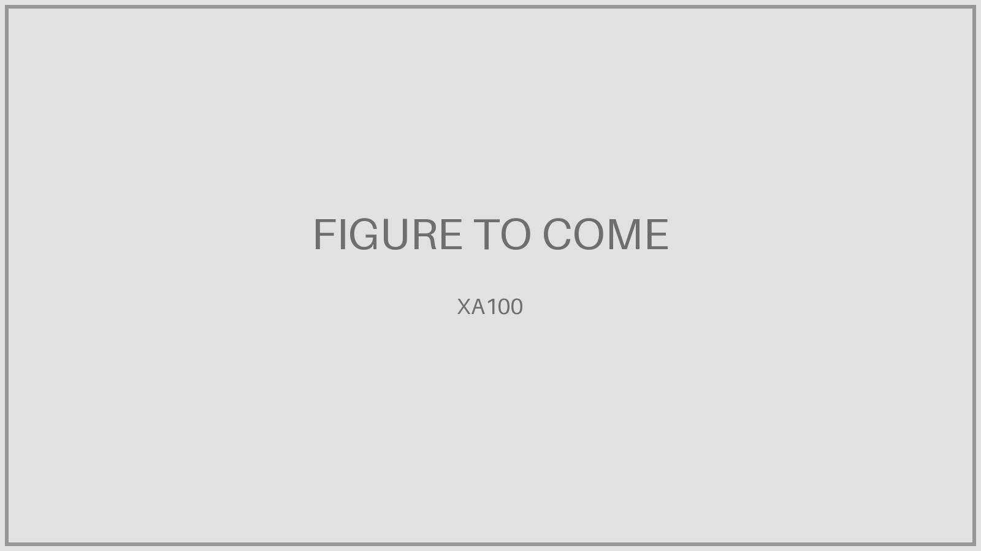

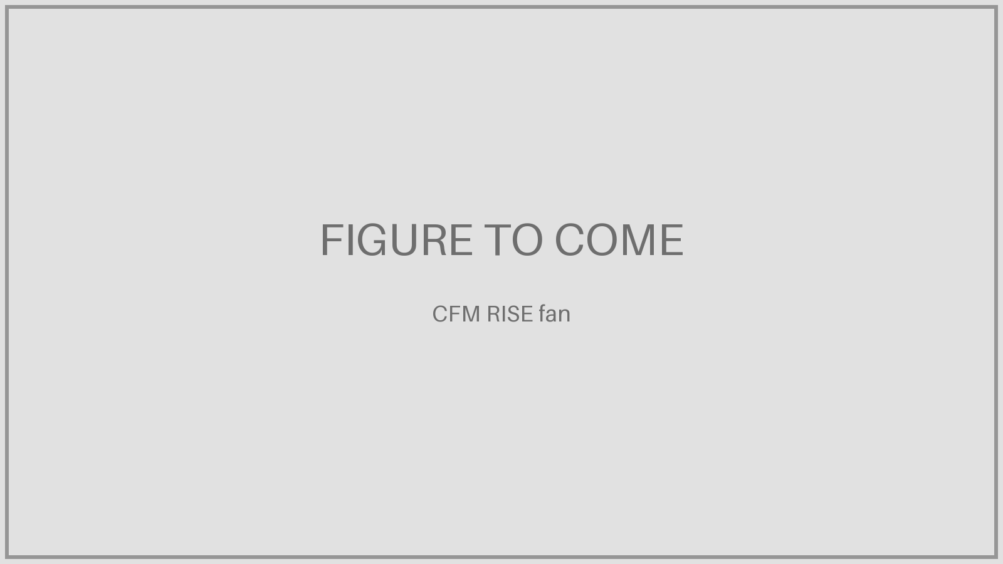
GE printed parts: product and technology journey
Small structures · 2012–2015 Complex geometry for fuel efficiency and durability >25-micron powder layers · Volumetric CT metrology · Material reuse Large structures · 2016–2019 Integrated system design for weight and performance Distortion simulation and compensation · Multi-laser stitching · Machining and surface finishing Advanced heat exchangers · 2020 → Integrated system-level thermal management In-situ metrology · 25–50× productivity · Functional cleaning and testing
2012
LEAP fuel nozzle designed
2013
First heat exchanger printed
2015
GE90 T25 sensor certified
2015
GE9X LPT blade printed
2016
LEAP fuel nozzle certified, enters service
2016
a-CT7 demonstrator
2017
Catalyst preliminary design (multiple parts)
2018
GE9X first flight (5 additive parts)
2020
XA100 testing begins (multiple parts)
2021
T901 first ground test (multiple parts)
2025
Catalyst certified
~2035
CFM next-generation engine
From GE capability slide, years approximate. CFM fleet then: >250K fuel tips, 150 operators, 81.2 M hours, 35.6 M cycles; July 2026: 100 M+ hours.
EXED Polytechnique - Additive Manufacturing - 04 Industries by Andrei Constantinescu 2027
Notes:
Timeline rebuilt from the GE capability slide “Product and technology journey”. Years are read from the slide and cross-checked where possible: T25 FAA certification 2015, LEAP entry into service Aug 2016, GE9X first flight 2018 on the flying testbed, Catalyst certified Feb 2025. Fleet statistics quoted on the slide come from cfmaeroengines.com/fleet-statistics; by July 2026 CFM reported more than 100 million LEAP flight hours. Technology row: small structures (2012–15), large structures (2016–19), advanced heat exchangers (2020 onwards).

Slide 34
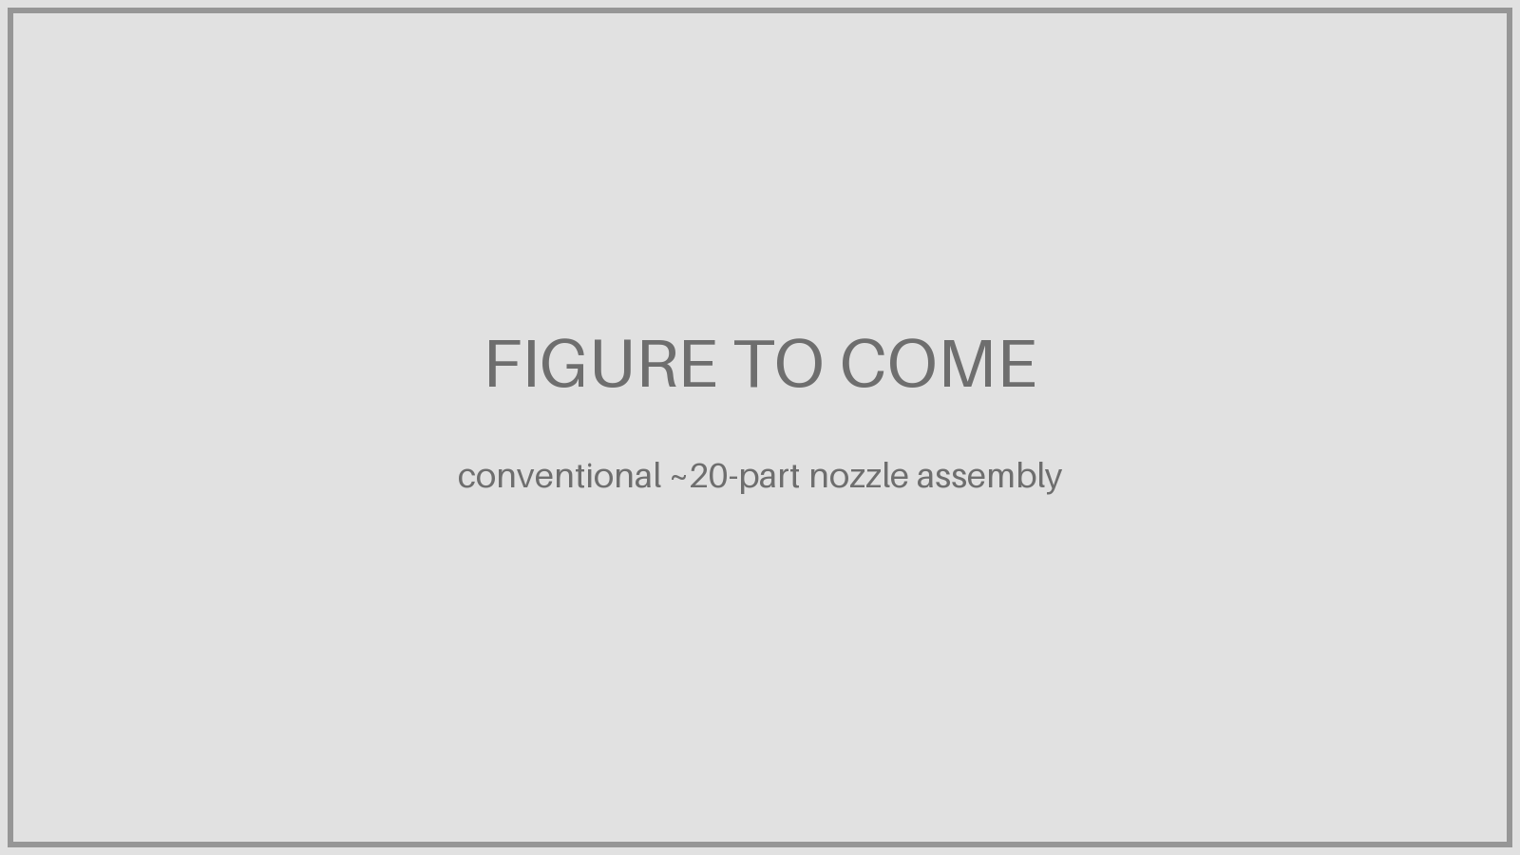
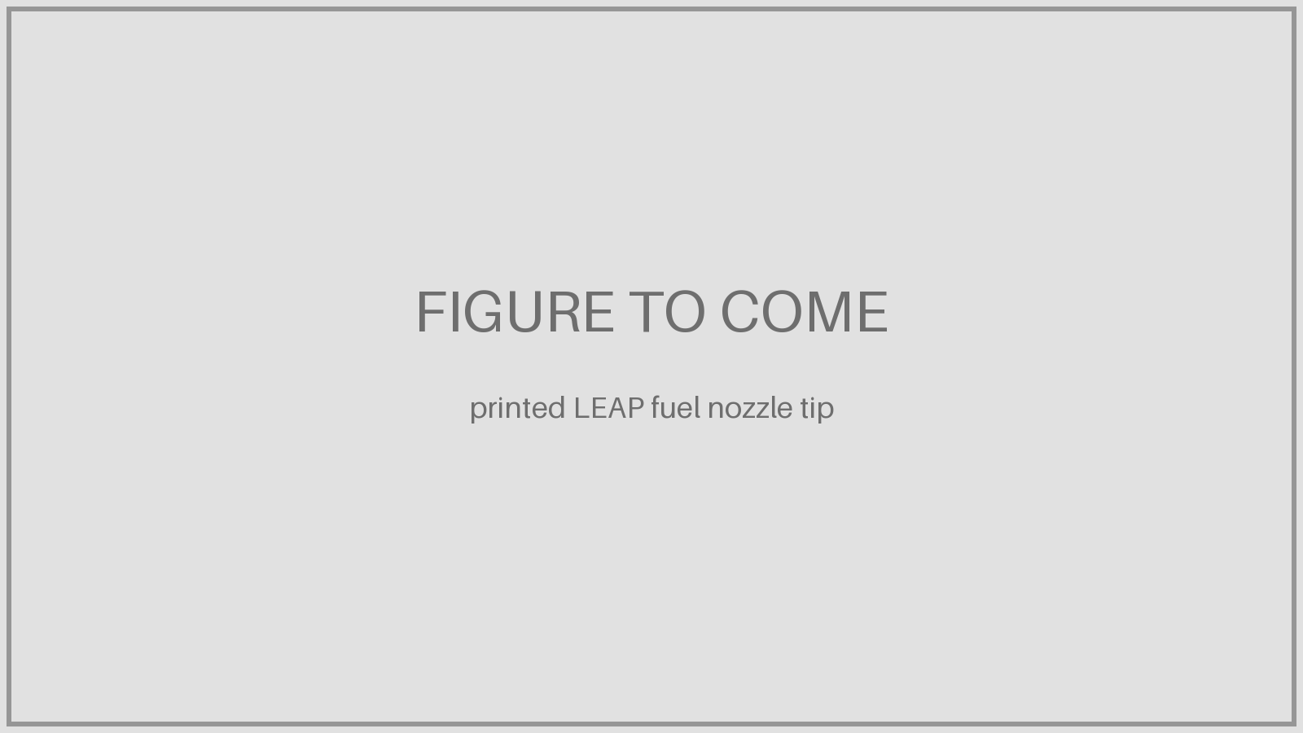
The fuel nozzle that proved metal AM could fly
1 The problem
The LEAP combustor needed a nozzle tip with intricate internal fuel passages. Made conventionally, it was about 20 machined parts, brazed and welded together.
2 The bet
GE combustion engineer Marie McMasters led a confidential project with Morris Technologies, a Cincinnati AM shop. GE bought Morris in 2012 and fixed the parameters for series production.
3 The result
One printed cobalt-chrome part: 25% lighter, 5× more durable, no brazing.
EXED Polytechnique - Additive Manufacturing - 04 Industries by Andrei Constantinescu 2027
Notes:
Some sources say 25 parts; 20 is the figure GE uses most. Morris Technologies was founded by Greg Morris in 1994.

Slide 35
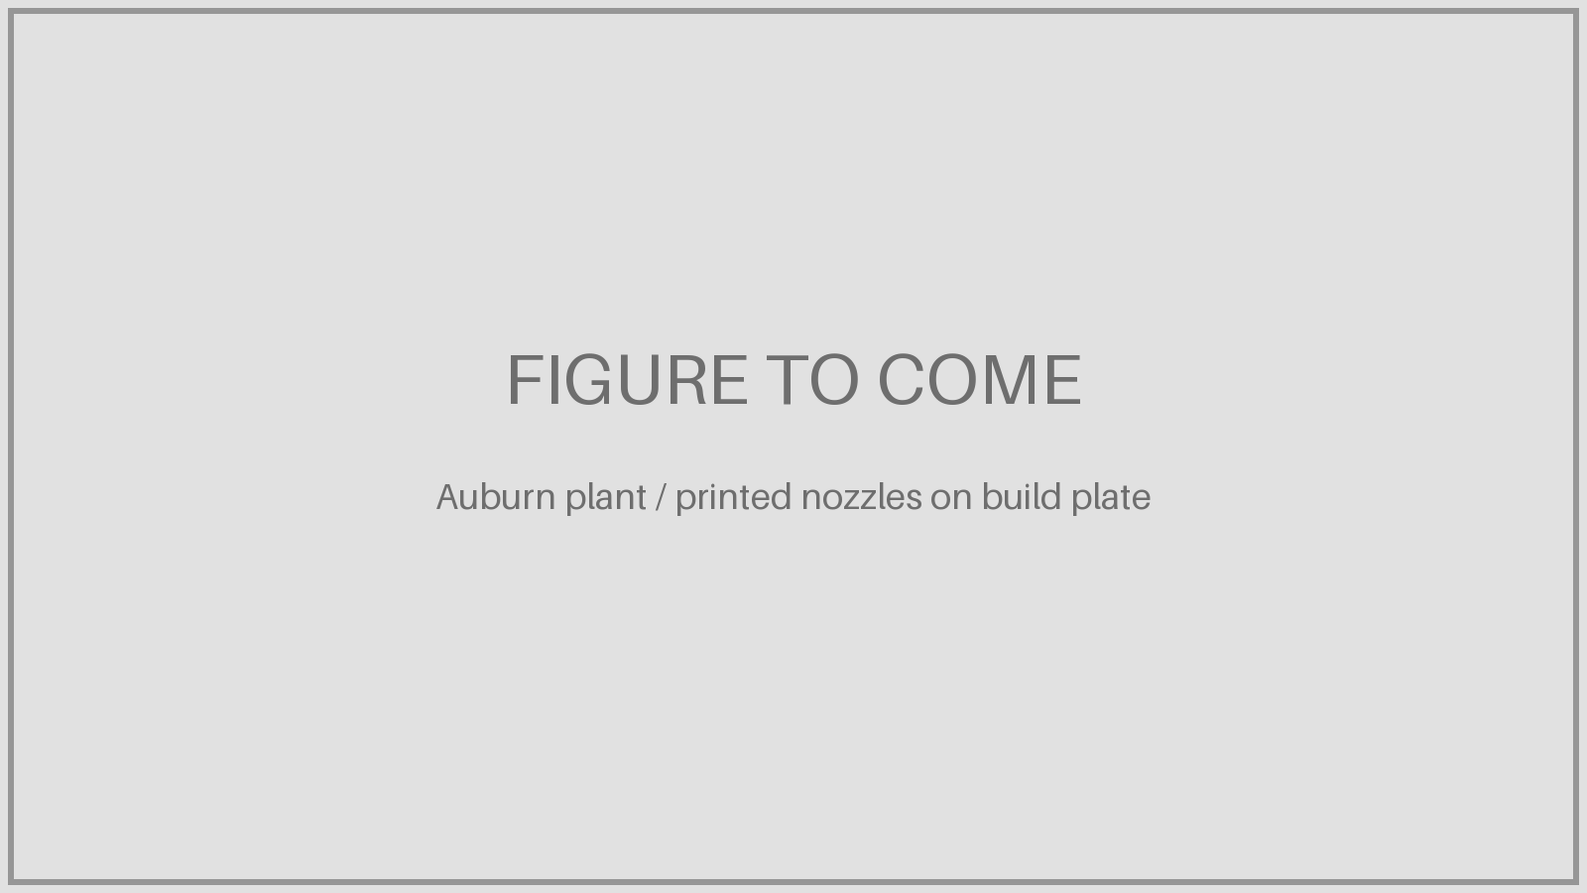
From one part to industrial scale
2012
GE acquires Morris Technologies
2015
Auburn, AL plant opens: first mass production of printed engine parts
2016
LEAP enters service (Pegasus, 2 Aug): 18–19 nozzles per engine
2017
8,000 nozzles delivered from 40+ printers
2021
100,000th nozzle tip shipped
2026
10,000+ LEAP engines, 100 M+ engine flight hours
20 → 1
parts
−25%
weight
5×
durability
35–45k
nozzles per year
≈1.9 bn
nozzle flight hours (est.)
Flight hours: 100 M+ LEAP engine flight hours (CFM, Jul 2026) × 18–19 nozzles per engine. Volume per year from the introduction slides.
EXED Polytechnique - Additive Manufacturing - 04 Industries by Andrei Constantinescu 2027
Notes:
Estimated nozzle flight hours: CFM reports more than 100 million LEAP engine flight hours (July and Oct 2026). Each engine has 18 or 19 nozzles, so the printed nozzles have accumulated roughly 1.8–1.9 billion nozzle flight hours. 10,000+ engines delivered implies roughly 185,000+ nozzles installed, before spares. 2021 fleet from your slides: ~1,400 aircraft, 10 M flight hours.

Slide 36
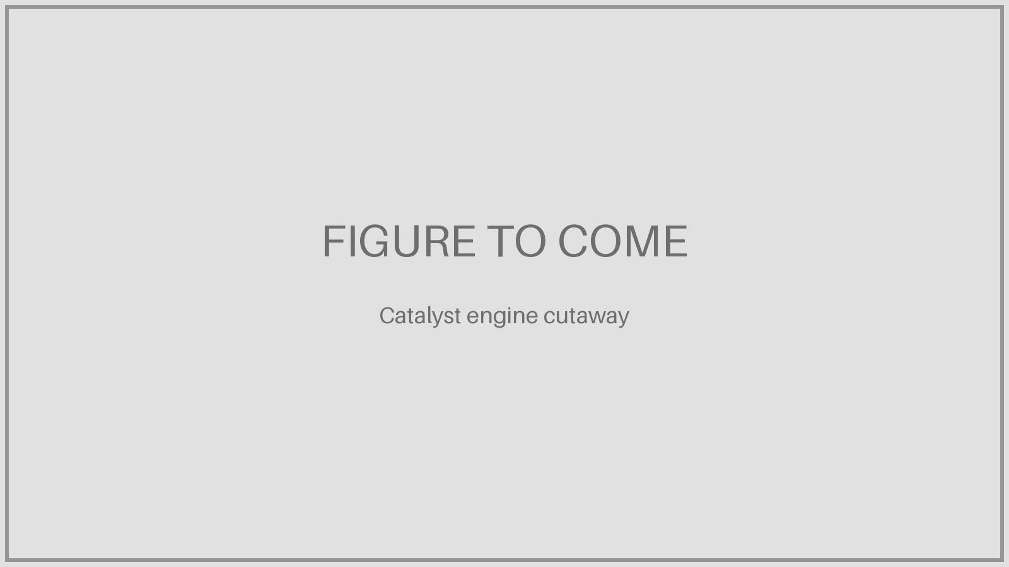
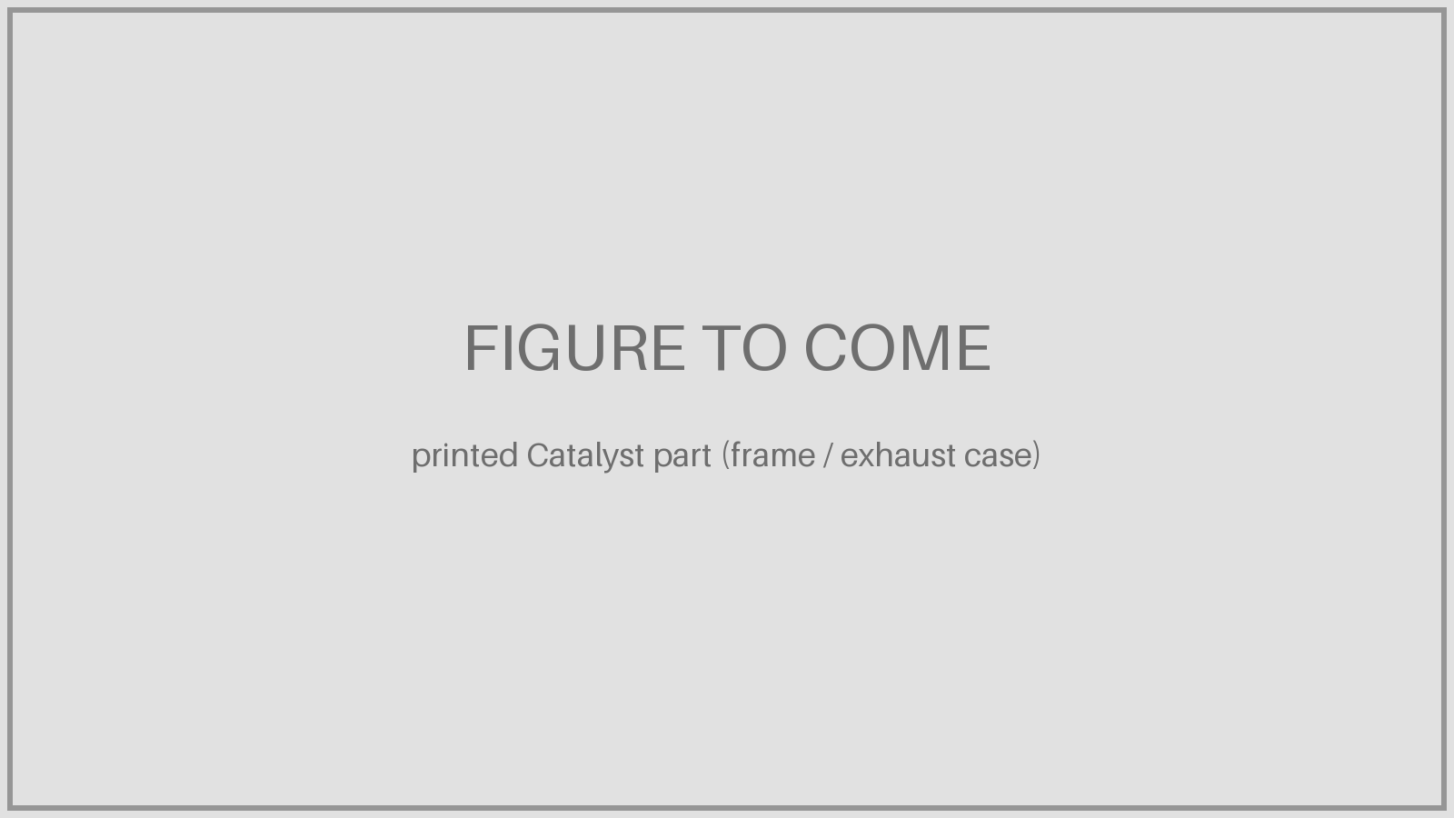
Catalyst: an engine designed around additive
855 → 12
parts merged into printed parts
Frames
Combustor liners
Sumps
Exhaust case
Bearing housings
Heat exchangers
Stationary flow-path parts
~1/3
of internal parts printed
−5%
engine weight (>45 kg)
up to 18%
better fuel burn vs rivals
+10%
cruise power vs rivals
EXED Polytechnique - Additive Manufacturing - 04 Industries by Andrei Constantinescu 2027
Notes:
Clean-sheet ~1,300 shp turboprop, 16:1 overall pressure ratio. The intro slides say 800 → 12 parts, +10% power, −20% fuel; published sources use 855 → 12 and up to 18% fuel. Pick one set before presenting.

Slide 37

From demonstrator to certified engine
2016
a-CT7 demonstrator: 900 parts become 16 printed ones, built and tested in 18 months
Dec 2017
First engine run at GE Aviation Czech, Prague
2018
Avio Aero opens additive plant in Brindisi; Catalyst AM parts move there from Ohio
Nov 2023
Beechcraft Denali, the first Catalyst aircraft, flies
Feb 2025
FAA Part 33 certification: 23 engines, 190+ component tests, 8,000+ hours
2026
Denali entry into service targeted
Built across Europe
Turin
Design, gearbox, combustor
Brindisi
Printed parts
Cameri
Additive production
Prague
Assembly and test
Warsaw
Design
EXED Polytechnique - Additive Manufacturing - 04 Industries by Andrei Constantinescu 2027
Notes:
Certification took about ten years from launch; GE attributed delays to more than 20 new requirements in the latest Part 33 standards. Check current Denali status before presenting.

Slide 38
A complete in-house design and manufacturing chain
1 Research
GE Aerospace Research, Niskayuna NY: materials and process physics
→
2 Design and materials
Evendale, Lynn (US); Querétaro (MX); Bangalore; Warsaw; Rivalta (IT); Istanbul
→
3 Powders and machines
Colibrium Additive: West Chester, Lichtenfels, Gothenburg; AP&C powders (Canada)
→
4 Process development
Additive Technology Center (West Chester); Turin Additive Lab
5 Series production
Auburn (LEAP nozzles), Cameri (GE9X TiAl blades), Brindisi (Catalyst parts)
→
6 Assembly, test, certification
Evendale; Prague (Catalyst); GE holds the FAA Part 33 type certificates
→
7 In service and MRO
10,000+ LEAP engines, 100 M+ flight hours; $1 bn MRO plan; data back to design
→
ONE OWNER
From powder to type certificate: GE can change design, material, machine and process, and requalify itself.
Sites from GE Aerospace / Colibrium capability slides; fleet data CFM 2026.
EXED Polytechnique - Additive Manufacturing - 04 Industries by Andrei Constantinescu 2027
Notes:
This is the reference model for the next section: GE owns every step. AP&C (Canada) came with Arcam in 2016 and makes metal powders.

Slide 39
Supplier models
PART 7
GA-ASI and Divergent, and why build-to-print alone is not enough.
• GA-ASI and Divergent
• DAPS
• Design-and-build chain
• Three sourcing models
EXED Polytechnique - Additive Manufacturing - 04 Industries by Andrei Constantinescu 2027

Slide 40
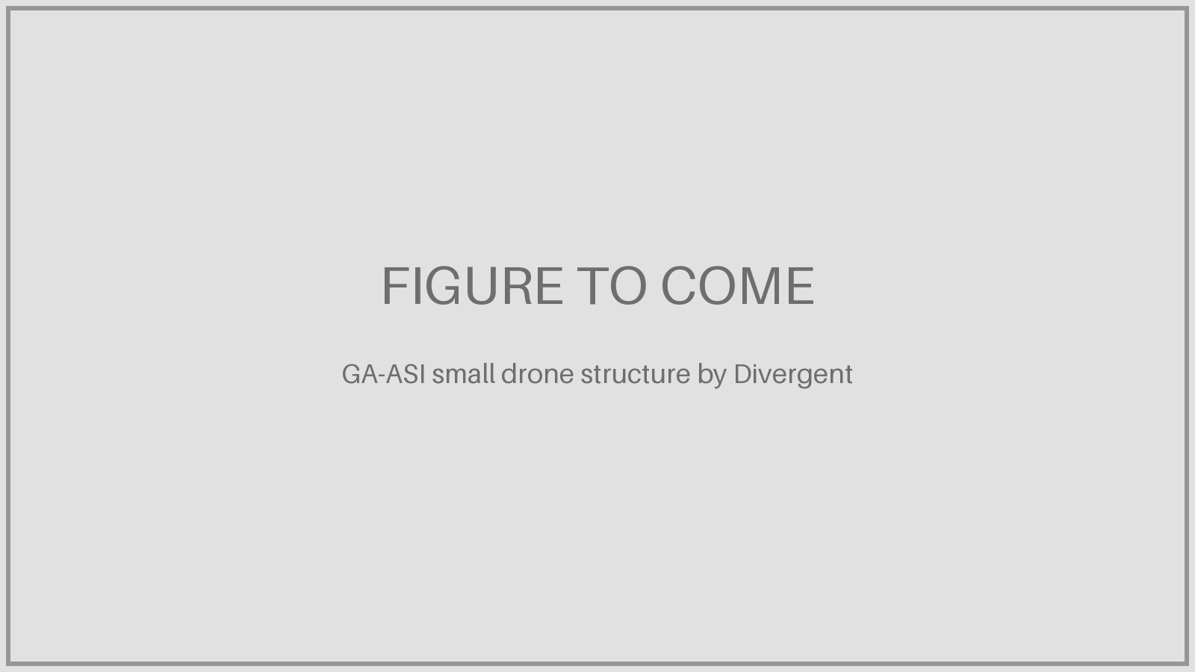
GA-ASI and Divergent: printed drone structures
GA-ASI
San Diego · maker of Predator and MQ-9B
• Additive Design & Manufacturing Center of Excellence since 2022
• MQ-9B: ~240 printed parts per aircraft, >$2 M tooling saved, >$300 k saved per aircraft
• 10,000+ printed parts installed; target 30–80% printed parts on small drones
Divergent Technologies
Torrance / Long Beach, CA · founded 2014
• Started with the Czinger hypercar; helped design the 12-laser SLM NXG XII 600
• $290 M round; customers GA-ASI, Saab, Mach Industries, RTX, Aston Martin, McLaren
• Saab: 15-ft fuselage from 26 printed parts (Dec 2025); Venom drone concept to flight in 71 days
The part made for GA-ASI
<500 lb
small drone structure
−95%
part count
<20 min
robotic assembly
<2 days
print-ready design to airframe
EXED Polytechnique - Additive Manufacturing - 04 Industries by Andrei Constantinescu 2027
Notes:
GA-ASI and Divergent started a joint development programme in 2022 and announced the partnership in Feb 2024: a small UAS aerostructure, AI-driven and topology-optimised, printed as an integrated metal structure, inspected via a full digital twin and assembled by robots without tooling in under 20 minutes. In June 2025 Divergent delivered the metallic core structure of a hybrid ground- and air-launched small UAS. GA-ASI also printed a five-foot LPBF airframe section with DoD and Divergent. Sources: ga.com, IMechE, 3DPrint.com, Defense Advancement, divergent3d.com.

Slide 41
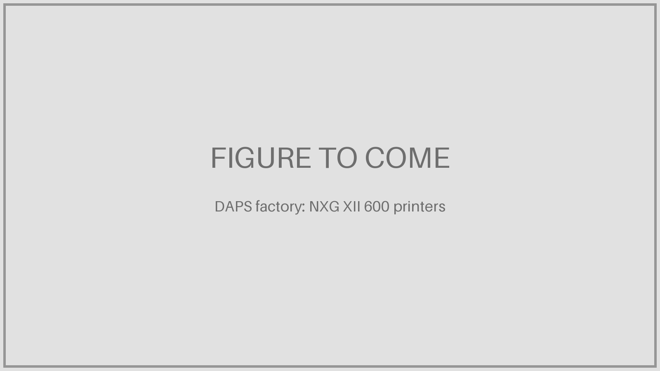
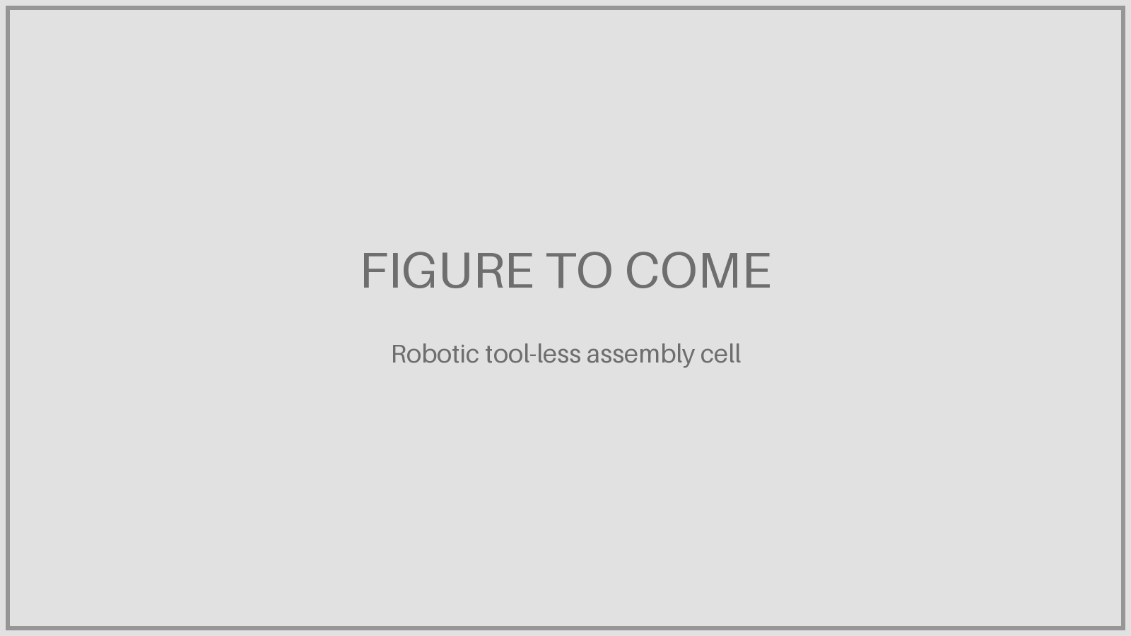
Divergent Adaptive Production System (DAPS)
1 AI-driven design
Generative, topology-optimised structure from loads and requirements
→
2 Industrial printing
Laser powder bed on 12-laser NXG XII 600; drone nodes in under 13 h
→
3 Inspection, digital twin
Each printed part measured and placed in a full digital twin
→
4 Tool-less assembly
Universal robots and structural adhesive; no fixtures; under 20 min
→
5 Qualification
America Makes DAWGS airworthiness programme with DoD, primes and NASA
No fixed tooling: the same factory builds car, drone and defence structures, sometimes on the same day (Divergent).
EXED Polytechnique - Additive Manufacturing - 04 Industries by Andrei Constantinescu 2027
Notes:
DAPS is described by Divergent as an end-to-end design and manufacturing system: AI-driven design, industrial-rate additive manufacturing and universal robotic assembly. Divergent runs more than six SLM (now Nikon SLM) NXG XII 600 machines, which it helped design.

Slide 42
The design-and-build supplier chain: who does what
Step | OEM (GA-ASI) | Supplier (Divergent) | Note
Mission and requirements | ● |  | OEM defines loads, interfaces, payload
Structural design (AI, topology) | ○ | ● | Supplier designs to the OEM’s requirements
Design review and integration | ● | ● | Joint: interfaces, weight targets
Printing, inspection, digital twin |  | ● | Supplier’s machines and process data
Robotic assembly of the structure |  | ● | Supplier delivers an assembled airframe
Systems, flight test | ● |  | OEM integrates and flies
Airworthiness evidence | ● | ● | Shared; DAWGS programme for the process
Variants and rate | ● | ● | Supplier reprints without new tooling
Key point: the supplier owns design, process and part data, so it can optimise and help qualify; the OEM keeps the aircraft and its certification.
EXED Polytechnique - Additive Manufacturing - 04 Industries by Andrei Constantinescu 2027
Notes:
● = leads, ○ = provides input. Our reading of the GA-ASI / Divergent model from public statements: GA-ASI’s AM, aircraft-integrity, materials and design teams work with Divergent to adapt, apply and qualify DAPS for GA-ASI production.

Slide 43
Three ways to source printed parts
 | In-house chain (GE) | Design-and-build supplier (Divergent for GA-ASI) | Build-to-print supplier only
Who designs the part | GE | Supplier, to OEM requirements | OEM; drawing handed over
Who owns the process specification | GE | Supplier, approved with OEM | OEM-approved; supplier only runs it
Change machine, powder or parameters | GE requalifies itself | Supplier, with OEM agreement | Only with OEM requalification
Part consolidation (the AM benefit) | Yes | Yes | No: geometry is frozen
Qualification effort carried by | GE | Shared | Supplier: machines, powder, tests
Value for the supplier | — | High, flexible capacity | Low margin, price vs casting and machining
Why build-to-print alone is not attractive under certification
• In AM the material and process specifications are part of the approved design, like a drawing (FAA)
• Key process variables are frozen: a new machine, powder or parameter set means requalification (FAA AC 33.15-3, EASA CM-S-008)
• The part maker is also the material maker: the supplier pays for machine qualification, powder control and testing
• Without design authority it cannot consolidate parts, so it competes on price with casting and machining
Certification procedures: to be covered in depth in a later session.
EXED Polytechnique - Additive Manufacturing - 04 Industries by Andrei Constantinescu 2027
Notes:
The table is our reading of the three models. FAA: material and process definition, including specifications, are part of the design and must be approved as such. AC 33.15-3 (June 2023) asks that parameters affecting chemical, metallurgical, dimensional or mechanical properties be treated as key variables with allowable ranges; EASA CM-S-008 Issue 04 (Sept 2025) asks for process specifications defining key variables, plus machine qualification and process qualification. NIAR/FAA: “the part manufacturer is the material manufacturer.”

Slide 44
State of play 2026
PART 8
What is in service and what is still missing.
• In service today
• What is still missing
EXED Polytechnique - Additive Manufacturing - 04 Industries by Andrei Constantinescu 2027

Slide 45
2026: in series production, but not yet everywhere
In service today
• LEAP: 10,000+ engines, 100 M+ flight hours on printed nozzles
• Airbus: 25,000+ polymer parts a year; wire-DED Ti parts in A350 production
• Whole engines: GE9X (2020) and Catalyst (2025) certified with printed parts
• Investment: GE $115 M for metal AM in Cincinnati, €110 M in Europe (2026); Safran campus scaling
• MRO: airlines and depots print certified spares (Etihad, US Navy)
What is still missing
• Qualified material data: AM design allowables still lag forgings and castings
• Few approved materials ; standards not yet harmonised worldwide (ISO/TC 261)
• Cost and scale: machines, powders, post-processing; testing on every programme
• Finish and tolerances: printed parts still need machining (hybrid)
• Large and critical parts: wire DED only now entering structure; wings and landing gear later
• Speed and skills: qualification bottlenecks and workforce gaps (AIAA 2026)
Market size 2026: estimates range from $2.7 bn to $6.4 bn depending on the analyst (GMI, Meticulous Research).
EXED Polytechnique - Additive Manufacturing - 04 Industries by Andrei Constantinescu 2027
Notes:
Sources: CFM/GE Aerospace July & Oct 2026 (LEAP); Stratasys/Airbus; Airbus newsroom Jan 2026; GE Aerospace investment news (3Druck, 3D Printing Industry, 2026); Machine Design 2026 on qualification and CM4QC; literature review (3D Printing Industry) on porosity, residual stress and ISO/TC 261; AIAA 2026 Key Issues report (Assembly Magazine); Machine Design Feb 2026 on hybrid print + CNC.

Slide 46
References
PART 9
All sources used in this deck.
• Links by topic
EXED Polytechnique - Additive Manufacturing - 04 Industries by Andrei Constantinescu 2027

Slide 47
References (1/7)
INTRODUCTION
GE: FAA clears first 3D-printed engine part (T25), 2015
ge.com/news/reports/the-faa-cleared-the-first-3d-printed-part-to-fly-2
Lima Corporate: 10 years of Trabecular Titanium
prnewswire.com/news-releases/ lima-corporate-celebrates-10-years-of-3d-printing-trabecular-titanium-616123024.html
SpaceX SuperDraco qualification, 2014
spaceref.com/?p=11071
Rolls-Royce XWB-97 bearing housing, 2015
3dprintingindustry.com/?p=61608
Siemens printed turbine blades, 2017
powerprogress.com/news/printed-blades-from-siemens/7002726.article
Bugatti titanium brake caliper, 2018
newsroom.bugatti.com/press-releases/world-premiere-brake-caliper-from-3-d-printer
US Navy FRCE flight-certified parts, 2026
trendhunter.com/trends/Flight-Certified-Metal
VALUE OF WEIGHT AND FUEL
Aircraft IT: cost of weight
aircraftit.com/articles/a-fuel-efficiency-masterclass-part-two-of-three
OpenAirlines: cost of weight
blog.openairlines.com/how-to-use-the-cost-of-weight-to-be-more-fuel-efficient
IPCC Aviation report 7.4: engine weight vs empty weight
grida.no/climate/ipcc/aviation/095.htm
Scholz (HAW Hamburg): mass growth factor, 2024
fzt.haw-hamburg.de/pers/Scholz/Aero/AERO_PRE_SAWE2024_MassGrowth_2024-05-22.pdf
EXED Polytechnique - Additive Manufacturing - 04 Industries by Andrei Constantinescu 2027
Notes:
All URLs omit https://. Also: introduction slides (01_introduction.pdf) and GE Aerospace / Colibrium capability slides.

Slide 48
References (2/7)
VALUE OF WEIGHT AND FUEL
IATA 2026 outlook: $152/bbl
travelweekly.com/Travel-News/Airline-News/IATA-downwardly-revises-airline-profit-forecast-2026
IATA monitor: $190.18/bbl, 9 Oct 2026 (Gulf News)
gulfnews.com/business/aviation/ jet-fuel-prices-surge-111-in-a-year-raising-fears-of-higher-airfares-1.500714789
A320neo fuel burn per hour
theflyingengineer.com/airbus-a320neo-vs-boeing-737-max-fuel-burn-comparison/
AVIATION MILESTONES AND EXAMPLES
Stratasys: Airbus A350 1,000+ printed parts, 2015
investors.stratasys.com/news-events/press-releases/detail/278/ stratasys-additive-manufacturing-solutions-selected-by
Stratasys: 25,000 Airbus parts a year
3dprintingindustry.com/news/ stratasys-powers-airbus-production-with-over-25000-flight-ready-3d-printed-parts-annually-247370/
Howmet/Arconic: A350 titanium bracket, 2017
howmet.com/press-release/2017-09-19/arconic-and-airbus-achieve-3d-printing-first/
Norsk Titanium: 787 parts, 2017
tctmagazine.com/norsk-titanium-deliver-3d-printed-titanium-parts-boeing/
Liebherr: A380 spoiler valve block, 2017
aerospacetestinginternational.com/news/technology/ first-3d-printed-primary-flight-control-component-flown-on-a380.html
Etihad Engineering 3D printing lab, 2019
aircraftinteriorsinternational.com/news/mro/ etihad-engineering-gains-easa-approval-to-3d-print-cabin-parts.html
EXED Polytechnique - Additive Manufacturing - 04 Industries by Andrei Constantinescu 2027
Notes:
All URLs omit https://. Also: introduction slides (01_introduction.pdf) and GE Aerospace / Colibrium capability slides.

Slide 49
References (3/7)
AVIATION MILESTONES AND EXAMPLES
GE9X FAA certification, 2020
geaerospace.com/news/press-releases/commercial-engines/ge9x-engine-achieves-faa-certification
GE9X EBM TiAl blades, 2019
metal-am.com/ ge-aviation-to-ramp-up-am-turbine-blade-production-with-a-further-twenty-seven-arcam-ebm-systems/
CompositesWorld: GE9X printed parts
compositesworld.com/articles/ mission-critical-an-additive-manufacturing-breakthrough-in-commercial-aviation(2)
Safran AM Campus, 2022
safran-group.com/download/press_release/file/2142991
Airbus: titanium wire-DED, 2026
airbus.com/en/newsroom/stories/ 2026-01-how-airbus-is-pioneering-aircraft-manufacturing-with-titanium-3d-printing
C919 printed parts, 2017
3dprintingindustry.com/news/ chinese-c919-commercial-airplane-takes-maiden-flight-3d-printed-components-114149/
PLAYERS
AddUp (Michelin + Fives)
addupsolutions.com/company/
Safran and Prodways partnership
3dprint.com/172612/safran-prodways-partnership/
JEOL JAM-5200EBM
3dprintingindustry.com/?p=226004
IHI Aerospace and 3DEO
metal-am.com/?p=98341
EXED Polytechnique - Additive Manufacturing - 04 Industries by Andrei Constantinescu 2027
Notes:
All URLs omit https://. Also: introduction slides (01_introduction.pdf) and GE Aerospace / Colibrium capability slides.

Slide 50
References (4/7)
PLAYERS
InssTek F-15K repair
3printr.com/f-15k-fighter-jet-repaired-using-metal-3d-printing-technology-3529346/
Liebherr, BLT and COMAC links
3dprint.com/310529/airbus-approves-serialized-3d-printing-of-complex-a350-flex-shaft-from-liebherr/
Dassault and AddUp (AEROPRINT)
3dprintingindustry.com/?p=229091
GE STORIES
GE Aerospace: Morris Technologies and the LEAP nozzle
geaerospace.com/news/articles/100-year-anniversary-manufacturing-technology/ outside-box-how-ge-aviation-entered-brave
GE Reports: walnut-sized part, 8,000 nozzles in 2017
ge.com/news/reports/transformation-3d-walnut-sized-part-changed-way-ge-aviation-builds-jet-engines
100,000th nozzle tip, 2021
alreporter.com/2021/08/31/ge-aviation-in-auburn-ships-100000th-fuel-nozzle/
CFM: 10,000 LEAP engines, 100 M flight hours, 2026
geaerospace.com/news/press-releases/cfm-secures-certification-leap-1b-durability-upgrades
Catalyst FAA certification, 2025
geaerospace.com/news/press-releases/catalyst-turboprop-engine-achieves-faa-certification
Metal AM: Catalyst 855 → 12
metal-am.com/ ge-aerospaces-catalyst-turboprop-engine-with-additively-manufactured-parts-receives-faa-certification/
New Atlas: a-CT7 demonstrator
newatlas.com/ge-aviation-turboprop-35-percent-printed/46279
3DPrint.com: Brindisi Catalyst plant
3dprint.com/266774/ge-aviation-plants-in-italy-and-the-us-3d-printing-parts-for-ge-catalyst-engine/
EXED Polytechnique - Additive Manufacturing - 04 Industries by Andrei Constantinescu 2027
Notes:
All URLs omit https://. Also: introduction slides (01_introduction.pdf) and GE Aerospace / Colibrium capability slides.

Slide 51
References (5/7)
GE STORIES
AvWeb: Catalyst certified / Denali
avweb.com/ownership/catalyst-turboprop-certified/
SUPPLIER MODELS AND CERTIFICATION
GA-ASI partners with Divergent (2024)
ga.com/ga-asi-partners-with-divergent-technologies-inc
Divergent delivers flight hardware for GA-ASI (2025)
divergent3d.com/company/news/story/supporting_ga-asi_20250611
3DPrint.com: Divergent drone for General Atomics
3dprint.com/298800/divergent-reveals-automated-assembly-of-3d-printed-drone-for-general-atomics/
GA-ASI: MQ-9B printed parts and savings
defenseadvancement.com/feature/ga-asi-advances-3d-printing-for-small-medium-altitude-uas/
3DPrint.com: Divergent is building a factory around 3D printing (2026)
3dprint.com/335497/divergent-is-building-a-factory-around-3d-printing/
Divergent and Mach Industries: Venom (2026)
divergent3d.com/company/news/story/venom_launch_20260217
FAA AC 33.15-3: powder bed fusion for engine parts (2023)
faa.gov/documentLibrary/media/Advisory_Circular/AC_33.15-3.pdf
EASA CM-S-008 Issue 04: additive manufacturing (2025)
easa.europa.eu/en/downloads/142439/en
FAA: additive manufacturing and design approval
faa.gov/aircraft/air_cert/design_approvals/dah/additive_mfg
NIAR: regulations for AM
wichita.edu/industry_and_defense/NIAR/Documents/0810-Regulations-for-AM-Ashforth.pdf
NEW EXAMPLES AND GE INVESTMENT
Rostec/UEC: VK-1600V designed in 3D
rostec.ru/en/news/uec-creates-first-russian-helicopter-engine-designed-completely-in-3d/
EXED Polytechnique - Additive Manufacturing - 04 Industries by Andrei Constantinescu 2027
Notes:
All URLs omit https://. Also: introduction slides (01_introduction.pdf) and GE Aerospace / Colibrium capability slides.

Slide 52
References (6/7)
NEW EXAMPLES AND GE INVESTMENT
Rostec ATC: large laser machine for VK-1600V
airframer.com/news/release/rostec-will-grow-parts-for-the-ka-62-engine
VK-1600V printed first-support housing (2024)
www1.ru/en/news/2024/11/12/ dlia-rossiiskogo-aviadvigatelia-vk-1600v-sozdali-s-pomoshhiu-3d-pecati-korpus-pervoi-opory.html
Metal AM: BLT A320 serial production contract (2024)
metal-am.com/blt-secures-airbus-a320-serial-production-contract/
VoxelMatters: BLT A320 O-ring work package
voxelmatters.com/blt-gains-airbus-atlantic-a320-o-ring-work-package/
EOS: ArianeGroup injector head
eos.info/industries/customer-success-stories/ aerospace-additive-manufacturing-for-ariane-injection-nozzles
Develop3D: Ariane 6 printed injector head
develop3d.com/profiles/mission-control-eos-tech-additive-manufacturing-ariane-group-3d-printing/
ArianeGroup: Vulcain 2.1 propulsion
ariane.group/en/space/propulsion
GE completes Avio acquisition (2013)
ge.com/news/press-releases/ge-completes-acquisition-avio-aviation-business
3DPrint.com: GE $1.4 bn bid for Arcam and SLM (2016)
3dprint.com/148290/ge-acquires-arcam-slm-solutions
American Machinist: GE buys Concept Laser for $599 M
americanmachinist.com/news/article/21899154/ge-buying-concept-laser-for-599m-resetting-3dp-strategy
EXED Polytechnique - Additive Manufacturing - 04 Industries by Andrei Constantinescu 2027
Notes:
All URLs omit https://. Also: introduction slides (01_introduction.pdf) and GE Aerospace / Colibrium capability slides.

Slide 53
References (7/7)
NEW EXAMPLES AND GE INVESTMENT
GE Aerospace €110 M in Europe (2026)
pulse.bot/manufacturing/news/ why-ge-aerospace-is-pouring-110m-into-european-factories-right-now-e3e75ea3-c6ba-4ae9-a4ce-bd6b795b545f
STATE OF PLAY 2026
GE Aerospace $1 bn US investment incl. $115 M metal AM
3druck.com/en/industry-2/ ge-aerospace-expands-production-and-increases-3d-pressure-for-engine-production-in-the-usa-23155114/
AIAA 2026 Key Issues
assemblymag.com/articles/99900-aiaa-calls-for-changes-to-speed-aerospace-manufacturing
Literature review: aviation AM hurdles
3dprintingindustry.com/news/ aviation-industry-faces-hurdles-in-3d-printing-adoption-new-literature-review-shows-237957/
Machine Design: AM qualification in aerospace (2026)
machinedesign.com/3d-printing-cad/article/55391765
GMI: aerospace AM market 2026
gminsights.com/industry-analysis/aerospace-additive-manufacturing-market
Stratview: 3D printing in aerospace
stratviewresearch.com/blogs/3d-printing-in-aerospace-from-prototypes-to-production-grade-hardware
EXED Polytechnique - Additive Manufacturing - 04 Industries by Andrei Constantinescu 2027
Notes:
All URLs omit https://. Also: introduction slides (01_introduction.pdf) and GE Aerospace / Colibrium capability slides.

