Slide 1
AM for repair — figures test
One slide per figure of the 'AM for Repair — Projects' deck. Grey boxes = figure still missing in 04_industries/figures/. Run: python tools/xfab.py sync 04_industries/slides/04_am_repair_figures_test.pptx
EXED Polytechnique - Additive Manufacturing - 04 Industries by Andrei Constantinescu 2027

Slide 2
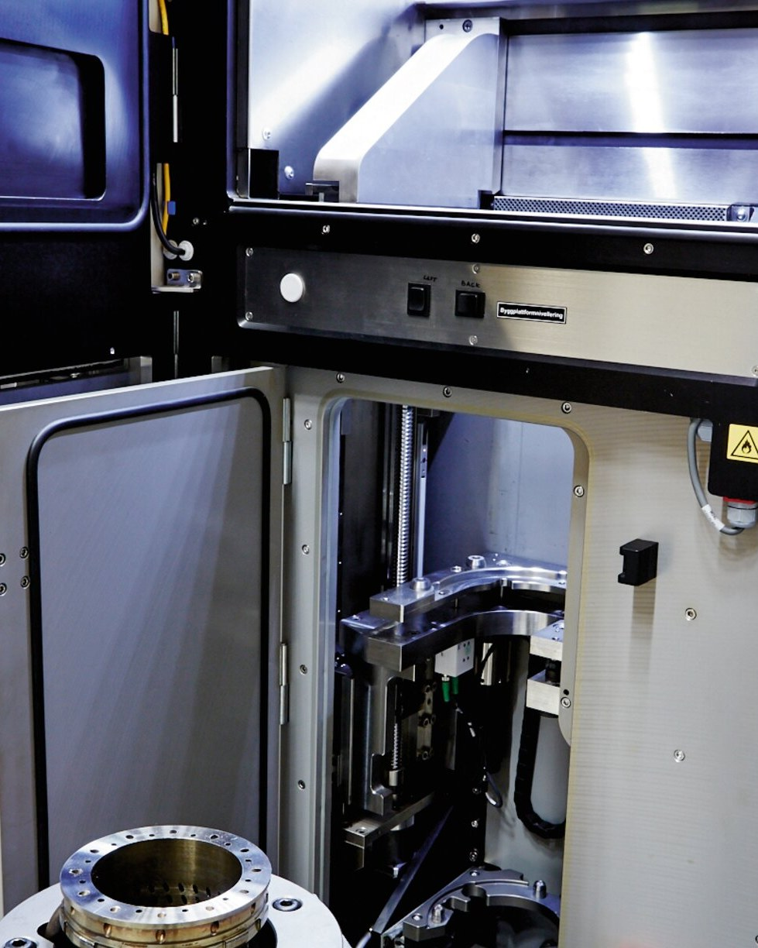
DED repair of a turbine blade tip
DED repair of a turbine blade tip
EXED Polytechnique - Additive Manufacturing - 04 Industries by Andrei Constantinescu 2027
Notes:
Source: optomec.com - turbine repair pages - credit Optomec - press image - ask permission

Slide 3
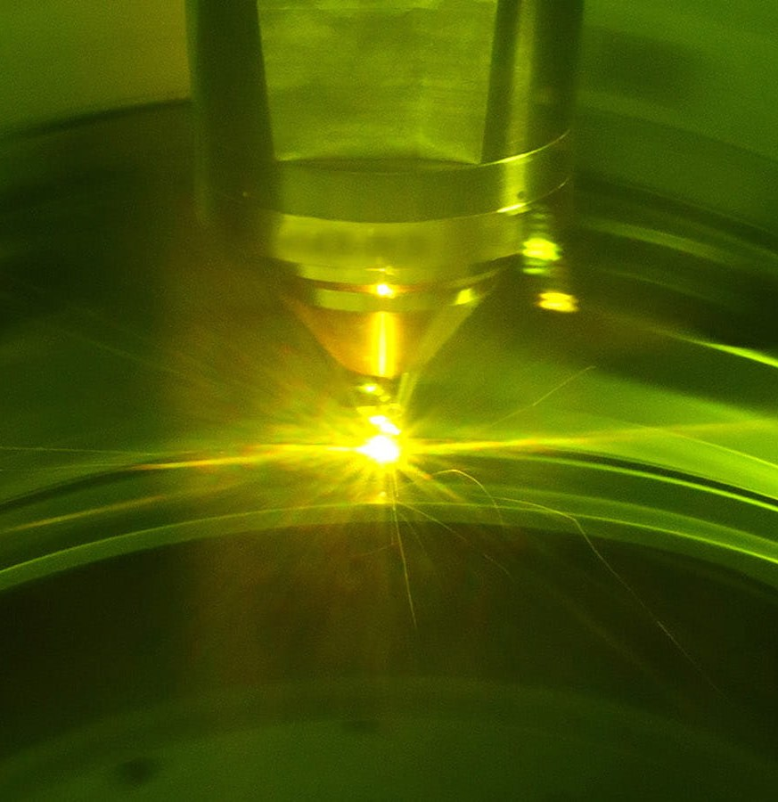
GTF engine / DED case repair
GTF engine / DED case repair
EXED Polytechnique - Additive Manufacturing - 04 Industries by Andrei Constantinescu 2027
Notes:
Source: prattwhitney.com newsroom; RTX press release 8 Apr 2025 - credit Pratt & Whitney - press image - credit Pratt & Whitney

Slide 4
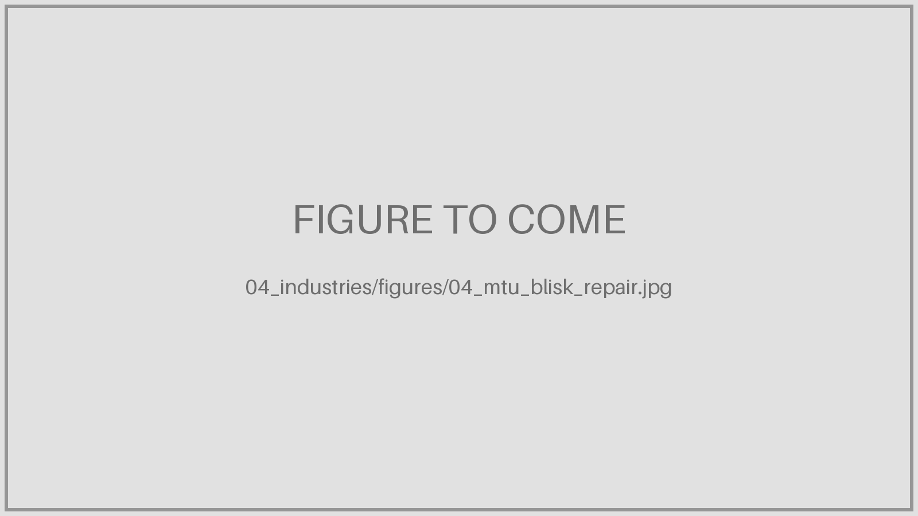
Blisk with blade tips rebuilt by laser deposition
Blisk with blade tips rebuilt by laser deposition
EXED Polytechnique - Additive Manufacturing - 04 Industries by Andrei Constantinescu 2027
Notes:
Source: mtu.de press images - credit MTU Aero Engines - press image - credit MTU

Slide 5
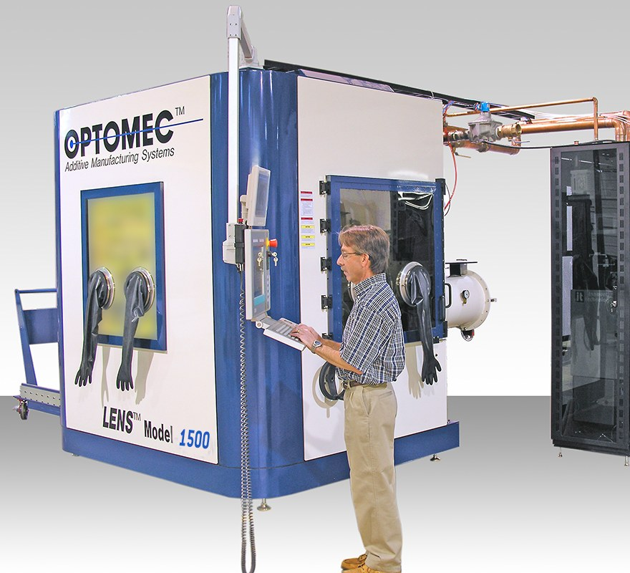
LENS DED repair cell / repaired blades
LENS DED repair cell / repaired blades
EXED Polytechnique - Additive Manufacturing - 04 Industries by Andrei Constantinescu 2027
Notes:
Source: optomec.com news Sept 2020 / June 2021 - credit Optomec - press image - credit Optomec

Slide 6
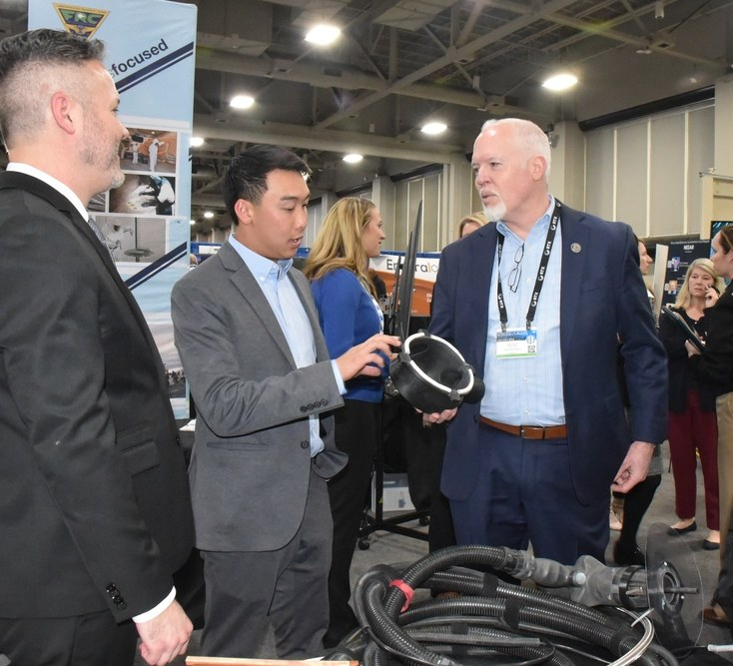
Cold-sprayed F/A-18 AMAD housing
Cold-sprayed F/A-18 AMAD housing
EXED Polytechnique - Additive Manufacturing - 04 Industries by Andrei Constantinescu 2027
Notes:
Source: dvidshub.net (FRCSW cold spray) / navair.navy.mil - credit US Navy - US government work - usually public domain; check DVIDS record

Slide 7
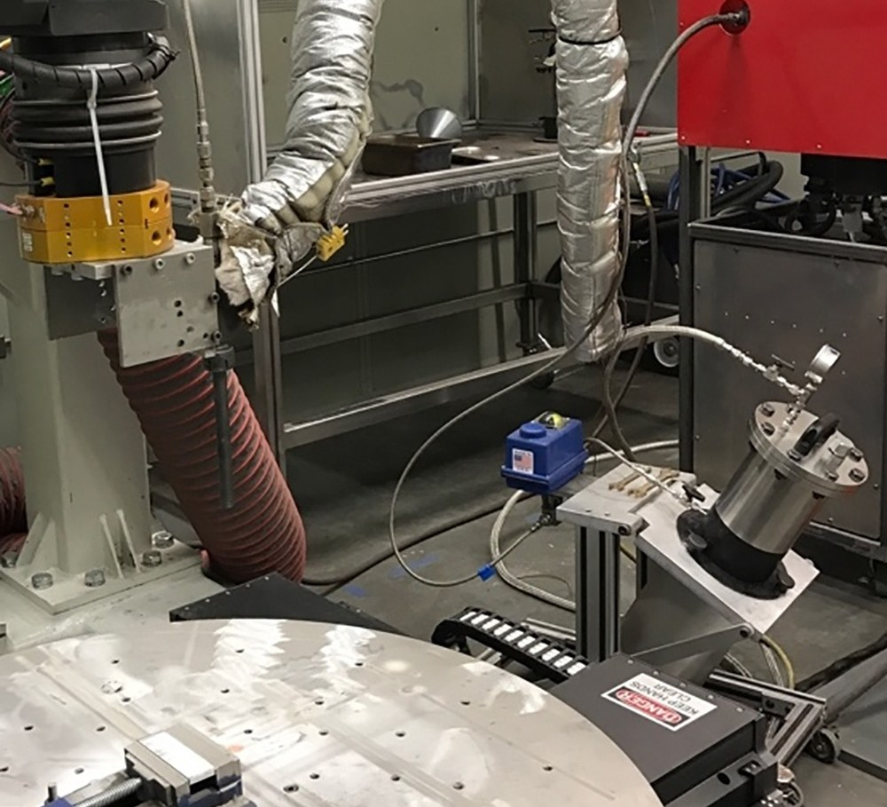
UH-60 magnesium transmission housing
UH-60 magnesium transmission housing
EXED Polytechnique - Additive Manufacturing - 04 Industries by Andrei Constantinescu 2027
Notes:
Source: serdp-estcp.mil / army.mil - credit US Army - US government work - usually public domain

Slide 8
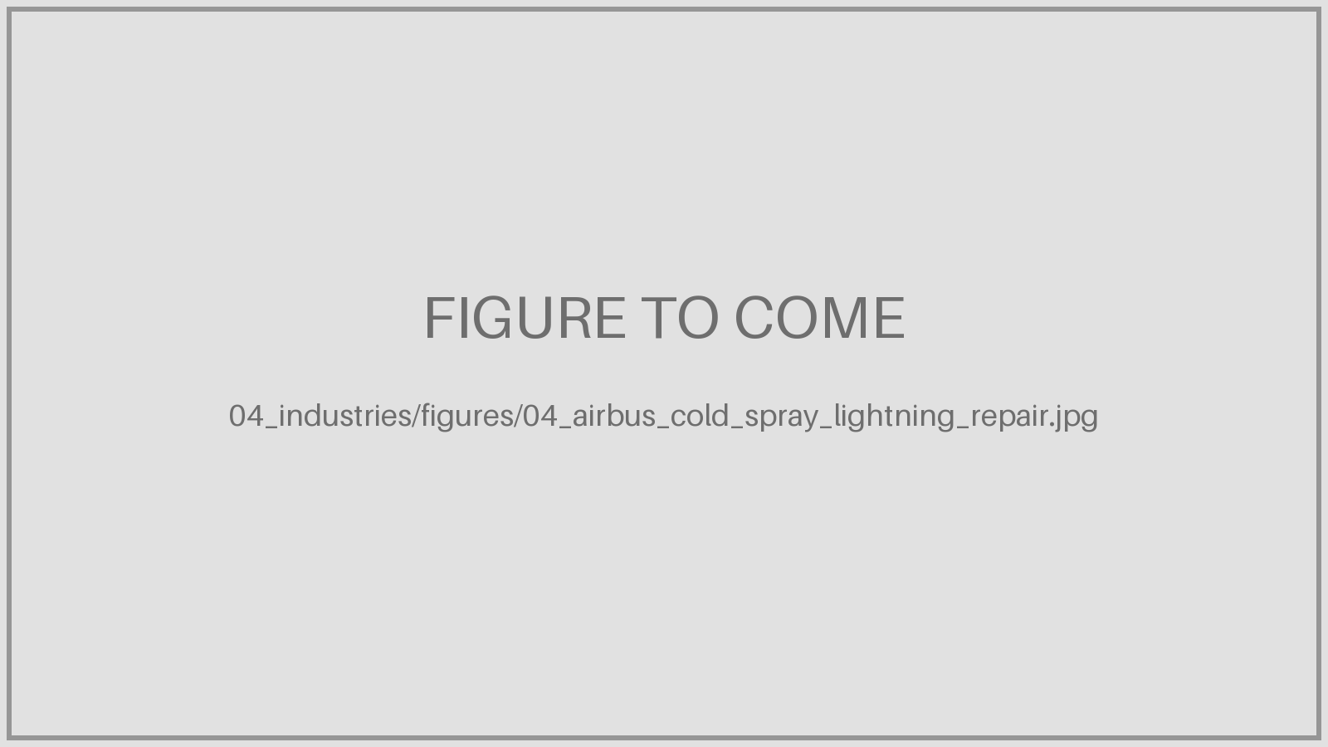
Lightning-strike damage and cold spray repairs (Airbus DS)
Lightning-strike damage and cold spray repairs (Airbus DS)
EXED Polytechnique - Additive Manufacturing - 04 Industries by Andrei Constantinescu 2027
Notes:
Source: D. Schimbaeck, Airbus Defence and Space, Aluminium Cold Spray Repair, Oct 2025, p. 11 - credit Airbus Defence and Space - Airbus Amber - internal; check with author before public distribution

Slide 9
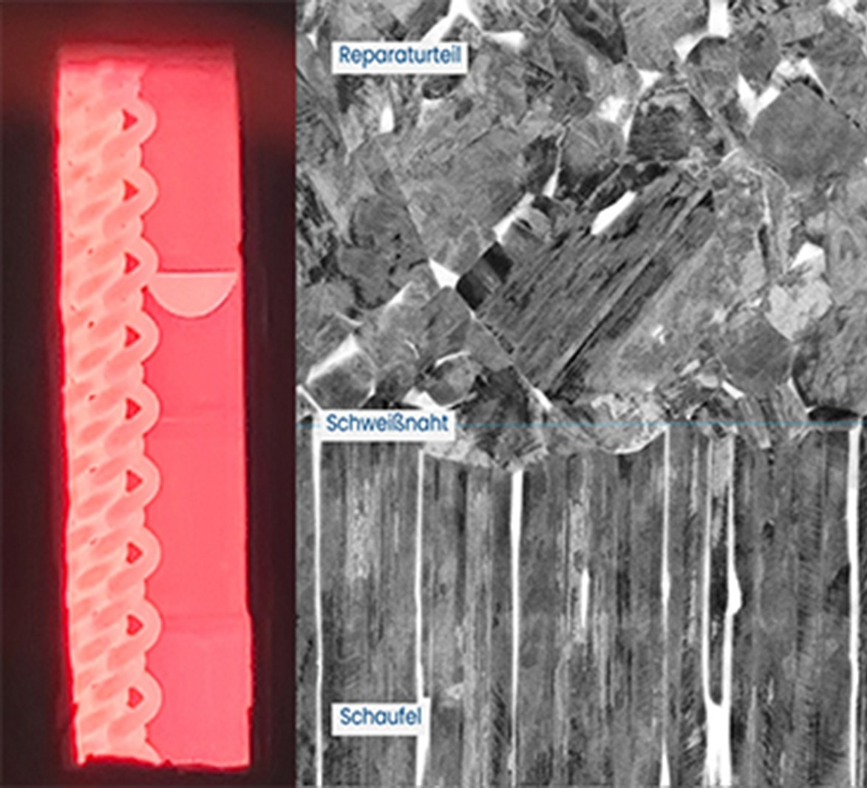
Diffusion-welded TiAl repair seam
Diffusion-welded TiAl repair seam
EXED Polytechnique - Additive Manufacturing - 04 Industries by Andrei Constantinescu 2027
Notes:
Source: hereon.de news 18 Feb 2022 - credit Hereon / Marcus Rackel - press image - credit Hereon

Slide 10
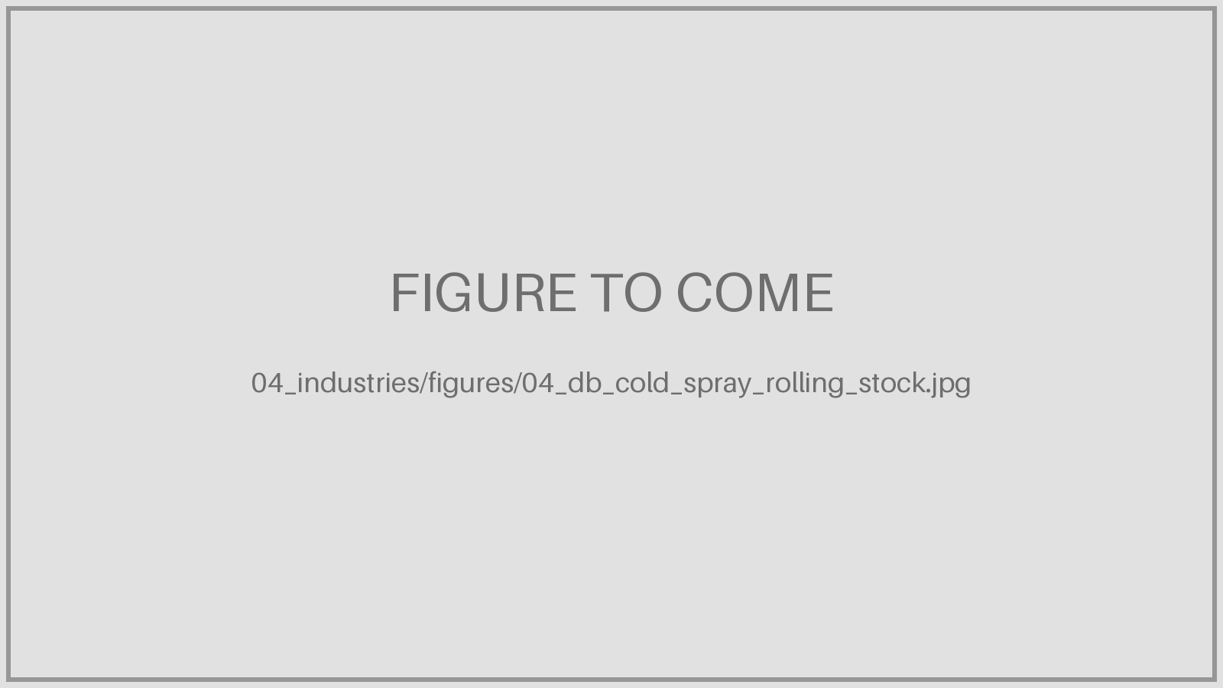
Cold spray on a rolling-stock part
Cold spray on a rolling-stock part
EXED Polytechnique - Additive Manufacturing - 04 Industries by Andrei Constantinescu 2027
Notes:
Source: titomic.com news 27 Jan 2026 - credit Titomic - press image - credit Titomic

Slide 11
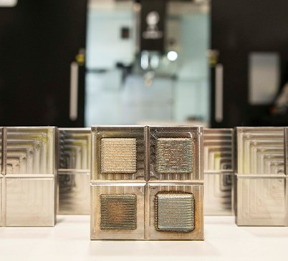
Forging die before and after LMD rebuild
Forging die before and after LMD rebuild
EXED Polytechnique - Additive Manufacturing - 04 Industries by Andrei Constantinescu 2027
Notes:
Source: nmis.scot / iom3.org Jan 2022 - credit NMIS - press image - credit NMIS

Slide 12
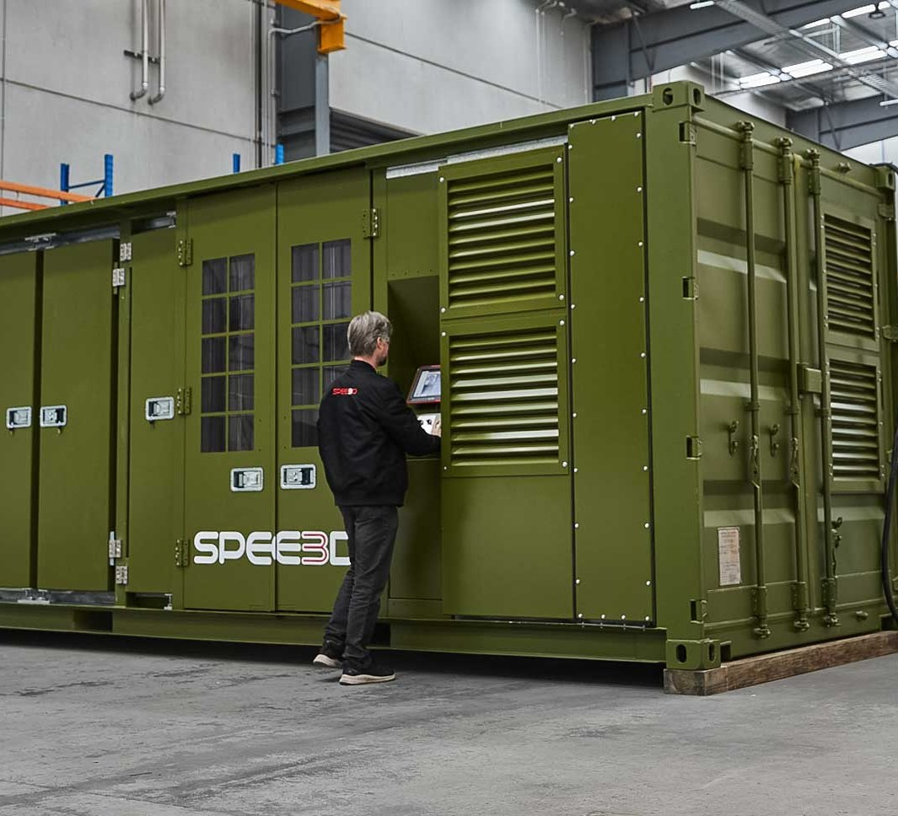
XSPEE3D containerised cold spray printer
XSPEE3D containerised cold spray printer
EXED Polytechnique - Additive Manufacturing - 04 Industries by Andrei Constantinescu 2027
Notes:
Source: dvidshub.net (SPEE3D) / spee3d.com - credit US Navy / SPEE3D - DVIDS: US government work; spee3d.com: press image

Slide 13
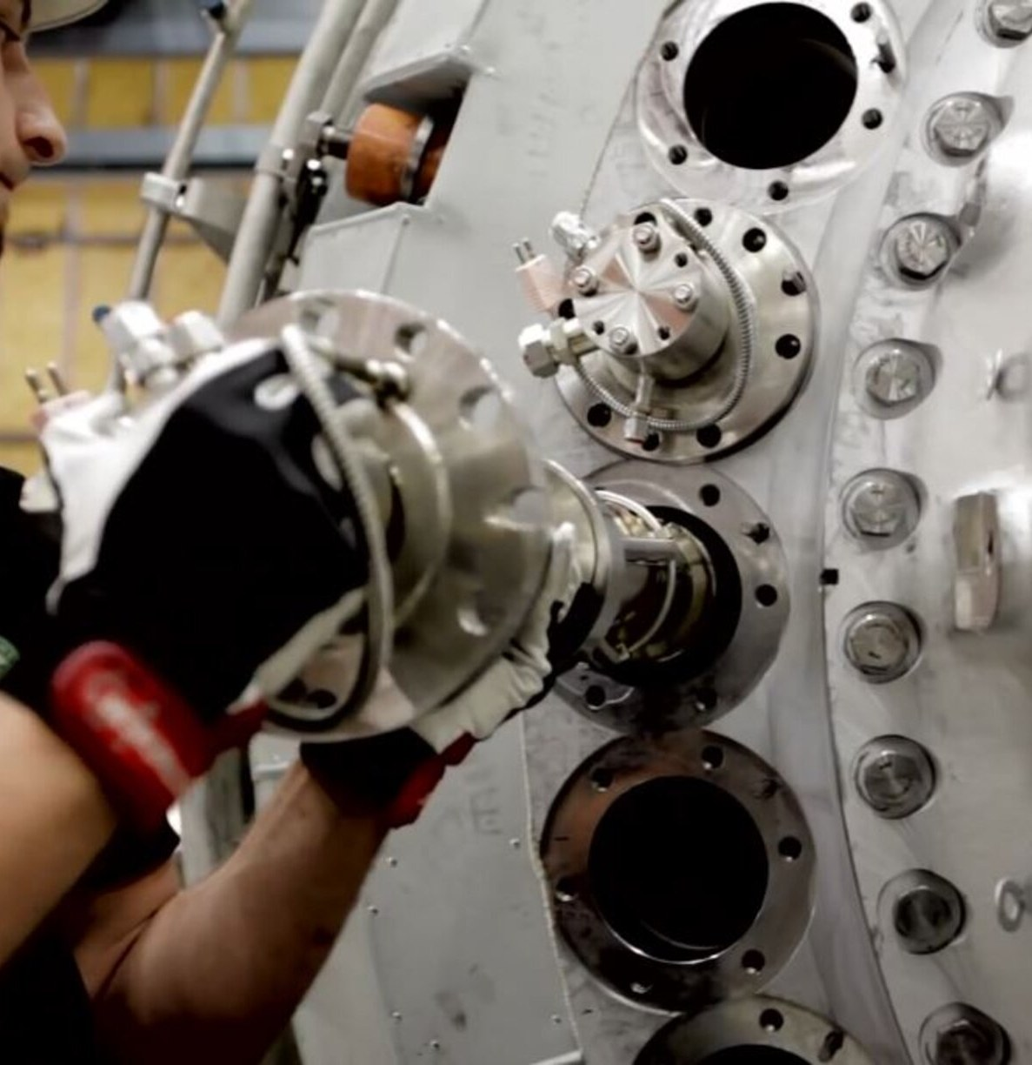
Burner tip with cut lines at 120 mm and 20 mm
Burner tip with cut lines at 120 mm and 20 mm
EXED Polytechnique - Additive Manufacturing - 04 Industries by Andrei Constantinescu 2027
Notes:
Source: eos.info Siemens case study; laserfocusworld.com Fig. 2 - credit Siemens Energy / EOS - press image - credit Siemens Energy

Slide 14
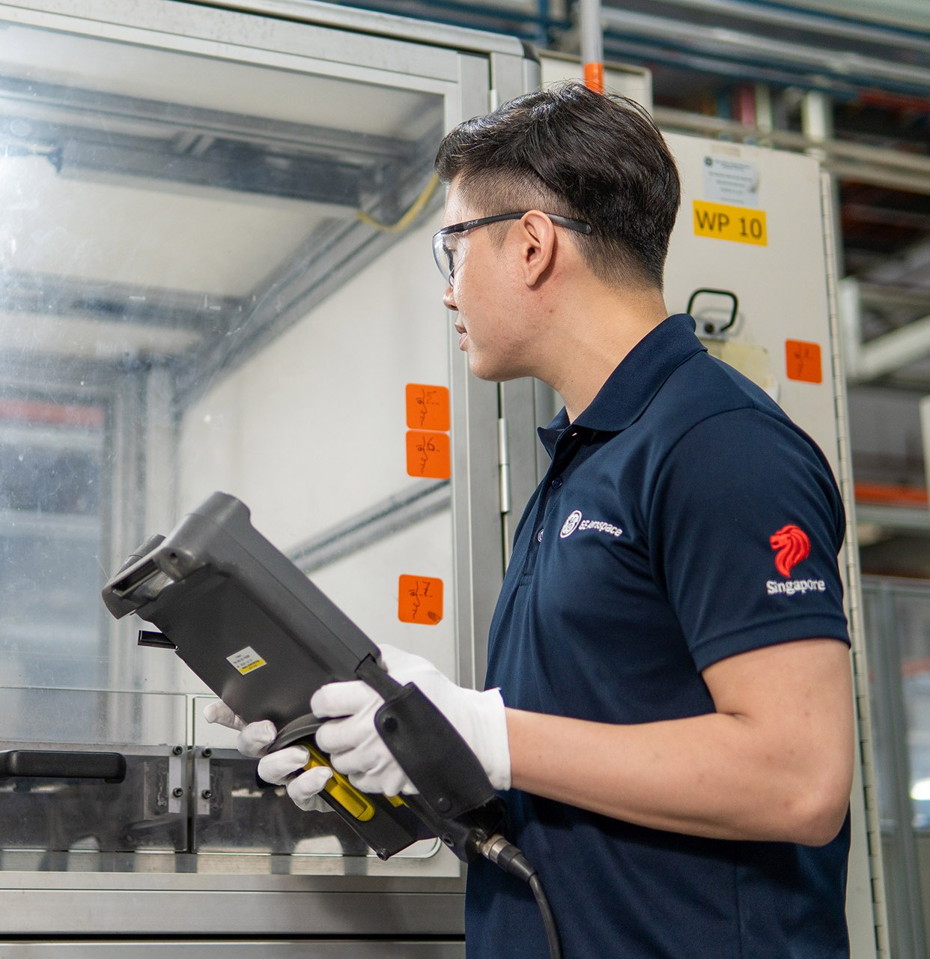
Concept Laser M2 printing HPC blade tips
Concept Laser M2 printing HPC blade tips
EXED Polytechnique - Additive Manufacturing - 04 Industries by Andrei Constantinescu 2027
Notes:
Source: geaerospace.com Singapore site / news - credit GE Aerospace - press image - credit GE Aerospace

Slide 15
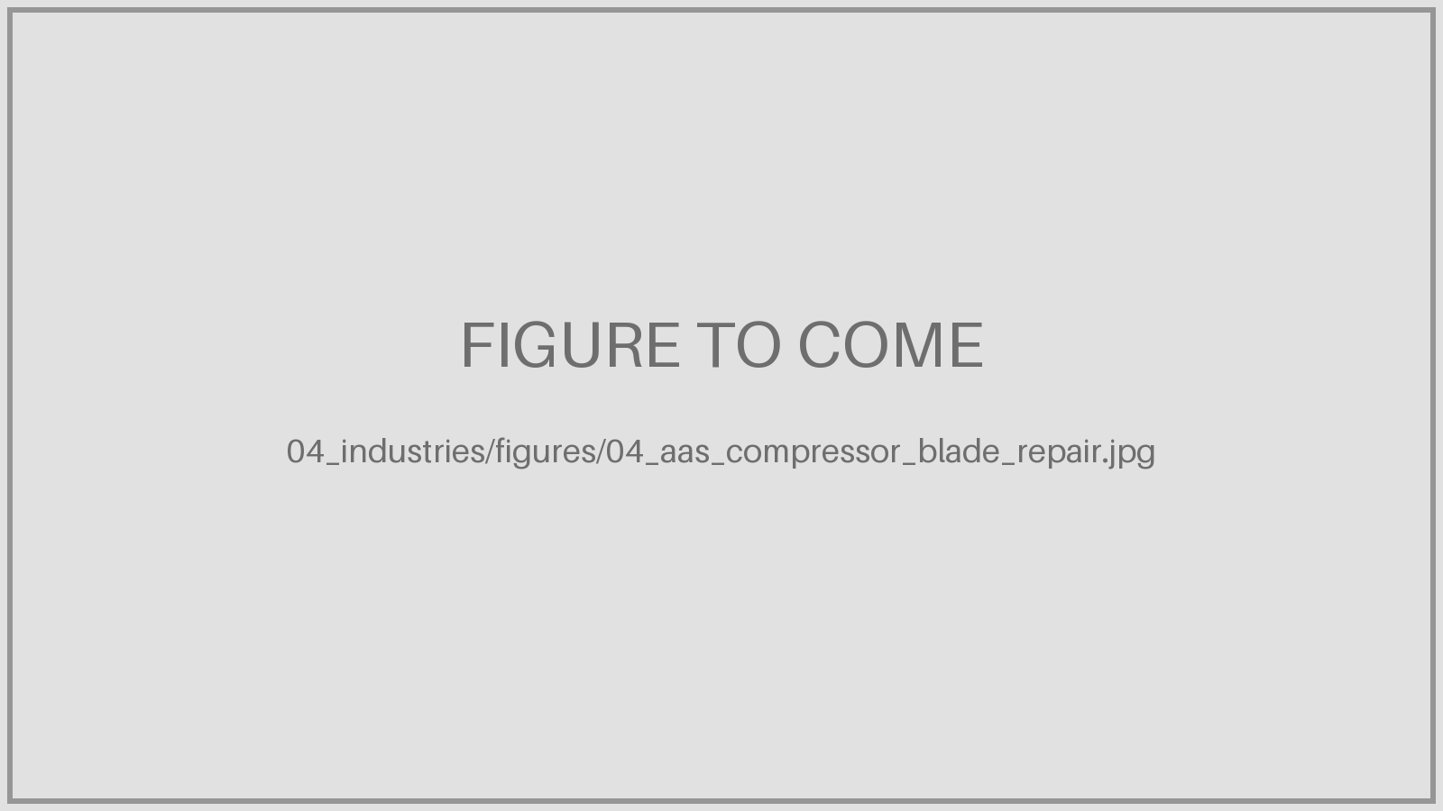
Safran & AFI KLM E&M: Airfoils Advanced Solutions
AAS shop, Rosult: compressor blade repair
EXED Polytechnique - Additive Manufacturing - 04 Industries by Andrei Constantinescu 2027
Notes:
Source: afiklmem.com joint ventures / safran-group.com implantations - credit Safran / AFI KLM E&M - press image

