Slide 1
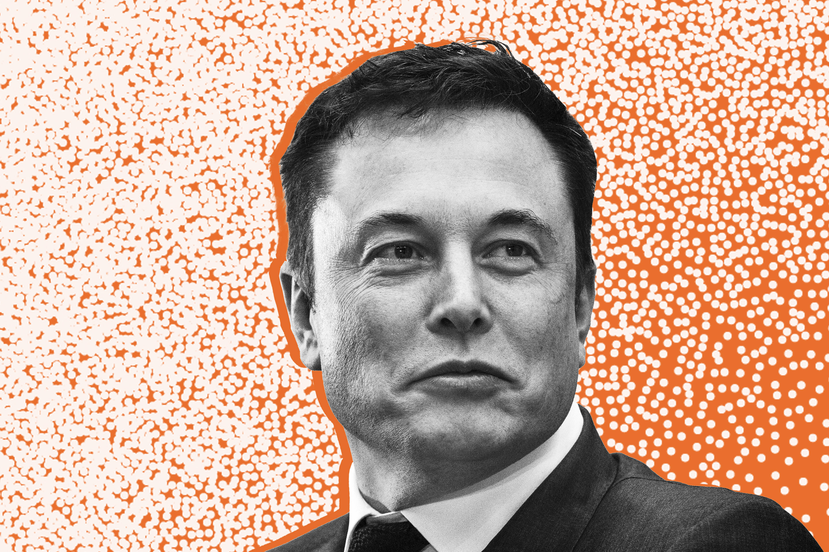

Project Grizzly
Elon Musk’s Influence Over Bitcoin
Ryan Mageno, Aiden Lucero, and Amelia Corea

Slide 2
Questions of Interest:
Is there any correlation between Elon Musk’s Twitter activity and the value of bitcoin?
Does mentioning “bitcoin” in a tweet influence the bitcoin value?
Do tweets about “Tesla” influence bitcoin value now that Tesla accepts bitcoin?
Is there any relation between how much Elon tweets and how many trades happen within the day?
Does any of this extend to other currencies, such as Dogecoin?

Slide 3
Why This Data?
Elon Musk is a wealthy figure that most people have heard of.
Elon Musk supports bitcoin through investments and Tesla’s acceptance of the currency.
Cryptocurrency is a social and financial topic that many are interested in learning more about.
If there is correlation, this allows for better investments!
Elon Musk is a man who loves memes and Twitter providing a lot of data to look at.

Slide 4

The Dataset:
Bitcoin & Dogecoin Databases:
Klines Binance Data Collection
CSV Files from 2019 to 2021.
Coin values per minute.
Elon Musk’s Twitter Activity:
Twint (Twitter Scraper)
Bypasses Twitter API restrictions.
Can pull almost everything you want from twitter.

Slide 5

Data Exploration & Cleanup (switching to vscode)

Slide 6
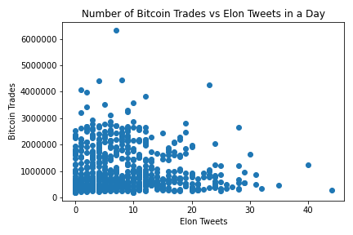
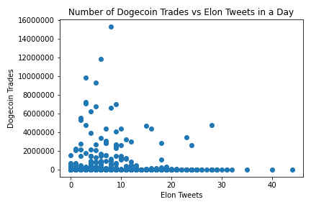
Data Analysis (Tweets Per Day vs BTC & DOGE Trades Per Day)

Slide 7
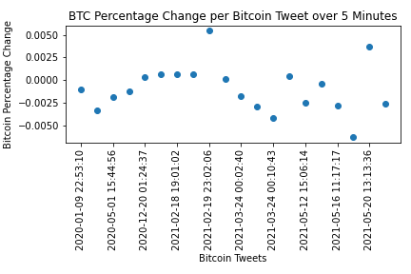
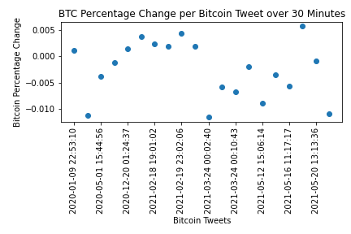
Data Analysis (Bitcoin Tweets to Bitcoin Value)

Slide 8
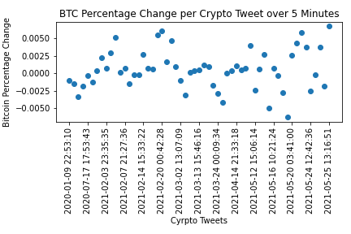
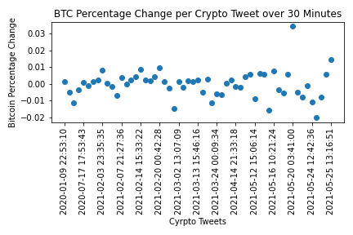
Data Analysis (Crypto Tweets to Bitcoin Value)

Slide 9
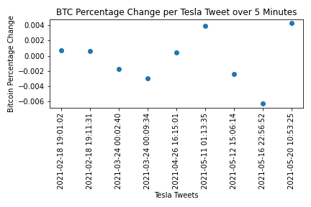
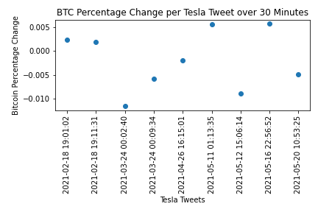
Data Analysis (Tesla Tweets to Bitcoin Value)

Slide 10
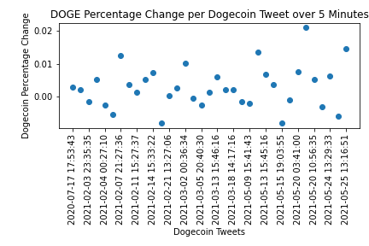
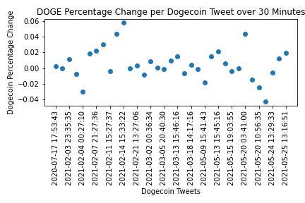
Data Analysis (Dogecoin Tweets to Dogecoin Value)

Slide 11
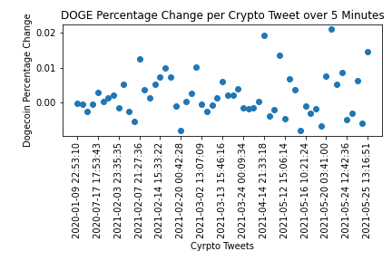
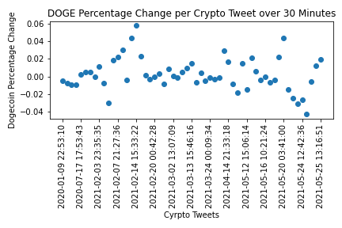
Data Analysis (Crypto Tweets to Dogecoin Value)

Slide 12

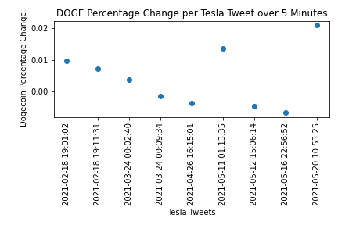
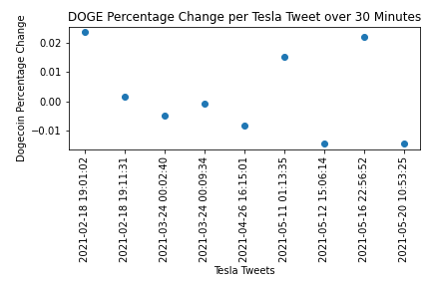
Data Analysis (Tesla Tweets to Dogecoin Value)

Slide 13
Data Analysis (Percent Change Averages)
5 Minute Intervals
Direct Tweets vs Value | Crypto Tweets vs Value | Tesla Tweets vs Value
-0.0009452762559729741 | 0.0005139165294424734 | -0.0003912220760144001
0.0029364871944572257 | 0.0021213957295413703 | 0.004343857002728367
Bitcoin
Dogecoin
30 Minute Intervals
Direct Tweets vs Value | Crypto Tweets vs Value | Tesla Tweets vs Value
-0.0024564851504824347 | -0.00023616057237313222 | -0.001919738462626144
0.004985512643982101 | 0.0025965941145320174 | 0.0021344164944828783
Bitcoin
Dogecoin

Slide 14
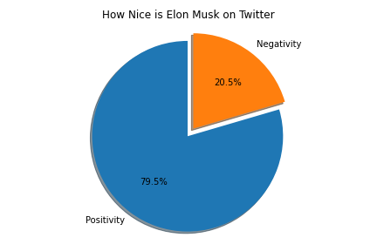

The Experimental Data (Tweet Polarity)

Slide 15
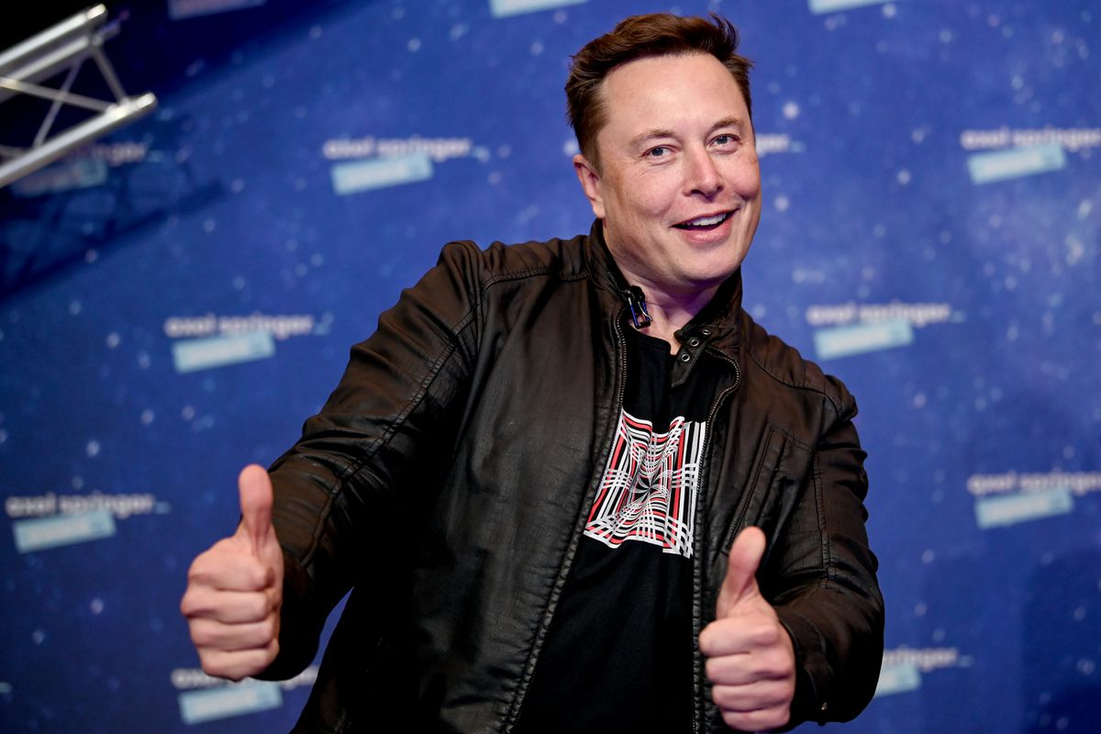
Conclusion
Bitcoin and dogecoin rapidly fluctuate in value throughout the day (milliseconds) which makes it challenging to correlate any effect on coin value from an outside influence.
The timing and content of Elon Musk’s tweets do not appear to have an effect on the value of bitcoin and dogecoin.
Looking at the experimental code and data it may be possible to conclude that Elon Musk primarily tweets positive messages and there for seems to be a nice guy on twitter.

