Slide 1
Antigenic Cartography Workshop – Map construction
ESFLU Training School, October 6-8, 2025
Antonia Netzl (she/her) an604@cam.ac.uk
Sarah James (she/her) slj38@cam.ac.uk
Sam Turner (he/him) sat65@cam.ac.uk
Sina Türeli (he/him) st757@cam.ac.uk
Derek Smith (he/him) djs200@cam.ac.uk
Centre for Pathogen Evolution, University of Cambridge, UK

Slide 2
Overview
Code for constructing an antigenic map
Titer data and map distances
Map optimization
Map styling
Map stress
Positional resolution
The interactive Racmacs viewer tool
Impact of noise on an antigenic map
Undetectable titers and map positioning
Comparing maps
Simulated SARS-CoV-2 map
Colouring by sequence
Link to Racmacs package: https://acorg.github.io/Racmacs/index.html

Slide 3
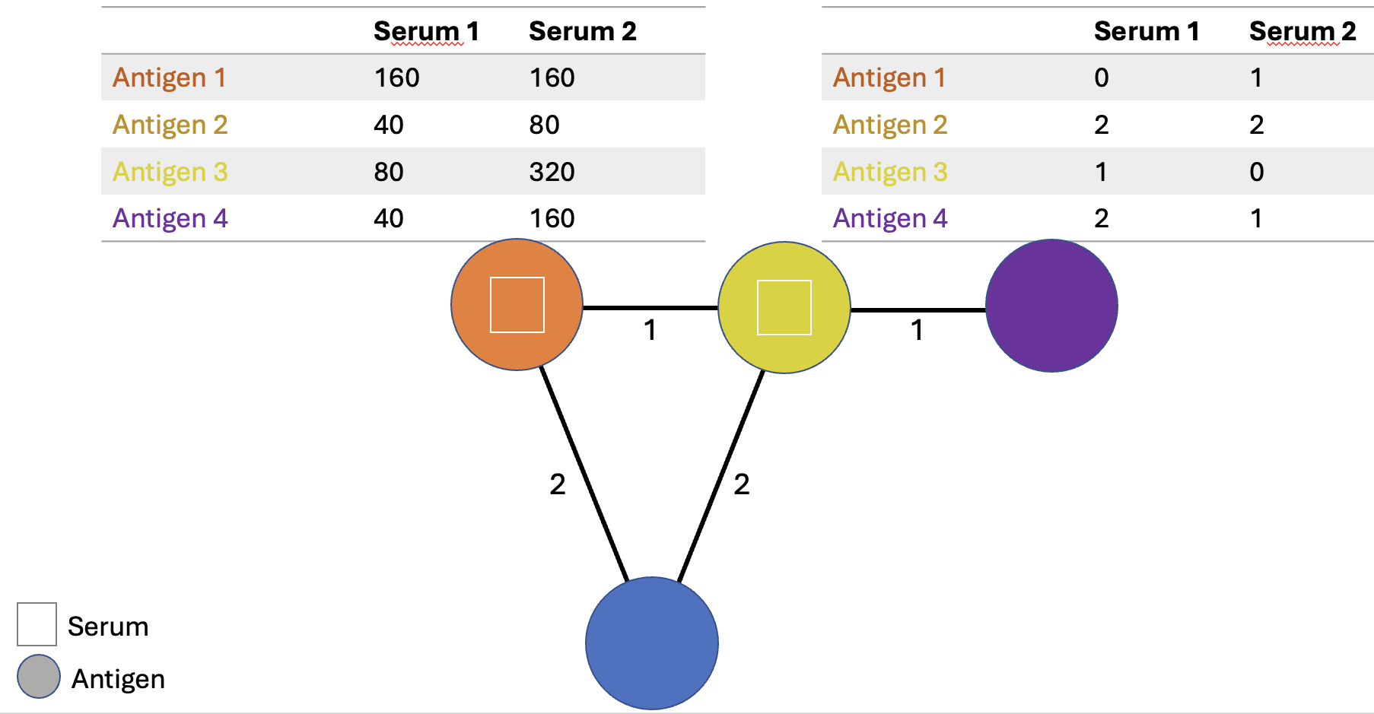
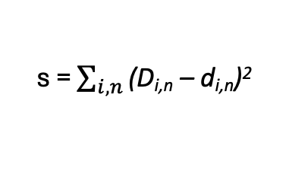
From titers to a map
 | Serum 1 | Serum 2 | … | Serum n
Antigen 1 | Titer_{1,1} | Titer_{1,2} | … | Titer_{1,n}
Antigen 2 | Titer_{2,1} | Titer_{2,2} | … | Titer_{2,n}
… | … | … | … | …
Antigen i | Titer_{i,1} | Titer_{i,2} | … | Titer_{i,n}
Log2 transform
calculate target distances (fold change from max titer per serum)
Table with target distances D
Optimize map distances d for each serum, antigen pair
Minimize map stress
Where D = log2(maxTiter/LOD) for titers below the limit of detection (LOD) and d>D without penalty
s = $\sum_{i,n}^{ }{\text{(}\text{D}\text{i}\text{,}\text{n}\text{ – }\text{di}\text{,}\text{n}\text{)}\text{2}}$
Antigenic map
2

Slide 4
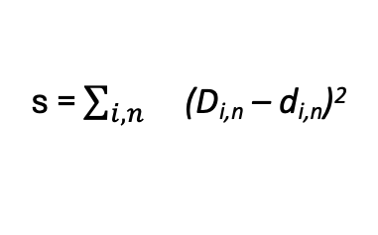
From titers to a map
 | Serum 1 | Serum 2 | … | Serum n
Antigen 1 | Titer_{1,1} | Titer_{1,2} | … | Titer_{1,n}
Antigen 2 | Titer_{2,1} | Titer_{2,2} | … | Titer_{2,n}
… | … | … | … | …
Antigen i | Titer_{i,1} | Titer_{i,2} | … | Titer_{i,n}
Log2 transform
calculate target distances (fold change from max titer per serum)
Table with target distances D
Optimize map distances d for each serum, antigen pair
Minimize map stress
Where D = log2(maxTiter/LOD) for titers below the limit of detection (LOD) and d>D without penalty
s = $\sum_{i,n}{}$(D_{i,n} – d_{i,n})²
Antigenic map
2

Slide 5
From titers to a map
 | Serum 1 | Serum 2
Antigen 1 | 160 | 160
Antigen 2 | 40 | 80
Antigen 3 | 80 | 320
Antigen 4 | 40 | 160
 | Serum 1 | Serum 2
Antigen 1 | 0 | 1
Antigen 2 | 2 | 2
Antigen 3 | 1 | 0
Antigen 4 | 2 | 1
1
1
2
2
Serum
Antigen

Slide 6
From titers to a map
 | Serum 1 | Serum 2
Antigen 1 | 160 | 160
Antigen 2 | 40 | 80
Antigen 3 | 80 | 320
Antigen 4 | <40 (40) | 80 (160)
 | Serum 1 | Serum 2
Antigen 1 | 0 | 1
Antigen 2 | 2 | 2
Antigen 3 | 1 | 0
Antigen 4 | >=2 | 2 (1)
1
1
Black map conformation gives stress for serum 2, antigen 4
2
2
Serum
Antigen

Slide 7
From titers to a map
 | Serum 1 | Serum 2
Antigen 1 | 160 | 160
Antigen 2 | 40 | 80
Antigen 3 | 80 | 320
Antigen 4 | <40 (40) | 80 (160)
 | Serum 1 | Serum 2
Antigen 1 | 0 | 1
Antigen 2 | 2 | 2
Antigen 3 | 1 | 0
Antigen 4 | >=2 | 2 (1)
1
1
1
Information from <LOD (limit of detection) titers captured by allowing map distance to be larger or equal to the distance from maximum titer to LOD without additional stress
Distances shorter than max titer to LOD increase map stress
2
2
Serum
Antigen

Slide 8
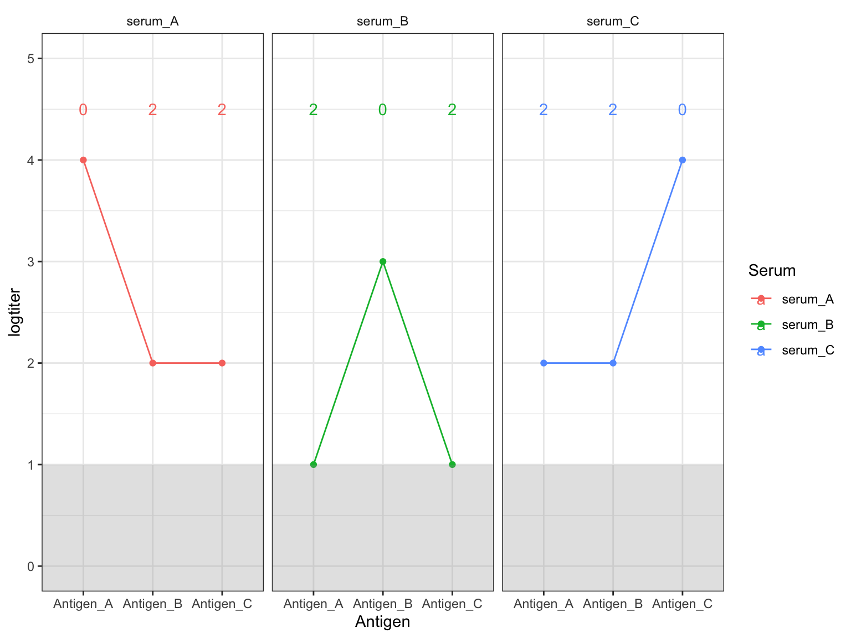
Map construction example:

Slide 9
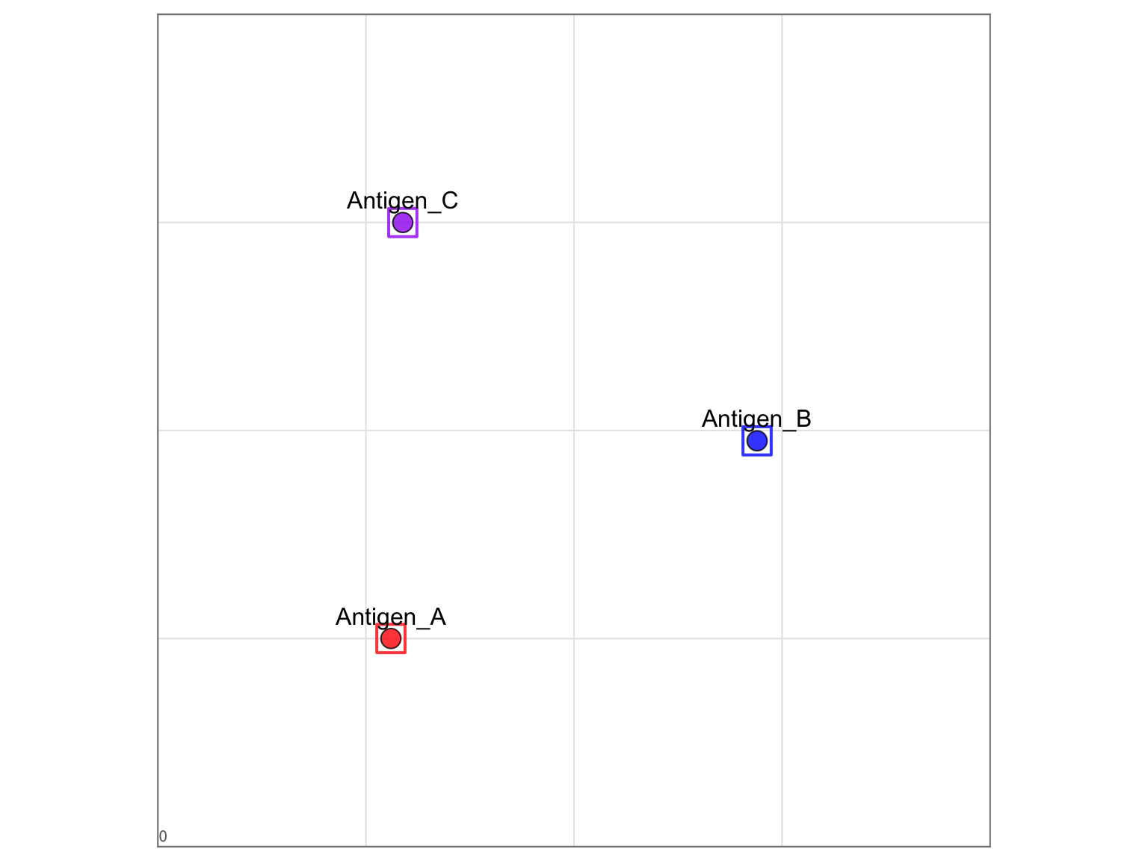
Map construction example:
Map stress = Error between table and map distances

Slide 10
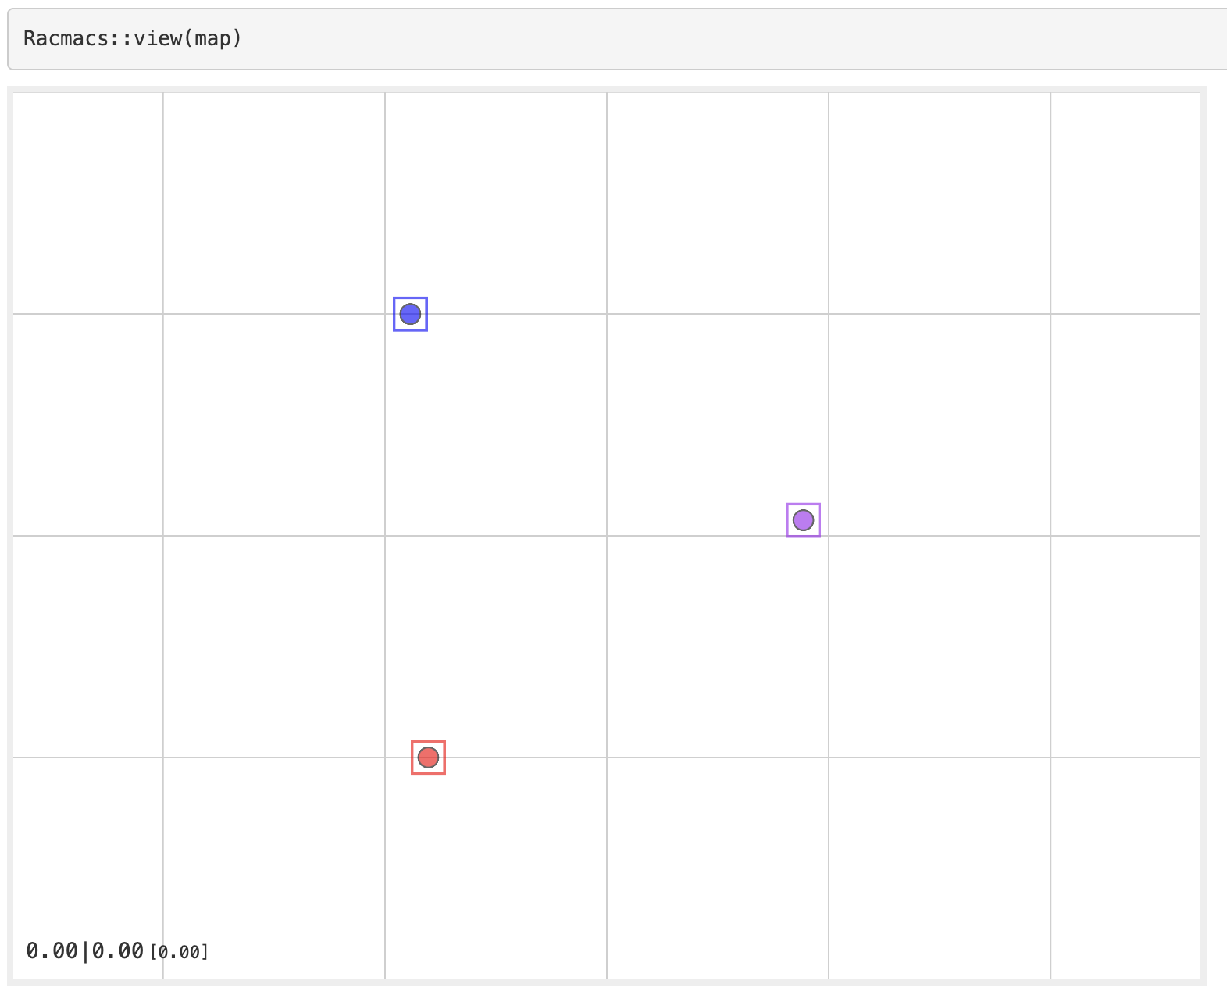
Map construction example:
Total stress | Stress per titer [stress per detectable titer]

Slide 11
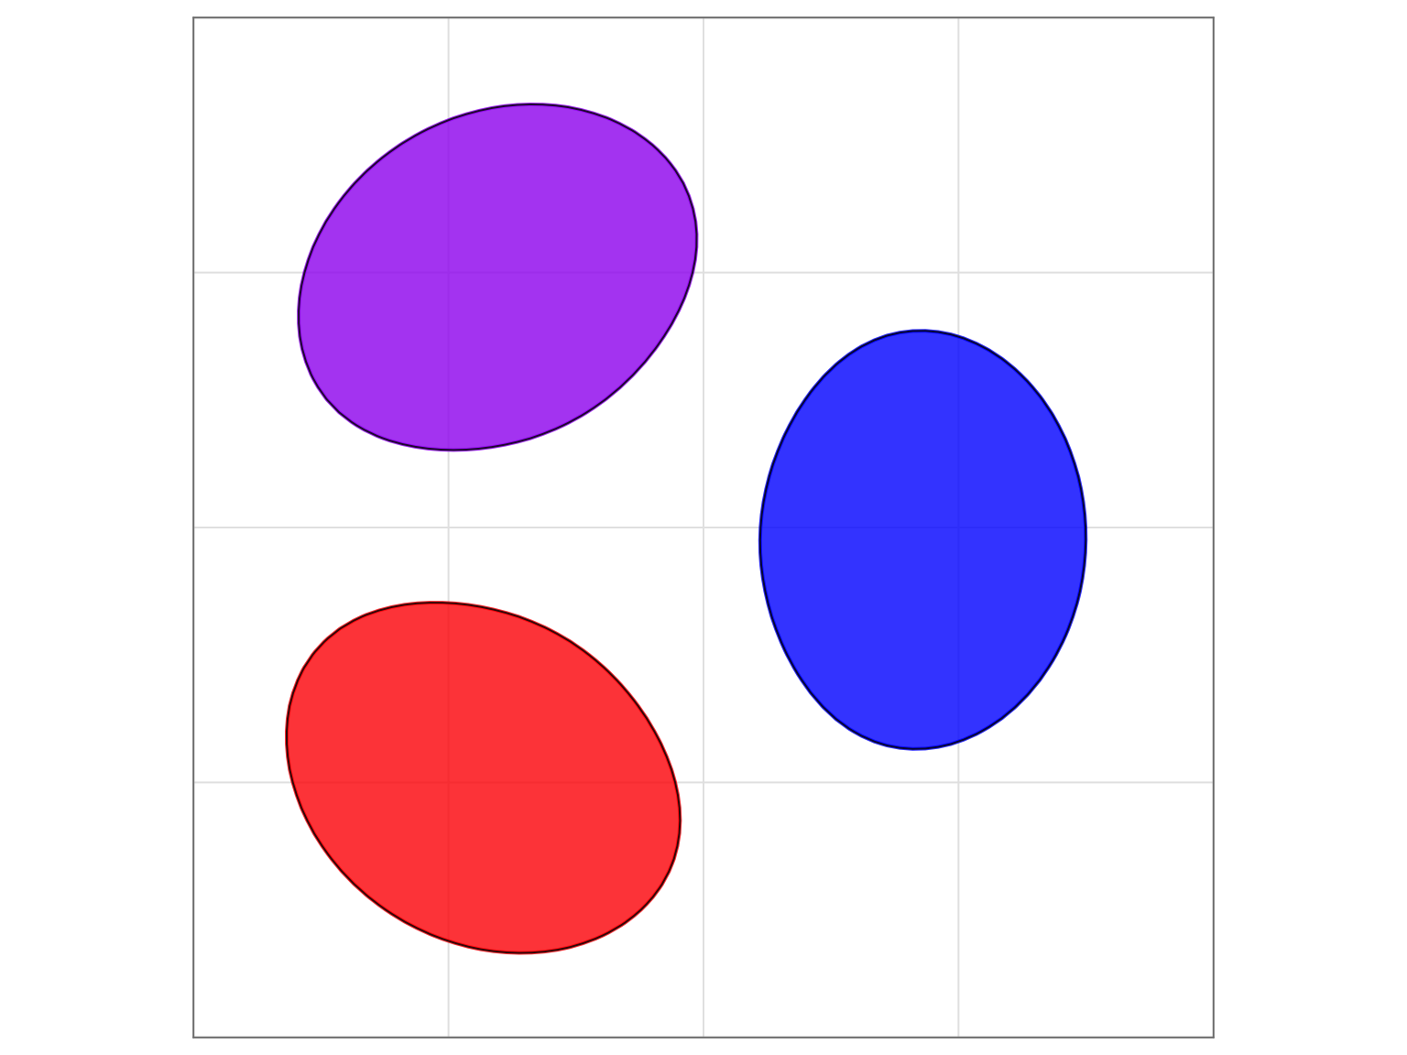
Map construction example: Point triangulation
Triangulation blobs:
Map area that an item can cover without
Increasing map stress by more than 1 unit

Slide 12
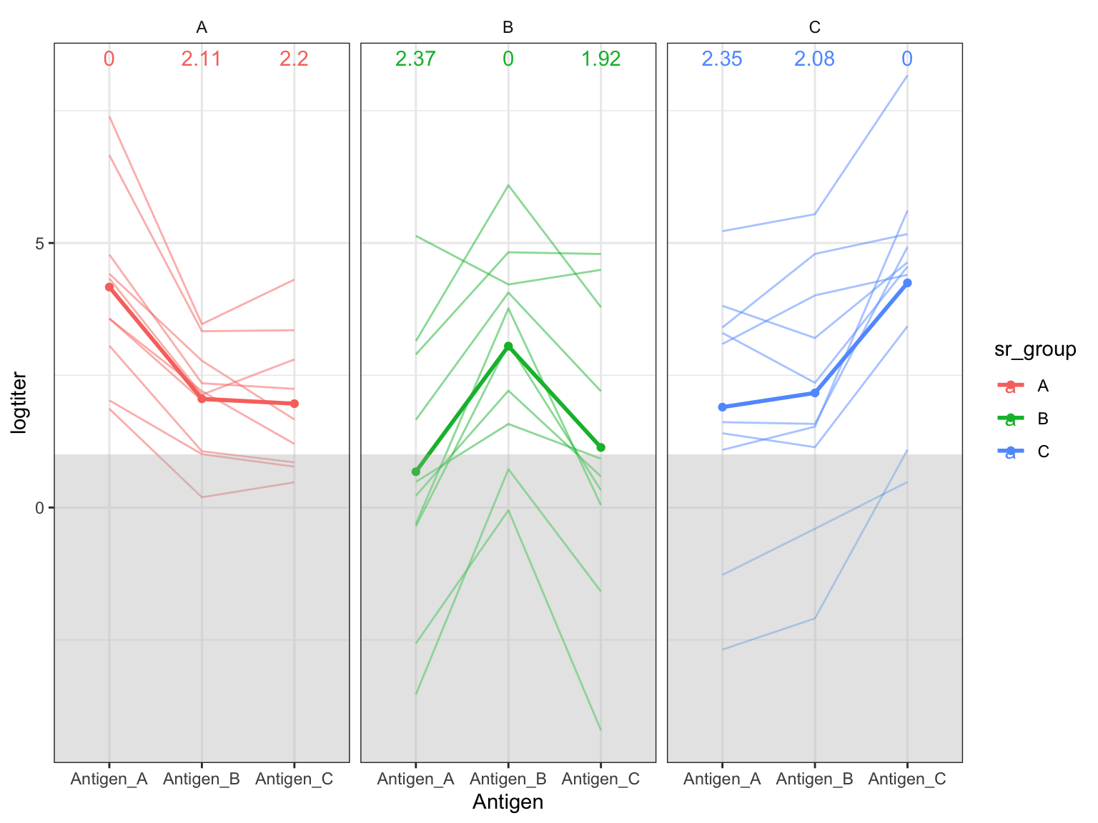
Maps from noisy data
Assumption: measured titer against antigen i in serum s varies from true population titer because of individual reactivity differences and random noise
𝑙𝑜𝑔𝑡𝑖𝑡𝑒𝑟_{𝑖,𝑠}=𝑠𝑟𝐺𝑟𝑜𝑢𝑝𝐺𝑀𝑇_{𝑖,𝑆}+𝑠𝑒𝑟𝑢𝑚𝐸𝑓𝑓𝑒𝑐𝑡_{𝑠}+𝑛𝑜𝑖𝑠𝑒_{𝑖,𝑠}

Slide 13
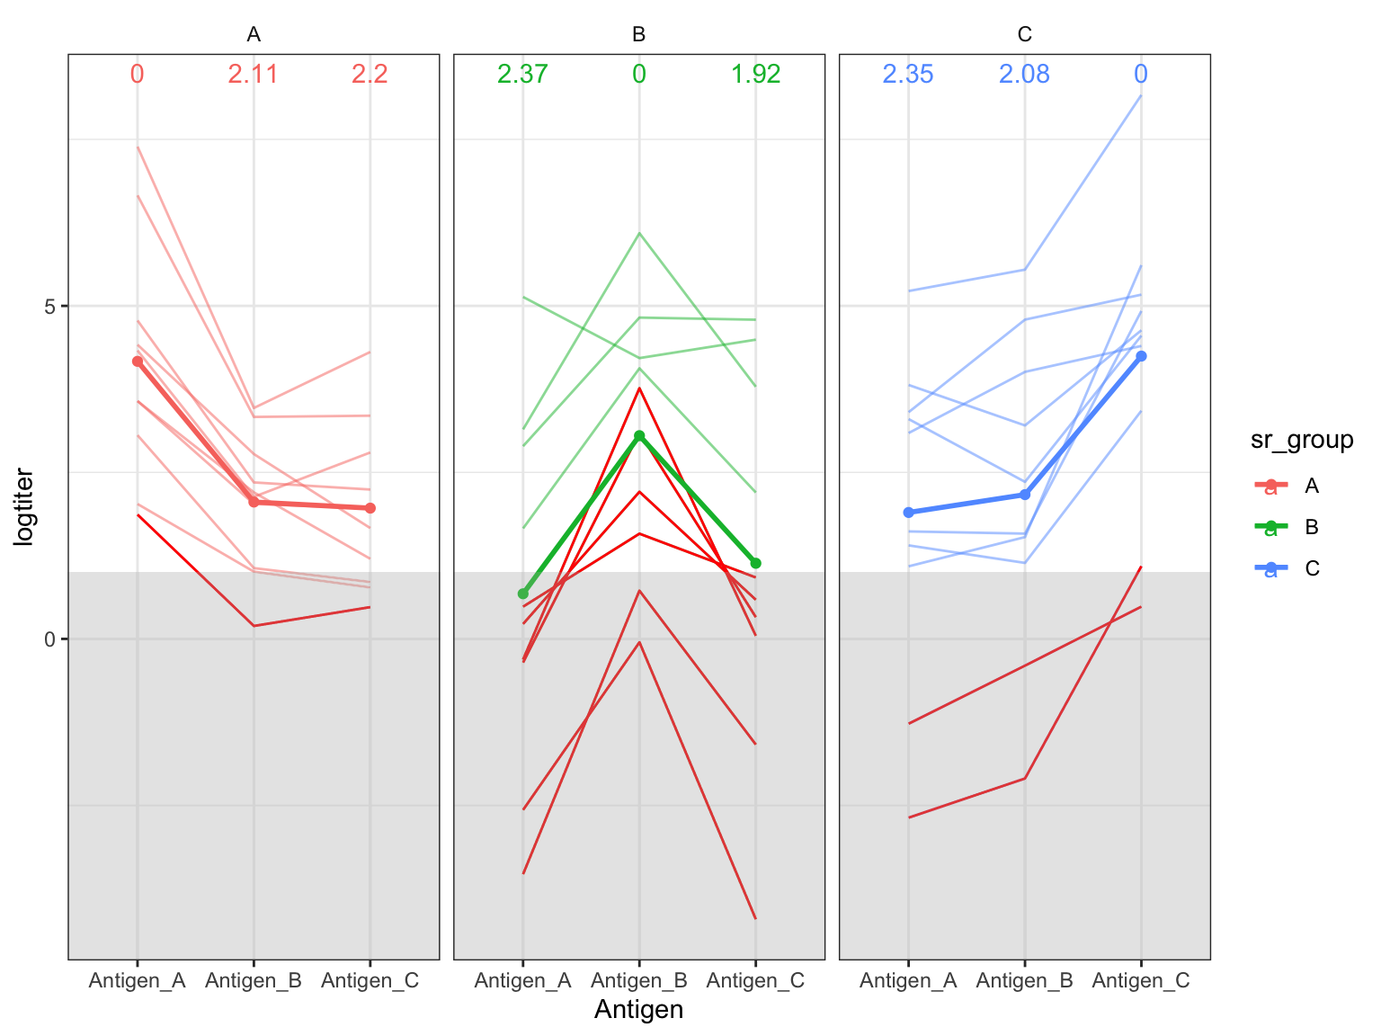
Maps from noisy data
Assumption: measured titer against antigen i in serum s varies from true population titer because of individual reactivity differences and random noise
𝑙𝑜𝑔𝑡𝑖𝑡𝑒𝑟_{𝑖,𝑠}=𝑠𝑟𝐺𝑟𝑜𝑢𝑝𝐺𝑀𝑇_{𝑖,𝑆}+𝑠𝑒𝑟𝑢𝑚𝐸𝑓𝑓𝑒𝑐𝑡_{𝑠}+𝑛𝑜𝑖𝑠𝑒_{𝑖,𝑠}

Slide 14
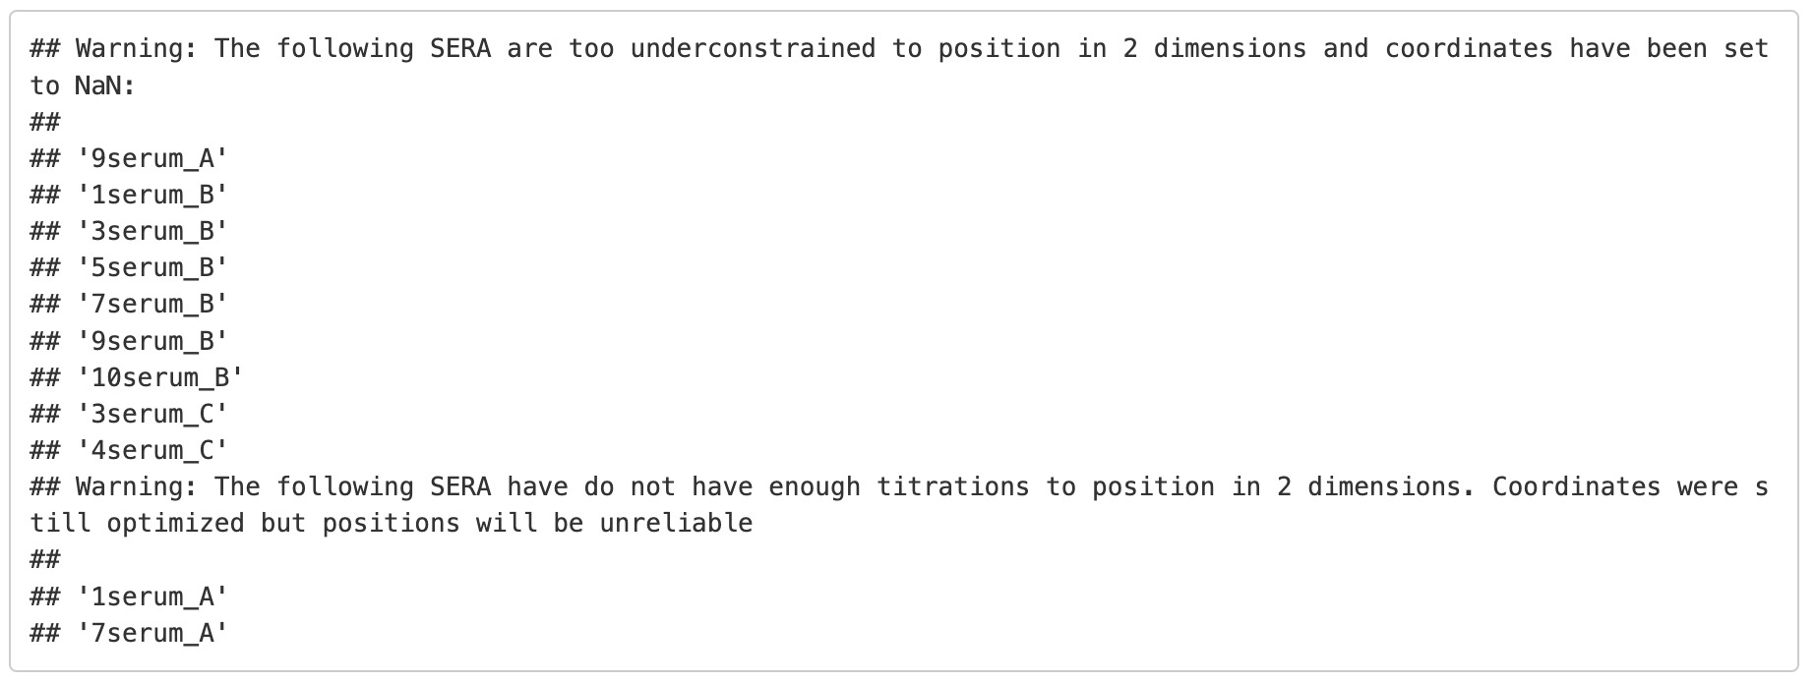
Maps from noisy data
Assumption: measured titer against antigen i in serum s varies from true population titer because of individual reactivity differences and random noise
𝑙𝑜𝑔𝑡𝑖𝑡𝑒𝑟_{𝑖,𝑠}=𝑠𝑟𝐺𝑟𝑜𝑢𝑝𝐺𝑀𝑇_{𝑖,𝑆}+𝑠𝑒𝑟𝑢𝑚𝐸𝑓𝑓𝑒𝑐𝑡_{𝑠}+𝑛𝑜𝑖𝑠𝑒_{𝑖,𝑠}

Slide 15
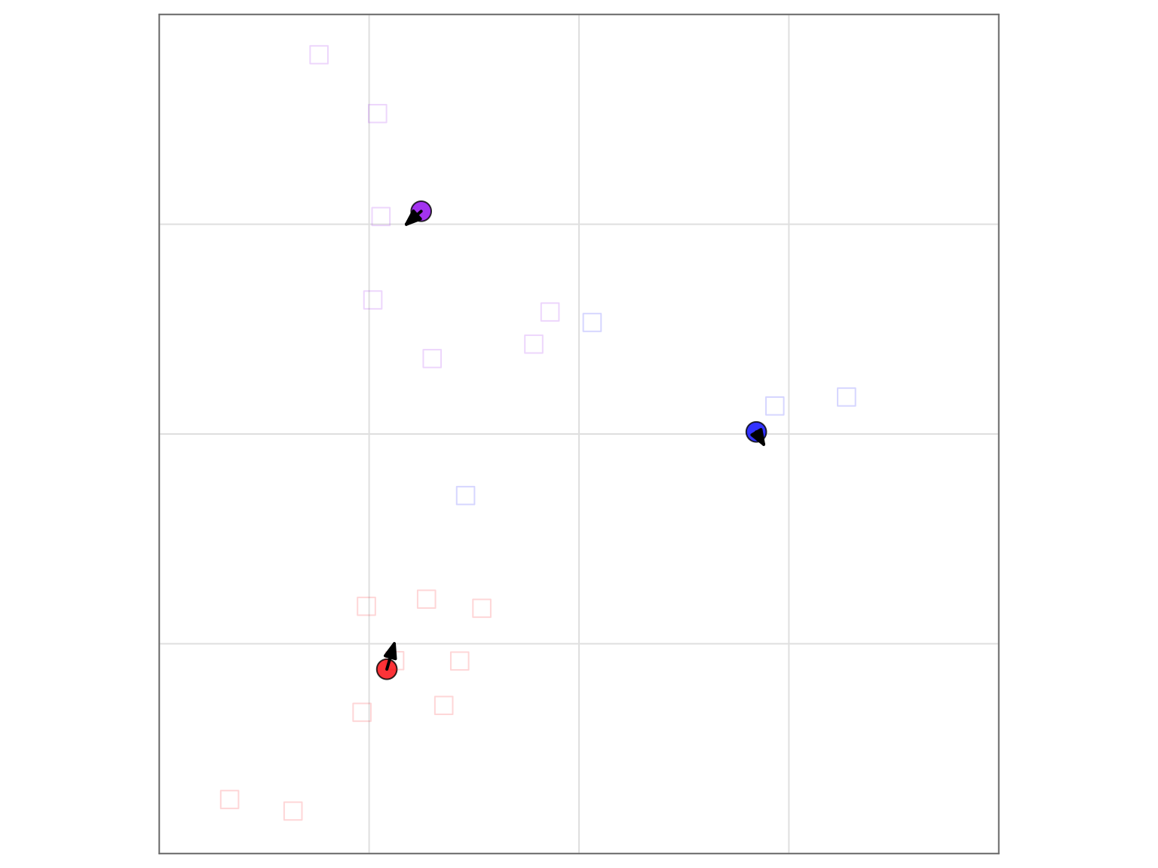
Maps from noisy data
Assumption: measured titer against antigen i in serum s varies from true population titer because of individual reactivity differences and random noise
𝑙𝑜𝑔𝑡𝑖𝑡𝑒𝑟_{𝑖,𝑠}=𝑠𝑟𝐺𝑟𝑜𝑢𝑝𝐺𝑀𝑇_{𝑖,𝑆}+𝑠𝑒𝑟𝑢𝑚𝐸𝑓𝑓𝑒𝑐𝑡_{𝑠}+𝑛𝑜𝑖𝑠𝑒_{𝑖,𝑠}
18.64|0.21[0.45]
Procrustes (arrows) point to position in map without added noise

Slide 16
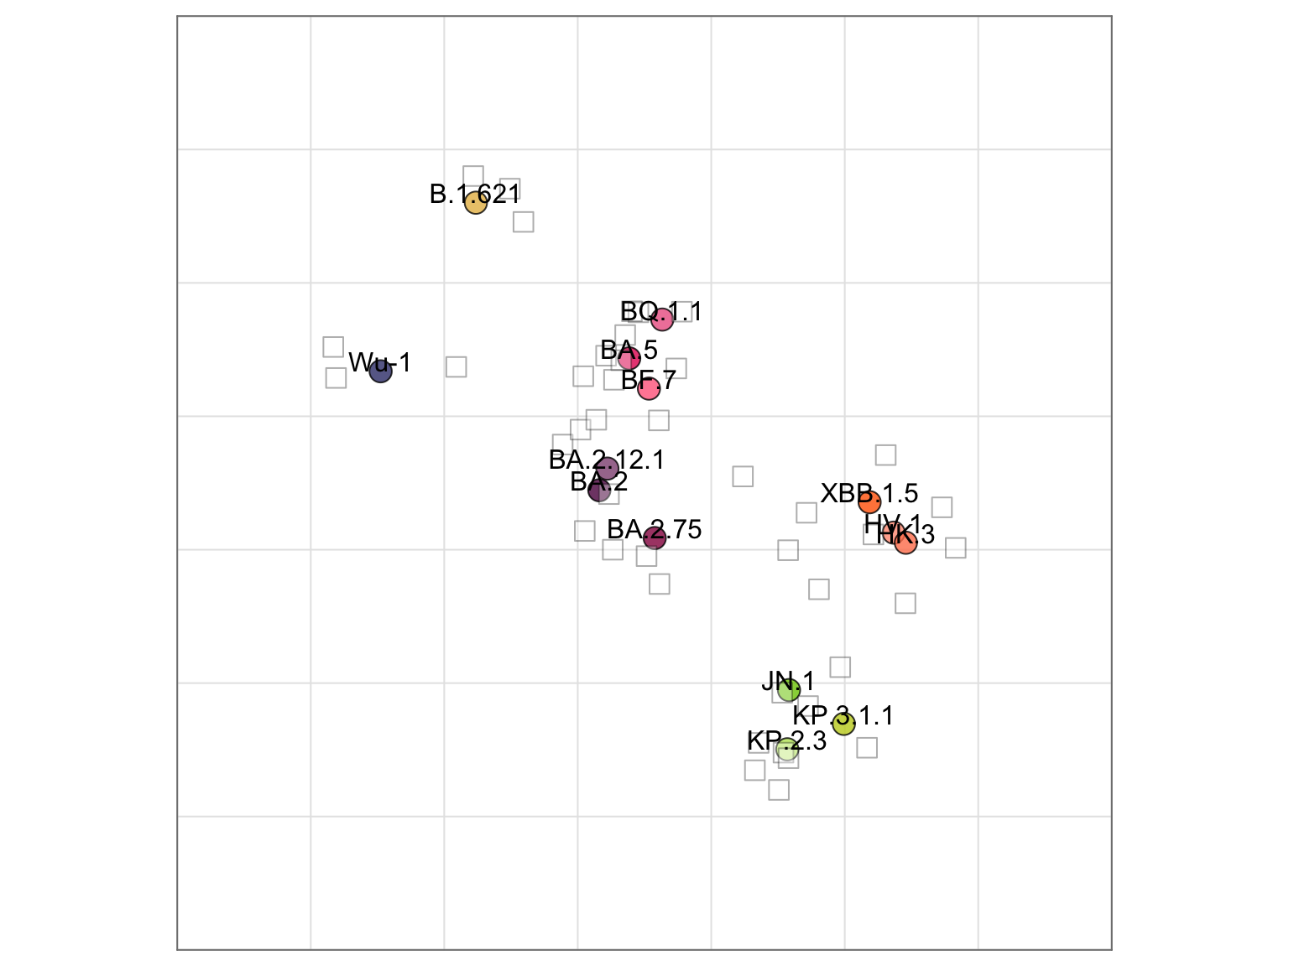
SARS-CoV-2 map from simulated data
Exercise: colouring by amino acid sequence

