Slide 1
Antigenic Cartography Workshop – Map Diagnostics
ESFLU Training School, October 6-8, 2025
Antonia Netzl (she/her) an604@cam.ac.uk
Sarah James (she/her) slj38@cam.ac.uk
Sam Turner (he/him) sat65@cam.ac.uk
Sina Türeli (he/him) st757@cam.ac.uk
Derek Smith (he/him) djs200@cam.ac.uk
Centre for Pathogen Evolution, University of Cambridge, UK

Slide 2
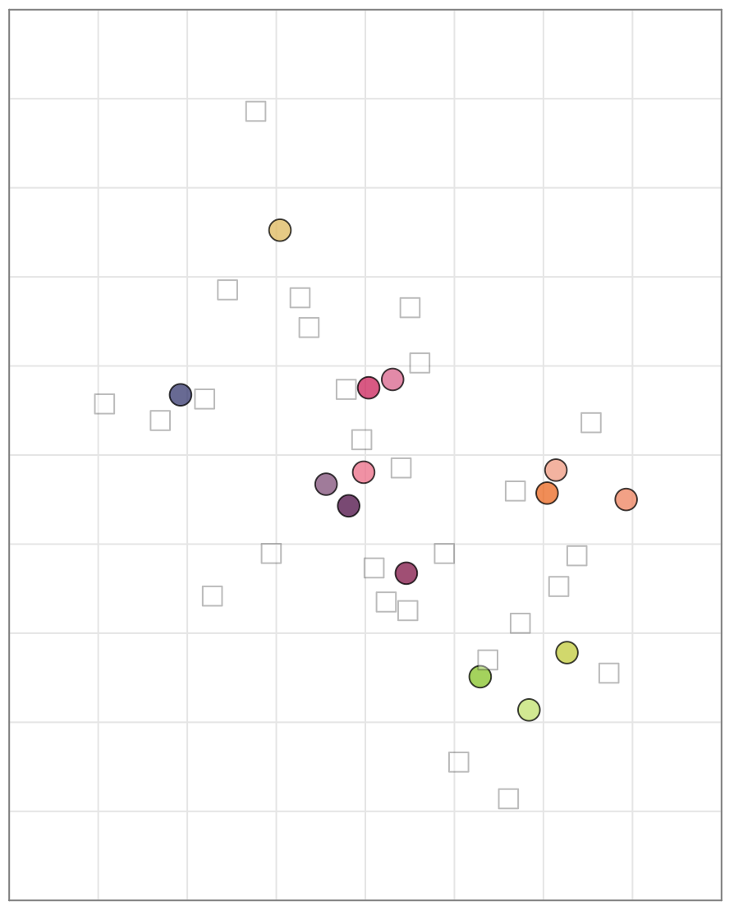
Visualizing model fit
Measured
 | SR: Wu1 | SR: BA.1 | …
Wu1 | 160 | 160 | …
BA.2 | 40 | 80 | …
BA.5 | 80 | 320 | …
… | … | …
Wu1
BA.5
BA.2

Slide 3
Visualizing model fit
Measured
 | SR: Wu1 | SR: BA.1 | …
Wu1 | 160 | 160 | …
BA.2 | 40 | 80 | …
BA.5 | 80 | 320 | …
… | … | …
Wu1
BA.5
BA.2
 | SR: Wu1 | SR: BA.1 | …
Wu1 | 158 | 134 | …
BA.2 | 54 | 79 | …
BA.5 | 98 | 345 | …
… | … | …
Reconstructed

Slide 4
Visualizing model fit
Measured
 | SR: Wu1 | SR: BA.1 | …
Wu1 | 160 | 160 | …
BA.2 | 40 | 80 | …
BA.5 | 80 | 320 | …
… | … | …
Wu1
BA.5
(steal max in column data values)
BA.2
 | SR: Wu1 | SR: BA.1 | …
Wu1 | 158 | 134 | …
BA.2 | 54 | 79 | …
BA.5 | 98 | 345 | …
… | … | …
Reconstructed

Slide 5
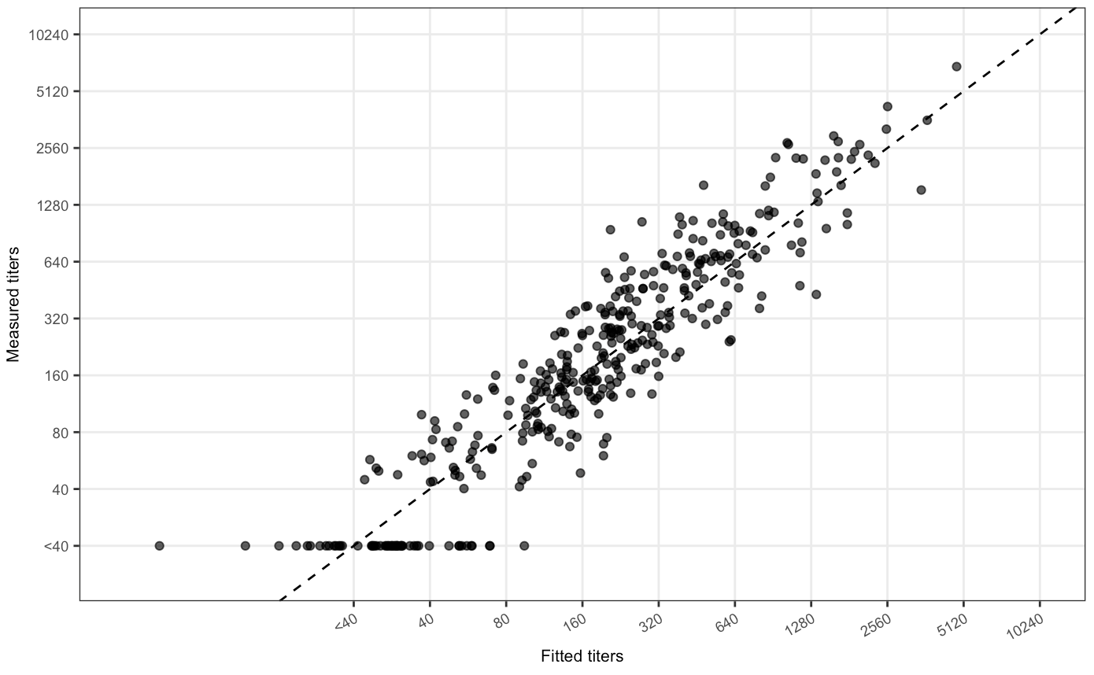
Visualizing model fit
Measured
 | SR: Wu1 | SR: BA.1 | …
Wu1 | 160 | 160 | …
BA.2 | 40 | 80 | …
BA.5 | 80 | 320 | …
… | … | …
Measured titers
 | SR: Wu1 | SR: BA.1 | …
Wu1 | 158 | 134 | …
BA.2 | 54 | 79 | …
BA.5 | 98 | 345 | …
… | … | …
Reconstructed
Fitted (reconstructed) titers

Slide 6
Visualizing model fit
stress ~ sum of squared residuals
Measured titers
Fitted (reconstructed) titers

Slide 7
Cross validation error
Measured
 | SR: Wu1 | SR: BA.1 | …
Wu1 | 160 | 160 | …
BA.2 | 40 | 80 | …
BA.5 | 80 | 320 | …
… | … | …
Wu1
BA.5
(steal max in column data values)
BA.2
 | SR: Wu1 | SR: BA.1 | …
Wu1 | 158 | 134 | …
BA.2 | 54 | 79 | …
BA.5 | 98 | 345 | …
… | … | …
Reconstructed

Slide 8
Cross validation error
Measured
 | SR: Wu1 | SR: BA.1 | …
Wu1 | 160 | 160 | …
BA.2 | 40 | X | …
BA.5 | 80 | 320 | …
… | … | …
Wu1
BA.5
(steal max in column data values)
BA.2
 | SR: Wu1 | SR: BA.1 | …
Wu1 | 158 | 134 | …
BA.2 | 54 | 72 | …
BA.5 | 98 | 345 | …
… | … | …
Reconstructed

Slide 9
Cross validation error
Measured
 | SR: Wu1 | SR: BA.1 | …
Wu1 | 160 | 160 | …
BA.2 | 40 | X | …
BA.5 | 80 | 320 | …
… | … | …
Wu1
BA.5
(steal max in column data values)
BA.2
 | SR: Wu1 | SR: BA.1 | …
Wu1 | 158 | 134 | …
BA.2 | 54 | 72 | …
BA.5 | 98 | 345 | …
… | … | …
Reconstructed
We know X = 80, so CV error is 80-72 = 8
(but really we work in log space, so CV error is 0.15)

Slide 10
Cross validation error
Measured
 | SR: Wu1 | SR: BA.1 | …
Wu1 | 160 | 160 | …
BA.2 | 40 | X | …
BA.5 | 80 | 320 | …
… | … | …
Wu1
BA.5
(steal max in column data values)
BA.2
 | SR: Wu1 | SR: BA.1 | …
Wu1 | 158 | 134 | …
BA.2 | 54 | 72 | …
BA.5 | 98 | 345 | …
… | … | …
Reconstructed
We know X = 80, so CV error is 80-72 = 8
Test more than 1 value each time
Repeat many cycles
(but really we work in log space, so CV error is 0.15)

Slide 11
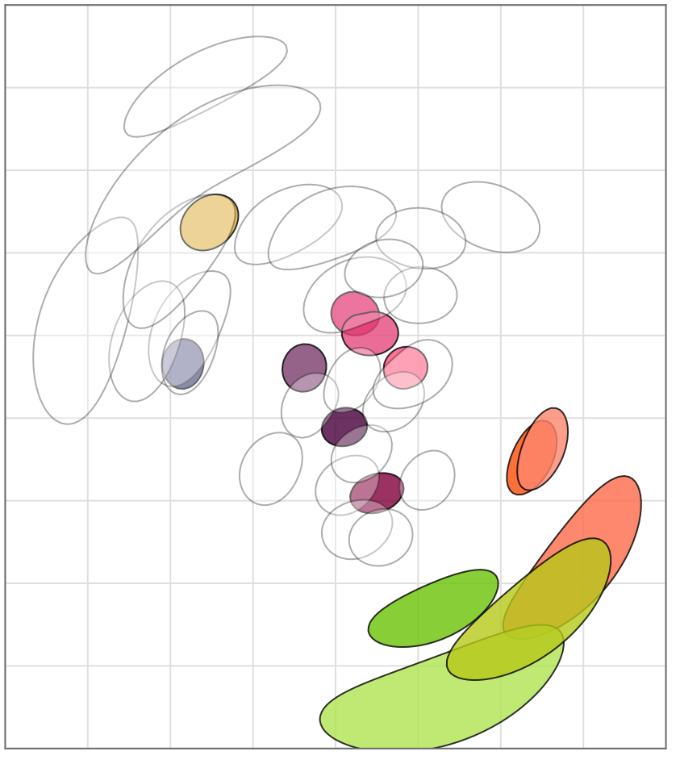
Map uncertainty
Triangulation
Noise in titers
Choice of antigens and sera to titrate

Slide 12
Triangulation
Triangulation
Noise in titers
Choice of antigens and sera to titrate
stress = 100

Slide 13
Triangulation
Triangulation
Noise in titers
Choice of antigens and sera to titrate
stress = 100
stress < 101

Slide 14
Titer uncertainty
Titers are noisy / uncertain, so antigenic positions are too!
Triangulation
Noise in titers
Choice of antigens and sera to titrate

Slide 15
Titer uncertainty
(2) Make maps
 | SR: Wu1 | SR: BA.1
Wu1 | 157 | 177
BA.2 | 22 | 109
BA.5 | 77 | 363
… | … | …
(1) Add normally-distributed noise
(3) Summarise distribution of positions
 | SR: Wu1 | SR: BA.1
Wu1 | 160 | 160
BA.2 | 40 | 80
BA.5 | 80 | 320
… | … | …
 | SR: Wu1 | SR: BA.1
Wu1 | 155 | 167
BA.2 | 49 | 97
BA.5 | 67 | 298
… | … | …
Estimate of per-titer variation from repeat data
 | SR: Wu1 | SR: BA.1
Wu1 | 150 | 155
BA.2 | 33 | 86
BA.5 | 65 | 270
… | … | …

Slide 16
Choice of titrations
Titrating a different subset of the antigens and sera against each other would result in a different map
Triangulation
Noise in titers
Choice of antigens and sera to titrate
 | SR: Wu1 | SR: BA.2 | SR: BA.5
Wu1 | 160 | 160 | 160
BA.2 | 40 | 80 | 80
BA.5 | 80 | 320 | 320
… | … | … | …
 | SR: Wu1 | SR: BA.2 | SR: BA.5
Wu1 | 160 | 160 | 160
BA.2 | 40 | 80 | 80
BA.5 | 80 | 320 | 320
… | … | … | …

Slide 17
Choice of titrations
(2) Make maps
(1) Randomly censor titers, and resample antigens and sera
 | SR: Wu1 | SR: BA.1
Wu1 | 157 | 177
BA.2 | 22 | 109
BA.5 | 77 | 363
… | … | …
(3) Summarise distribution of positions
 | SR: Wu1 | SR: BA.1
Wu1 | 160 | 160
BA.2 | 40 | 80
BA.5 | 80 | 320
… | … | …
 | SR: Wu1 | SR: BA.1
Wu1 | 155 | 167
BA.2 | 49 | 97
BA.5 | 67 | 298
… | … | …
 | SR: Wu1 | SR: BA.1
Wu1 | 150 | 155
BA.2 | 33 | 86
BA.5 | 65 | 270
… | … | …

