Slide 1
Antigenic Cartography Workshop – Antibody Landscapes
ESFLU Training School, October 6-8, 2025
Antonia Netzl (she/her) an604@cam.ac.uk
Sarah James (she/her) slj38@cam.ac.uk
Sam Turner (he/him) sat65@cam.ac.uk
Sina Türeli (he/him) st757@cam.ac.uk
Derek Smith (he/him) djs200@cam.ac.uk
Centre for Pathogen Evolution, University of Cambridge, UK

Slide 2
Overview
Motivation
Fitting antibody landscapes
Cone fit vs. loess fit
Predicting titers with antibody landscapes
Styling antibody landscapes
Evaluating antibody landscapes

Slide 3
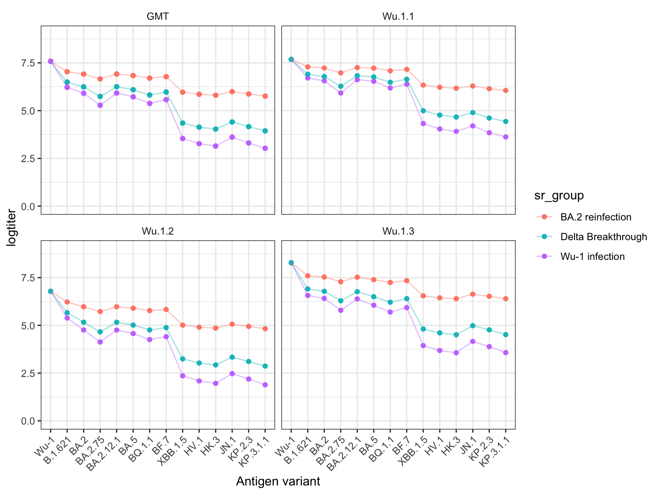
Motivation: Maps from multi exposure sera
Same sera, distinct exposure
Histories simulated
How would map change?
What sera to put together in the map?
What do we want to map with this input data?

Slide 4
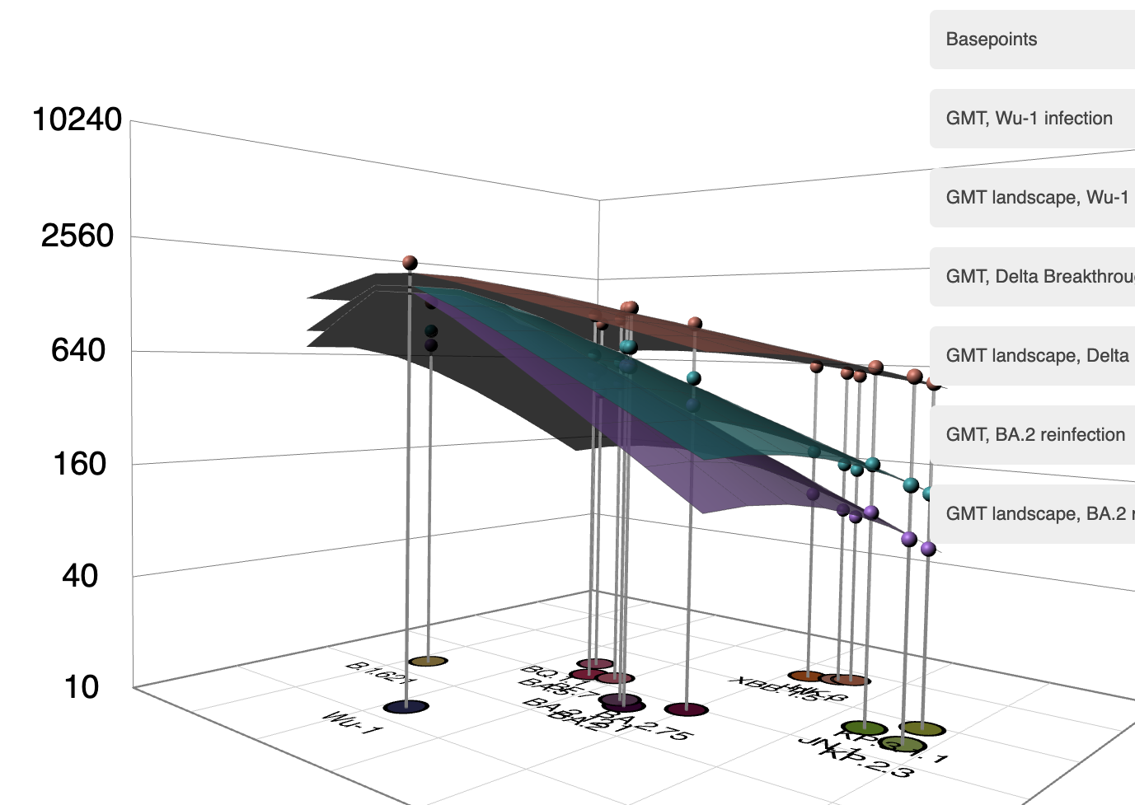
Antibody landscapes: Modelling immunity across antigenic space
Immunity as a function of antigenic distance

Slide 5
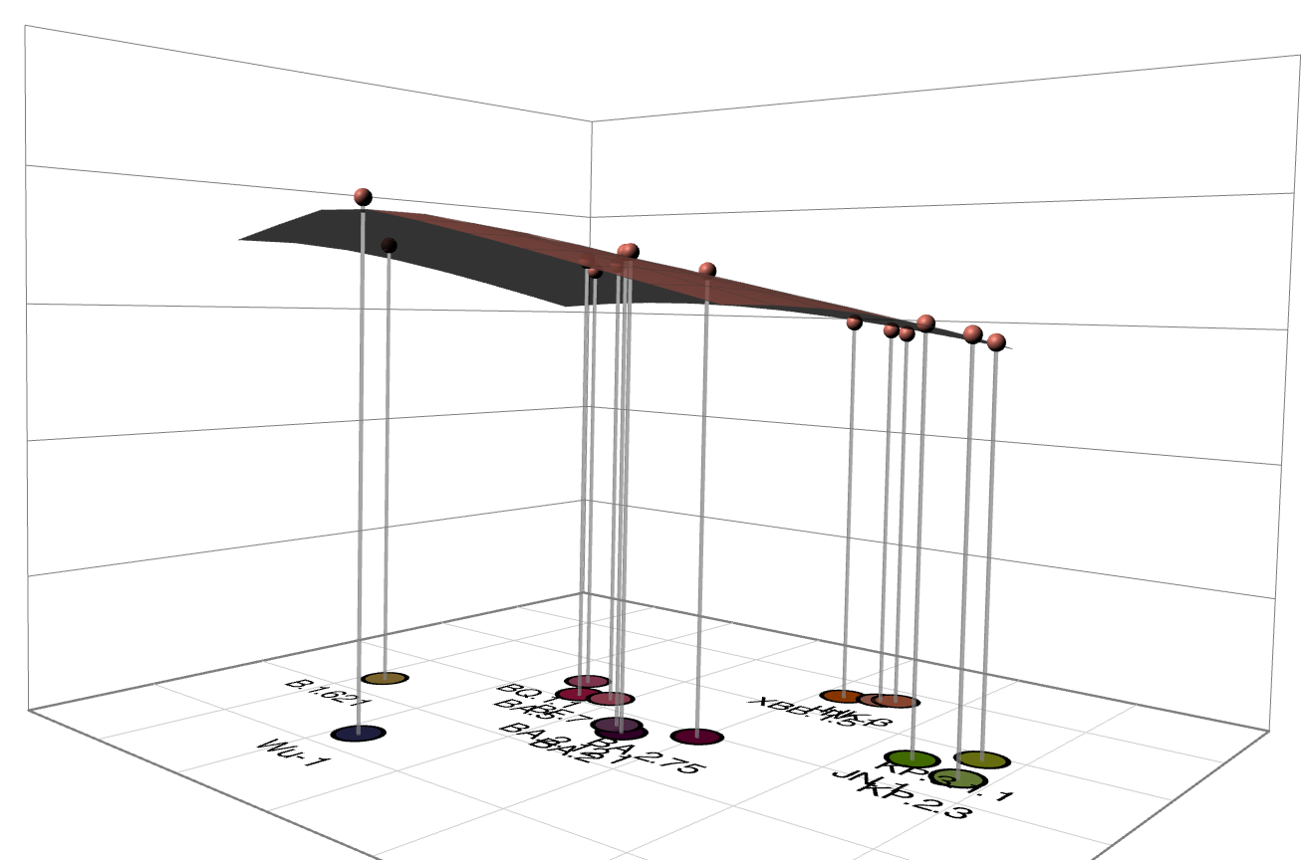
Single cone landscape
Immunity distributes across antigenic space like a single cone

Slide 6
Single cone landscape
Immunity distributes across antigenic space like a single cone
Fit: cone height, cone x,y coordinates, cone slope
Cone slope (1/antigenic distance unit)
Cone height
X,y coords

Slide 7
Single cone landscape
Immunity distributes across antigenic space like a single cone
Fit: cone height, cone x,y coordinates, cone slope
Cone slope (1/antigenic distance unit)
Cone height
Cone x,y coords

Slide 8

Single cone landscape
Immunity distributes across antigenic space like a single cone
Fit: cone height, cone x,y coordinates, cone slope
f(x) = d – k x x
Logtiter(x1, y1) = cone_height – cone_slope x point_dist(x1, y1)
point_dist(x1, y1) = antigenic distance =
$\sqrt{{\left(x_{cone}−x_{1}\right)}^{2}+{\left(y_{cone}−y_{1}\right)}^{2}}$ =
Cone slope (1/antigenic distance unit)
Cone height
Cone x,y coords

Slide 9
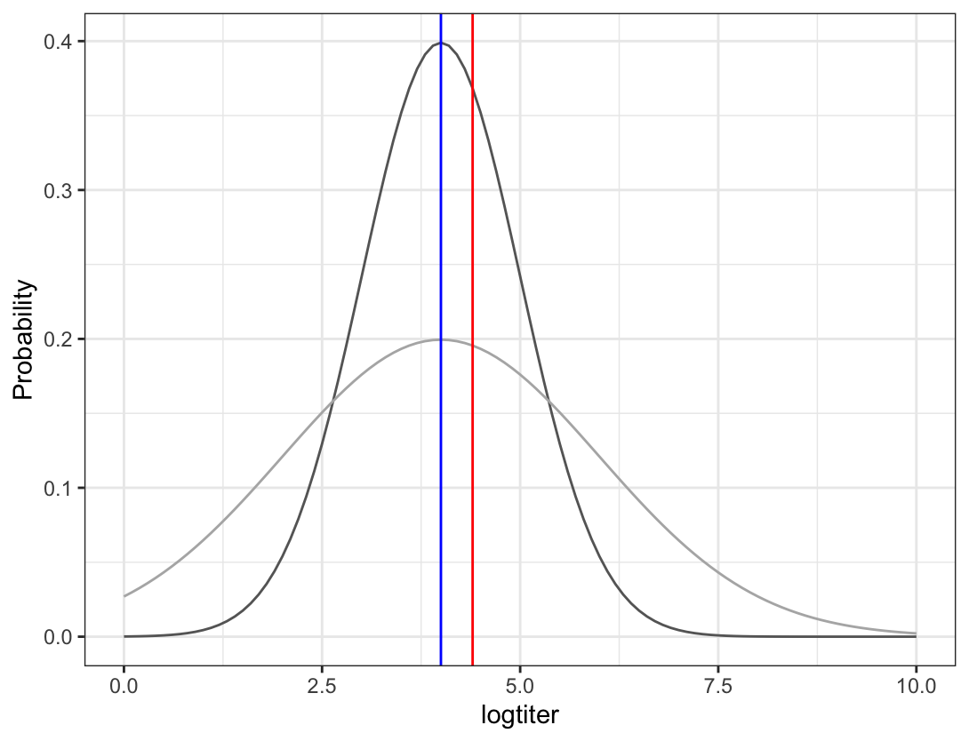
Parameter optimization
Optimize parameters such that likelihood to obtain measured value with the given parameter set is maximized
Likelihood modelled as normal distribution with
Mean = fitted value
SD = user input (the wider, the more likely large difference between fitted and measured value)
→ How likely is measuring the input logtiter when the expected value is the fitted logtiter?
Fitted
logtiter
Measured logtiter
SD = 1
SD = 2

Slide 10
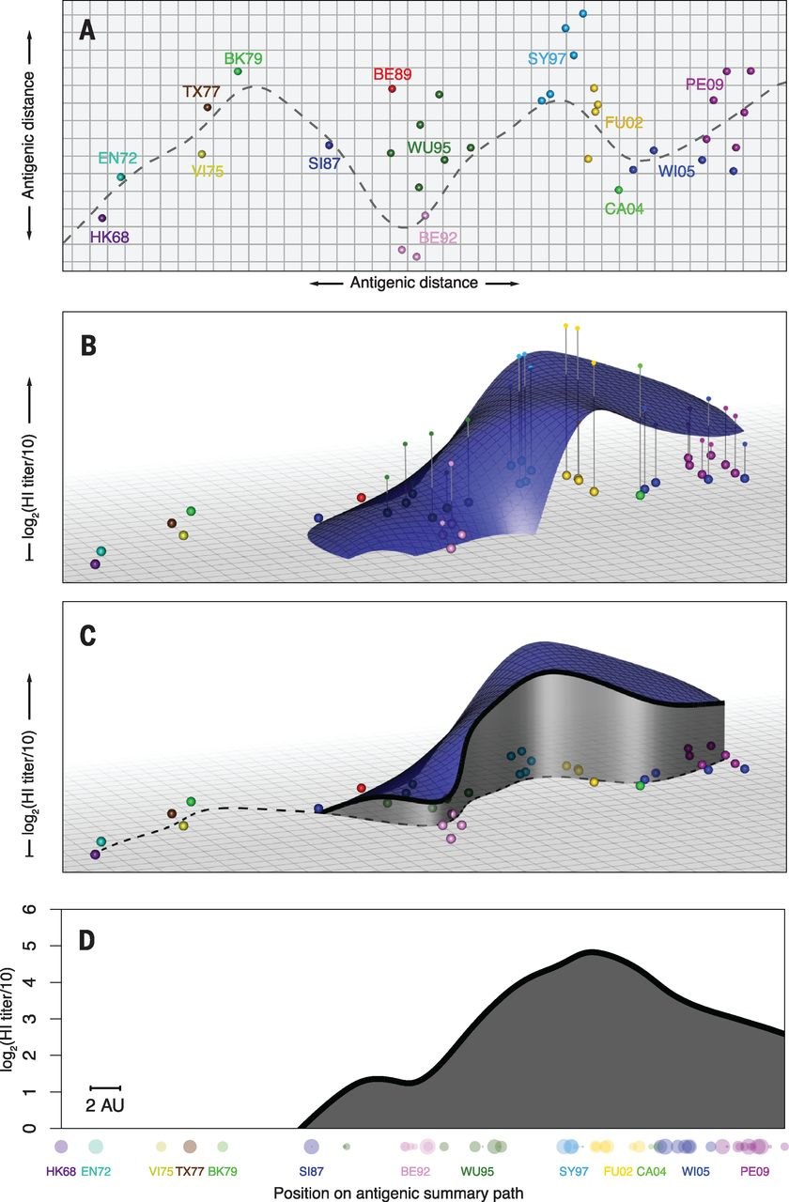
LO(W)ESS fit: locally (weighted) estimated scatterplot smoothing
Immunity distributes across antigenic space in hills and valleys
Figure from Fonville et al. 2014 https://doi.org/10.1126/science.1256427

Slide 11
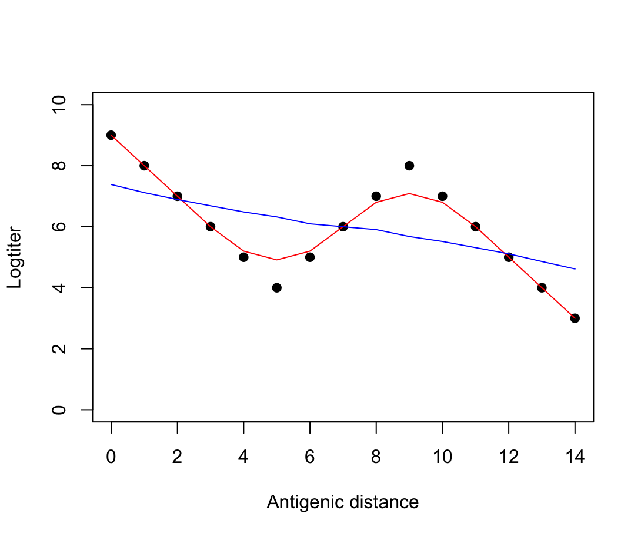
LO(W)ESS
Fit local polynomial regression
Degree of polynomial (here 1)
Span (bandwidth) = How many points to include in local regression, often fraction of data points (larger span → more points included)
Points in the center are weighted more
Span = 0.5
Span = 1

