Slide 1
Antigenic Cartography Workshop
NIAID CEIRR Training Program, July 9-10, 2025
Antonia Netzl (she/her) an604@cam.ac.uk
Sam Turner (he/him) sat65@cam.ac.uk
Sina Türeli (he/him) st757@cam.ac.uk
Derek Smith (he/him) djs200@cam.ac.uk
Centre for Pathogen Evolution, University of Cambridge, UK

Slide 2
Agenda
Wednesday, July 9, 2025
8:30 - 9:00 | Registration, helping with software installation
9:00 – 10:10 | Theoretical introduction to antigenic cartography
10:10 – 10:30 | Coffee break, helping with software installation
10:30 – 12:00 | Practical session: Map construction
 | Constructing an antigenic map from a titer table Map styling Interpreting the antigenic map Interactive Tool: Racmacs Viewer
The morning session should contain enough information to create your own map from your data and give it a first assessment
12:00 – 13:00 | Lunch
13:00 – 14:30 | Practical Session: Map Diagnostics
 | Evaluating map distances vs. titer distances Investigating map stability Map cross-validation Map dimensionality
14:30 – 15:00 | Coffee break
15:00 – 16:30 | Practical session: Troubleshooting
 | Recognizing common data issues and how they are reflected in antigenic maps Approaches to address these challenges
Official end Day 1, but workshop organizers will be available for discussing questions and data
Thursday, July 10, 2025
9:00 – 10:30 | Practical session: Antibody Landscapes
 | Antibody landscapes to model complex exposure histories Antibody landscape construction Landscape plotting Landscape evaluation
10:30 – 11:00 | Coffee break
11:00 – 12:30 | Data clinic
 | Work on your own data or try practical examples with provided data with support from the workshop organizers

Slide 3
Introduction to antigenic cartography
Notes:
Describe what group has been rsearching: The evolution of viruses, can we predict it? and how this is connected to immunity. Immunity against evolving viruses
improving our understanding and ability to predict pathogen evolution in humans and other animals, provides support to the World Health Organization (WHO) influenza vaccine strain selection process, to the NIH SARS-CoV-2 Assessment of Viral Evolution (SAVE) and develop and distribute free high-quality software.

Slide 4
Overview
Understanding influenza evolution with the help of antigenic cartography
Antigenic change in SARS-CoV-2
Mapping complex exposure histories with antibody landscapes
Population immunity and SARS-CoV-2 variant vaccines

Slide 5

Centre for Pathogen Evolution University of Cambridge
Is virus evolution predictable?
Computational methods
Experimental design
Influenza
Since 2020 SARS-CoV-2
Prof. Derek Smith
Notes:
Centre for Pathogen Evolution, Dept of Zoology, Cambridge
Basic science
Methodolgy
Vaccine design
Influenza
Since 2020 SARS-CoV-2

Slide 6
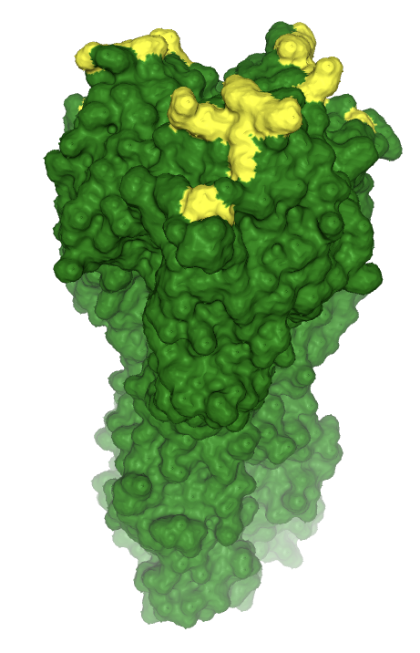
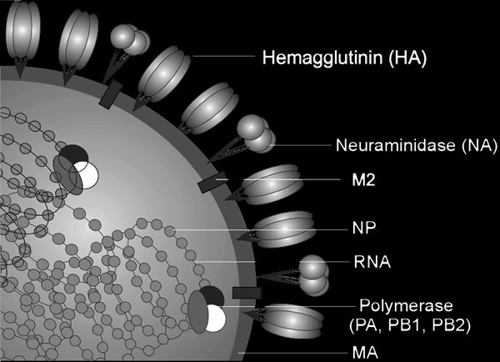
Influenza virus
Influenza A causes seasonal epidemics
Segmented (-)RNA genome
Mutations on HA surface protein

Slide 7
Subtypes of influenza A
Antigenic drift
Spanish flu
(H1N1)
Asian flu
(H2N2)
HongKong flu
(H3N2)
1918
1957
1968
Antigenic shift
Antigenic shift
Notes:
Antigenic shift (subtypes)
Antigenic drift -> repeated vaccination. Not like measles

Slide 8
Subtypes of influenza A
WHO Surveillance
Epidemilogical
Genetic
Antigenic
Spanish flu
(H1N1)
Asian flu
(H2N2)
HongKong flu
(H3N2)
1918
1957
1968

Slide 9

Antigenic data
Ab
1:2
1:2
1:2
Virus
Neut
X

Slide 10
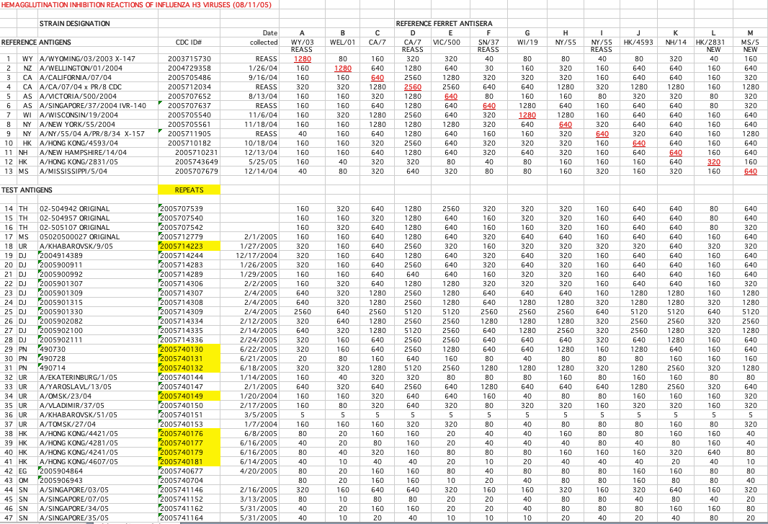
Antigenic data
Ab
1:2
1:2
1:2
Virus
Neut
X

Slide 11
Antigenic data
Ab
1:2
1:2
1:2
Difficult to interpet → antigenic cartography as geometric interpretation
Virus
Neut
X

Slide 12
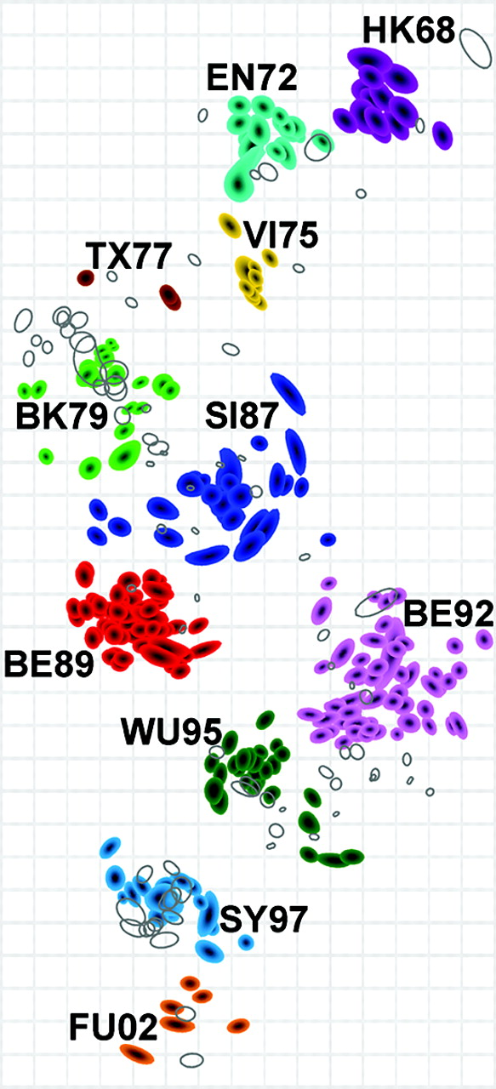
Antigenic cartography visualizes multi-dimensional titer data in lower dimensions
Antigenic map of influenza H3N2 from 1968 – 2002 by Smith et al Science 305, 371-376, 2004
Notes:
In this antigenic map the coloured shapes are viruses, the unfilled shapes antibodies (antisera). The blob-like shape of a point indicates a 2-dimensional confidence interval in the positioning of the point. The name of each antigenic cluster is composed of two letters indicating the part of the world that the vaccine strain used in the cluster was isolated (HongKong, England, Victoria Australia, Texas, Bangkok, Sichuan, Bejing, Beijing, Wuhan, Sydney, Fujian; and the year that cluster first emerged.

Slide 13
From titers to a map
 | Antigen 1 | Antigen 2 | Antigen 3 | Antigen 4
Titer | 160 | 40 | 80 | 40
Log2(Titer/10) | 4 | 2 | 3 | 2
Log2(maxTiter/10) – Log2(Titer/10) | 4 - 4 = 0 | 4 -2 = 2 | 4 – 3 = 1 | 4 -2 = 2
Fold change (FC) from max titer | 160/160 = 1 | 160/40 = 4 | 160/80 = 2 | 160/40 = 4
Log2(FC) | 0 | 2 | 1 | 2
Difference of titers = fold change
Log2(fold change) = antigenic distance
→ Geometric interpretation of neutralization titers
Serum
Antigen

Slide 14
From titers to a map
 | Antigen 1 | Antigen 2 | Antigen 3 | Antigen 4
Titer | 160 | 40 | 80 | 40
Log2(Titer/10) | 4 | 2 | 3 | 2
Log2(maxTiter/10) – Log2(Titer/10) | 4 - 4 = 0 | 4 -2 = 2 | 4 – 3 = 1 | 4 -2 = 2
Fold change (FC) from max titer | 160/160 = 1 | 160/40 = 4 | 160/80 = 2 | 160/40 = 4
Log2(FC) | 0 | 2 | 1 | 2
Serum
Antigen

Slide 15
From titers to a map
 | Antigen 1 | Antigen 2 | Antigen 3 | Antigen 4
Titer | 160 | 40 | 80 | 40
Log2(Titer/10) | 4 | 2 | 3 | 2
Log2(maxTiter/10) – Log2(Titer/10) | 4 - 4 = 0 | 4 -2 = 2 | 4 – 3 = 1 | 4 -2 = 2
Fold change (FC) from max titer | 160/160 = 1 | 160/40 = 4 | 160/80 = 2 | 160/40 = 4
Log2(FC) | 0 | 2 | 1 | 2
Serum
Antigen
2

Slide 16
From titers to a map
 | Antigen 1 | Antigen 2 | Antigen 3 | Antigen 4
Titer | 160 | 40 | 80 | 40
Log2(Titer/10) | 4 | 2 | 3 | 2
Log2(maxTiter/10) – Log2(Titer/10) | 4 - 4 = 0 | 4 -2 = 2 | 4 – 3 = 1 | 4 -2 = 2
Fold change (FC) from max titer | 160/160 = 1 | 160/40 = 4 | 160/80 = 2 | 160/40 = 4
Log2(FC) | 0 | 2 | 1 | 2
1
1
Serum
Antigen
2

Slide 17
From titers to a map
 | Antigen 1 | Antigen 2 | Antigen 3 | Antigen 4
Titer | 160 | 40 | 80 | 40
Log2(Titer/10) | 4 | 2 | 3 | 2
Log2(maxTiter/10) – Log2(Titer/10) | 4 - 4 = 0 | 4 -2 = 2 | 4 – 3 = 1 | 4 -2 = 2
Fold change (FC) from max titer | 160/160 = 1 | 160/40 = 4 | 160/80 = 2 | 160/40 = 4
Log2(FC) | 0 | 2 | 1 | 2
1
1
Serum
Antigen
2

Slide 18
From titers to a map
 | Serum 1 | Serum 2
Antigen 1 | 160 | 160
Antigen 2 | 40 | 80
Antigen 3 | 80 | 320
Antigen 4 | 40 | 160
 | Serum 1 | Serum 2
Antigen 1 | 0 | 1
Antigen 2 | 2 | 2
Antigen 3 | 1 | 0
Antigen 4 | 2 | 1
1
1
Serum
Antigen

Slide 19
From titers to a map
 | Serum 1 | Serum 2
Antigen 1 | 160 | 160
Antigen 2 | 40 | 80
Antigen 3 | 80 | 320
Antigen 4 | 40 | 160
 | Serum 1 | Serum 2
Antigen 1 | 0 | 1
Antigen 2 | 2 | 2
Antigen 3 | 1 | 0
Antigen 4 | 2 | 1
1
1
2
2
Serum
Antigen

Slide 20
From titers to a map
 | Serum 1 | Serum 2 | … | Serum n
Antigen 1 | Titer_{1,1} | Titer_{1,2} | … | Titer_{1,n}
Antigen 2 | Titer_{2,1} | Titer_{2,2} | … | Titer_{2,n}
… | … | … | … | …
Antigen i | Titer_{i,1} | Titer_{i,2} | … | Titer_{i,n}
Log2 transform
calculate distances
Table with target distances D
Optimize map distances d for each serum, antigen pair
Minimize map stress
Where D = log2(maxTiter/LOD) for titers below the limit of detection (LOD) and d>D without penalty
s = $\sum_{i,n}{}$(D_{i,n} – d_{i,n})²
Antigenic map
2

Slide 21
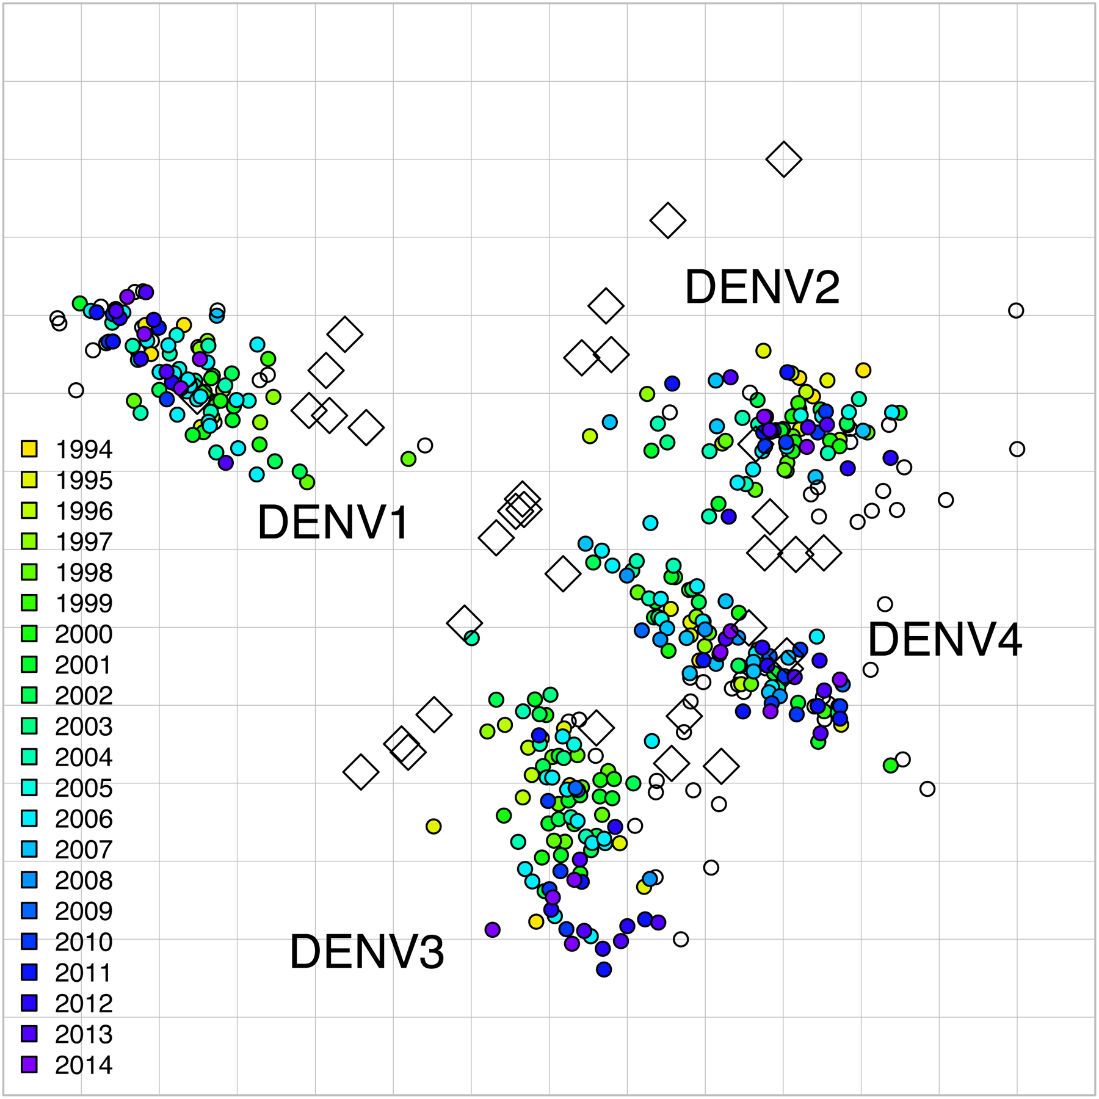
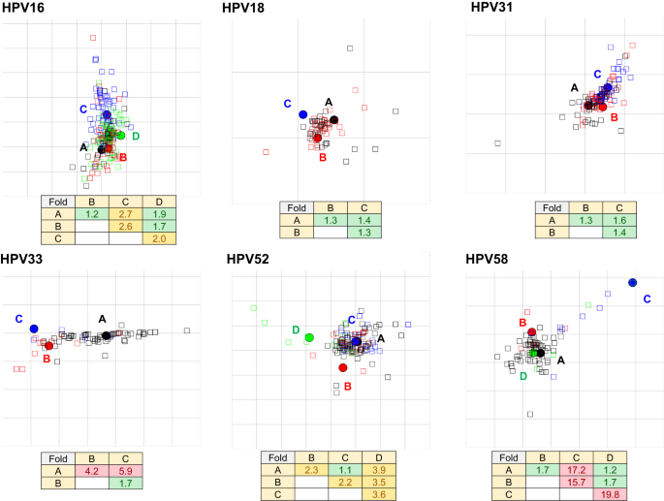
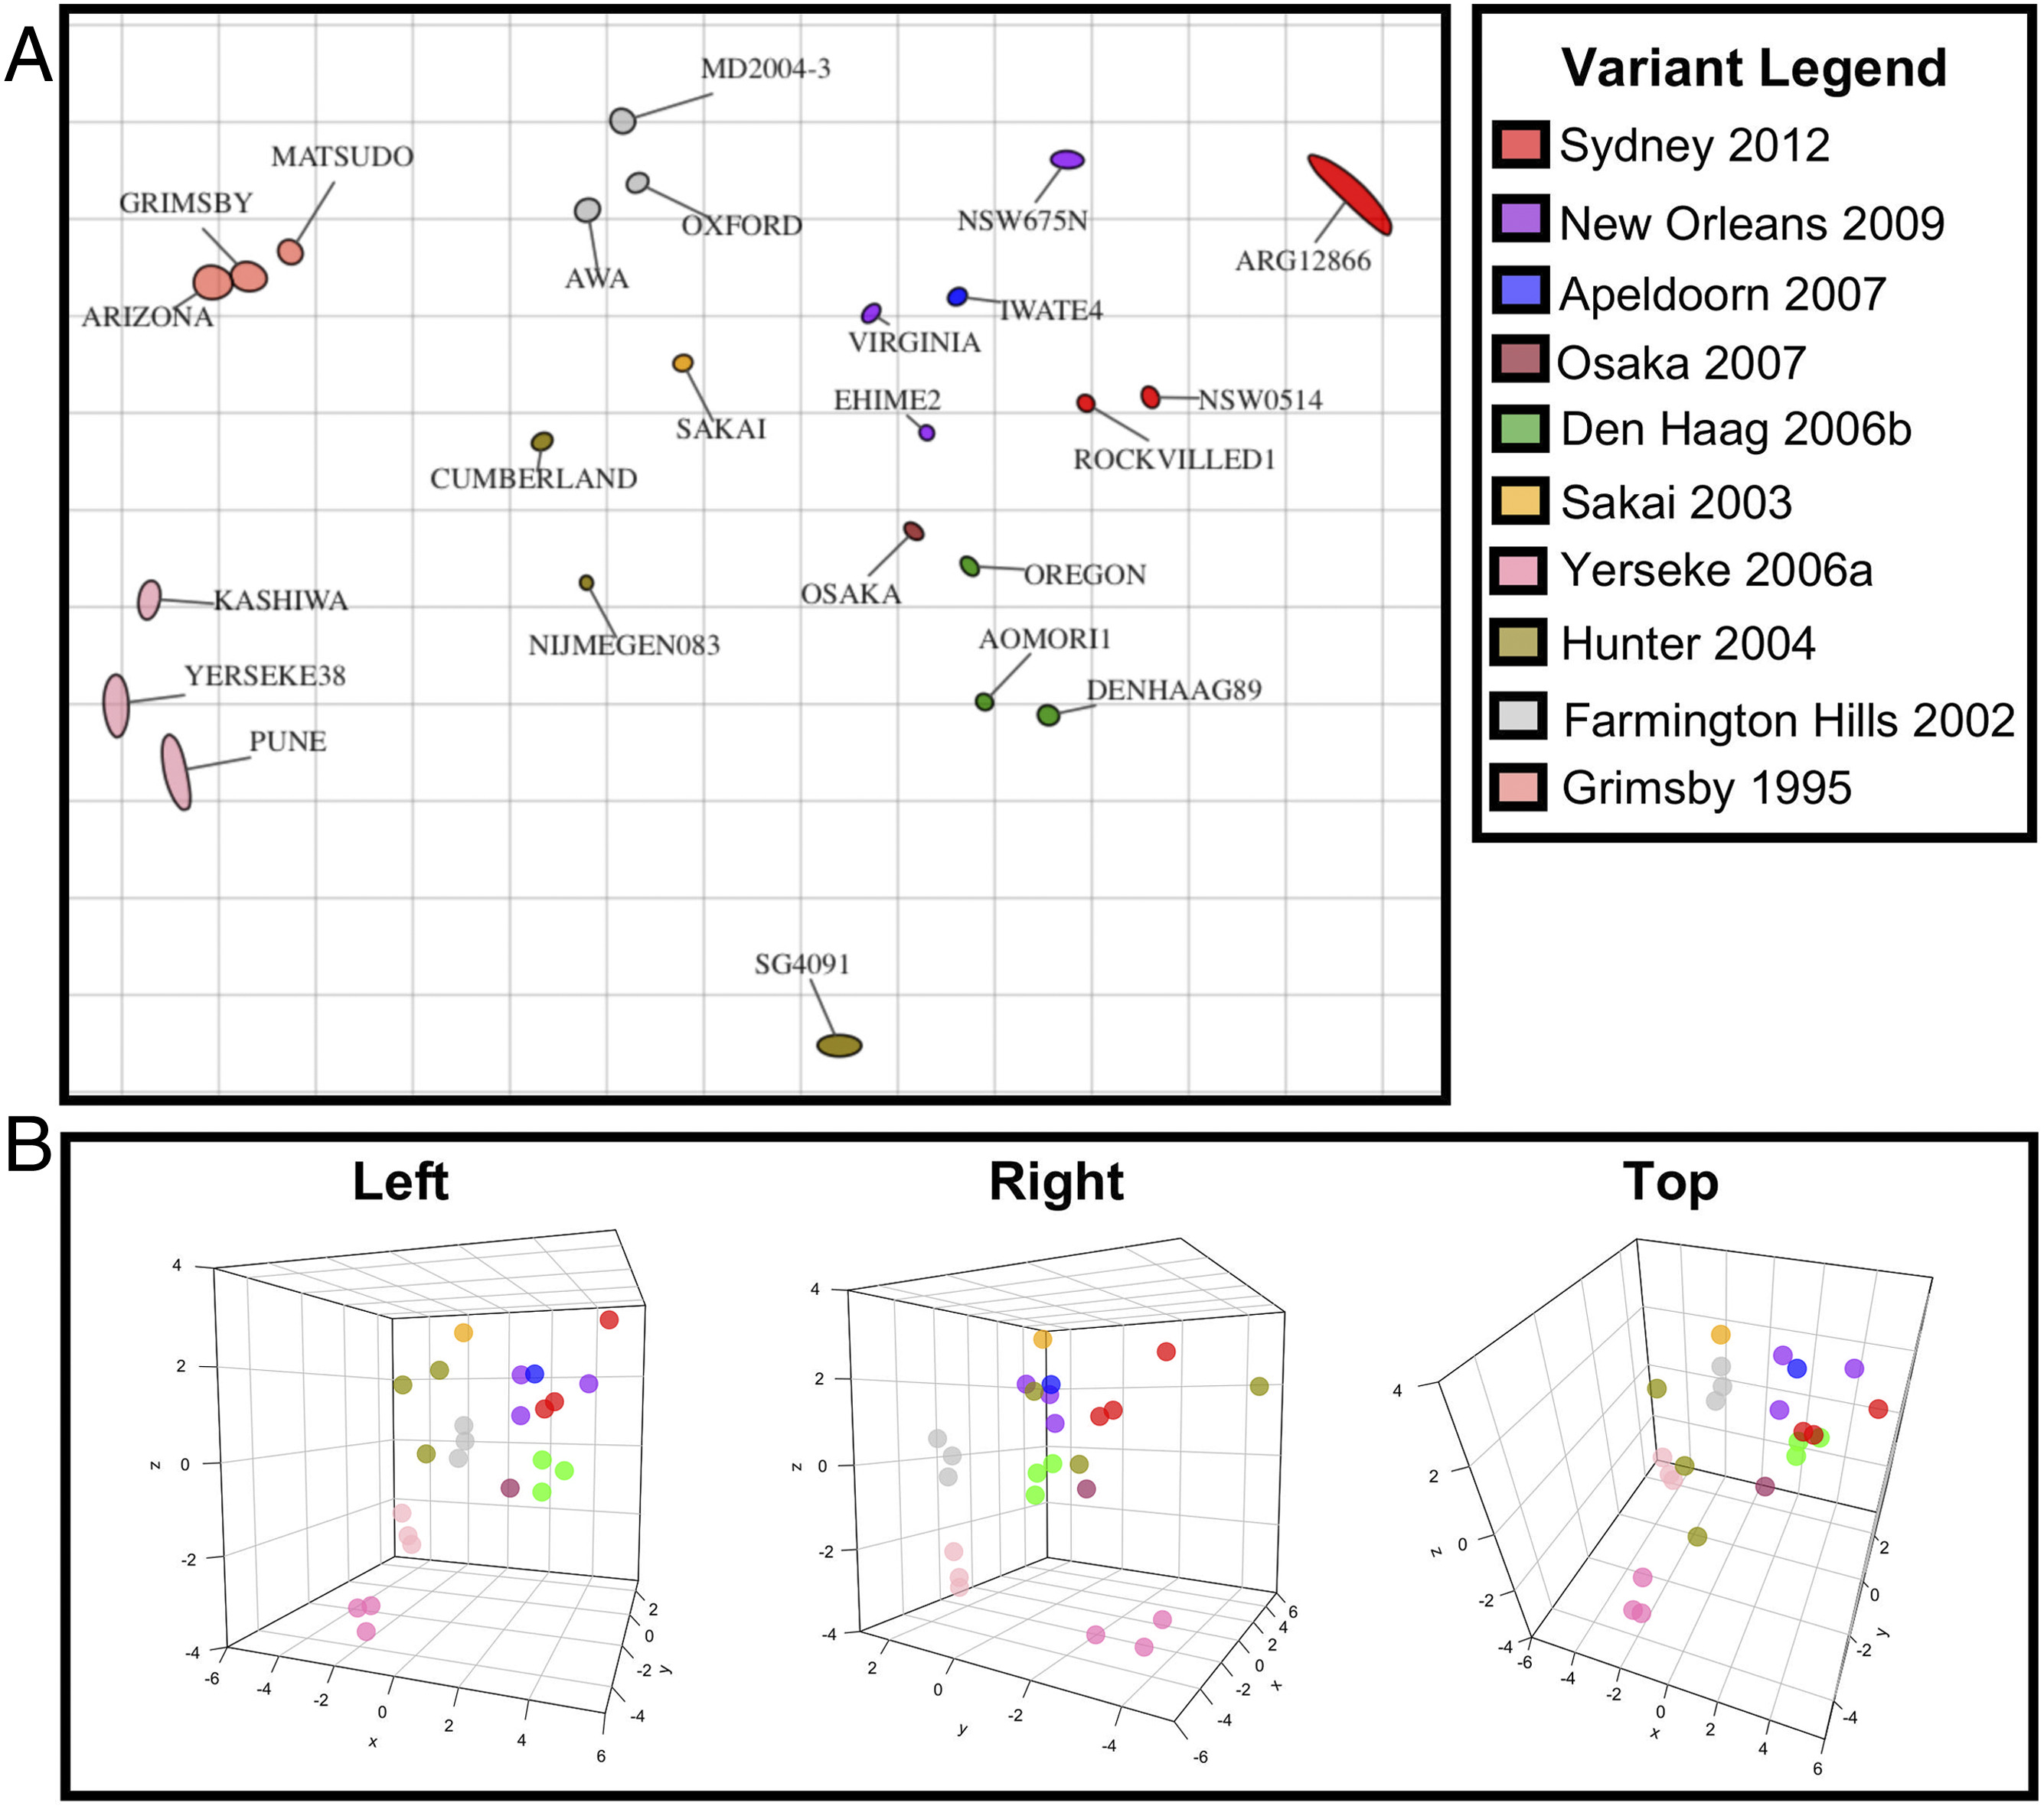
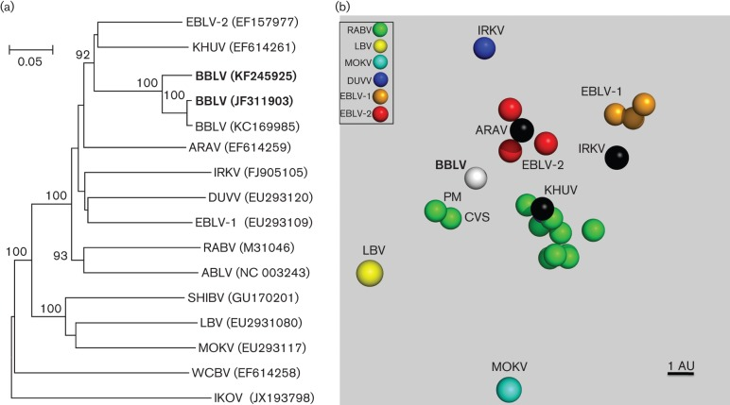
Antigenic cartography of other viruses
Dengue virus by Katzelnick, et al. 2021
doi: 10.1126/science.abk0058
HPV by Kamuyu, et al. 2024 https://doi.org/10.1038/s41467-024-45807-w
Norovirus by Kendra et al. 2021
https://doi.org/10.1073/pnas.2015874118
Lyssavirus By Nolden, et al. 2014 doi: 10.1099/vir.0.065953-0.

Slide 22
Key Points
Antigenic cartography is a geometric interpretation of neutralization data Map distance corresponds to neutralization titer fold change Variants that elicit the same titers in the same sera are close together in map Variants that escape sera are far away from these sera in a map Map distance reflects antigenic relationship
Notes:
16

Slide 23
Understanding influenza evolution with the help of antigenic cartography

Slide 24
Antigenic map of influenza H3N2 from 1968 – 2002 by Smith et al Science 305, 371-376, 2004
Evolution in antigenic clusters
Infection/vaccination in one cluster gives protection against strains from cluster

Slide 25
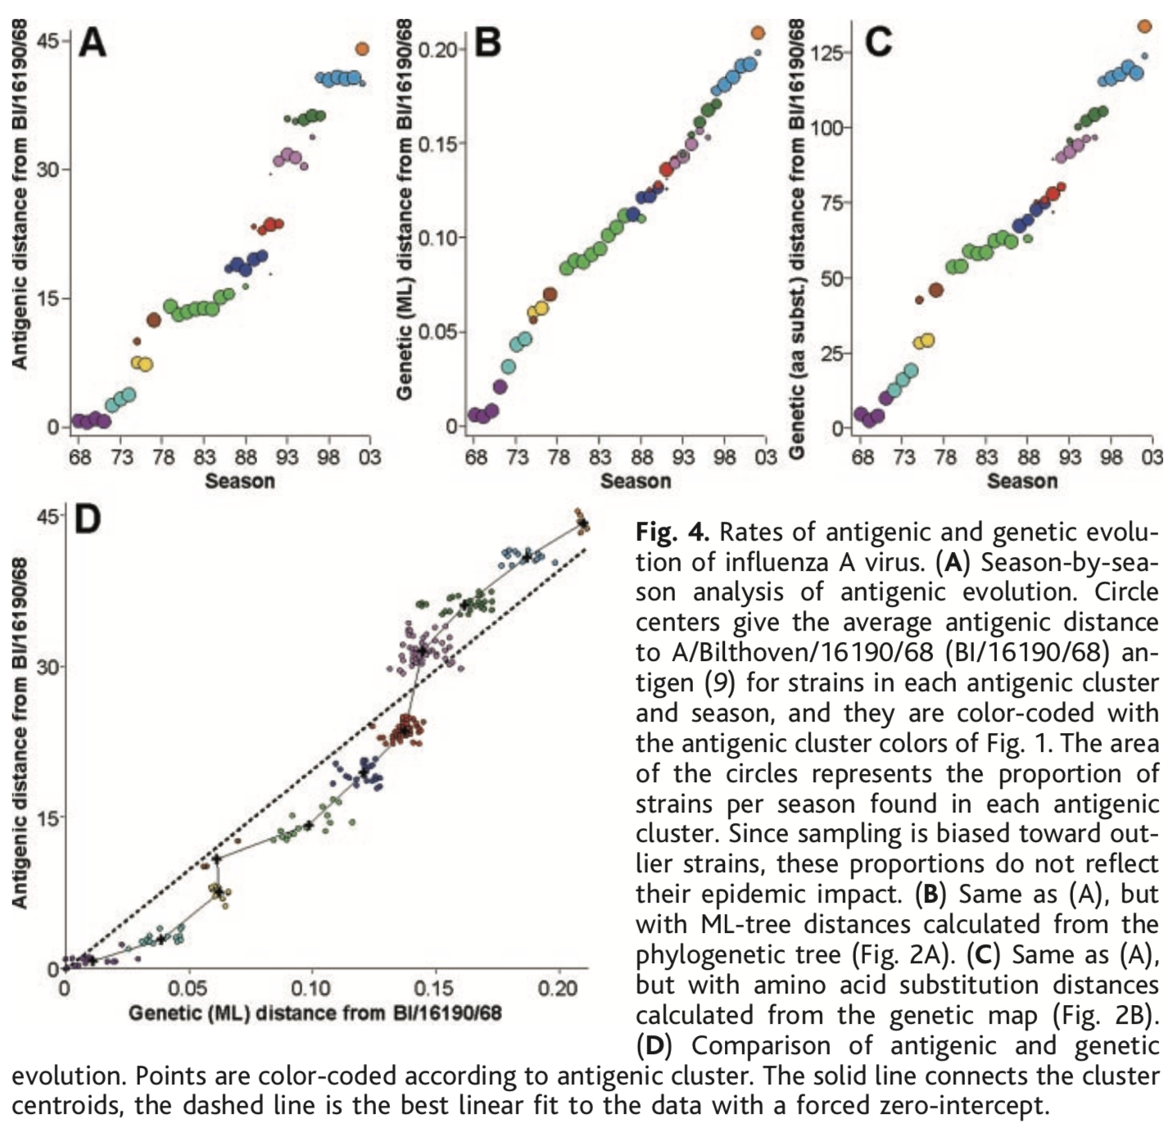
Antigenic evolution less continuous than genetic
Higher rate of antigenic evolution
Between clusters than within clusters
Smith et al Science 305, 371-376, 2004
Notes:
Need to read about the figure D here and the panel B distance here too. ML: maximum likelihood phylogenetic tree. C: aa sequence subsitution.
The average rates of evolution are given
by the slope of the best linear fit to the data in
Fig. 4, A, B, and C. The average rate of
antigenic drift calculated this way was 1.2
units per year, the average rate of amino acid
substitutions was 3.6 per year, and the average
rate of change in ML distance was 0.0060
per year.
D: Sometimes the rate of antigenic evolution was faster than genetic evolution and sometimes vice versa, as shown by the deviations from the linear regression line in Fig. 4D, again, this indicates a remarkable correspondence, with significant exceptions.
clustered antigenic drift with similar antigenic distances between consecutive cluster centroids.
selective advantage for clusters that move away linearly from previous clusters as they most effectively
escape existing population-level immunity, and this is a plausible explanation for the somewhat linear antigenic evolution in regions of the antigenic map (Fig. 1). The
observed deviations from a linear path, as
well as the rate of the antigenic evolution,
might be determined by tradeoffs between
intrinsic viral fitness and extrinsic fitness determined
by population-level immunity, possibly
in concert with stochastic seeding processes
(34), short-lived broad immunity (13),
and the phylodynamics of the virus

Slide 26
Antigenic evolution less continuous than genetic
Smith et al Science 305, 371-376, 2004
Notes:
Need to read about the figure D here and the panel B distance here too. ML: maximum likelihood phylogenetic tree. C: aa sequence subsitution.
The average rates of evolution are given
by the slope of the best linear fit to the data in
Fig. 4, A, B, and C. The average rate of
antigenic drift calculated this way was 1.2
units per year, the average rate of amino acid
substitutions was 3.6 per year, and the average
rate of change in ML distance was 0.0060
per year.
D: Sometimes the rate of antigenic evolution was faster than genetic evolution and sometimes vice versa, as shown by the deviations from the linear regression line in Fig. 4D, again, this indicates a remarkable correspondence, with significant exceptions.
clustered antigenic drift with similar antigenic distances between consecutive cluster centroids.
selective advantage for clusters that move away linearly from previous clusters as they most effectively
escape existing population-level immunity, and this is a plausible explanation for the somewhat linear antigenic evolution in regions of the antigenic map (Fig. 1). The
observed deviations from a linear path, as
well as the rate of the antigenic evolution,
might be determined by tradeoffs between
intrinsic viral fitness and extrinsic fitness determined
by population-level immunity, possibly
in concert with stochastic seeding processes
(34), short-lived broad immunity (13),
and the phylodynamics of the virus

Slide 27
“Where” to does the virus evolve?
Smith et al Science 305, 371-376, 2004

Slide 28
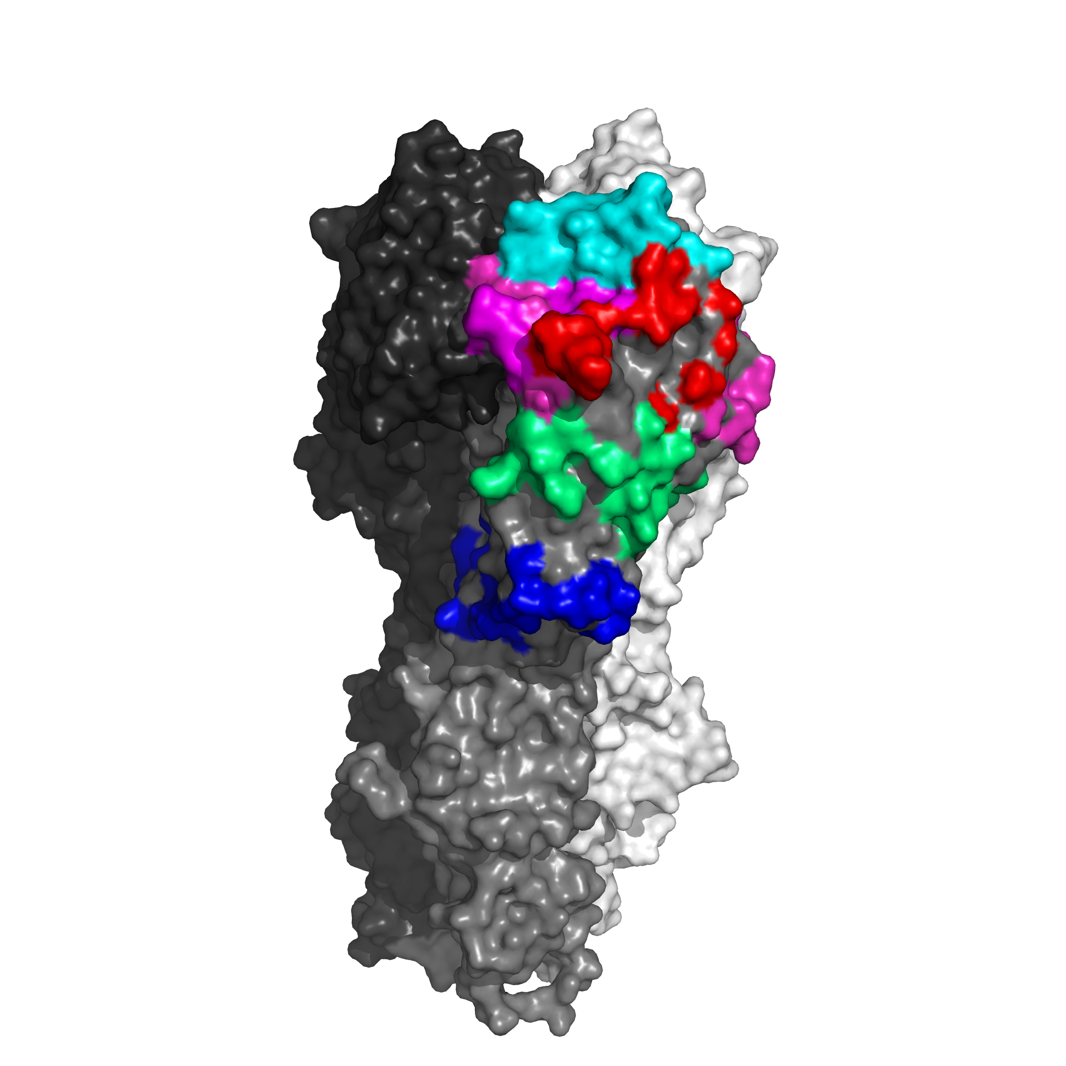
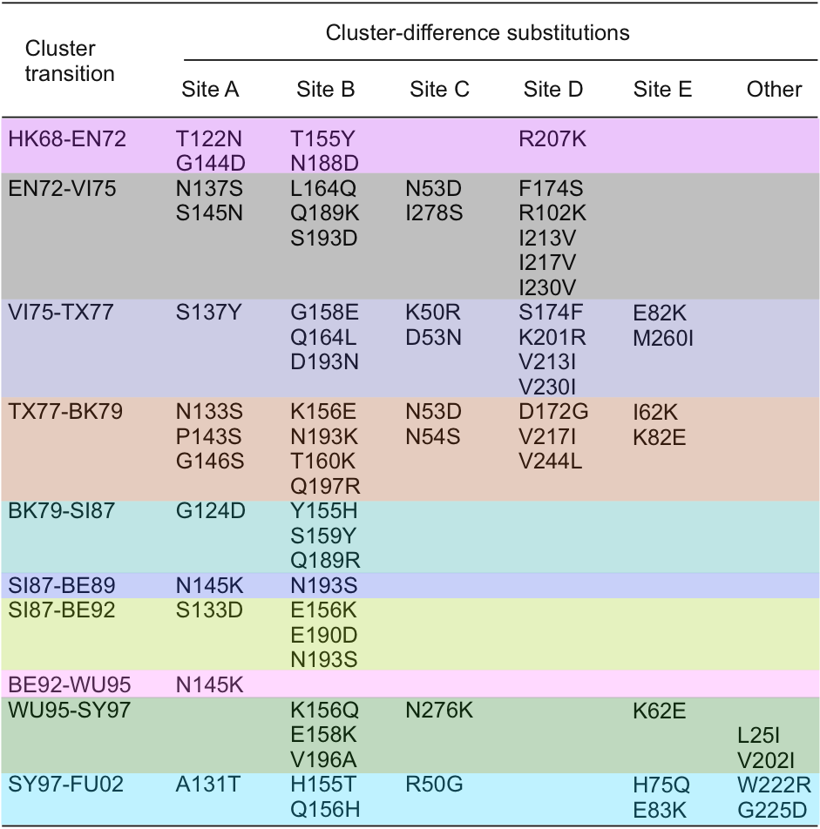
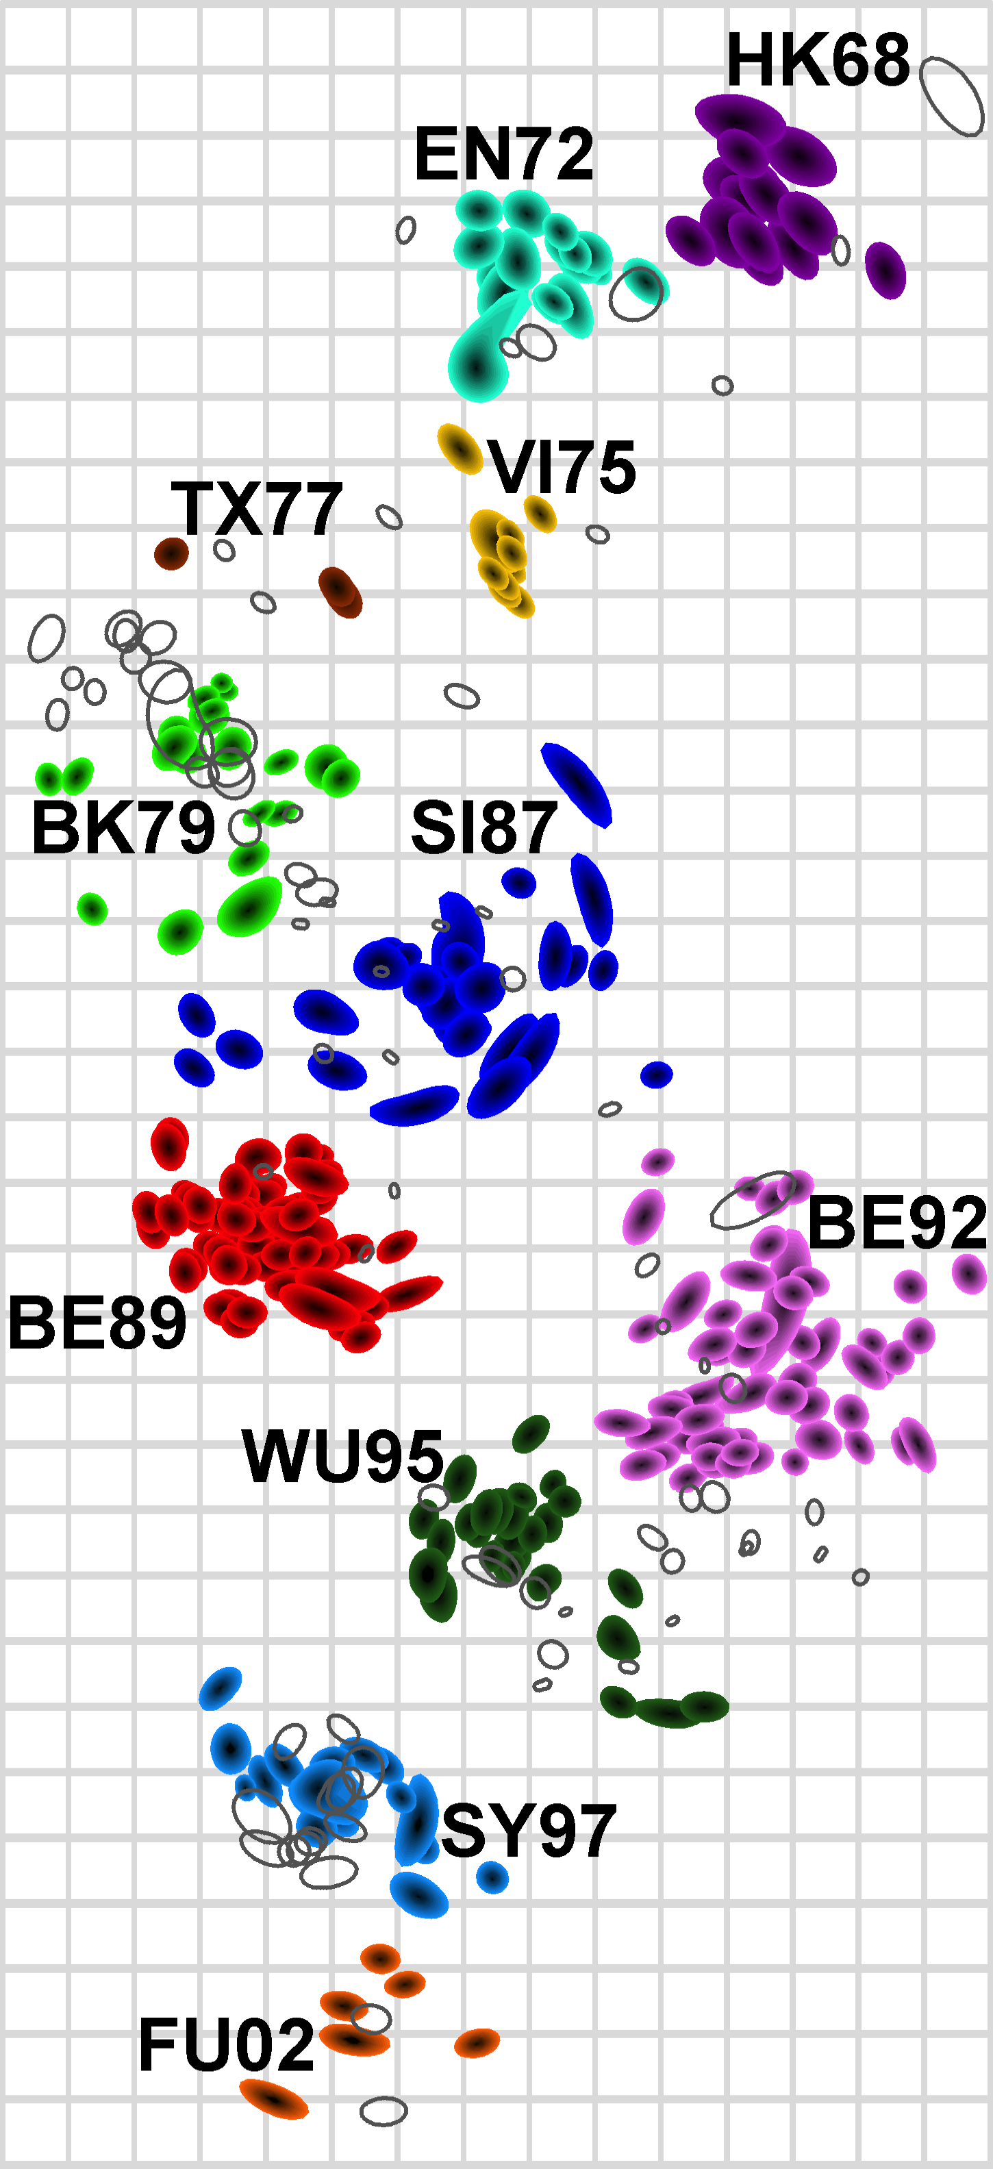
Genetic basis of antigenic change
Site A
Site B
Site C
Wiley, Wilson, Skehel
Nature, 289, 373-378, 1981
Site D
Site E
Smith et al, Science, 2004
Koel et al, Science,
2013
Notes:
The swine ‘natural experiment’ gives us the idea to guess, or more formally conjecture, that there is a constraint on the evolution. If the virus does not have to change, then it does not, implying there is a cost to evolution.
The table shows the amino acids that are different between the strains in one cluster and its adjacent cluster. Bjorn set out to ask which of these amino acid substitutions are responsible for antigenic change.
He selected one virus from each cluster to be a representative of that cluster

Slide 29
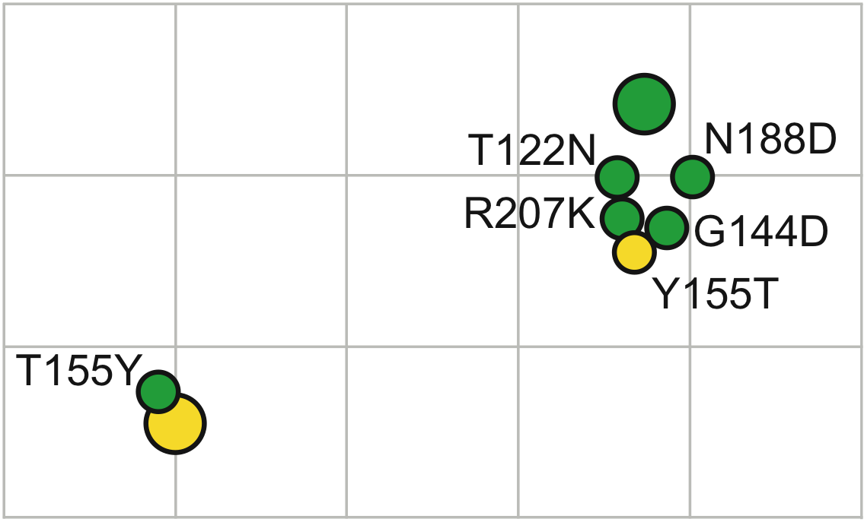
A(H3) HK/68 to England/72
1968
1972
EN72
EN72
EN72
Notes:
And the reverse of that substitution, when put in the EN72 cluster, reverted that virus back to the HK68 phenotype.

Slide 30
Genetic basis of antigenic change
Smith et al, Science, 2004
Koel et al, Science,
2013
Notes:
The swine ‘natural experiment’ gives us the idea to guess, or more formally conjecture, that there is a constraint on the evolution. If the virus does not have to change, then it does not, implying there is a cost to evolution.
The table shows the amino acids that are different between the strains in one cluster and its adjacent cluster. Bjorn set out to ask which of these amino acid substitutions are responsible for antigenic change.
He selected one virus from each cluster to be a representative of that cluster

Slide 31
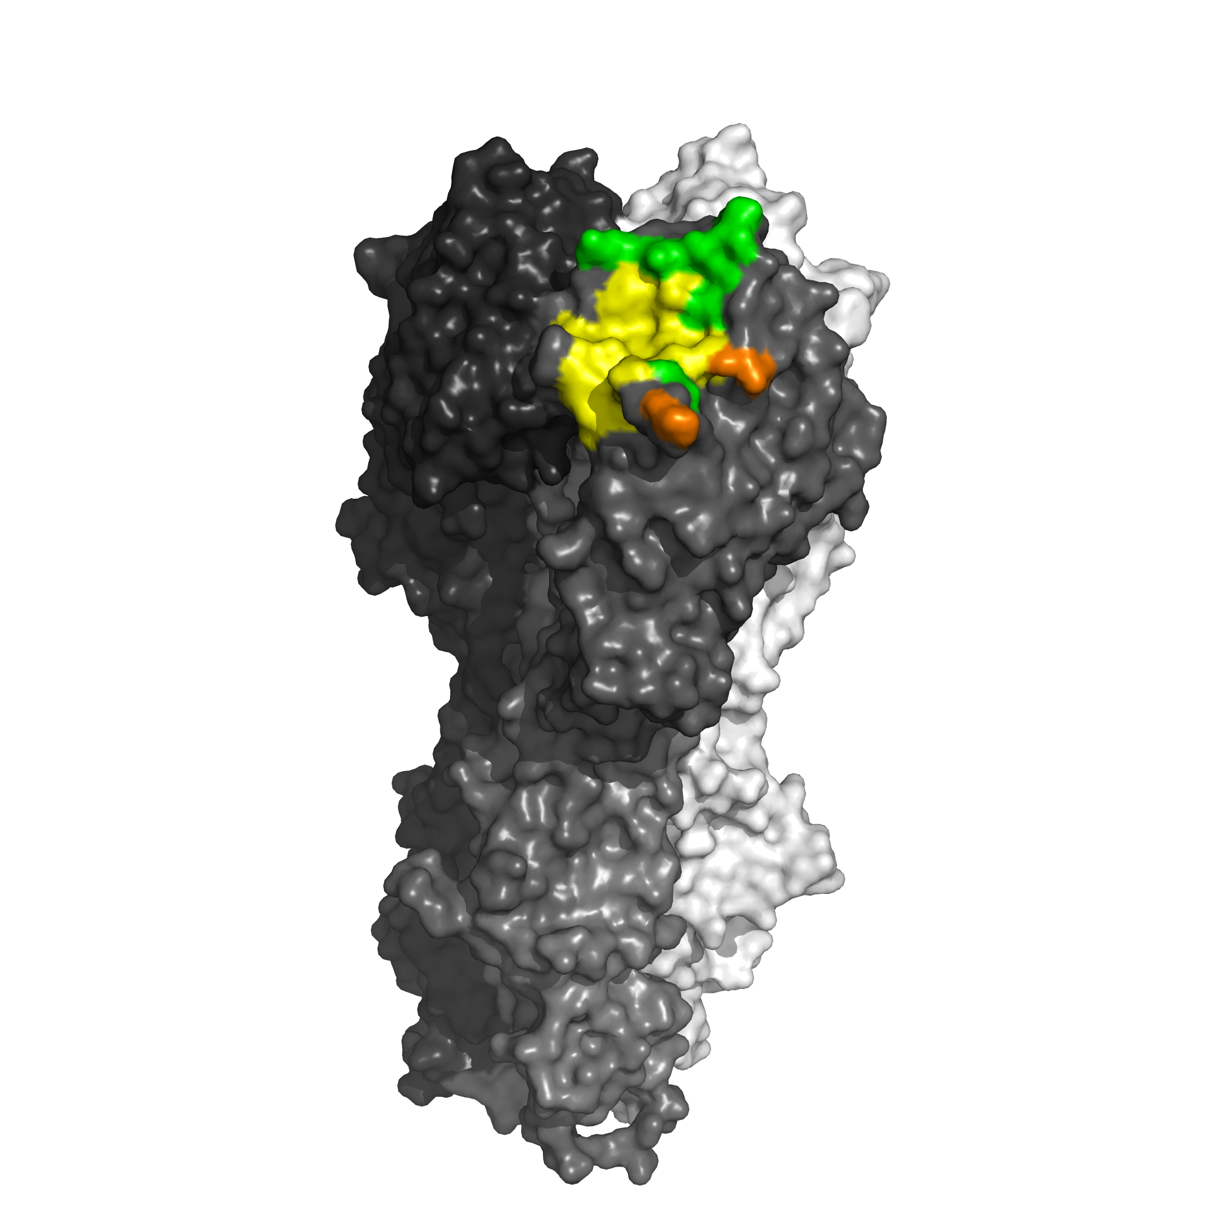
Site A
Crucial residue
Site B
Site C
Accessory residue
Site D
Site E
RBS
Koel et al, Science, 2013
Notes:
On the left we have the 135 aa positions in 5 antigenic sites that had previously been identified as being able to cause antigenic change. On the right is marked in green the 7 ‘critical’ amino acid positions found by Koel. We find these 7 are in a prey particular position—on the periphery of the receptor binding site (RBS).

Slide 32
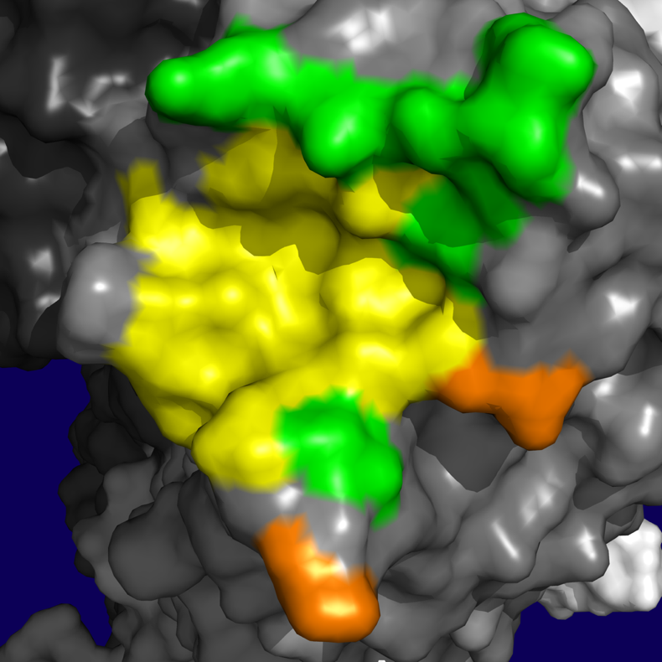
Crucial residue
159
189
193
156
Accessory residue
158
155
RBS
133
145
143
Koel et al,
Science, 2013
Notes:
One thing that can be conjectured from Bjorn’s findings is that only antibodies that occlude the receptor binding pocket are protective in nature. And that perhaps having to change close to the binding site like this, in order to escape those antibodies, distorts the site, thus reducing the ability of the virus to bind to the sialic acids in our upper respiratory tract. Perhaps this is the constraint that slows down the phenotypic evolution of the virus.

Slide 33
Antigenic change in SARS-CoV-2

Slide 34
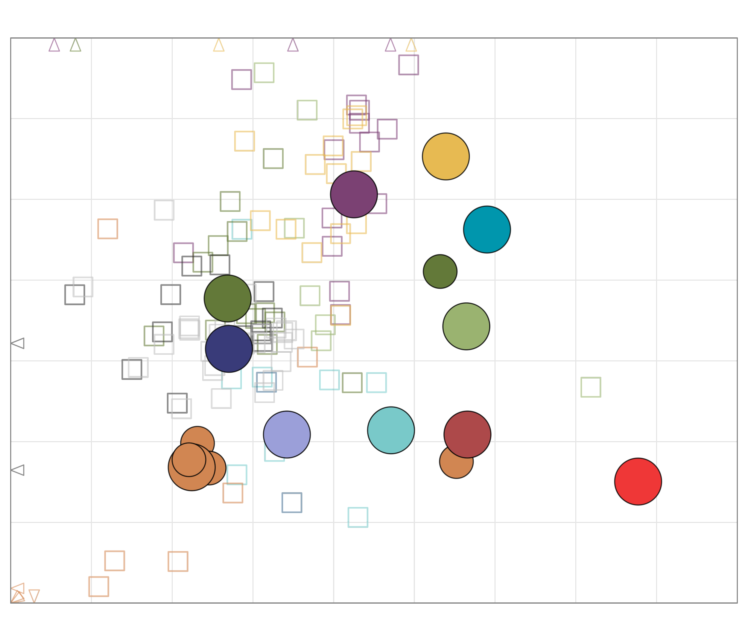
P.1 (Gamma)
L18F, T20N, P26S, D138Y, R190S, K417T, E484K, N501Y, D614G, H655Y, T1027I
B.1.351 (Beta)
L18F, D80A, D215G, Δ242-244, R246I, K417N, E484K, N501Y, D614G, A701V
B.1.1.7 (Alpha)
Δ69-70, Δ144, N501Y, A570D, D614G, P681H, T716I, S982A, D1118H
B.1.621 (Mu)
T95I, insert143T, Y144S, Y145N, R346K, E484K, N501Y, D614G, P681H, D950N
D614G
B.1.1.7+E484K
Δ69-70, Δ144, E484K, N501Y, A570D, D614G, P681H, T716I, S982A, D1118H
B.1.429 (Epsilon)
S13I, W152C, L452R, D614G
B.1.617.2 (AY.1)+K417N
T19R, T95I, G142D, Δ156-157, R158G, W258L, K417N, L452R, T478K, D614G, P681R, D950N
B.1.526+E484K (Iota)
L5F, T95I, D253G, E484K, D614G, A701V
B.1.617.2+K417N
T19R, G142D, Δ156-F157, R158G, K417N, L452R, T478K, D614G, P681R, D950N
B.1.617.1 (Kappa)
G142D, E154K, L452R, E484Q, D614G, P681R, Q1071H
B.1.617.2 (Delta)
T19R, G142D, Δ156-F157, R158G, L452R, T478K, D614G, P681R, D950N
B.1.1.529 (Omicron BA.1)
A67V, Δ69-70, T95I, G142D, Δ143-145, N211I, Δ212, insert214EPE, G339D, S371L, S373P, S375F, K417N, N440K, G446S, S477N, T478K, E484A, Q493R, G496S, Q498R, N501Y, Y505H, T547K, D614G, H655Y, N679K, P681H, N764K, D796Y, N856K, Q954H, N969K, L981F
B.1.617.2 (AY.2)+K417N
T19R, V70F, G142D, Δ156-157, R158G, A222V, K417N, L452R, T478K, D614G, P681R, D950N
C.37 (Lambda)
G75V, T76I, Δ246-252, D253N, L452Q, F490S, D614G, T859N
B.1.617.2 (AY.3)+E484Q
T19R, G142D, Δ156-157, R158G, L452R, T478K, E484Q, D614G, P681R, D950N
Samuel H Wilks, Barbara Mühlemann, Xiaoying Shen et al. Science 2023 DOI: 10.1126/science.adj0070

Slide 35
P.1 (Gamma)
L18F, T20N, P26S, D138Y, R190S, K417T, E484K, N501Y, D614G, H655Y, T1027I
B.1.351 (Beta)
L18F, D80A, D215G, Δ242-244, R246I, K417N, E484K, N501Y, D614G, A701V
484K
501Y
417N/T
B.1.1.7 (Alpha)
Δ69-70, Δ144, N501Y, A570D, D614G, P681H, T716I, S982A, D1118H
B.1.621 (Mu)
T95I, insert143T, Y144S, Y145N, R346K, E484K, N501Y, D614G, P681H, D950N
D614G
B.1.1.7+E484K
Δ69-70, Δ144, E484K, N501Y, A570D, D614G, P681H, T716I, S982A, D1118H
B.1.429 (Epsilon)
S13I, W152C, L452R, D614G
B.1.617.2 (AY.1)+K417N
T19R, T95I, G142D, Δ156-157, R158G, W258L, K417N, L452R, T478K, D614G, P681R, D950N
B.1.526+E484K (Iota)
L5F, T95I, D253G, E484K, D614G, A701V
484K
B.1.617.2+K417N
T19R, G142D, Δ156-F157, R158G, K417N, L452R, T478K, D614G, P681R, D950N
B.1.617.1 (Kappa)
G142D, E154K, L452R, E484Q, D614G, P681R, Q1071H
452R
452Q
452R
484Q
B.1.617.2 (Delta)
T19R, G142D, Δ156-F157, R158G, L452R, T478K, D614G, P681R, D950N
B.1.1.529 (Omicron BA.1)
A67V, Δ69-70, T95I, G142D, Δ143-145, N211I, Δ212, insert214EPE, G339D, S371L, S373P, S375F, K417N, N440K, G446S, S477N, T478K, E484A, Q493R, G496S, Q498R, N501Y, Y505H, T547K, D614G, H655Y, N679K, P681H, N764K, D796Y, N856K, Q954H, N969K, L981F
B.1.617.2 (AY.2)+K417N
T19R, V70F, G142D, Δ156-157, R158G, A222V, K417N, L452R, T478K, D614G, P681R, D950N
C.37 (Lambda)
G75V, T76I, Δ246-252, D253N, L452Q, F490S, D614G, T859N
B.1.617.2 (AY.3)+E484Q
T19R, G142D, Δ156-157, R158G, L452R, T478K, E484Q, D614G, P681R, D950N
Samuel H Wilks, Barbara Mühlemann, Xiaoying Shen et al. Science 2023 DOI: 10.1126/science.adj0070

Slide 36
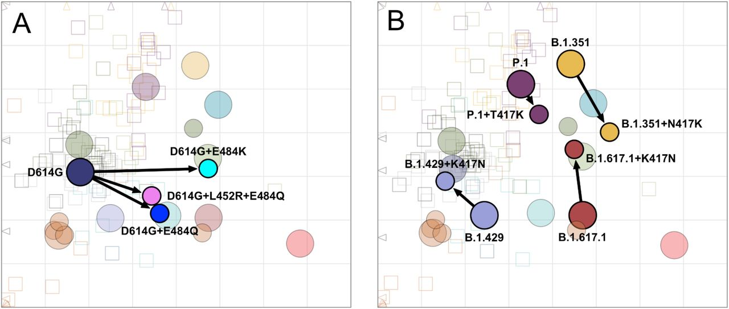
Single substitutions contribute to antigenic change in SARS-CoV-2
Samuel H Wilks, Barbara Mühlemann, Xiaoying Shen et al. Science 2023 DOI: 10.1126/science.adj0070

Slide 37
Key Points
Influenza A/H3N2 evolves in clusters Antigenic evolution more punctuated than genetic evolution The same positions are repeatedly involved in cluster transitions Single amino acid subsitutions contribute more to antigenic change
Notes:
30

Slide 38
Mapping complex exposure histories
From antigenic maps to antibody landscapes (Fonville et al. Science, 2014)

Slide 39
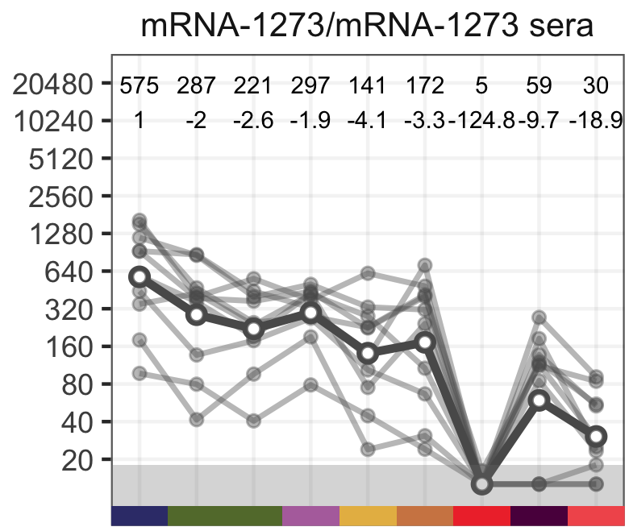
Secondary exposures overshadow underlying relationships
Log2 FC
0 ~7 ~3 ~4
Antibody titer
D614G
Alpha
Gamma
Beta
Delta
BA.1
BA.2
BA.5
Alpha+484K
Rössler, Netzl, et al. (2022) DOI: 10.1038/s41467-022-35312-3
Rössler, Netzl, et al. (2023) https://doi.org/10.1038/s41467-023-41049-4

Slide 40
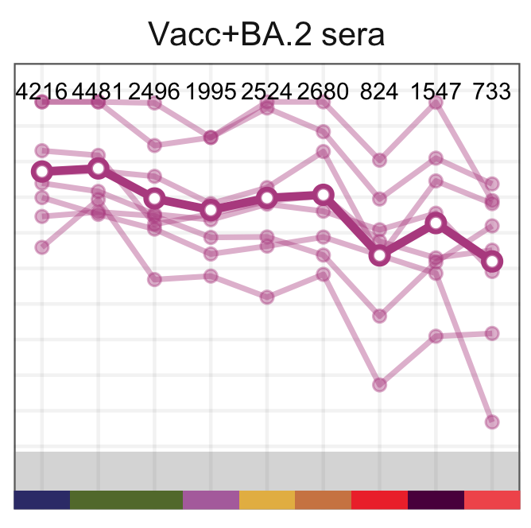
Secondary exposures overshadow underlying relationships
-5.1 -2.7 -5.8
Log2 FC
0 ~7 ~3 ~4
~2. ~1.4 ~2.5
Antibody titer
D614G
Alpha
Gamma
Beta
Delta
BA.1
BA.2
BA.5
D614G
Alpha
Beta
Delta
BA.1
BA.2
BA.5
Alpha+484K
Gamma
Alpha+484K
Rössler, Netzl, et al. (2022) DOI: 10.1038/s41467-022-35312-3
Rössler, Netzl, et al. (2023) https://doi.org/10.1038/s41467-023-41049-4

Slide 41
Secondary exposures overshadow underlying relationships
-5.1 -2.7 -5.8
Log2 FC
0 ~7 ~3 ~4
~2. ~1.4 ~2.5
Antibody titer
D614G
Alpha
Gamma
Beta
Delta
BA.1
BA.2
BA.5
D614G
Alpha
Beta
Delta
BA.1
BA.2
BA.5
Alpha+484K
Gamma
Alpha+484K
Rössler, Netzl, et al. (2022) DOI: 10.1038/s41467-022-35312-3
Rössler, Netzl, et al. (2023) https://doi.org/10.1038/s41467-023-41049-4

Slide 42
Secondary exposures overshadow underlying relationships
-5.1 -2.7 -5.8
Log2 FC
0 ~7 ~3 ~4
~2. ~1.4 ~2.5
Antibody titer
D614G
Alpha
Gamma
Beta
Delta
BA.1
BA.2
BA.5
D614G
Alpha
Beta
Delta
BA.1
BA.2
BA.5
Alpha+484K
Gamma
Alpha+484K
Multiple (distinct) exposures increase cross-neutralization and therefore decrease antigenic distance (log2 fold changes). It is not, however, the variants’ antigenic properties that change with multiple exposures but the antibody composition in the serum → Antibody landscapes on top of a single exposure serum map
Rössler, Netzl, et al. (2022) DOI: 10.1038/s41467-022-35312-3
Rössler, Netzl, et al. (2023) https://doi.org/10.1038/s41467-023-41049-4

Slide 43
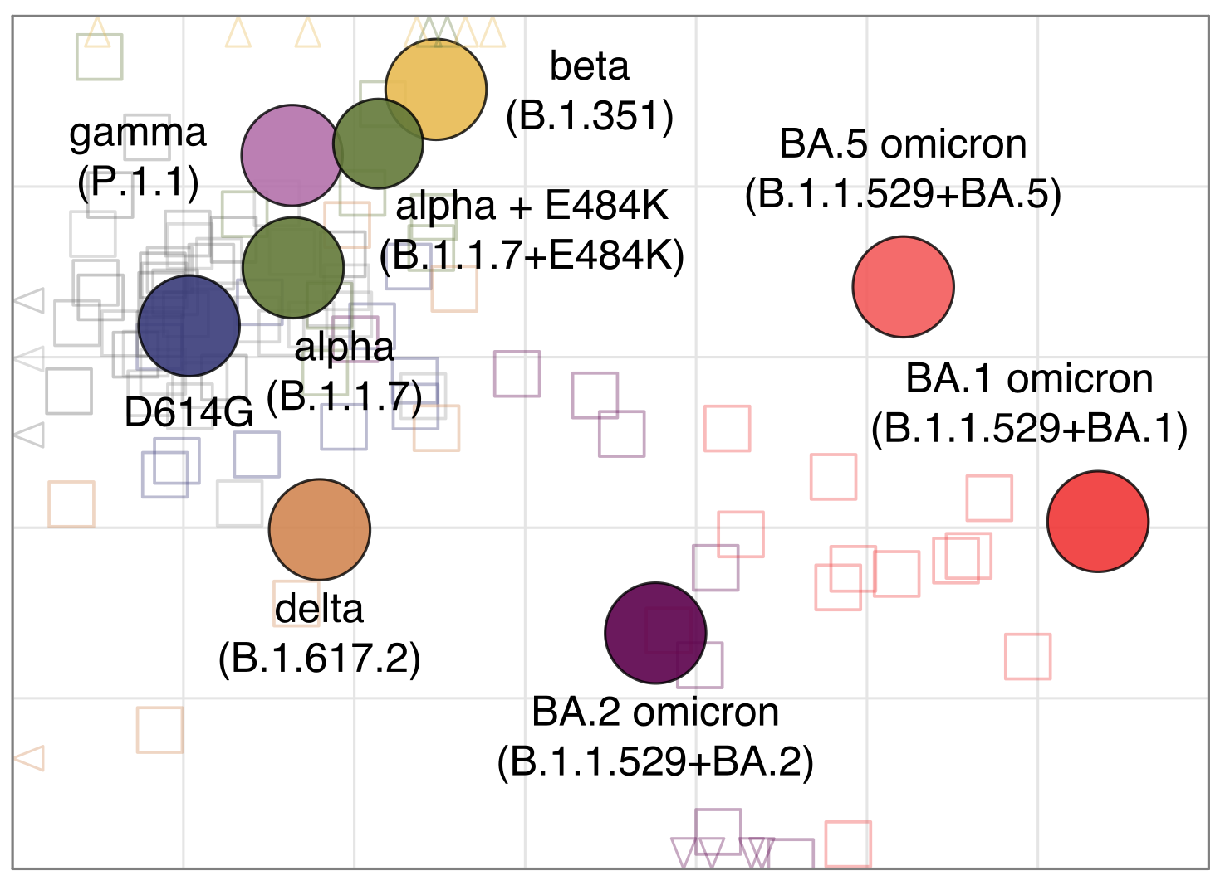
From antigenic maps to antibody landscapes
+
Rössler, Netzl, et al. (2022) DOI: 10.1038/s41467-022-35312-3
Fonville, Wilks, et al. (2014) DOI: 10.1126/science.1256427
Notes:
Fit surface to antibody titers to obtain antibody landscapes per serum groups
Ablandscapes: DOI: 10.1126/science.1256427
Fonville, J., Wilks, S. H., et al. (2014) DOI: 10.1126/science.1256427

Slide 44
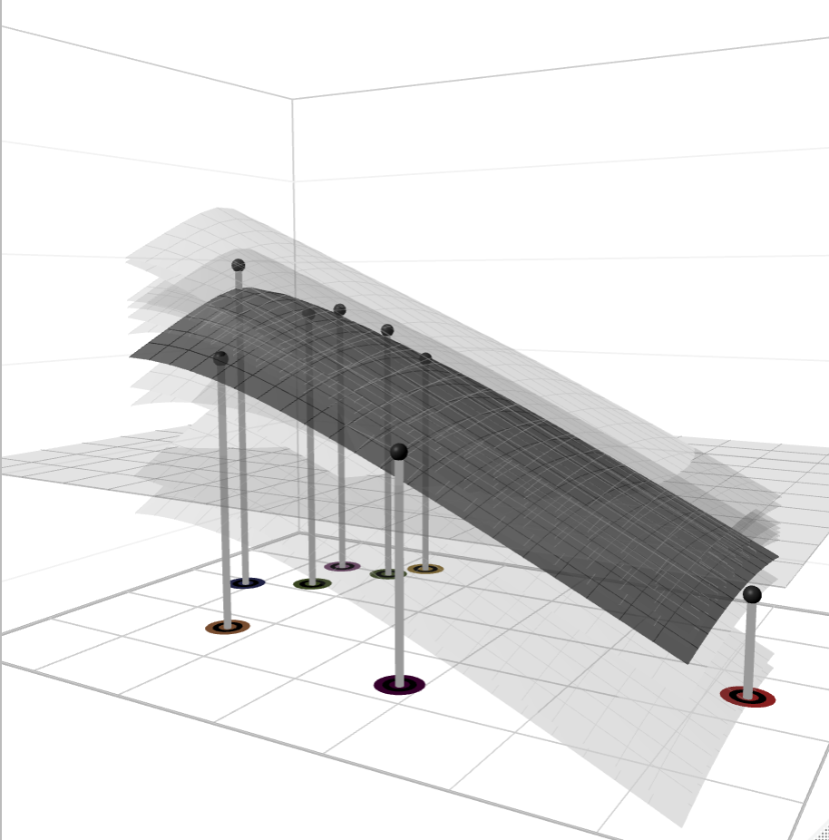
From antigenic maps to antibody landscapes
+
Rössler, Netzl, et al. (2022) DOI: 10.1038/s41467-022-35312-3
Fonville, Wilks, et al. (2014) DOI: 10.1126/science.1256427
Notes:
Fit surface to antibody titers to obtain antibody landscapes per serum groups
Ablandscapes: DOI: 10.1126/science.1256427
Fonville, J., Wilks, S. H., et al. (2014) DOI: 10.1126/science.1256427

Slide 45
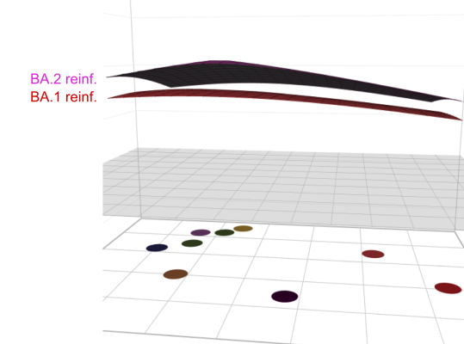
Distant exposures broaden immune profiles → vaccine update to include antigenically distant variant
From antigenic maps to antibody landscapes
+
2x Moderna vaccinated
Pre-omicron + Omicron convalescent
Convalescent
Beta
Delta
Wu-1
Alpha
BA.2
BA.1
BA.2
BA.1
Rössler, Netzl, et al. (2022) DOI: 10.1038/s41467-022-35312-3
Fonville, Wilks, et al. (2014) DOI: 10.1126/science.1256427
Notes:
Fit surface to antibody titers to obtain antibody landscapes per serum groups
Ablandscapes: DOI: 10.1126/science.1256427
Fonville, J., Wilks, S. H., et al. (2014) DOI: 10.1126/science.1256427

Slide 46
Key Points
Multiple exposures broaden immune response and decrease titer fold changes Multiple exposures change the neutralizing properties of the serum, not the antigenic properties of the variants Antibody landscapes show titers across a mapped antigenic space Antibody landscapes show how serum properties change over time without changing the antigenic relationships of mapped variants
Notes:
16

Slide 47
Cartography, the immunologic backboost and vaccine strain selection

Slide 48
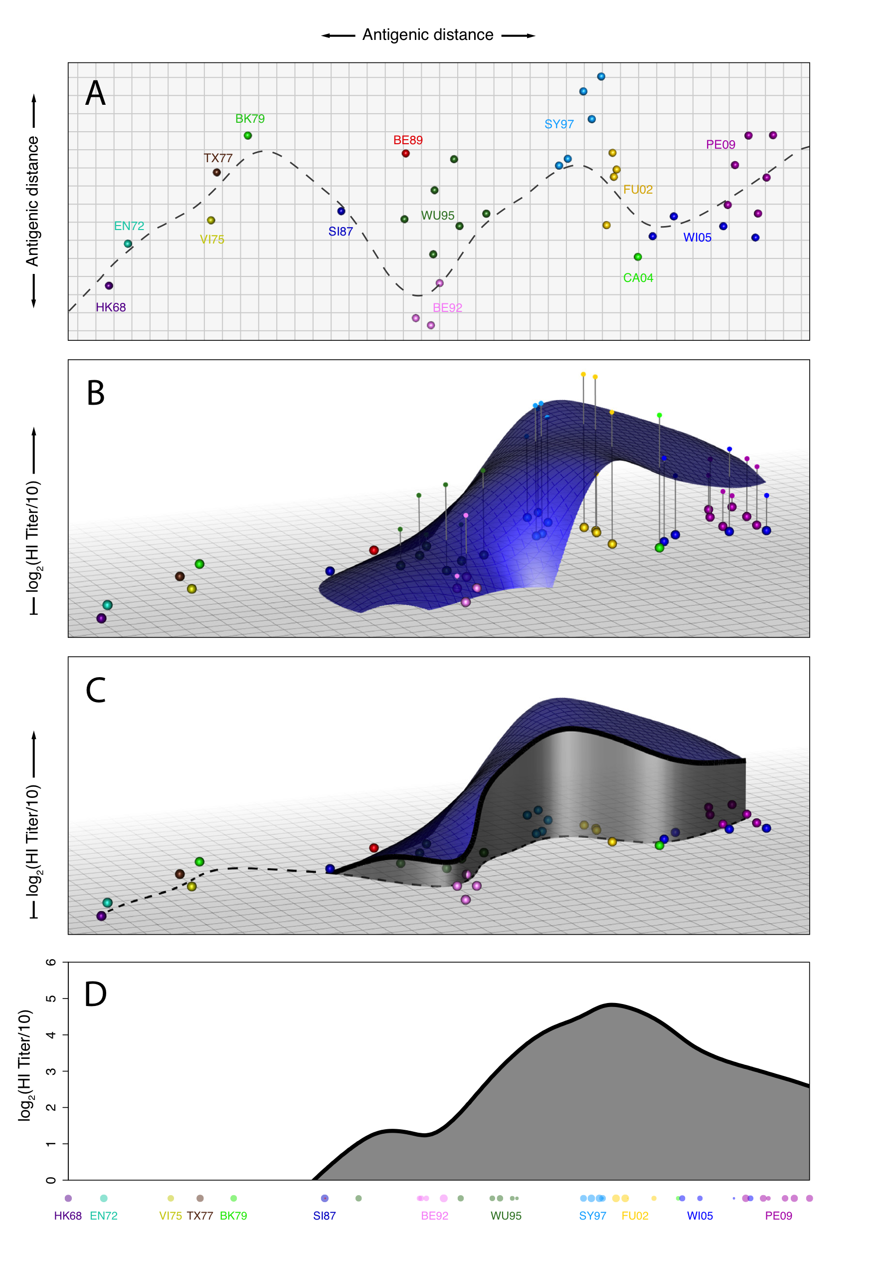
Influenza A/H3N2
Fonville et al, Science, 2014 (OUCRU Vietnam, VIDRL, Rotterdam)
Notes:
In a third dimension we indicate how well antibodies from a human bind with each of the viruses in the “base” antigenic map. Human sera is the result of exposures to multiple influenza virus infections (and vaccinations in some cases). Thus, human sera cannot be used to make the base antigenic map, unless it is sera from children after their first infection.
An antibody landscape is also a fitness landscape showing one component of the fitness of each virus.

Slide 49
Fonville et al, Science, 2014

Slide 50
Fonville et al, Science, 2014
Notes:
This slice through a landscape is a reasonably accurate representation of the 3D landscape, and an easier visualization with which to compare multiple landscapes.

Slide 51
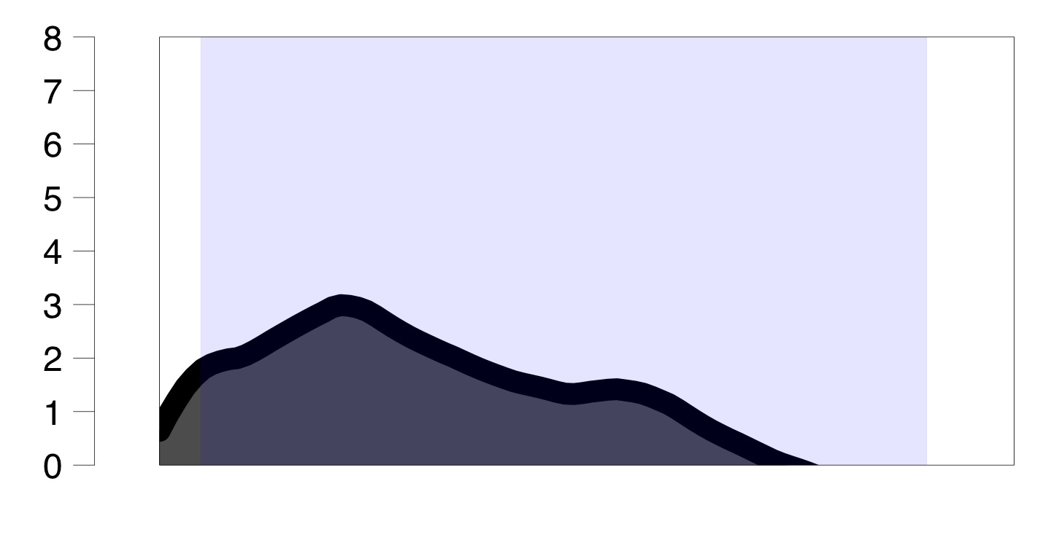
Notes:
This individual was infected with a strain indicated by the arrow.

Slide 52
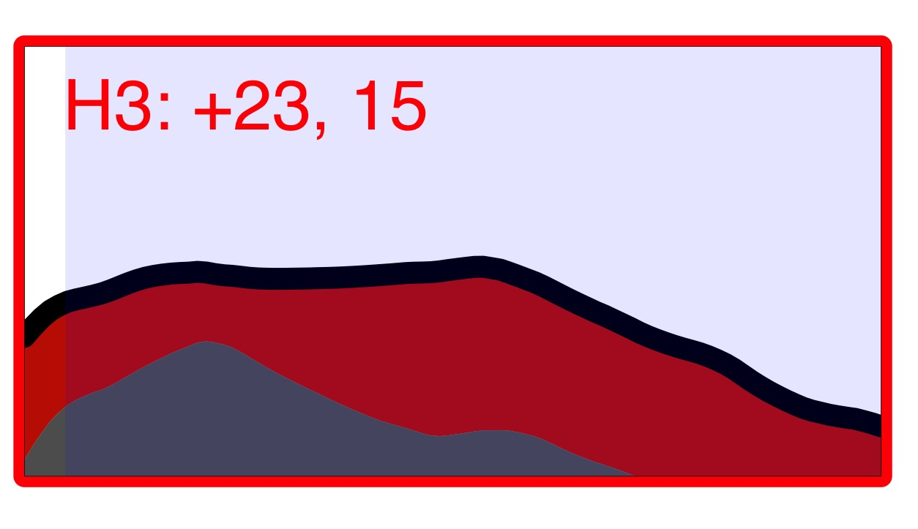
Ha Nam household cohort study
Notes:
Post infection, this individual not only had an immune response against the infecting virus, but their prior immunity against all other influenza viruses in the same subtype (H3) was also boosted.

Slide 53
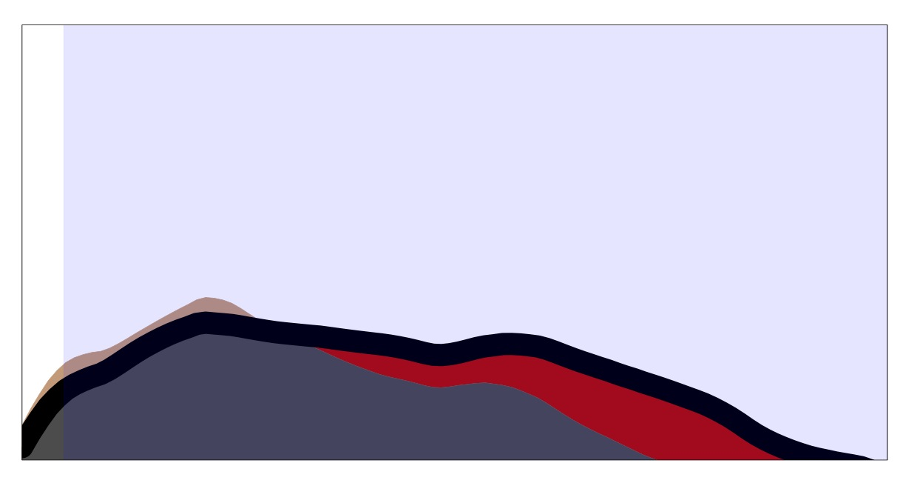
Notes:
The same individual was followed, and gave a blood sample each year over 5 years, The individuals landscape after year year is shown in the top row of figures. The post infection landscape decreases after one year (decrease shown in brown). All other years the landscape is stable. The bottom figure indicates the long-term effect on the landscape as a result of the infection.

Slide 54
Wuhan95 vaccine
~100 Individuals. Solvay & CSL
Notes:
As a result of this vaccination there is not much immunity against the next cluster to come (indicated by the dashed vertical line).

Slide 55
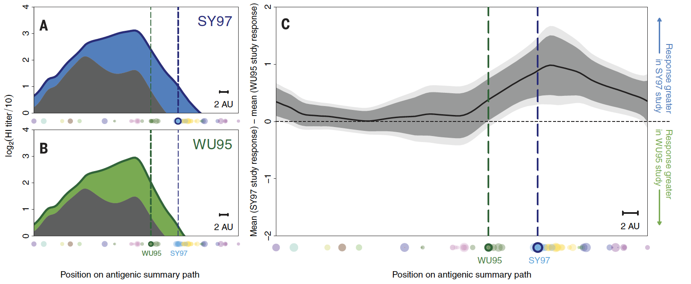
Notes:
The top figure shows the average pre and post landscapes from a different 100 individuals, this time they were vaccinated with the solid ilne (with the Sydney 97 vaccine strain). The pre-vaccination landscapes are similar, the post landscapes different in their response to the Sydney97 antigenic cluster. The boosting of the Wuhan95 cluster is the same in both cases. Thus an antigenically advanced vaccine protects against the advanced cluster, and as well a vaccine from the previous cluster as a vaccine in the previous cluster would protect.

Slide 56
Notes:
The top figure shows the average pre and post landscapes from a different 100 individuals, this time they were vaccinated with the solid ilne (with the Sydney 97 vaccine strain). The pre-vaccination landscapes are similar, the post landscapes different in their response to the Sydney97 antigenic cluster. The boosting of the Wuhan95 cluster is the same in both cases. Thus an antigenically advanced vaccine protects against the advanced cluster, and as well a vaccine from the previous cluster as a vaccine in the previous cluster would protect.

Slide 57
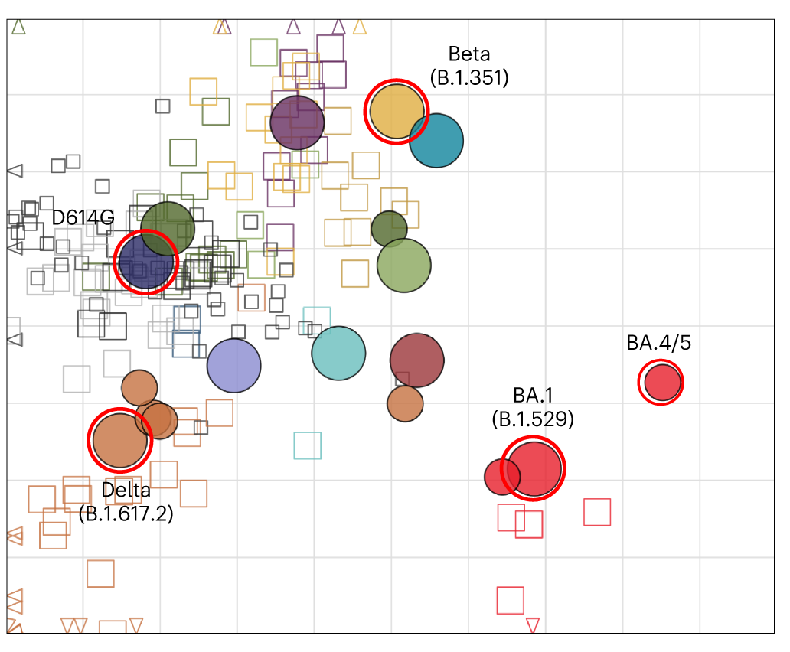
The COVAIL trial COVID-19 Variant Immunologic Landscape Trial
US NIH NIAID
National Institute of Allergy and Infectious Diseases
A phase 2 randomized open-label clinical trial to compare bivalent and monovalent SARS-CoV-2 variant vaccines
Branche, et al. (2023) DOI: https://doi.org/10.1038/s41591-023-02503-4

Slide 58
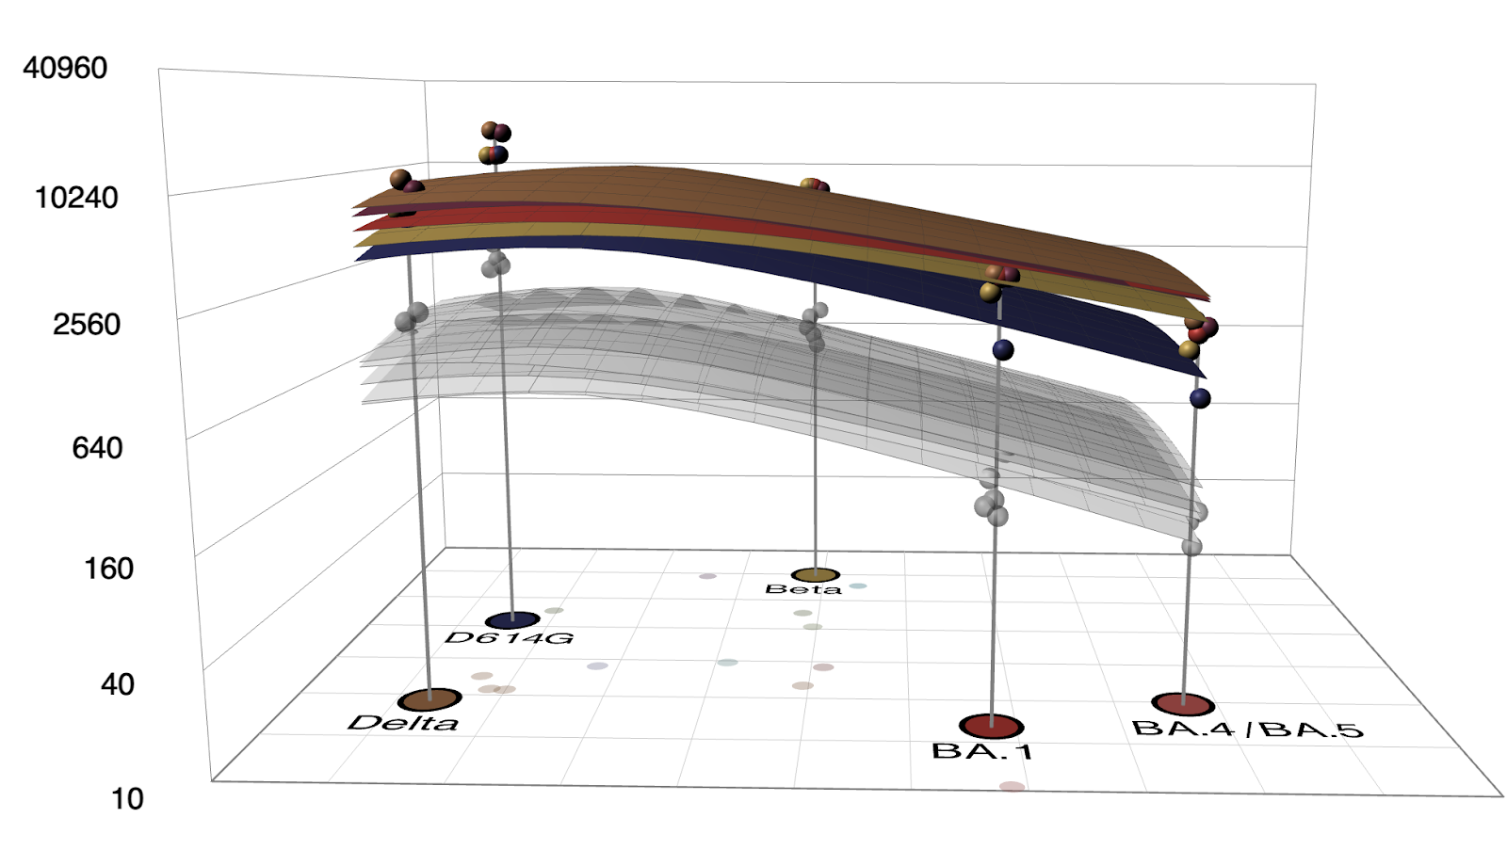
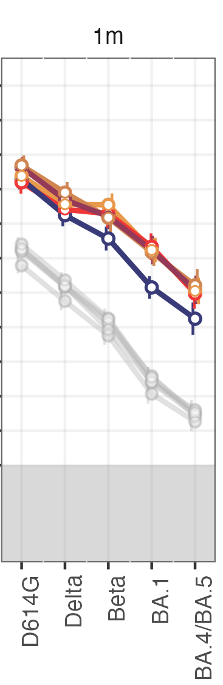
Pre and 1m post
BA.1 + Delta
BA.1 + Prototype
BA.1
BA.1 + Beta
Prototype
Branche, et al. (2023) DOI: https://doi.org/10.1038/s41591-023-02503-4

Slide 59
Key Points
Antibody landscapes visualize population immunity after diverse exposure histories in antigenic space Vaccination boosts titers against previously circulating strains Vaccinating with an antigenically advanced strain induces superior titers against the advanced and non-inferior titers against current and previous strains
Notes:
44

Slide 60
Resources
Antigenic cartography: Smith et al., Science (2004) DOI: 10.1126/science.1097211
Antibody landscapes: Fonville et al., Science (2014) DOI: 10.1126/science.1256427
Racmacs R package for map making: Wilks S (2023). Racmacs: Antigenic Cartography Macros. R package version 1.2.9, https://github.com/acorg/Racmacs/, https://acorg.github.io/Racmacs/.
Antibody landscapes R package: Wilks S (2021). _ablandscapes: Making Antibody landscapes Using R_. R package version 1.1.0, <https://github.com/acorg/ablandscapes>.
Map diagnostics in supplementary material of these publications: Rössler, A., Nat Commun 13, 7701 (2022). https://doi.org/10.1038/s41467-022-35312-3 Rössler, A., Nat Commun 14, 5224 (2023). https://doi.org/10.1038/s41467-023-41049-4
Workshop materials: https://github.com/acorg/NIAID_CEIRR_antigenic_cartography_workshop2025

Slide 61
Agenda
Wednesday, July 9, 2025
8:30 - 9:00 | Registration, helping with software installation
9:00 – 10:10 | Theoretical introduction to antigenic cartography
10:10 – 10:30 | Coffee break, helping with software installation
10:30 – 12:00 | Practical session: Map construction
 | Constructing an antigenic map from a titer table Map styling Interpreting the antigenic map Interactive Tool: Racmacs Viewer
The morning session should contain enough information to create your own map from your data and give it a first assessment
12:00 – 13:00 | Lunch
13:00 – 14:30 | Practical Session: Map Diagnostics
 | Evaluating map distances vs. titer distances Investigating map stability Map cross-validation Map dimensionality
14:30 – 15:00 | Coffee break
15:00 – 16:30 | Practical session: Troubleshooting
 | Recognizing common data issues and how they are reflected in antigenic maps Approaches to address these challenges
Official end Day 1, but workshop organizers will be available for discussing questions and data
Thursday, July 10, 2025
9:00 – 10:30 | Practical session: Antibody Landscapes
 | Antibody landscapes to model complex exposure histories Antibody landscape construction Landscape plotting Landscape evaluation
10:30 – 11:00 | Coffee break
11:00 – 12:30 | Data clinic
 | Work on your own data or try practical examples with provided data with support from the workshop organizers

