Slide 1

Redux
One way to help you manage your app’s state

Slide 2
Date | Topic
September 13 | React
September 20 | React Native
September 27 | Redux

Slide 3
What’s up?
First a quick re-cap from the React session
Then a theoretical introduction
Finally, we will begin the tutorial part by implementing Redux from scratch and then continue with refactoring our video player app
Notes:
Understanding the pattern

Slide 4

Re-cap
Notes:
phone conference irl

Slide 5
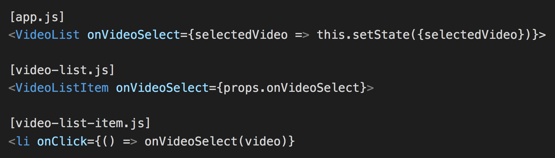
Some words about application state
The state easily gets very complex and hard to reason about as the app grows bigger and bigger with deeply nested components
In the video player app, state was set by passing callbacks (via props) between parent and child components in multiple levels:
Notes:
Not recommended more than two levels, so this is what we want to overcome with Redux!

Slide 6
Intro to Redux
”Redux is a predictable state container for JavaScript apps”
It is a tiny open source library surrounded by an ecosystem of tools
But most importanty, it is a design pattern enforcing a unidirectional data flow
Inspired by but not affiliated with Facebook’s Flux and Elm’s ”model view update”-architecture
Notes:
Dan Abramov
Simplification of Facebooks Flux architecture which is kind of a pattern
Redux = Name is a combination of Reducer (as in an array reduce function) and Flux
99 LoC

Slide 7
The three principles of Redux
Single source of truth
The state of your whole application is stored in an object tree within a single store.
State is read-only
The only way to change the state is to dispatch an action, an object describing what happened.
Changes are made with pure functions
To specify how the state tree is transformed by actions, you write pure reducers.
Notes:
Important

Slide 8
Concepts and data flow
State
contains
defines
Store
UI
updates
triggers
Reducer
Action
sent to
Notes:
Redux = Actions, Reducers and Store

Slide 9
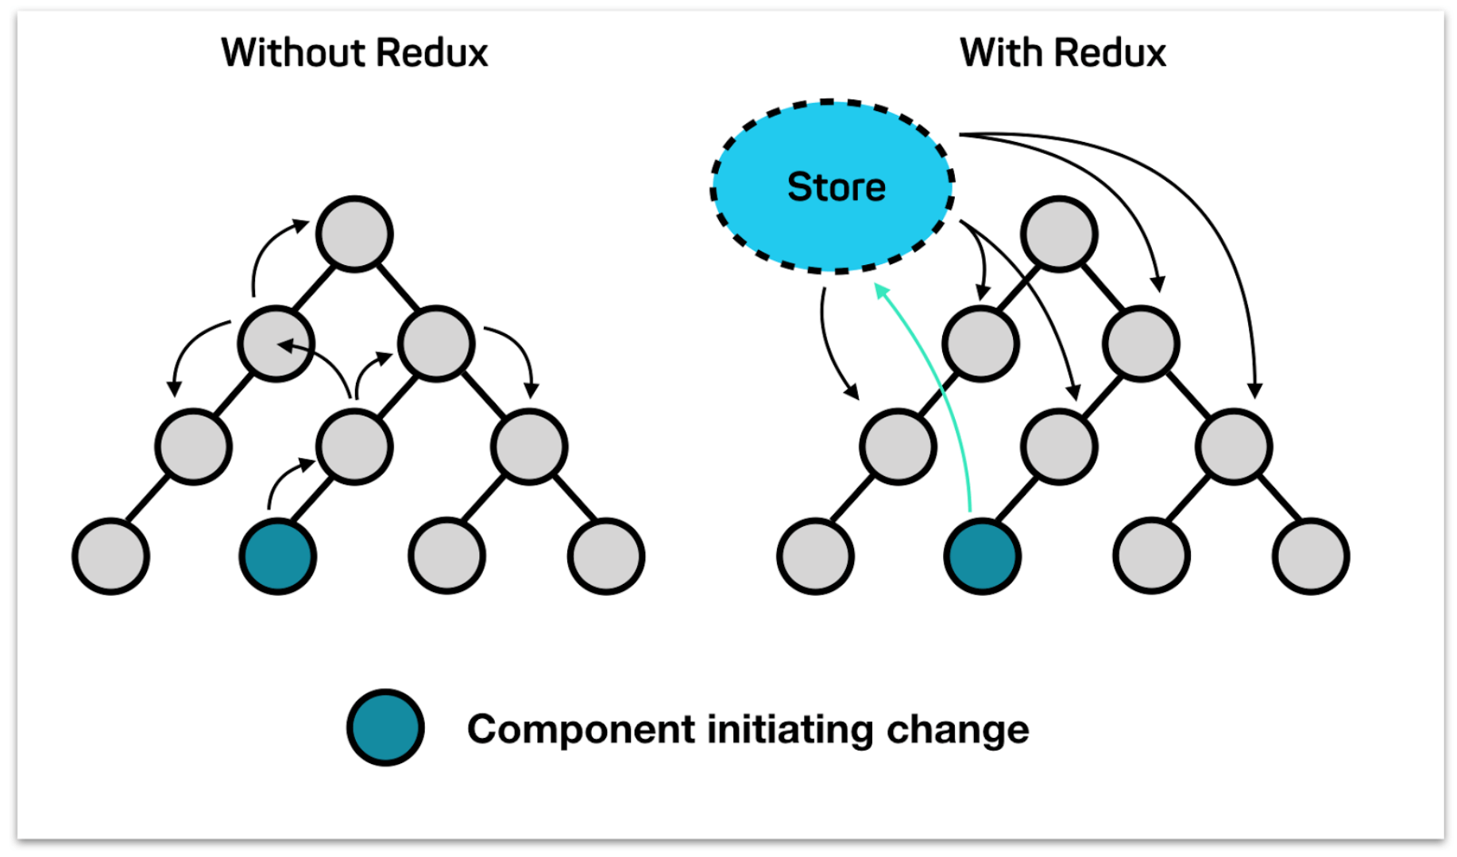
What happens when something changes?

Slide 10
Actions
The only way to change the state
Describes what should happen
Plain JavaScript object with the type of action and a payload
{
type: ‘ADD_TODO’,
text: ‘Go out and pick mushrooms’
}

Slide 11
Reducers
Specifies how the application’s state changes in response to actions
Pure function, no mutation of state, no side effects
Returns the exact same output for the given inputs
Takes the previous state and an action and returns a new state
(previousState, action) => newState
Notes:
Like a state machine

Slide 12
Reducers – what not to do inside them
Mutate its arguments
Performing things that might throw or have side effects like async functions, API calls, database calls, routing etc.
Call non-pure functions, e.g. Date.now() or Math.random()
But then how can we deal with such things? Introduce more states and use middleware!
Notes:
Will get back to middleware

Slide 13
Store
Holds application state as a plain JavaScript object
Allows access to state via getState()
Allows state to be updated via dispatch(action)
Registers listeners via subscribe(listener) so that they can be notified when the state changes
Notes:
render()

Slide 14
Designing the state structure
Data state (business data) – app-wide (Redux)
Communication state (status of network requests) – app-wide (Redux)
Control state (form input values, selected items) – component (React)
Session state (User info, permissions etc.) – app-wide (Redux)
Location state (URL/page) – in the browser
Keep the state as normalized and flat as possible to avoid data duplication
Notes:
One way to split it
Don’t nest entities

Slide 15
Pros
State gets more predictable and easier to reason about because it is immutable
Easier to debug because there is only one way that the state can change
State is serializable, good for logging purposes and to automate bug reports
Undo history feature very easy to impement
Caching of state and optimistic updates of UI out of the box
Notes:
Natural to store in local storage
Replay erroneous state

Slide 16
Redux Library and ecosystem
npm install redux
Exposes a createStore() function
combineReducers() – split reducer logic into multiple functions
applyMiddleware() – Middleware is an extension point between dispatching an action, and the moment it reaches the reducer. Useful for async stuff, logging, etc. so that actions always pass by certain code before dispatching
Action Creators - Functions that return actions
Redux DevTools Extension - Time travel debugging, import/export and more

Slide 17
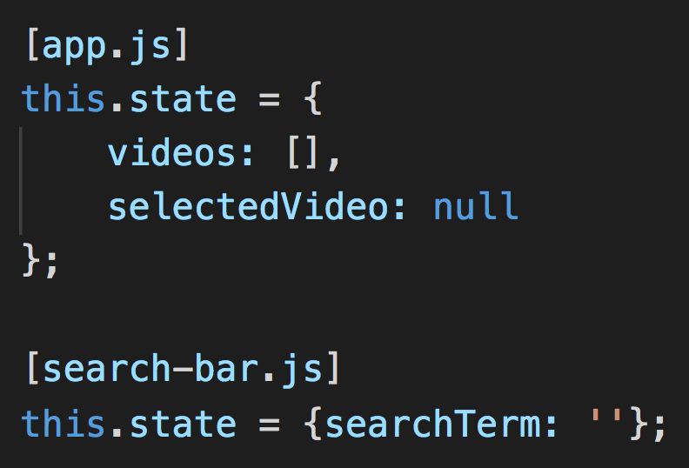
React Redux
♥
Redux works especially well with libraries like React because it lets you describe UI as a function of state, and Redux emits state updates in response to actions!

Slide 18
npm install react-redux
“React bindings for Redux”
<Provider /> – a component that makes the Redux store available in your app
connect(mapStateToProps, mapDispatchToProps) – a function that generates container components and connects our component to the store
mapStateToProps – defines how the state can be transformed into props
mapDispatchToProps – defines what actions the component might dispatch

Slide 19
Possible drawbacks of using Redux
You might not need it, depends on the complexity of your app!
Some boilerplate (concepts needed to follow the pattern)
Store’s lifecycle is different from that of the components
Notes:
Pure React state fine for small applications
Components sharing state etc, then it’s good

Slide 20
Time to code!
Let’s begin with implementing Redux from scratch!
After that, we will replace our store with the Redux library store which will enable us to make use of the Redux DevTools Extension.
Finally, we’ll get back to the video player app and use Redux with the official bindings for React.
https://github.com/appsupport-at-acorn/react-and-rn-intro/tree/master/tutorial/redux

Slide 21
Summary of concepts
Actions – { type: ‘ADD_TODO’, text: ‘Learn Redux’ }
Reducers - (previousState, action) => newState
Store - getState(), dispatch(action), subscribe(listener)

