Slide 1
80x86 Processor Architecture

Slide 2
8086 and 8088
The foundation of all the 80x86 family
Processor model
  BIU
    Generates memory and I/O addresses for transfer of data (internal and external)
  EU
    Receives program instruction codes and data from the BIU
    Executes the instructions
    Stores results in general registers
  Processor architecture allows fetch and execute to overlap

Slide 3
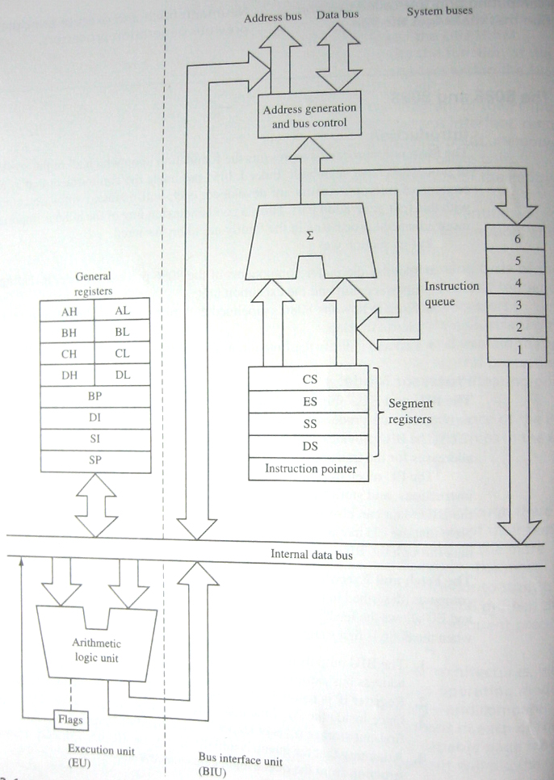
8086 and 8088 Processor Model

Slide 4
Fetch and Execute Cycle in the 8086
BIU outputs address (using the instruction pointer) and read a byte or word in the BIU
Instruction pointer is updated
Instruction is passed to the queue
EU draws instruction from queue and executes
BIU fetches a new instruction while the EU executes the current instruction
Cycles continues with BIU filling the instruction with the EU executing the instructions

Slide 5
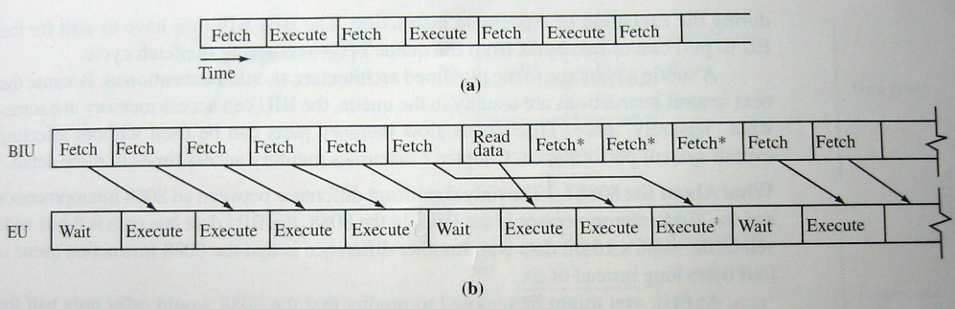
Fetch and Execute Cycle in the 8086

Slide 6
Conditions where EU enters into wait mode
Instruction requires access to memory location not in queue
Instruction is a jump instruction
BIU suspends fetching instruction

Slide 7
8086 Programming Model
Data Registers
  AX, BX, CX, DX
  Used for storing temporary results
Pointer and Index Registers
  SP, BP, SI, DI, IP
  Used as memory pointers
Status and Control Flags
  Status indicators reflecting properties of the result of the last arithmetic or logical instruction
Segment Registers
  Used by BIU to determine memory address output by the processor when reading or writing from the memory unit

Slide 8
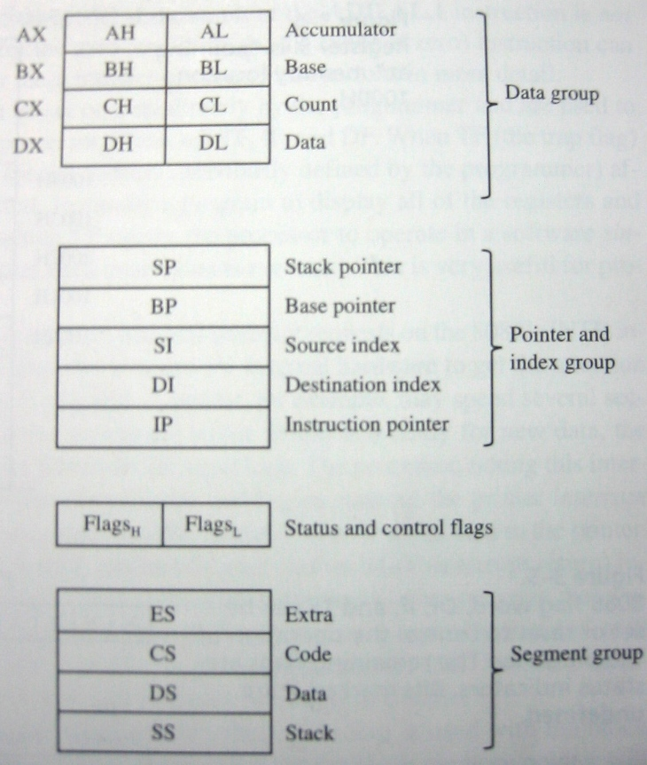
8086 Programming Model

Slide 9
8086 Segmented Memory
8086 memory uses even and odd memory banks to access 8-bit or 16-bit data
  Each memory address is 1-byte
  To access a 16-bit data, 2 memory locations are used
  Access to 16-bit data is one bus cycle if memory address is aligned
Using segment registers, physical address is computed as:
  (Segment register * 10H) + offset value – IP, BX, SI, DI

Slide 10
8086 Segmented Memory
Advantage
  One program can work on different sets of data
  Programs that reference logical addresses can be loaded and run anywhere in memory
Disadvantage
  Introduces complexity in H/W and S/W

Slide 11
80386
Operating Modes
  Real mode
    Address space is limited to 1 MB
    Segmented memory addressing mechanism of the 8086 is retained
  Protected Mode
    Each segment may range from single byte to 4 GB
    Supports virtual memory
    Privilege levels for individual task or programs
    Virtual 8086 – hands each real mode program its own 1 MB space

Slide 12
80386 Processor Model
BIU
  Manages the 32-bit address, data bus and control signals
  Keeps instruction queue full
  Can do address pipelining and dynamic data bus sizing
CPU
  Consist of IU and EU
  IU – retrieves instruction and decodes
  EU – executes the instruction
MMU
  Segmentation unit generates addresses
  Paging unit allows accesses to memory in 4KB pages

Slide 13
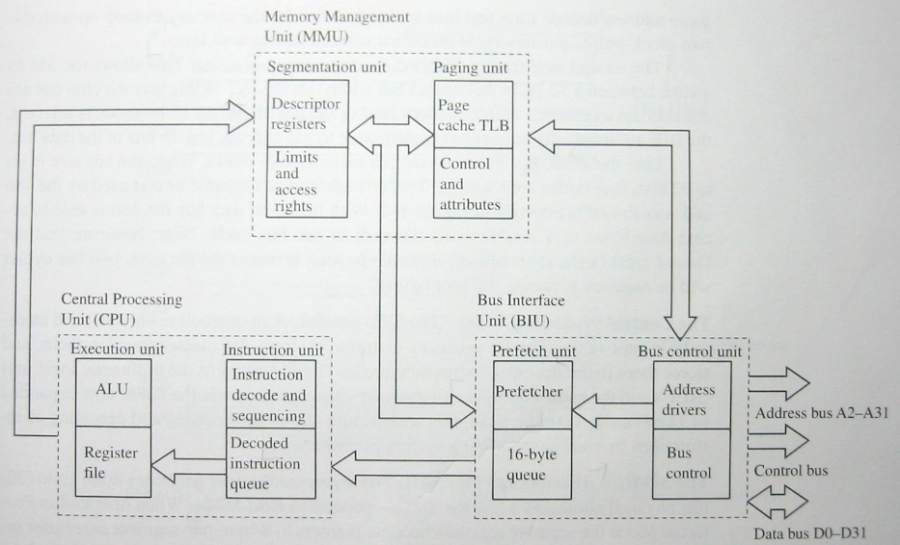
80836 Processor Model

Slide 14
80386 Programming Model
Data and Address Group
  Has been expanded to 32-bit
  EAX, EBX, ECX, EDX, ESP, EBP, ESI, EDI, EIP
Status and Control Flags
  Extended to 32-bits
  Includes VM – virtual mode, RF – Resume flag, NT – Nested Task, IOPL – I/O Privilege Level
Segment Group
  FS and GS – added, six different segments can be active
  Used as pointers in protected mode

Slide 15
80386 Programming Model
Control Registers
  Not normally used
  Intended for controlling the processing Protected Mode and for testing
  CR0 – enables paging mechanism, monitor task switching, enable coprocessor emulation, select protected or Real mode
  CR2 – holds address of last instruction to caused a page fault – reference to a page or segment not in memory
  CR3 – used when virtual memory via paging is enabled

Slide 16
80836 Programming Model
System address Registers
  Hold information about the descriptor tables used in protected mode
Debugging Registers
  Used to set program breakpoints
  Processor issues a type 1 S/W interrupt
Test Registers
  Used to test the memory in the Translation Lookaside Buffer

Slide 17
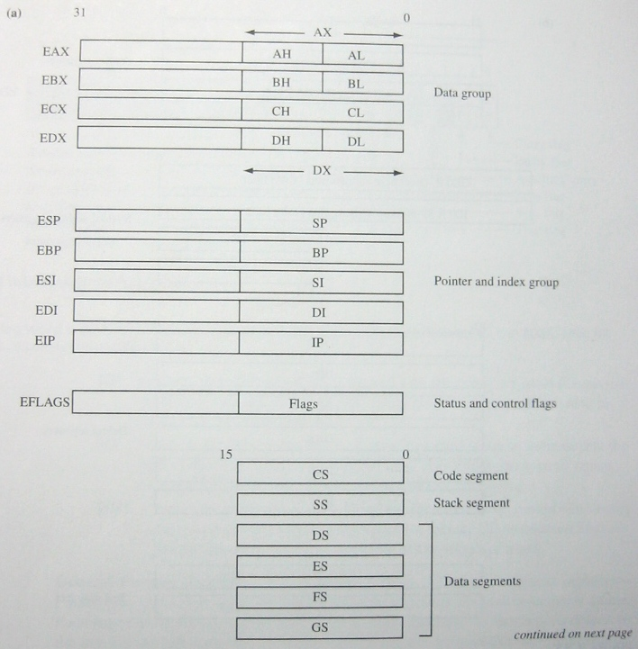
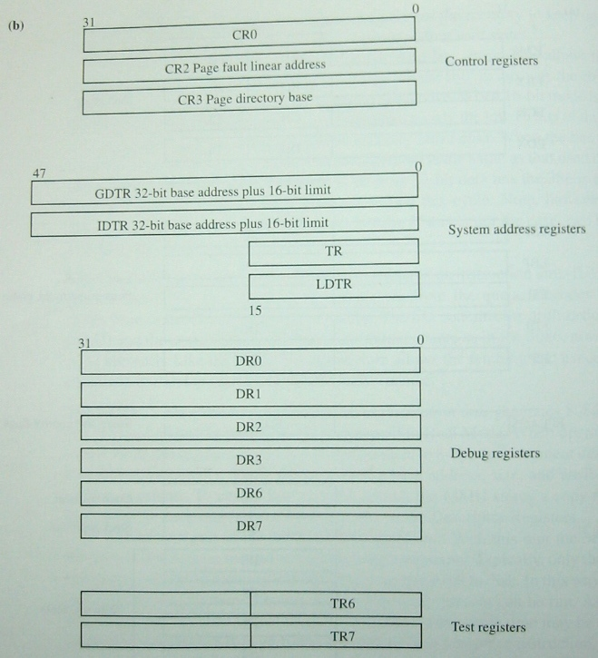
80386 Programming Model

Slide 18
80386 Protected Mode Memory Segments
Segment size can be as large as a byte to 4GB
Each memory is assigned a protection level
Allows as many as 16,384 different segments to be defined
Segments can be swapped out to disk to support virtual memory
Segments can be read-only to protect code and data

Slide 19
80386 Protected Mode Memory Segments
Segment registers are now pointers (selectors)to descriptor table
  Global – available to all task in the system
  Local – segments associated for a task
  Interrupt – starting address of interrupt services
Each descriptor entry is 8-bytes long
Descriptor entry specifies base address of the segment, size of segment and segment attributes

Slide 20
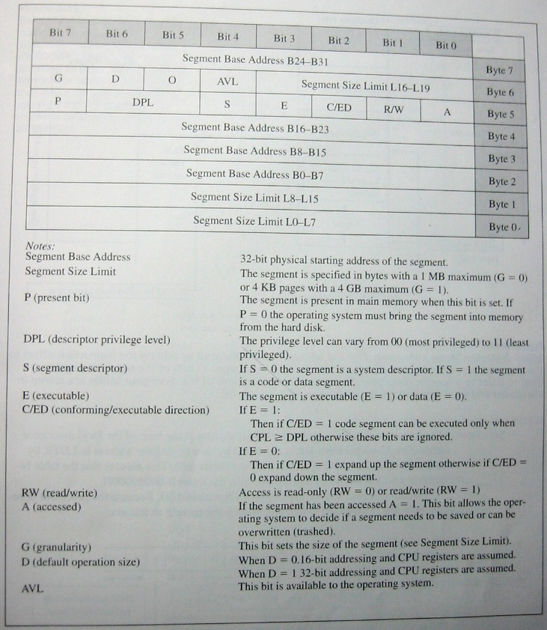
Descriptor Table Definition

Slide 21
Steps in computing physical address of a memory operand
Bit 2 of the segment register is examined to determine if the global or local bit is used
Upper 13-bits of the segment register are added to the base address in the system address register GDTR or LDTR, selcting a particular descriptor
The EPL of the current program is compared with the DPL of the descriptor, a fault is generated if EPL is less privileged than DPL
If privilege level of EPL is equal or higher than DPL, 32-bit offset is added to the 32-bit base address of the segment to form physical address

Slide 22
Example!
The following 80386 program instructions are used to setup the protected mode code segment. Use the descriptor in the next slide
  mov ax, 0005h
  lldt ax
  mov ax, 0017h
  mov cs,ax

Slide 23
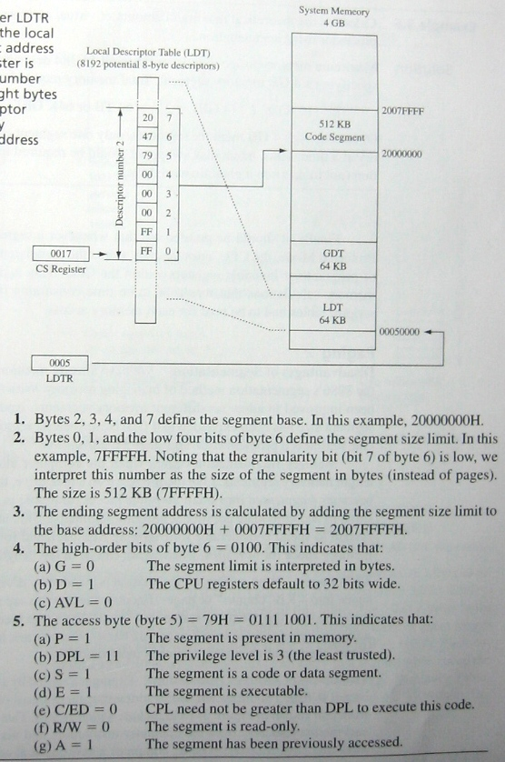
Solution

Slide 24
80386 Paging
Segmentation can cause memory fragmentation
  Available memory space becomes fragmented into small usable pieces
Paging technique divides memory space into 4KB chunks
Operating system can “pack” chunks more efficiently

Slide 25
80836 Paging – Physical Address
The top 10 bits of the linear address are used as an offset to select one of 1024 entries in the Page Directory Table
  Register CR3 specifies the base address of the table
Middle 10 bits of the linear address are used to select one of the 1024 entries in the selected Page Directory Table
Address translation is completed by adding the 12-bit offset obtained from the linear address to the 4KB base address obtained from the Page Directory Table

Slide 26
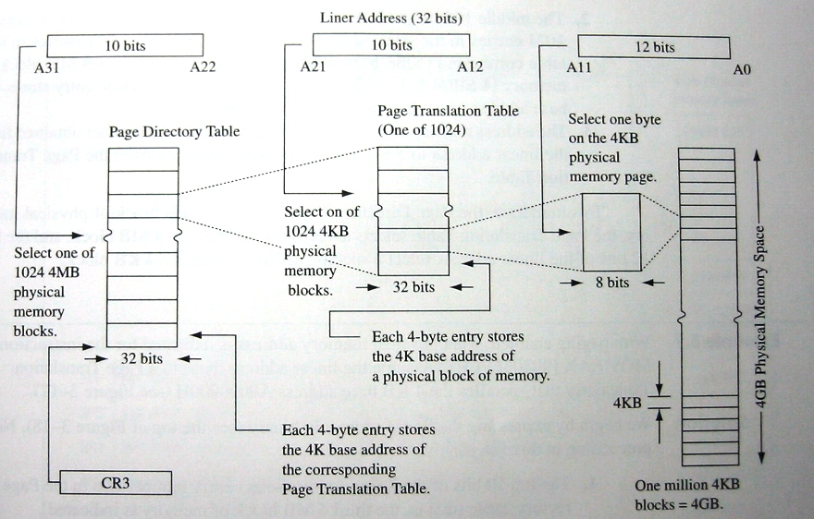
80386 Paging – Physical Address

Slide 27
Example!
With paging enabled, what is the physical address is indicated for the instruction MOV EAX, [00803ffEH]? Assume the linear address maps to a Page Translation Table entry that specifies the 4KB base address A0000000H.

Slide 28
Solution
The top 10 bits of the linear address select entry number in the Page Directory Table
The middle 10 bits select entry number three in Page Translation Table number two
Bottom three hex digits specify the 12-bit linear offset

Slide 29
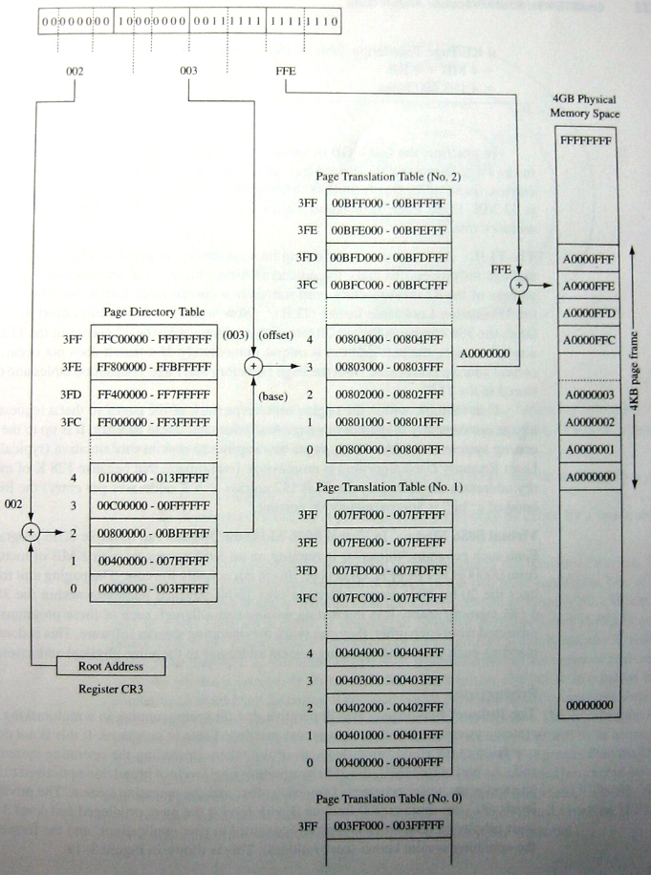
Solution

Slide 30
80486
Retains all the features of the 80386
Has a five-stage instruction pipeline
Integrated floating point coprocessor
On-board 8KB Cache (L1)
  Write through 8KB code and data cache – four way set associative
Can do burst mode
No change in programming model
Additional control registers bits for controlling cache and coprocessor

Slide 31
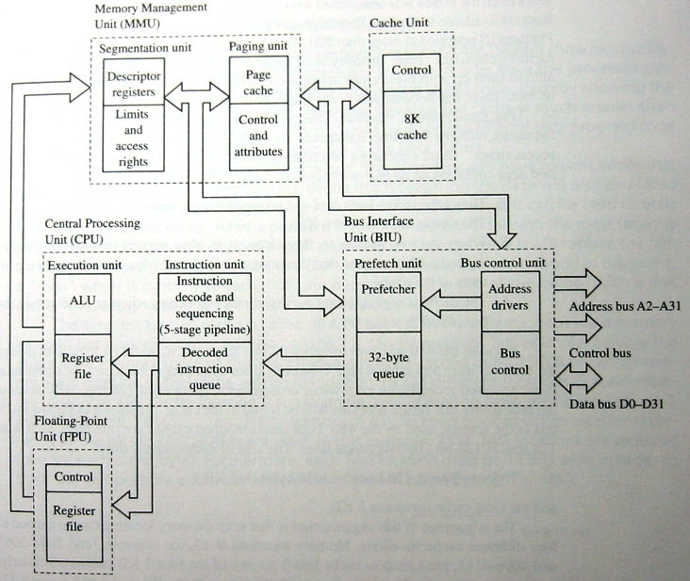
80486 Processor Model

Slide 32
Pentium
Uses a Superscaler architecture
  There are two pipelined execution units
  Prefecther sorts instruction to which execution pipeline is it to be inputted
Floating-point unit is an 8-stage pipeline
Increased cache size – 16K
  Separate data and code cache
Programming model is compatible with 80486
Later models
  Low-power models
  Support for dual processor
  MMX instructions
    Instructions for multimedia applications
    Can do SIMD
    Cache size from 16K to 32K

Slide 33
P6 Processors
Includes
  Celeron and Celeron A, Pentium II and III and Xeon
Features
  Dynamic execution
  Includes L2 cache with non-blocking technique

