Slide 1
Advanced Memory Architectures

Slide 2
Memory Interface
Three main types of interface modules:
  SIMM
  DIMM
  RIMM

Slide 3
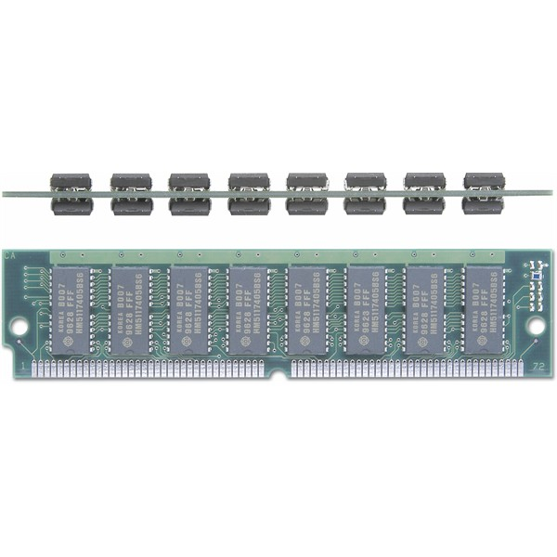
SIMM
Single In-line Memory Module
Single byte module – 30 pins
Four byte module – 72 pins

Slide 4
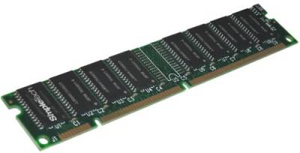
DIMM
Dual In-Line Memory Module
Eight byte module – 168 pins
SIMMs with pins on both sides

Slide 5
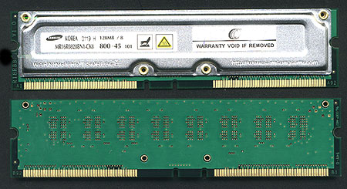
RIMM
Rambus In-line Memory Module
184 pin system
Can transfer 16-bit data at 400Mhz using serial data channel
Requires all sockets to be populated or use of continuity module

Slide 6
Advanced Memory Types
Fast Page Mode
Extended Data Out
Synchronous DRAM

Slide 7
Fast Page Mode
Fast page mode is used during filling of cache
Faster than using full DRAM access in filling cache
Burst cycle
  Mechanism where the first cycle is slower while next accesses are faster
  Example: 5-3-3-3

Slide 8
Extended Data Out
Conventional DRAM drawback
  Data is turned off during CAS pre-charge time
Data remains turned-on
Allows a better data out window

Slide 9
SDRAM
FPM and EDO are optimized for 66Mhz or less bus
SDRAM control signals are applied on one clock rising edge and data appears on a subsequent rising edge
Designed to operate for burst mode
  Employs an internal burst counter
  Also employs interleaving

Slide 10
DDR
Data can be outputted twice
  Rising and falling edge
Can have up to eight access burst mode

Slide 11
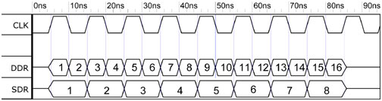
SDRAM and DDR Timing

