Slide 1

AML-2103 Visualization for AI and ML
Lambton College
School of Computer Studies
[Prepared By: Vahid Hadavi, PhD]

Slide 2
Lecture7 7. Examine Visualization using Seaborn
Major Topics:
7.1 Discuss advantages of Seaborn
7.2 Apply figure aesthetics control (figure style, removing axes spines)
7.3 Discuss Seaborn color paletters (categorical, sequential and diverging color platters)
7.4 Demonstrate Multi-plot in seaborn

Slide 3
7.1 Discuss advantages of Seaborn

Slide 4
Seaborn
Unlike Matplotlib, Seaborn is not a standalone Python library.
It is built on top of Matplotlib and provides a higher-level abstraction to make visually appealing statistical visualizations.
The most prominent features of Seaborn are as follows:
Beautiful out of the box plots with different themes
Built-in color palettes that can be used to reveal patterns in the dataset
Dataset-oriented interface
A high-level abstraction that still allows for complex visualizations

Slide 5
Seaborn Advantages
It uses fewer syntax and has easily interesting default themes.
While Matplotlib is highly customizable and powerful, Seaborn avoids a ton of boilerplate by providing default themes which are commonly used.
A neat feature of Seaborn is the ability to integrate with DataFrames from the pandas library.
Seaborn works with the dataset as a whole and is much more intuitive than Matplotlib.
In Seaborn, replot() is the entry API with ‘kind’ parameter to specify the type of plot which could be line, bar, or many of the other types (default scatter).

Slide 6
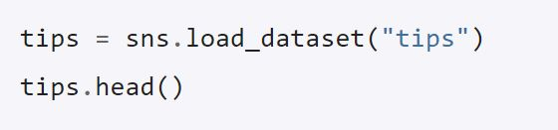
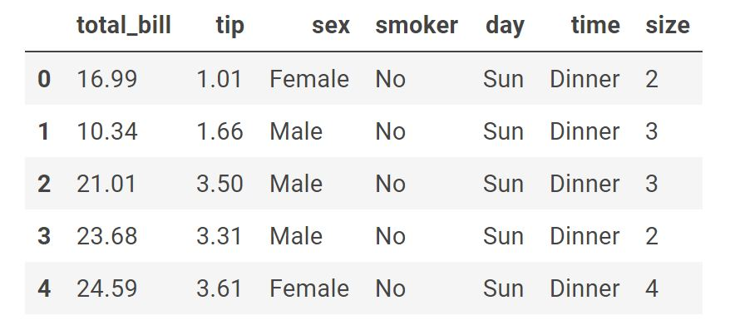
Seaborn example
Seaborn needs to imported.

Slide 7
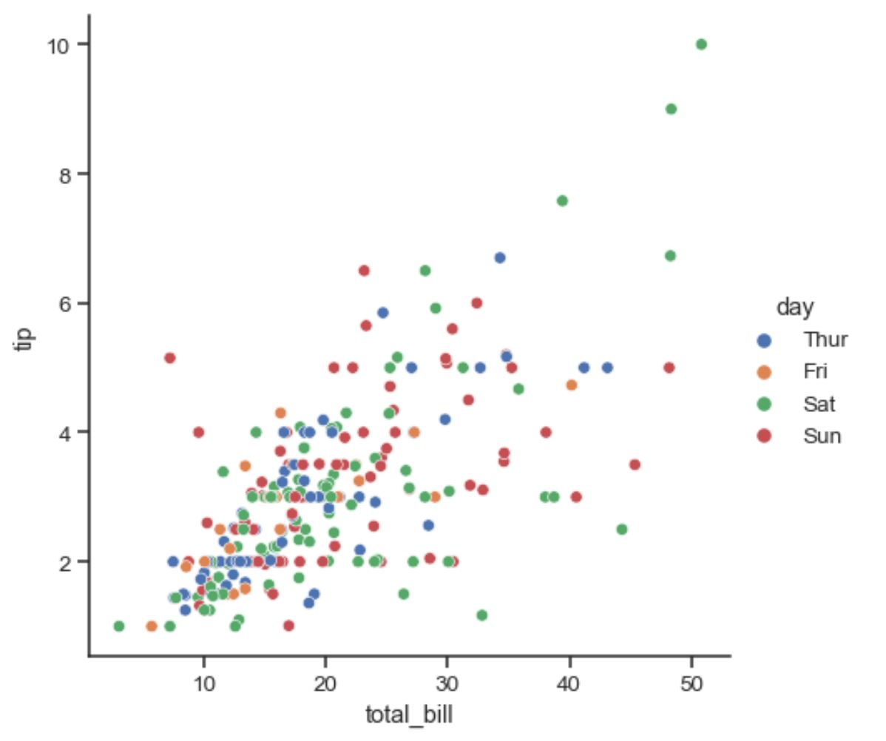
Seaborn example

Slide 8
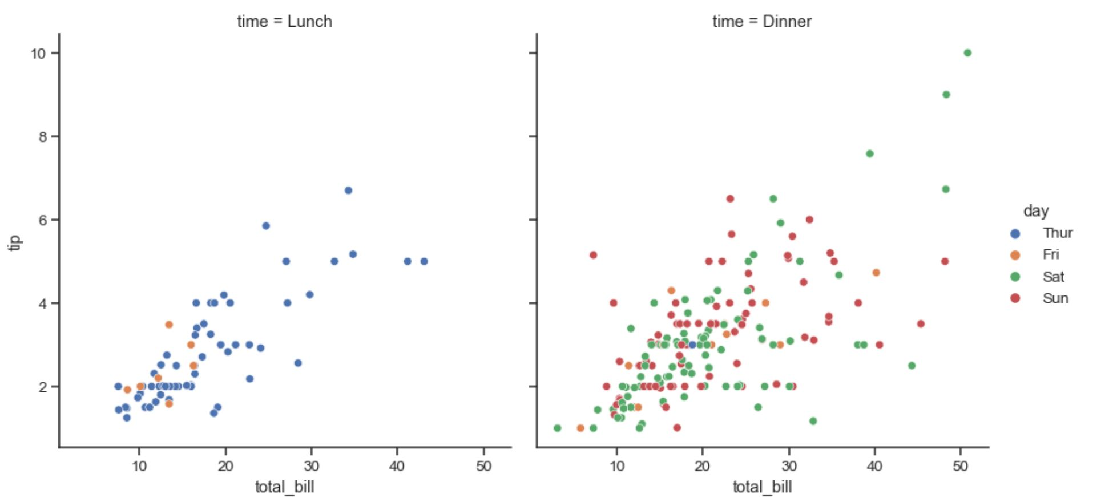
Seaborn example

Slide 9
7.2 Apply figure aesthetics control (figure style, removing axes spines)

Slide 10
Figure aesthetics; Style
To control the style, Seaborn provides two methods:
set_style(style, [rc])
axes_style(style, [rc])
Parameters:
style: A dictionary of parameters or the name of one of the following preconfigured sets: darkgrid, whitegrid, dark, white, or ticks
rc (optional): Parameter mappings to override the values in the preset Seaborn style dictionaries.

Slide 11
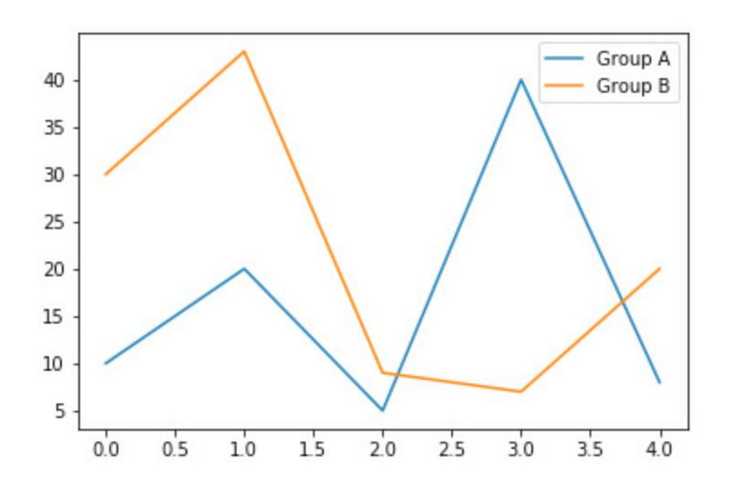
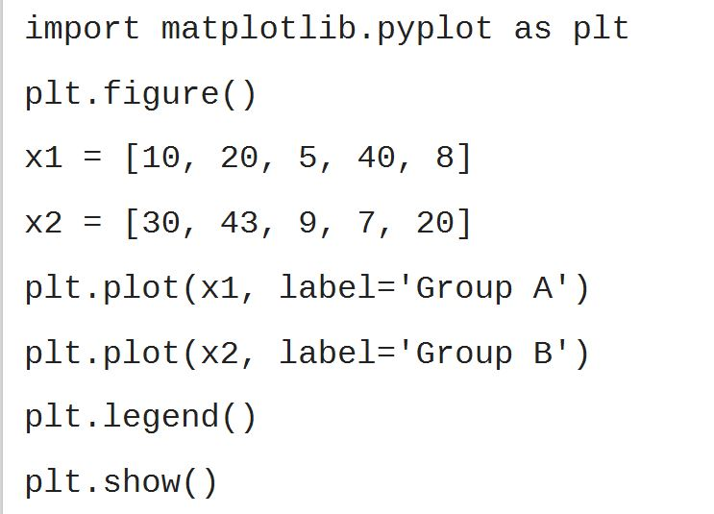
Figure aesthetics; Style
Matplotlib visualization

Slide 12
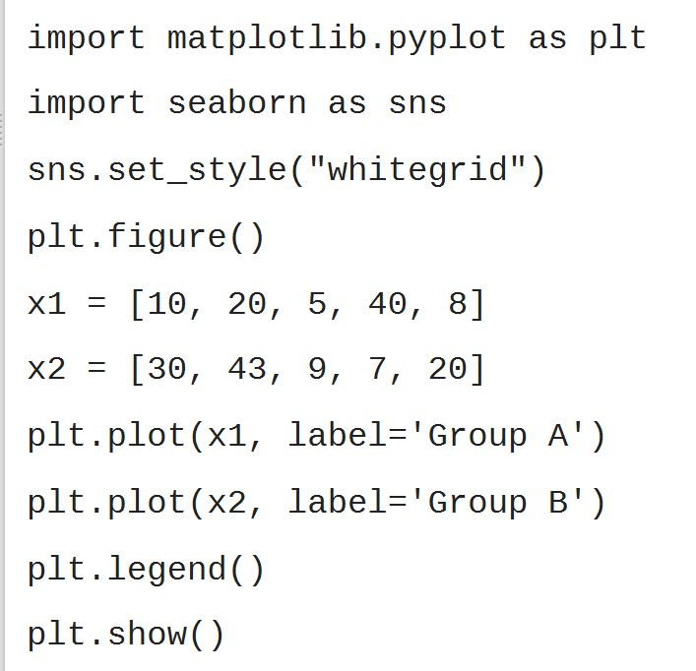
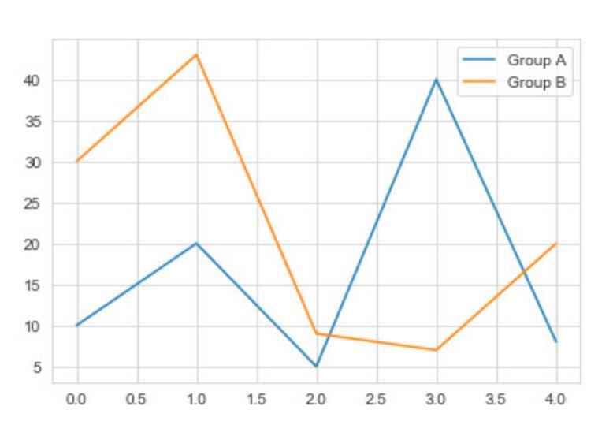
Figure aesthetics; Style
Adding ‘whitegrid’ background using set_style Seaborn

Slide 13
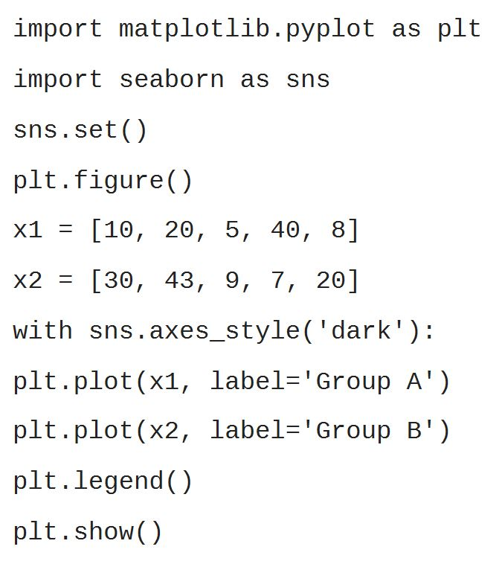
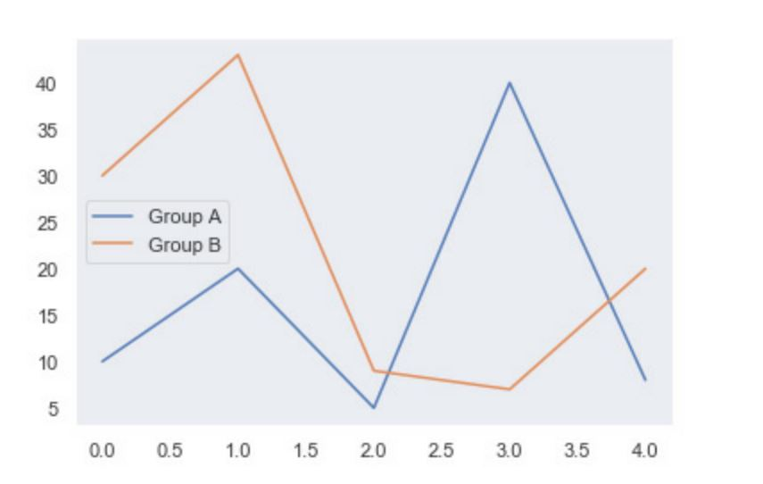
Figure aesthetics; Style
Adding ‘dark’ background using axes_style Seaborn

Slide 14
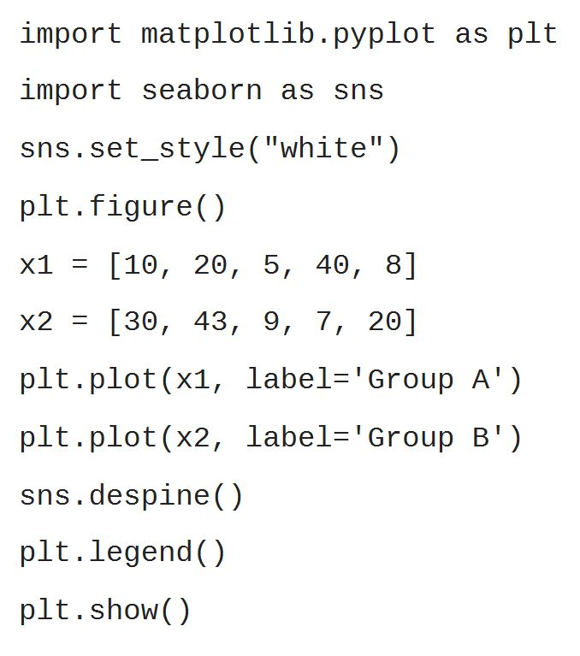
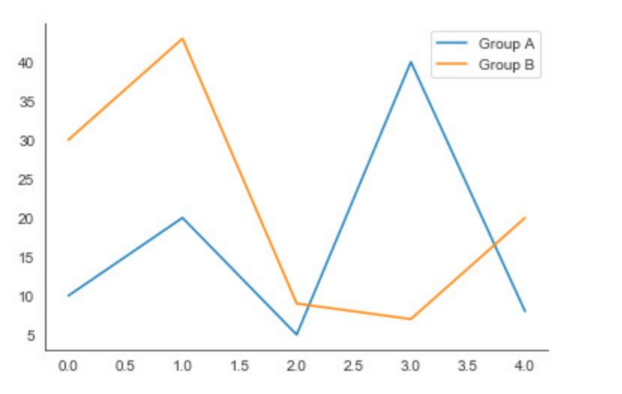
Figure aesthetics; Removing spines
Sometimes, we want to remove the top and right axes spines.

Slide 15
7.3 Discuss Seaborn color paletters (qualitative, sequential and diverging color platters)

Slide 16
Color Palettes
The color_palette() function on Seaborn provides an interface for many of the possible ways to generate colors.
palette (optional): Name of palette or None to return the current palette.
n_colors (optional): Number of colors in the palette. If the specified number of colors is larger than the number of colors in the palette, the colors will be cycled.
desat (optional): Proportion to desaturate each color by.
We can set the palette for all plots with set_palette().
This function accepts the same arguments as color_palette()

Slide 17
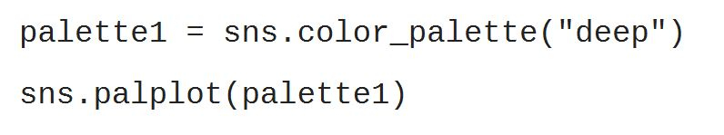
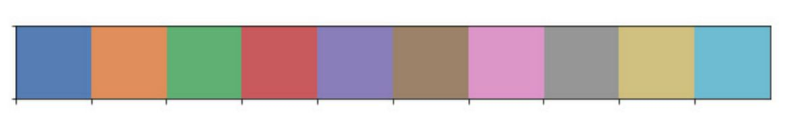
Qualitative color Palettes
When using a dataset that uses distinct but non-ordered categories, it’s good to use qualitative palettes.
Qualitative palettes are sets of distinct colors which make it easy to distinguish the categories when plotted.
They do not imply any particular ordering or meaning.

Slide 18
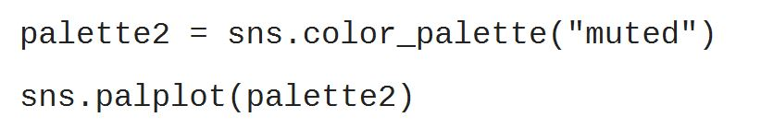
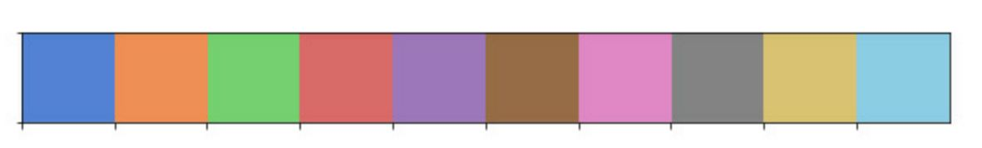
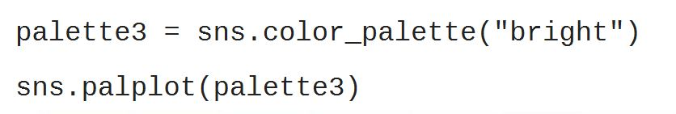
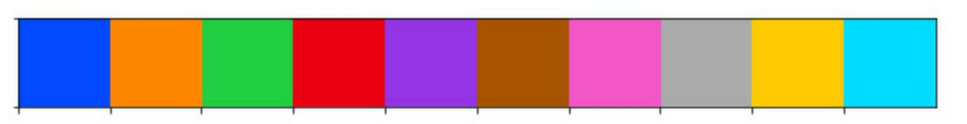
Qualitative color Palettes

Slide 19
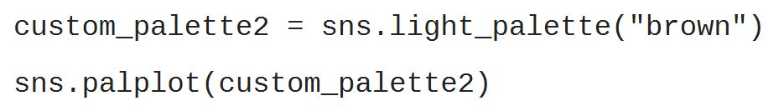
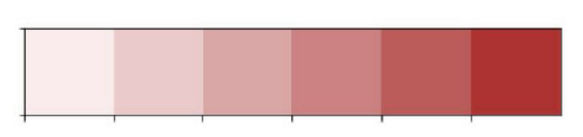
Sequential color Palettes
Just as the name implies, sequential palettes are a set of colors that move sequentially from a lighter to a darker color.
Sequential color palettes are appropriate when:
A variable exists as ordered categories, such as grade in school
Continuous values that can be put into groups, such as yearly income.
Because the darkest colors will attract the most visual attention, sequential palettes are most useful when only high values need to be emphasized.

Slide 20
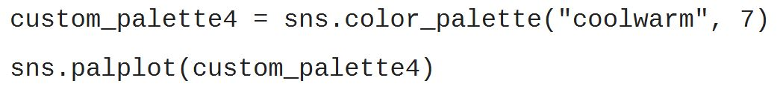
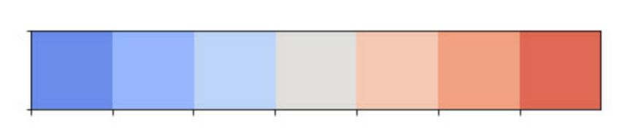
Diverging color Palettes
Diverging palettes are best suited for datasets where both the low and high values might be of equal interest, such as hot and cold temperatures.
They are used for data that consists of a well-defined midpoint

Slide 21
7.4 Demonstrate Multi-plot in seaborn

Slide 22
Multi-plot with FacetGrid
The FacetGrid is used to visualize a certain plot for multiple variables separately.
A FacetGrid can be drawn with up to three dimensions: row, col, and hue.
col and row have the obvious correspondence to the rows and columns of an array.
hue is the third dimension and shown with different colors (described by legend).
The FacetGrid class has to be initialized with a DataFrame and the names of the variables that will form the row, column, or hue dimensions of the grid.
The selected variables should be categorical or discrete.
We can have Share x/y axes across rows/columns, by specifying ‘sharex’ and ‘sharey’.

Slide 23
Multi-plot with FacetGrid
Initializing the grid does not draw anything on them yet.
For visualizing data on this grid, the FacetGrid.map() method has to be used.
You can provide any plotting function and the name(s) of the variable(s) in the data frame to plot.

Slide 24
Multi-plot with FacetGrid

Slide 25
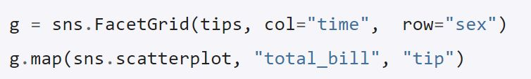
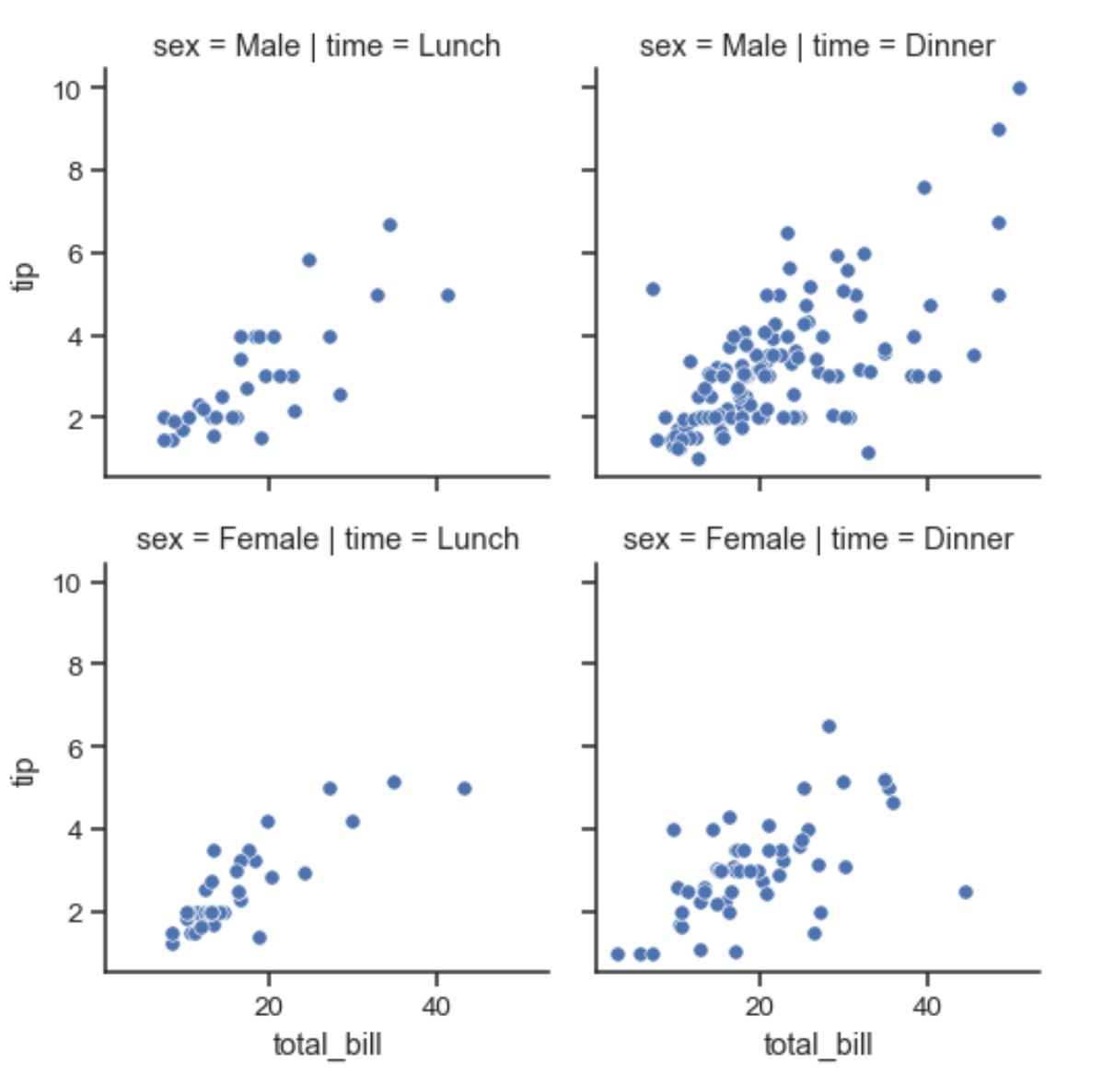
Multi-plot with FacetGrid
There are two values for ‘time’ variable (Dinner & Lunch) and two values for ‘sex’ variable (Female & Male).

Slide 26
Any questions so far? Any comments?

