Slide 1
Chapter 2 Introduction to Java Applications; Input/Output and Operators
Java How to Program, 11/e
Questions? E-mail paul.deitel@deitel.com

Slide 2
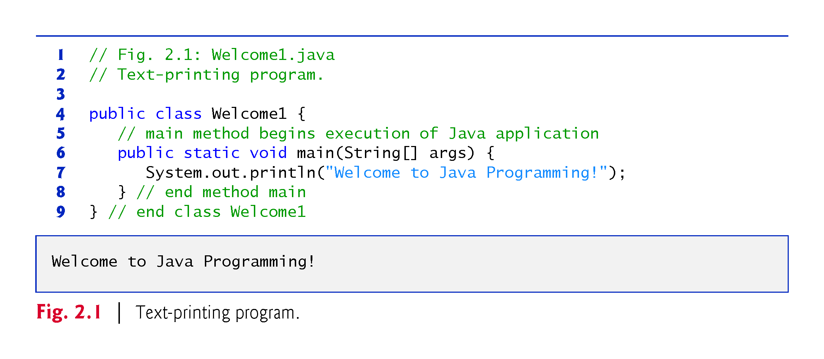

Slide 3
2.2 Your First Program in Java: Printing a Line of Text (Cont.)
Class Names and Identifiers
By convention, begin with a capital letter and capitalize the first letter of each word they include (e.g., SampleClassName).
A class name is an identifier—a series of characters consisting of letters, digits, underscores (_) and dollar signs ($) that does not begin with a digit and does not contain spaces.
Java is case sensitive—uppercase and lowercase letters are distinct—so a1 and A1 are different (but both valid) identifiers.
Underscore (_) in Java 9
As of Java 9, you can no longer use an underscore (_) by itself as an identifier.

Slide 4
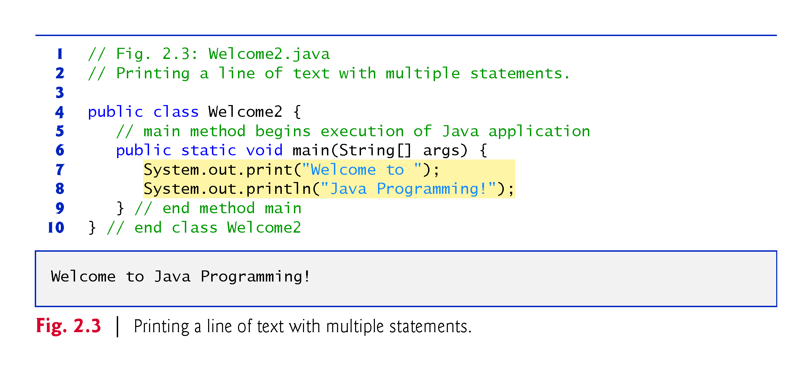

Slide 5
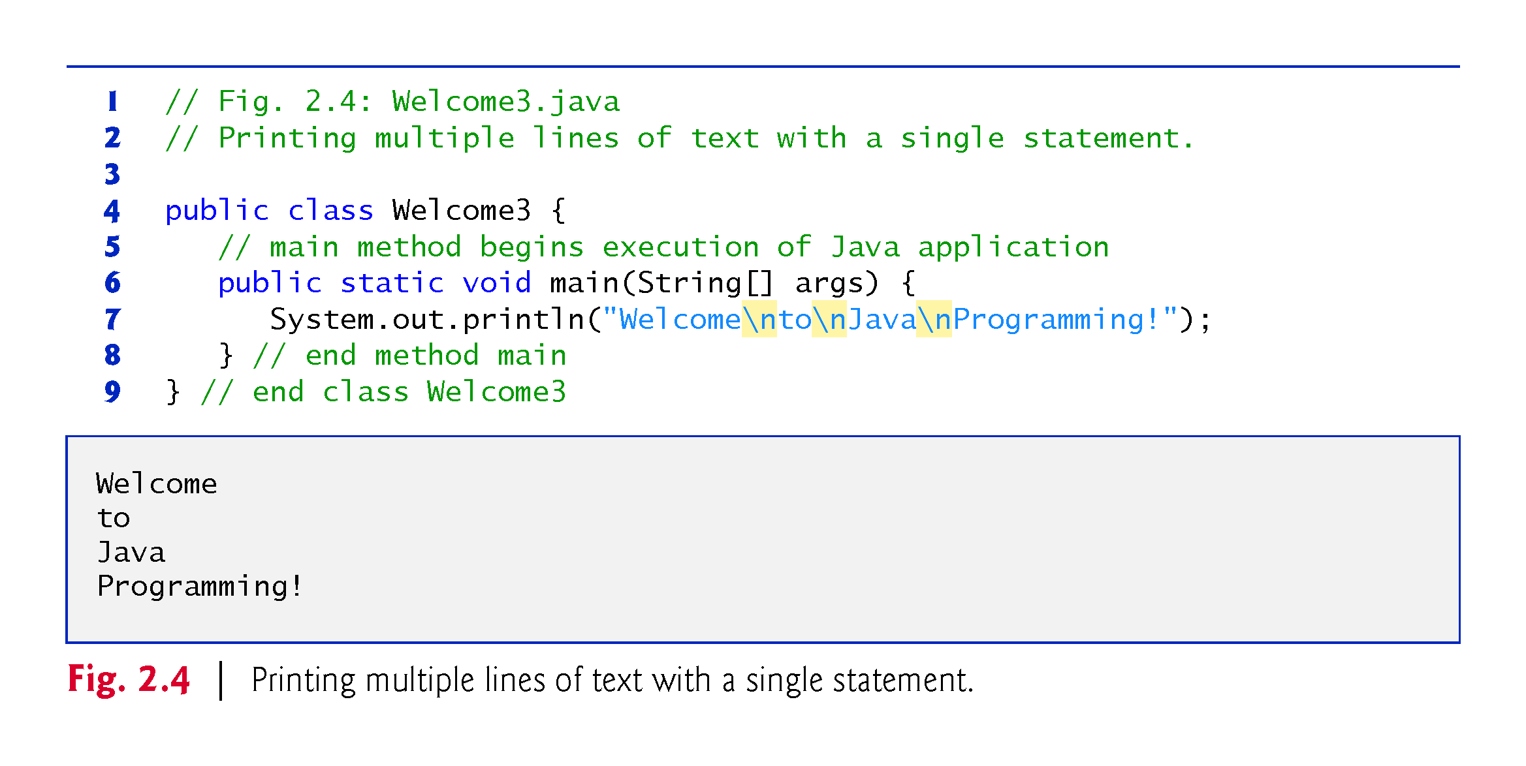

Slide 6
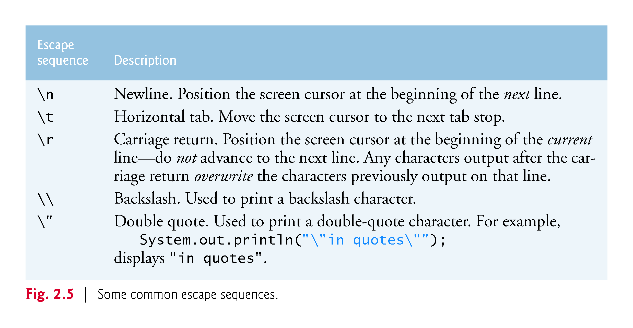

Slide 7
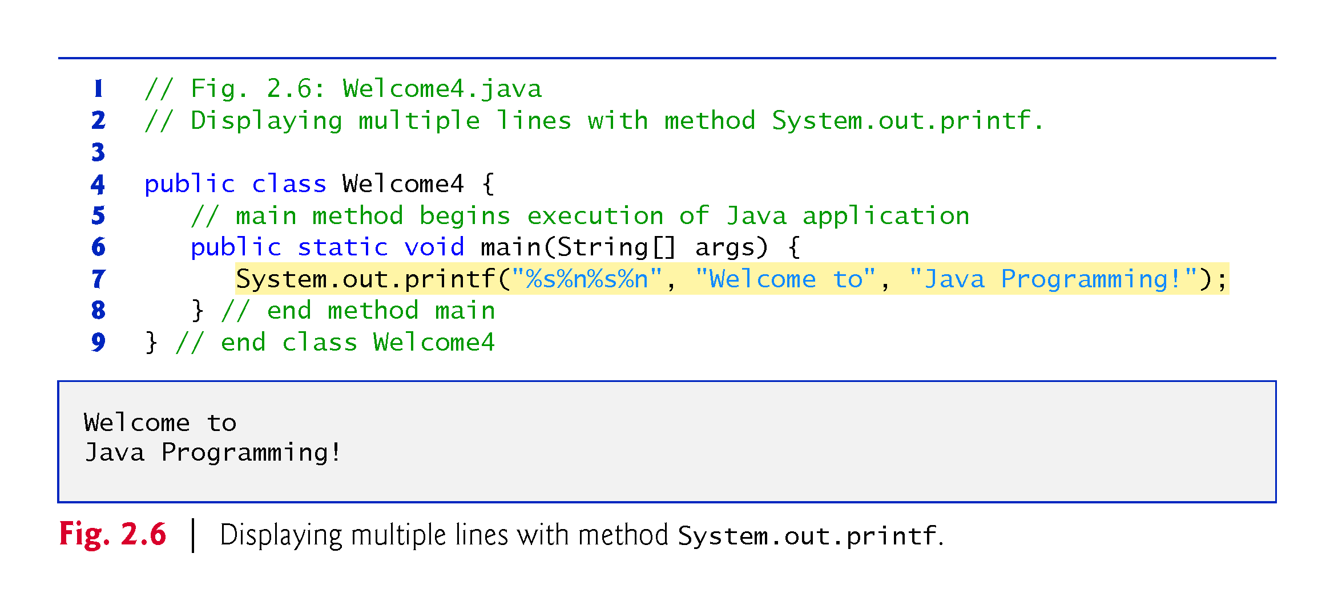

Slide 8
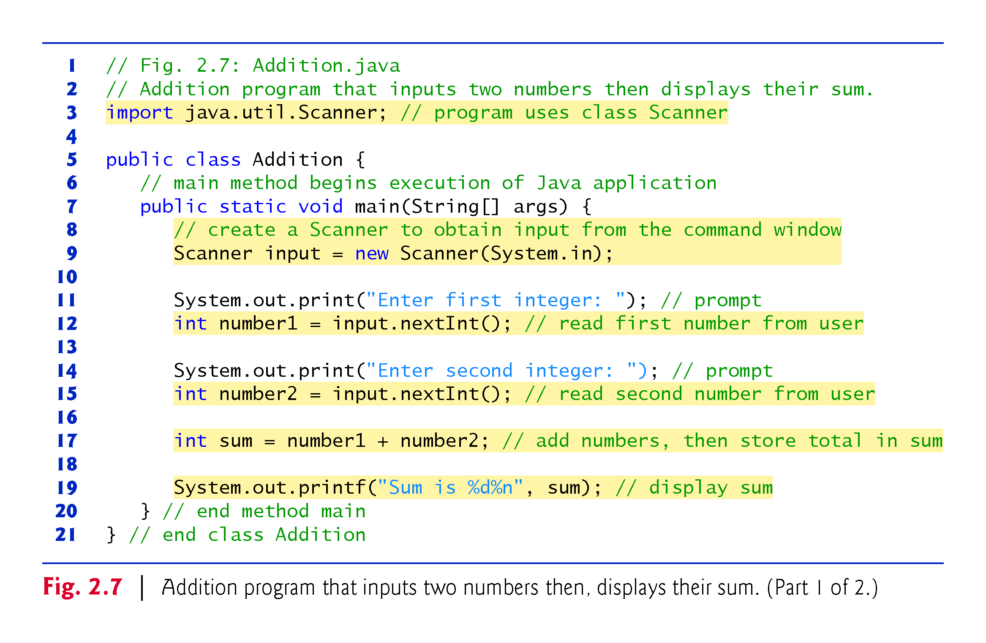

Slide 9
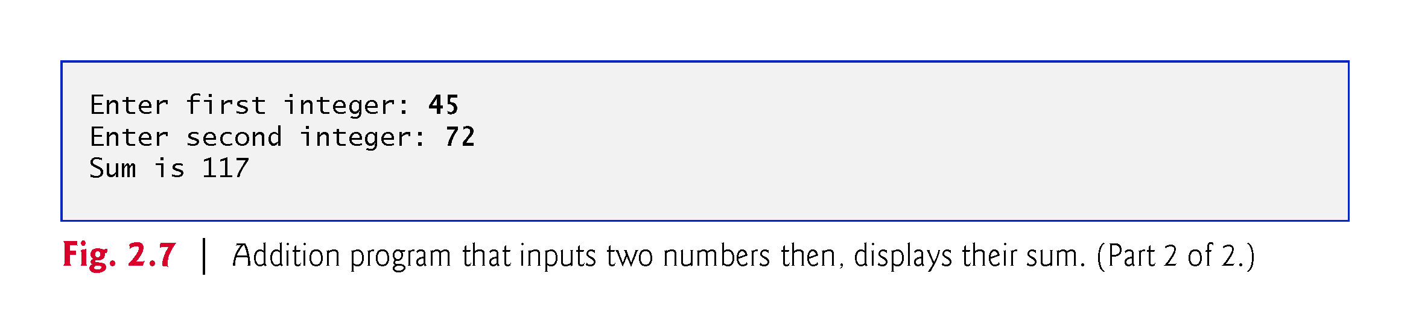

Slide 10
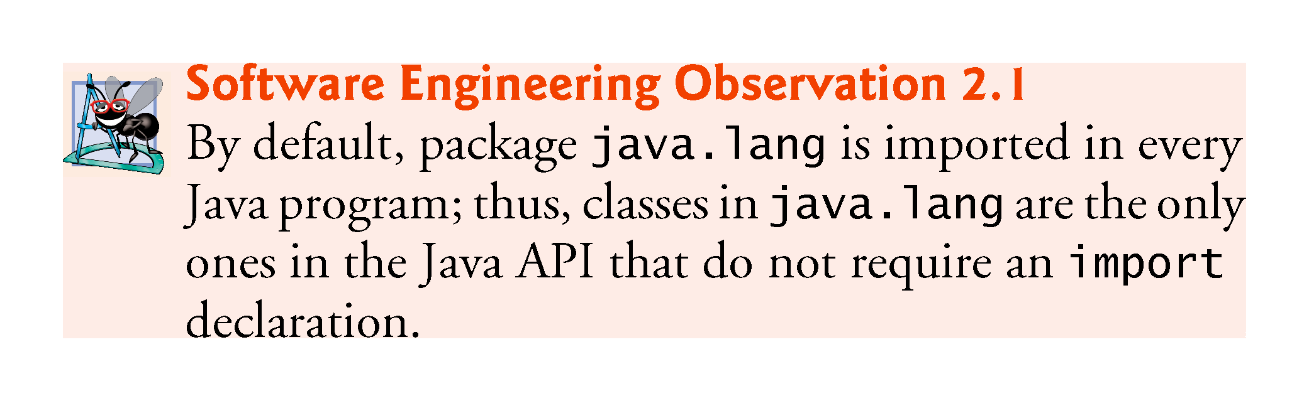

Slide 11
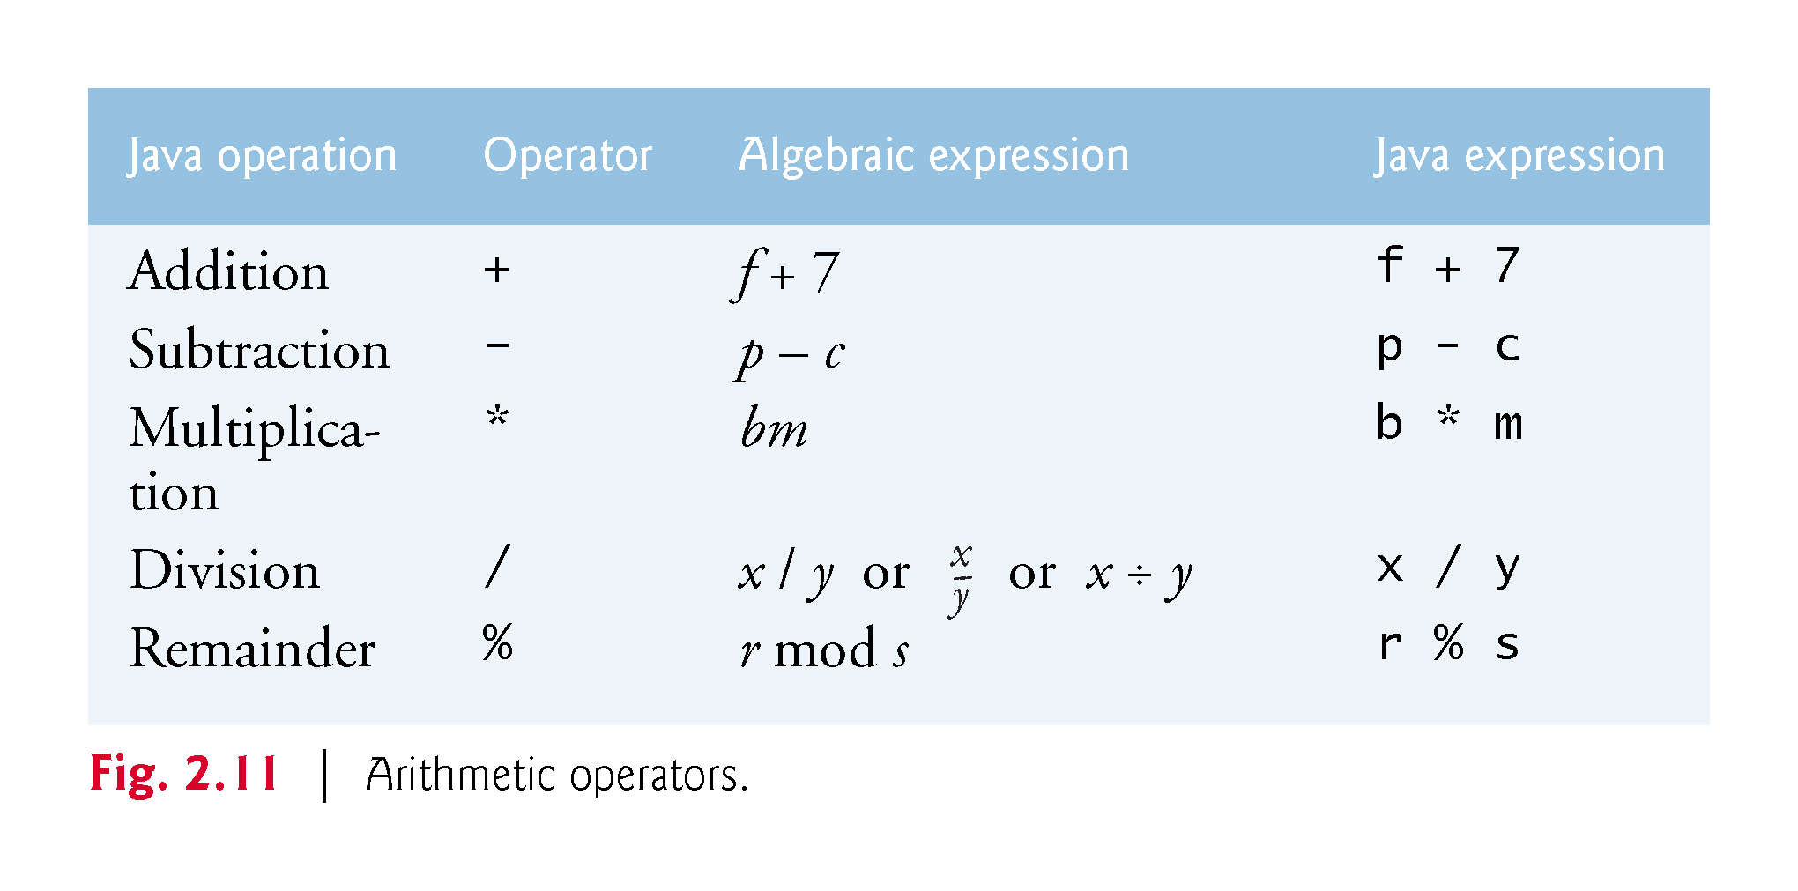

Slide 12
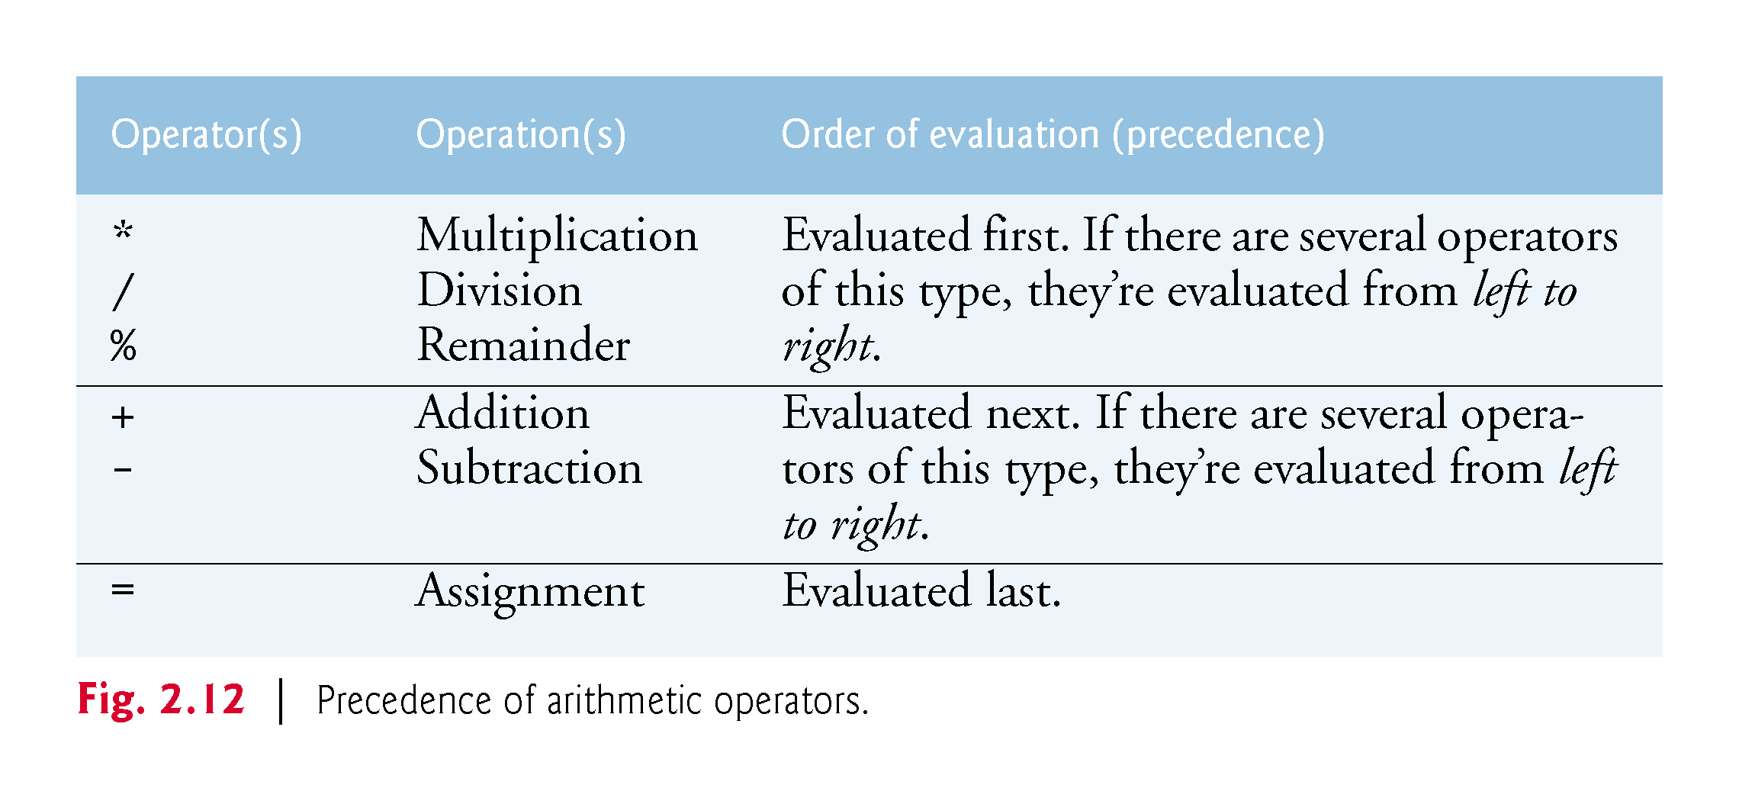

Slide 13
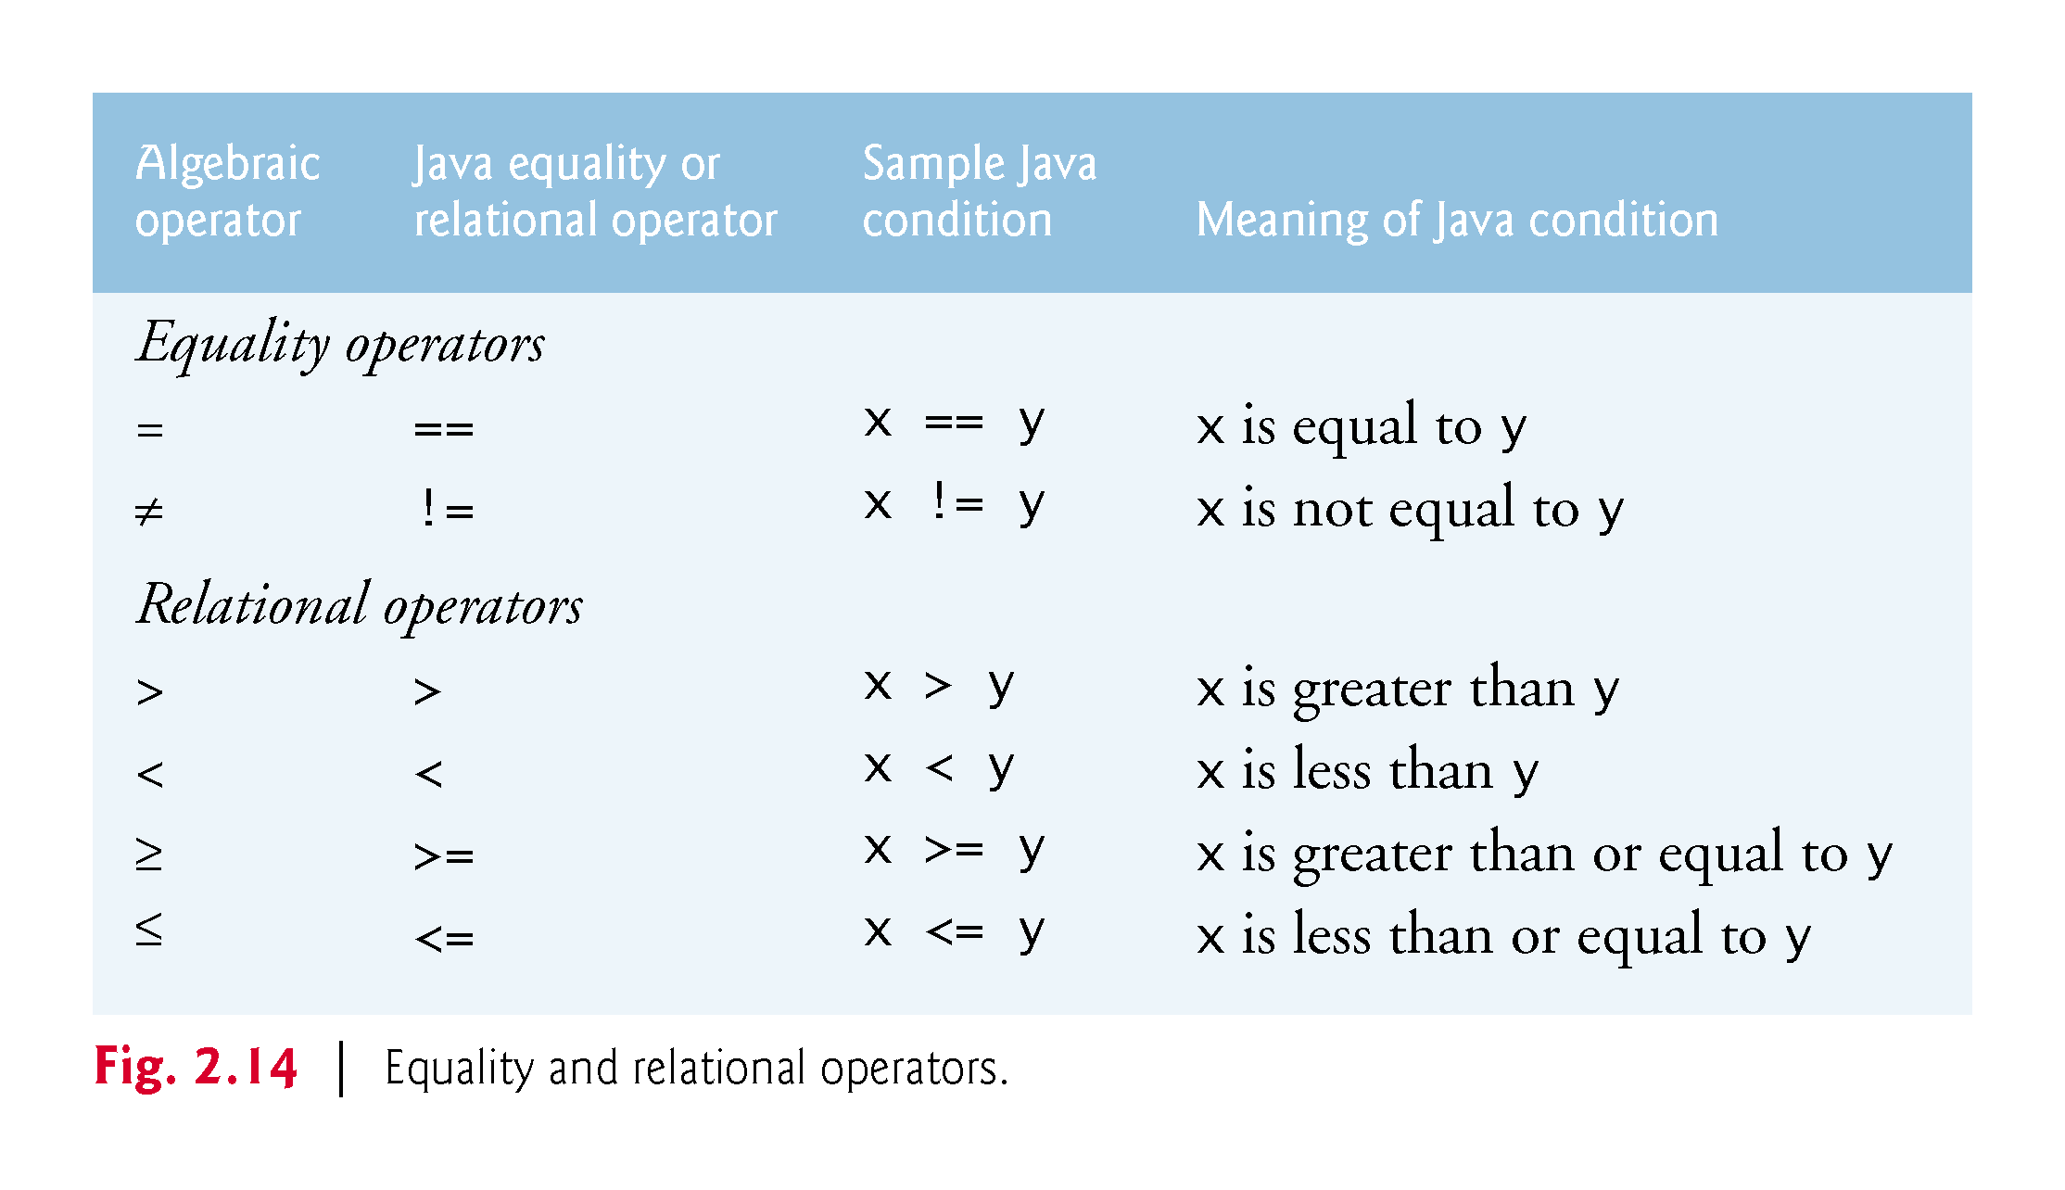

Slide 14
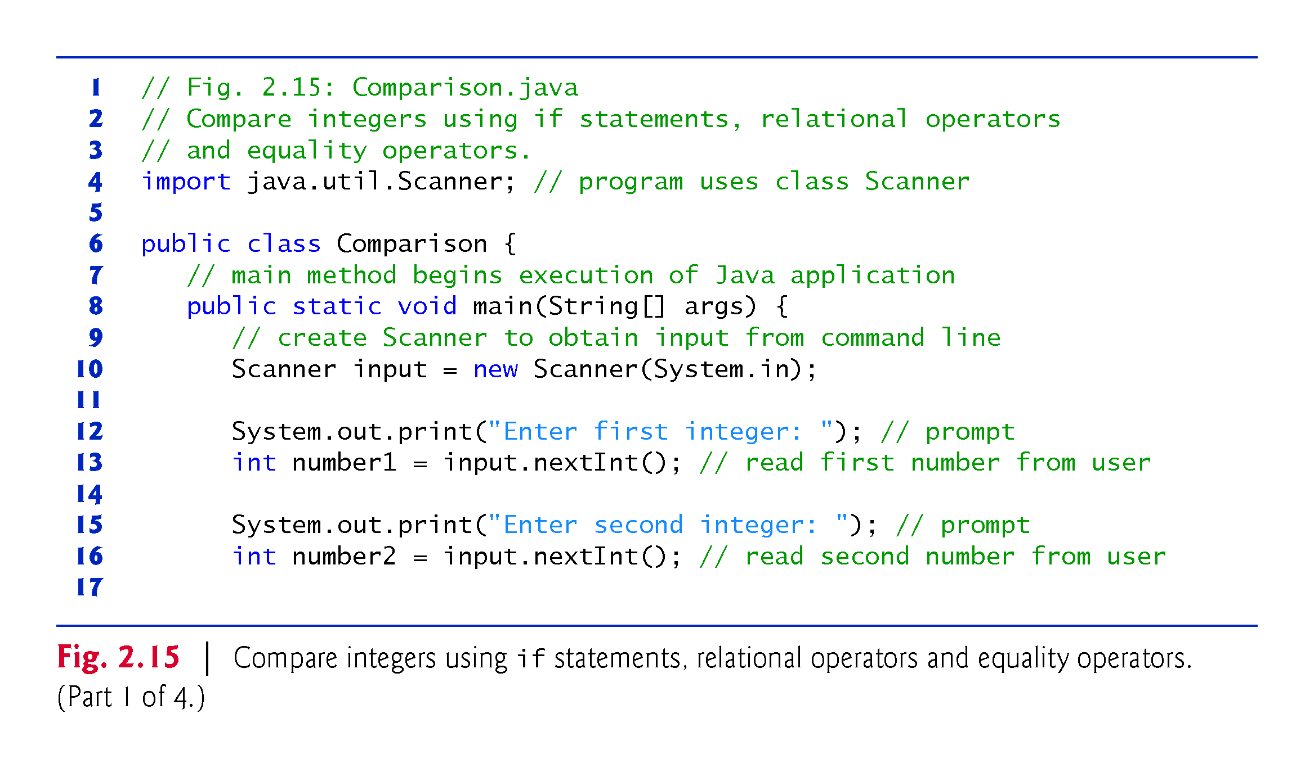

Slide 15
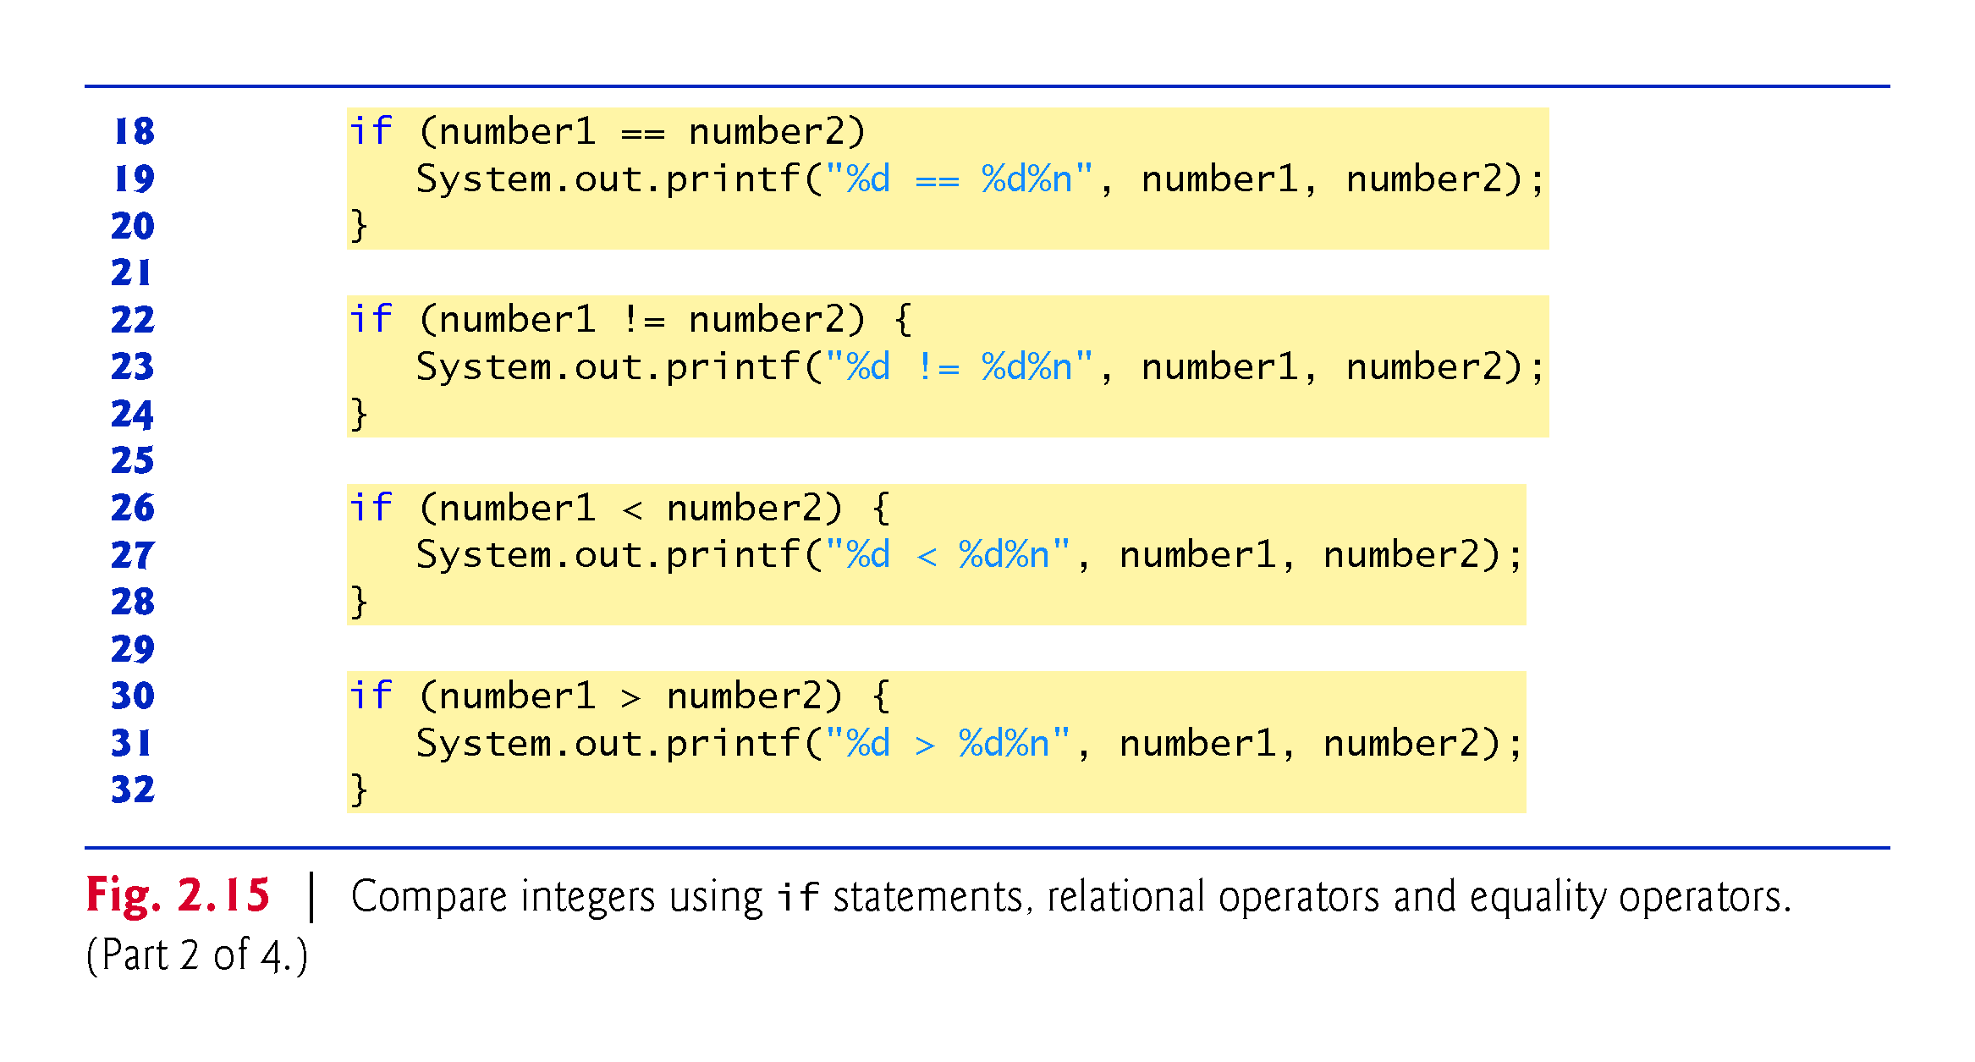

Slide 16
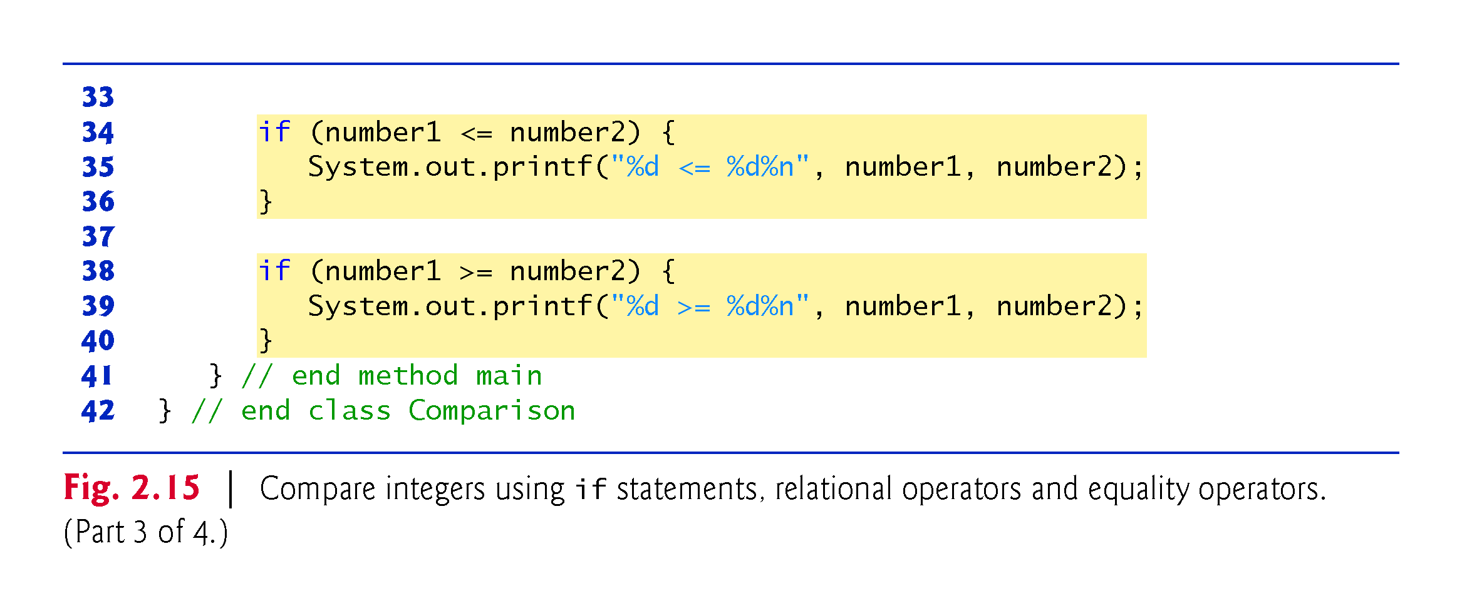

Slide 17
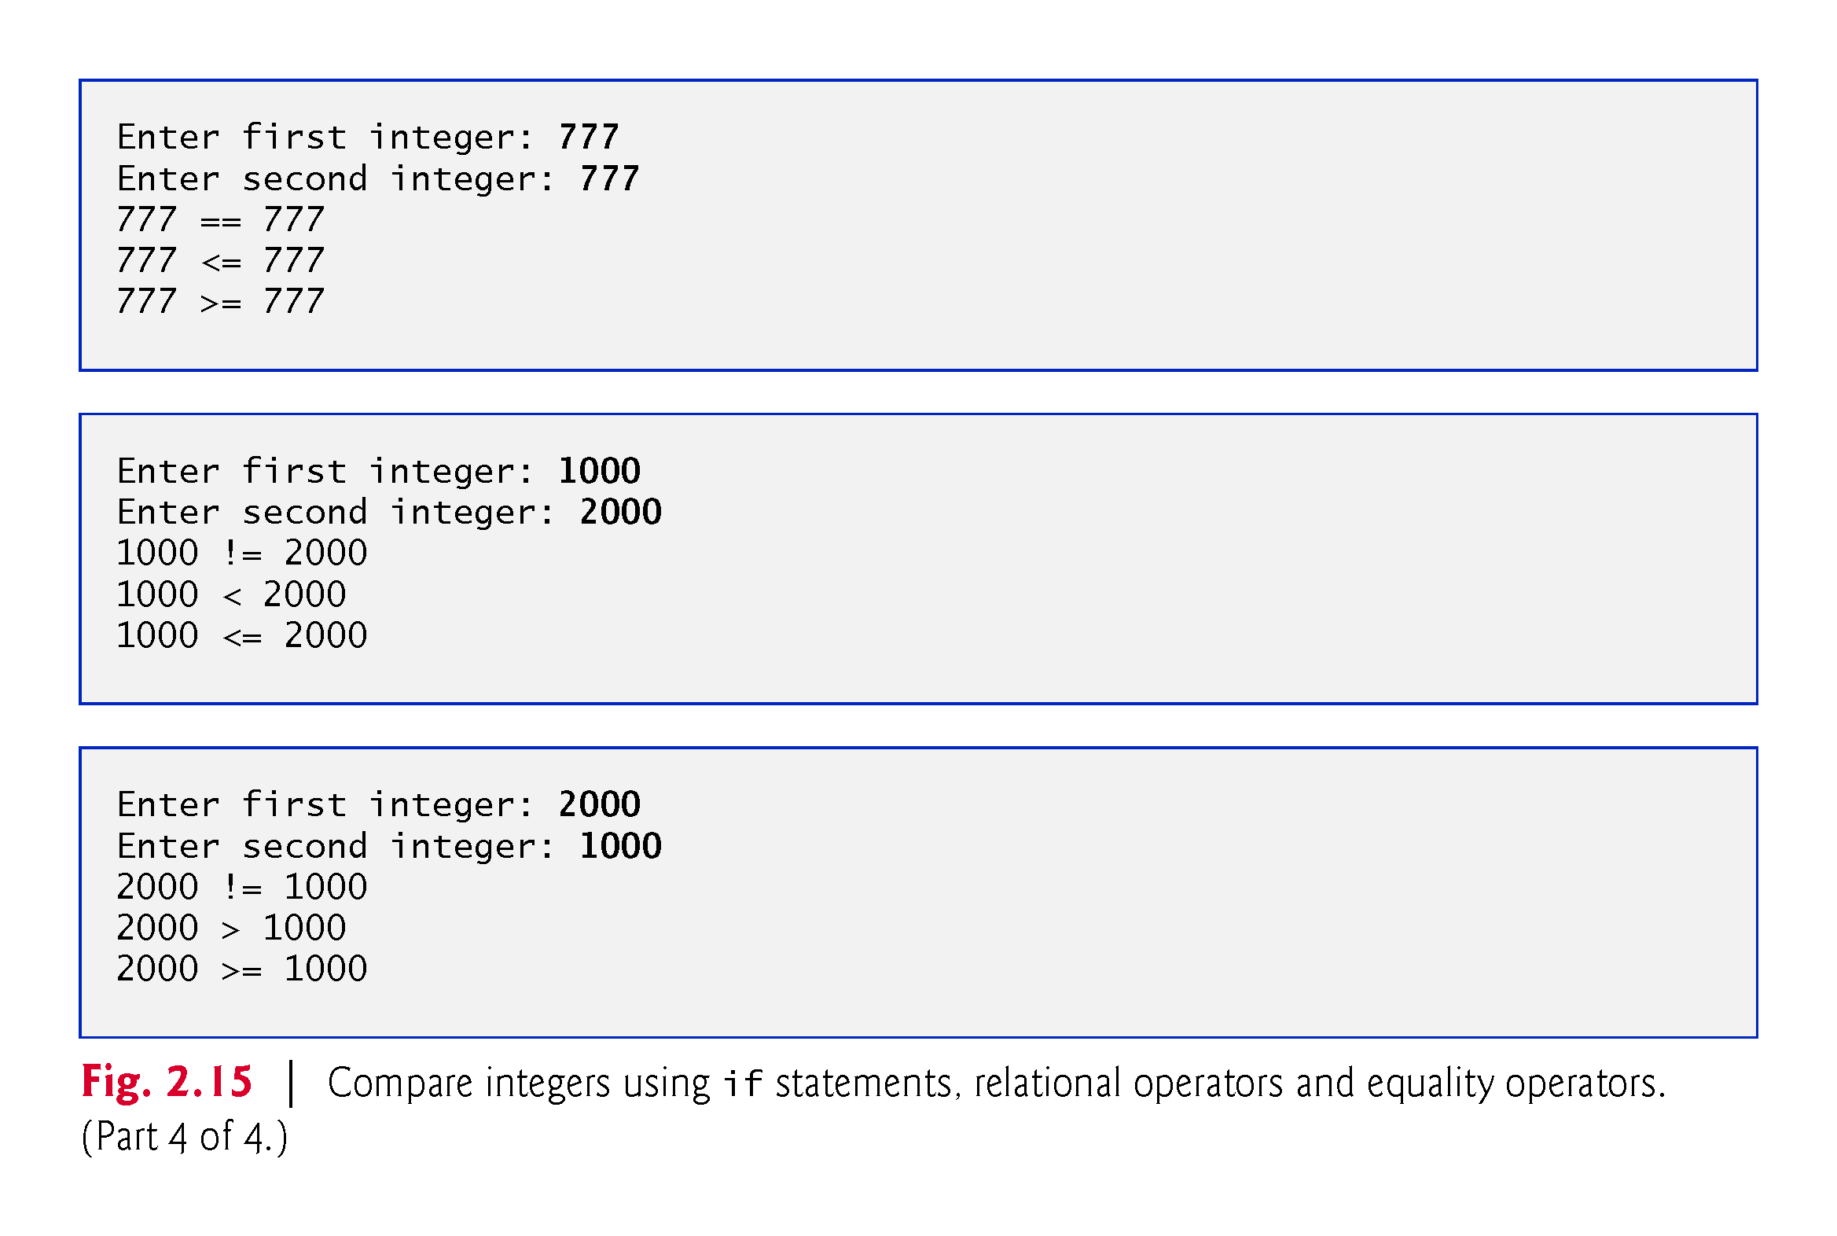

Slide 18
