Slide 1
Chapter 3 Introduction to Classes, Objects, Methods and Strings
Java How to Program, 11/e
Questions? E-mail paul.deitel@deitel.com

Slide 2
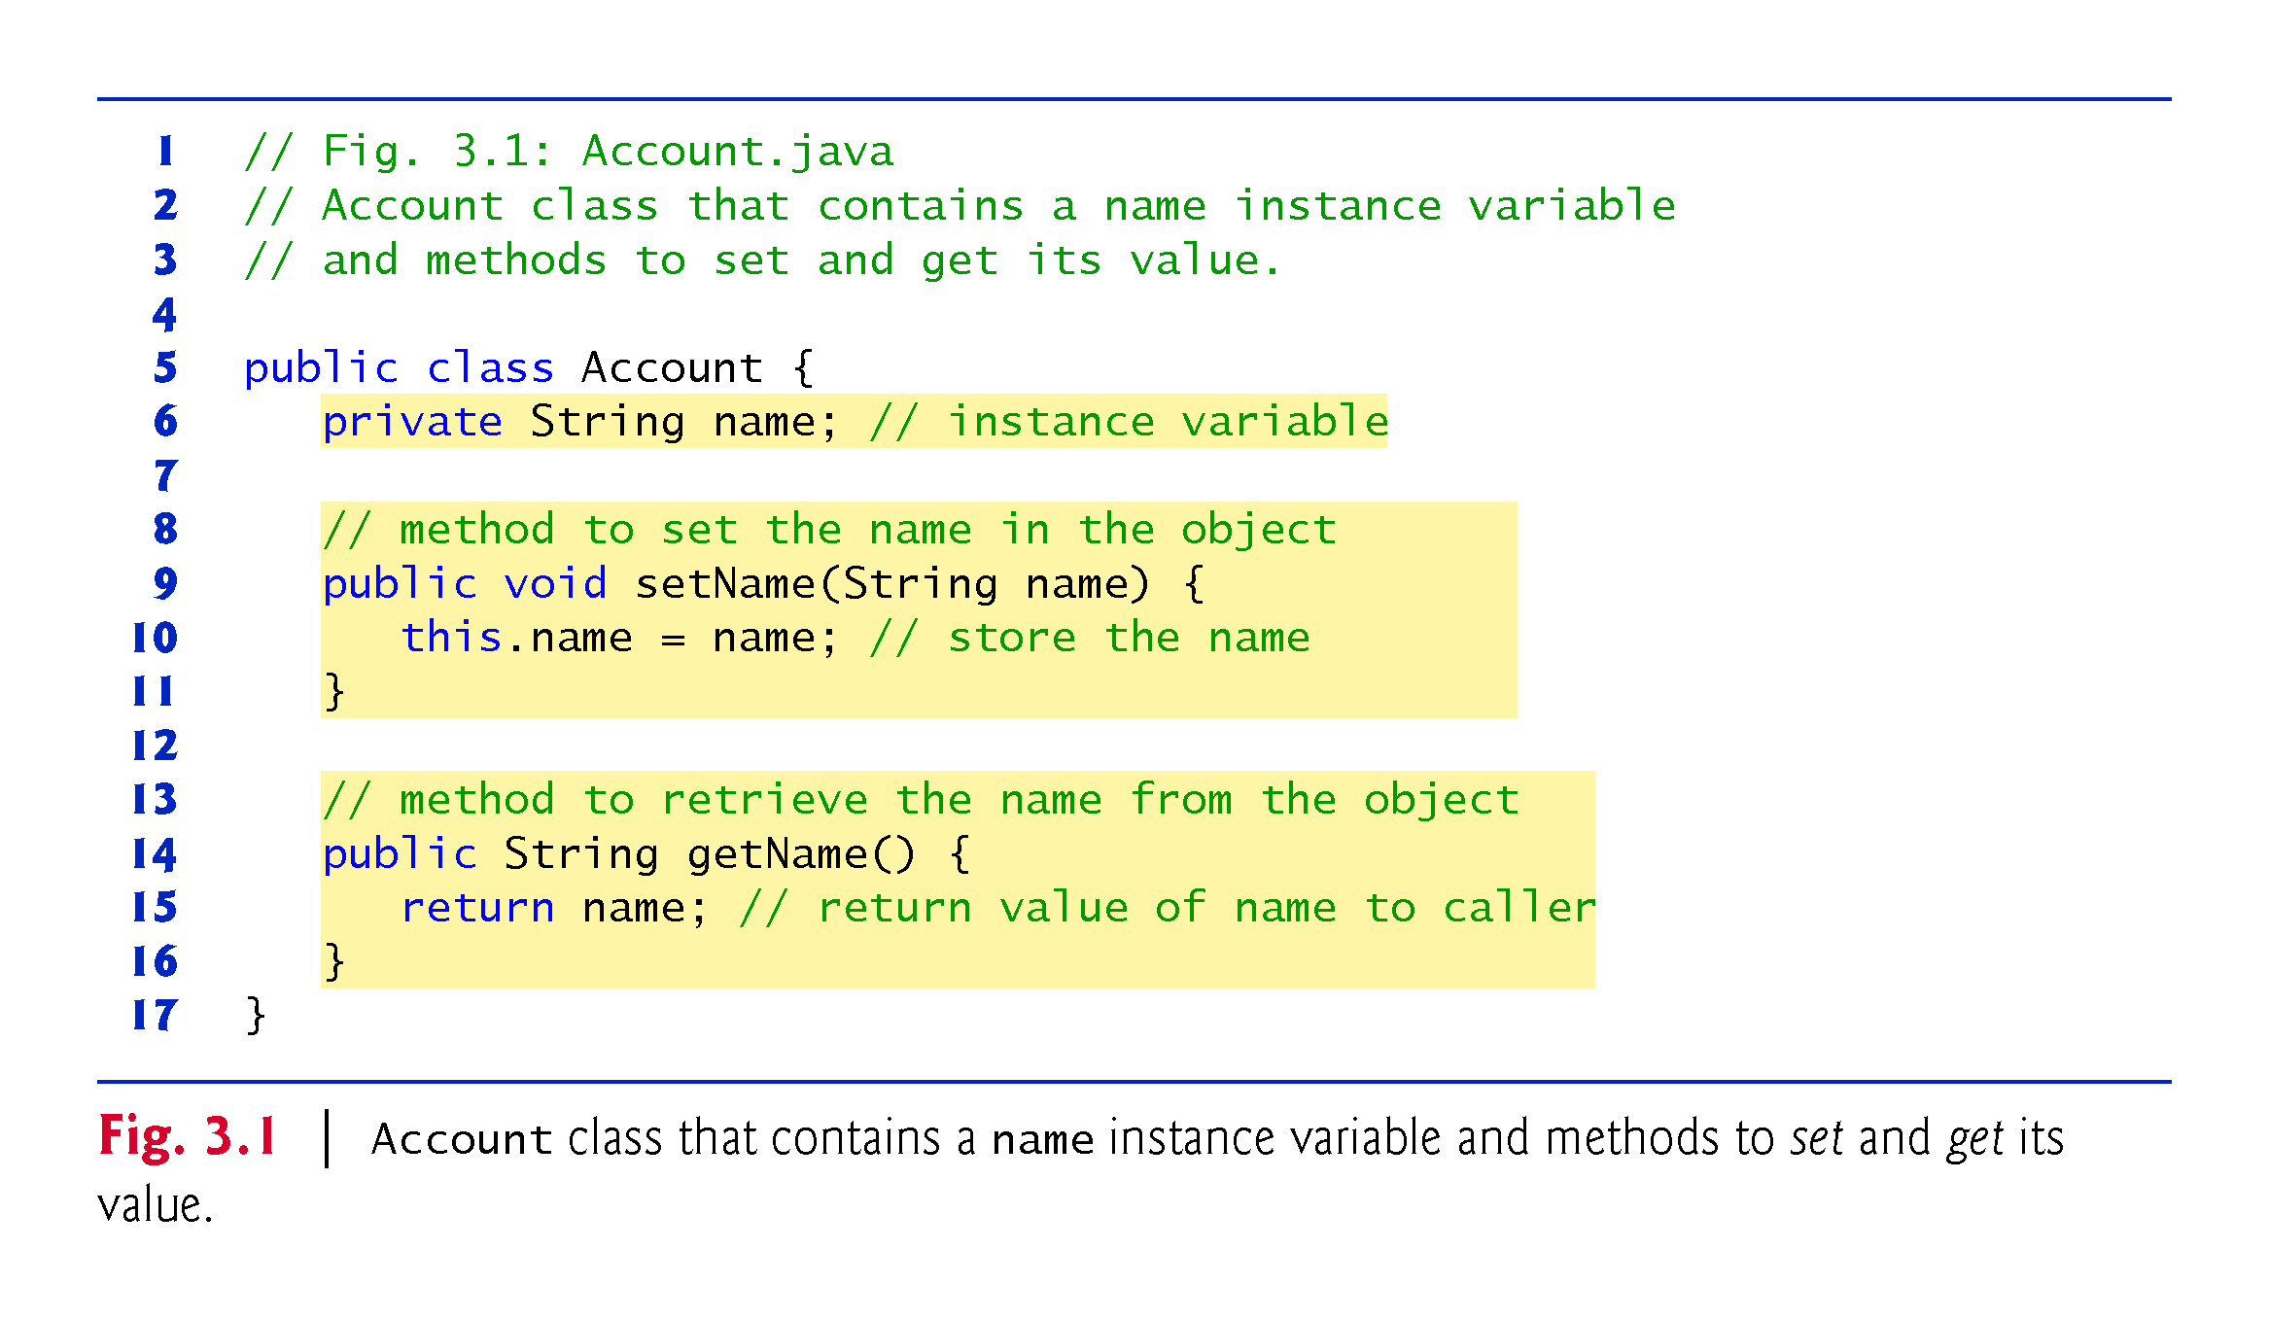

Slide 3
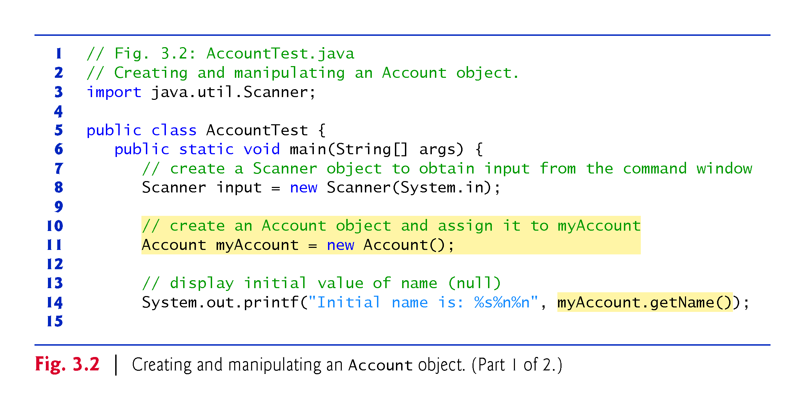

Slide 4
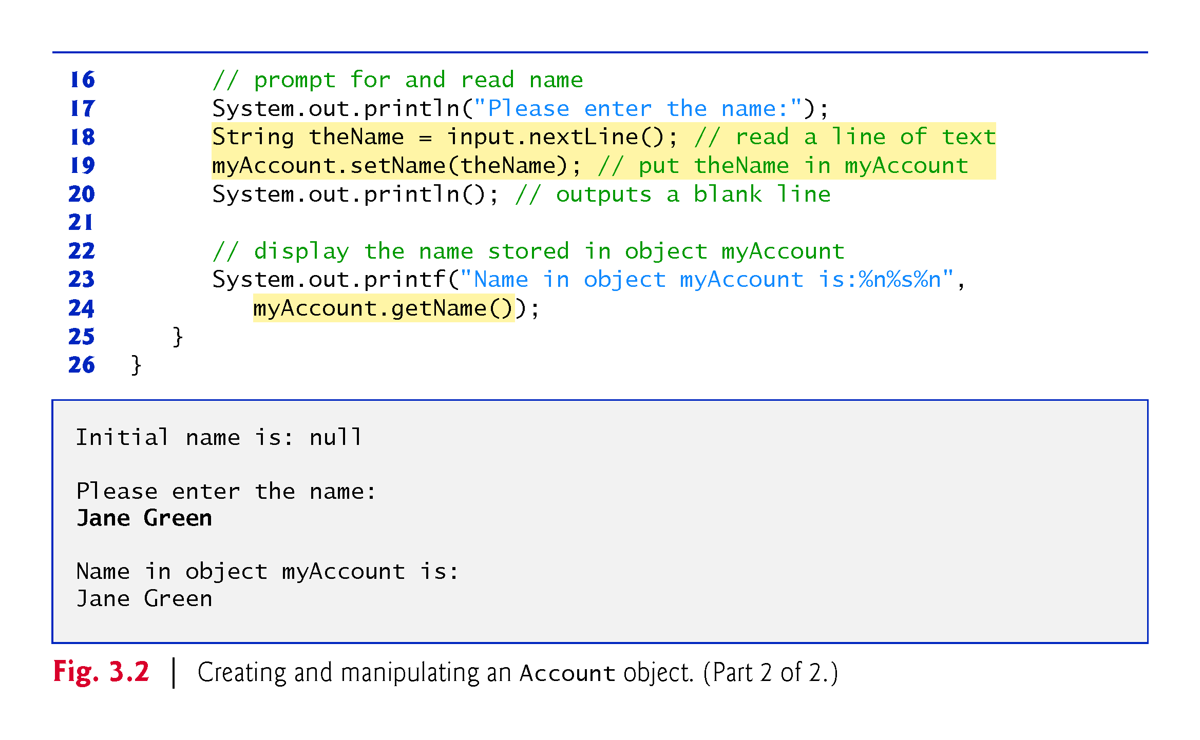

Slide 5
3.2.2 AccountTest Class That Creates and Uses an Object of Class Account (Cont.)
null—the Default Initial Value for String Variables
Local variables are not automatically initialized.
Every instance variable has a default initial value—a value provided by Java when you do not specify the instance variable’s initial value.
The default value for an instance variable of type String is null.

Slide 6
3.2.3 Compiling and Executing an App with Multiple Classes
The javac command can compile multiple classes at once.
Simply list the source-code filenames after the command with each filename separated by a space from the next.
If the directory containing the app includes only one app’s files, you can compile all of its classes with the command javac *.java.
The asterisk (*) in *.java indicates that all files in the current directory ending with the filename extension “.java” should be compiled.

Slide 7
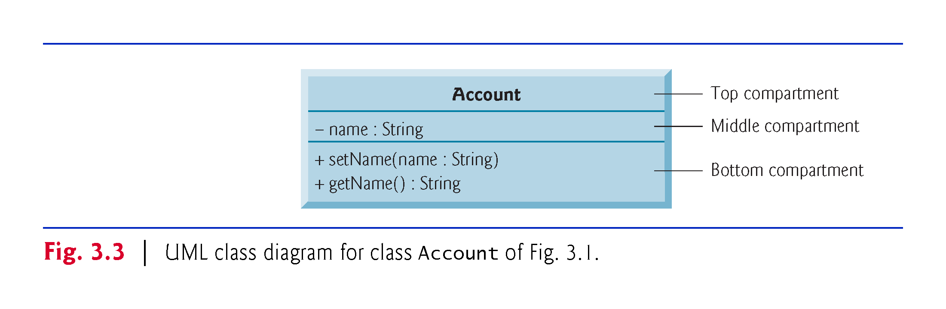

Slide 8
3.2.4 Account UML Class Diagram
Top Compartment
In the UML, each class is modeled in a class diagram as a rectangle with three compartments. The top one contains the class’s name centered horizontally in boldface.

Slide 9
3.2.4 Account UML Class Diagram
Middle Compartment
The middle compartment contains the class’s attributes, which correspond to instance variables in Java.

Slide 10
3.2.4 Account UML Class Diagram
Bottom Compartment
The bottom compartment contains the class’s operations, which correspond to methods and constructors in Java.
The UML represents instance variables as an attribute name, followed by a colon and the type.
Private attributes are preceded by a minus sign (–) in the UML.
The UML models operations by listing the operation name followed by a set of parentheses.
A plus sign (+) in front of the operation name indicates that the operation is a public one in the UML (i.e., a public method in Java).

Slide 11
3.2.4 Account UML Class Diagram
Return Types
The UML indicates an operation’s return type by placing a colon and the return type after the parentheses following the operation name.
UML class diagrams do not specify return types for operations that do not return values.
Declaring instance variables private is known as data hiding or information hiding.

Slide 12
3.2.4 Account UML Class Diagram
Parameters
The UML models a parameter of an operation by listing the parameter name, followed by a colon and the parameter type between the parentheses after the operation name

Slide 13
3.2.5 Additional Notes on Class AccountTest
static Method main
You must call most methods other than main explicitly to tell them to perform their tasks.
A key part of enabling the JVM to locate and call method main to begin the app’s execution is the static keyword, which indicates that main is a static method that can be called without first creating an object of the class in which the method is declared.

Slide 14
3.2.5 Additional Notes on Class AccountTest (Cont.)
Notes on import Declarations
Most classes you’ll use in Java programs must be imported explicitly.
There’s a special relationship between classes that are compiled in the same directory.
By default, such classes are considered to be in the same package—known as the default package.
Classes in the same package are implicitly imported into the source-code files of other classes in that package.

Slide 15
3.2.5 Additional Notes on Class AccountTest (Cont.)
An import declaration is not required when one class in a package uses another in the same package.
An import- declaration is not required if you always refer to a class with its fully qualified class name, which includes its package name and class name.

Slide 16
3.2.6 Software Engineering with private Instance Variables and public set and get Methods
Declaring instance variables private is known as data hiding or information hiding.

Slide 17
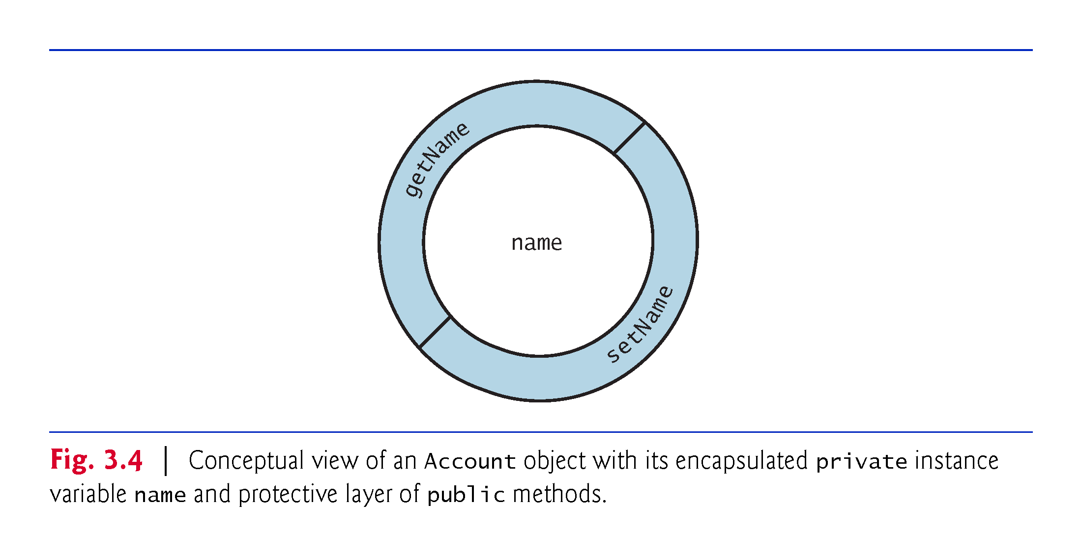
3.2.6 Software Engineering with private Instance Variables and public set and get Methods

Slide 18
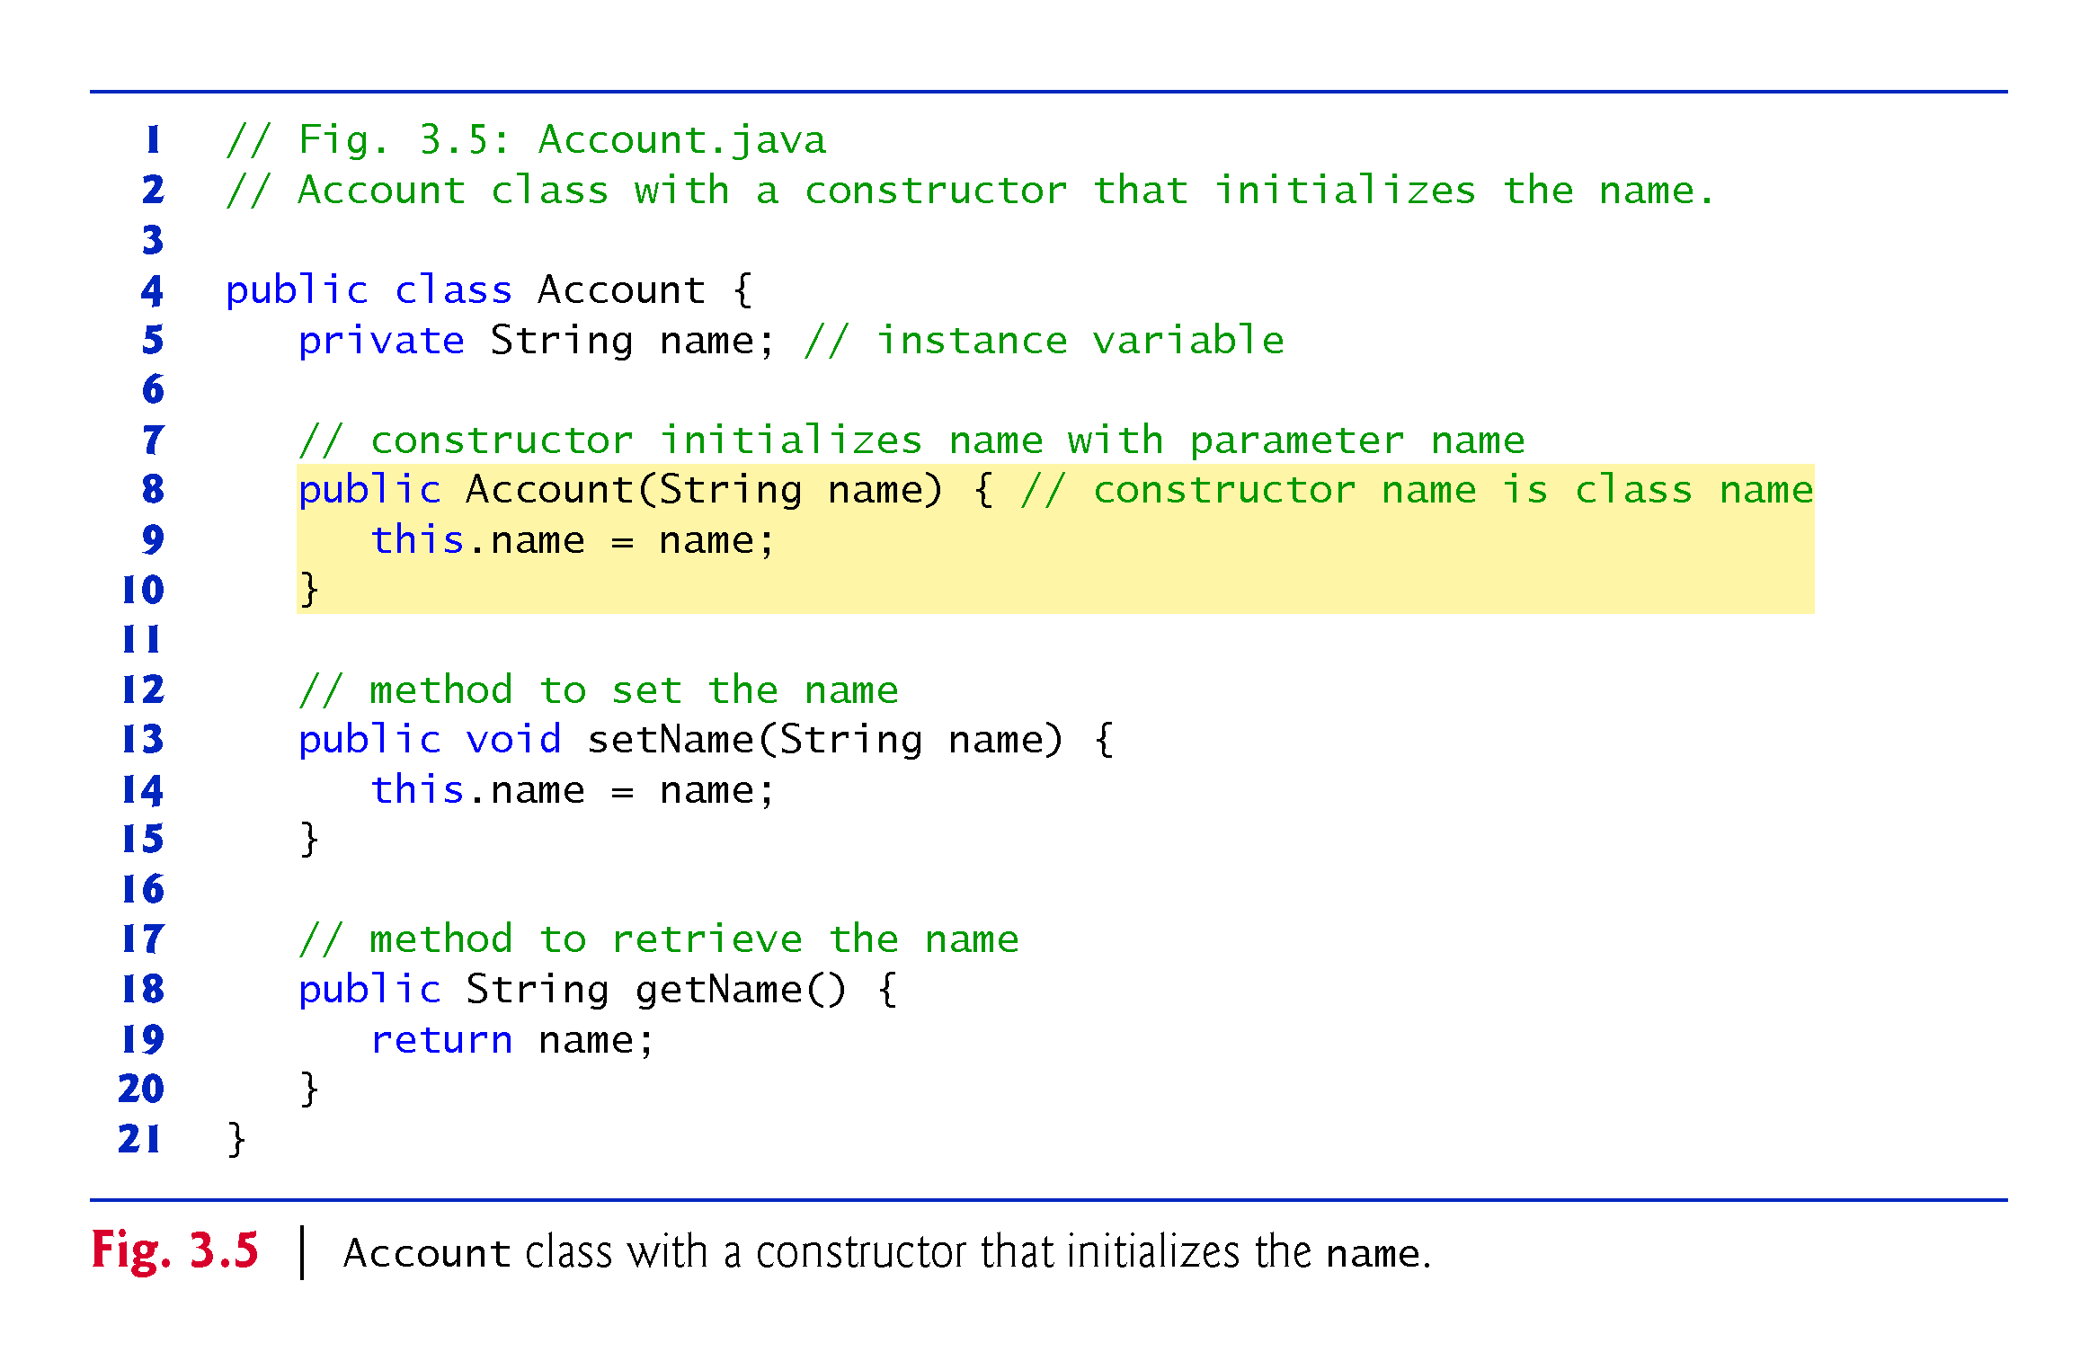

Slide 19
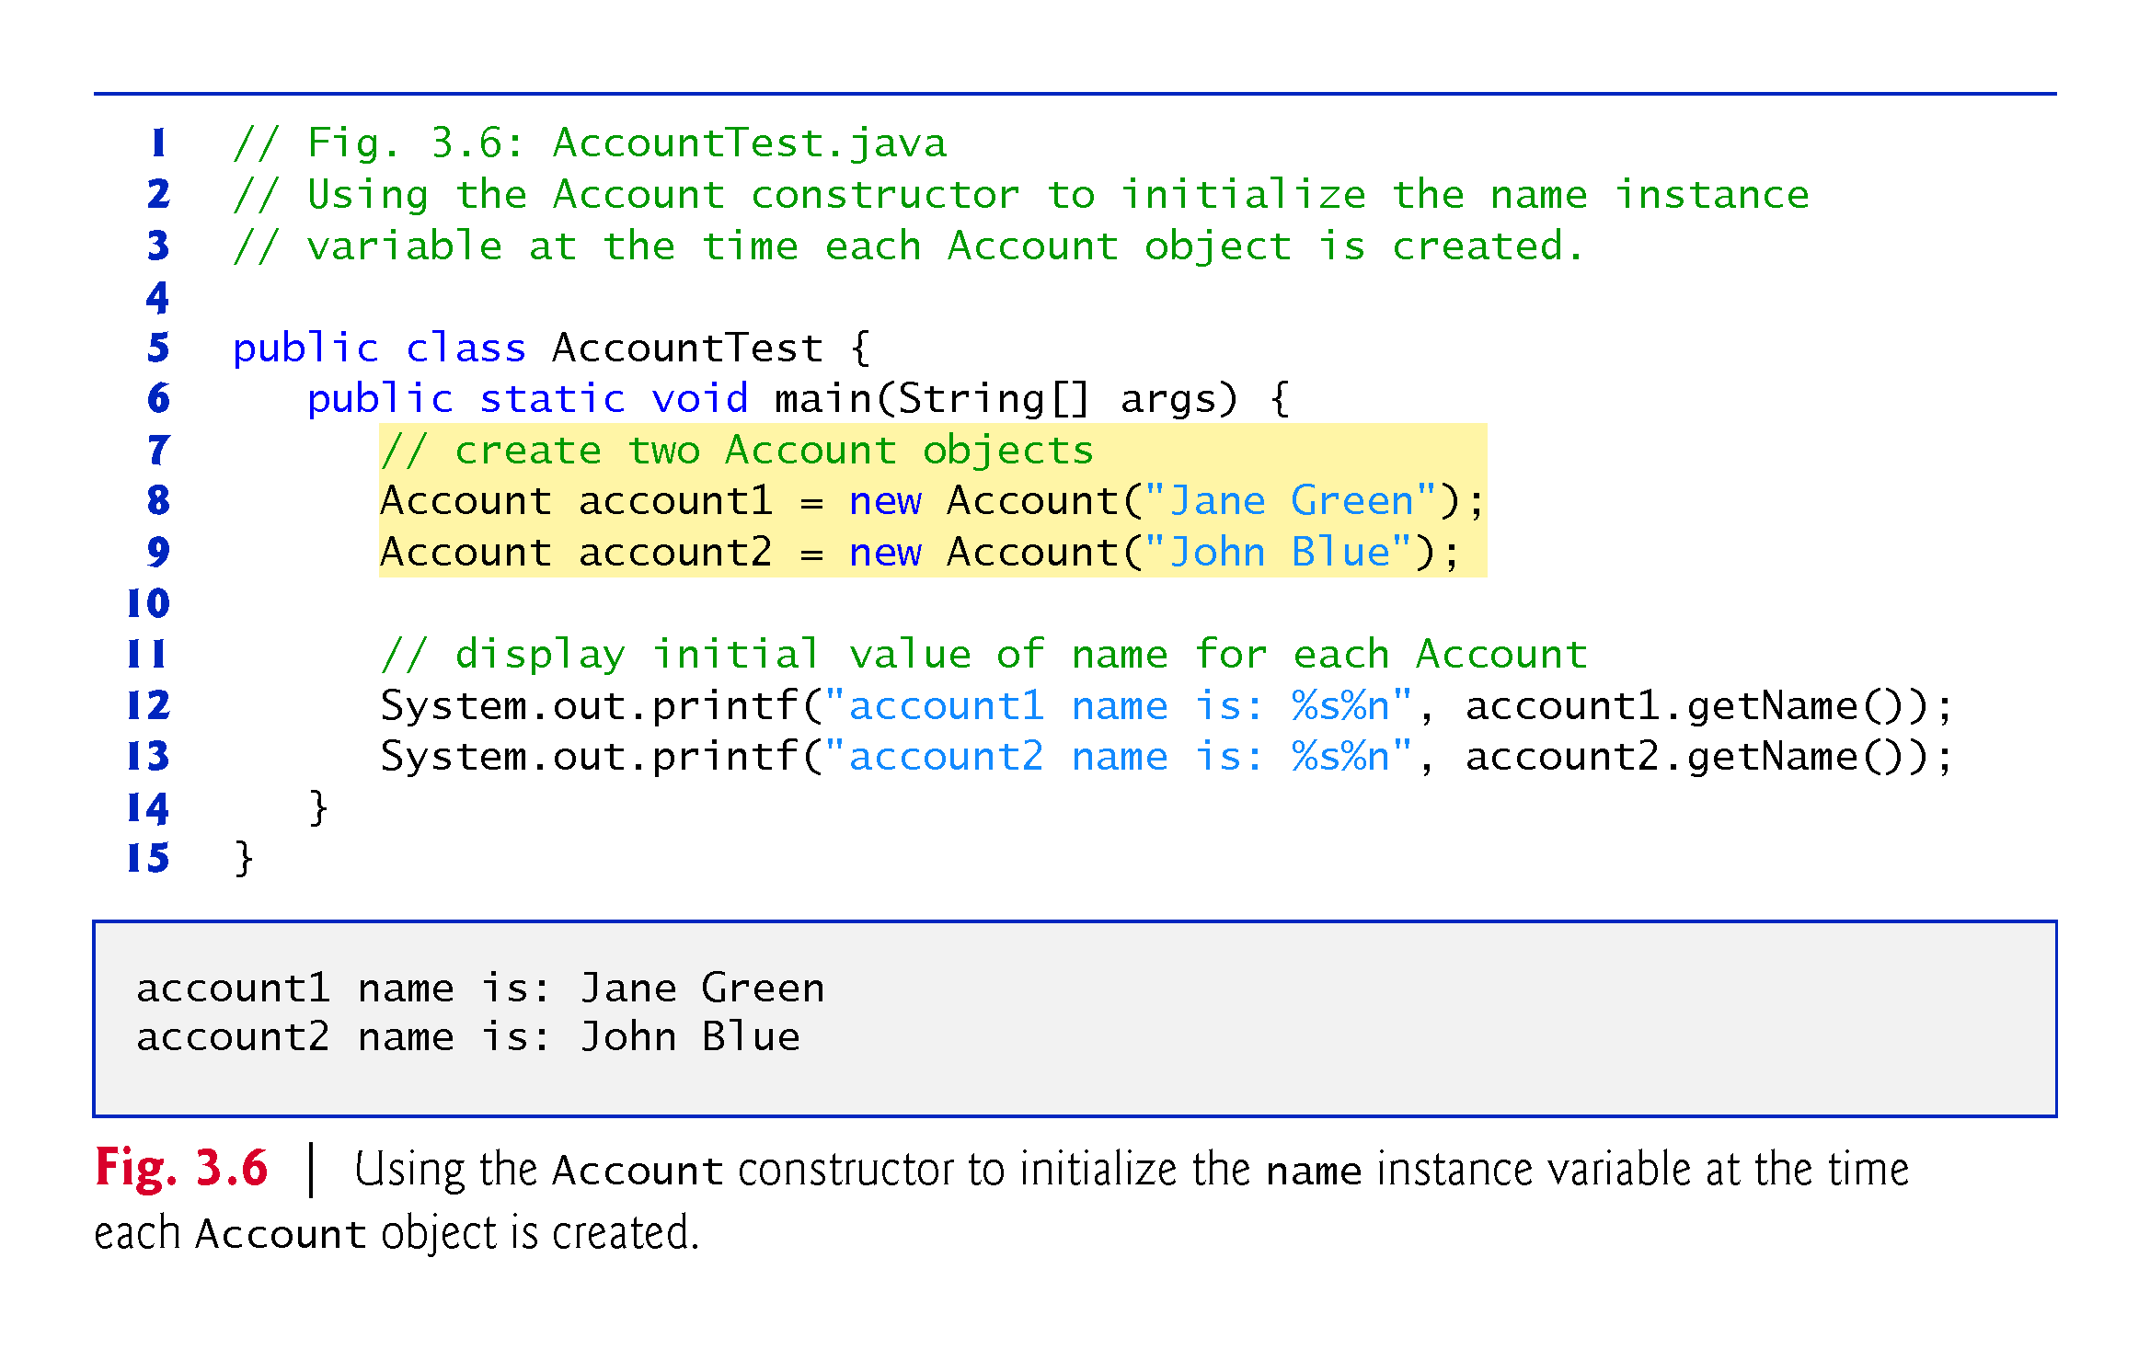

Slide 20
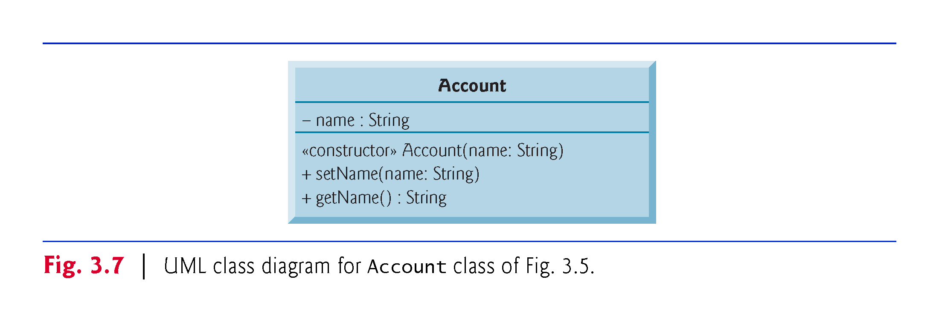

Slide 21
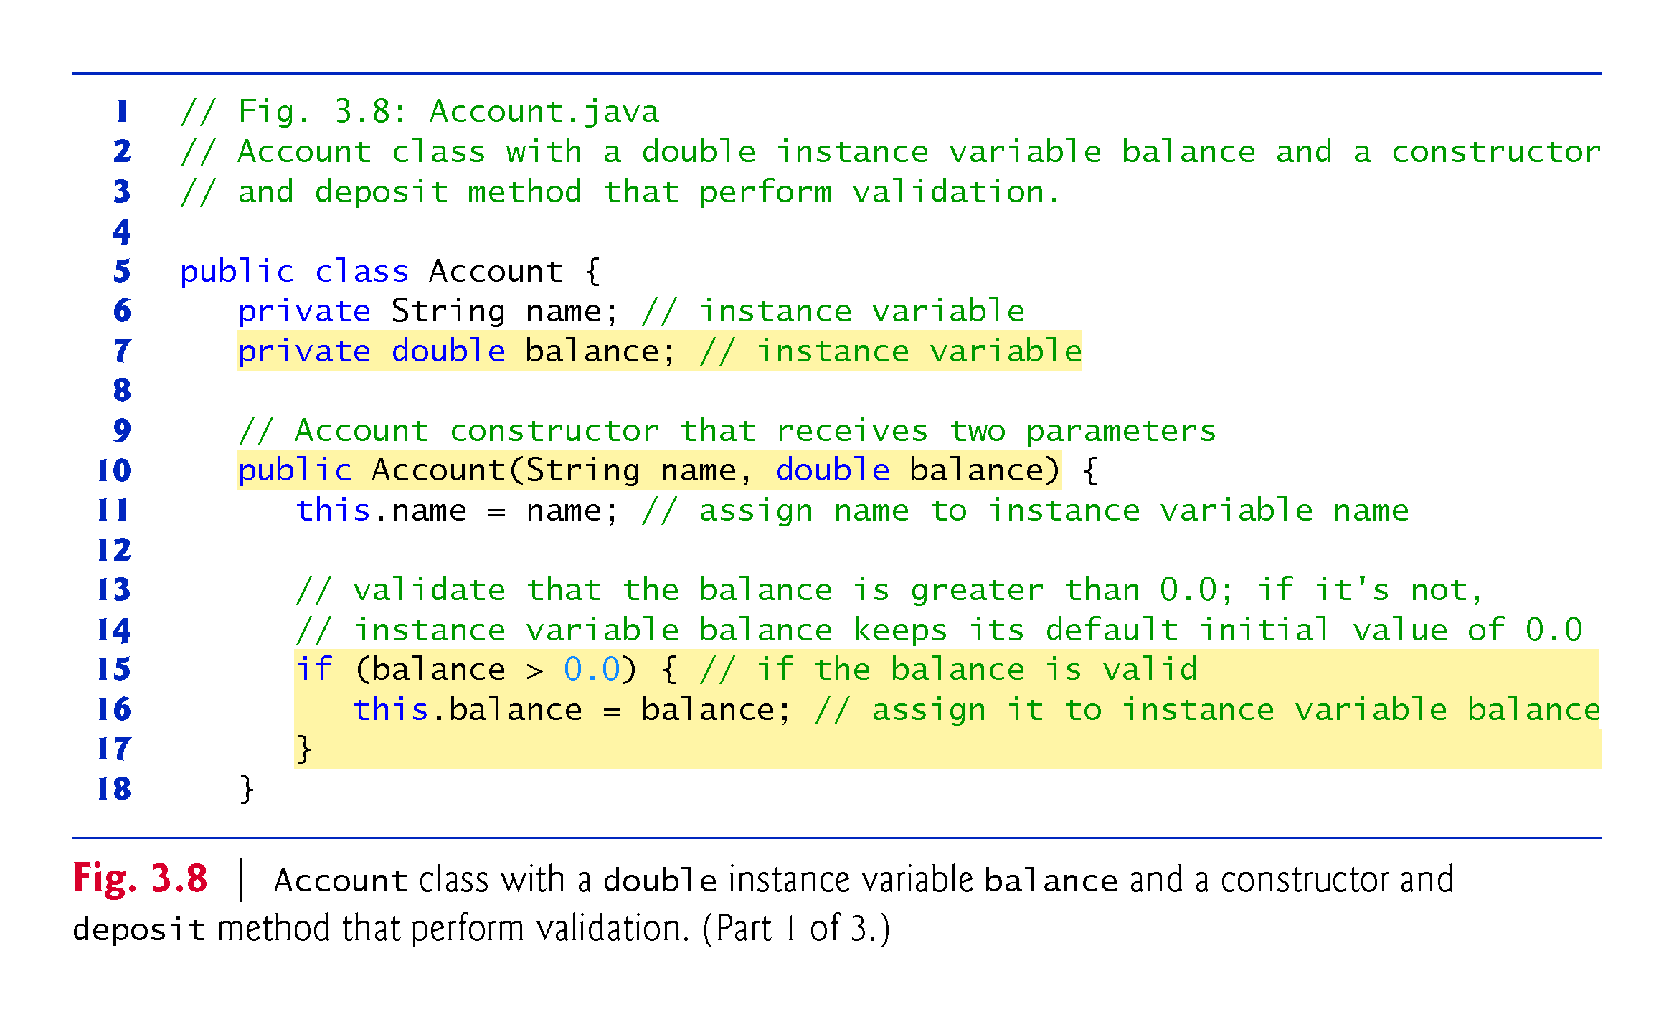

Slide 22
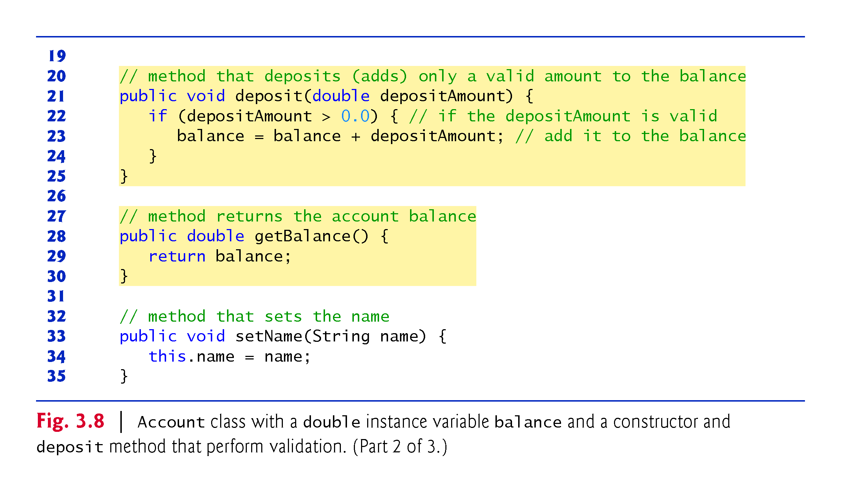

Slide 23
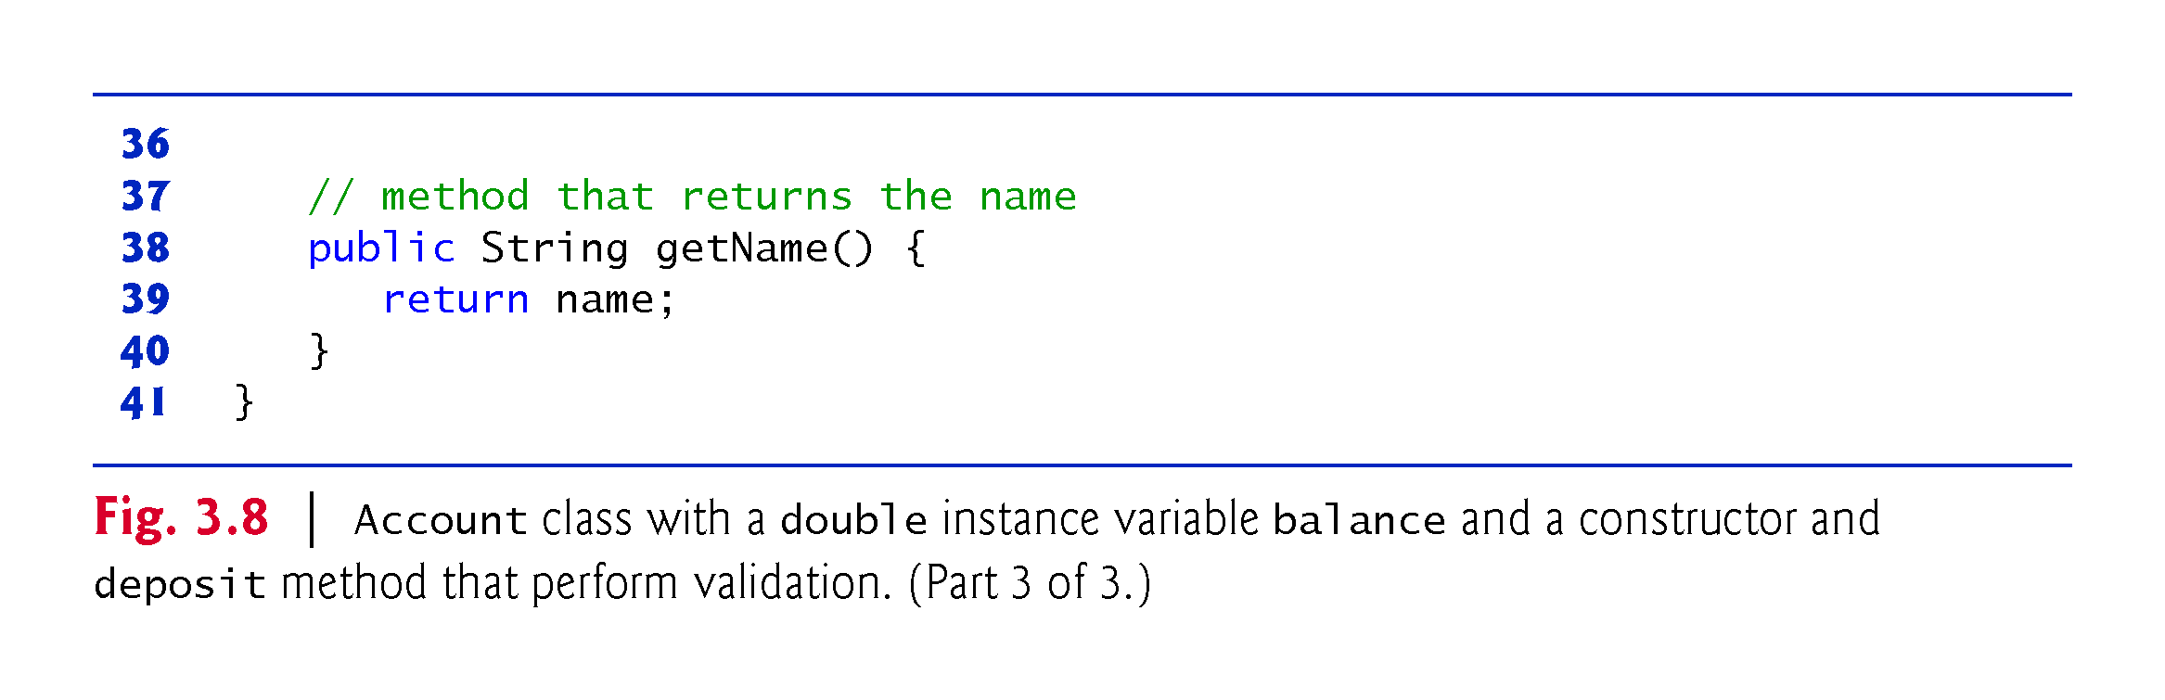

Slide 24
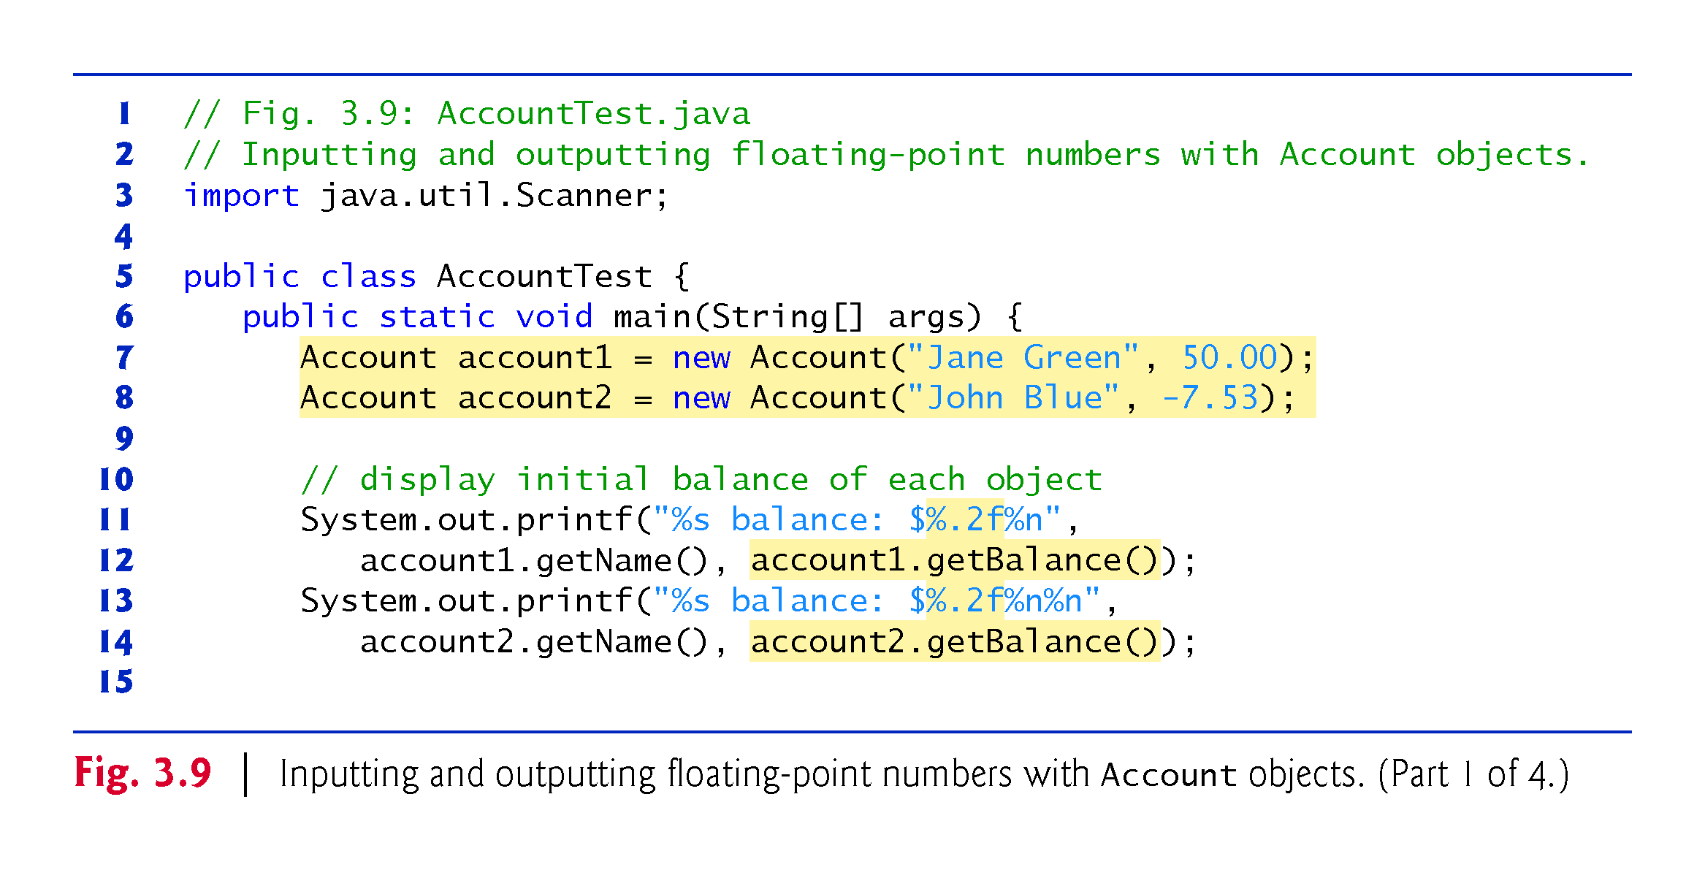
3.4.2 AccountTest Class to Use Class Account

Slide 25
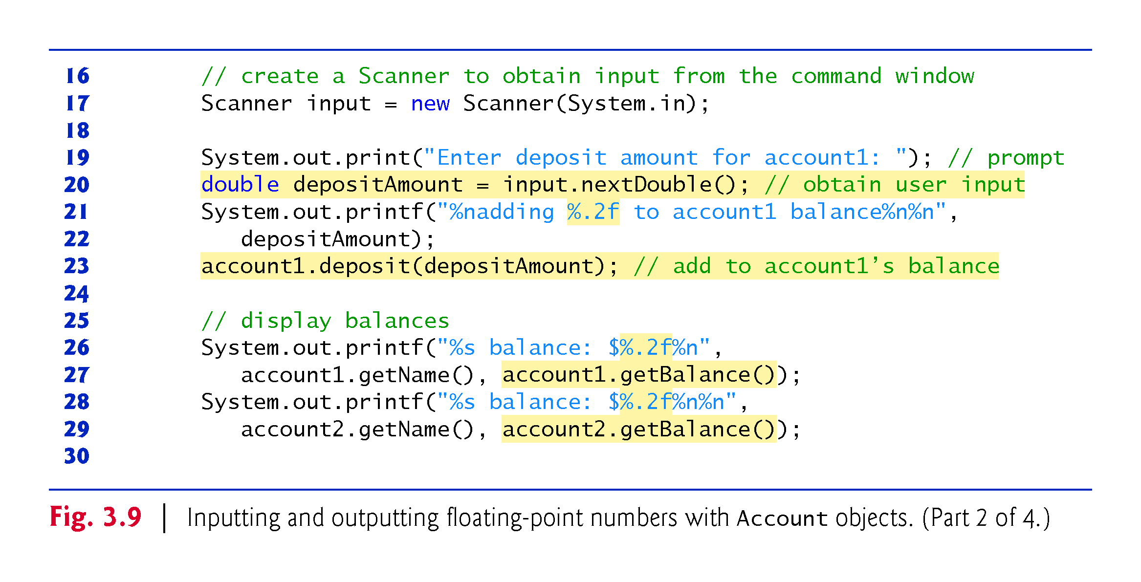

Slide 26
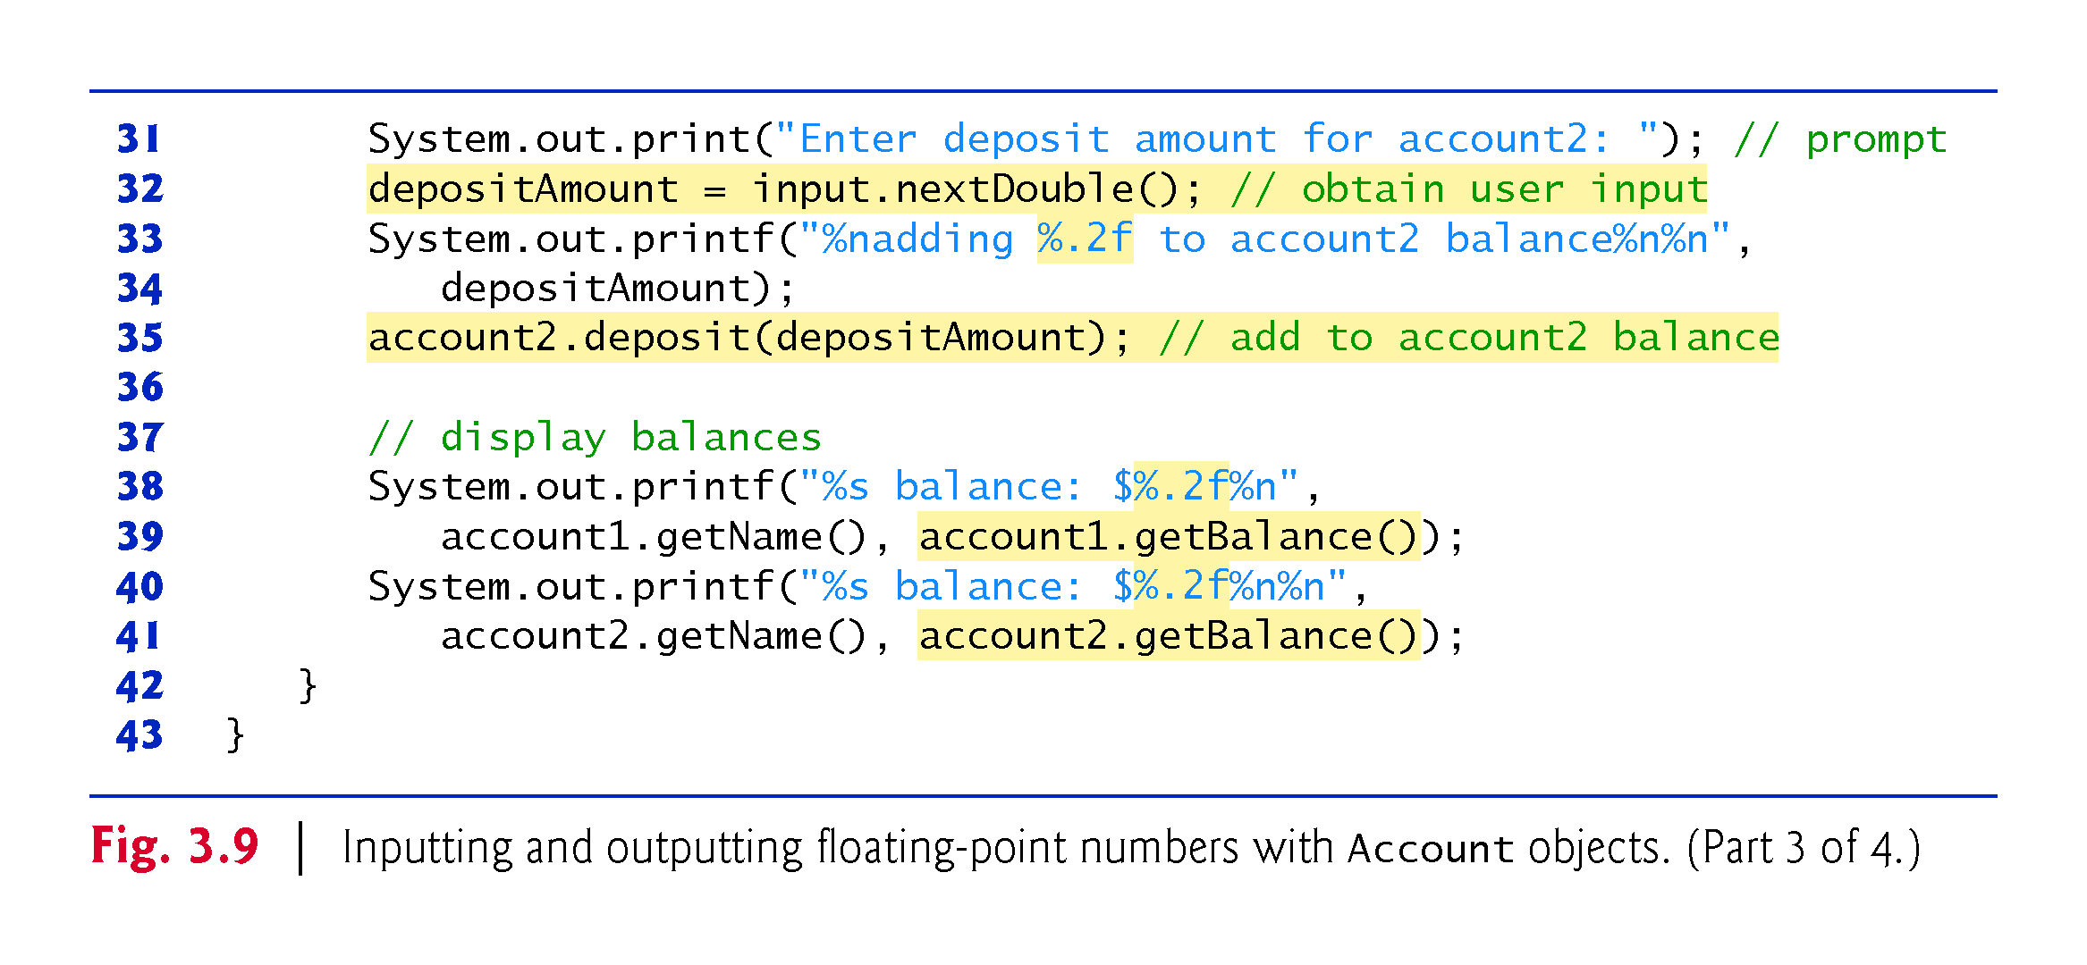

Slide 27
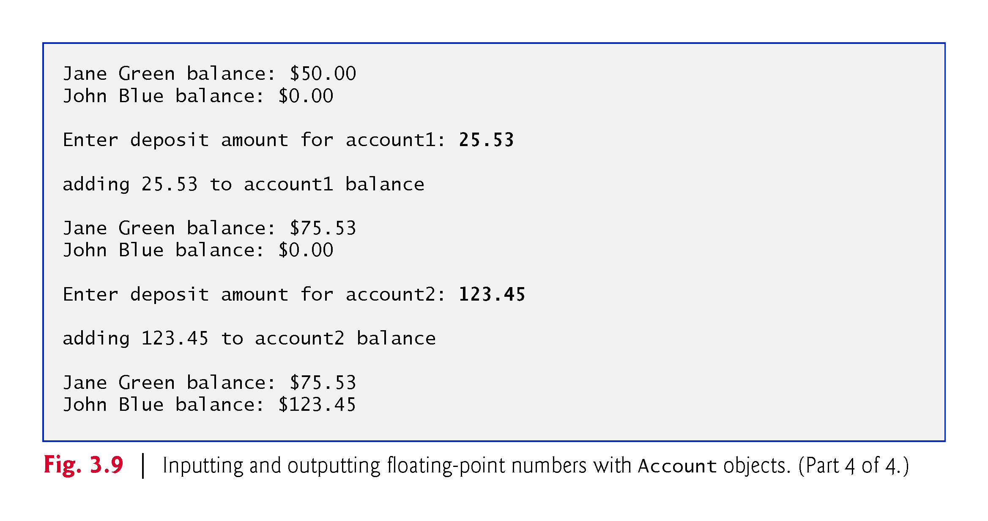

Slide 28
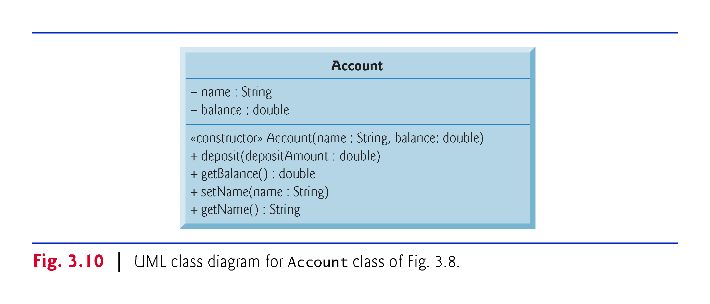

Slide 29
3.5 Primitive Types vs. Reference Types
Types in Java are divided into two categories—primitive types and reference types.
The primitive types are boolean, byte, char, short, int, long, float and double.
All other types are reference types, so classes, which specify the types of objects, are reference types.
A primitive-type variable can store exactly one value of its declared type at a time.
Primitive-type instance variables are initialized by default.
Variables of types byte, char, short, int, long, float and double are initialized to 0.

Slide 30
3.5 Primitive Types vs. Reference Types (Cont.)
Variables of type boolean are initialized to false.
Reference-type variables (called references) store the location of an object in the computer’s memory. [e.g., account1 and account2 in Fig. 3.9]
Such variables refer to objects in the program.
The object that’s referenced may contain many instance variables and methods.
Reference-type instance variables are initialized by default to the value null.
A reference to an object is required to invoke an object’s methods.
A primitive-type variable does not refer to an object and therefore cannot be used to invoke a method.

