Slide 1
Chapter 7 Arrays and ArrayLists
Java How to Program, 11/e
Questions? E-mail paul.deitel@deitel.com

Slide 2
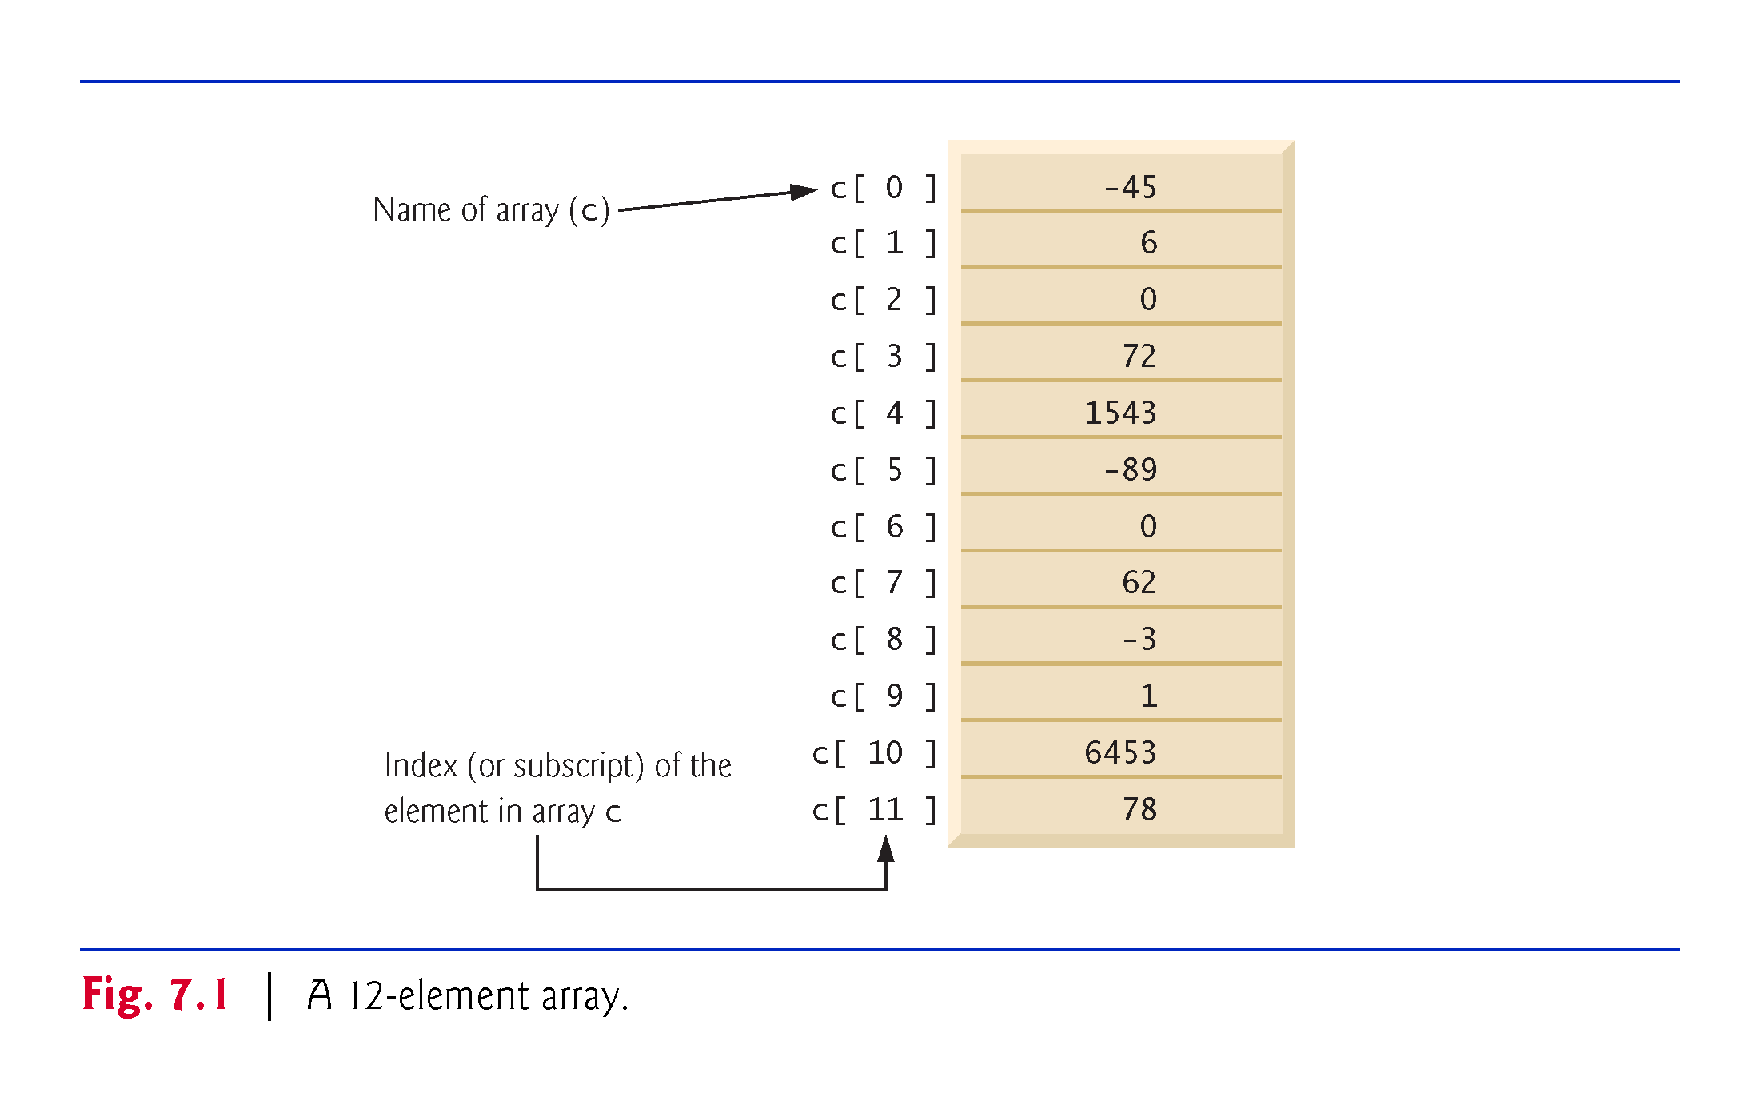

Slide 3
7.2 Arrays
Array
Group of variables (called elements) containing values of the same type.
Arrays are objects so they are reference types.
Elements can be either primitive or reference types.
Refer to a particular element in an array
Use the element’s index.
Array-access expression—the name of the array followed by the index of the particular element in square brackets, [].
The first element in every array has index zero.
The highest index in an array is one less than the number of elements in the array.
Array names follow the same conventions as other variable names.

Slide 4
7.2 Arrays (Cont.)
An index must be a nonnegative integer.
Can use an expression as an index.
An indexed array name is an array-access expression.
Can be used on the left side of an assignment to place a new value into an array element.
Every array object knows its own length and stores it in a length instance variable.
length cannot be changed because it’s a final variable.

Slide 5
7.3 Declaring and Creating Arrays
Array objects
Created with keyword new.
You specify the element type and the number of elements in an array-creation expression, which returns a reference that can be stored in an array variable.
Declaration and array-creation expression for an array of 12 int elements
int[] c = new int[12];
Can be performed in two steps as follows:
int[] c; // declare the array variable c = new int[12]; // creates the array

Slide 6
7.3 Declaring and Creating Arrays (Cont.)
In a declaration, square brackets following a type indicate that a variable will refer to an array (i.e., store an array reference).
When an array is created, each element of the array receives a default value
Zero for the numeric primitive-type elements, false for boolean elements and null for references.

Slide 7
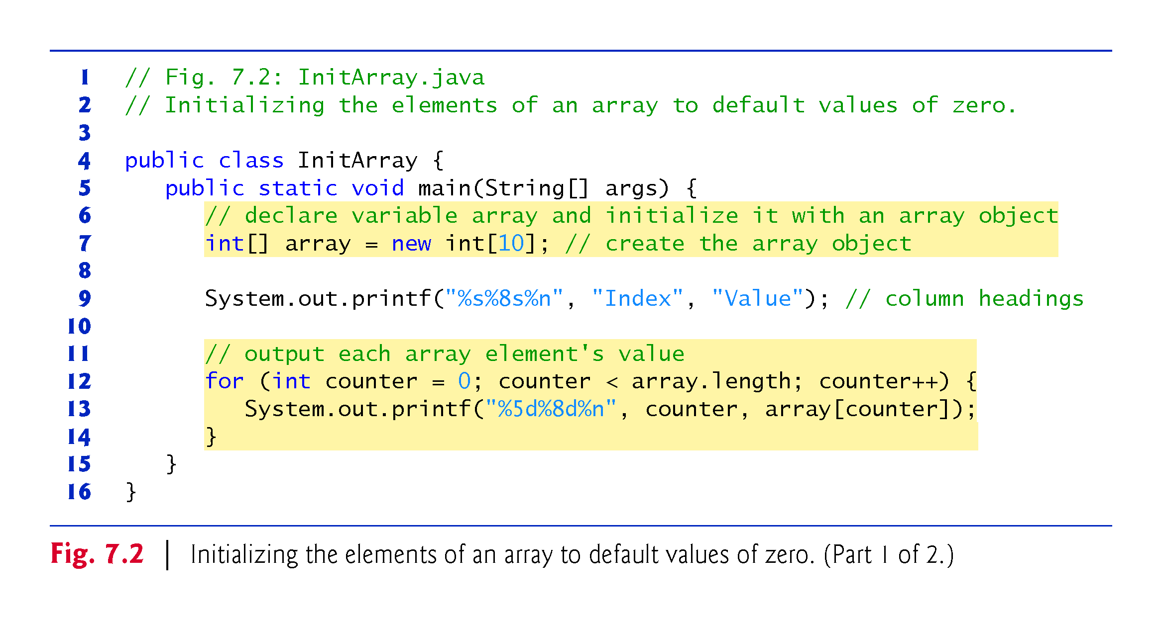

Slide 8
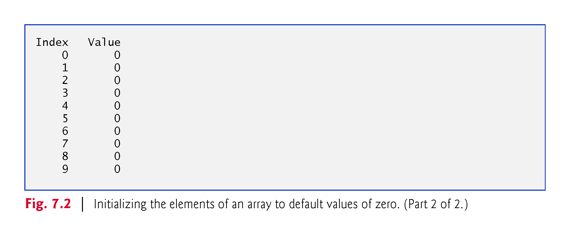

Slide 9
7.4.2 Using an Array Initializer
Array initializer
A comma-separated list of expressions (called an initializer list) enclosed in braces.
Used to create an array and initialize its elements.
Array length is determined by the number of elements in the initializer list.
int[] n = {10, 20, 30, 40, 50};
Creates a five-element array with index values 0–4.
Compiler counts the number of initializers in the list to determine the size of the array
Sets up the appropriate new operation “behind the scenes.”

Slide 10
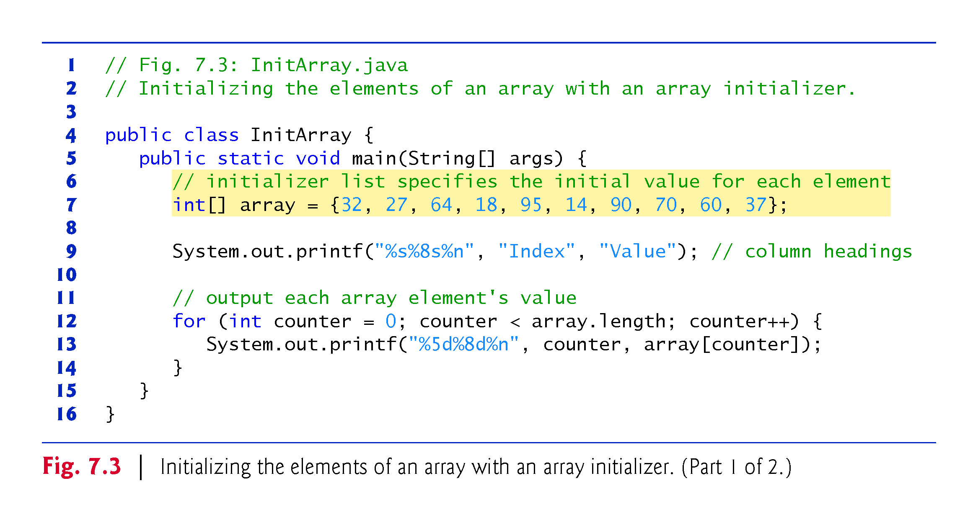

Slide 11
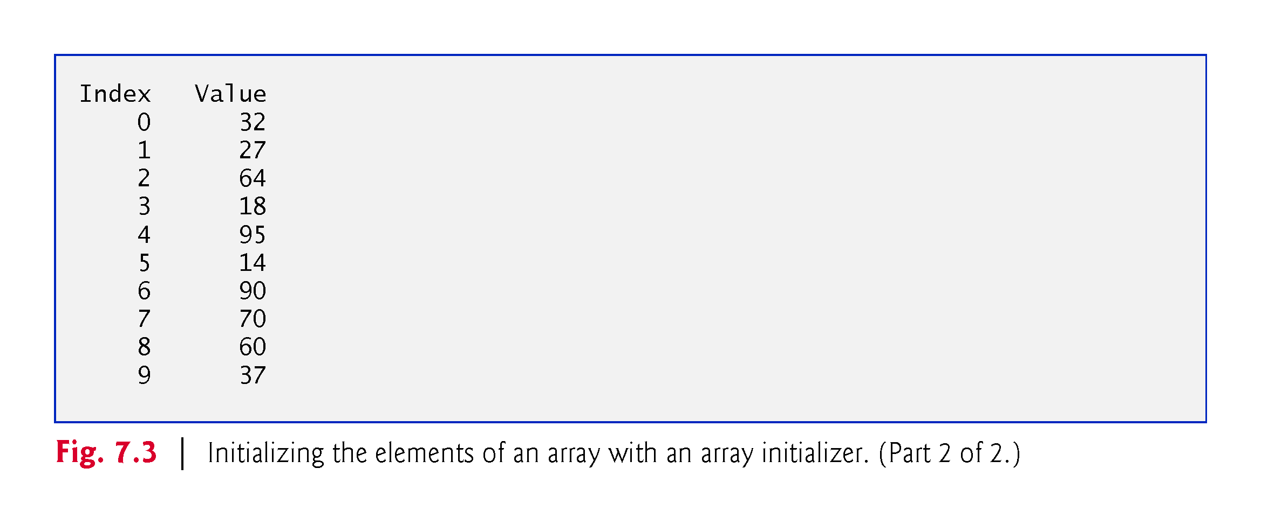

Slide 12
7.4.3 Calculating the Values to Store in an Array
The application in Fig. 7.4 creates a 10-element array and assigns to each element one of the even integers from 2 to 20 (2, 4, 6, …, 20).

Slide 13
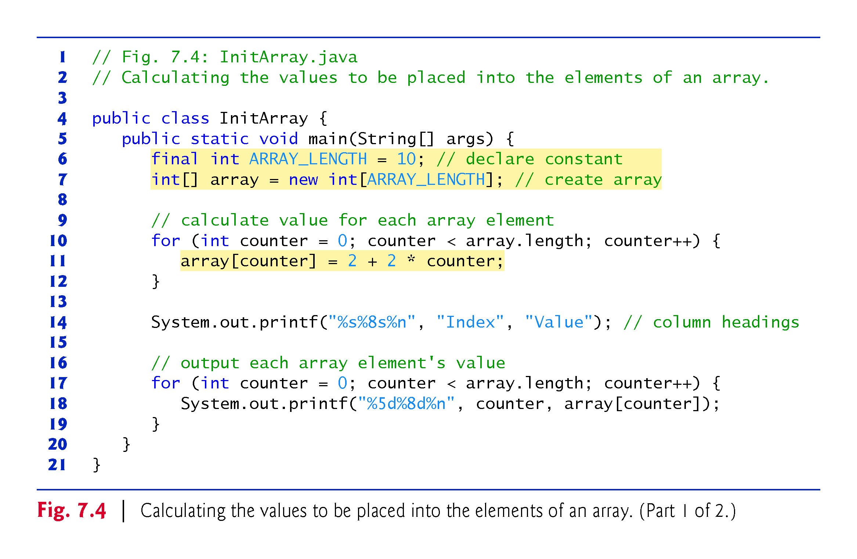

Slide 14
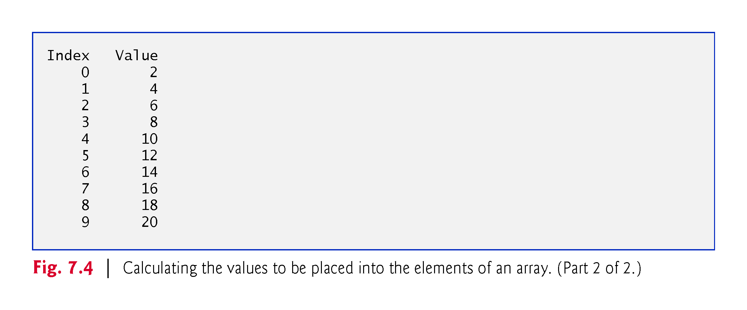

Slide 15
7.4 Examples Using Arrays (Cont.)
final variables must be initialized before they are used and cannot be modified thereafter.
An attempt to modify a final variable after it’s initialized causes a compilation error
cannot assign a value to final variable variableName
An attempt to access the value of a final variable before it’s initialized causes a compilation error
variable variableName might not have been initialized

Slide 16
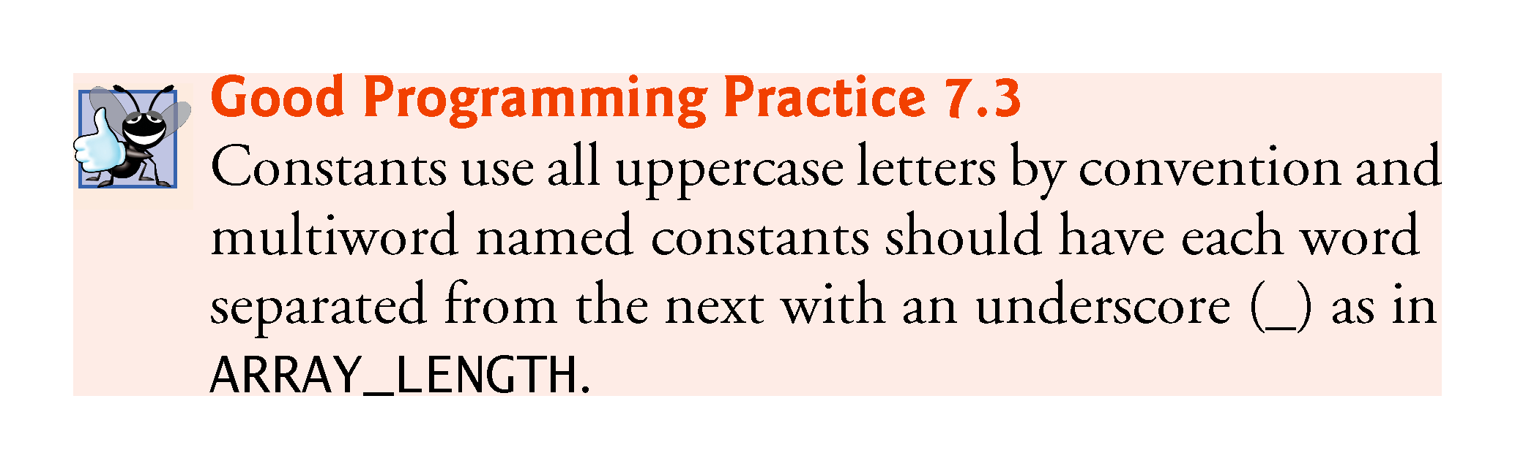

Slide 17
7.4.4 Summing the Elements of an Array
Figure 7.5 sums the values contained in a 10-element integer array.
Often, the elements of an array represent a series of values to be used in a calculation.

Slide 18
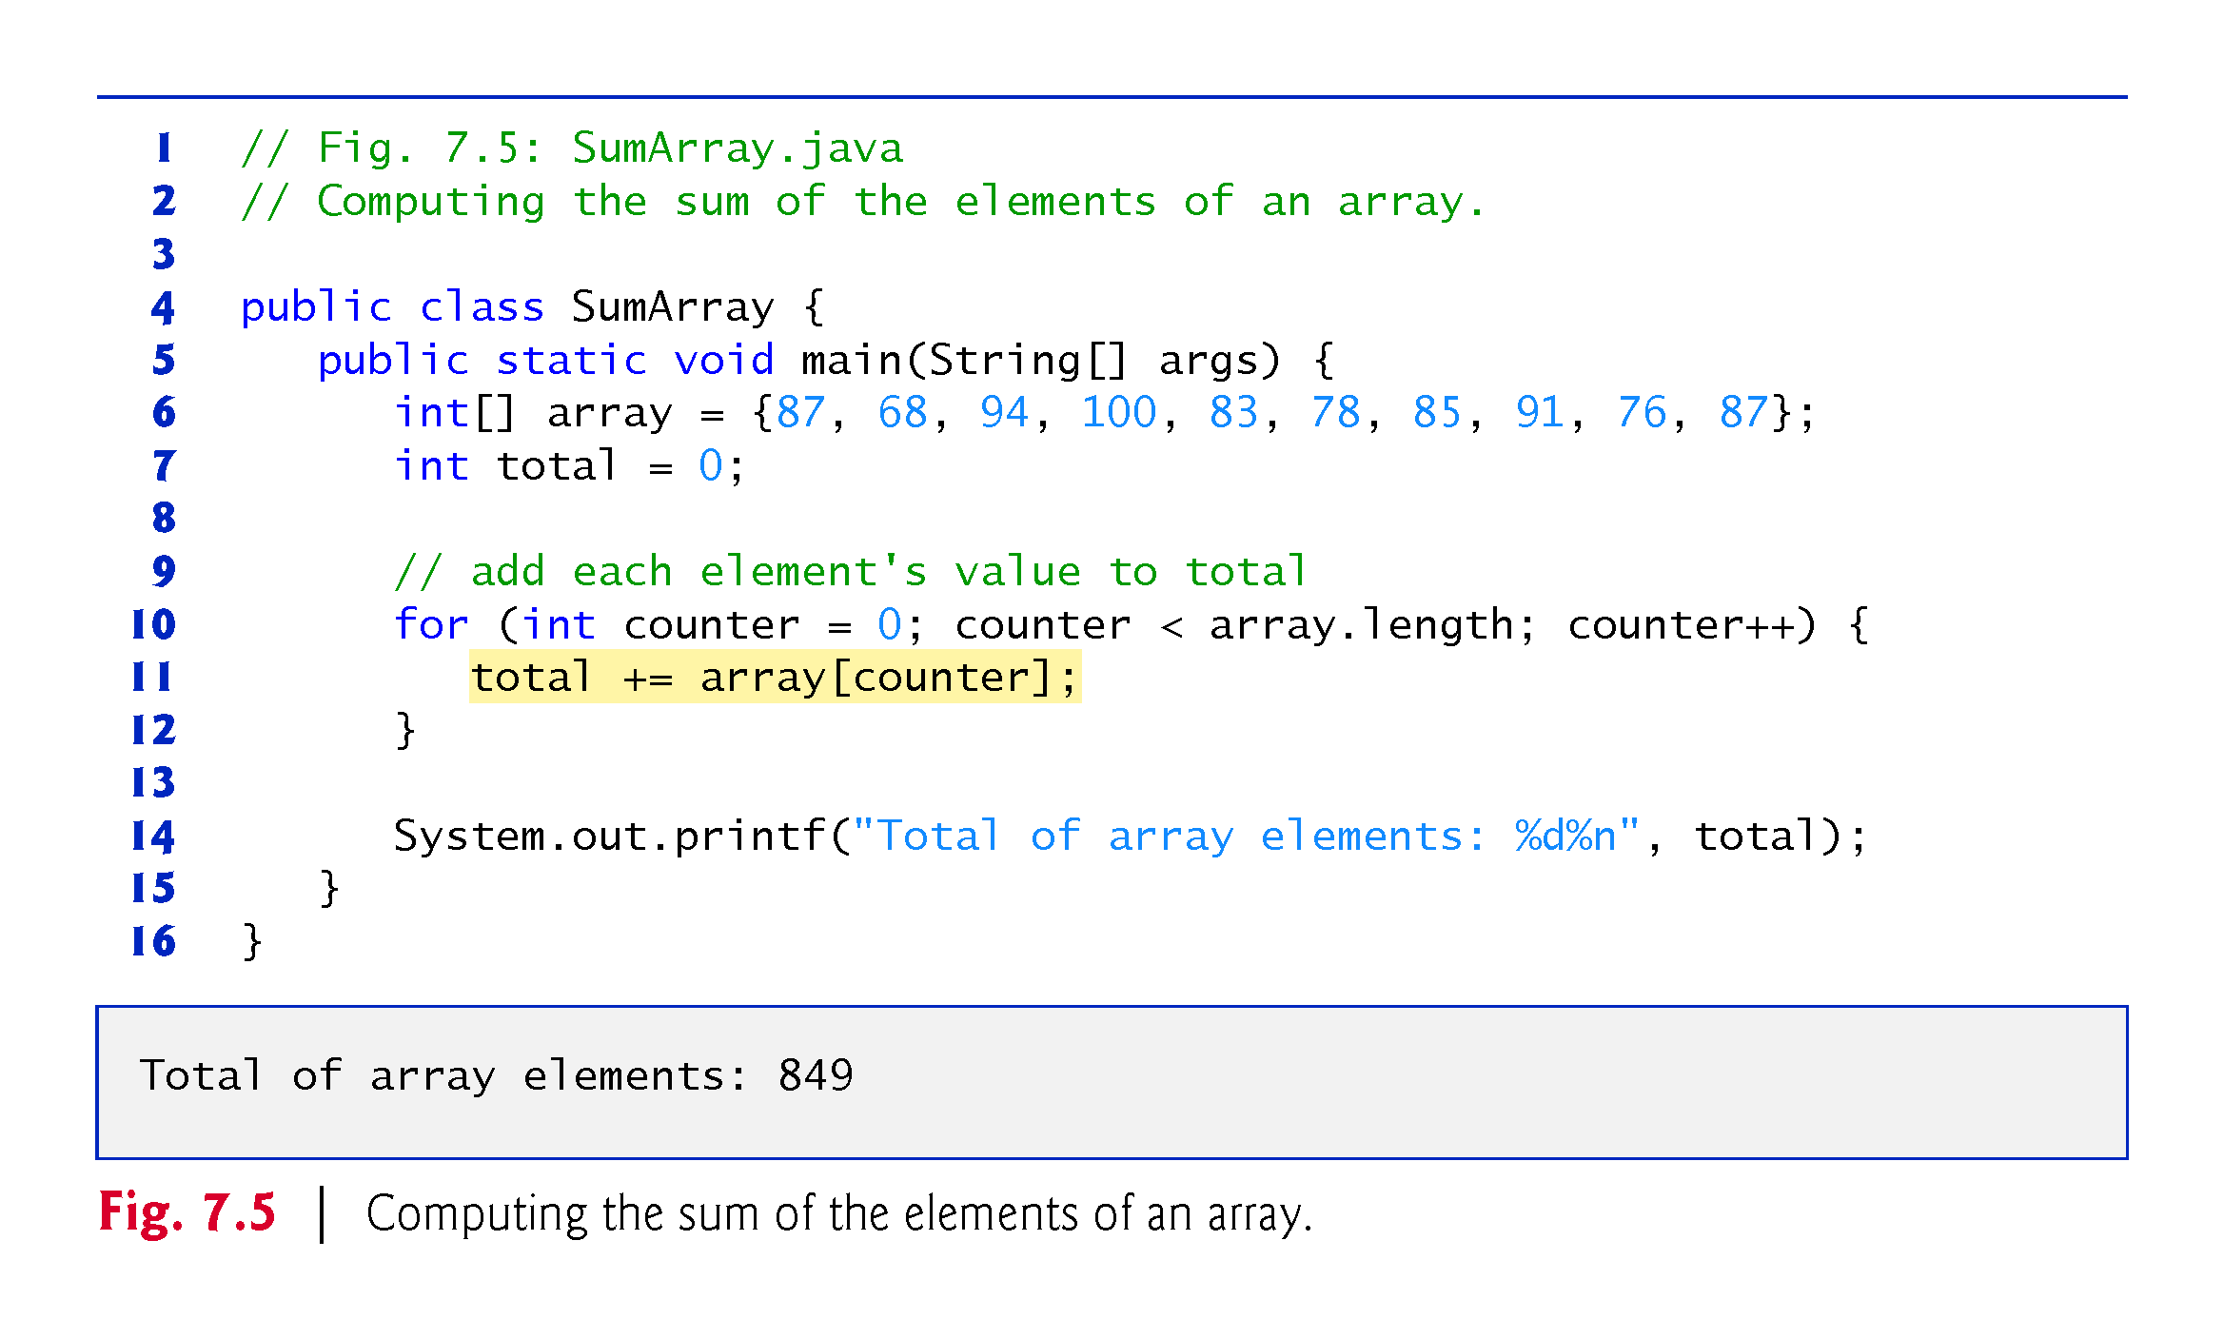

Slide 19
7.4.5 Using Bar Charts to Display Array Data Graphically
Many programs present data to users in a graphical manner.
Numeric values are often displayed as bars in a bar chart.
Longer bars represent proportionally larger numeric values.
A simple way to display numeric data is with a bar chart that shows each numeric value as a bar of asterisks (*).
Format specifier %02d indicates that an int value should be formatted as a field of two digits.
The 0 flag displays a leading 0 for values with fewer digits than the field width (2).

Slide 20
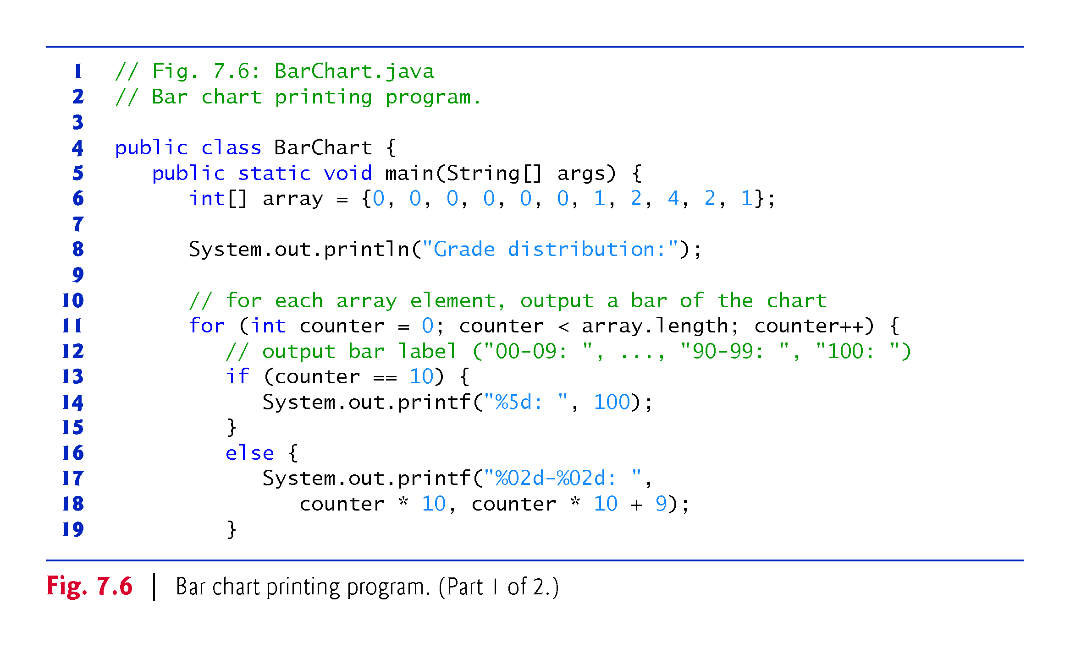

Slide 21
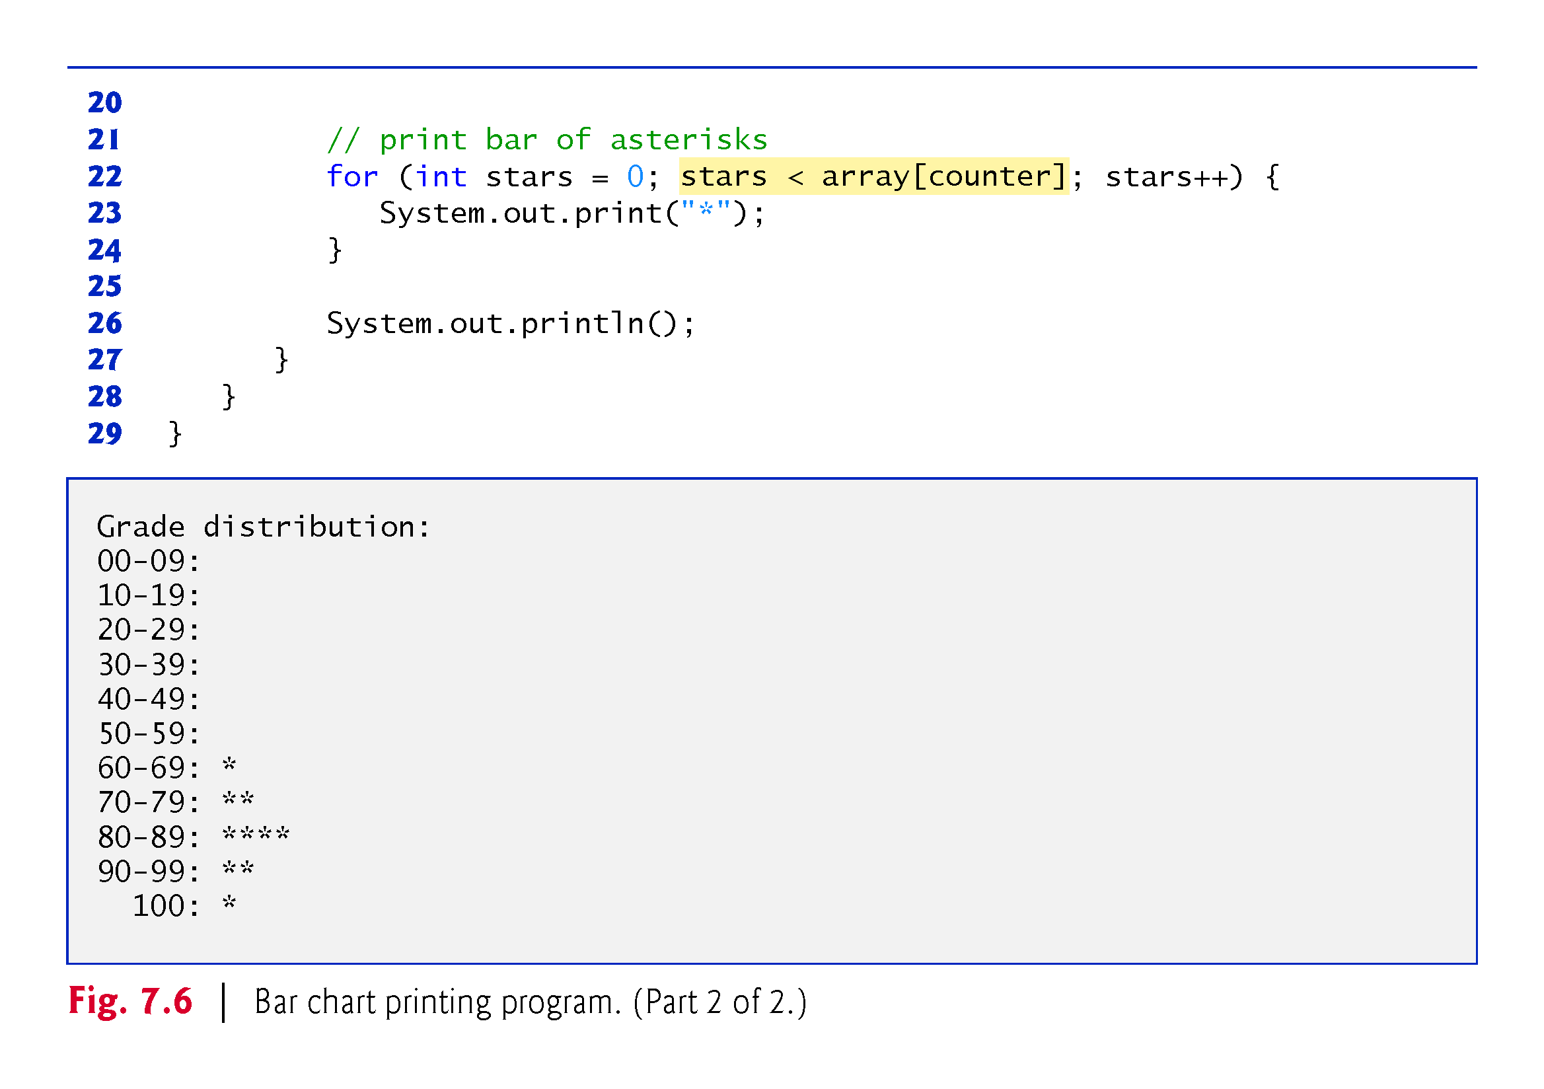

Slide 22
7.4.6 Using the Elements of an Array as Counters
Sometimes, programs use counter variables to summarize data, such as the results of a survey.
Fig. 6.7 used separate counters in a die-rolling program to track the number of occurrences of each side of a six-sided die as the program rolled the die 60,000,000 times.
Fig. 7.7 shows an array version of this application.
Array frequency must be large enough to store six counters.
We use a seven-element array in which we ignore frequency[0]
More logical to have the face value 1 increment frequency[1] than frequency[0].

Slide 23
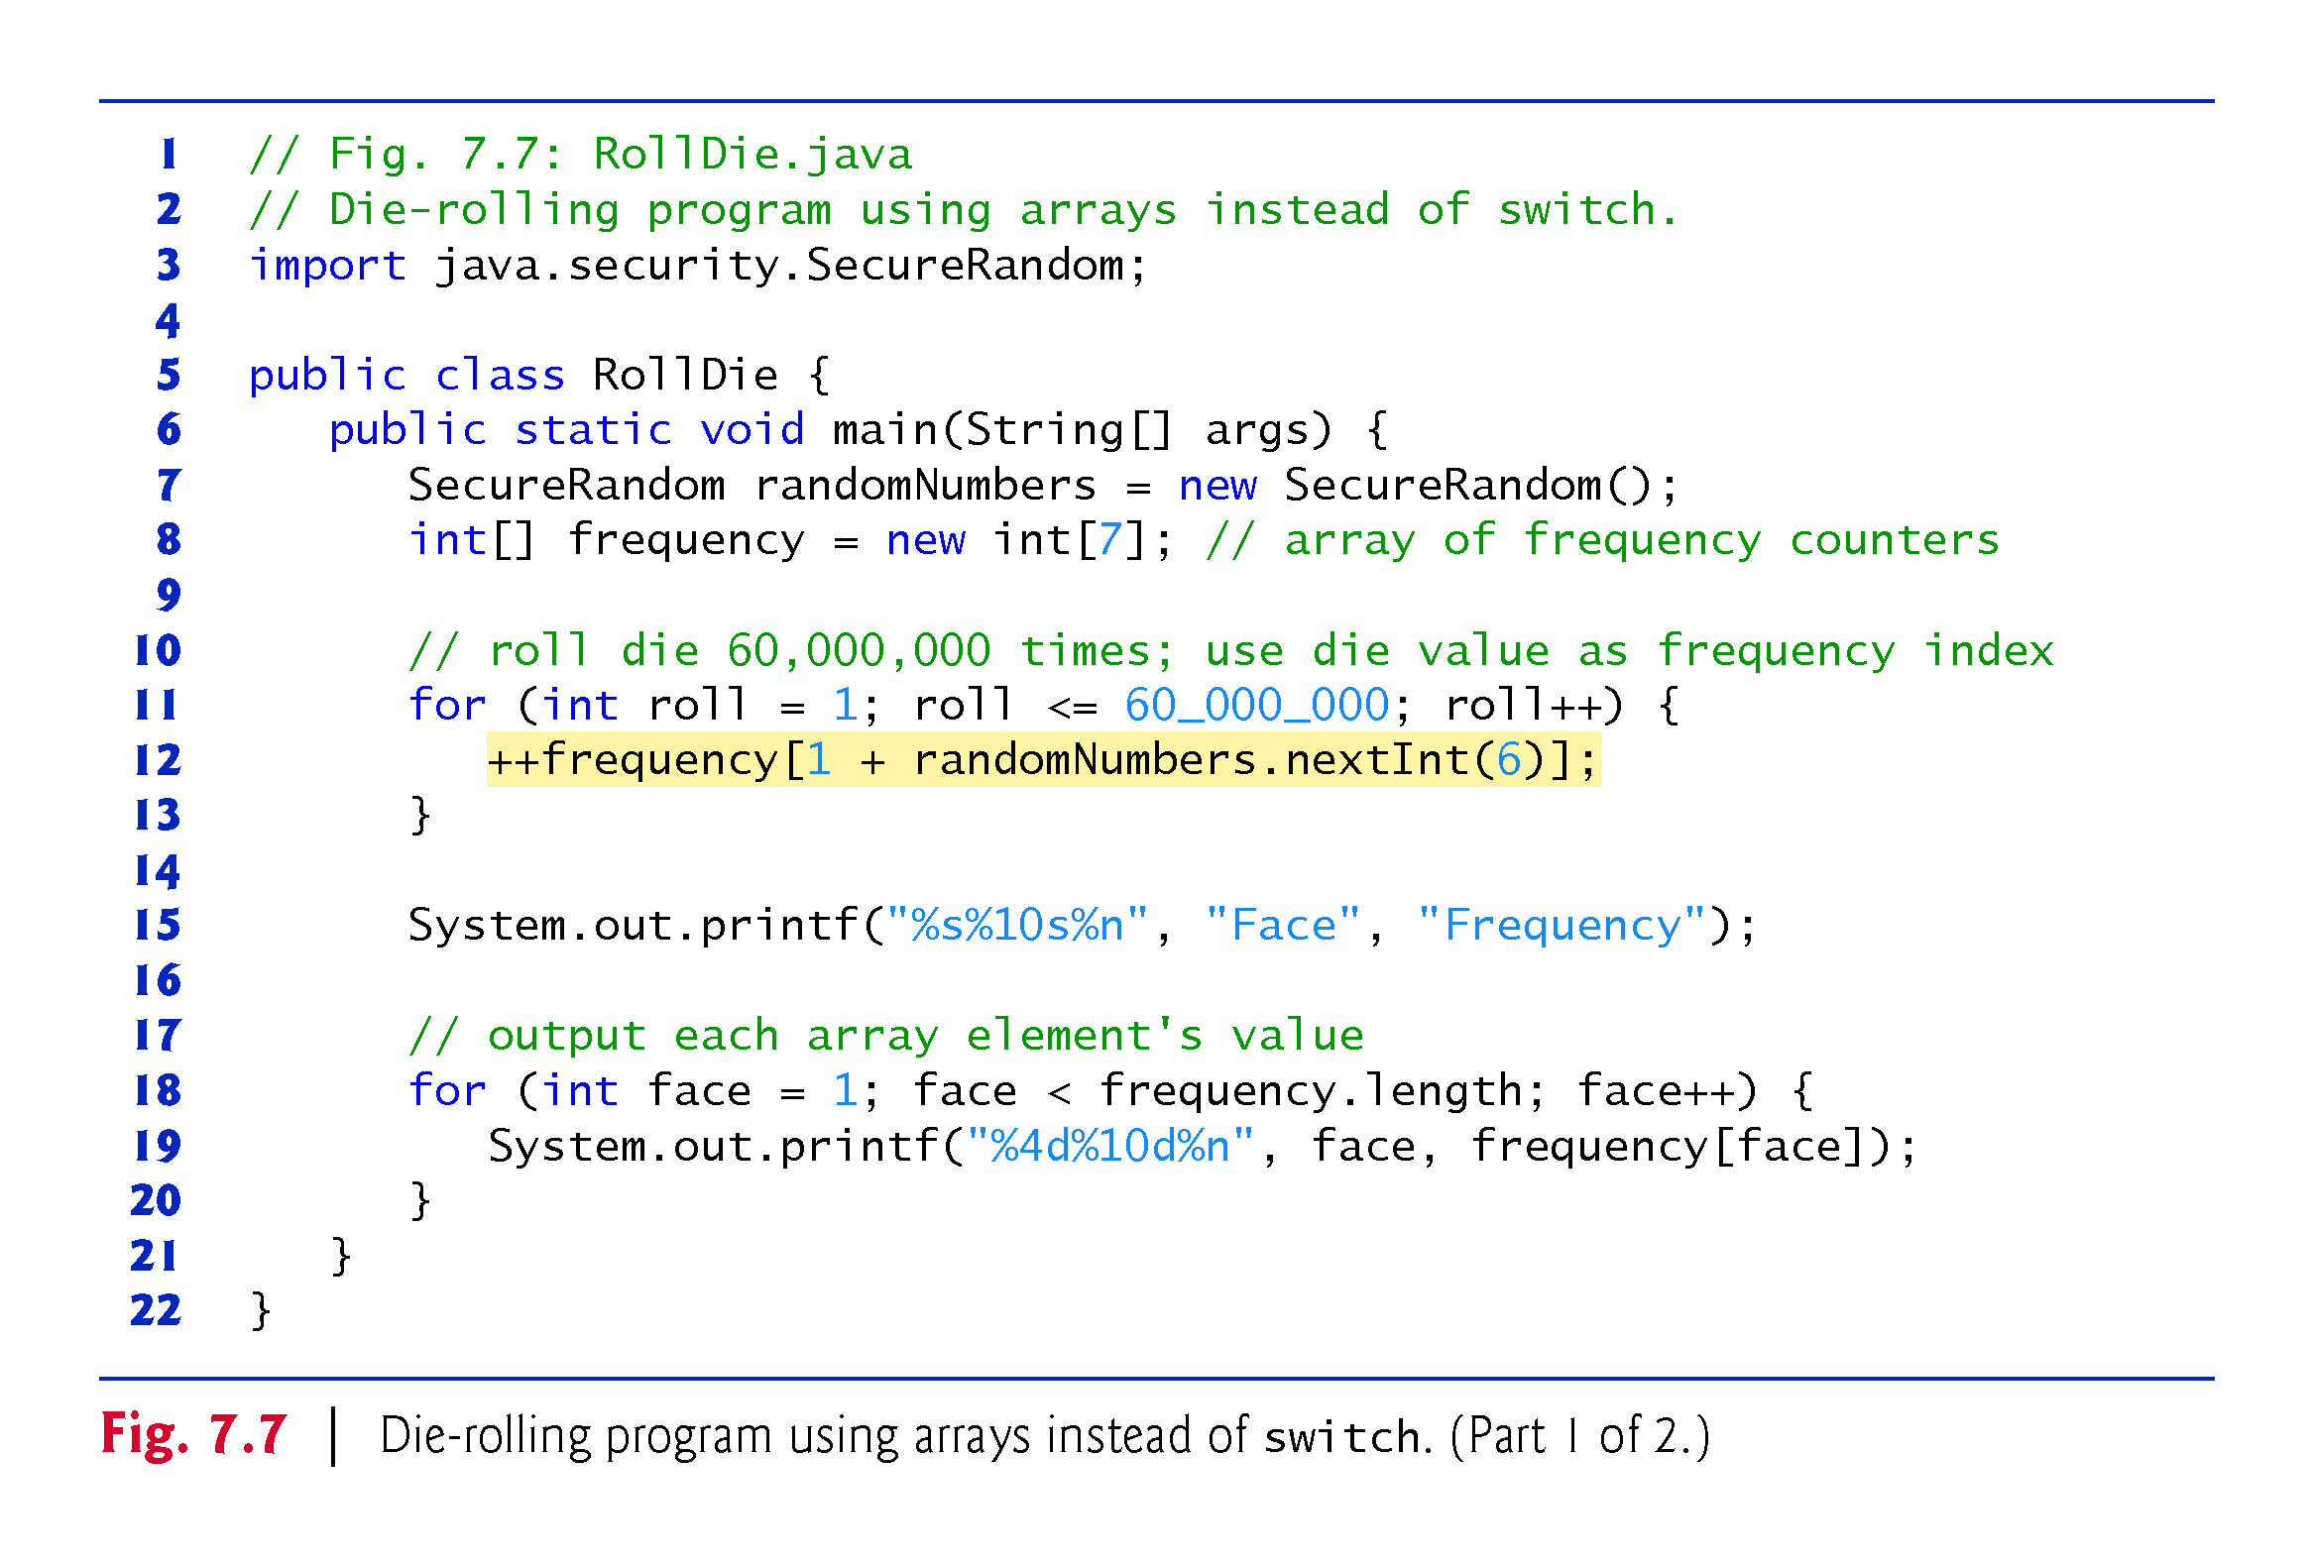

Slide 24
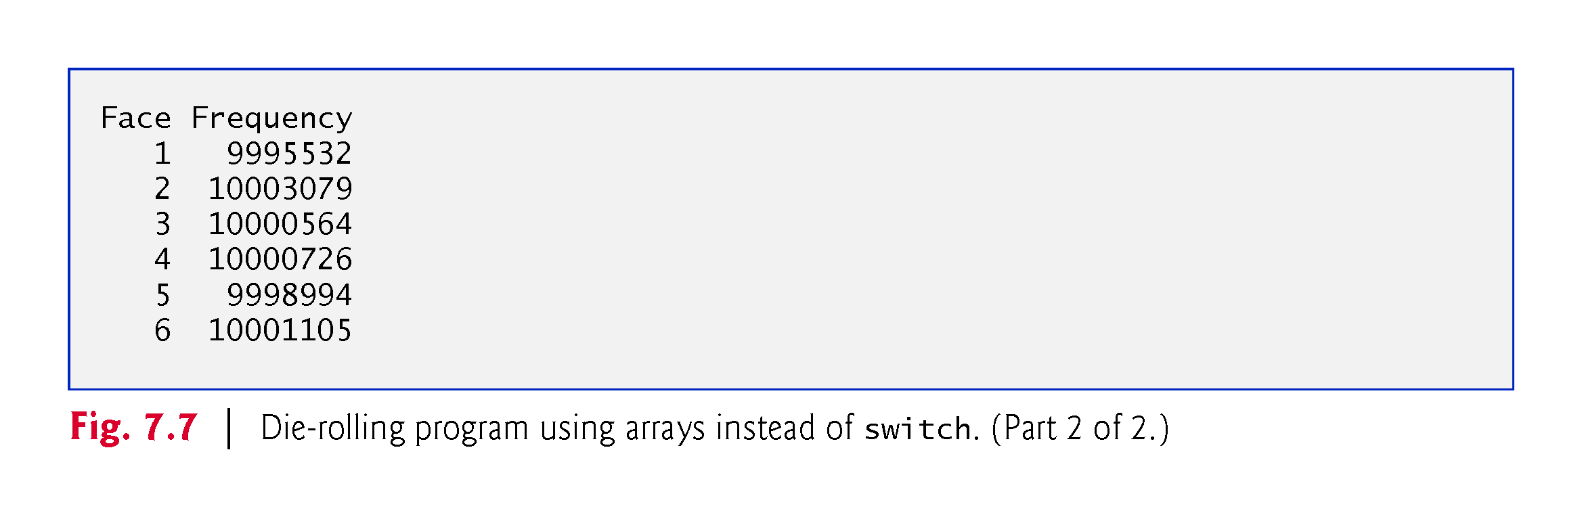

Slide 25
7.4.7 Using Arrays to Analyze Survey Results
Figure 7.8 uses arrays to summarize the results of data collected in a survey:
Twenty students were asked to rate on a scale of 1 to 5 the quality of the food in the student cafeteria, with 1 being “awful” and 5 being “excellent.” Place the 20 responses in an integer array and determine the frequency of each rating.
Array responses is a 20-element int array of the survey responses.
6-element array frequency counts the number of occurrences of each response (1 to 5).
Each element is initialized to zero by default.
We ignore frequency[0].

Slide 26
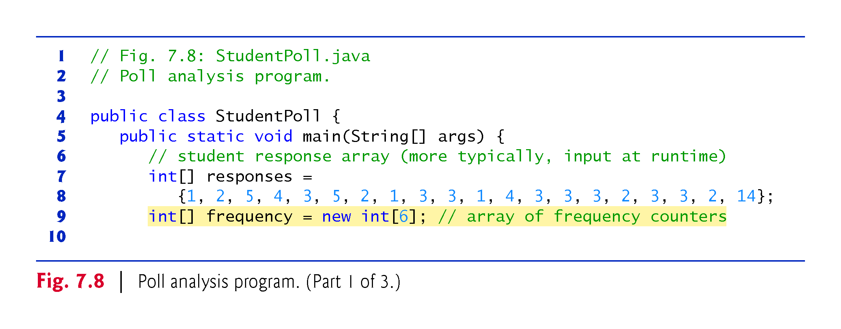

Slide 27
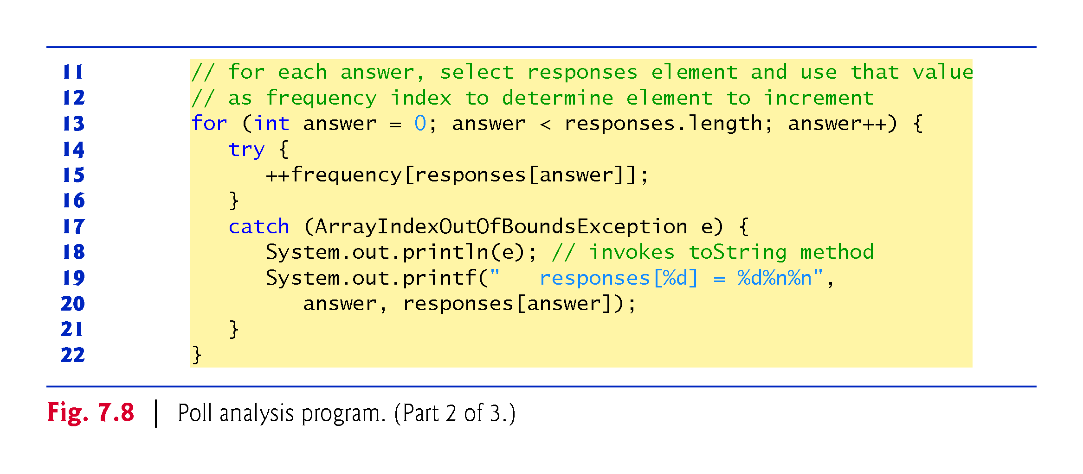

Slide 28
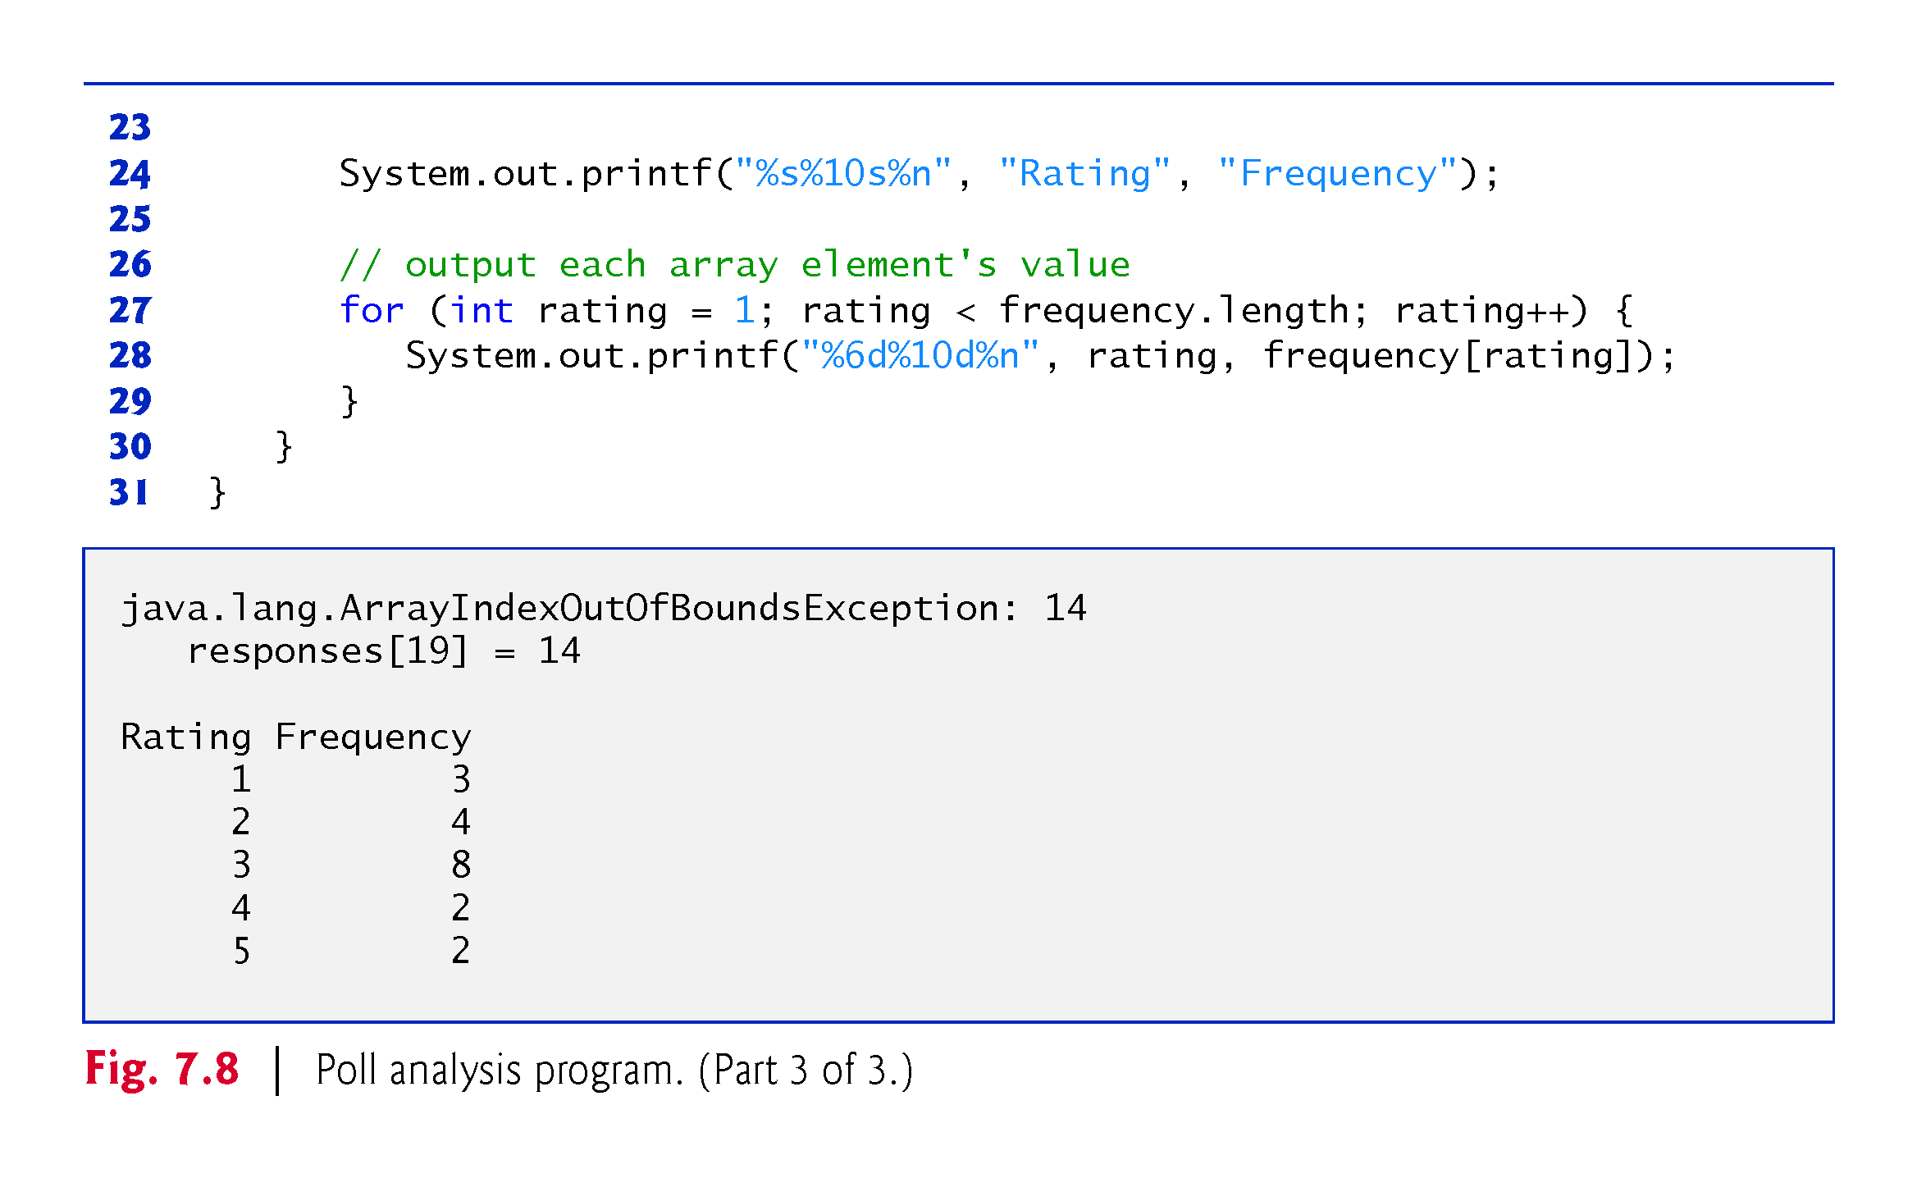

Slide 29
7.4.7 Using Arrays to Analyze Survey Results (Cont.)
If a piece of data in the responses array is an invalid value, such as 14, the program attempts to add 1 to frequency[14], which is outside the bounds of the array.
Java doesn’t allow this.
JVM checks array indices to ensure that they are greater than or equal to 0 and less than the length of the array—this is called bounds checking.
If a program uses an invalid index, Java generates a so-called exception to indicate that an error occurred in the program at execution time.

Slide 30
7.5 Exception Handling: Processing the Incorrect Response
An exception indicates a problem that occurs while a program executes.
The name “exception” suggests that the problem occurs infrequently—if the “rule” is that a statement normally executes correctly, then the problem represents the “exception to the rule.”
Exception handling helps you create fault-tolerant programs that can resolve (or handle) exceptions.

Slide 31
7.5 Exception Handling: Processing the Incorrect Response (Cont.)
When the JVM or a method detects a problem, such as an invalid array index or an invalid method argument, it throws an exception—that is, an exception occurs.

Slide 32
7.5.1 The try Statement
To handle an exception, place any code that might throw an exception in a try statement.
The try block contains the code that might throw an exception.
The catch block contains the code that handles the exception if one occurs. You can have many catch blocks to handle different types of exceptions that might be thrown in the corresponding try block.

Slide 33
7.5.2 Executing the catch Block
When the program encounters the invalid value 14 in the responses array, it attempts to add 1 to frequency[14], which is outside the bounds of the array—the frequency array has only six elements (with indexes 0–5).
Because array bounds checking is performed at execution time, the JVM generates an exception—specifically an ArrayIndexOutOfBoundsException to notify the program of this problem.
At this point the try block terminates and the catch block begins executing—if you declared any local variables in the try block, they’re now out of scope.

Slide 34
7.5.2 Executing the catch Block (Cont.)
The catch block declares an exception parameter (e) of type ArrayIndexOutOfBoundsException.
Inside the catch block, you can use the parameter’s identifier to interact with a caught exception object.

Slide 35
7.5.3 toString Method of the Exception Parameter
The exception object’s toString method returns the error message that’s implicitly stored in the exception object.
The exception is considered handled when program control reaches the closing right brace of the catch block.

Slide 36
7.6 Case Study: Card Shuffling and Dealing Simulation
Examples thus far used arrays containing elements of primitive types.
Elements of an array can be either primitive types or reference types.
Next example uses an array of reference-type elements—objects representing playing cards—to develop a class that simulates card shuffling and dealing.

Slide 37
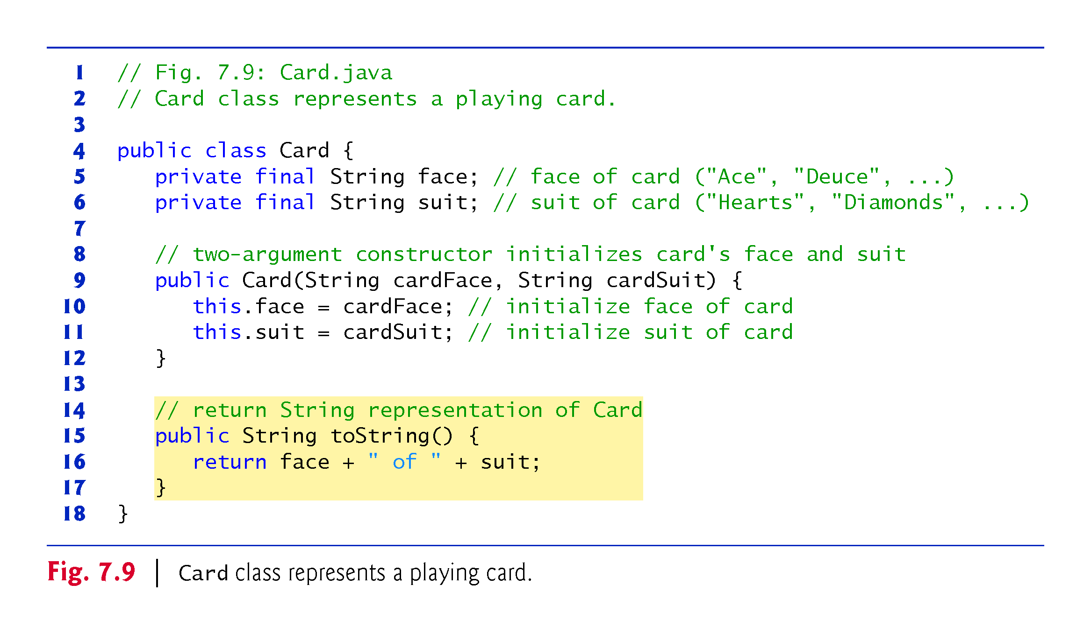

Slide 38
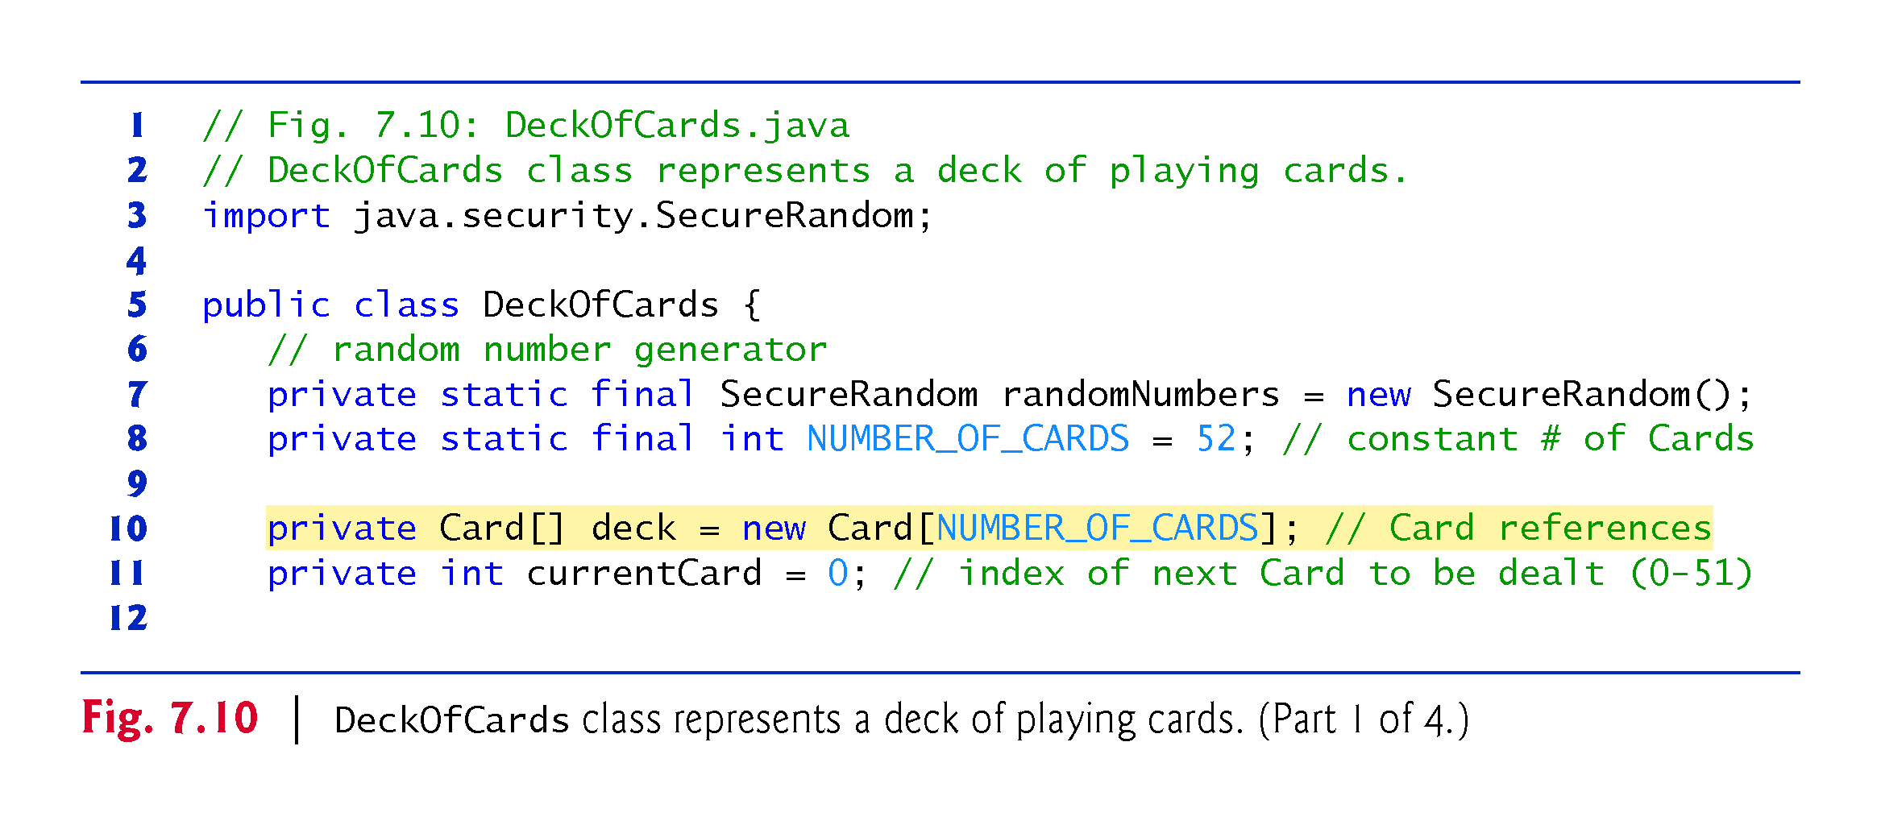

Slide 39
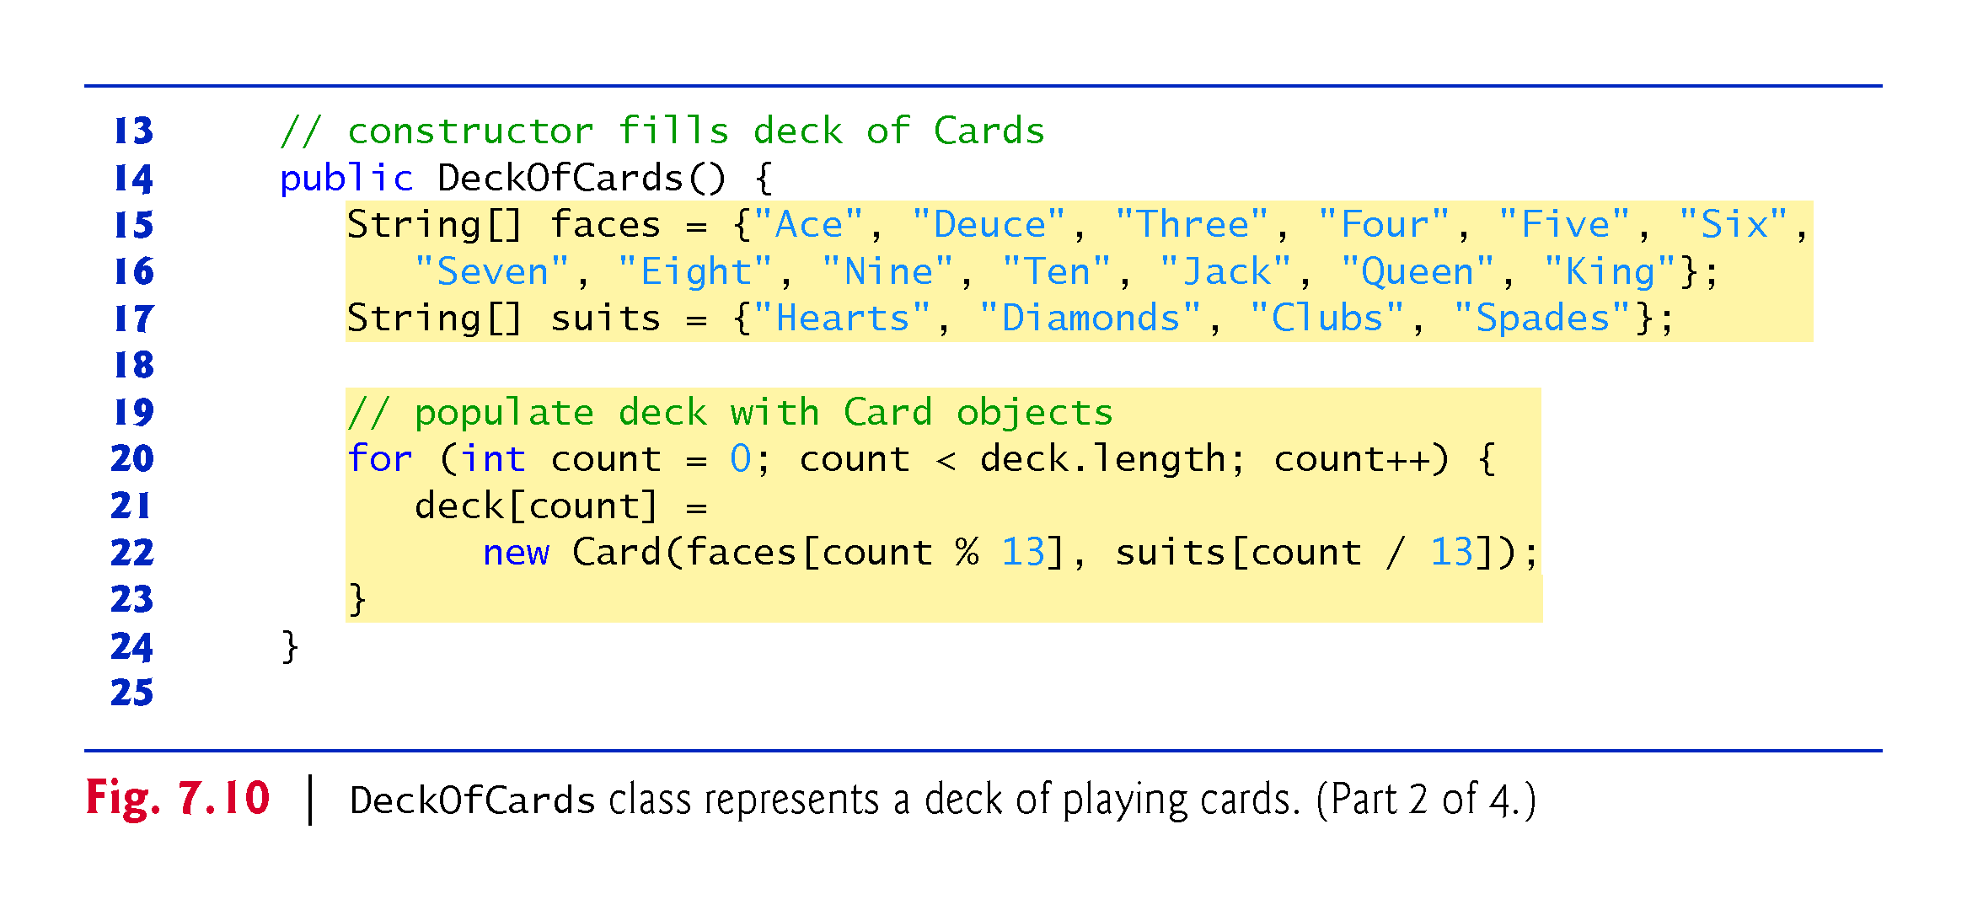

Slide 40
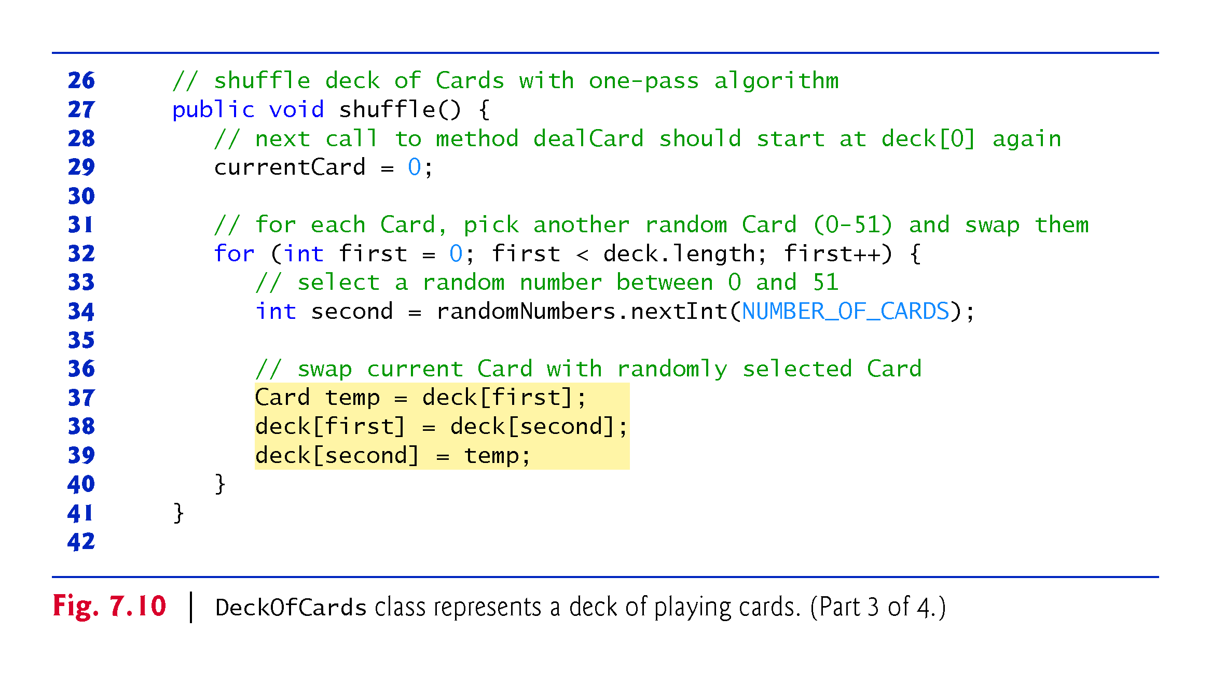

Slide 41
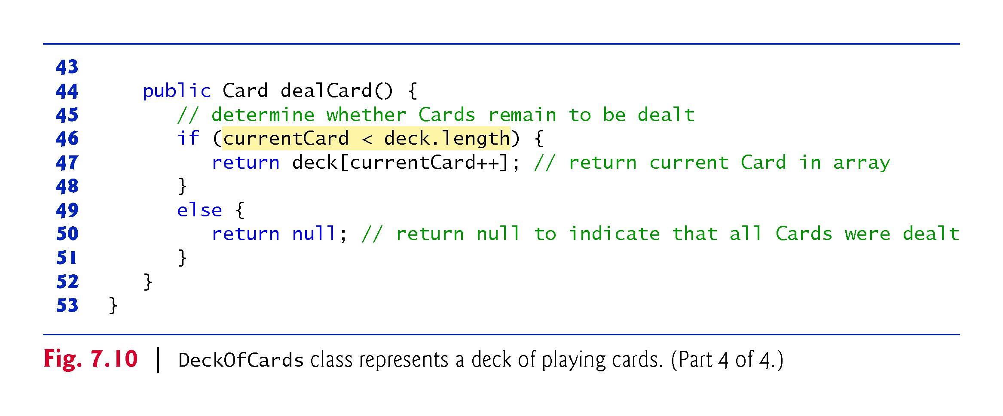

Slide 42
7.6 Case Study: Card Shuffling and Dealing Simulation (Cont.)
Figure 7.11 demonstrates class DeckOfCards.
When a Card is output as a String, the Card’s toString method is implicitly invoked.

Slide 43
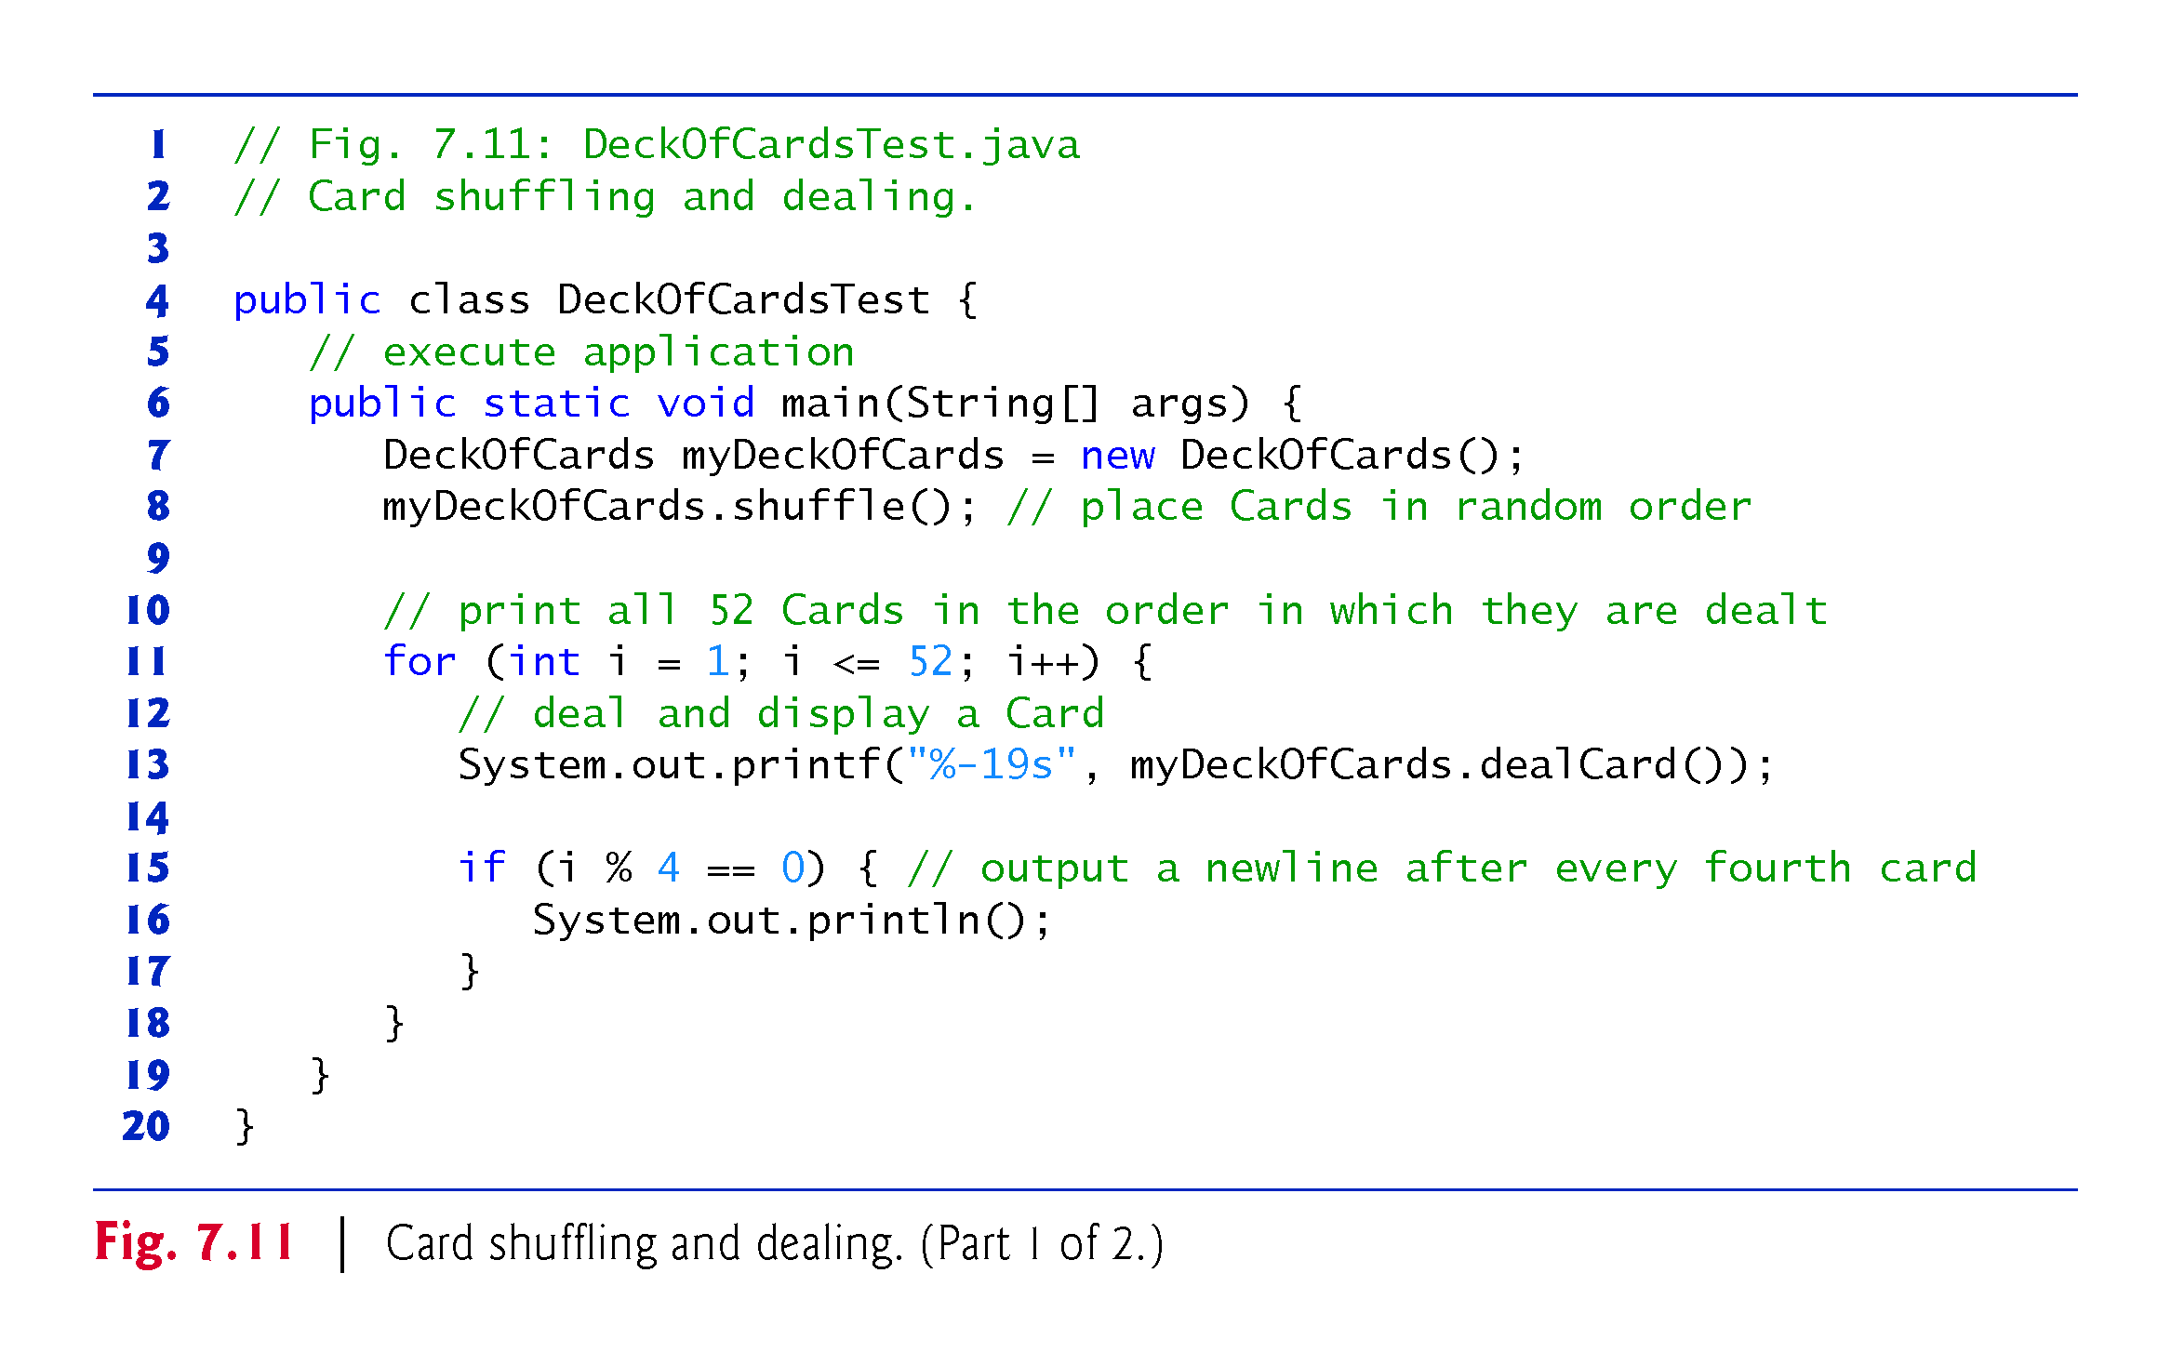

Slide 44
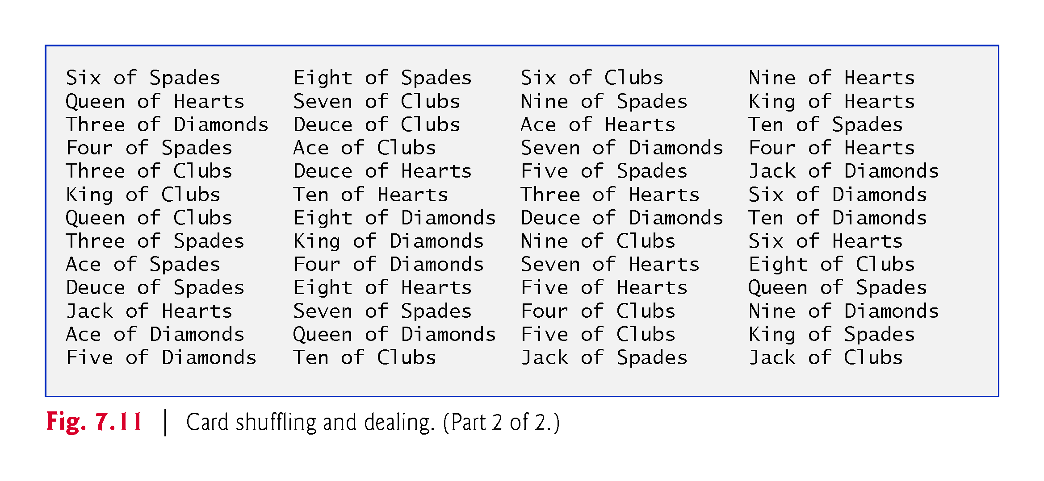

Slide 45
7.6 Case Study: Card Shuffling and Dealing Simulation (Cont.)
Preventing NullPointerExceptions
In Fig. 7.10, we created a deck array of 52 Card references—each element of every reference-type array created with new is default initialized to null.
Reference-type variables which are fields of a class are also initialized to null by default.
A NullPointerException occurs when you try to call a method on a null reference.
In industrial-strength code, ensuring that references are not null before you use them to call methods prevents NullPointerExceptions.

Slide 46
7.7 Enhanced for Statement
Enhanced for statement
Iterates through the elements of an array without using a counter.
Avoids the possibility of “stepping outside” the array.
Also works with the Java API’s prebuilt collections (see Section 7.14).
Syntax:
for (parameter : arrayName) { statement }
where parameter has a type and an identifier and arrayName is the array through which to iterate.
Parameter type must be consistent with the array’s element type.
The enhanced for statement simplifies the code for iterating through an array.

Slide 47
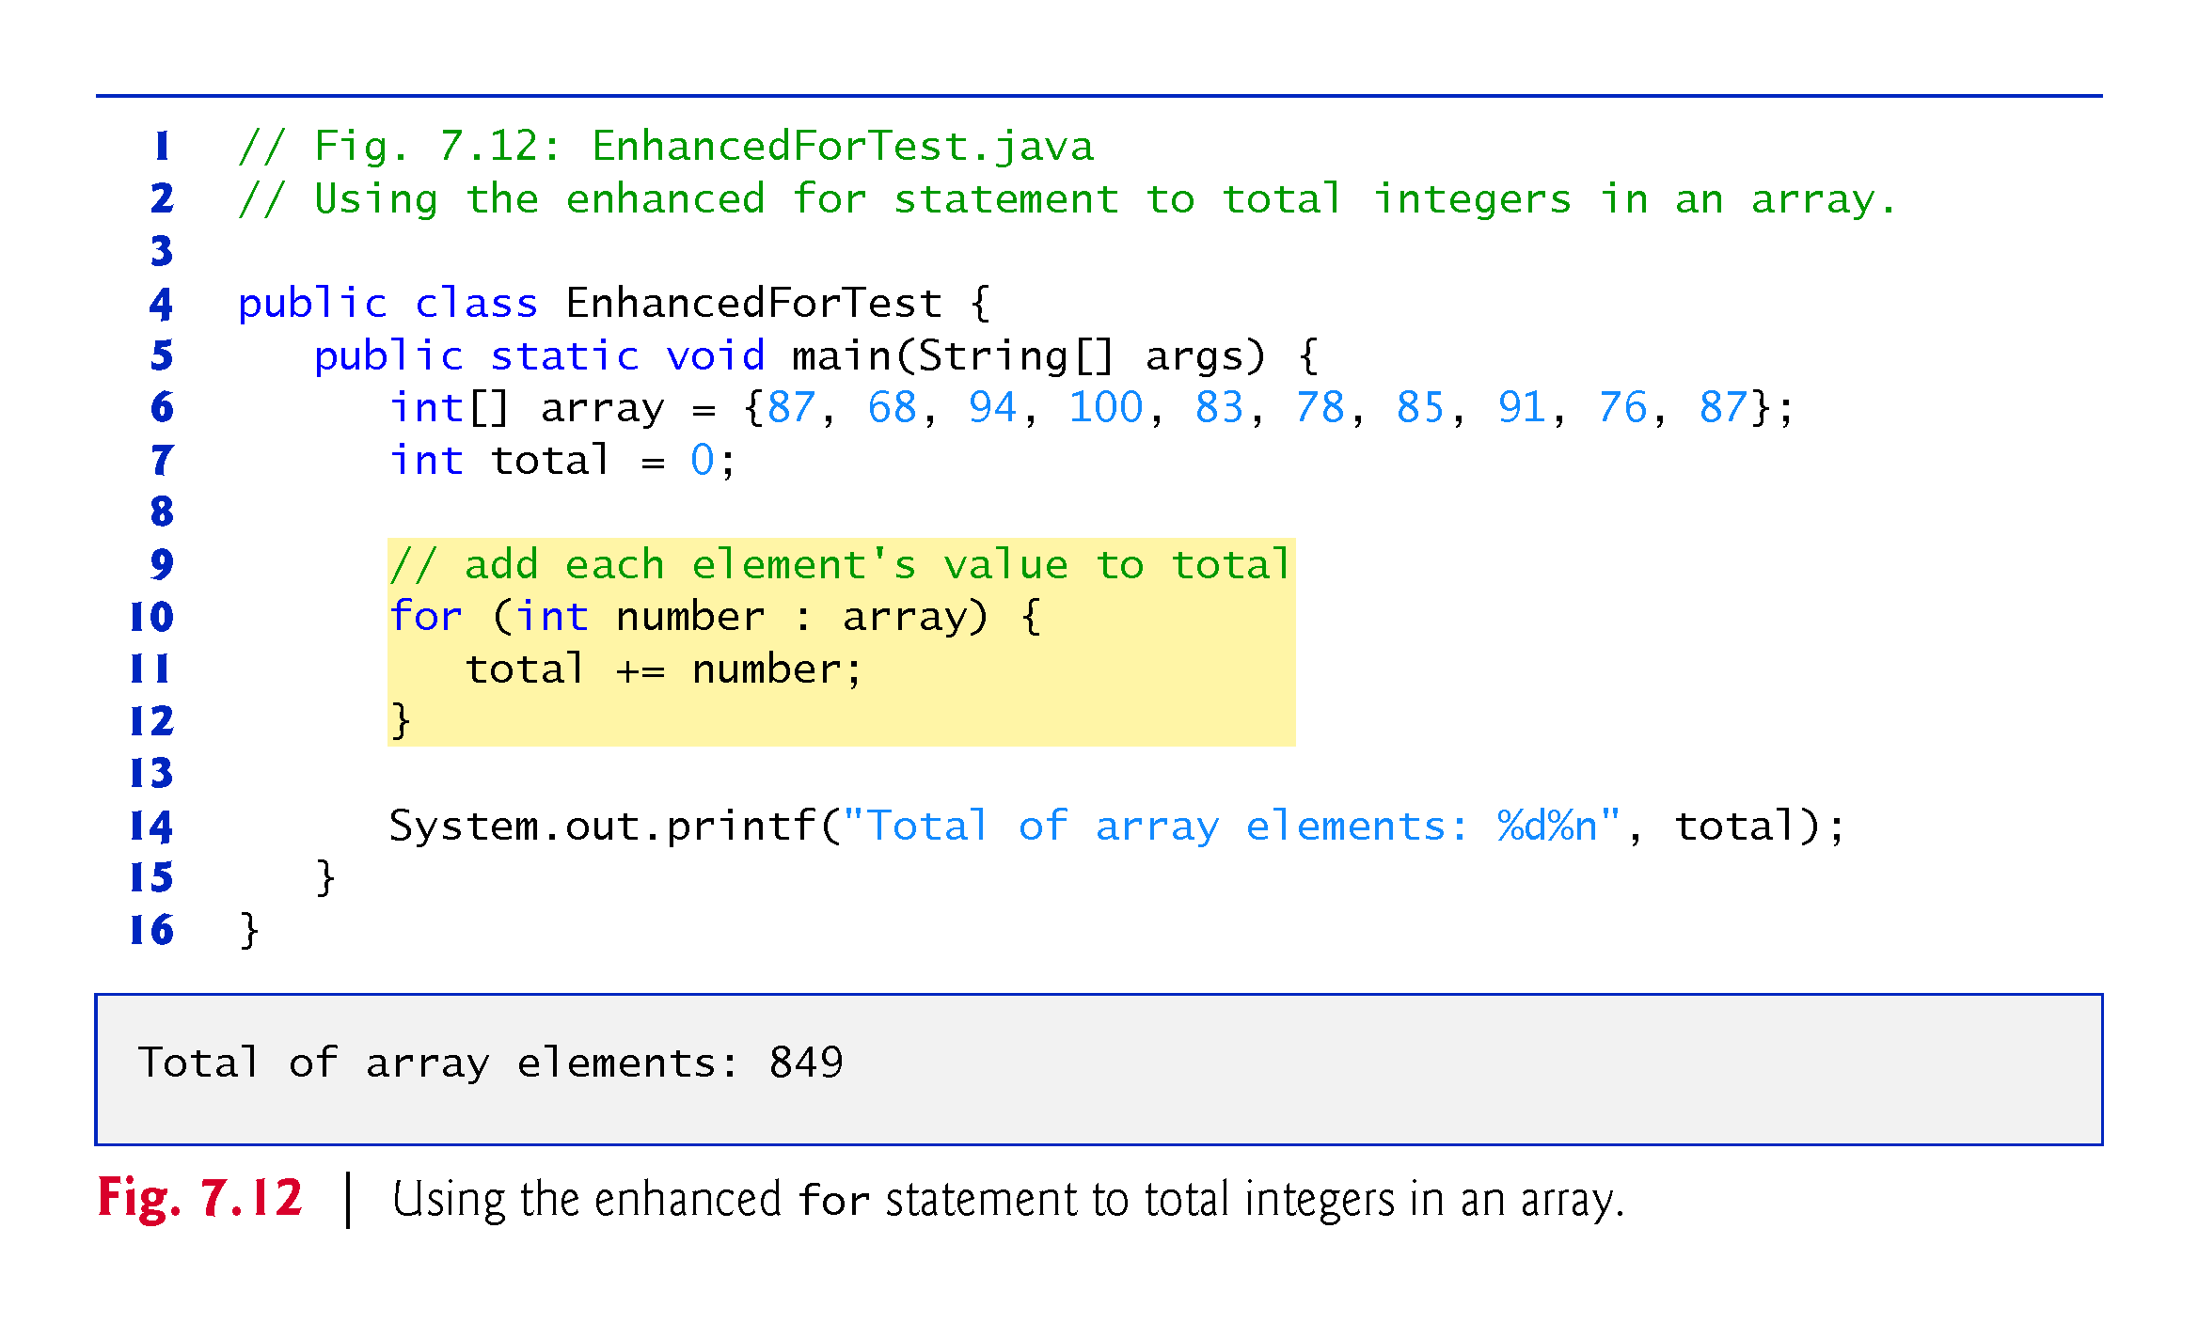

Slide 48
7.7 Enhanced for Statement (Cont.)
The enhanced for statement can be used only to obtain array elements
It cannot be used to modify elements.
To modify elements, use the traditional counter-controlled for statement.
Can be used in place of the counter-controlled for statement if you don’t need to access the index of the element.

Slide 49
7.8 Passing Arrays to Methods
To pass an array argument to a method, specify the name of the array without any brackets.
Since every array object “knows” its own length, we need not pass the array length as an additional argument.
To receive an array, the method’s parameter list must specify an array parameter.
When an argument to a method is an entire array or an individual array element of a reference type, the called method receives a copy of the reference.
When an argument to a method is an individual array element of a primitive type, the called method receives a copy of the element’s value.
Such primitive values are called scalars or scalar quantities.

Slide 50
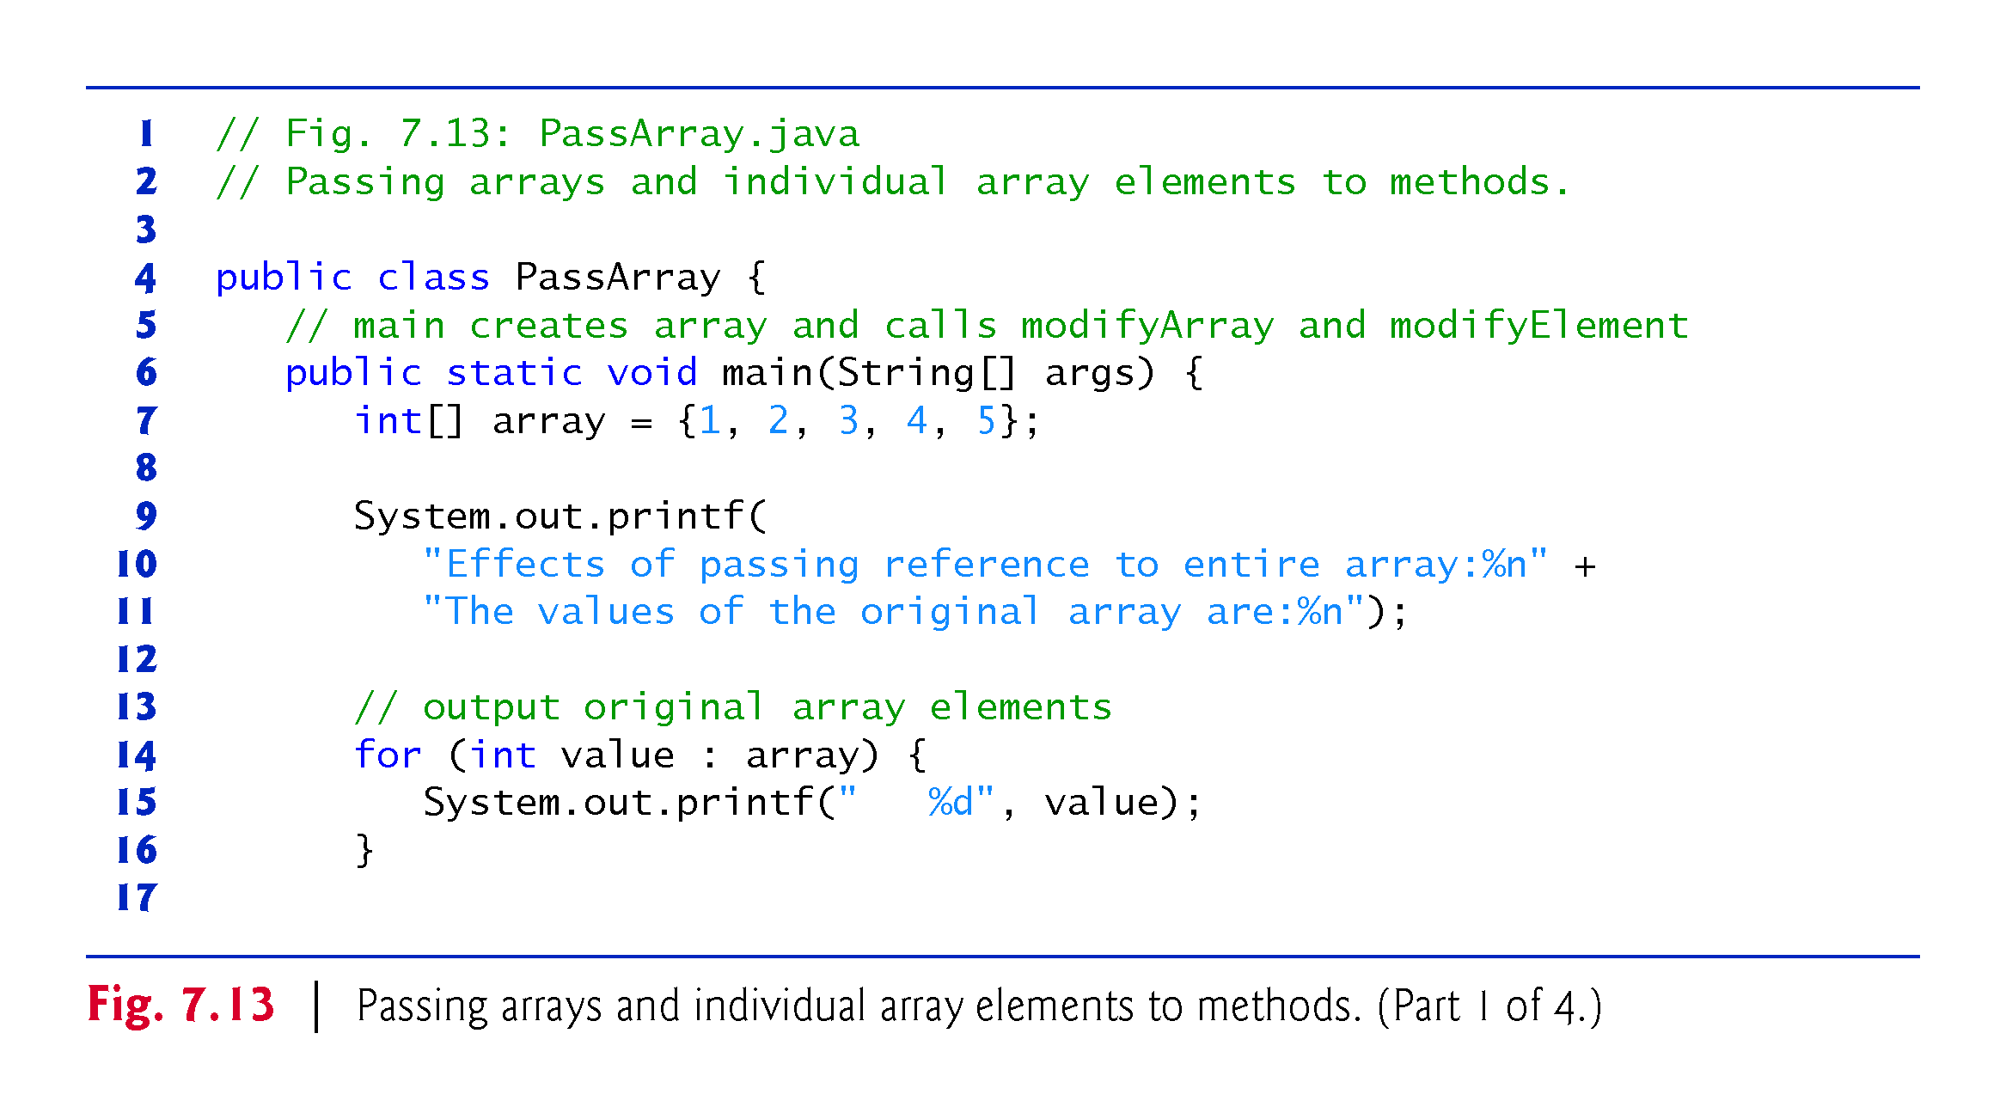

Slide 51
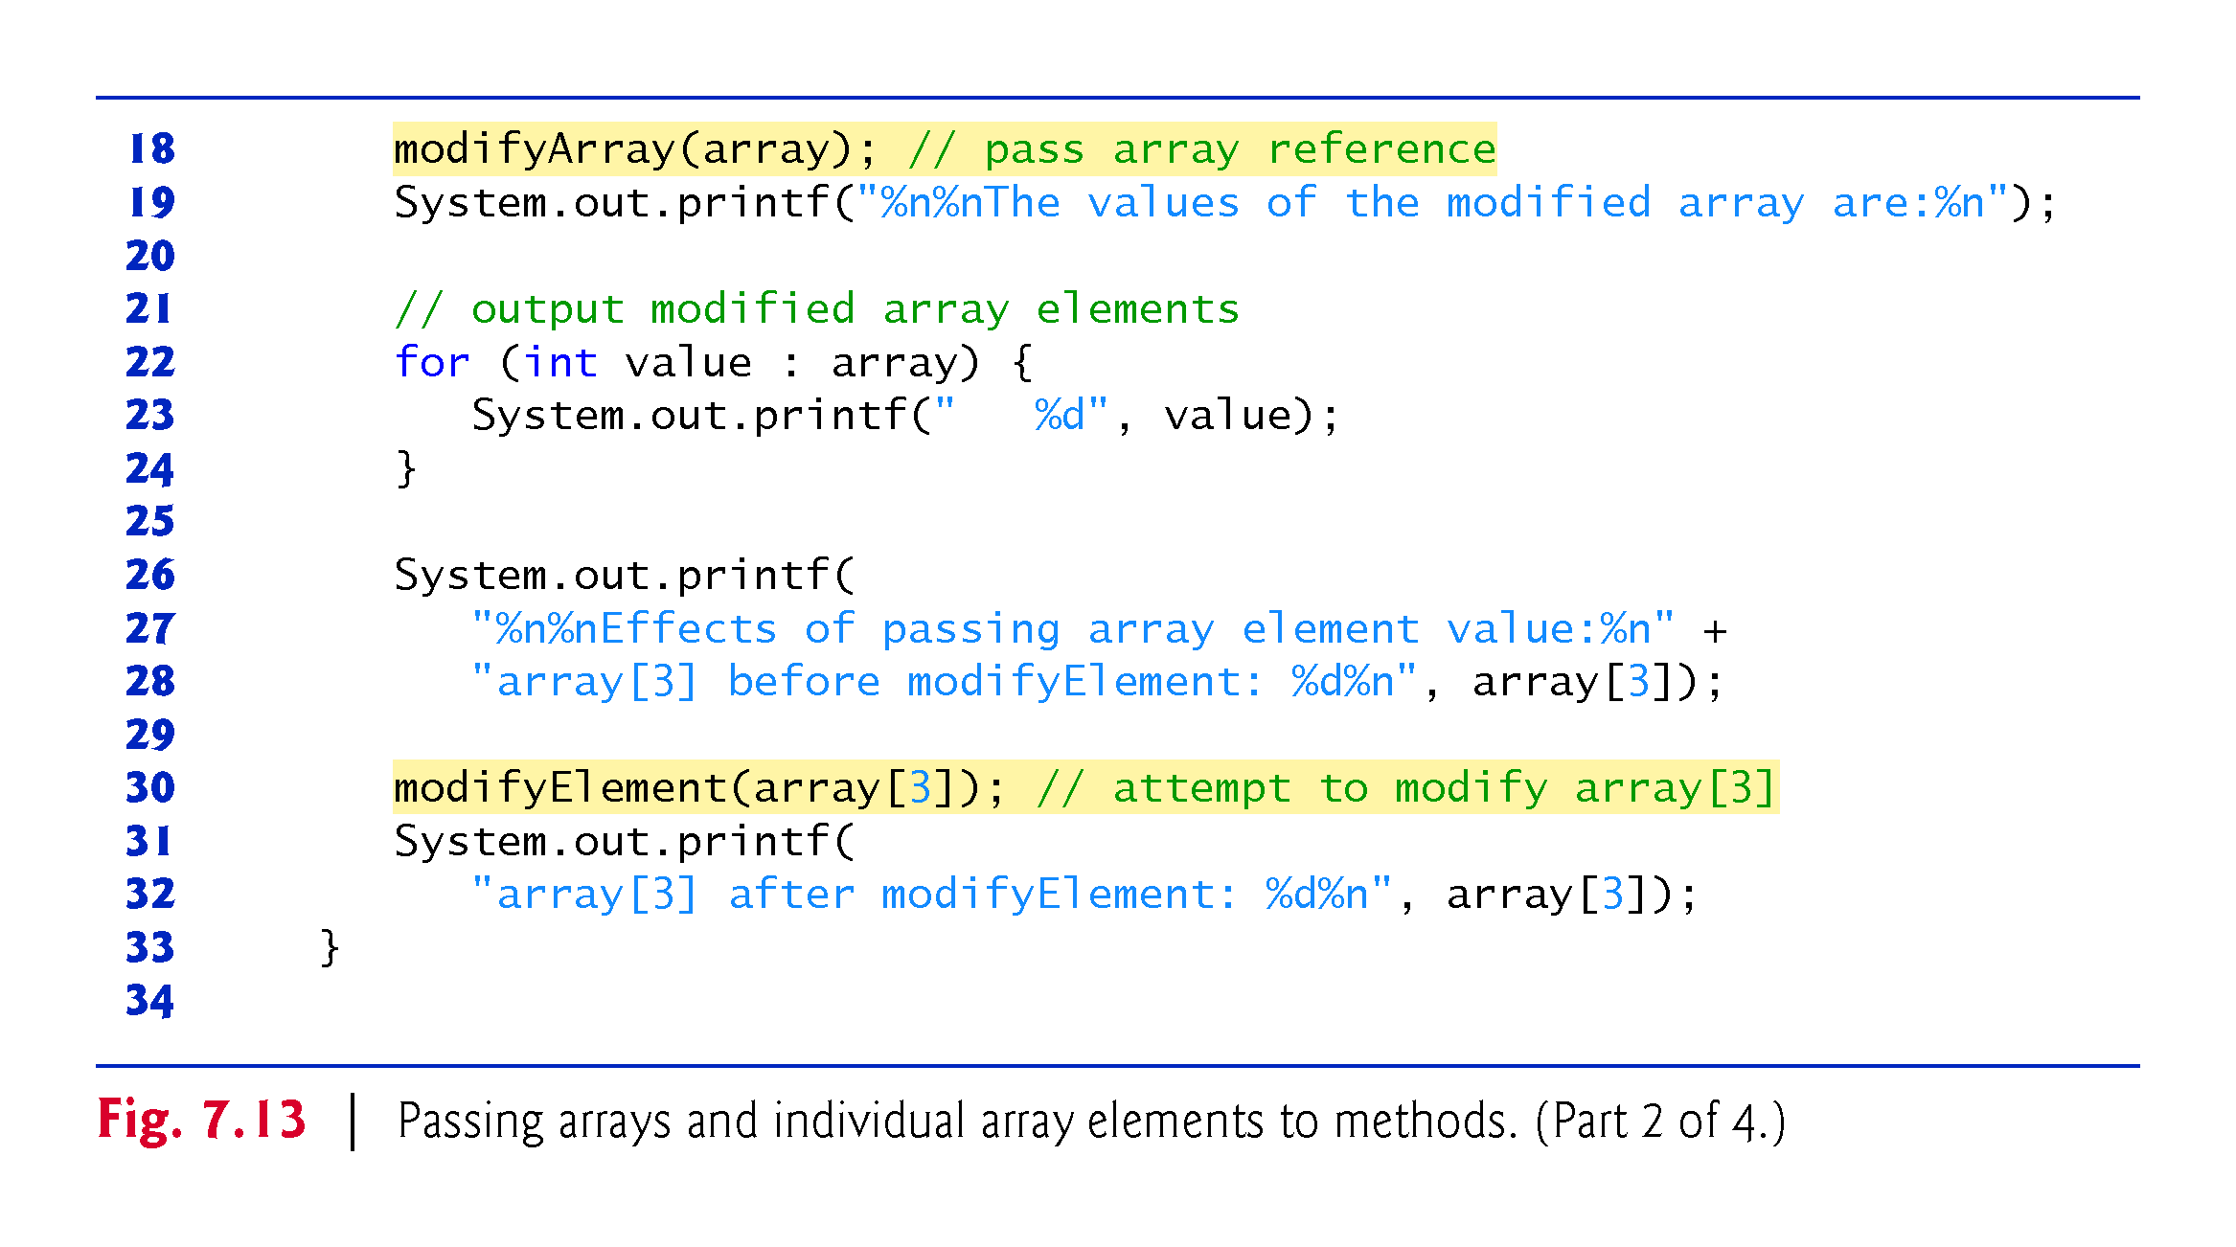

Slide 52
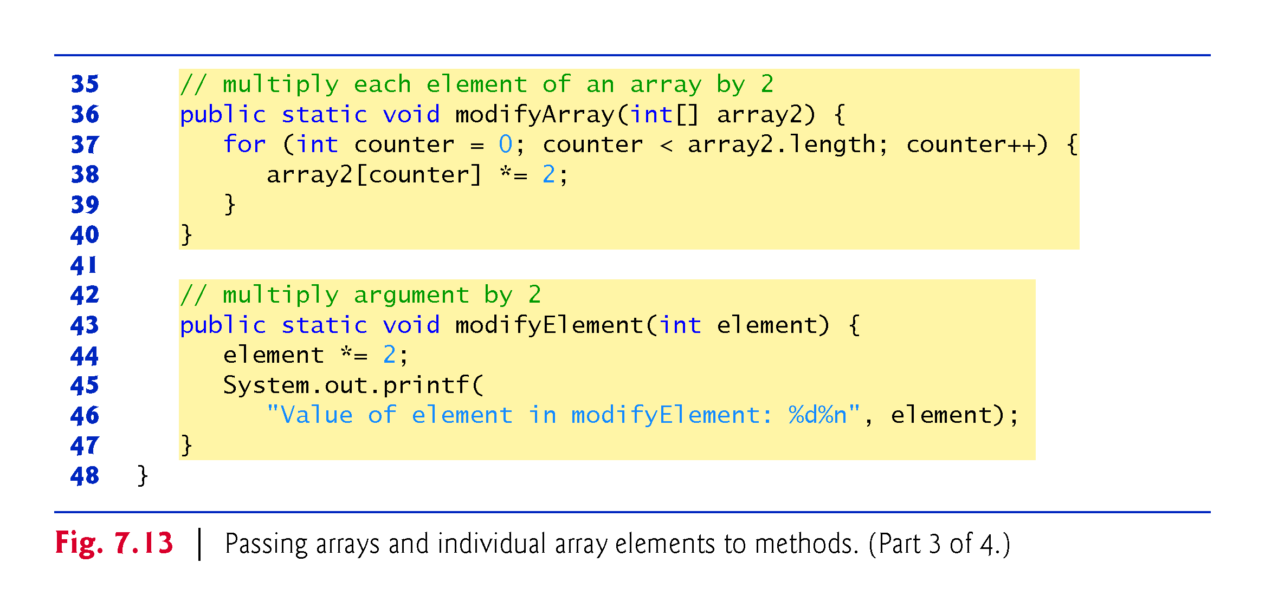

Slide 53
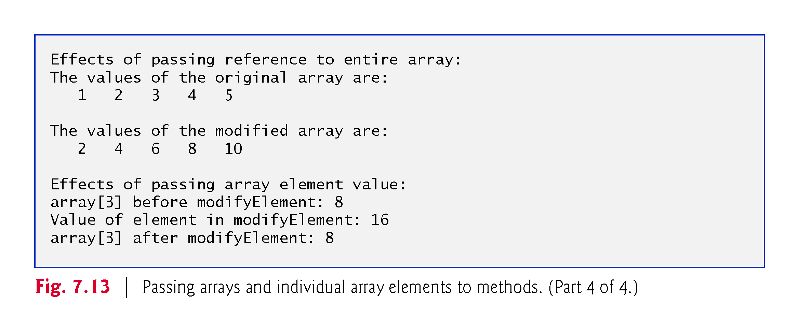

Slide 54
7.9 Pass-By-Value vs. Pass-By-Reference
Pass-by-value (sometimes called call-by-value)
A copy of the argument’s value is passed to the called method.
The called method works exclusively with the copy.
Changes to the called method’s copy do not affect the original variable’s value in the caller.
Pass-by-reference (sometimes called call-by-reference)
The called method can access the argument’s value in the caller directly and modify that data, if necessary.
Improves performance by eliminating the need to copy possibly large amounts of data.

Slide 55
7.9 Pass-By-Value vs. Pass-By-Reference (Cont.)
All arguments in Java are passed by value.
[Stated in book, p. 280. Seems to be an error/confusion here. When the “value” passed is a reference to an object, this is “pass by reference”.]
A method call can pass two types of values to a method
Copies of primitive values
Copies of references to objects
Objects cannot be passed to methods.

Slide 56
7.10 Case Study: Class GradeBook Using an Array to Store Grades
We now present the first part of our case study on developing a GradeBook class that instructors can use to maintain students’ grades on an exam and display a grade report that includes the grades, class average, lowest grade, highest grade and a grade distribution bar chart.
The version of class GradeBook presented in this section stores the grades for one exam in a one-dimensional array.
In Section 7.12, we present a version of class GradeBook that uses a two-dimensional array to store students’ grades for several exams.

Slide 57
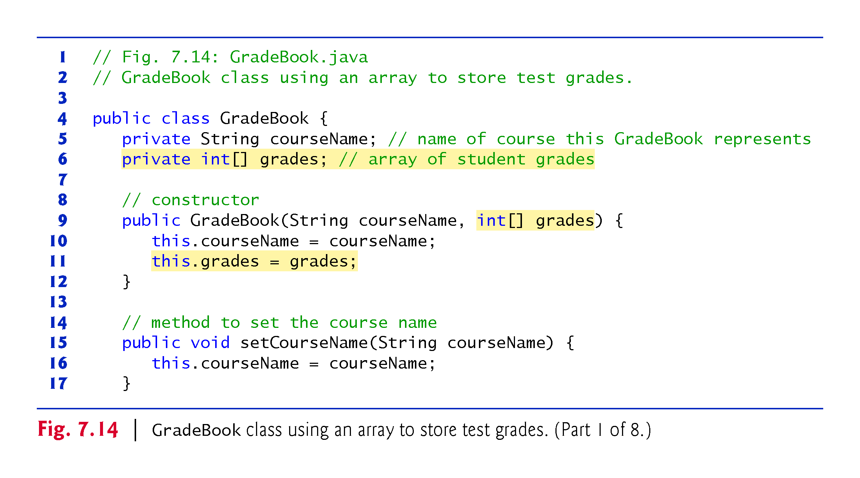

Slide 58
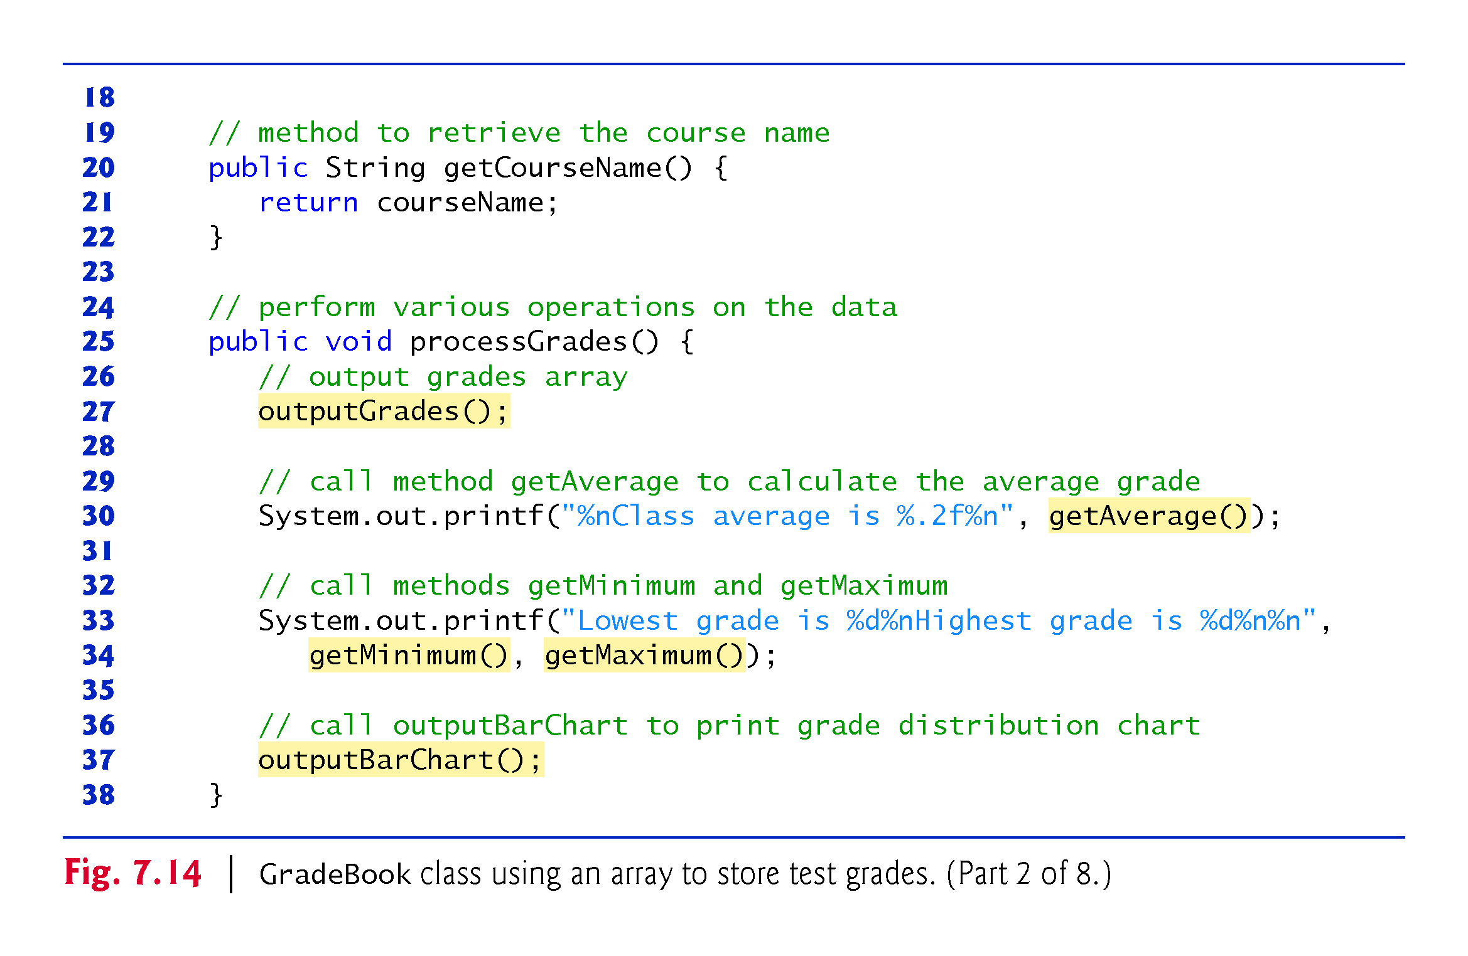

Slide 59
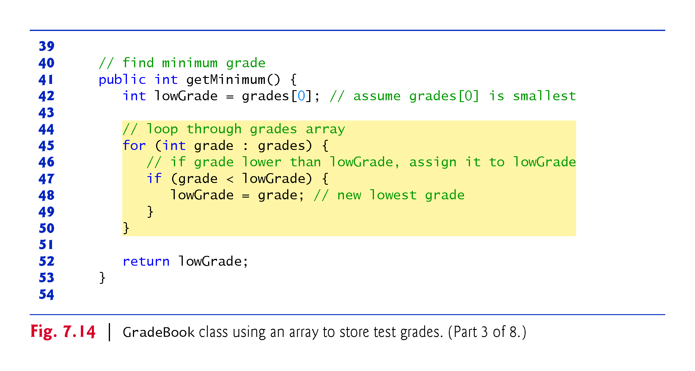

Slide 60
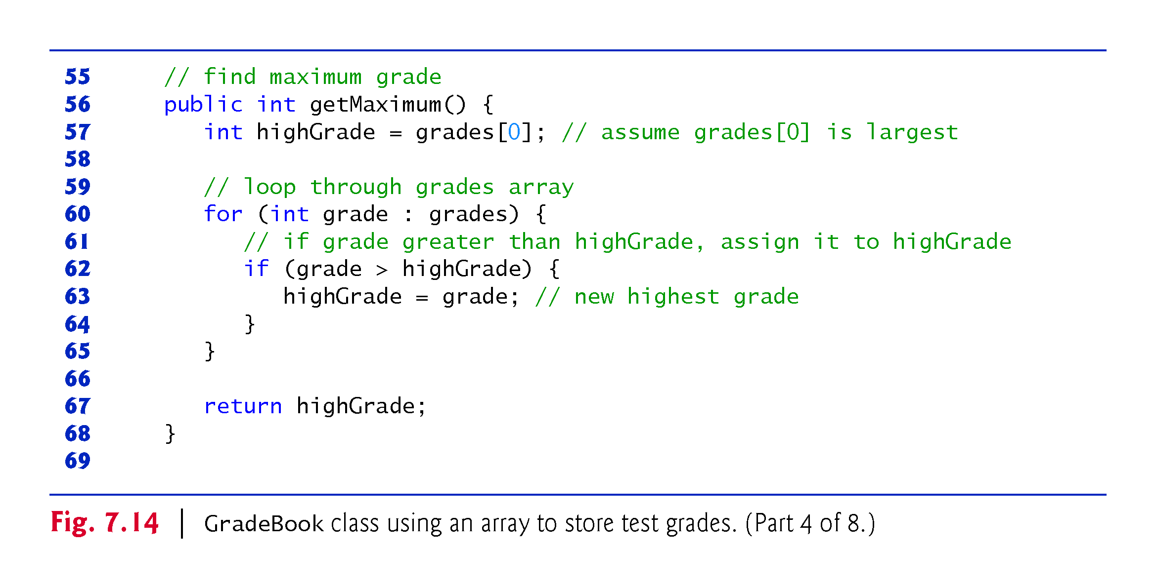

Slide 61
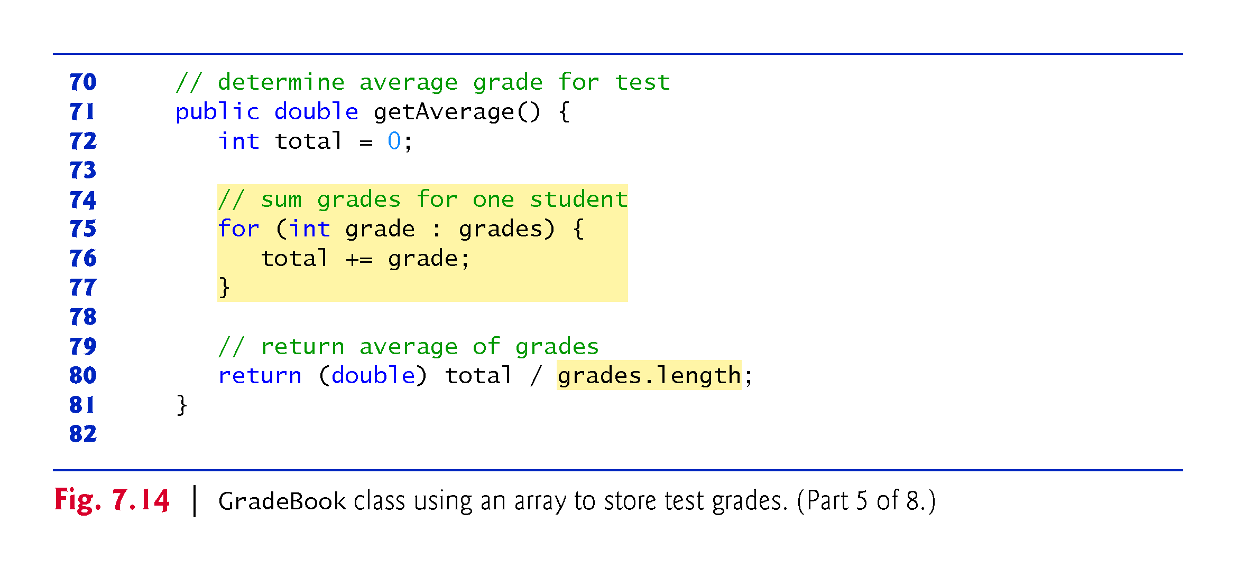

Slide 62
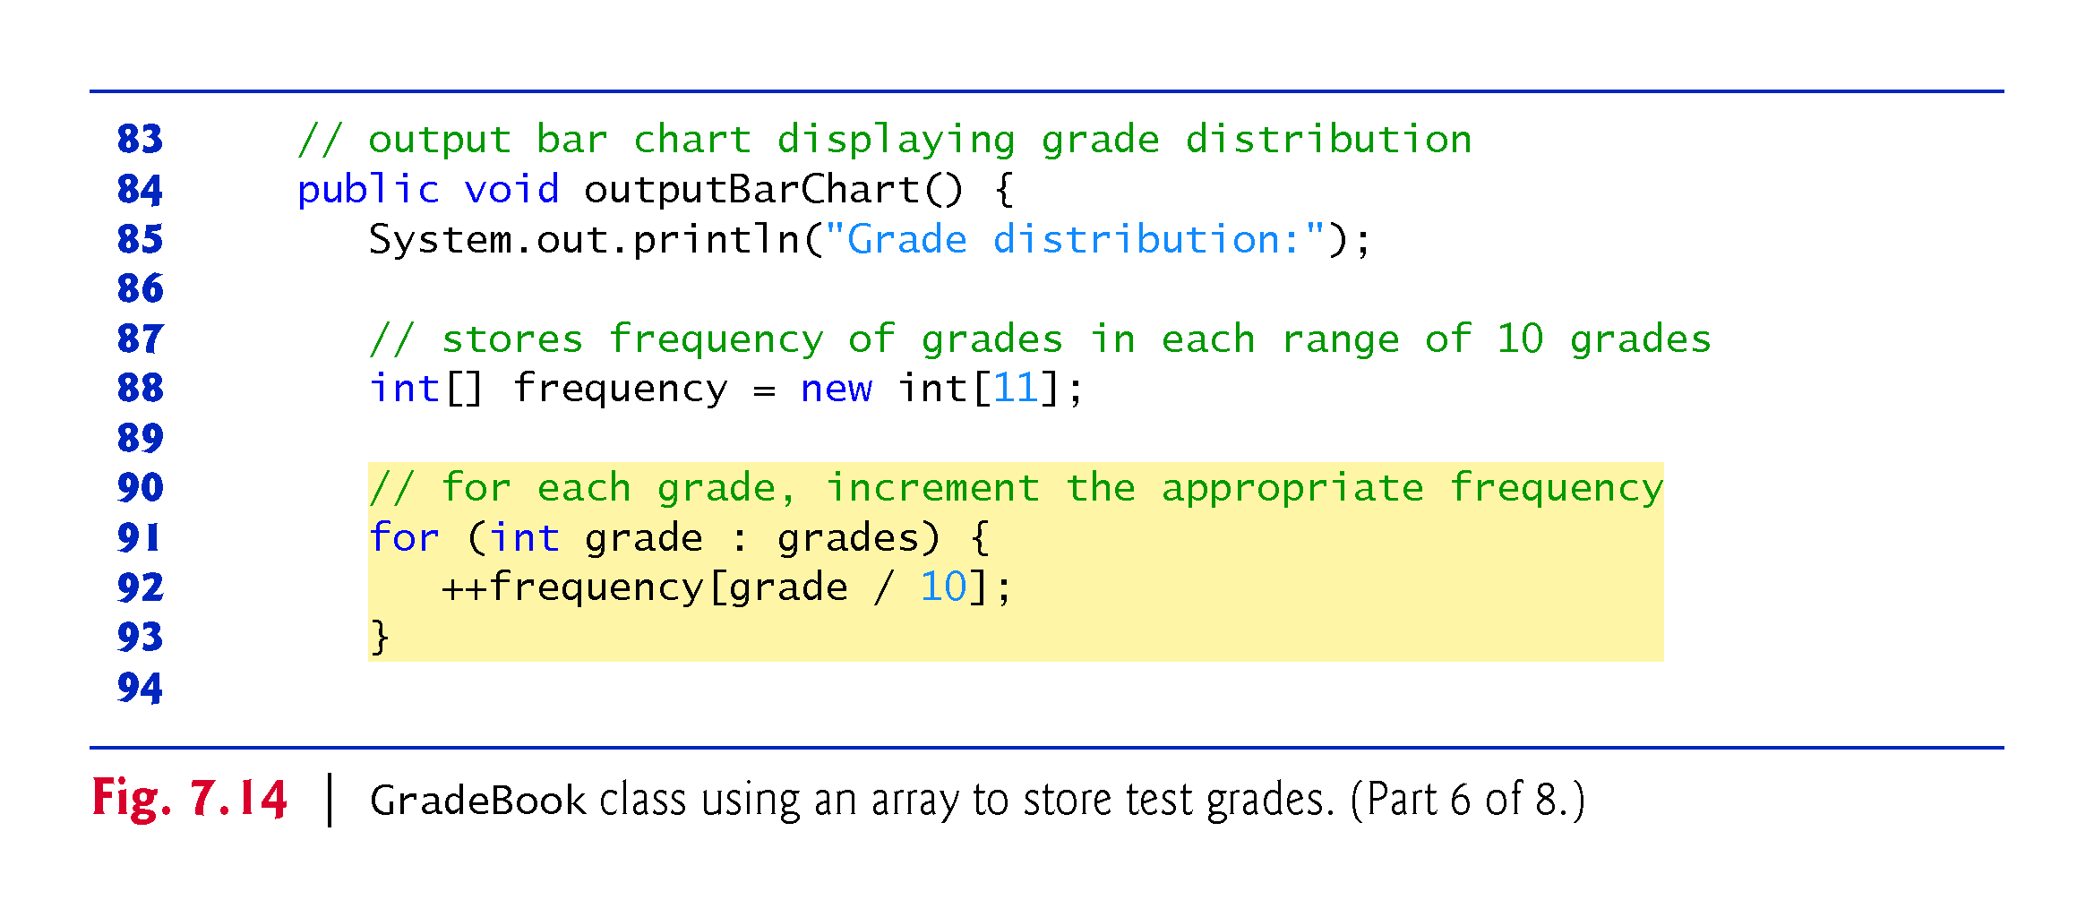

Slide 63
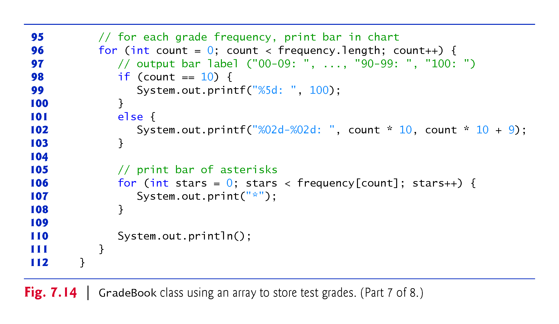

Slide 64
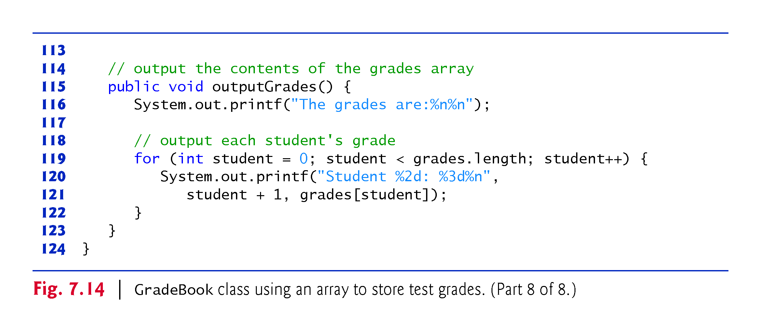

Slide 65
7.10 Case Study: Class GradeBook Using an Array to Store Grades (Cont.)
The application of Fig. 7.15 creates an object of class GradeBook (Fig. 7.14) using the int array grades-Array.
Lines 9-10 pass a course name and gradesArray to the GradeBook constructor.

Slide 66
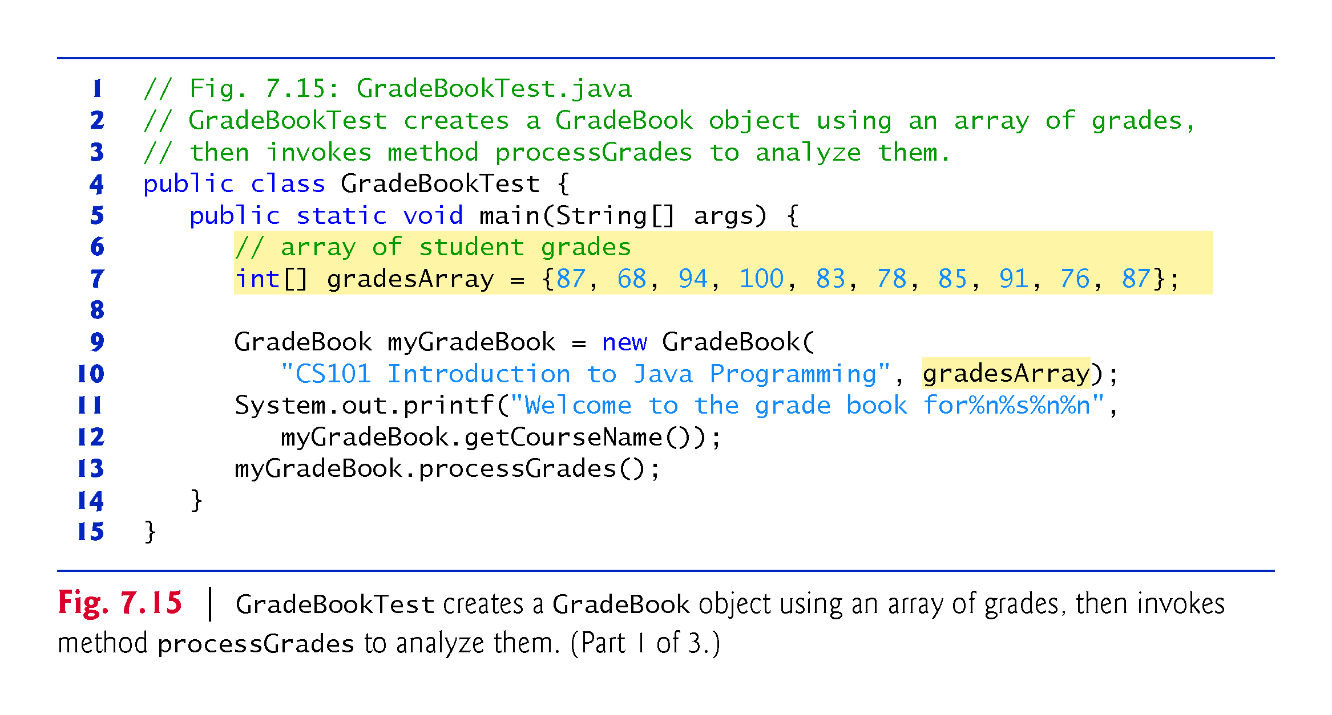

Slide 67
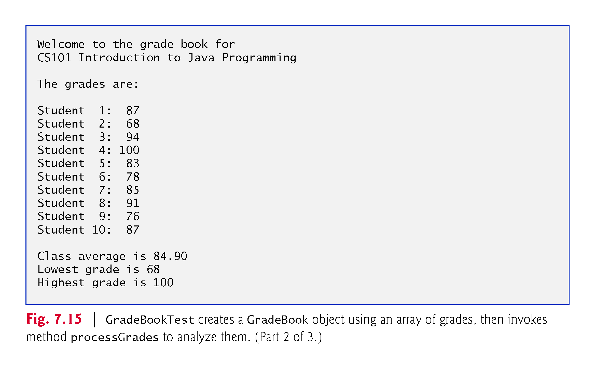

Slide 68
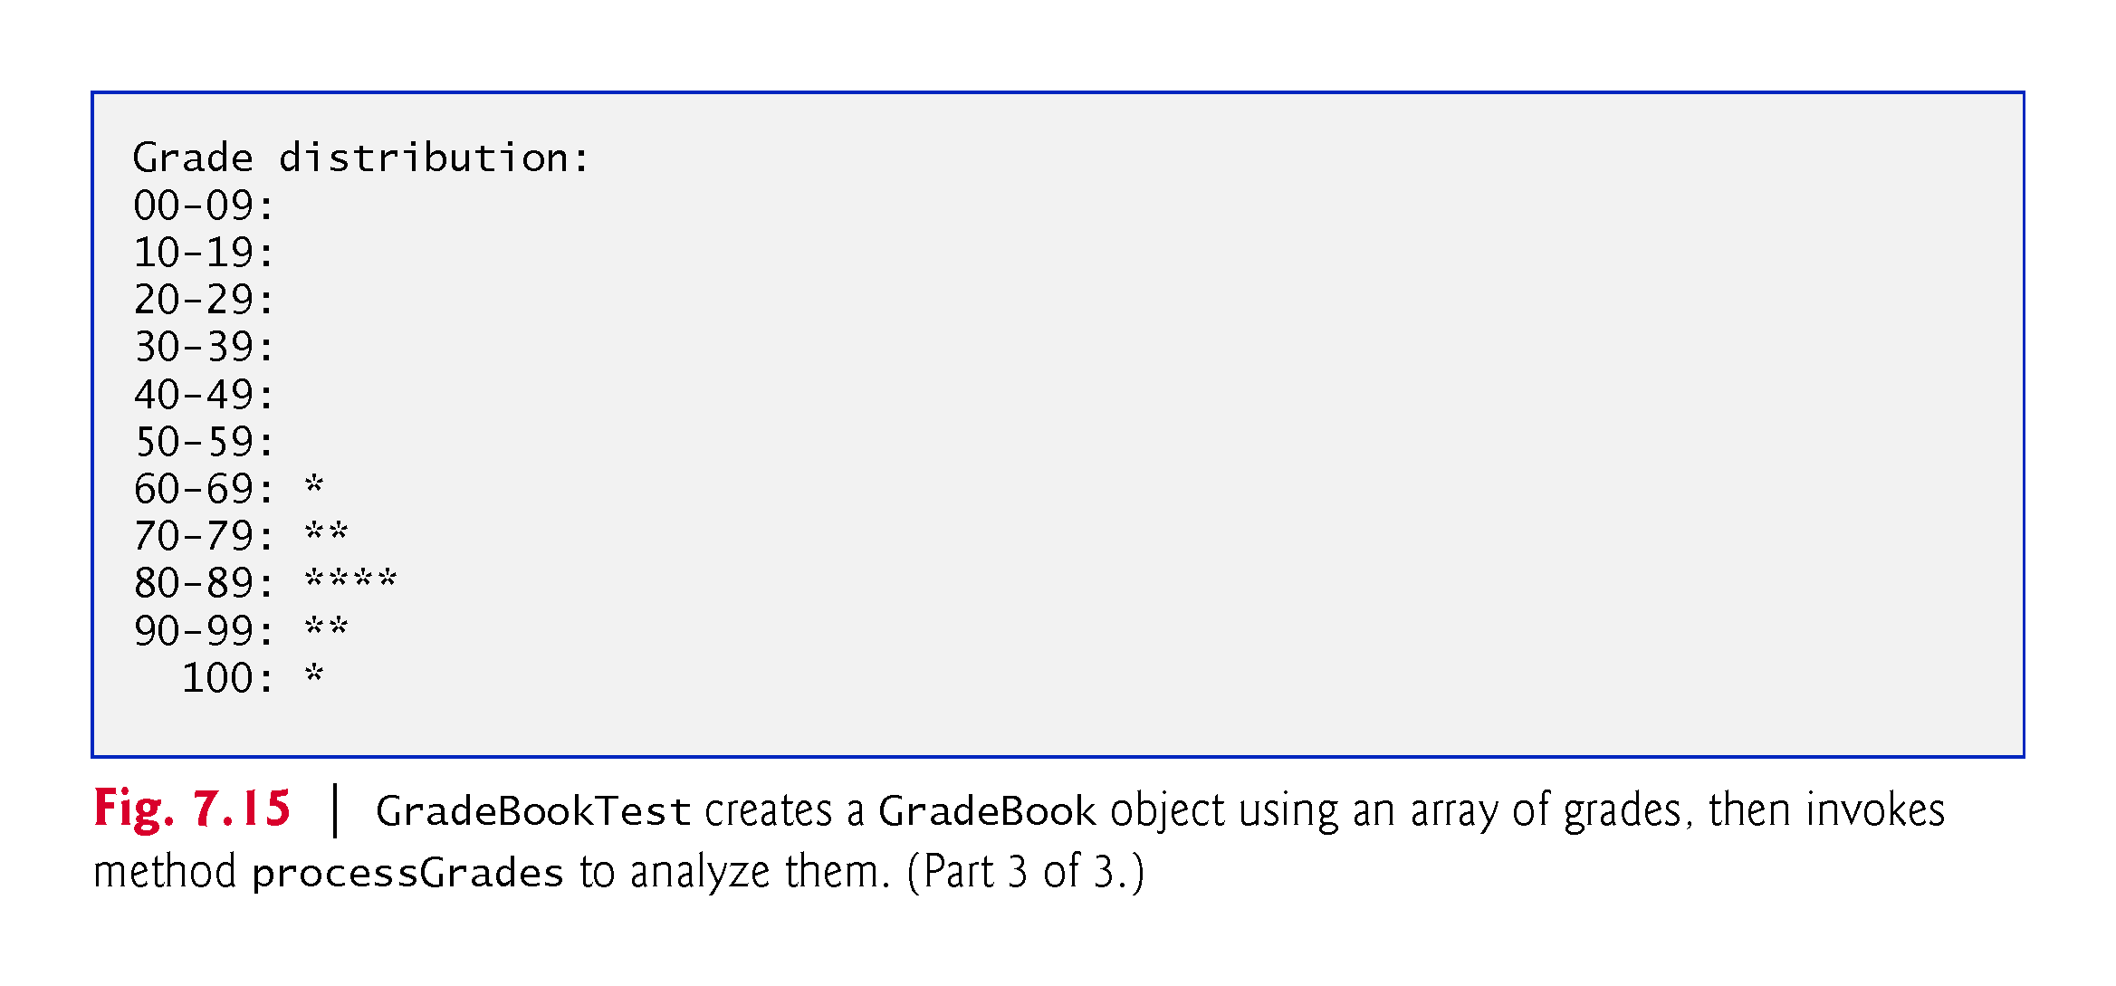

Slide 69
7.11 Multidimensional Arrays
Two-dimensional arrays are often used to represent tables of values with data arranged in rows and columns.
Identify each table element with two indices.
By convention, the first identifies the element’s row and the second its column.
Multidimensional arrays can have more than two dimensions.
Java does not support multidimensional arrays directly
Allows you to specify one-dimensional arrays whose elements are also one-dimensional arrays, thus achieving the same effect.
In general, an array with m rows and n columns is called an m-by-n array.

Slide 70
7.11 Multidimensional Arrays (Cont.)
Multidimensional arrays can be initialized with array initializers in declarations.
A two-dimensional array b with two rows and two columns could be declared and initialized with nested array initializers as follows:
int[][] b = {{1, 2}, {3, 4}};
The initial values are grouped by row in braces.
The number of nested array initializers (represented by sets of braces within the outer braces) determines the number of rows.
The number of initializer values in the nested array initializer for a row determines the number of columns in that row.
Rows can have different lengths.

Slide 71
7.11 Multidimensional Arrays (Cont.)
The lengths of the rows in a two-dimensional array are not required to be the same:
int[][] b = {{1, 2}, {3, 4, 5}};
Each element of b is a reference to a one-dimensional array of int variables.
The int array for row 0 is a one-dimensional array with two elements (1 and 2).
The int array for row 1 is a one-dimensional array with three elements (3, 4 and 5).

Slide 72
7.11 Multidimensional Arrays (Cont.)
A multidimensional array with the same number of columns in every row can be created with an array-creation expression.
int[][] b = new int[3][4];
3 rows and 4 columns.
The elements of a multidimensional array are initialized when the array object is created.
A multidimensional array in which each row has a different number of columns can be created as follows:
int[][] b = new int[2][]; // create 2 rows b[0] = new int[5]; // create 5 columns for row 0 b[1] = new int[3]; // create 3 columns for row 1
Creates a two-dimensional array with two rows.
Row 0 has five columns, and row 1 has three columns.

Slide 73
7.11 Multidimensional Arrays (Cont.)
Figure 7.17 demonstrates initializing two-dimensional arrays with array initializers and using nested for loops to traverse the arrays.

Slide 74
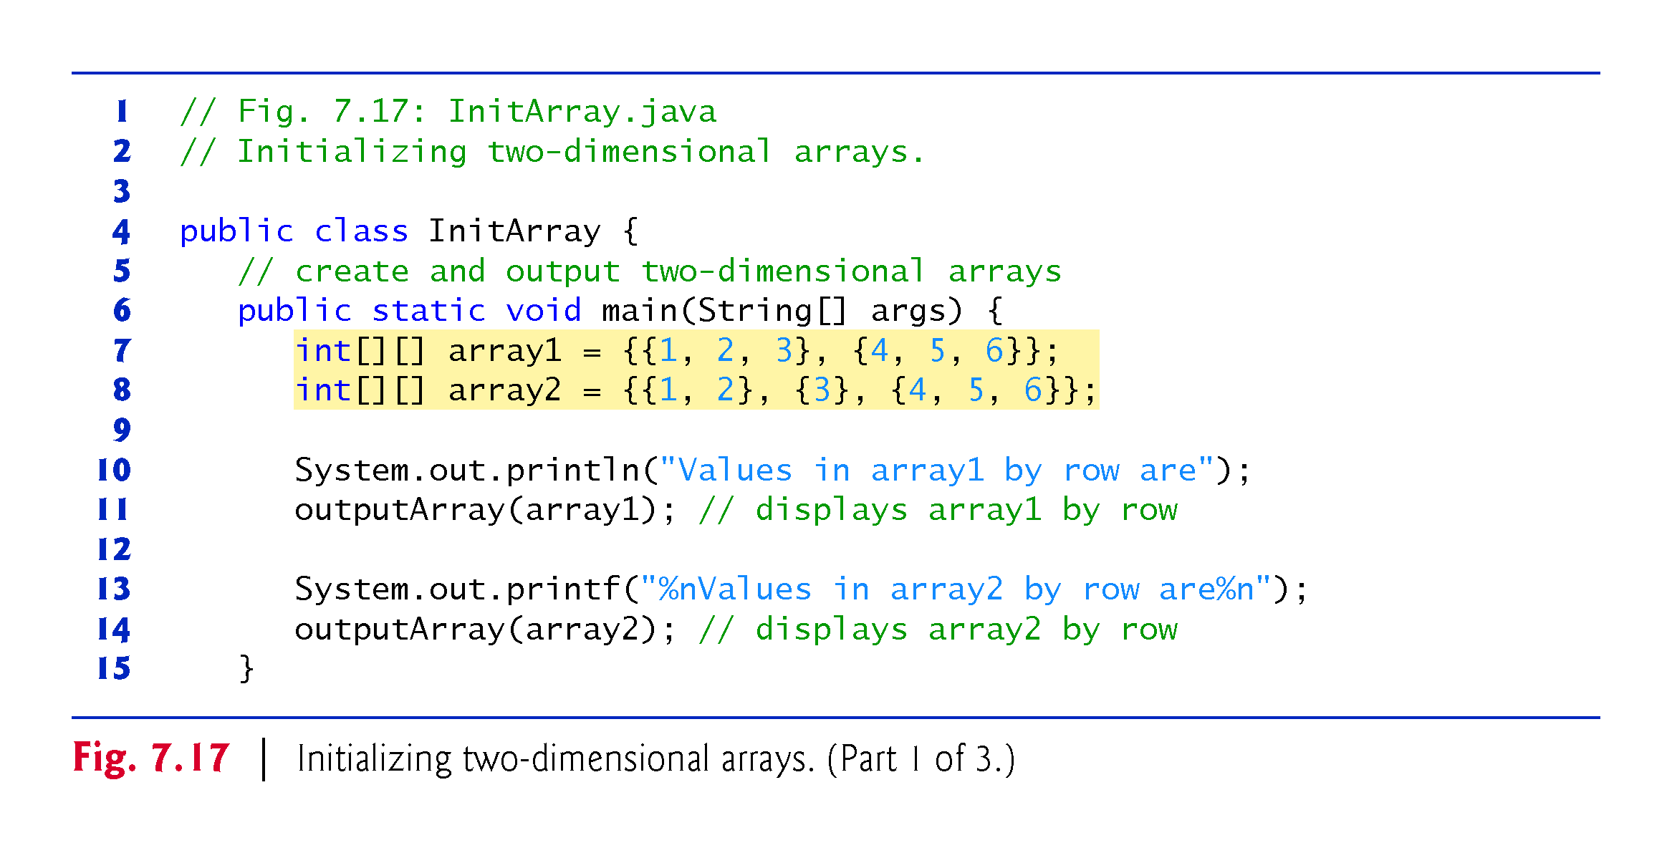

Slide 75
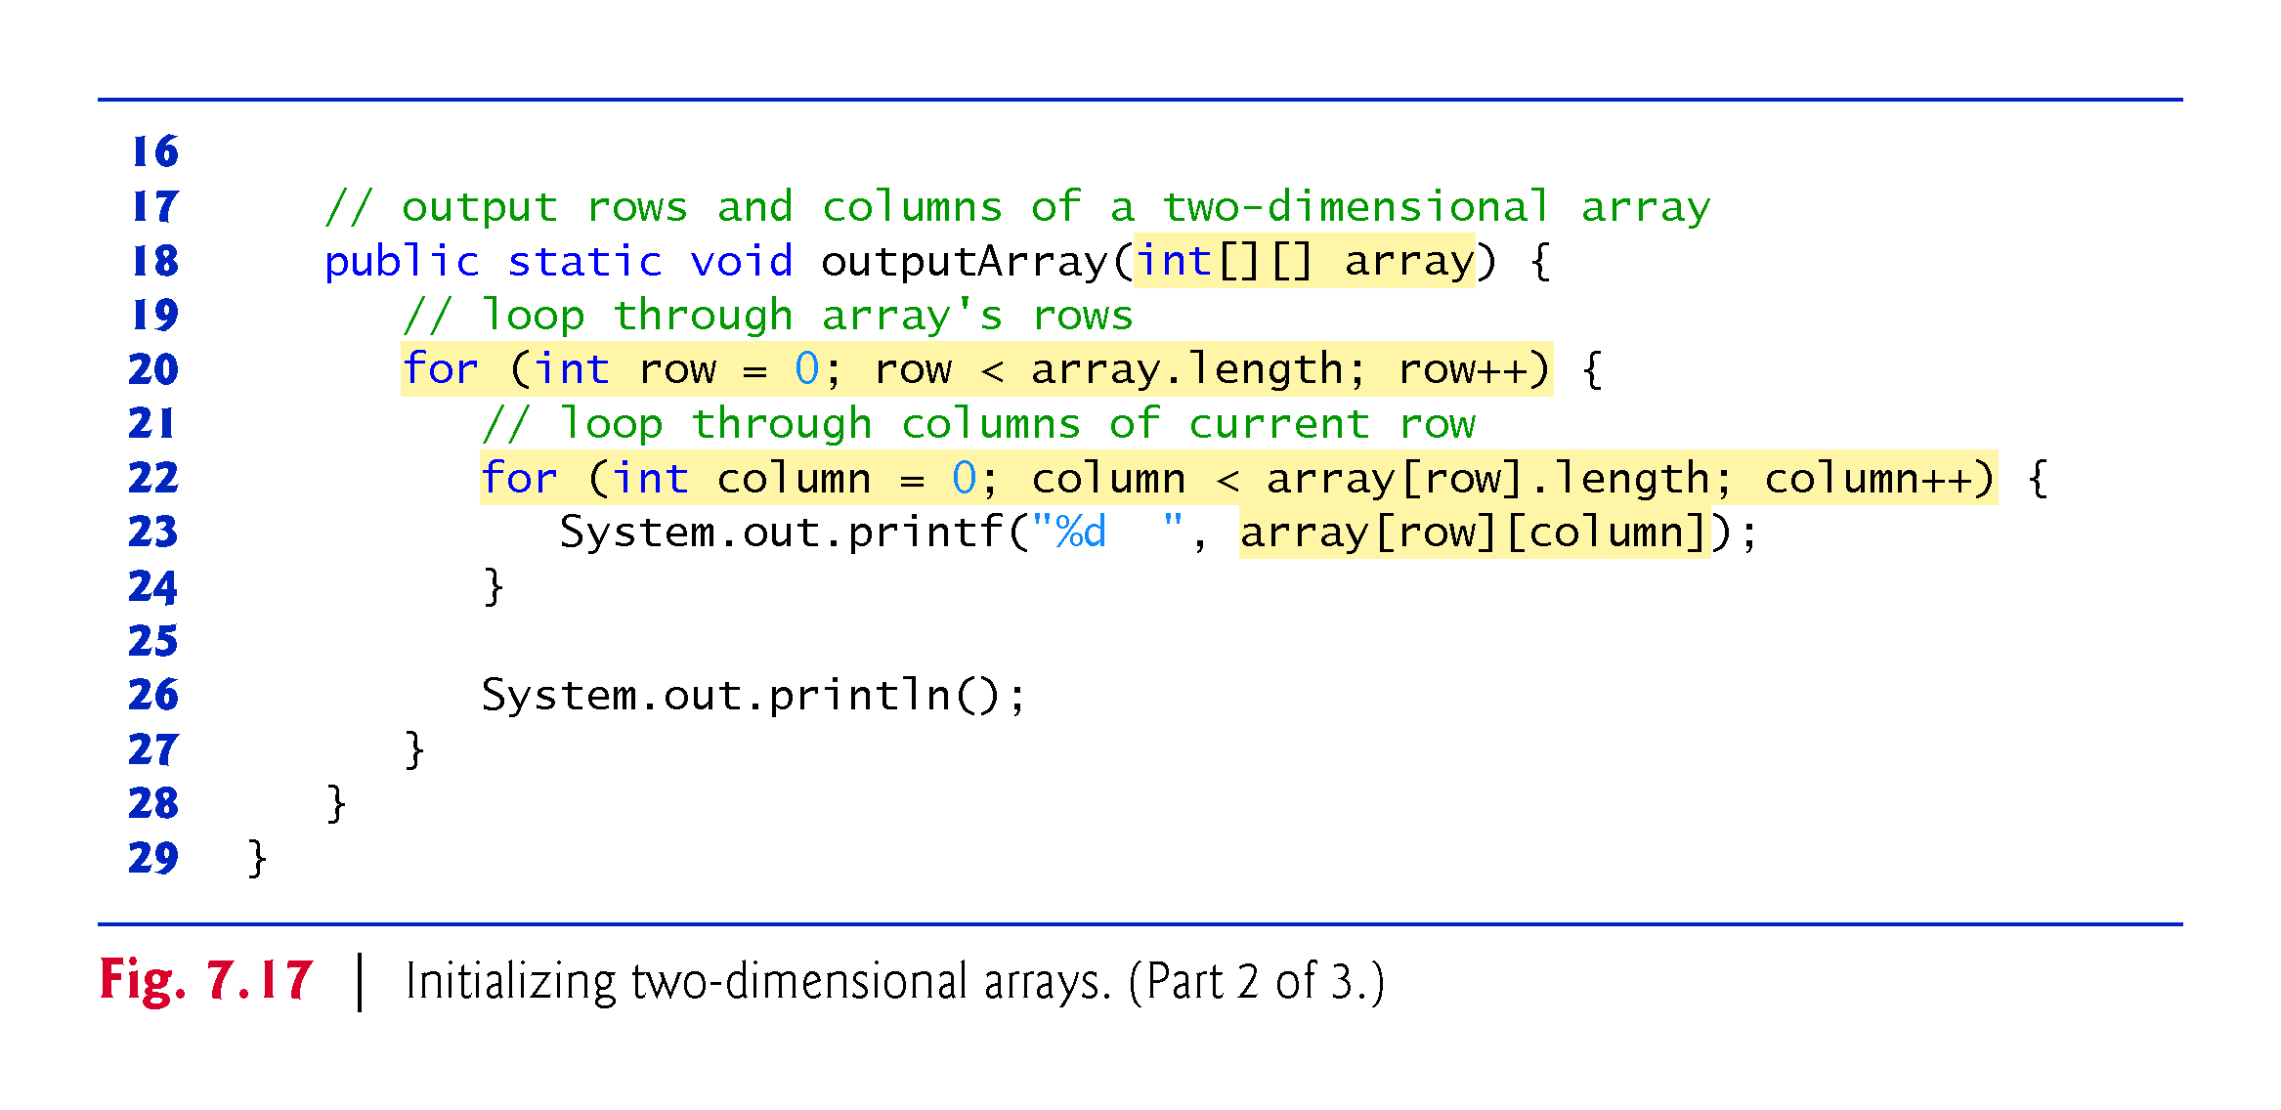

Slide 76
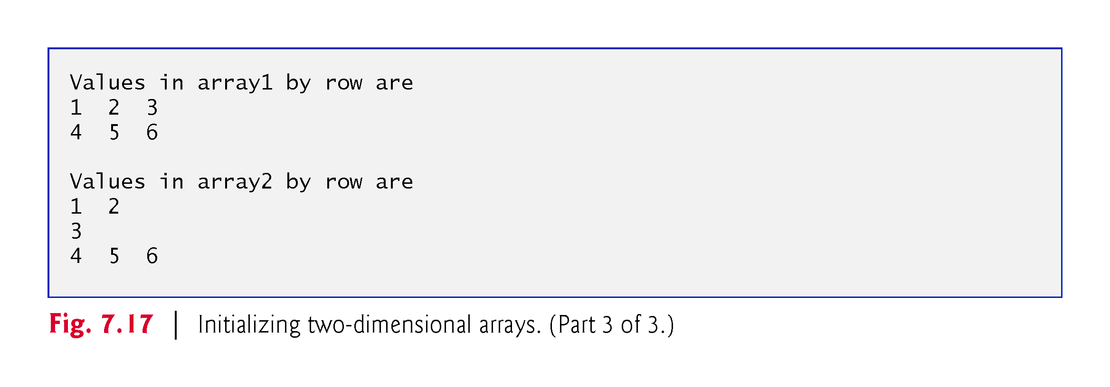

Slide 77
7.12 Case Study: Class GradeBook Using a Two-Dimensional Array
In most semesters, students take several exams.
Figure 7.18 contains a version of class GradeBook that uses a two-dimensional array grades to store the grades of several students on multiple exams.
Each row represents a student’s grades for the entire course.
Each column represents the grades of all the students who took a particular exam.
In this example, we use a ten-by-three array containing ten students’ grades on three exams.

Slide 78
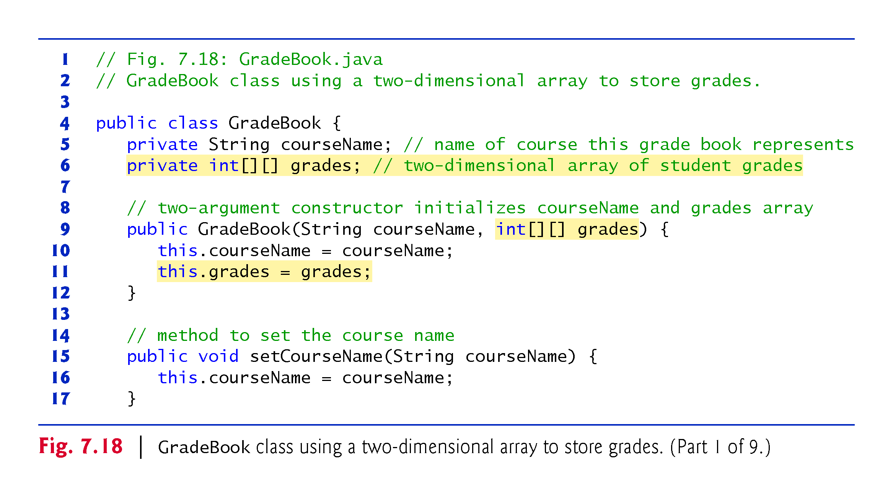

Slide 79
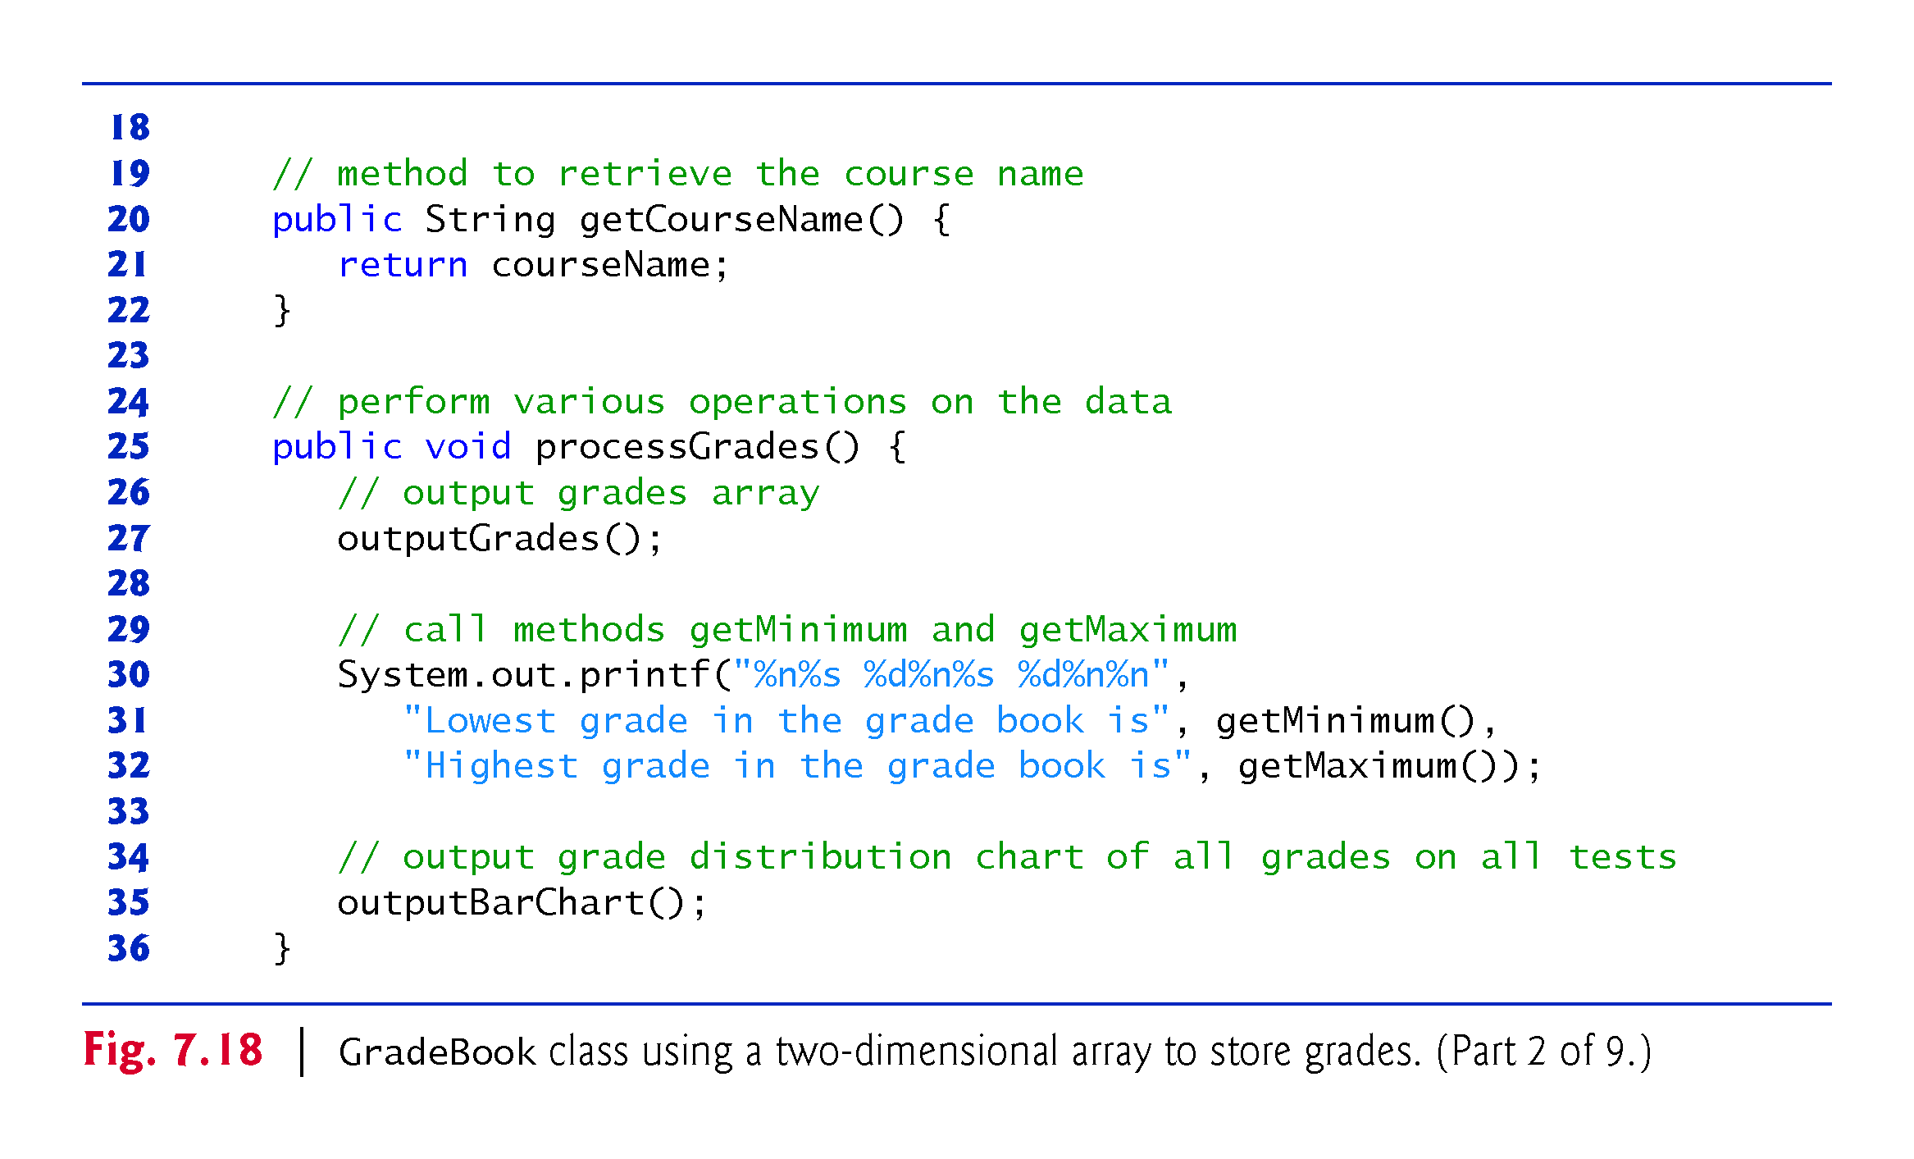

Slide 80
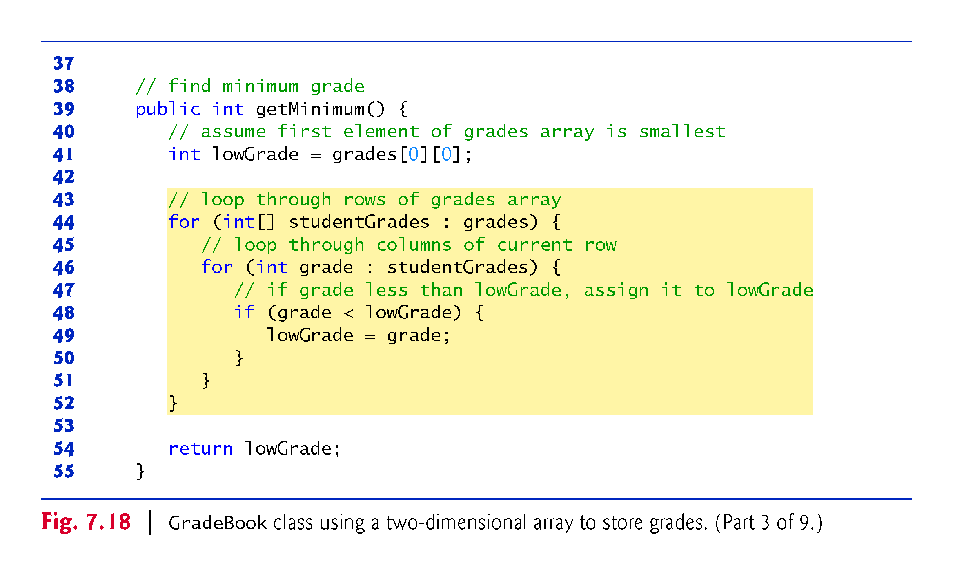

Slide 81
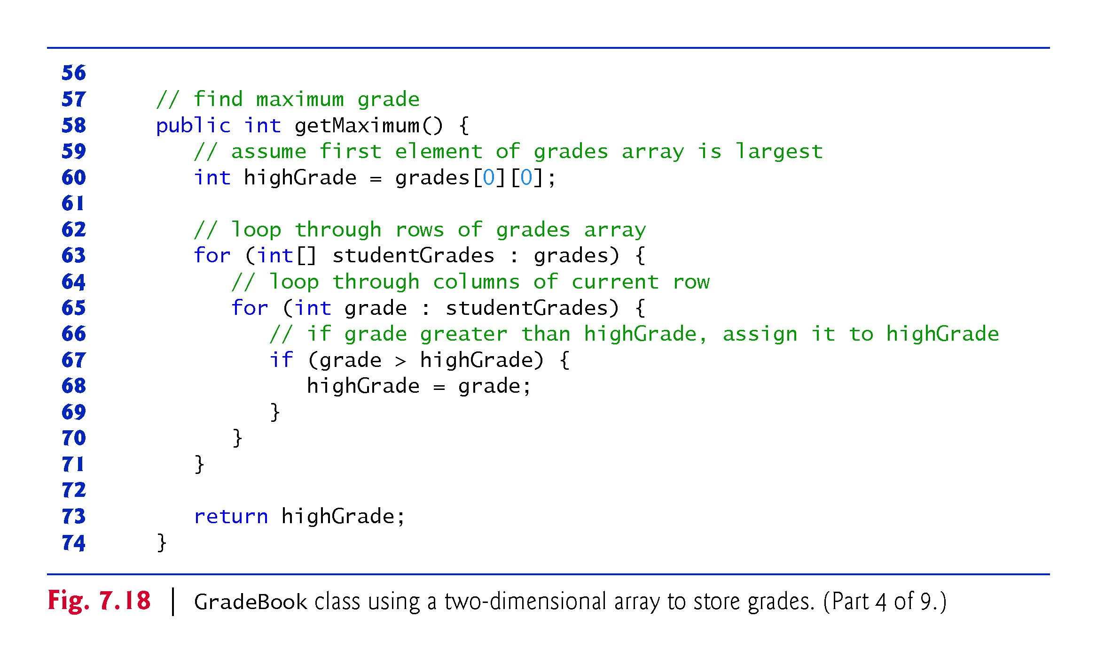

Slide 82
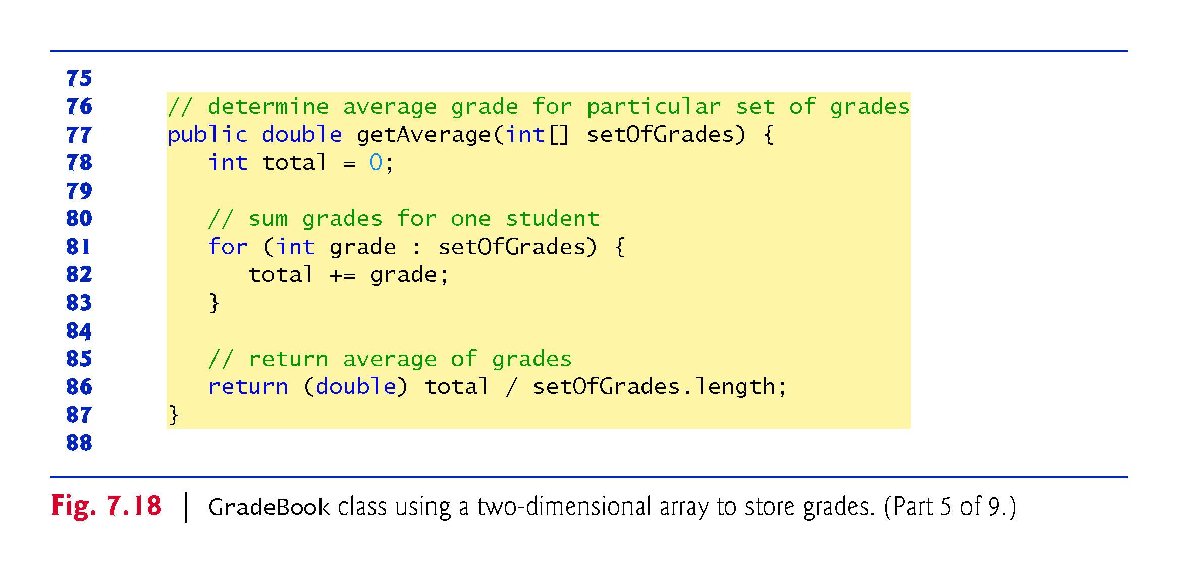

Slide 83
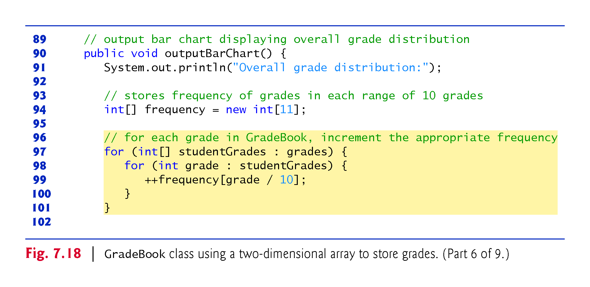

Slide 84
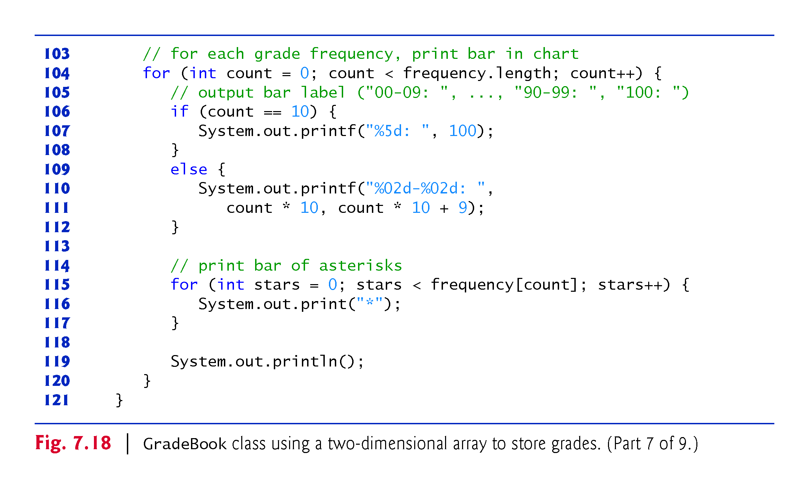

Slide 85
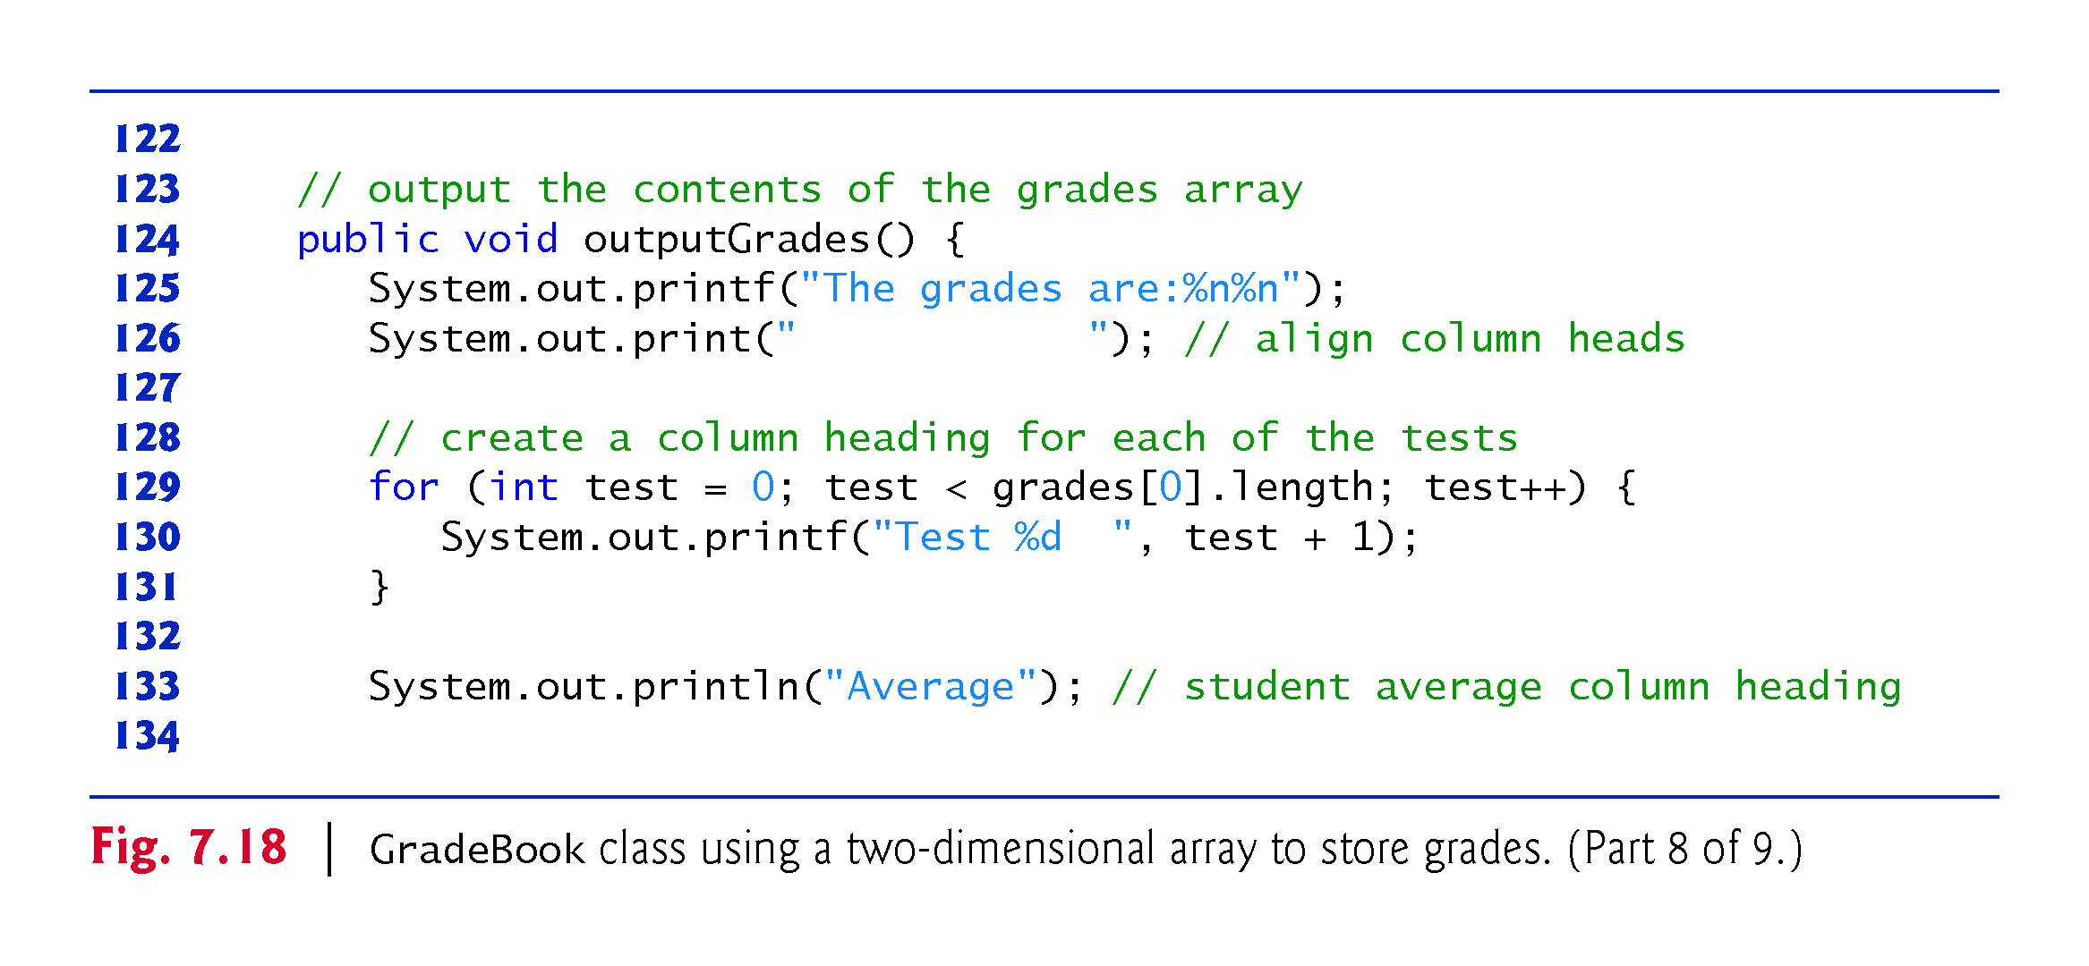

Slide 86


Slide 87


Slide 88


Slide 89


Slide 90


Slide 91
7.13 Variable-Length Argument Lists
Variable-length argument lists
Can be used to create methods that receive an unspecified number of arguments.
Parameter type followed by an ellipsis (...) indicates that the method receives a variable number of arguments of that particular type.
The ellipsis can occur only once at the end of a parameter list.

Slide 92


Slide 93


Slide 94


Slide 95
7.14 Using Command-Line Arguments
It’s possible to pass arguments from the command line to an application via method main’s String[] parameter, which receives an array of Strings.
Command-line arguments that appear after the class name in the java command are received by main in the String array args.
The number of command-line arguments is obtained by accessing the array’s length attribute.
Command-line arguments are separated by white space, not commas.

Slide 96


Slide 97


Slide 98


Slide 99


Slide 100
7.15 Class Arrays
Arrays class
Provides static methods for common array manipulations.
Methods include
sort for sorting an array (ascending order by default)
binarySearch for searching a sorted array
equals for comparing arrays
fill for placing values into an array.
Methods are overloaded for primitive-type arrays and for arrays of objects.
System class static arraycopy method
Copies contents of one array into another.

Slide 101


Slide 102


Slide 103


Slide 104


Slide 105


Slide 106
7.16 Introduction to Collections and Class ArrayList
Java API provides several predefined data structures, called collections, used to store groups of related objects in memory.
Each provides efficient methods that organize, store and retrieve your data without requiring knowledge of how the data is being stored.
Reduce application-development time.
Arrays do not automatically change their size at execution time to accommodate additional elements.
ArrayList<E> (package java.util) can dynamically change its size to accommodate more elements.
E is a placeholder for the type of element stored in the collection.
Classes with this kind of placeholder that can be used with any type are called generic classes.

Slide 107


Slide 108
7.16 Introduction to Collections and Class ArrayList (Cont.)
Figure 7.24 demonstrates some common ArrayList capabilities.
An ArrayList’s capacity indicates how many items it can hold without growing.
When the ArrayList grows, it must create a larger internal array and copy each element to the new array.
This is a time-consuming operation. It would be inefficient for the ArrayList to grow each time an element is added.
An ArrayList grows only when an element is added and the number of elements is equal to the capacity—i.e., there is no space for the new element.

Slide 109
7.16 Introduction to Collections and Class ArrayList (Cont.)
Method add adds elements to the ArrayList.
One-argument version appends its argument to the end of the ArrayList.
Two-argument version inserts a new element at the specified position.
Collection indices start at zero.
Method size returns the number of elements in the ArrayList.
Method get obtains the element at a specified index.
Method remove deletes an element with a specific value.
An overloaded version of the method removes the element at the specified index.
Method contains determines if an item is in the ArrayList.

Slide 110


Slide 111


Slide 112


Slide 113


Slide 114
7.16 Introduction to Collections and Class ArrayList (Cont.)
Java SE 7—Diamond (<>) Notation for Creating an Object of a Generic Class
Consider this statement from Fig. 7.24:
ArrayList<String> items = new ArrayList<String>();
Notice that ArrayList<String> appears in the variable declaration and in the class instance creation expression. Java SE 7 introduced the diamond (<>) notation to simplify statements like this. Using <> in a class instance creation expression for an object of a generic class tells the compiler to determine what belongs in the angle brackets.

Slide 115
7.16 Introduction to Collections and Class ArrayList (Cont.)
In Java SE 7 and higher, the preceding statement can be written as:
ArrayList<String> items = new ArrayList<>();
When the compiler encounters the diamond (<>) in the class instance creation expression, it uses the declaration of variable items to determine the ArrayList’s element type (String)—this is known as inferring the element type.

