Slide 1
Chapter 10 Object-Oriented Programming: Polymorphism and Interfaces
Java How to Program, 11/e
Questions? E-mail paul.deitel@deitel.com

Slide 2
10.1 Introduction
Polymorphism
Enables you to “program in the general” rather than “program in the specific.”
Polymorphism enables you to write programs that process objects that share the same superclass as if they were all objects of the superclass; this can simplify programming.

Slide 3
10.2 Polymorphism Examples
Example: Quadrilaterals
If Rectangle is derived from Quadrilateral, then a Rectangle object is a more specific version of a Quadrilateral.
Any operation that can be performed on a Quadrilateral can also be performed on a Rectangle.
These operations can also be performed on other Quadrilaterals, such as Squares, Parallelograms and Trapezoids.
Polymorphism occurs when a program invokes a method through a superclass Quadrilateral variable—at execution time, the correct subclass version of the method is called, based on the type of the reference stored in the superclass variable.

Slide 4
10.3 Demonstrating Polymorphic Behavior
In the next example, we aim a superclass reference at a subclass object.
Invoking a method on a subclass object via a superclass reference invokes the subclass functionality
The type of the referenced object, not the type of the variable, determines which method is called
This example demonstrates that an object of a subclass can be treated as an object of its superclass, enabling various interesting manipulations.
A program can create an array of superclass variables that refer to objects of many subclass types.
Allowed because each subclass object is an object of its superclass.

Slide 5
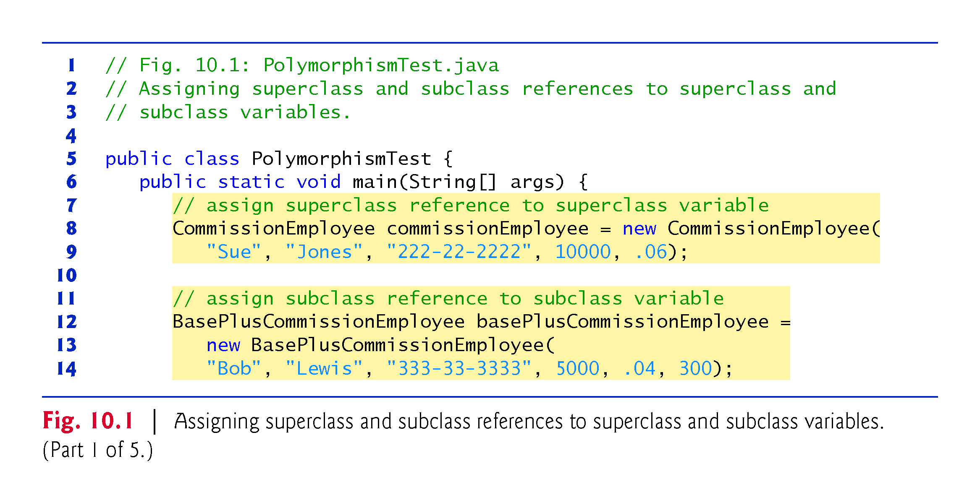

Slide 6
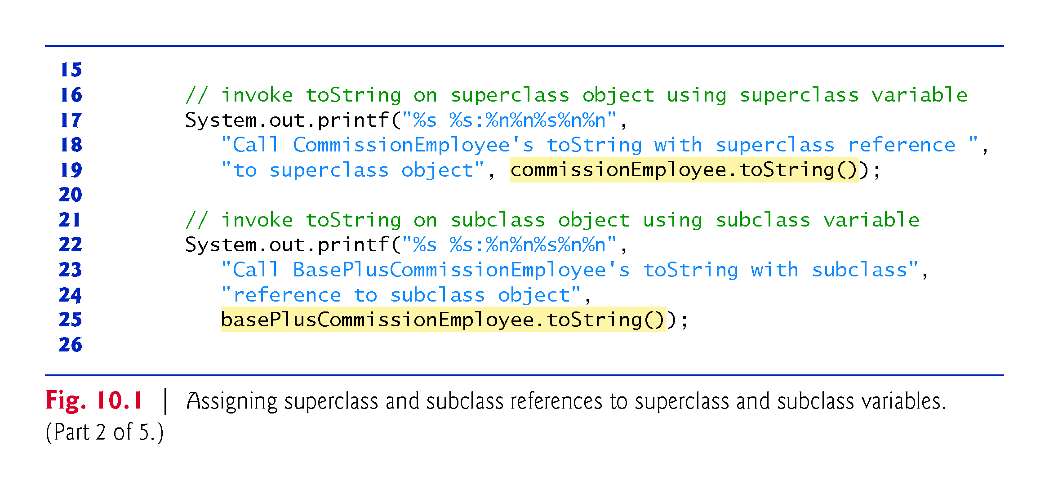

Slide 7
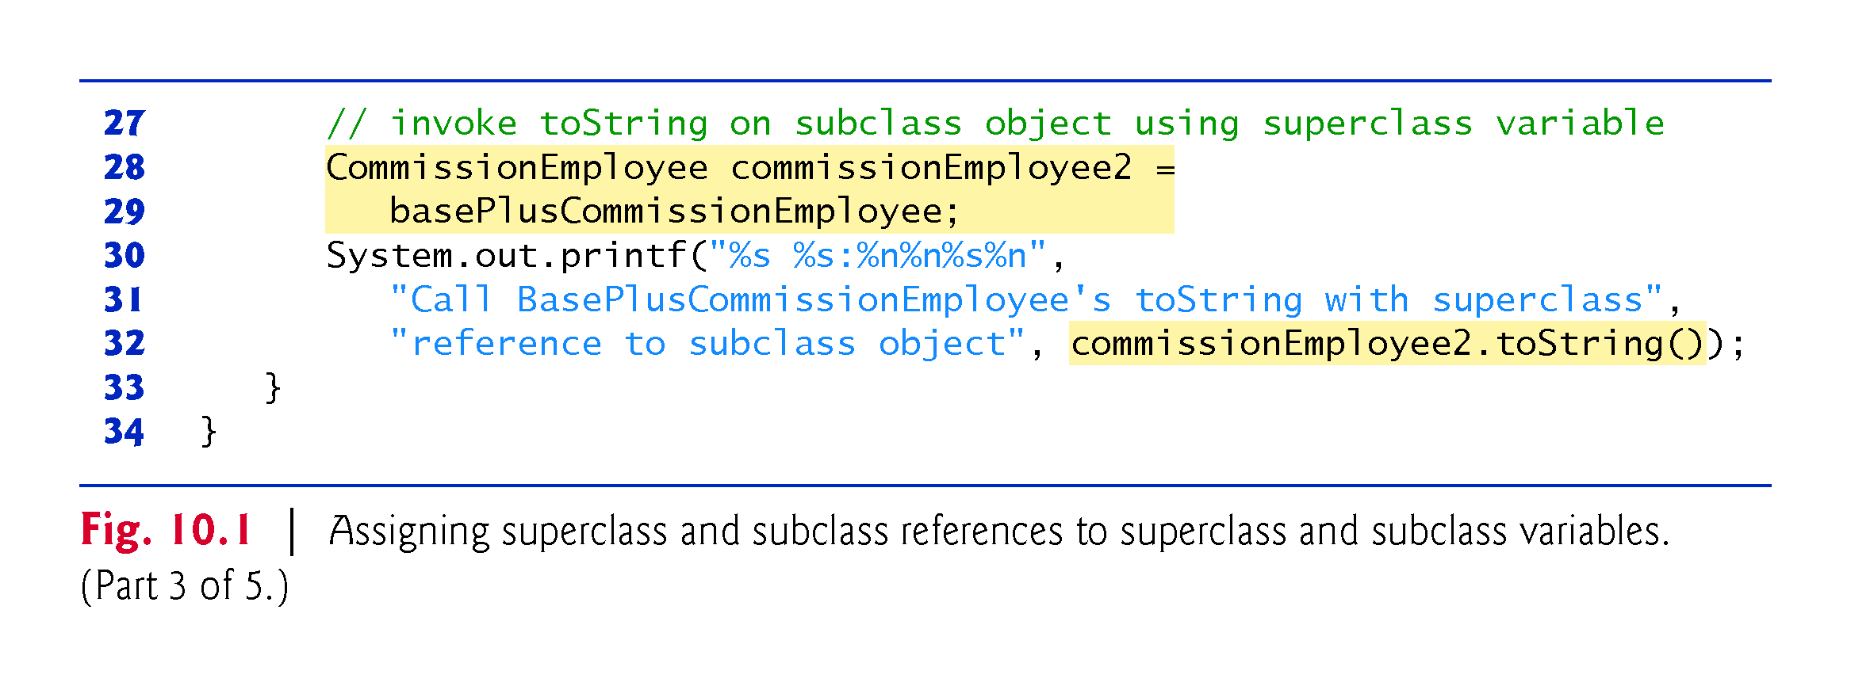

Slide 8
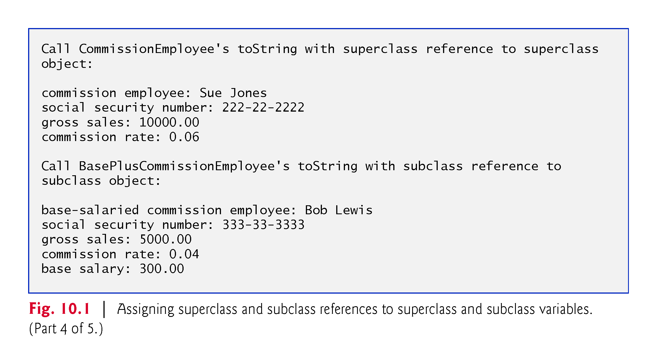

Slide 9
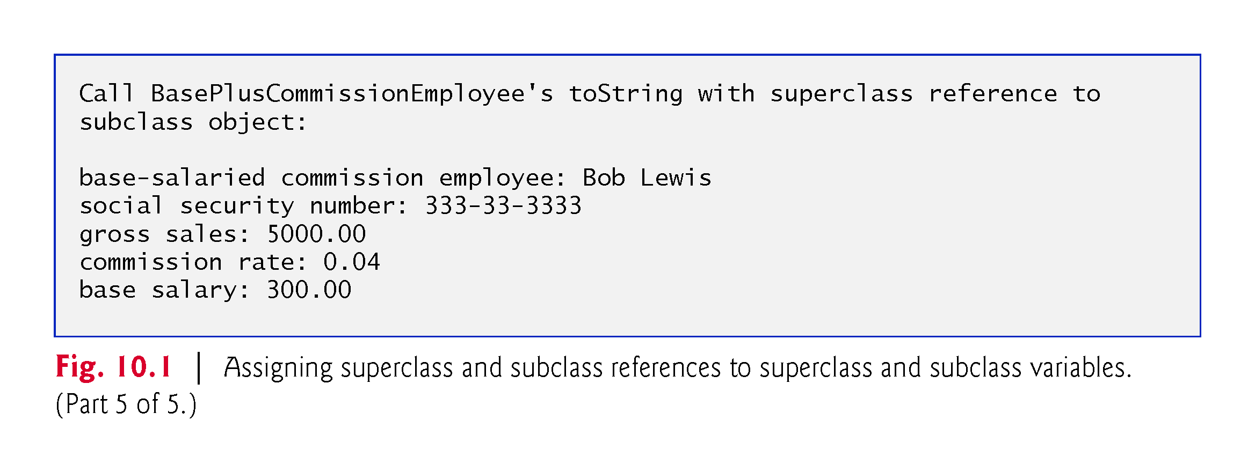

Slide 10
10.3 Demonstrating Polymorphic Behavior (Cont.)
When a superclass variable contains a reference to a subclass object, and that reference is used to call a method, the subclass version of the method is called.
Determined during run time (see below).
When the compiler encounters a method call made through a variable, the compiler determines if the method can be called by checking the variable’s class type.
At execution time, the type of the object to which the variable refers determines the actual method to use.
This process is called dynamic binding.

Slide 11
10.4 Abstract Classes and Methods
Abstract classes
Sometimes it’s useful to declare classes for which you never intend to create objects.
Used only as superclasses in inheritance hierarchies, so they are sometimes called abstract superclasses.
Cannot be used to instantiate objects—abstract classes are incomplete.
Subclasses must declare the “missing pieces” to become “concrete” classes, from which you can instantiate objects; otherwise, these subclasses, too, will be abstract.
An abstract class provides a superclass from which other classes can inherit and thus share a common design.

Slide 12
10.4 Abstract Classes and Methods (Cont.)
Classes that can be used to instantiate objects are called concrete classes.
Such classes provide implementations of every method they declare (some of the implementations can be inherited).
Abstract superclasses are too general to create real objects—they specify only what is common among subclasses.

Slide 13
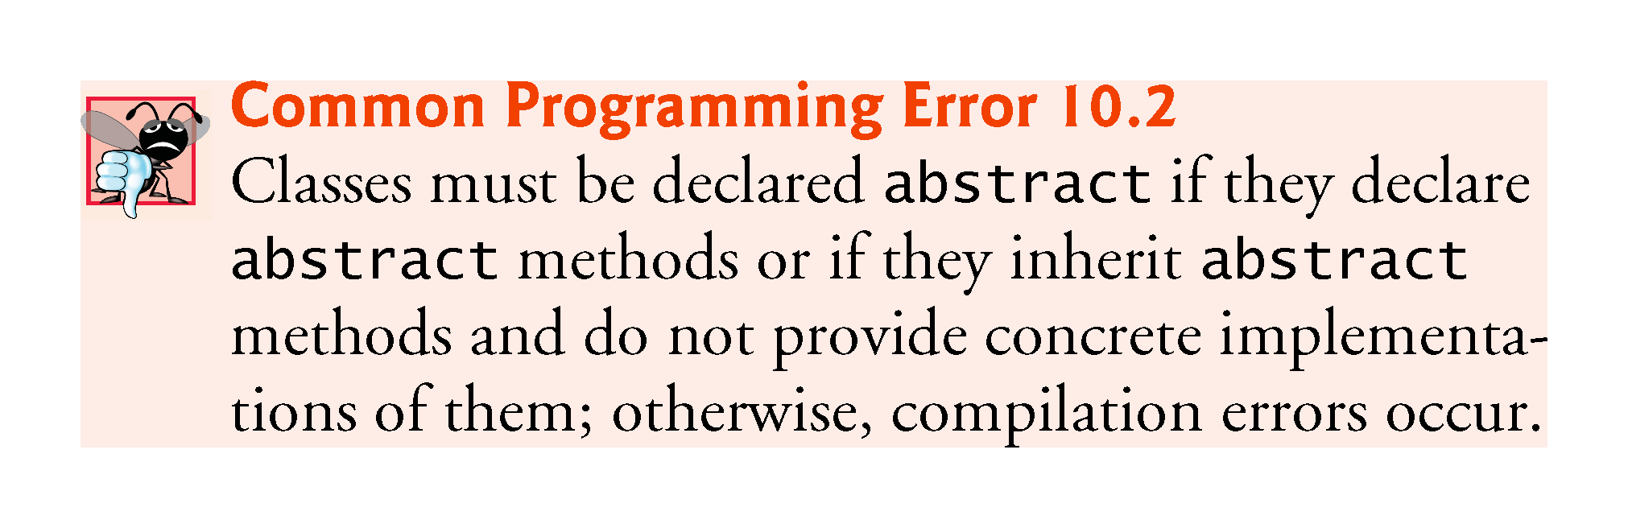

Slide 14
10.5 Case Study: Payroll System Using Polymorphism
Use an abstract method and polymorphism to perform payroll calculations based on the type of inheritance hierarchy headed by an employee.
Enhanced employee inheritance hierarchy requirements:
A company pays its employees on a weekly basis. The employees are of four types: Salaried employees are paid a fixed weekly salary regardless of the number of hours worked, hourly employees are paid by the hour and receive overtime pay (i.e., 1.5 times their hourly salary rate) for all hours worked in excess of 40 hours, commission employees are paid a percentage of their sales and base-salaried commission employees receive a base salary plus a percentage of their sales. For the current pay period, the company has decided to reward base-salaried commission employees by adding 10% to their base salaries. The company wants you to write a Java application that performs its payroll calculations polymorphically.

Slide 15
10.5 Case Study: Payroll System Using Polymorphism (Cont.)
abstract class Employee represents the general concept of an employee.
Subclasses: SalariedEmployee, CommissionEmployee , HourlyEmployee and BasePlusCommissionEmployee (an indirect subclass)
Fig. 10.2 shows the inheritance hierarchy for our polymorphic employee-payroll application.
Abstract class names are italicized in the UML.

Slide 16
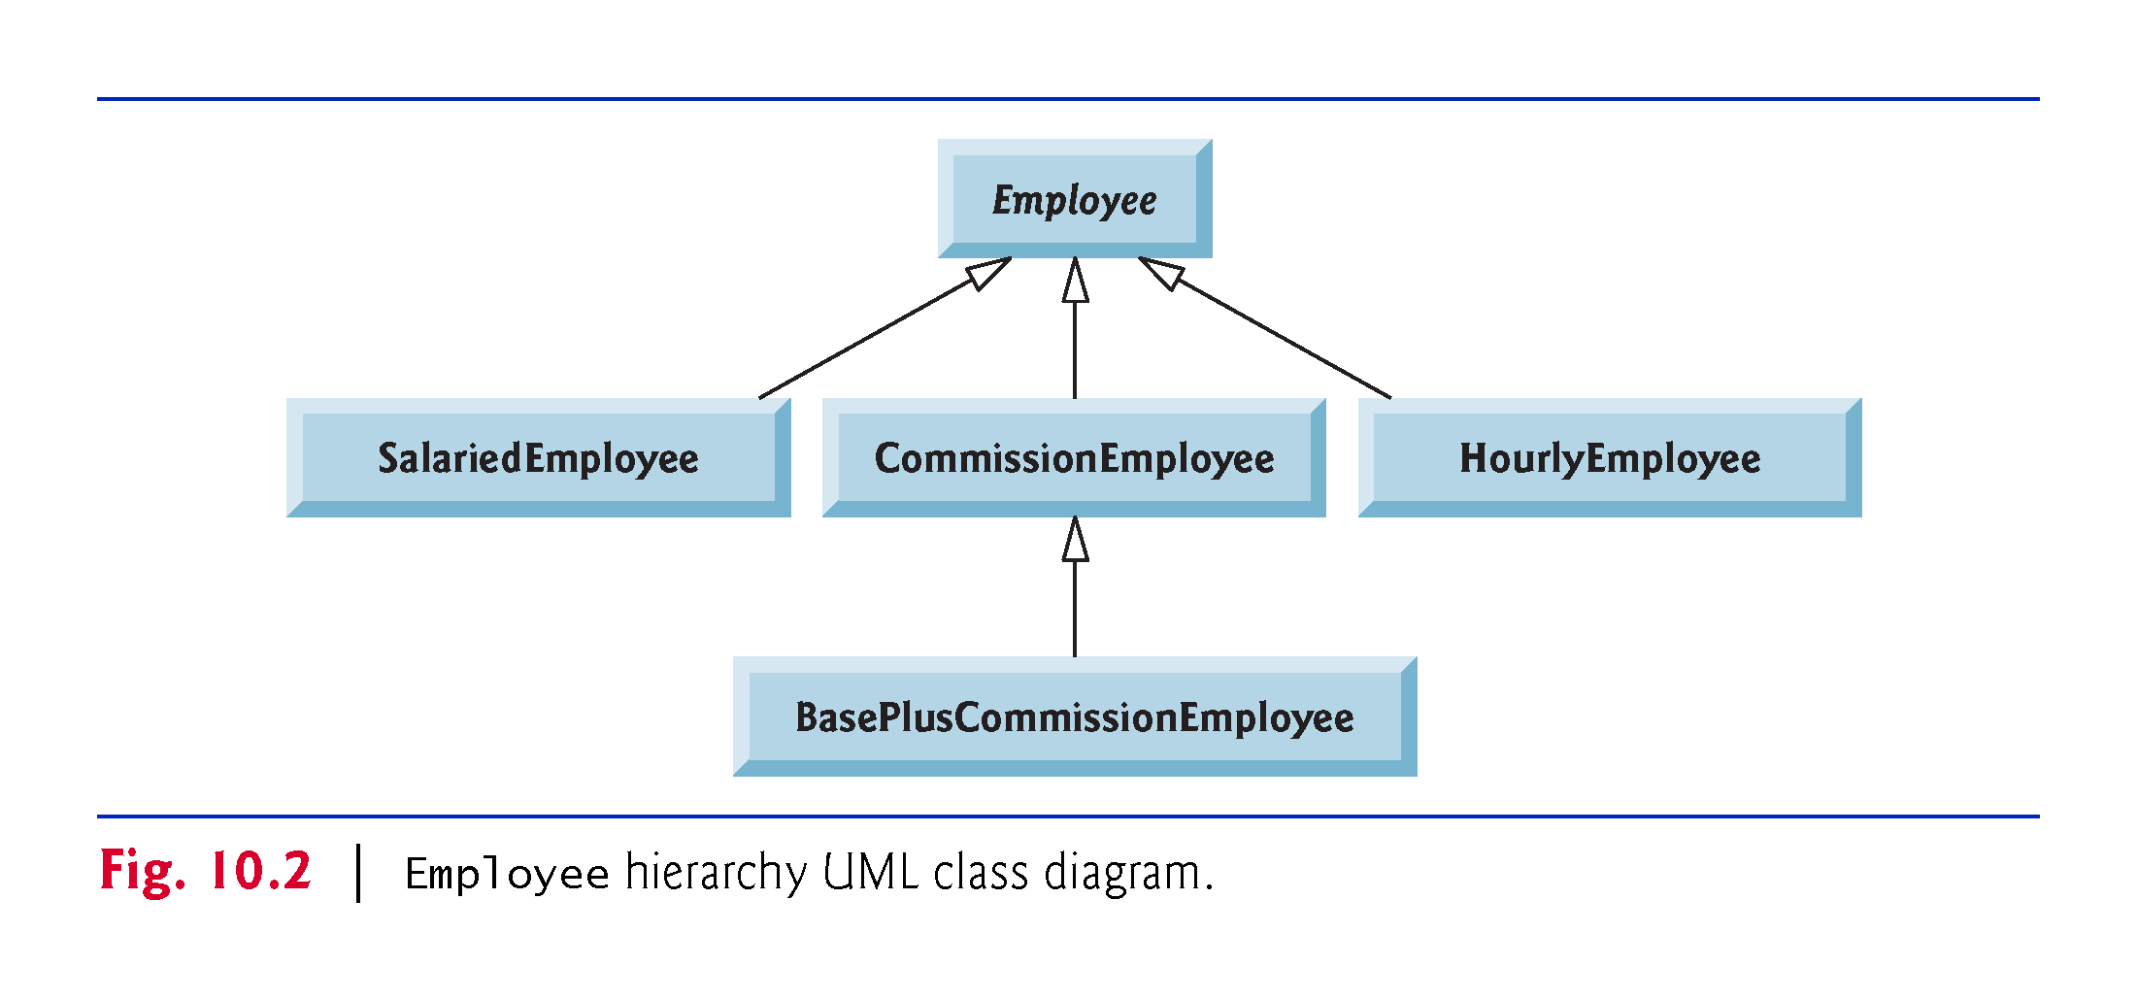

Slide 17
10.5 Case Study: Payroll System Using Polymorphism (Cont.)
Abstract superclass Employee declares the “interface” to the hierarchy—that is, the set of methods that a program can invoke on all Employee objects.
We use the term “interface” here in a general sense to refer to the various ways programs can communicate with objects of any Employee subclass.
Each employee has a first name, a last name and a social security number defined in abstract superclass Employee.

Slide 18
10.5.1 Abstract Superclass Employee
Class Employee (Fig. 10.4) provides methods earnings and toString, in addition to the get and set methods that manipulate Employee’s instance variables.
An earnings method applies to all employees, but each earnings calculation depends on the employee’s class.
An abstract method—there is not enough information to determine what amount earnings should return.
Each subclass overrides earnings with an appropriate implementation.

Slide 19
10.5.1 Abstract Superclass Employee (Cont.)
The diagram in Fig. 10.3 shows each of the five classes in the hierarchy down the left side and methods earnings and toString across the top.
For each class, the diagram shows the desired results of each method.
Declaring the earnings method abstract indicates that each concrete subclass must provide an appropriate earnings implementation and that a program will be able to use superclass Employee variables to invoke method earnings polymorphically for any type of Employee.

Slide 20
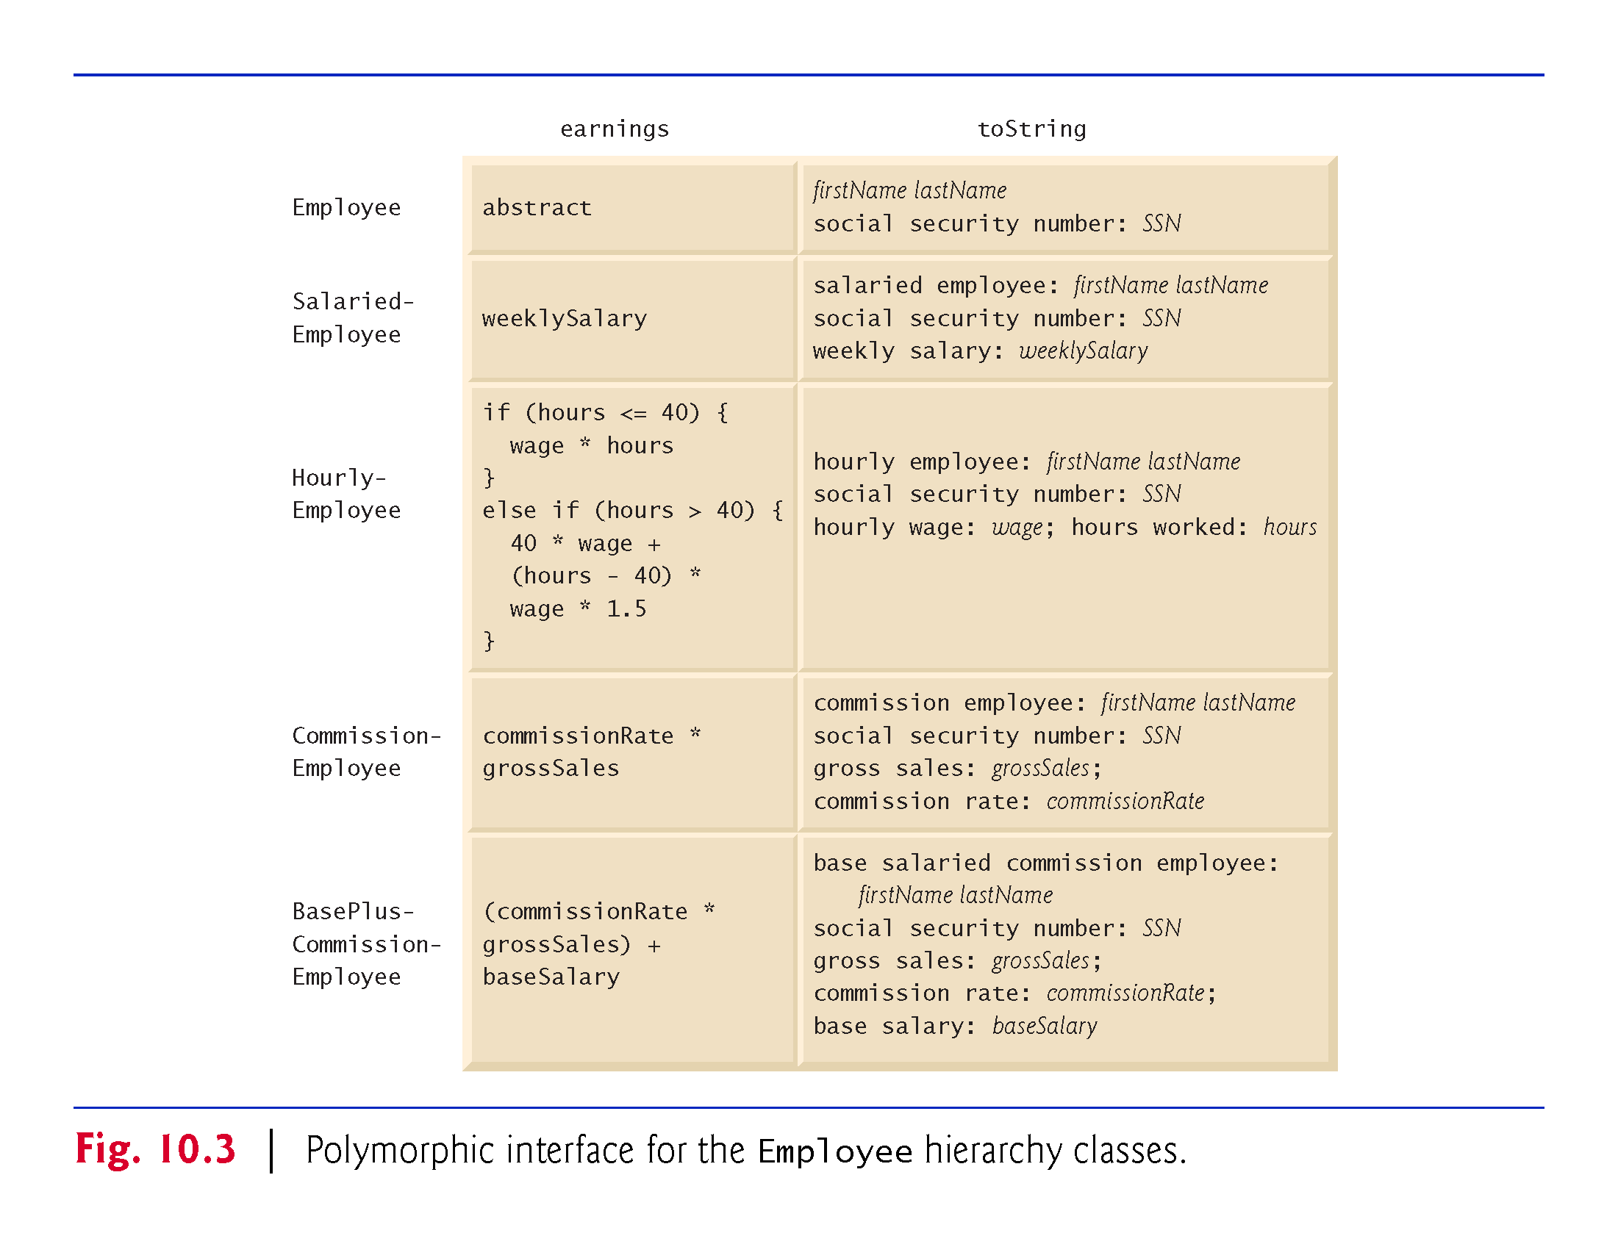

Slide 21
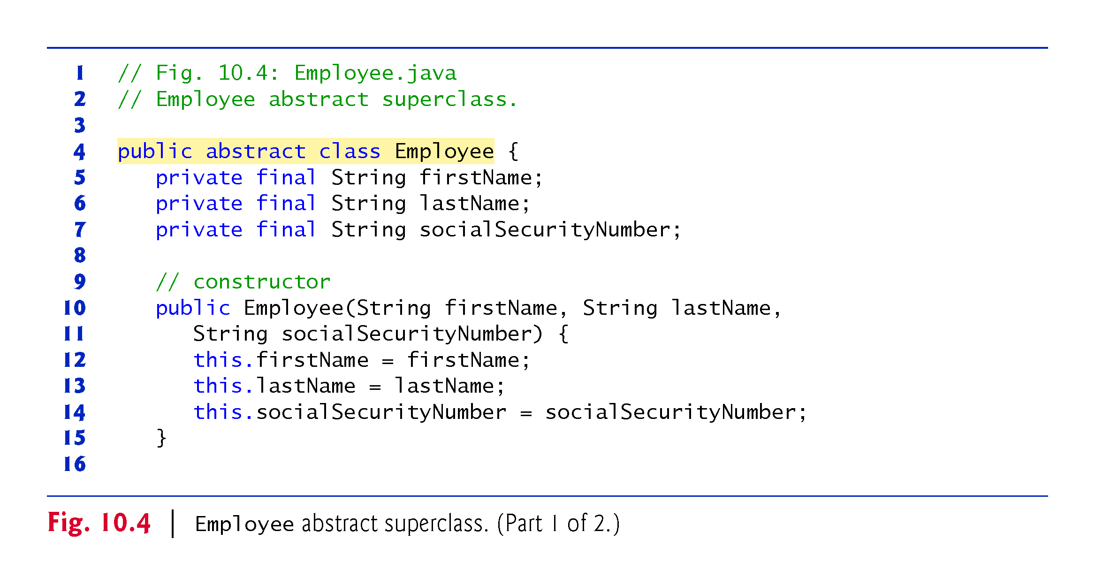

Slide 22
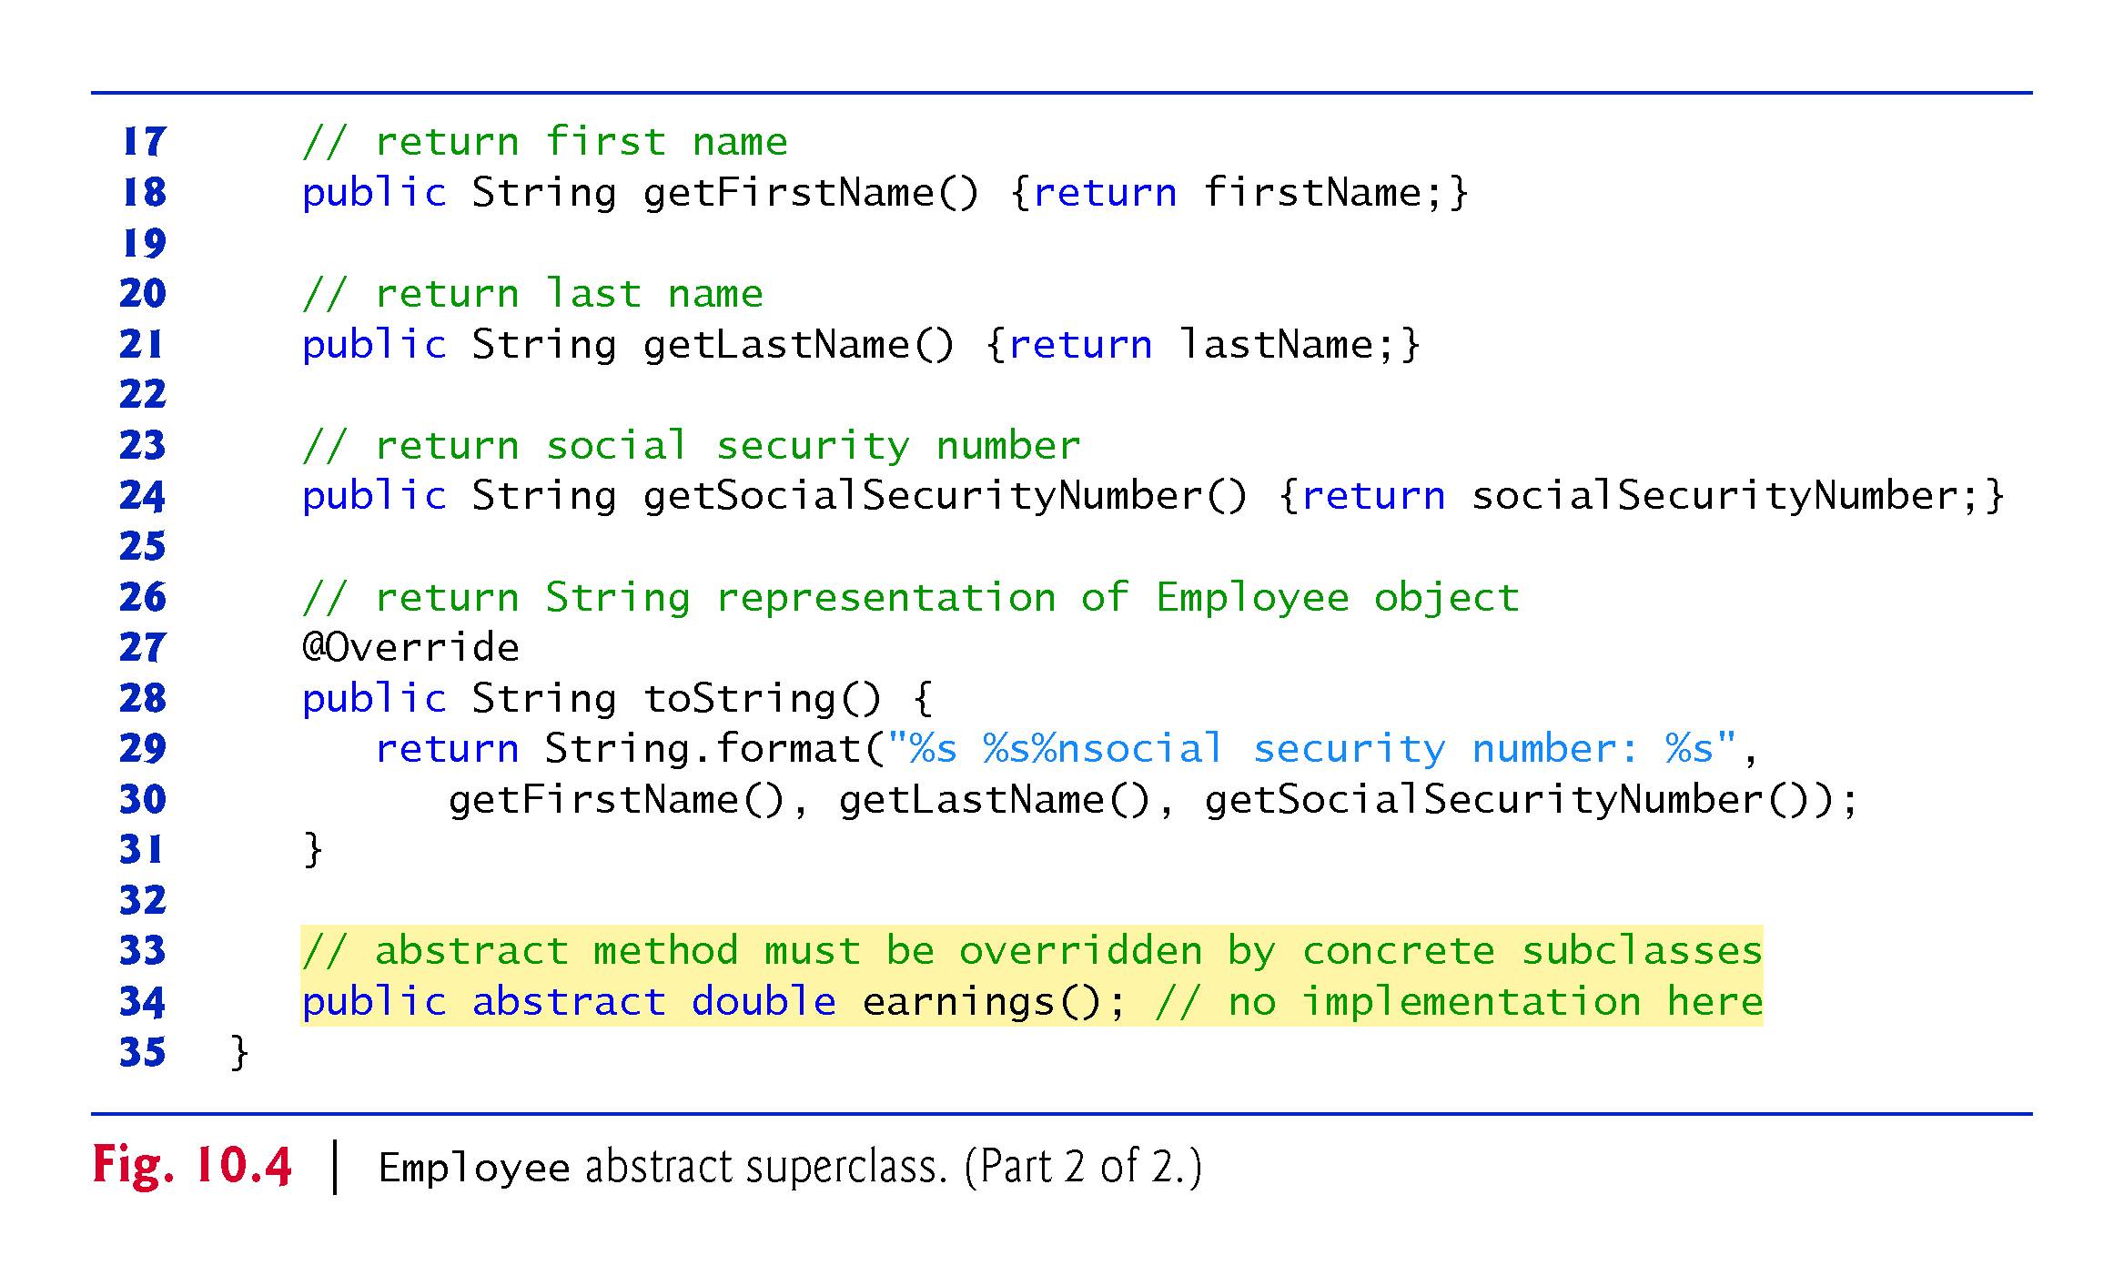

Slide 23
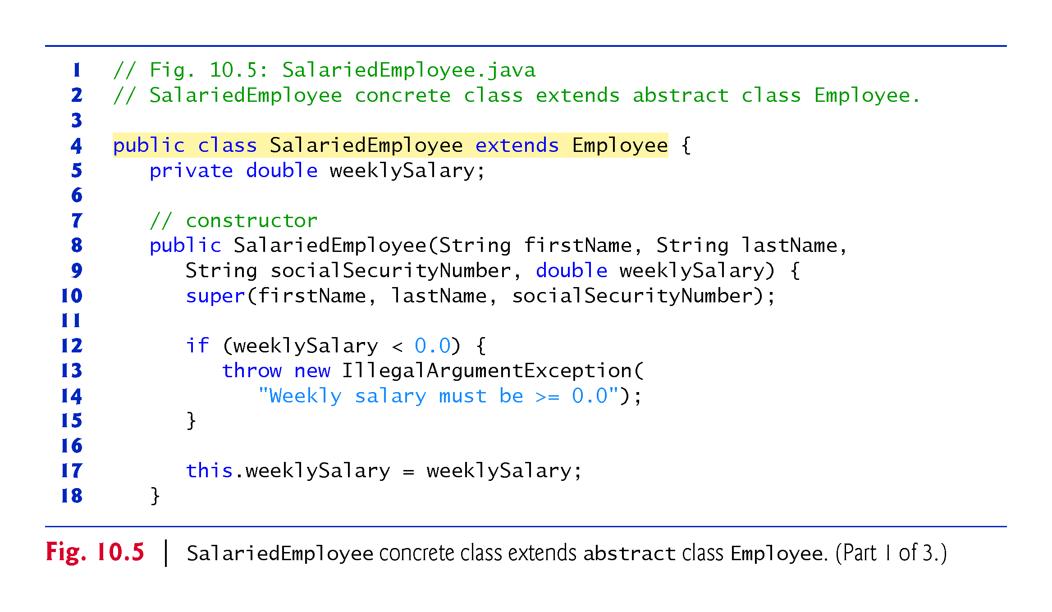

Slide 24
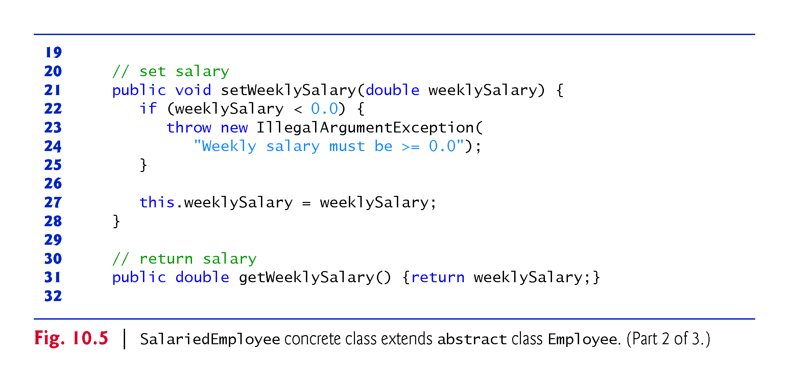

Slide 25
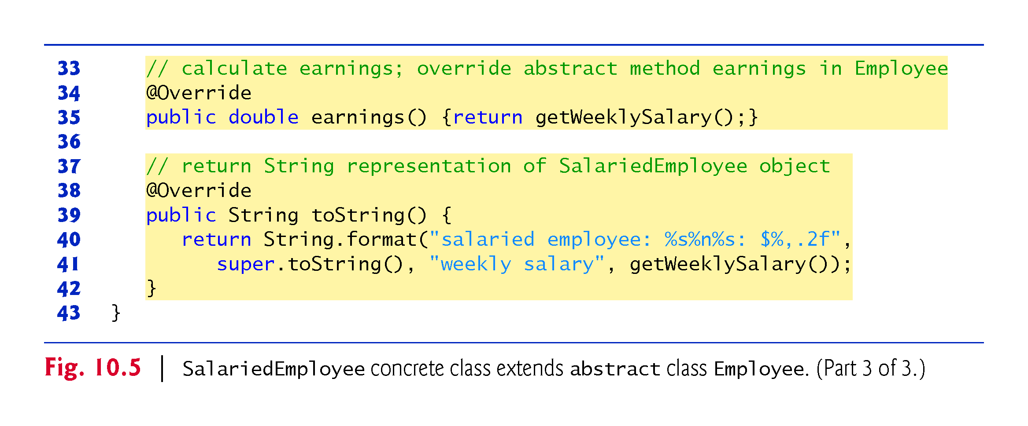

Slide 26
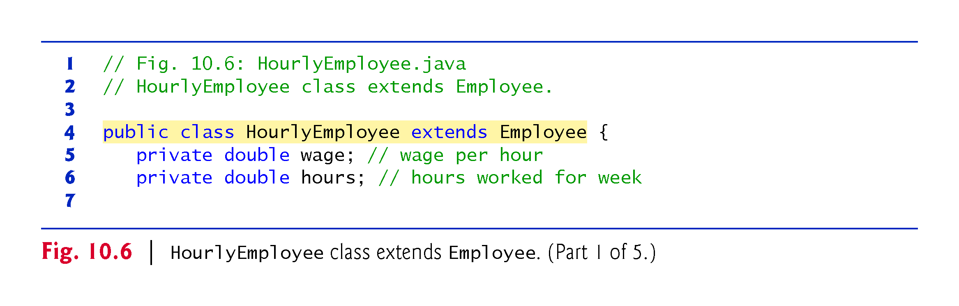

Slide 27
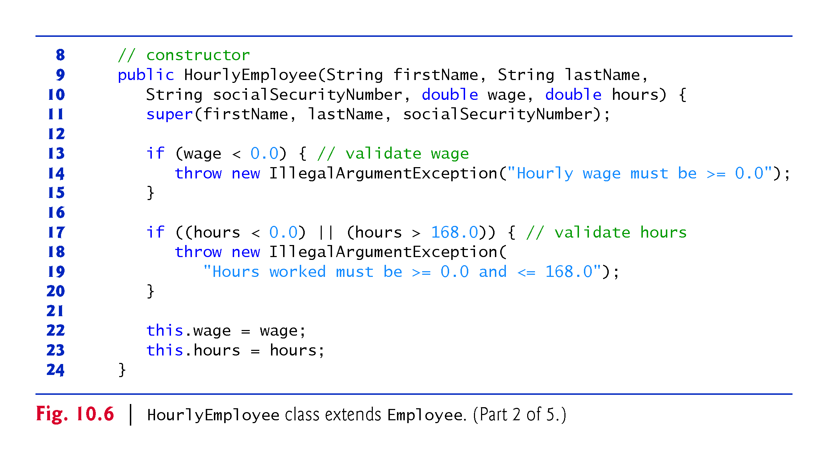

Slide 28
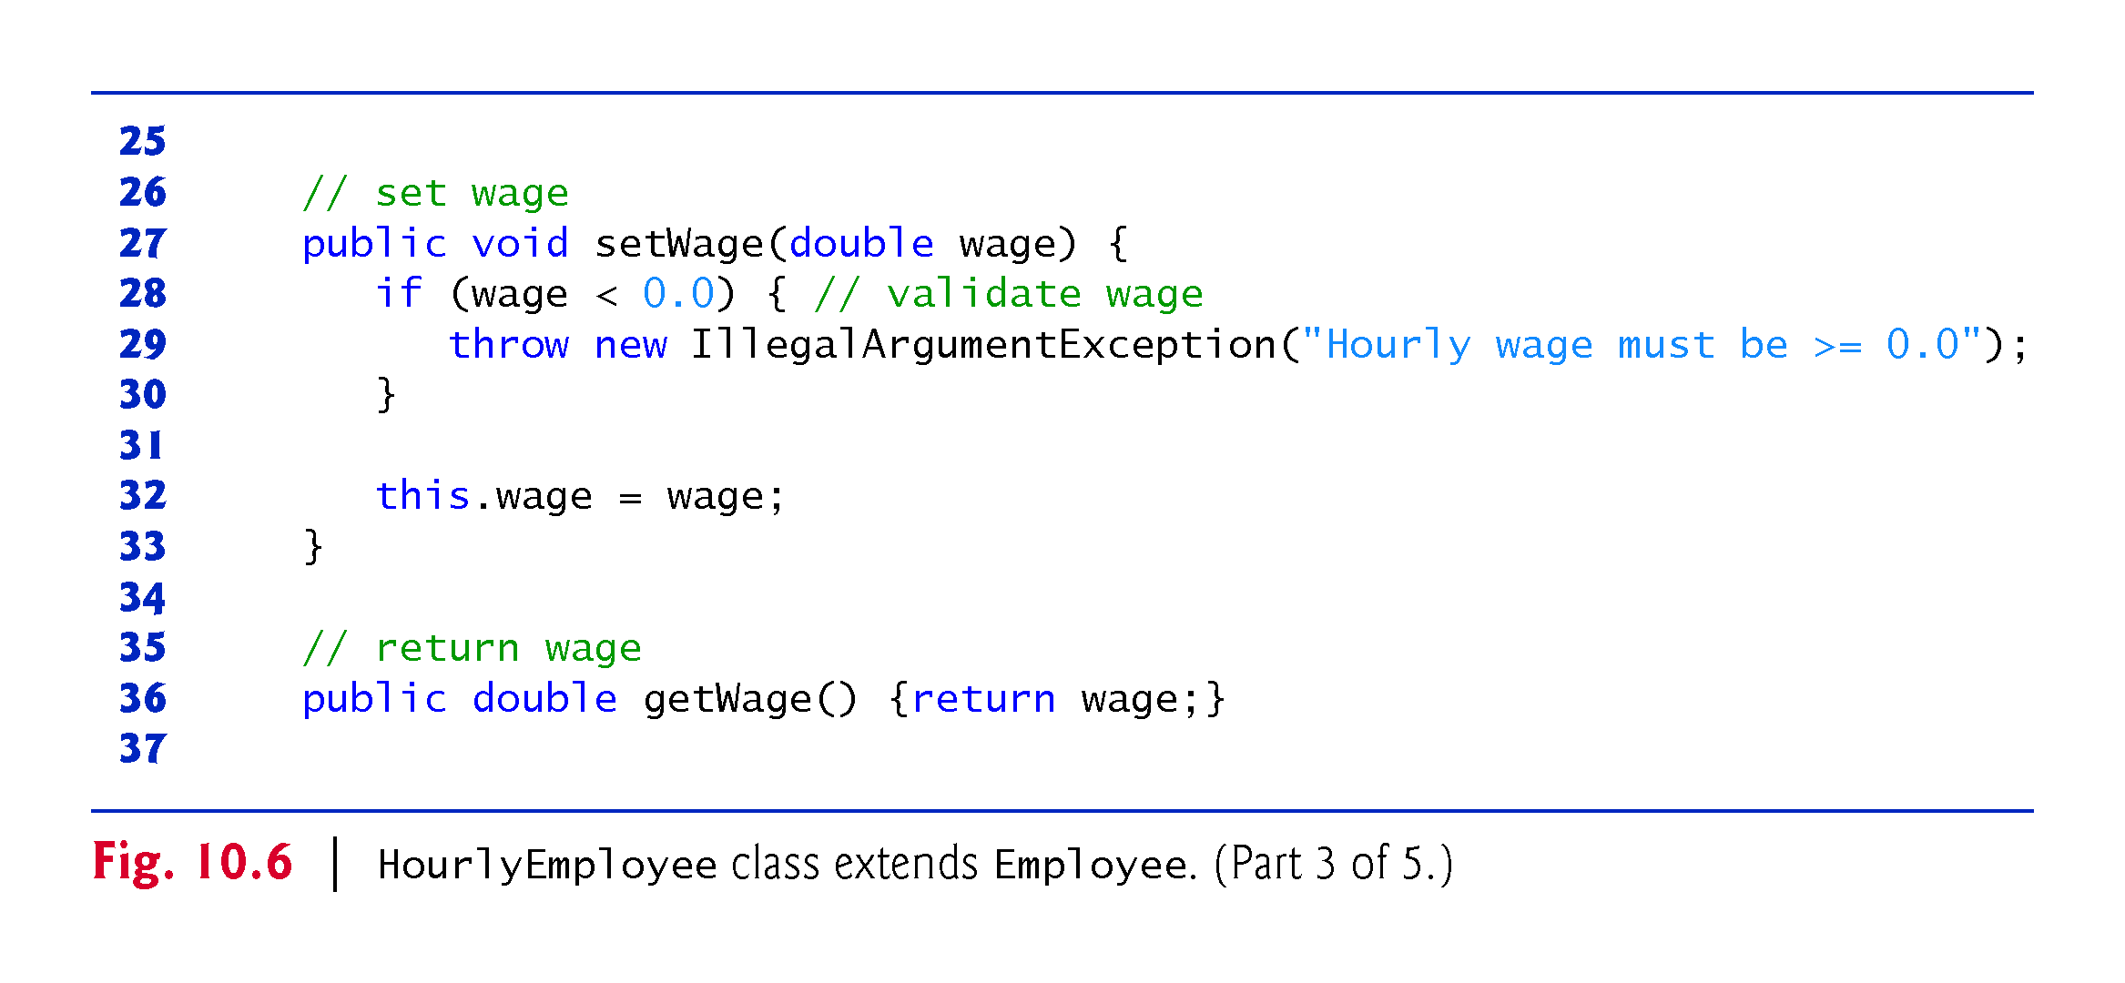

Slide 29
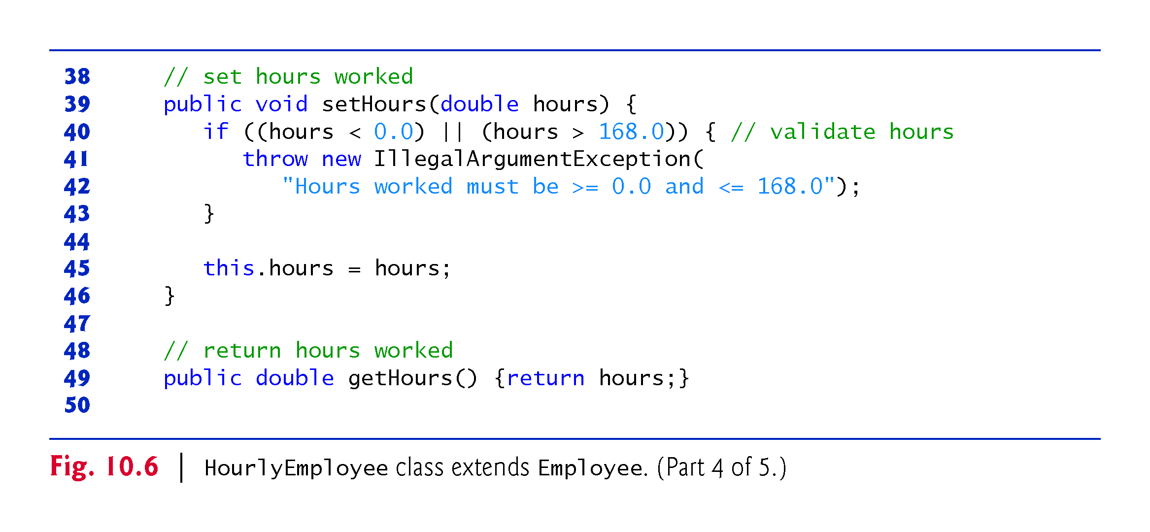

Slide 30
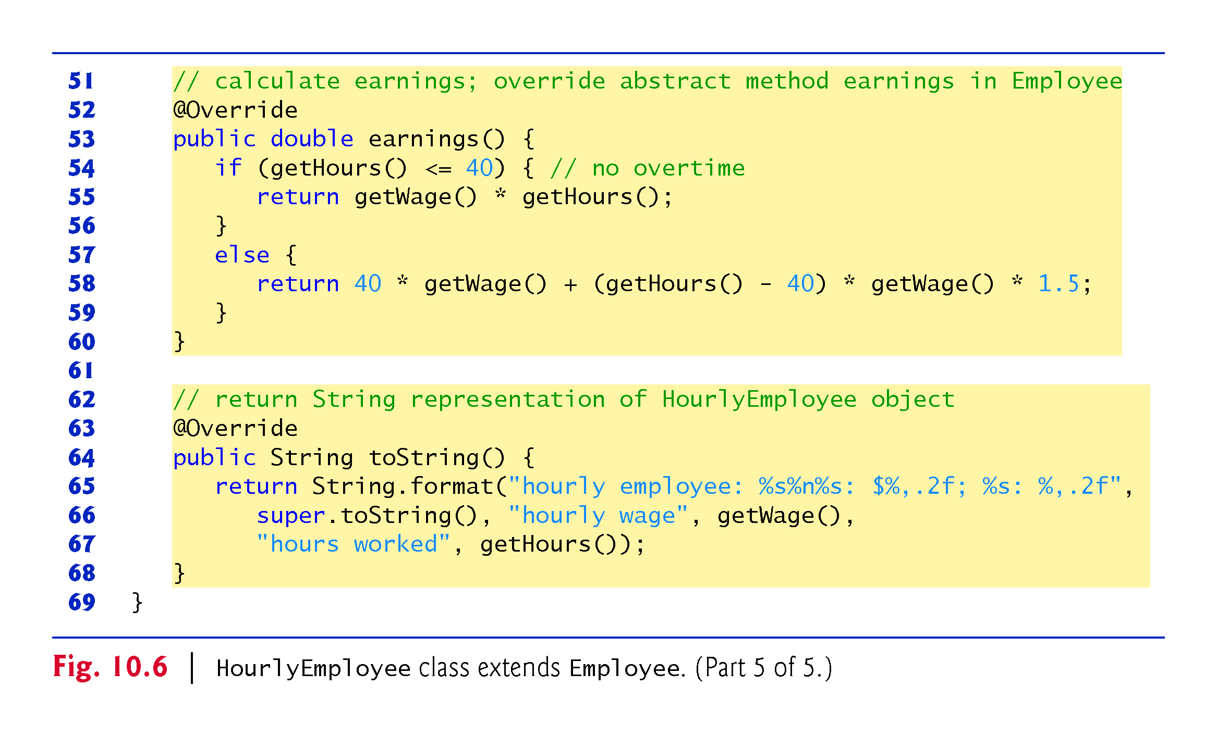

Slide 31
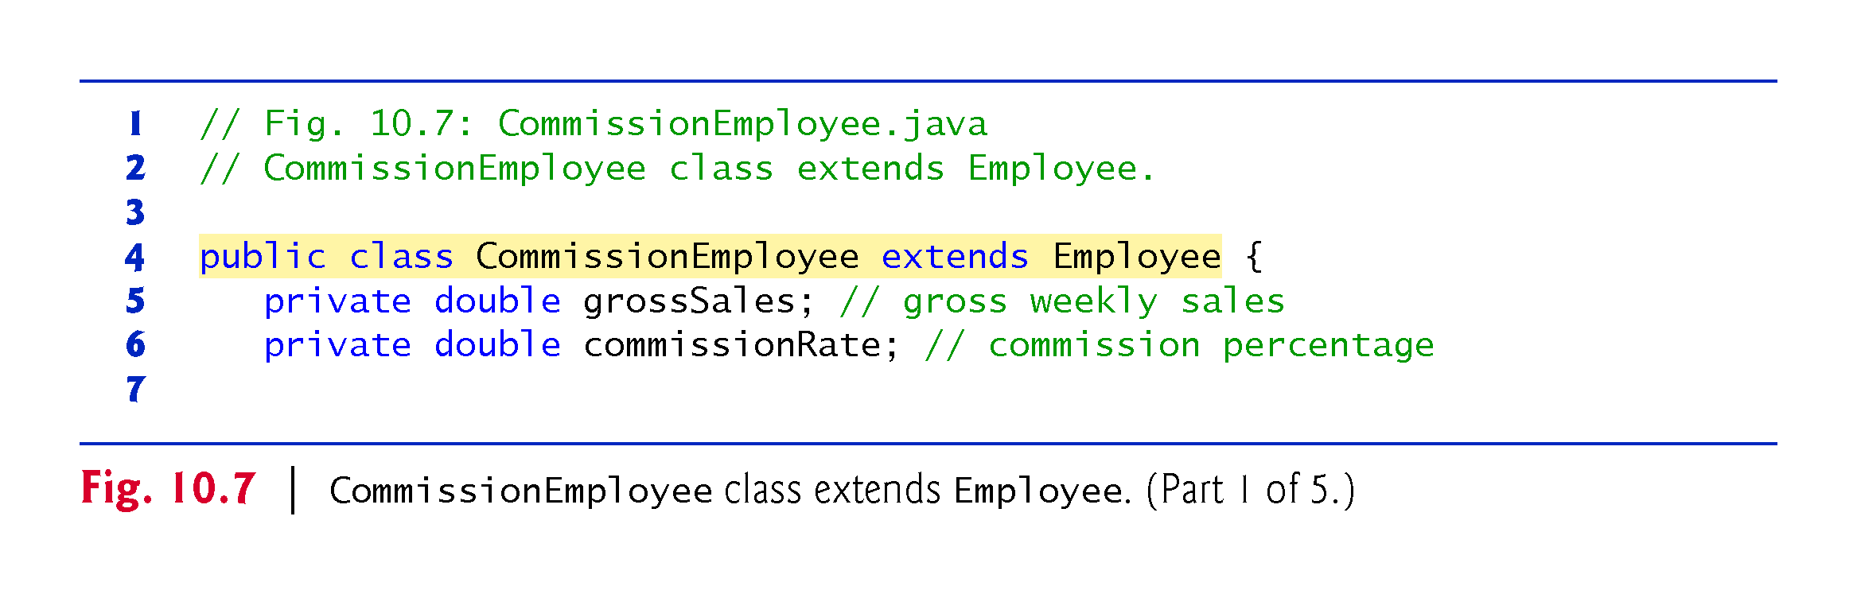

Slide 32
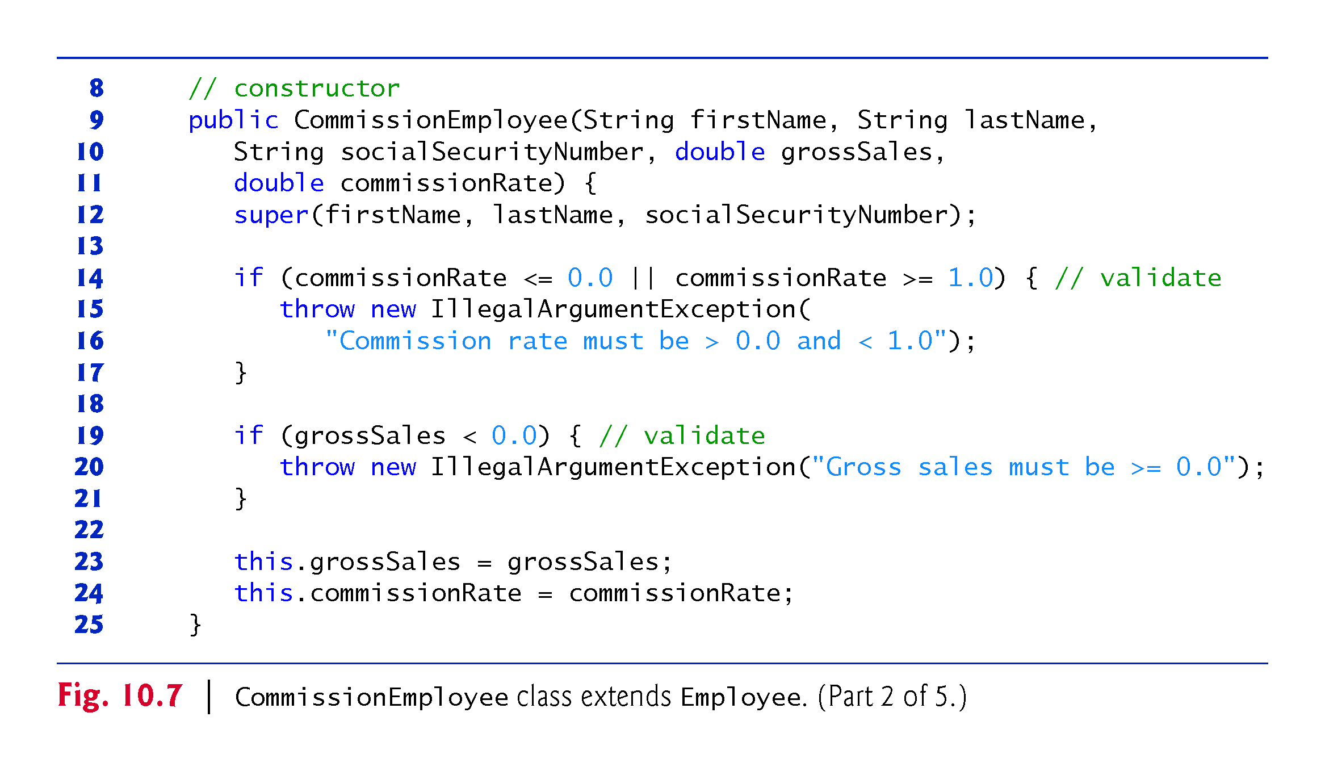

Slide 33
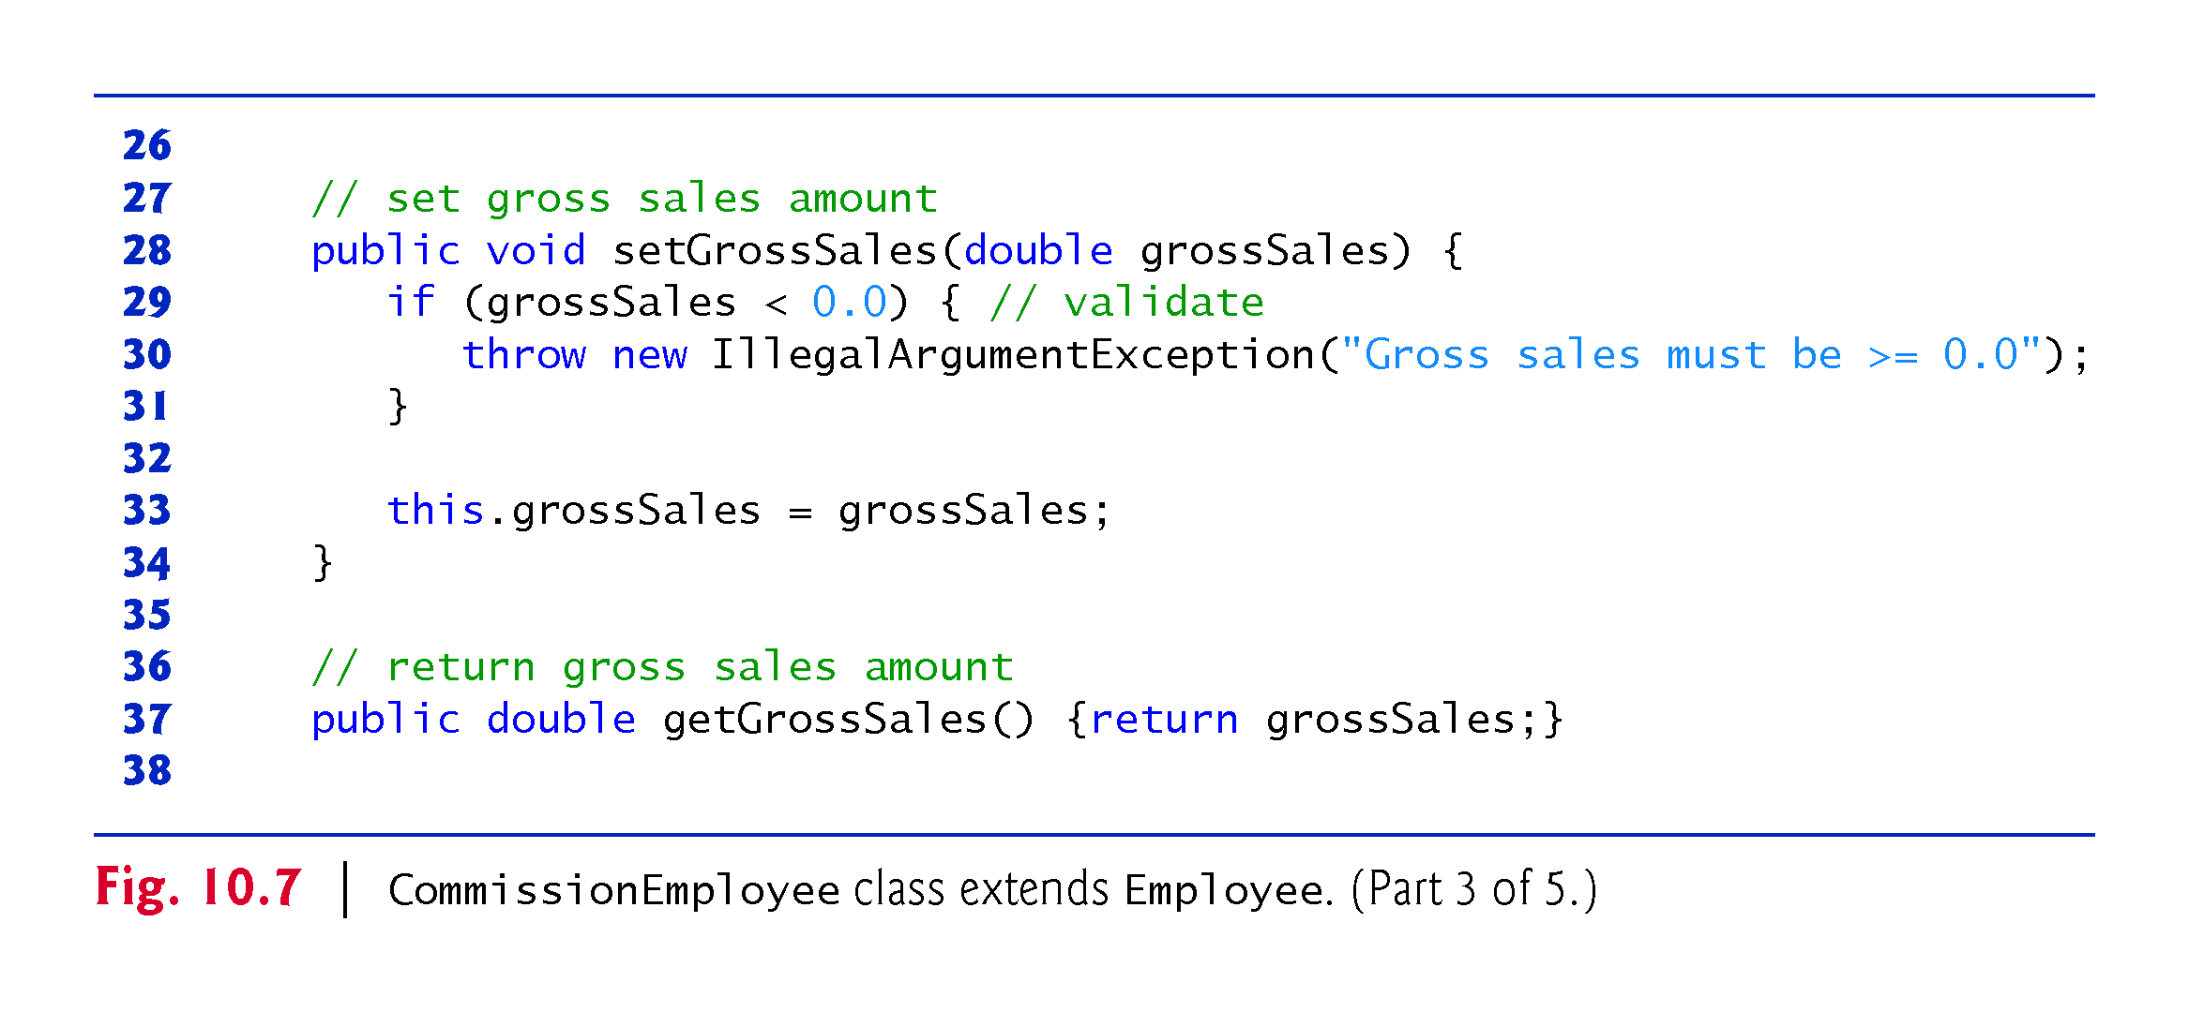

Slide 34
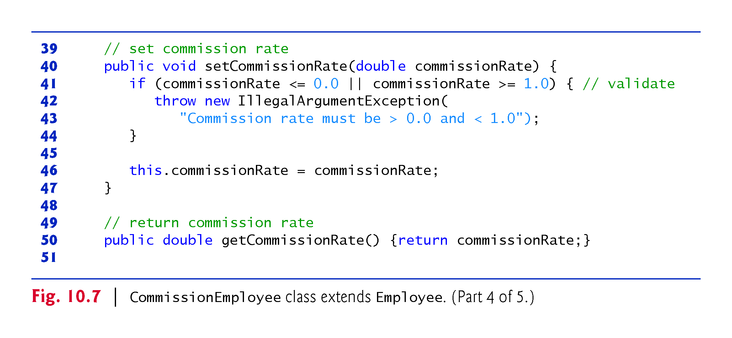

Slide 35
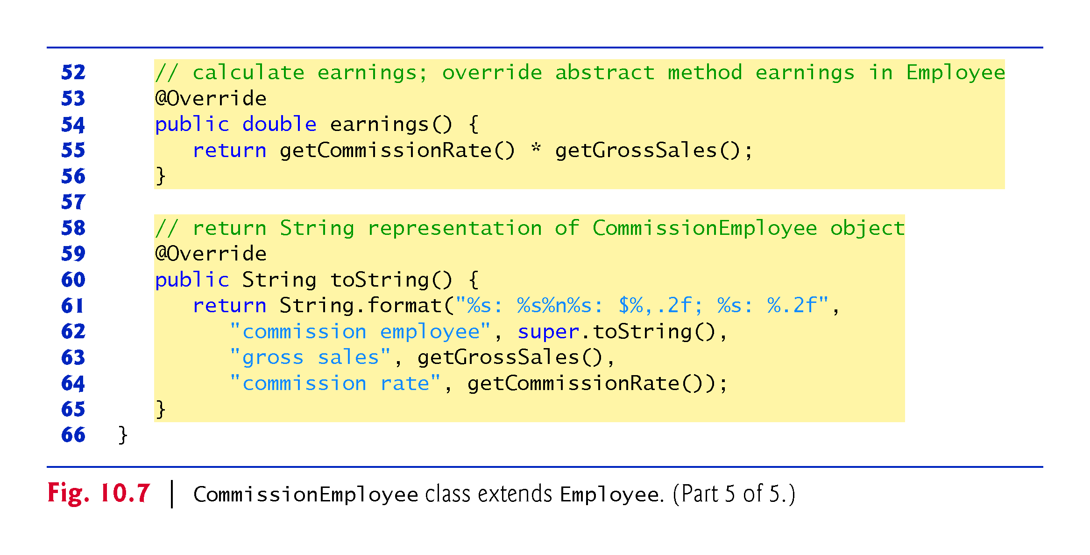

Slide 36
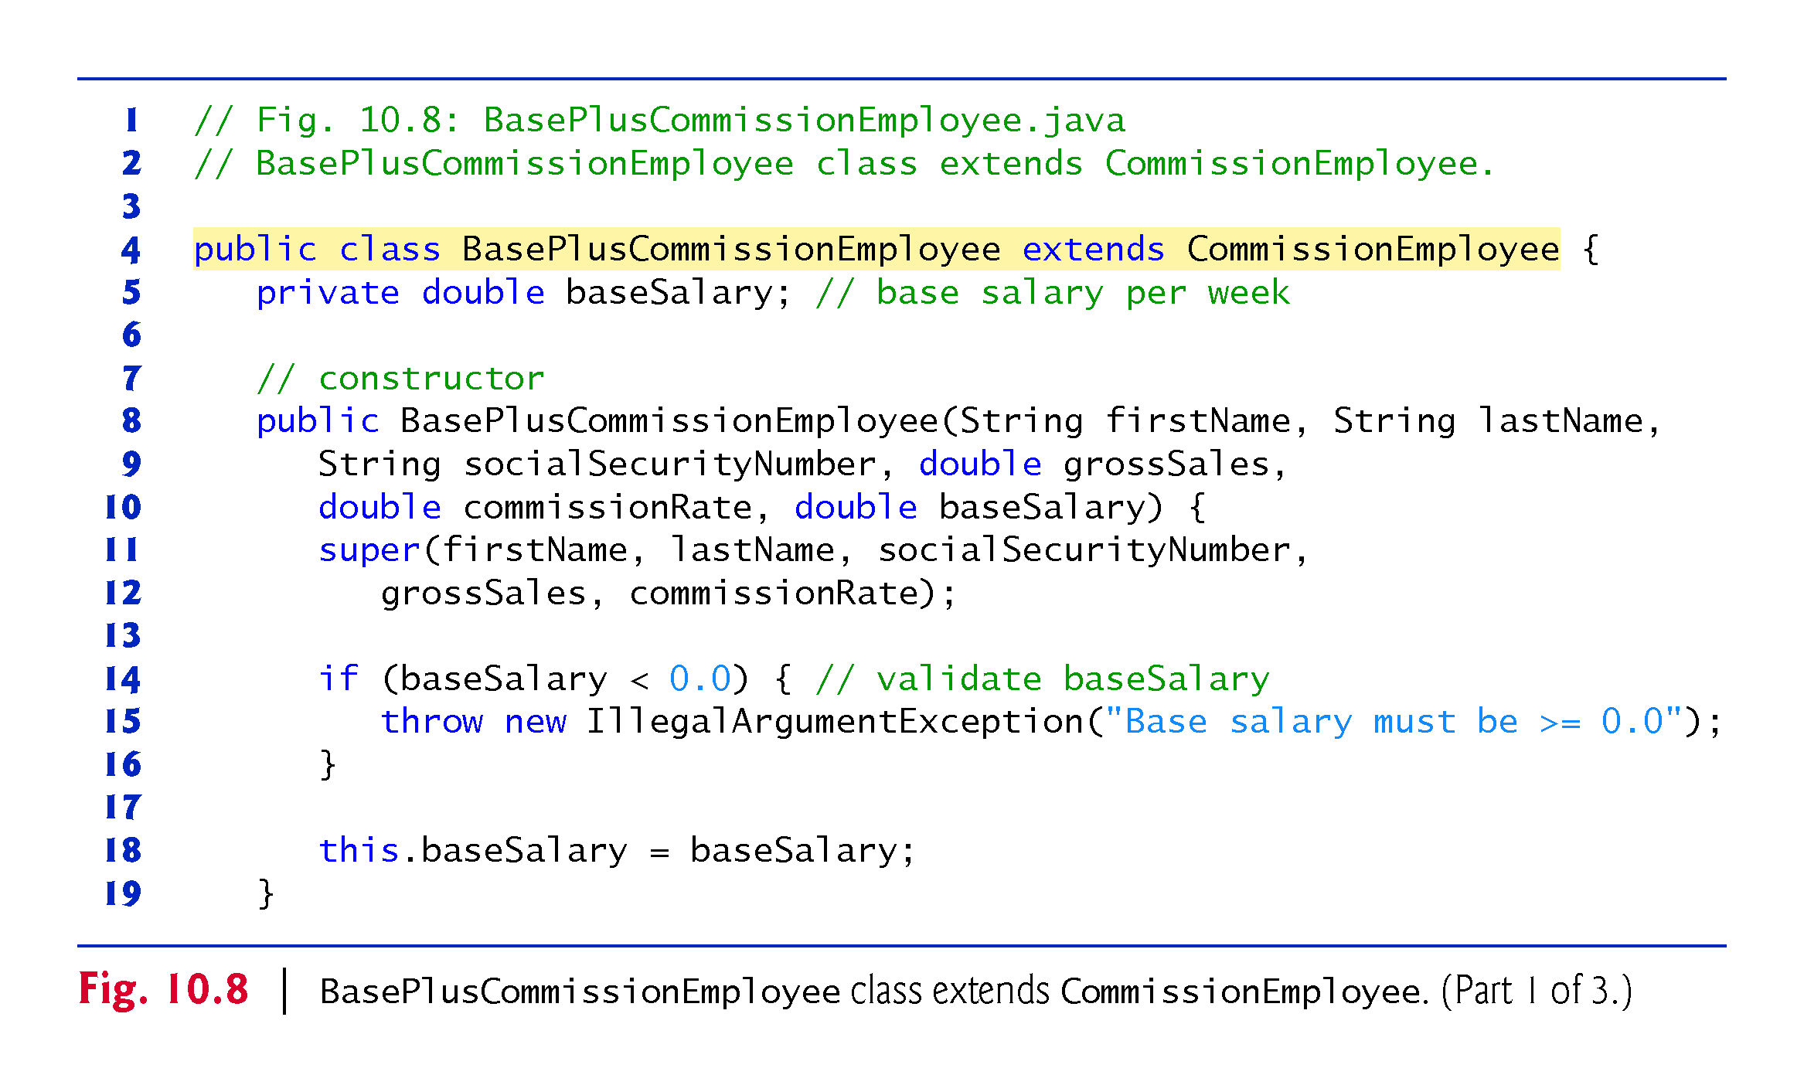

Slide 37
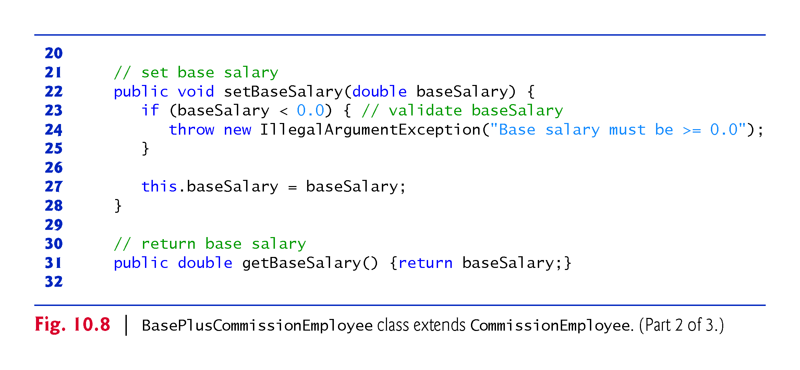

Slide 38
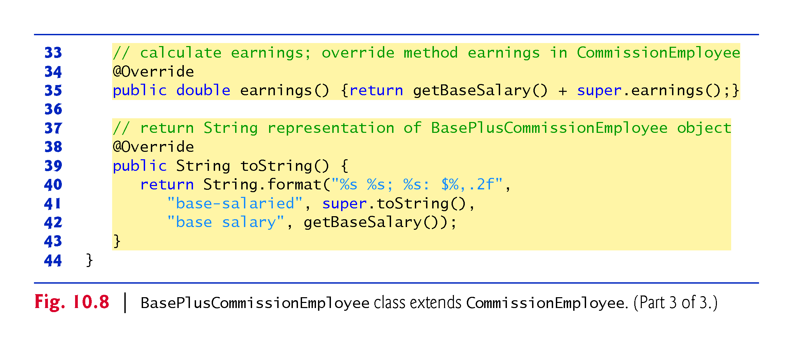

Slide 39
10.5.6 Polymorphic Processing, Operator instanceof and Downcasting
Fig. 10.9 creates an object of each of the four concrete.
Manipulates these objects nonpolymorphically, via variables of each object’s own type, then polymorphically, using an array of Employee variables.
While processing the objects polymorphically, the program increases the base salary of each BasePlusCommissionEmployee by 10%
Requires determining the object’s type at execution time.
Finally, the program polymorphically determines and outputs the type of each object in the Employee array.

Slide 40
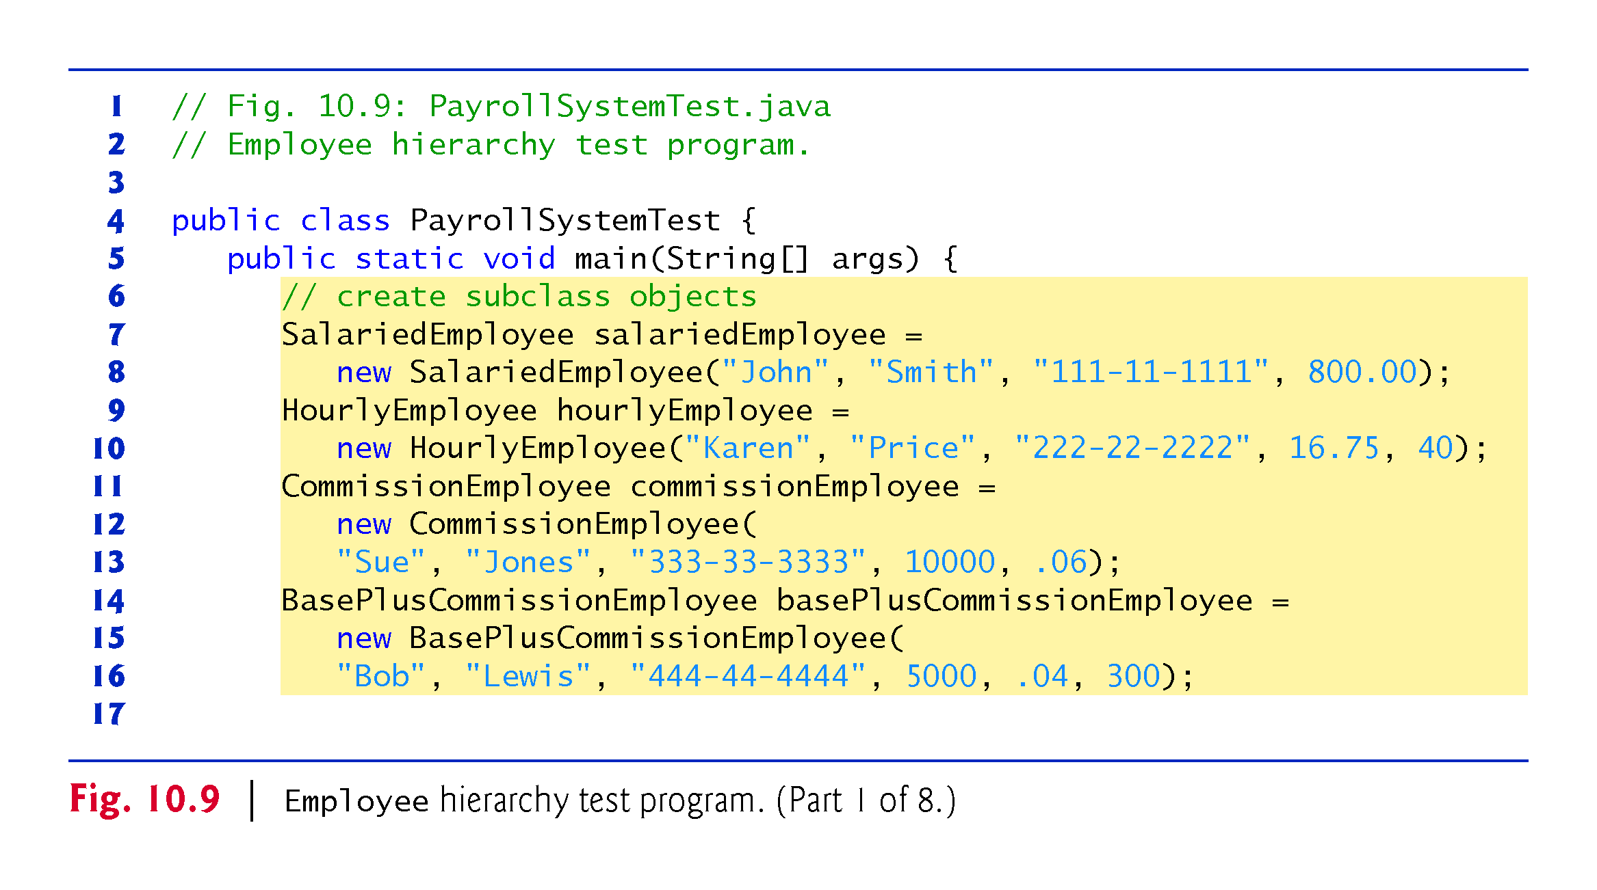

Slide 41
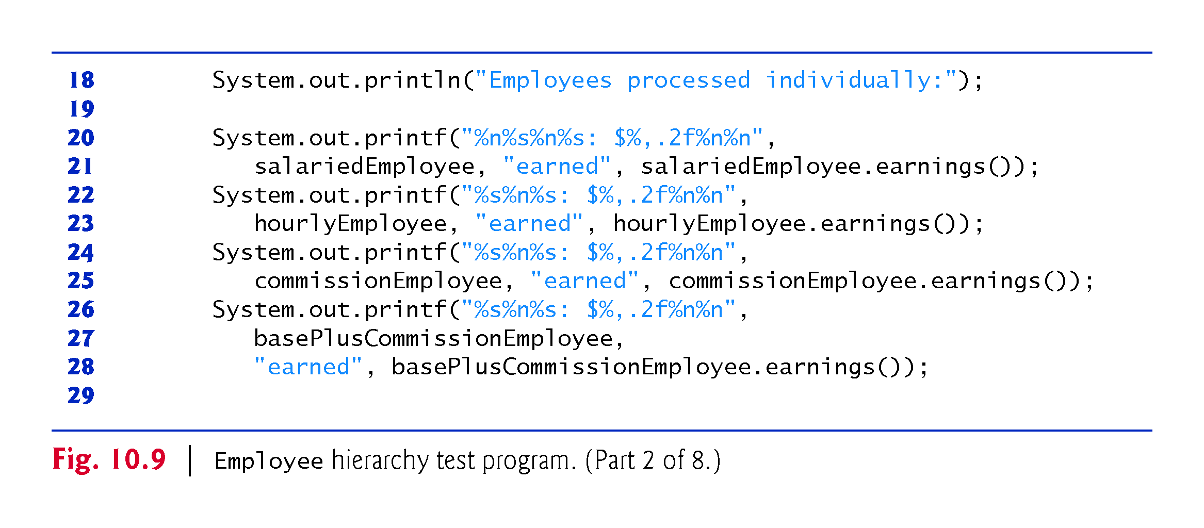

Slide 42
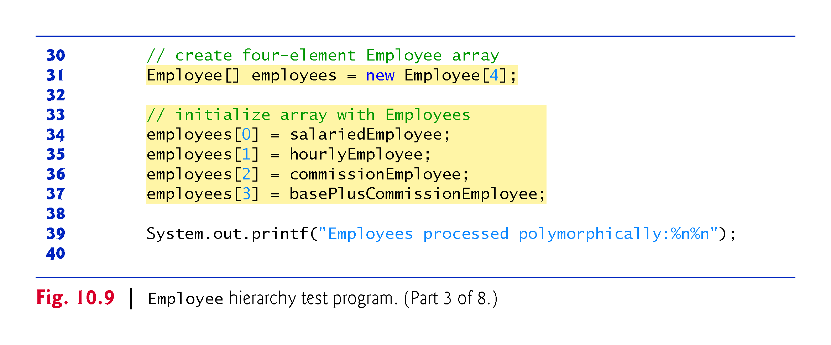

Slide 43
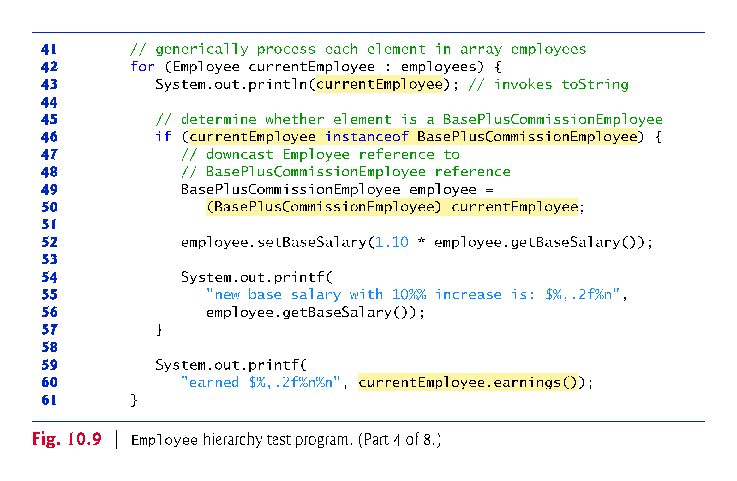

Slide 44
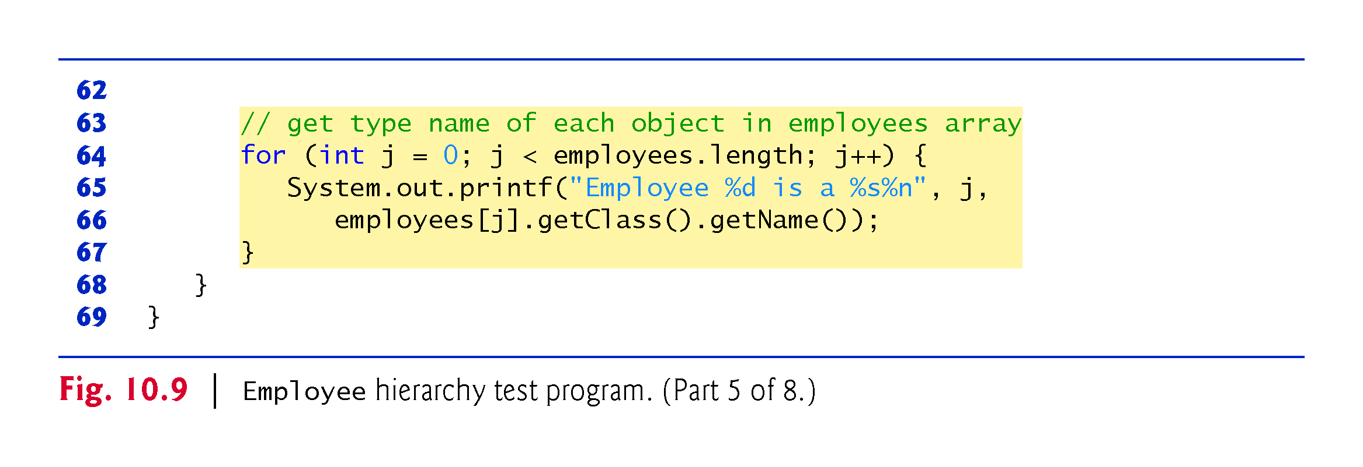

Slide 45
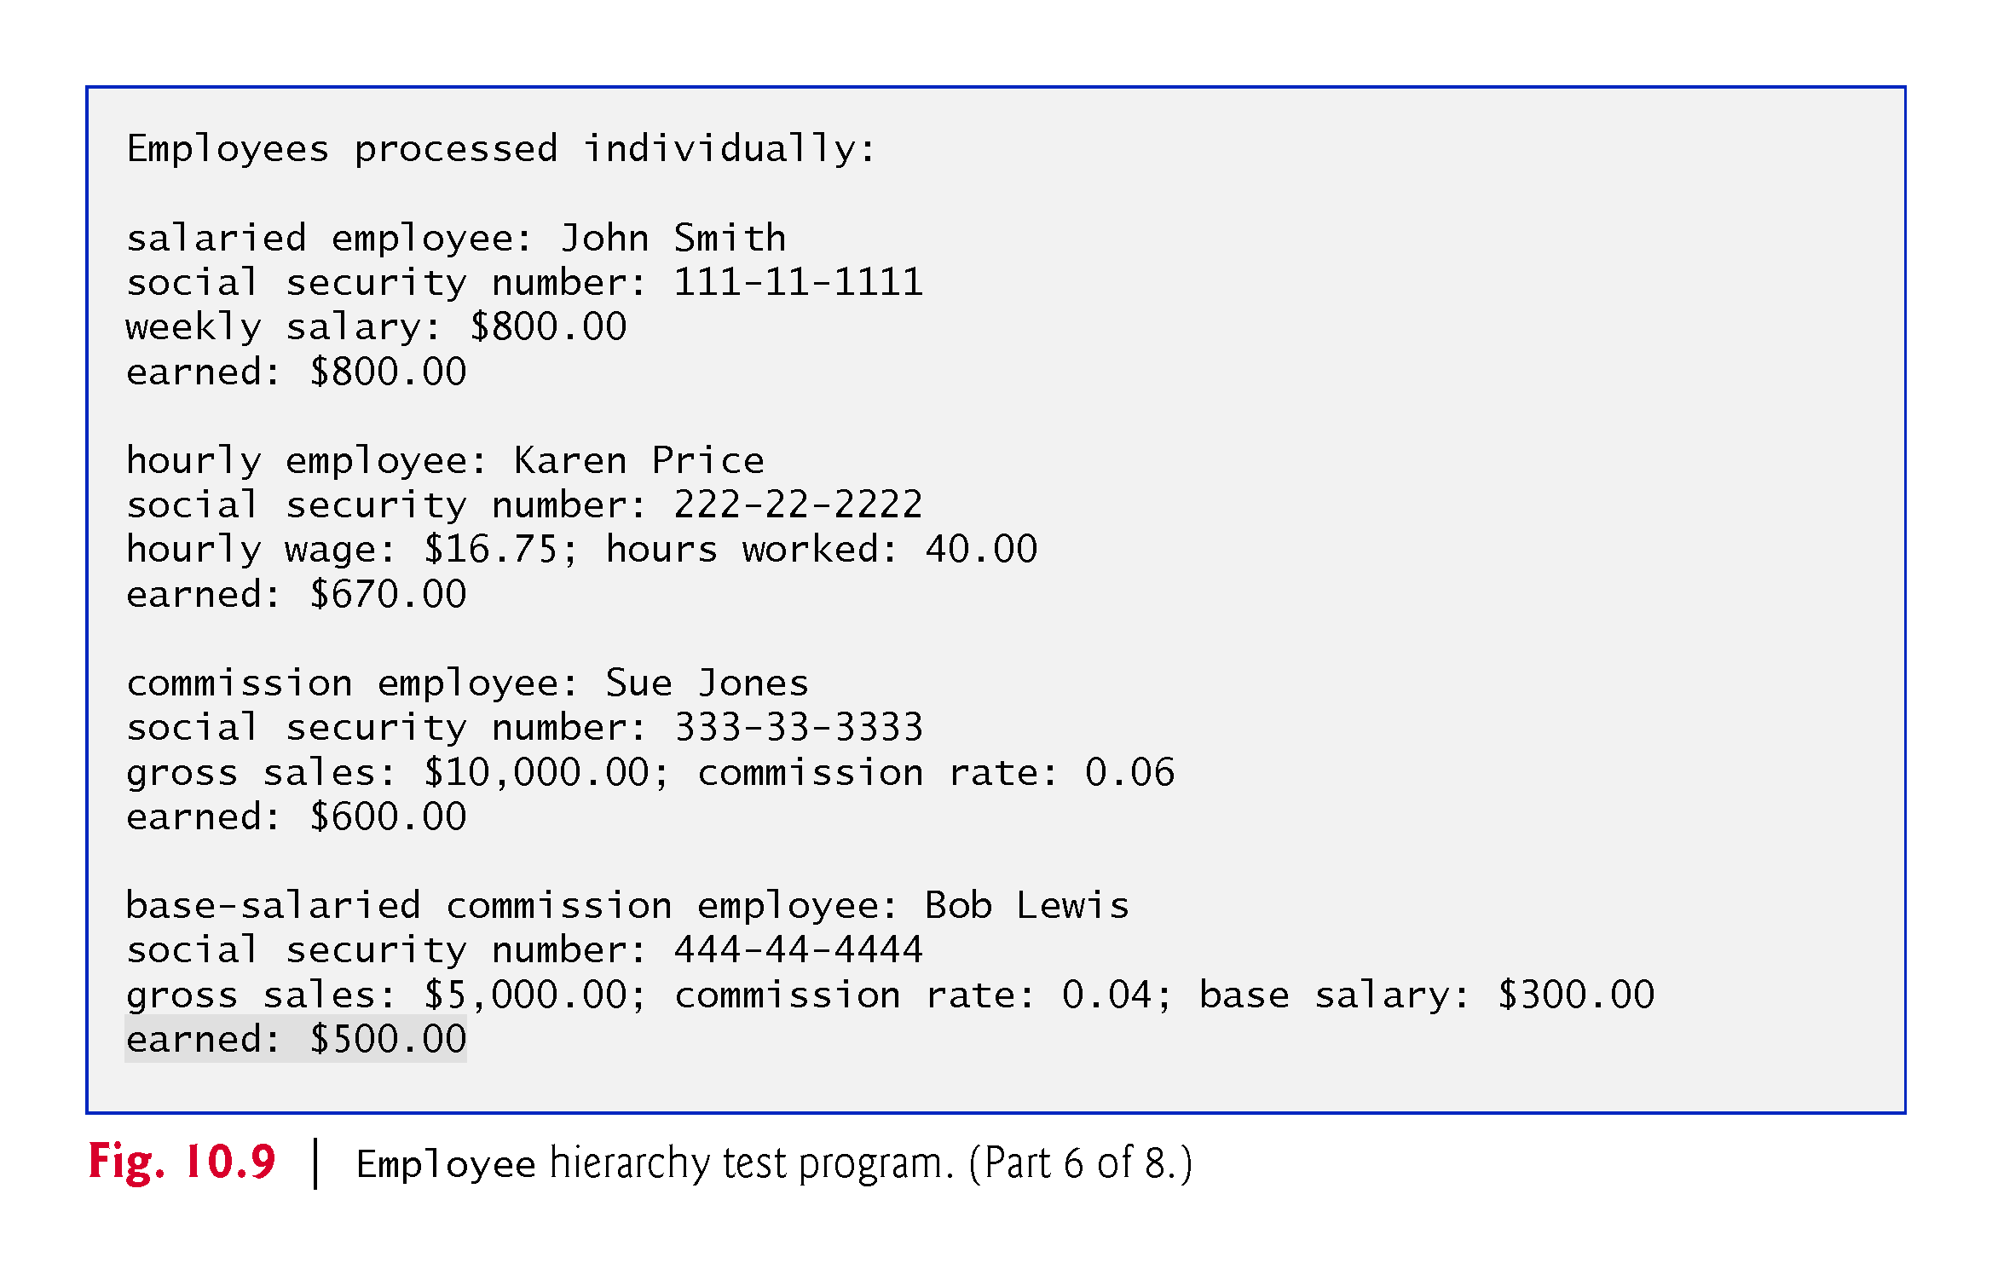

Slide 46
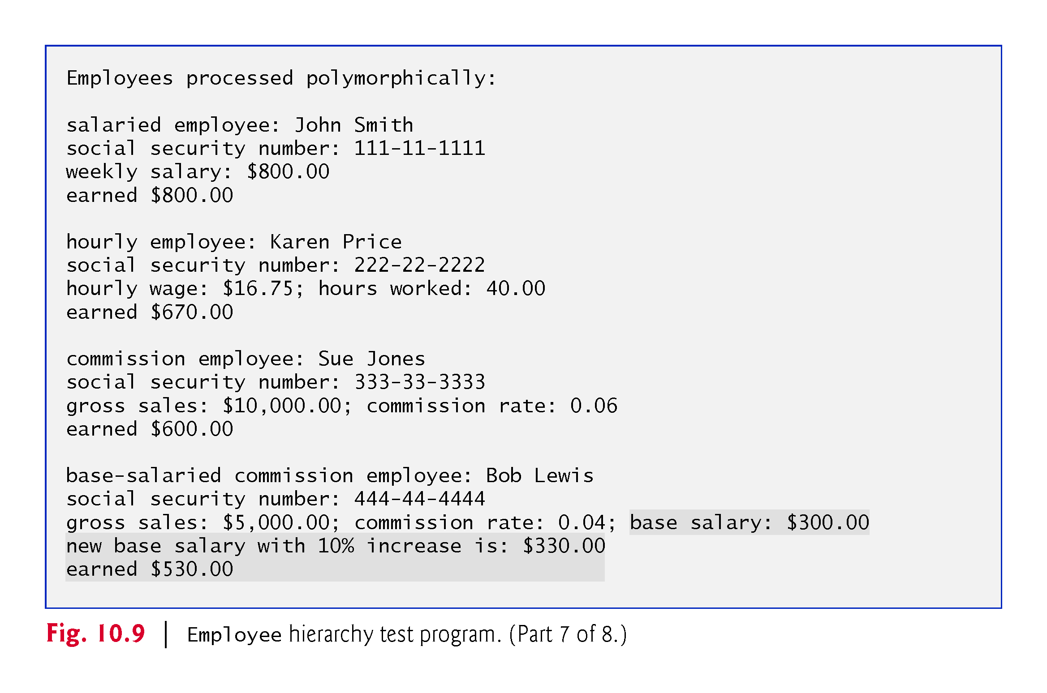

Slide 47
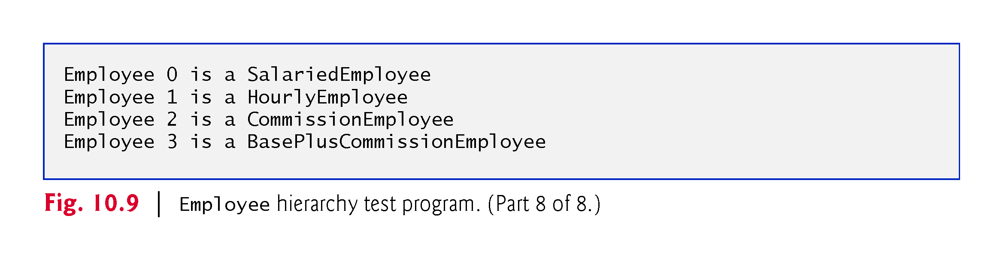

Slide 48
10.5.6 Polymorphic Processing, Operator instanceof and Downcasting (Cont.)
All calls to method toString and earnings are resolved at execution time, based on the type of the object to which currentEmployee refers.
Known as dynamic binding or late binding.
Java decides which class’s toString method to call at execution time rather than at compile time

Slide 49
10.5.6 Polymorphic Processing, Operator instanceof and Downcasting (Cont.)
Every object knows its own class and can access this information through the getClass method, which all classes inherit from class Object.
The getClass method returns an object of type Class (from package java.lang), which contains information about the object’s type, including its class name.
The result of the getClass call is used to invoke getName to get the object’s class name.

Slide 50
10.6 Summary of the Allowed Assignments Between Superclass and Subclass Variables
There are three proper ways to assign superclass and subclass references to variables of superclass and subclass types.
Assigning a superclass reference to a superclass variable is straightforward.
Assigning a subclass reference to a subclass variable is straightforward.
Assigning a subclass reference to a superclass variable is safe, because the subclass object is an object of its superclass.
The superclass variable can be used to refer only to superclass members.
If this code refers to subclass-only members through the superclass variable, the compiler reports errors.

Slide 51
10.7 final Methods and Classes
A final method in a superclass cannot be overridden in a subclass.
Methods that are declared private are implicitly final, because it’s not possible to override them in a subclass.
Methods that are declared static are implicitly final.
A final method’s declaration can never change, so all subclasses use the same method implementation, and calls to final methods are resolved at compile time—this is known as static binding.

Slide 52
10.7 final Methods and Classes (Cont.)
A final class cannot be extended to create a subclass.
All methods in a final class are implicitly final.
Class String is an example of a final class.
If you were allowed to create a subclass of String, objects of that subclass could be used wherever Strings are expected.
Since class String cannot be extended, programs that use Strings can rely on the functionality of String objects as specified in the Java API.
Making the class final also prevents programmers from creating subclasses that might bypass security restrictions.

Slide 53
10.8 A Deeper Explanation of Issues with Calling Methods from Constructors
Do not call overridable methods from constructors.
When creating a subclass object, this could lead to an overridden method being called before the subclass object is fully initialized.
Recall that when you construct a subclass object, its constructor first calls one of the direct superclass’s constructors.
If the superclass constructor calls an overridable method, the subclass’s version of that method will be called by the superclass constructor—before the subclass constructor’s body has a chance to execute.
This could lead to subtle, difficult-to-detect errors if the subclass method that was called depends on initialization that has not yet been performed in the subclass constructor’s body.
It’s acceptable to call a static method from a constructor.

Slide 54
10.9 Creating and Using Interfaces
Our next example reexamines the payroll system of Section 10.5.
Suppose that the company involved wishes to perform several accounting operations in a single accounts payable application
Calculating the earnings that must be paid to each employee
Calculate the payment due on each of several invoices (i.e., bills for goods purchased)
Both operations have to do with obtaining some kind of payment amount.
For an employee, the payment refers to the employee’s earnings.
For an invoice, the payment refers to the total cost of the goods listed on the invoice.

Slide 55
10.9 Creating and Using Interfaces (Cont.)
Interfaces offer a capability requiring that unrelated classes implement a set of common methods.
Interfaces define and standardize the ways in which things such as people and systems can interact with one another.

Slide 56
10.9 Creating and Using Interfaces (Cont.)
To use an interface, a concrete class must specify that it implements the interface and must declare each method in the interface with specified signature.
Add the implements keyword and the name of the interface to the end of your class declaration’s first line.
A class that does not implement all the methods of the interface is an abstract class and must be declared abstract.
Implementing an interface is like signing a contract with the compiler that states, “I will declare all the methods specified by the interface or I will declare my class abstract.”

Slide 57
10.9 Creating and Using Interfaces (Cont.)
An interface is often used when disparate classes (i.e., unrelated classes) need to share common methods and constants.
Allows objects of unrelated classes to be processed polymorphically by responding to the same method calls.
You can create an interface that describes the desired functionality, then implement this interface in any classes that require that functionality.

Slide 58
10.9.1 Developing a Payable Hierarchy
Next example builds an application that can determine payments for employees and invoices alike.
Classes Invoice and Employee both represent things for which the company must be able to calculate a payment amount.
Both classes implement the Payable interface, so a program can invoke method getPaymentAmount on Invoice objects and Employee objects alike.
Enables the polymorphic processing of Invoices and Employees.

Slide 59
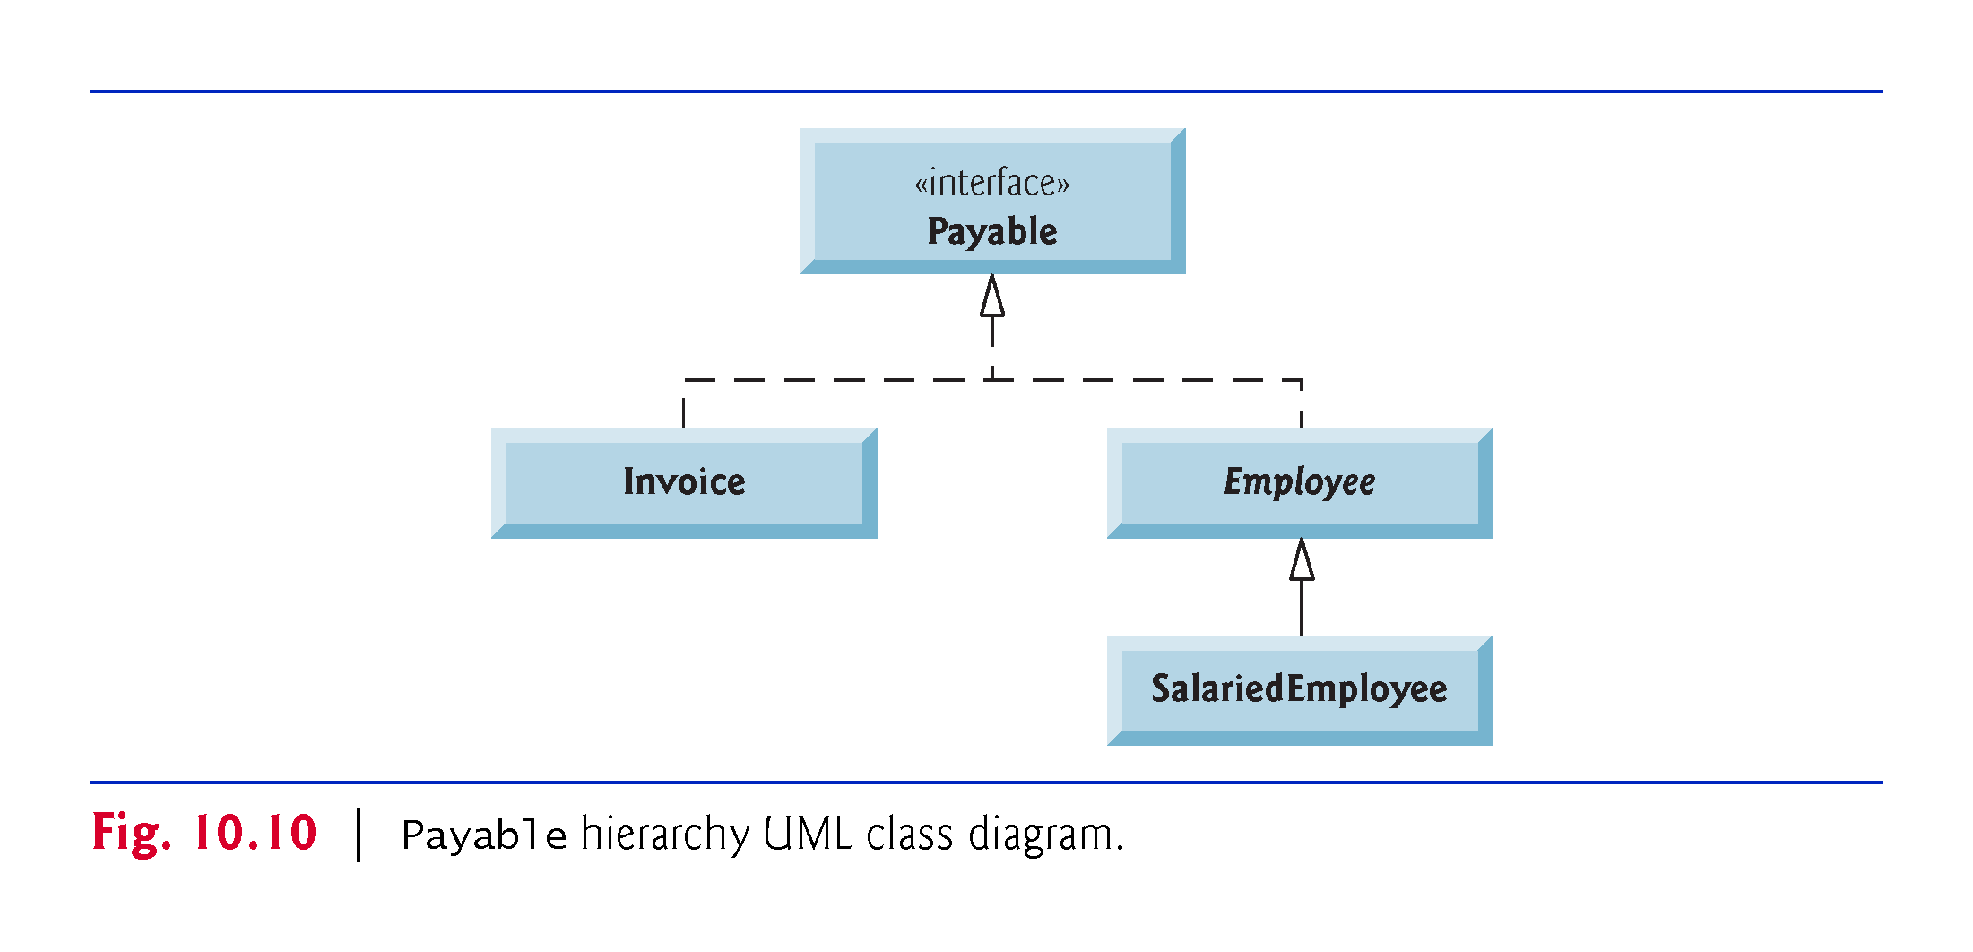

Slide 60
10.9.2 Interface Payable
Fig. 10.11 shows the declaration of interface Payable.
Interface methods are always public and abstract, so they do not need to be declared as such.
Interfaces can have any number of methods, and the methods can have parameters.
Interfaces may also contain final and static constants

Slide 61
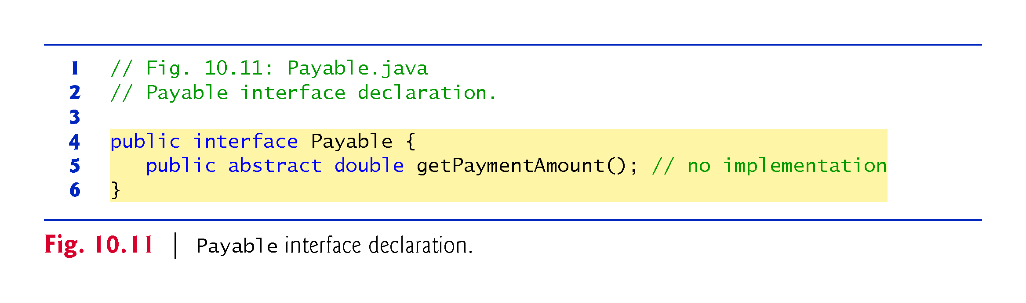

Slide 62
10.9.3 Class Invoice
Class Invoice (Fig. 19.12) represents a simple invoice that contains billing information for only one kind of part
Java does not allow subclasses to inherit from more than one superclass, but it allows a class to inherit from one superclass and implement as many interfaces as it needs.
To implement more than one, use a comma-separated list of interface names after keyword implements in the class declaration, as in:
public class ClassName extends SuperclassName implements FirstInterface, SecondInterface, …

Slide 63
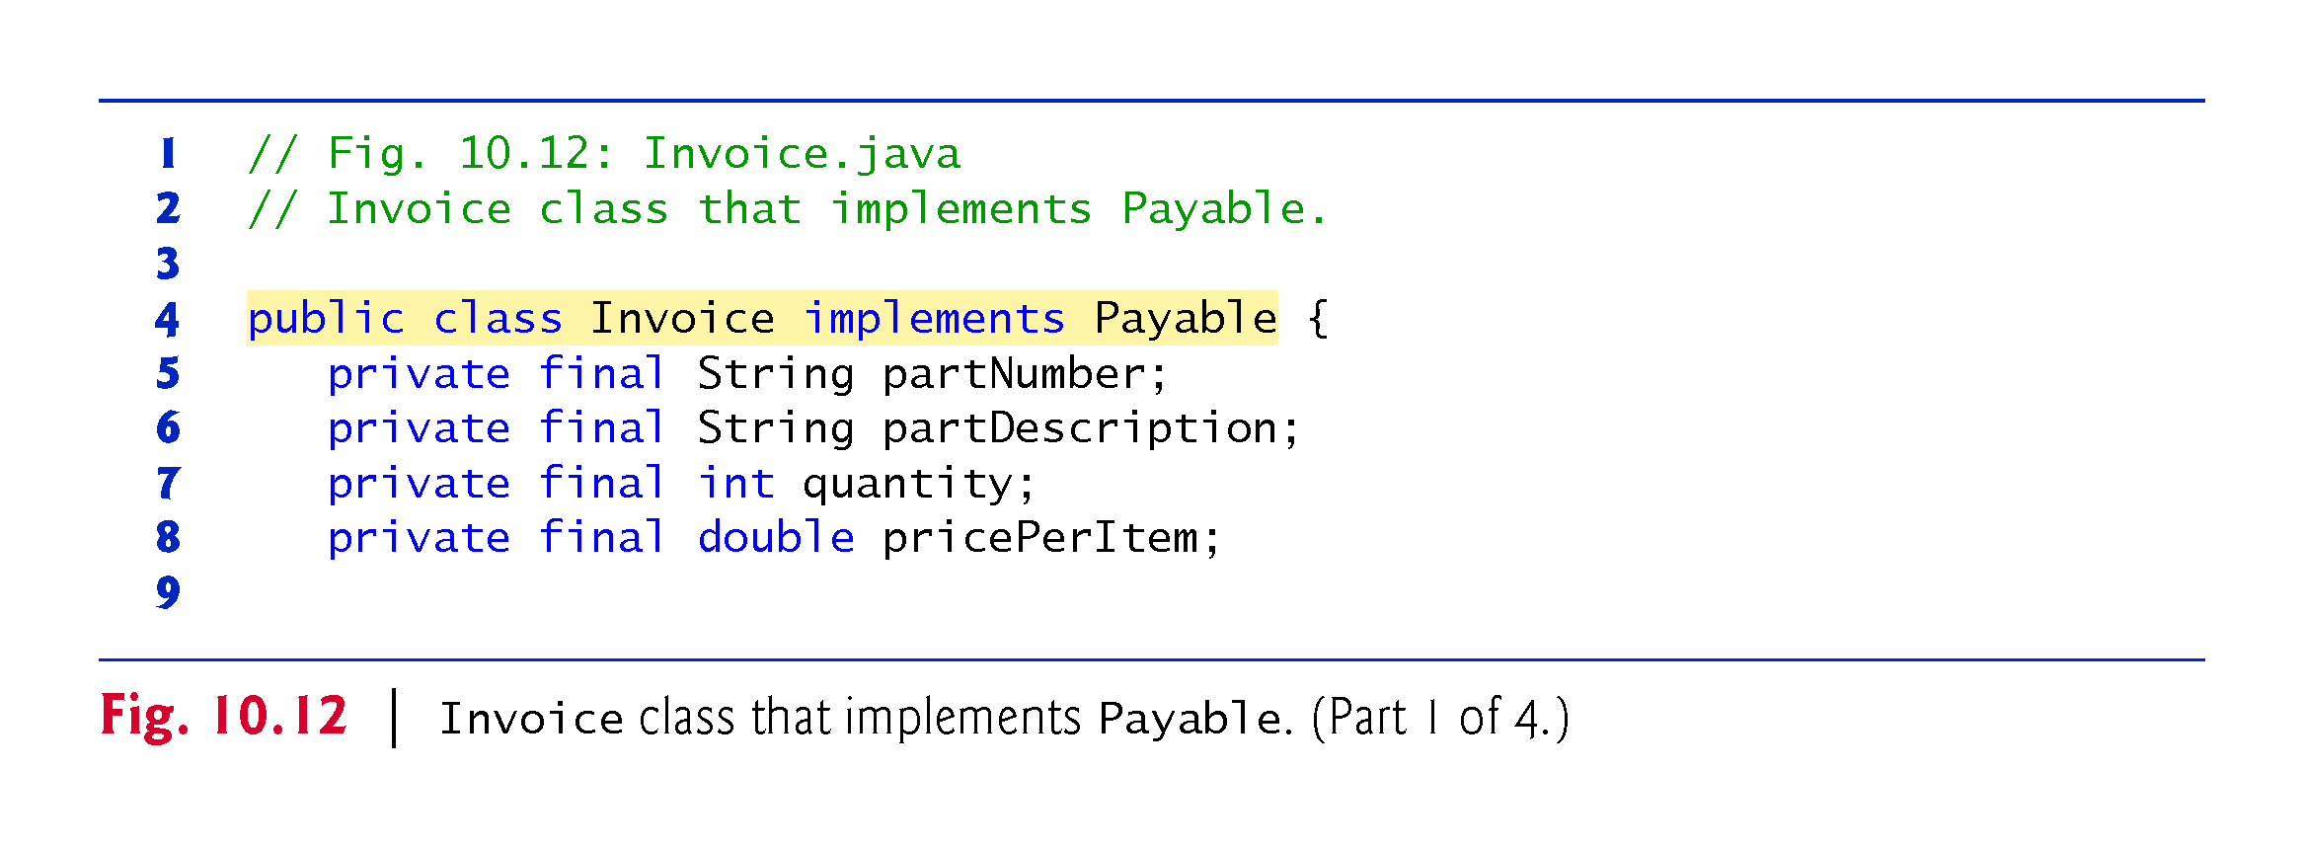

Slide 64
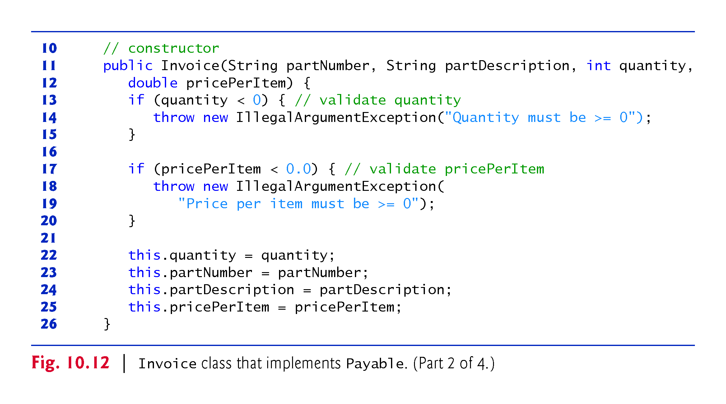

Slide 65
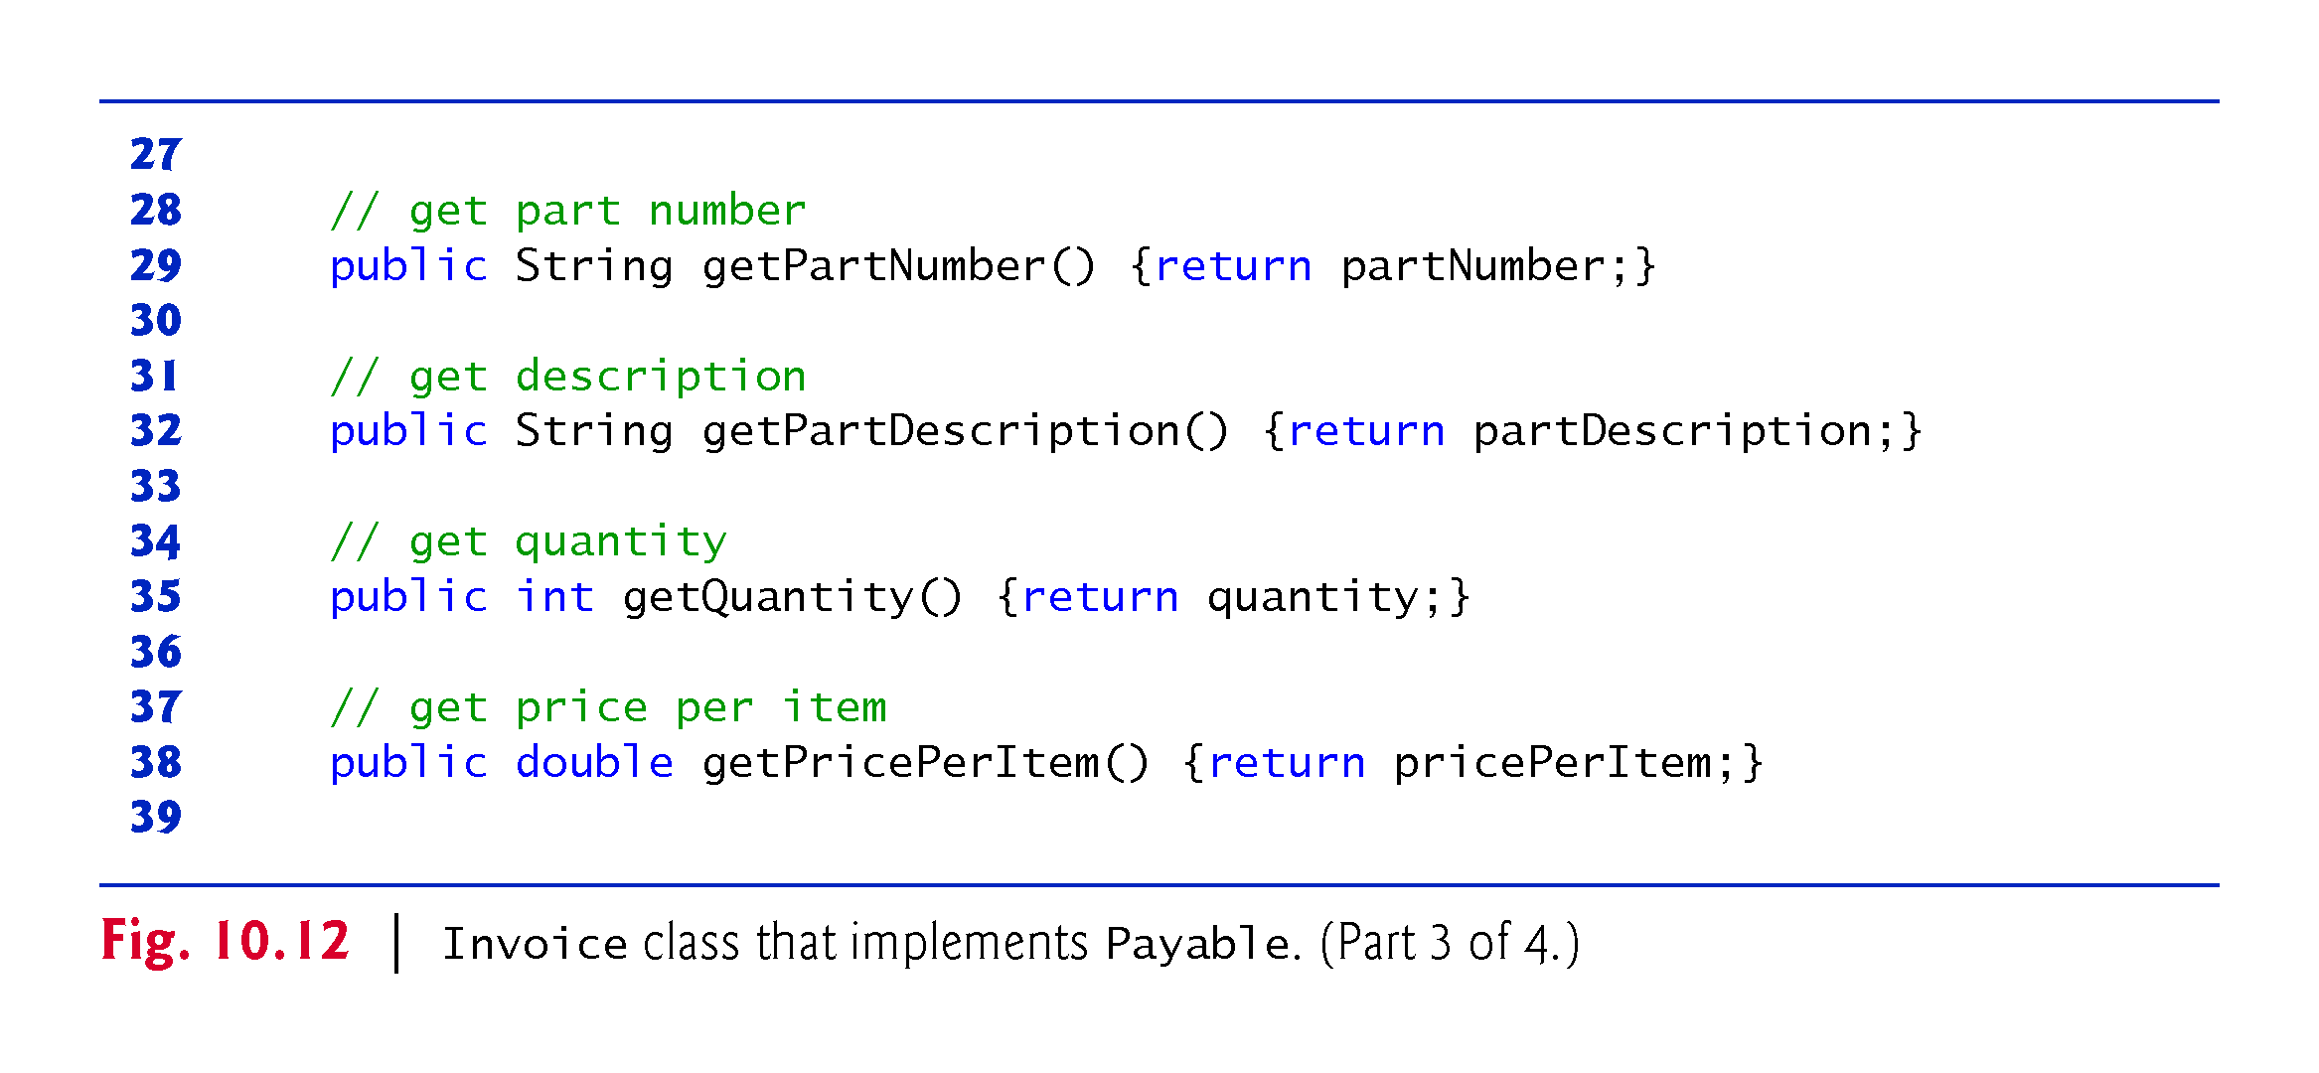

Slide 66
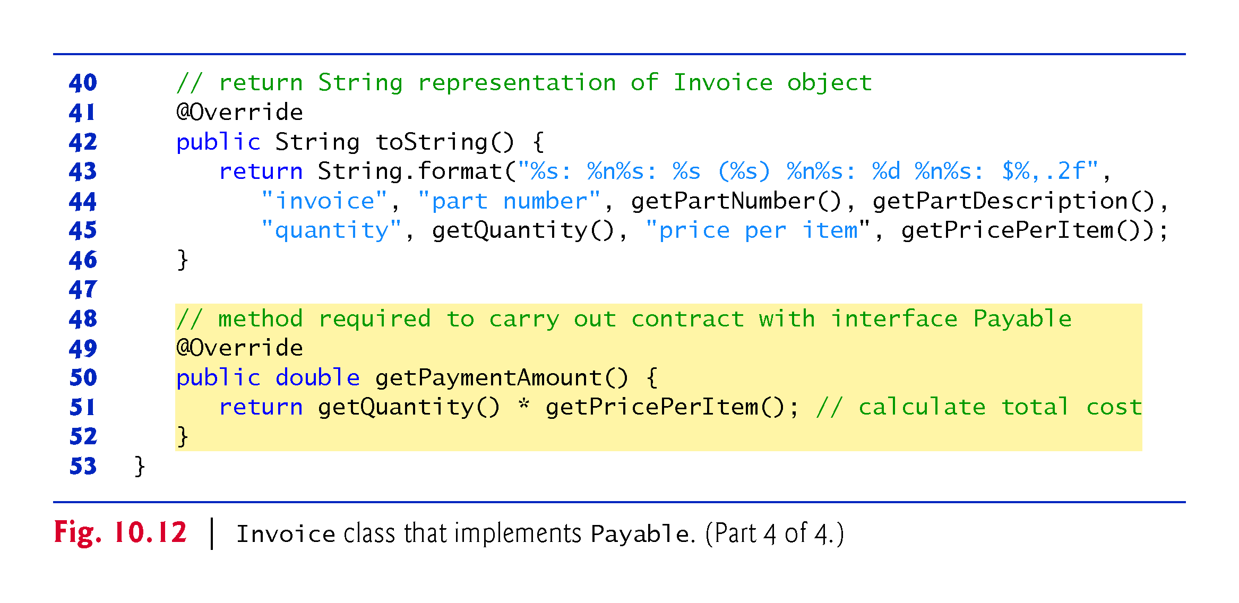

Slide 67
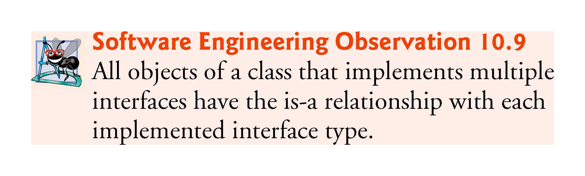

Slide 68
10.9.4 Modifying Class Employee to Implement Interface Payable
We now modify class Employee to implement interface Payable. This class declaration is identical to that of Fig. 10.4 with two exceptions:
Line 4 of indicates that class Employee now implements Payable.
Line 38 implements interface Payable’s getPaymentAmount method.
getPaymentAmount simply calls Employee’s abstract method earnings
At execution time, when getPaymentAmount is called on an object of an Employee subclass, getPaymentAmount calls that subclass’s concrete earnings method, which knows how to calculate earnings for objects of that subclass type.
See Fig. 10.4, slide 21, and Fig. 10.5, slide 23

Slide 69
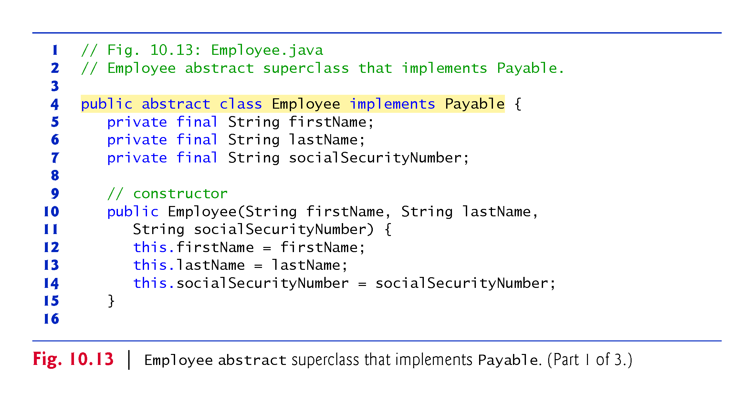

Slide 70
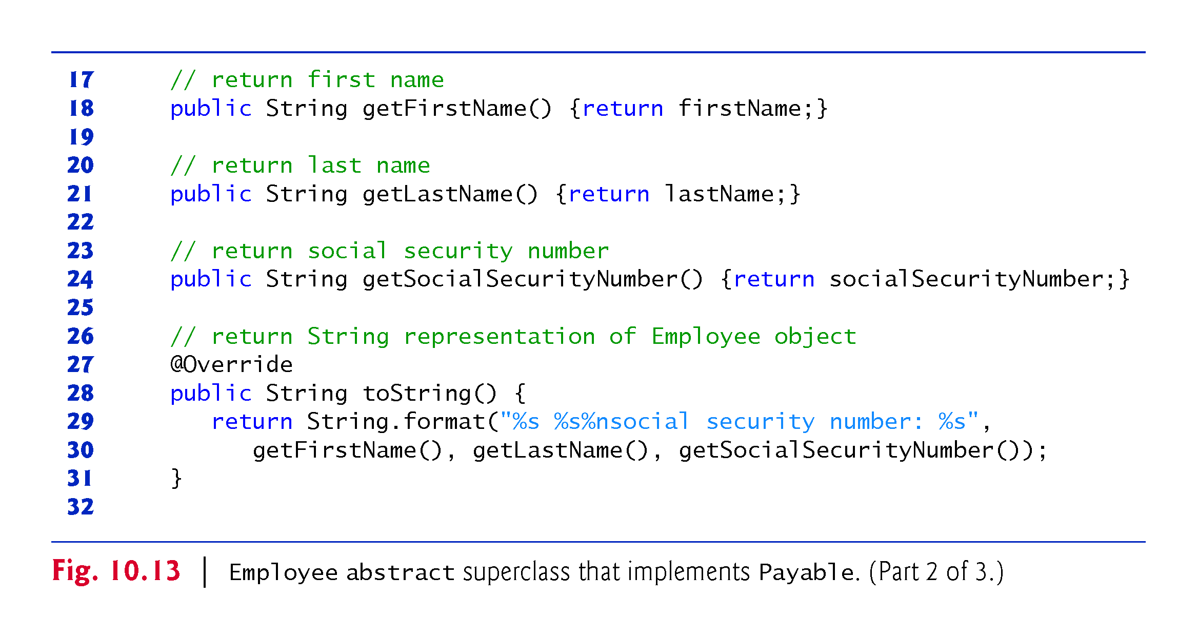

Slide 71
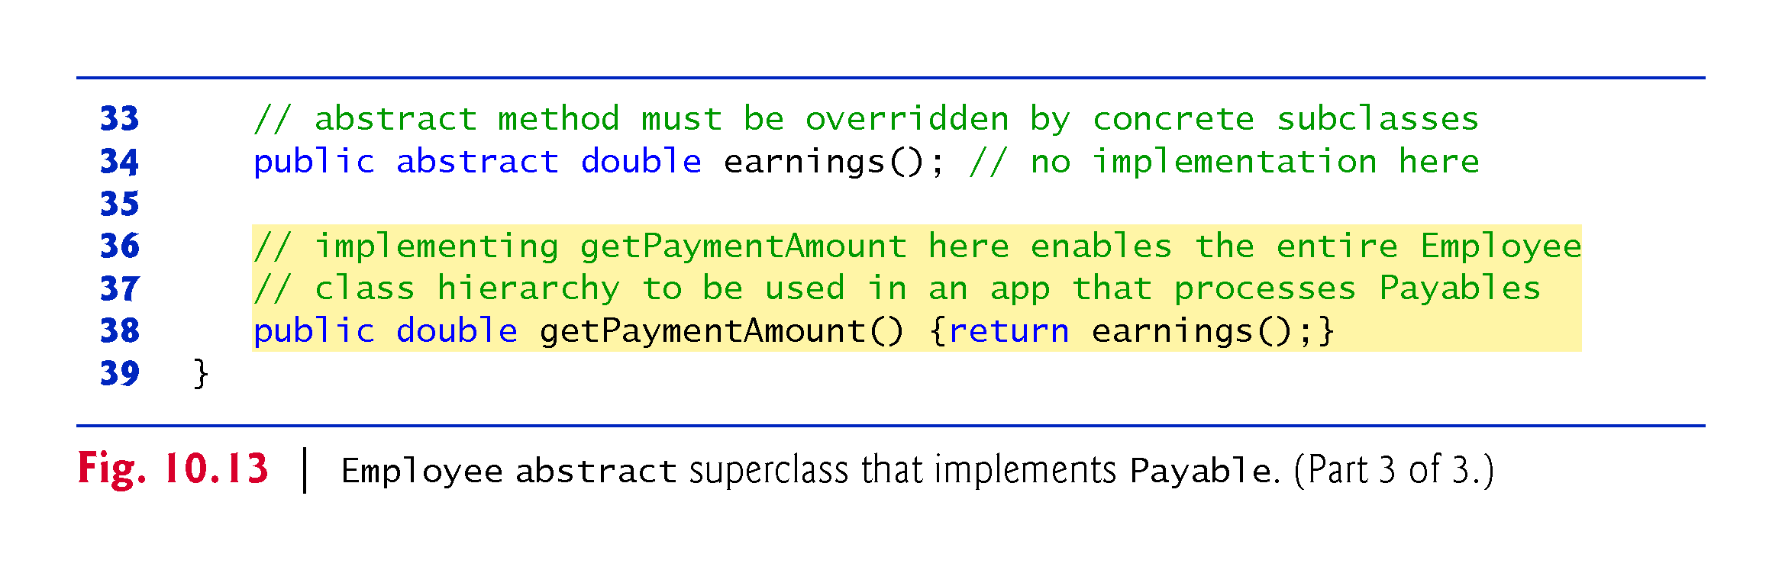

Slide 75
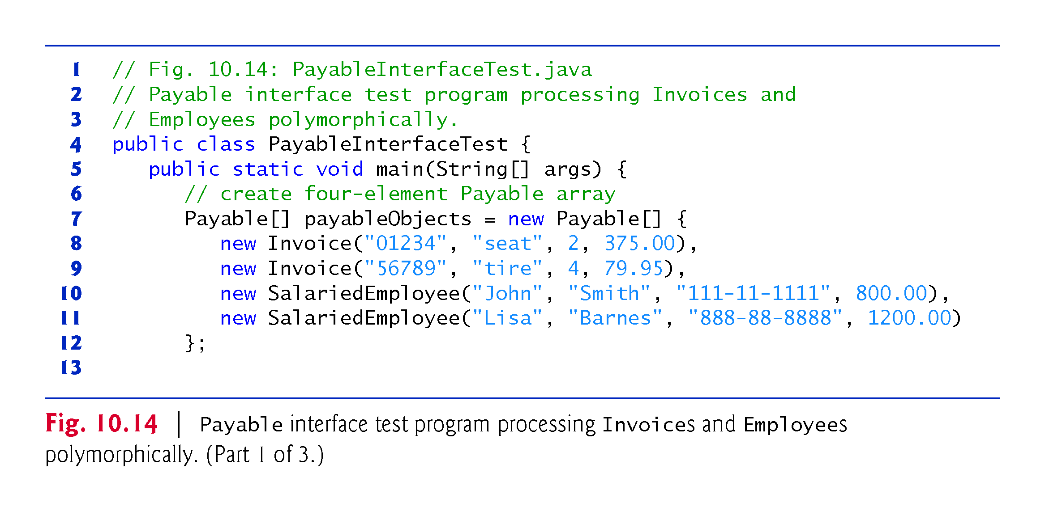

Slide 76
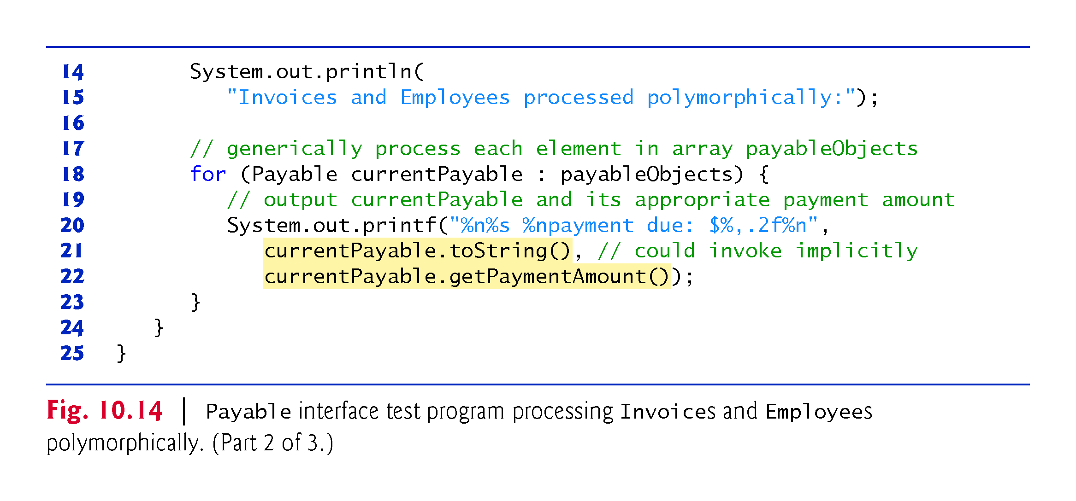

Slide 77
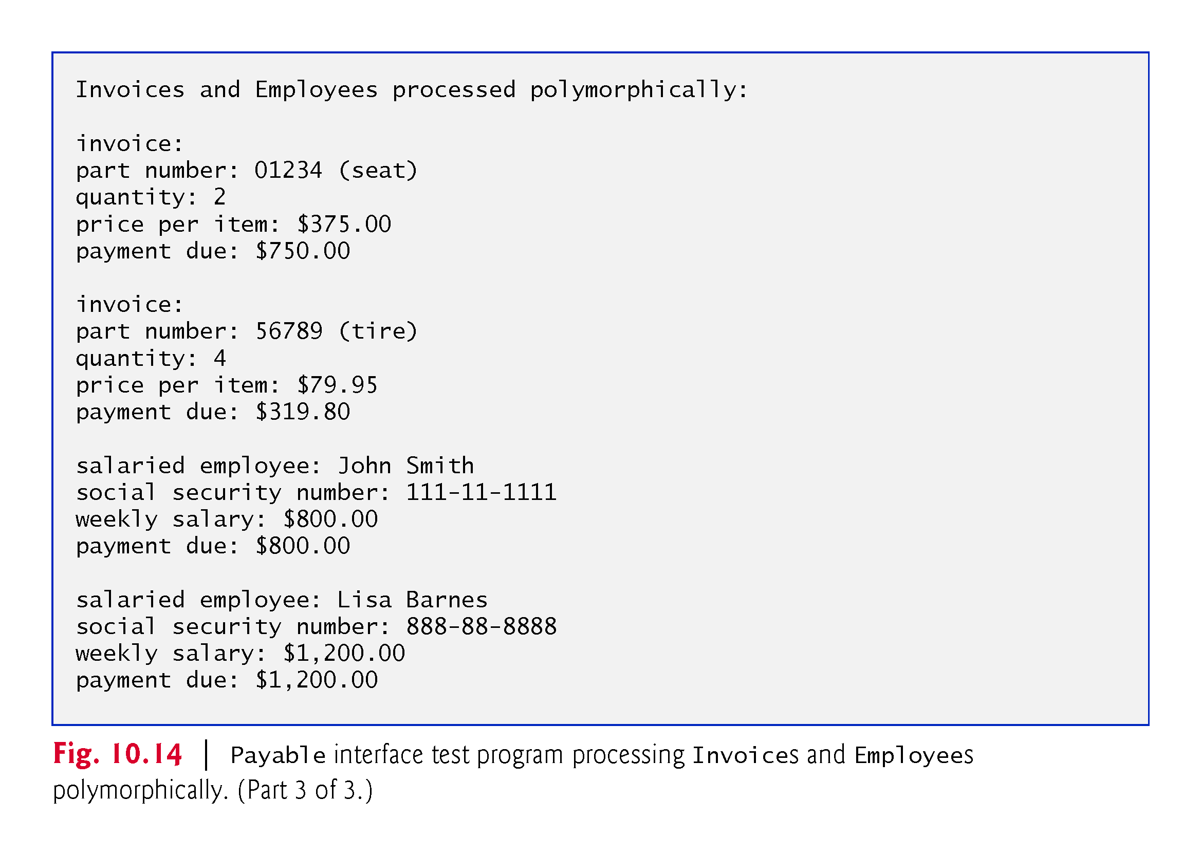

Slide 78
10.9.7 Some Common Interfaces of the Java API
You’ll use interfaces extensively when developing Java applications. The Java API contains numerous interfaces, and many of the Java API methods take interface arguments and return interface values.
Figure 10.16 overviews a few of the more popular interfaces of the Java API that we use in later chapters.

Slide 79
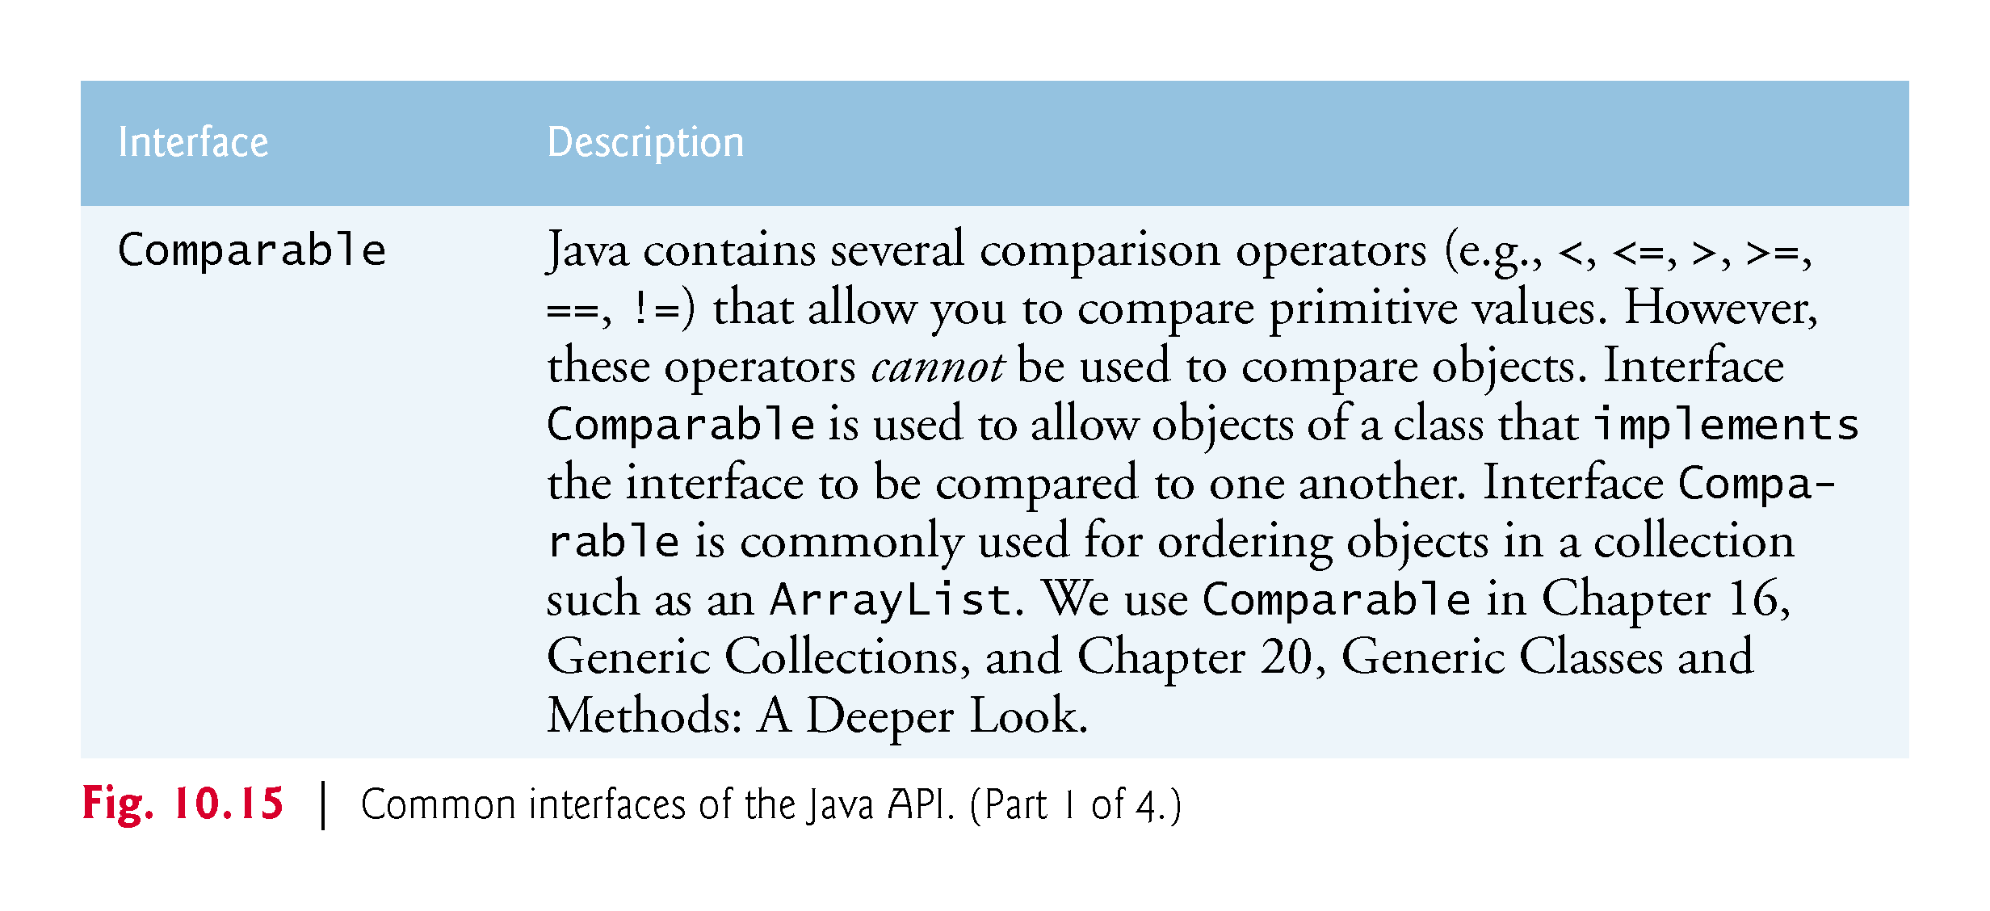

Slide 80
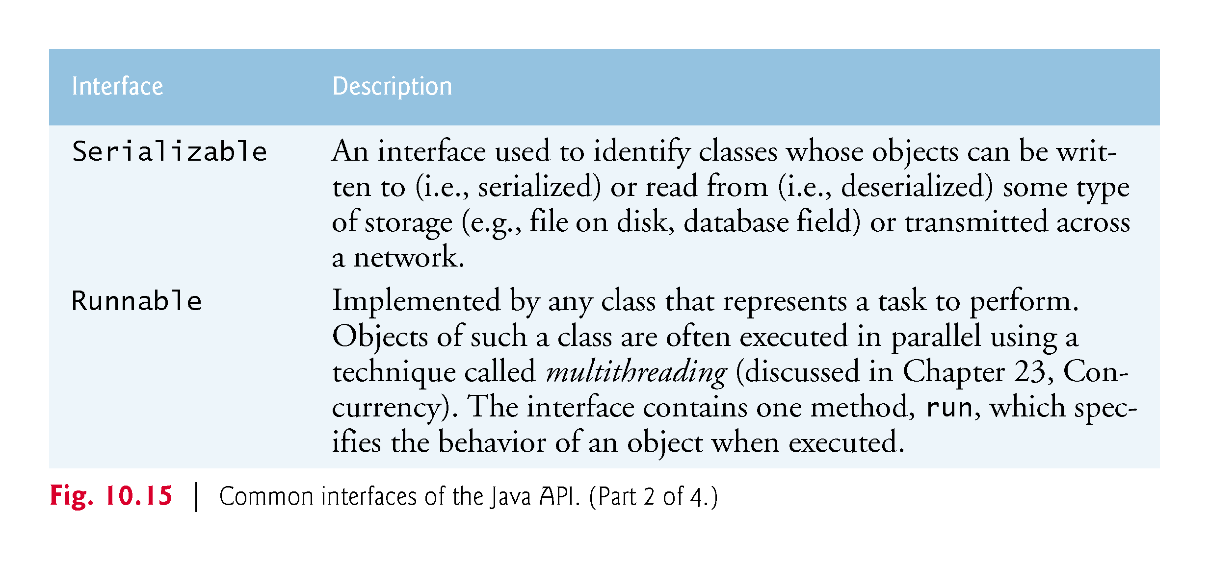

Slide 81
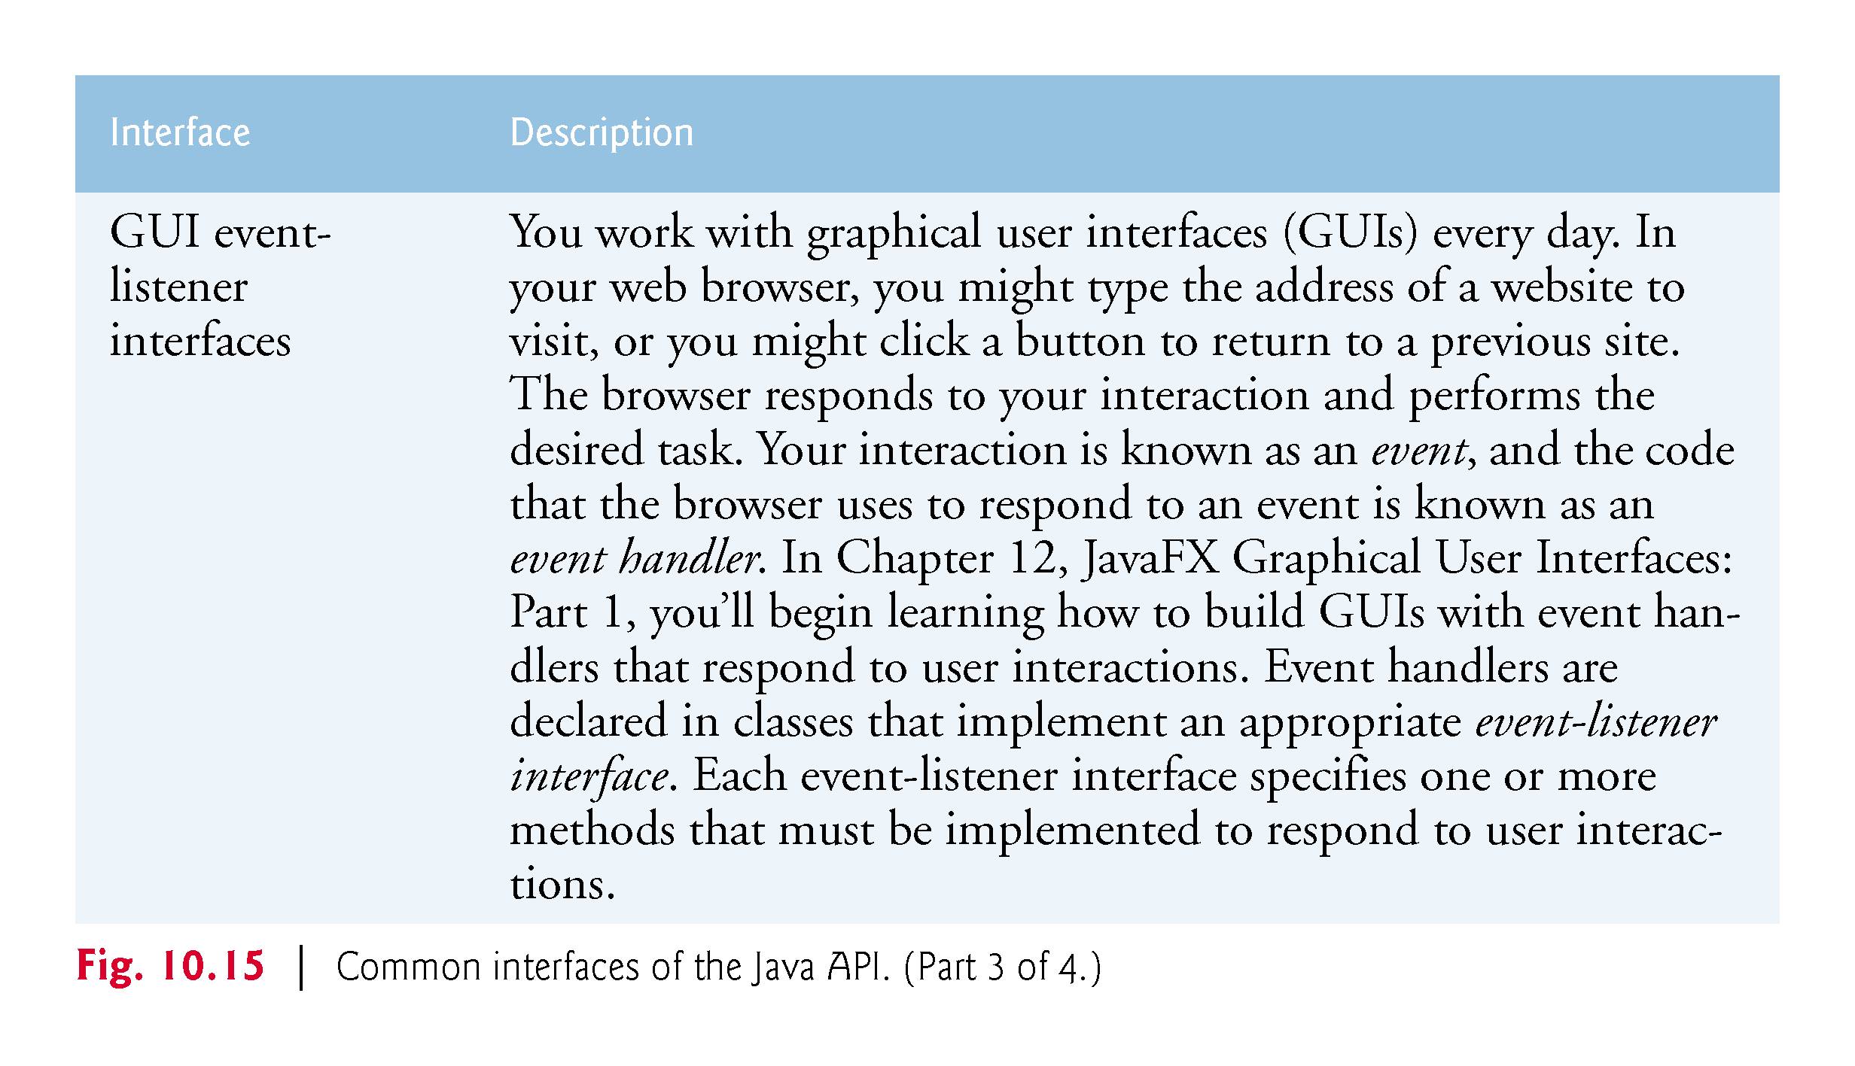

Slide 82


Slide 83
10.10 Java SE 8 Interface Enhancements
This section introduces interface features that were added in Java SE 8
We discuss these in more detail in later chapters.
For purposes of COP3252 we only need to know about functional interfaces, section 10.10.3; sections 10.10.1 and 10.10.2 can be skipped.

Slide 84
10.10.1 default Interface Methods
Prior to Java SE 8, interface methods could be only public abstract methods.
An interface specified what operations an implementing class must perform but not how the class should perform them.
In Java SE 8, interfaces also may contain public default methods with concrete default implementations that specify how operations are performed when an implementing class does not override the methods.
If a class implements such an interface, the class also receives the interface’s default implementations (if any).
To declare a default method, place the keyword default before the method’s return type and provide a concrete method implementation.

Slide 85
10.10.1 default Interface Methods (Cont.)
Adding Methods to Existing Interfaces
Any class that implements the original interface will not break when a default method is added.
The class simply receives the new default method.
When a class implements a Java SE 8 interface, the class “signs a contract” with the compiler that says,
“I will declare all the abstract methods specified by the interface or I will declare my class abstract”
The implementing class is not required to override the interface’s default methods, but it can if necessary.

Slide 86
10.10.1 default Interface Methods (Cont.)
Interfaces vs. abstract Classes
Prior to Java SE 8, an interface was typically used (rather than an abstract class) when there were no implementation details to inherit—no fields and no method implementations.
With default methods, you can instead declare common method implementations in interfaces
This gives you more flexibility in designing your classes, because a class can implement many interfaces, but can extend only one superclass

Slide 87
10.10.2 static Interface Methods (Cont.)
Prior to Java SE 8, it was common to associate with an interface a class containing static helper methods for working with objects that implemented the interface.
In Chapter 16, you’ll learn about class Collections which contains many static helper methods for working with objects that implement interfaces Collection, List, Set and more.
Collections method sort can sort objects of any class that implements interface List.
With static interface methods, such helper methods can now be declared directly in interfaces rather than in separate classes.

Slide 88
10.10.3 Functional Interfaces
As of Java SE 8, any interface containing only one abstract method is known as a functional interface—also called SAM (Single Abstract Method) interfaces
Functional interfaces that you’ll use in this book include:
ActionListener (Chapter 12)—You’ll implement this interface to define a method that’s called when the user clicks a button.
Comparator (Chapter 16)—You’ll implement this interface to define a method that can compare two objects of a given type to determine whether the first object is less than, equal to or greater than the second.
Runnable (Chapter 23)—You’ll implement this interface to define a task that may be run in parallel with other parts of your program.

Slide 89
10.12 private Constructors
Sometimes it’s useful to declare one or more of a class’s constructors as private.
Preventing Object Instantiation
You can prevent client code from creating objects of a class by making the class’s constructors private
Consider class Math, which contains only public static constants and public static methods
There’s no need to create a Math object to use the class’s constants and methods, so its constructor is private

Slide 90
10.12 private Constructors (cont.)
Sharing Initialization Code in Constructors
One common use of a private constructor is sharing initialization code among a class’s other constructors
You can use delegating constructors (introduced in Fig. 8.5) to call the private constructor that contains the shared initialization code

Slide 91
10.12 private Constructors (cont.)
Factory Methods
Another common use of private constructors is to force client code to use so-called “factory methods” to create objects
A factory method is a public static method that creates and initializes an object of a specified type (possibly of the same class), then returns a reference to it
A key benefit of this architecture is that the method’s return type can be an interface or a superclass (either abstract or concrete)

Slide 92
10.13 Program to an Interface, Not an Implementation
Recall that Java does not allow a class to inherit from more than one superclass
With interface inheritance, a class implements an interface describing various abstract methods that the new class must provide
The new class also may inherit some method implementations (allowed in interfaces as of Java SE 8), but no instance variables
Recall that Java allows a class to implement multiple interfaces in addition to extending one class
An interface also may extend one or more other interfaces.

Slide 93
10.13.1 Implementation Inheritance Is Best for Small Numbers of Tightly Coupled Classes
Implementation inheritance is primarily used to declare closely related classes
many of the same instance variables and method implementations
Every subclass object has the is-a relationship with the superclass
anywhere a superclass object is expected, a subclass object may be provided
Classes declared with implementation inheritance are tightly coupled
you define the common instance variables and methods once in a superclass, then inherit them into subclasses
Changes to a superclass directly affect all corresponding subclasses
When you use a superclass variable, only a superclass object or one of its subclass objects may be assigned to the variable.

Slide 94
10.13.1 Implementation Inheritance Is Best for Small Numbers of Tightly Coupled Classes (cont.)
A key disadvantage of implementation inheritance is that the tight coupling among the classes can make it difficult to modify the hierarchy
As we mentioned in Chapter 9, small inheritance hierarchies under the control of one person tend to be more manageable than large ones maintained by many people
This is true even with the tight coupling associated with implementation inheritance

Slide 95
10.13.2 Interface Inheritance Is Best for Flexibility
Interface inheritance often requires more work than implementation inheritance, because you must provide implementations of the interface’s abstract methods
even if those implementations are similar or identical among classes
Gives you additional flexibility by eliminating the tight coupling between classes
When you use a variable of an interface type, you can assign it an object of any type that implements the interface directly or indirectly
Allows you to add new types to your code easily and to replace existing objects with objects of new and improved implementation classes.
Device drivers are a good example of how interfaces enable systems to be modified easily

