Slide 1
Course S&DAI Nutri-MAS Hybrid multi-agent system for personalized nutritional assistance
Acossi Giorgio Roberto - S5339095

Slide 2
Creative project Proposed difficulty medium-hard

Slide 3
Project specification
Nutri-MAS is a conversational assistant that combines reactive agents, BDI agents, and LLM-based agents.
The system collects the user's profile, calculates indicative caloric targets, builds weekly plan, generates recipes, records the meals actually consumed, and rebalances the subsequent slots when the plan is modified.

Slide 4
Motivation
Nutritional assistance is a dynamic constraint-management problem, is not only recipe generation
User constraints
Calories
Diet
Allergens
preferences
Runtime Adaptation
Off-plan meals
Recalculation
Rebalancing
Planning constraints
Meal slots
Variety
Food frequencies
Reliable planning, flexible interaction, continuous adaptation

Slide 5



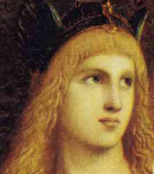

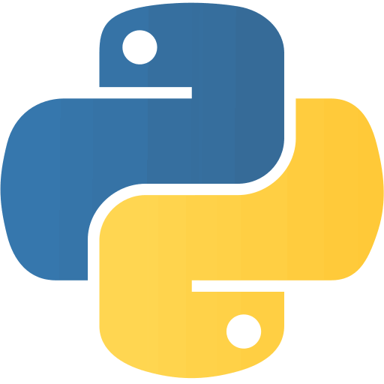

Technology stack
Streamlit
SPADE
Qdrant
Agent Speak
Python
XMPP
Lite LLM

Slide 6
Why a hybrid multi-agent system?
Each task is assigned to the decision-making model that best fits it
Reactive Agent
Reactive coordination
Gateway
BDI agents
Explicit reasoning and control
Nutritionist · Planner · Chef
LLM agents
Flexible interpretation and generation
NLP Agent · Creative Cook
Explicit rules provide control and LLMs provide flexibility

Slide 7
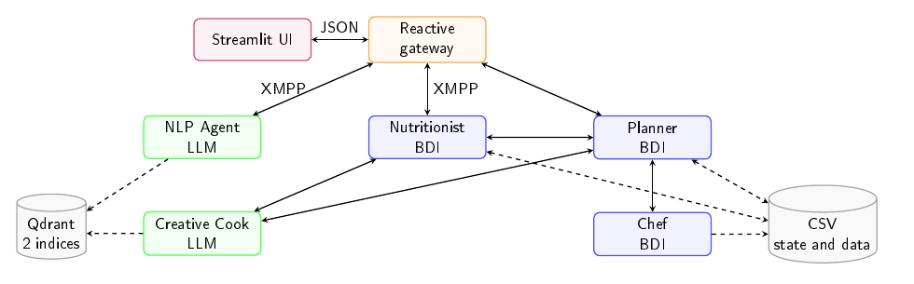
Nutri-MAS System Architecture
How reactive, BDI and LLM agents collaborate within Nutri-MAS
Agent | Responsibility
Gateway | Communication, validation and routing
NLP Agent | Natural language → AgentSpeak
Nutritionist | User state and daily monitoring
Planner | Weekly planning and local replanning
Chef | Valid template selection
Creative Cook | Recipe generation and meal estimation

Slide 8
Gateway
Reactive coordination between the user interface and the multi-agent system
Receive
Receives user messages from the Streamlit UI
Preserves the context of questions and answers
Sends natural-language requests to the NLP Agent
Validate & Route
Validates translated AgentSpeak commands
Routes each command to the correct domain agent
Reply
Receives structured responses from the agents
Publishes results and system notifications to the UI

Slide 9
NLP Agent
Controlled translation from natural language to AgentSpeak commands
Interpret
Receives natural-language requests from the Gateway
Uses the previous question as context when interpreting short or ambiguous answers
Retrieve & select
Searches Qdrant for semantically related linguistic templates
Retrieves candidate message definitions from the registry
Selects the message that best matches the user’s intent
Build & validate
Fills the arguments defined by the selected schema
Validates syntax, arity, variables and destination agent
Submits the resulting AgentSpeak command

Slide 10
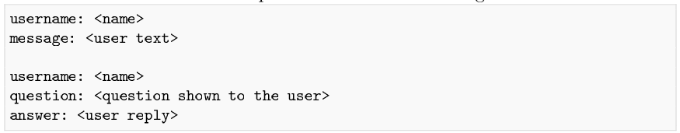
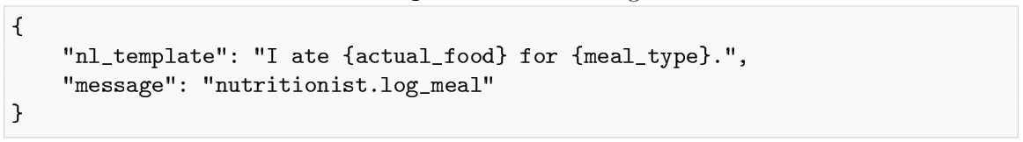
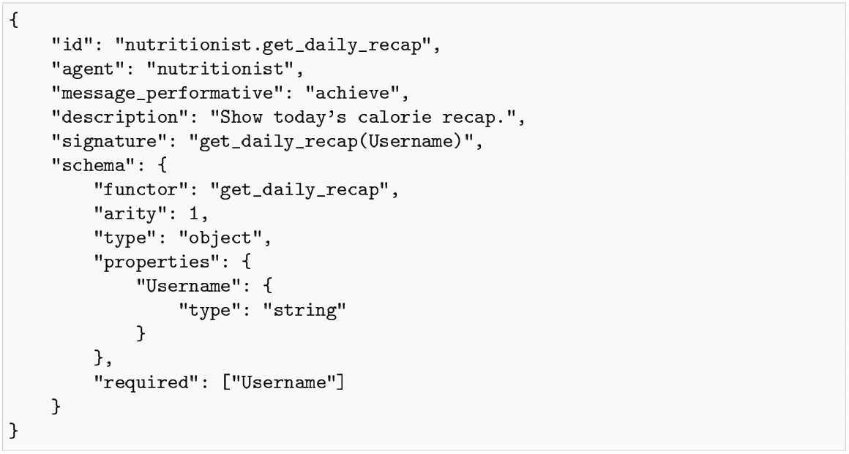
NLP Agent
Natural language translation pipeline
Input Context
Found template
Performative schema

Slide 11
Nutrizionist
User state, nutritional targets and daily adaptation
Manage the user state
Collects and updates the user profile
Calculates nutritional goals, calories and macronutrient targets
Maintains weight and meal histories
Monitor the daily plan
Detects when a meal-slot time is crossed
Requests confirmation of the planned meal
Records confirmed meals or off-plan consumption
Adapt the plan
Regenerates the weekly plan after relevant profile changes
Triggers local rebalancing after an off-plan meal
Coordinates Planner and Creative Cook when updates are required

Slide 12
Planner
Global weekly planning, recipe orchestration and local replanning
Build the weekly structure
Converts nutritional targets into the meal slots
Requests valid template domains from the Chef
Choose templates while enforcing daily variety, weekly category frequencies and nutritional constraints
Materialize and activate the plan
Sends selected templates to the Creative Cook
Collects the generated recipes in a temporary draft
Replan individual meals
Receives updated targets from the Nutritionist
Rebuilds only future meals affected by a deviation
Coordinates Chef and Creative Cook for the replacement

Slide 13
Chef
Deterministic filtering of valid meal templates
Maintain the template knowledge base
Stores available meal templates as BDI beliefs
Associates each template with diet type, meal slot, food category, calories and macronutrients
Filter valid candidates
Applies explicit rules for diet, slot and nutritional targets
Excludes templates already used or explicitly forbidden
Supports guided requests for a specific food category
Introduces variability only among valid candidates
Return planning candidates
Provides the complete valid domain during weekly planning
Selects one strict candidate during local replanning
Returns an explicit failure when no valid template exists

Slide 14
Creative Cook
LLM-based recipe generation and off-plan meal estimation
Recipe generation
Receives a validated meal template and nutritional targets
Retrieves diet, allergens and culinary preferences
Searches Qdrant for suitable ingredients
Defines ingredients, quantities and preparation steps
Estimates calories and macronutrients
Returns a structured recipe to the Planner
Off-plan meal evaluation
Interprets a freely described meal
Searches for the complete dish or decomposes it into ingredients
Estimates portions, calories and macronutrients
Maps the meal to the closest available template
Returns the nutritional estimate to the Nutritionist

Slide 15
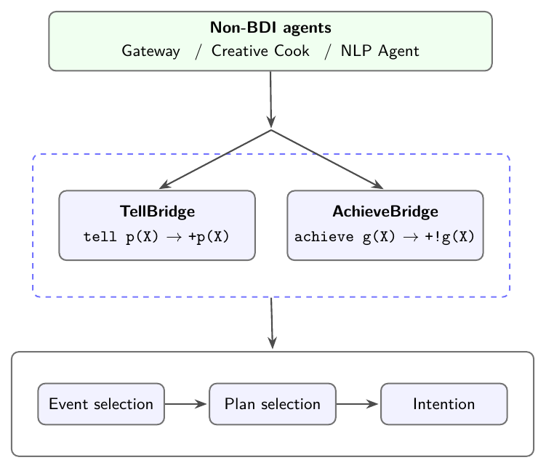
How do the agents communicate?
All agents exchange messages through XMPP while message bodies use AgentSpeak-compatible syntax.
Adapting messages to the BDI model:
TellBridge: converts a tell message into a belief update
AchieveBridge: converts an achieve message into an achievement goal
The resulting belief or goal becomes an event processed by the BDI reasoning cycle
BDI agents communicate with non-BDI components through custom Python actions, which send standard XMPP messages.

Slide 16
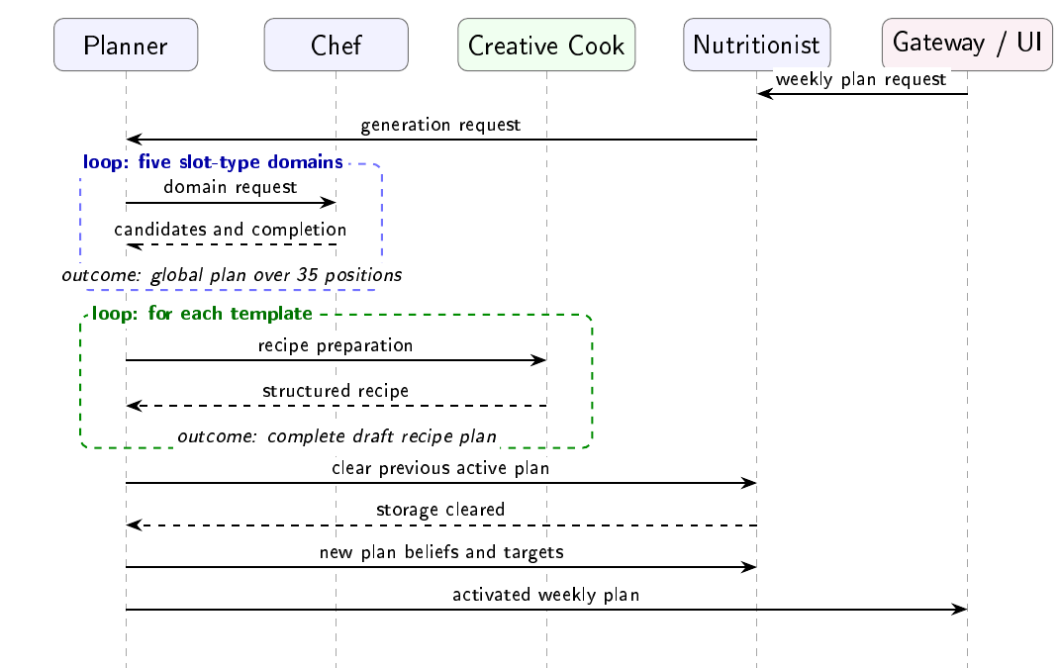
Weekly plan generation

Slide 17
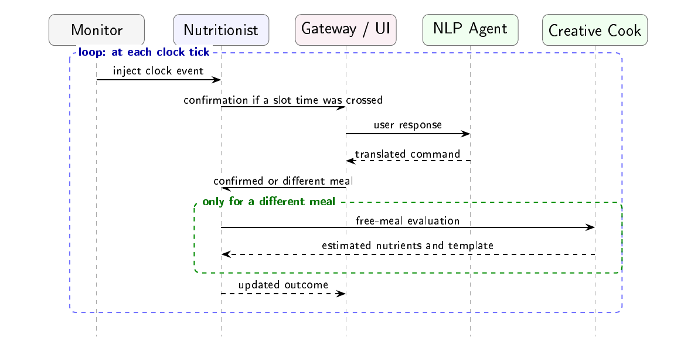
Meal Monitoring

Slide 18
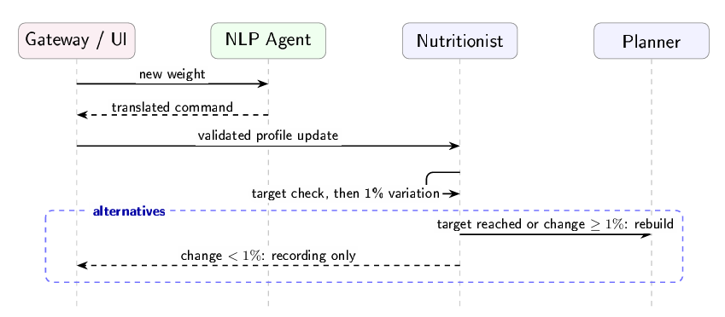
Weight Update

Slide 19
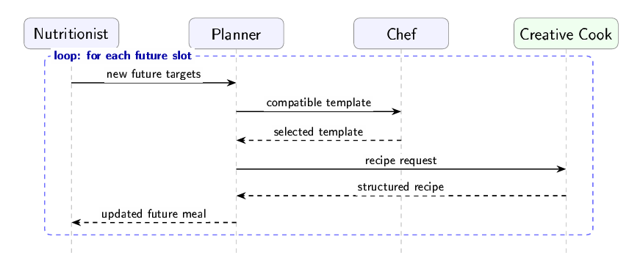
Daily Plan Rebalancing

Slide 20
Data management
CSV
Qdrant
Persistent state
user, weight logs, meal logs
Materialized plans
weekly recipes and selected templates
Static knowledge
templates, nutrition rules, ingredients
Ingredients
semantic search over food names and nutrients
Translations
user question mapped to performative

Slide 21
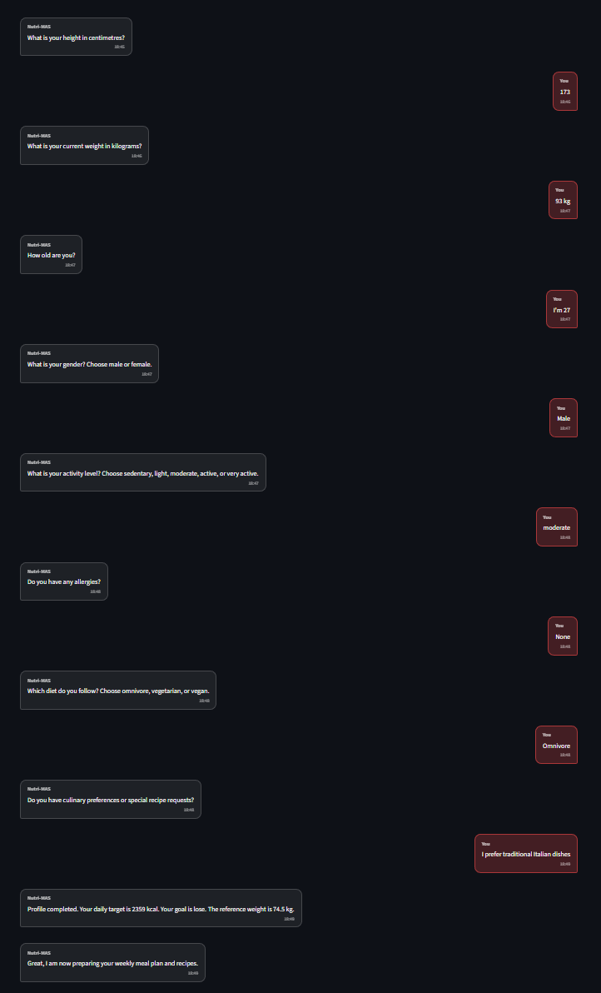
Demo
Onboarding

Slide 22
Demo
Onboarding

Slide 23
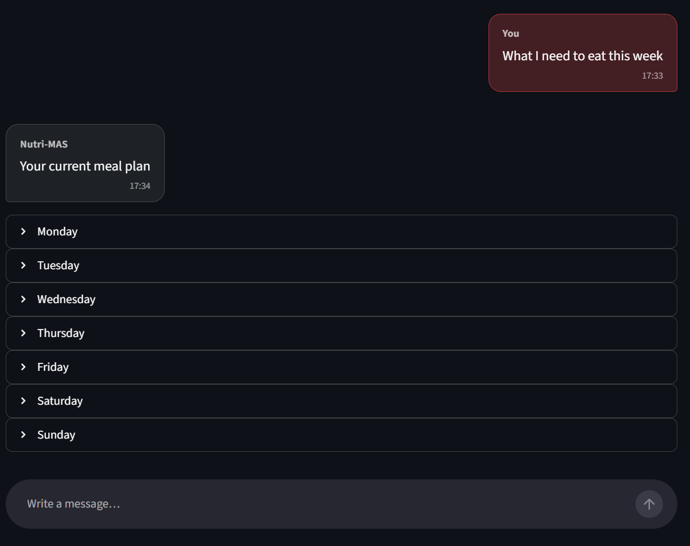
Demo
Week plan

Slide 24
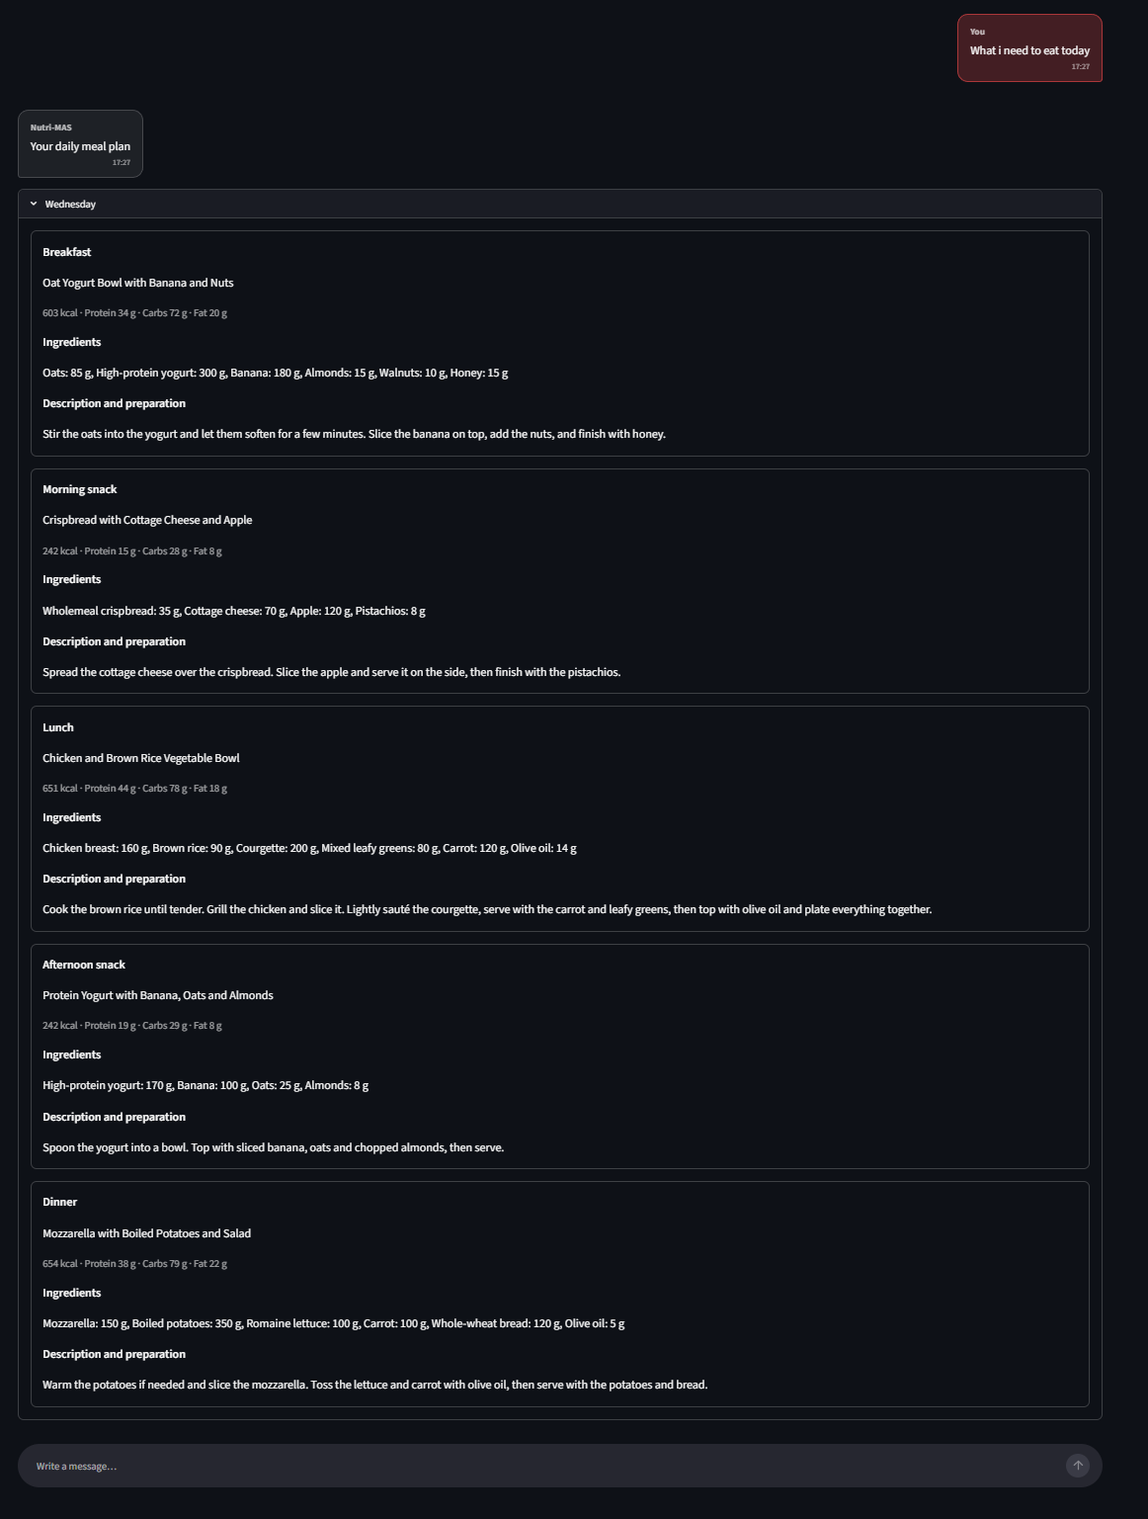
Demo
Daily plan

Slide 25
Demo
Week plan

Slide 26
Demo
Daily plan

Slide 27
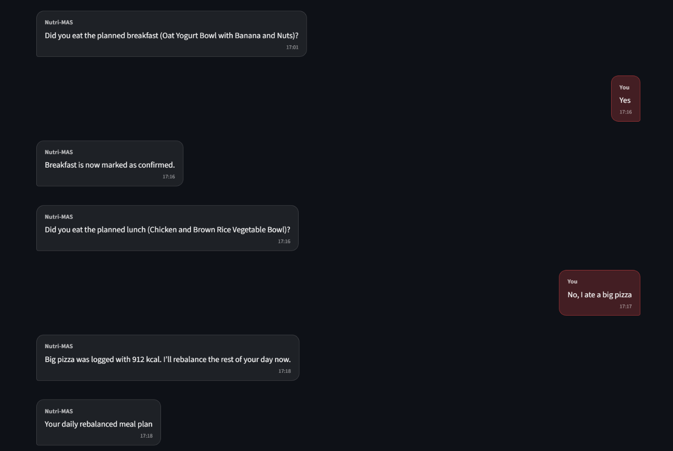
Demo
Active Monitoring

Slide 28
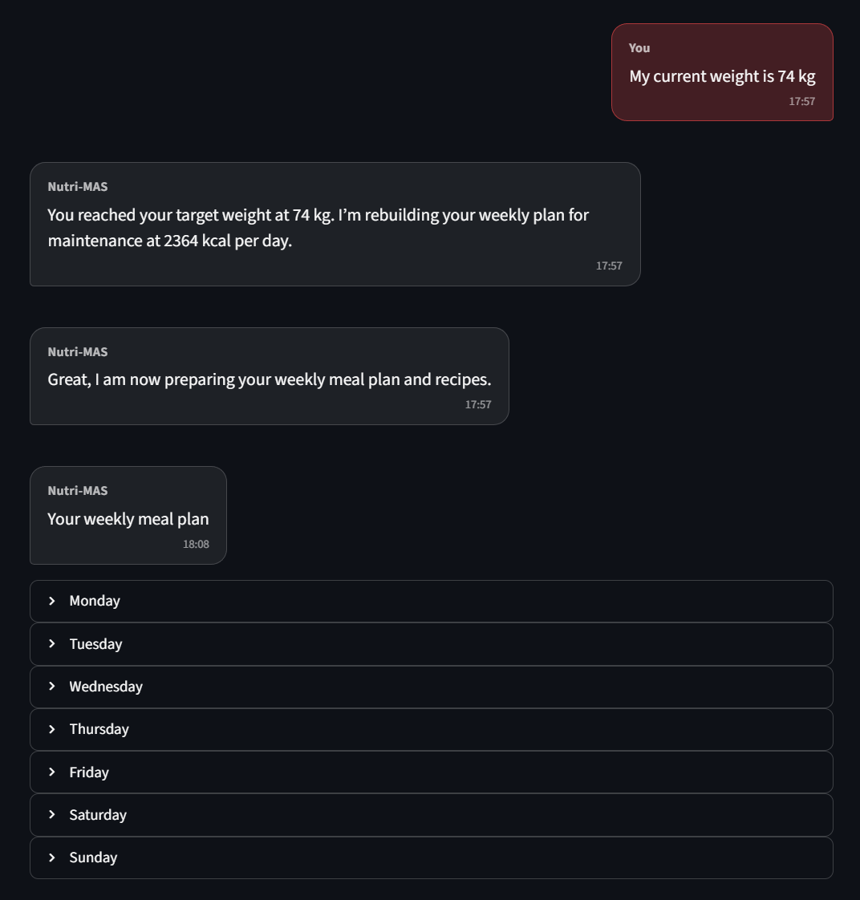
Demo
Target Reached

Slide 29
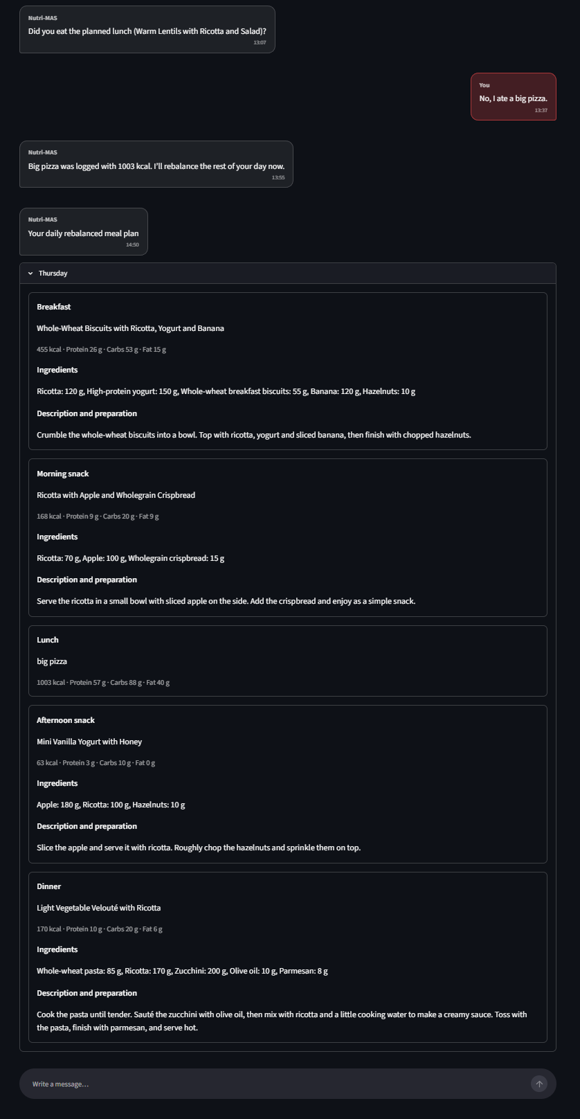
Demo
Rebalancing

Slide 30
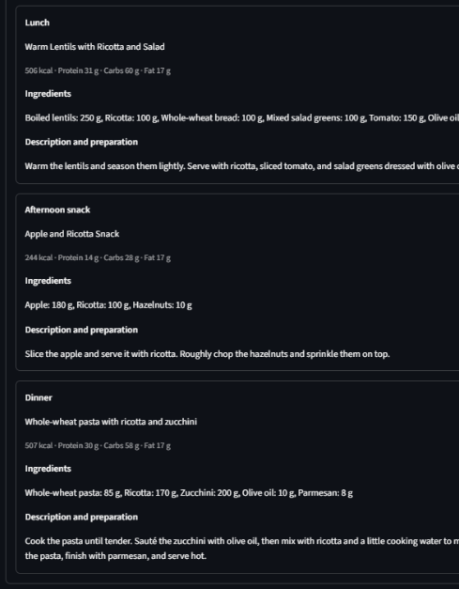
Demo
Rebalancing
Before
Rebalanced

Slide 31
Limitations
LANGUAGE & KNOWLEDGE
Finite linguistic templates
Sometime the NLP Agent choose the wrong performative
Manually encoded meal templates
NUTRITIONAL SAFETY
Heuristic calorie and macronutrient targets
Limited robustness of allergen and dietary constraint enforcement
PLAN OPTIMIZATION
Rebalancing modifies only future meals of the current day
Weekly constraints are not globally re-optimized

Slide 32
References
Mifflin et al. (1990) Equation used to estimate the user’s resting energy expenditure and daily caloric requirement.
Food Standards Australia New Zealand (2025) Australian Food Composition Database used as the source of ingredient calories and macronutrients.
Centers for Disease Control and Prevention Adult BMI categories used to determine the user’s initial nutritional goal.

