Slide 1
MULTIPLE RESPONSE
REGRESSION MODELS
Cesar Acosta
Qile Wang
Department of Industrial and Systems Engineering
University of Southern California

Slide 2
INTRODUCTION
Linear regression with one response (LR)
Linear regression with two or more responses (MRLR)

Slide 3
INTRODUCTION
Linear regression with one response (LR)
m1 <- lm(y1 ~ x1+x2+x3, data = d1)
Linear regression with two or more responses (MRLR)
m12 <- lm(c(y1,y2) ~ x1+x2+x3, data = d1)

Slide 4
INTRODUCTION
Differences LR vs MRLR
When should be used?
How to build a MRLR?
Selecting predictors
Making predictions

Slide 5
INTRODUCTION
Examples
4 responses, 2 predictors
2 responses, 5 predictors

Slide 6
INTRODUCTION
MRLR is a linear regression model with two
or more responses
Responses are correlated
share same predictors

Slide 7
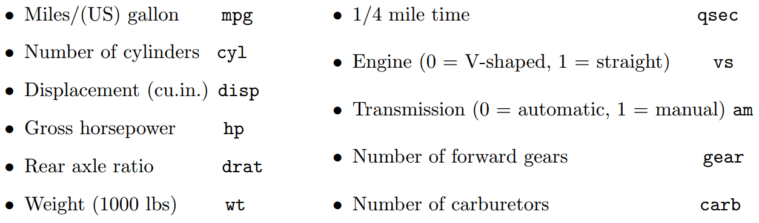
EXAMPLE 1 - mtcars
Dataframe of 11 car attributes

Slide 8
EXAMPLE 1 - mtcars
mpg | disp | hp | wt | cyl | am | carb | qsec | vs | gear | drat
21 | 160 | 110 | 2.62 | 6 | 1 | 4 | 16.46 | 0 | 4 | 3.9
21 | 160 | 110 | 2.875 | 6 | 1 | 4 | 17.02 | 0 | 4 | 3.9
22.8 | 108 | 93 | 2.32 | 4 | 1 | 1 | 18.61 | 1 | 4 | 3.85
21.4 | 258 | 110 | 3.215 | 6 | 0 | 1 | 19.44 | 1 | 3 | 3.08
18.7 | 360 | 175 | 3.44 | 8 | 0 | 2 | 17.02 | 0 | 3 | 3.15
18.1 | 225 | 105 | 3.46 | 6 | 0 | 1 | 20.22 | 1 | 3 | 2.76
14.3 | 360 | 245 | 3.57 | 8 | 0 | 4 | 15.84 | 0 | 3 | 3.21
24.4 | 146.7 | 62 | 3.19 | 4 | 0 | 2 | 20 | 1 | 4 | 3.69
22.8 | 140.8 | 95 | 3.15 | 4 | 0 | 2 | 22.9 | 1 | 4 | 3.92
19.2 | 167.6 | 123 | 3.44 | 6 | 0 | 4 | 18.3 | 1 | 4 | 3.92
17.8 | 167.6 | 123 | 3.44 | 6 | 0 | 4 | 18.9 | 1 | 4 | 3.92

Slide 9
EXAMPLE 1 - mtcars
mpg | disp | hp | wt | cyl | am | carb
21 | 160 | 110 | 2.62 | 6 | 1 | 4
21 | 160 | 110 | 2.875 | 6 | 1 | 4
22.8 | 108 | 93 | 2.32 | 4 | 1 | 1
21.4 | 258 | 110 | 3.215 | 6 | 0 | 1
18.7 | 360 | 175 | 3.44 | 8 | 0 | 2
18.1 | 225 | 105 | 3.46 | 6 | 0 | 1
14.3 | 360 | 245 | 3.57 | 8 | 0 | 4
24.4 | 146.7 | 62 | 3.19 | 4 | 0 | 2
22.8 | 140.8 | 95 | 3.15 | 4 | 0 | 2
19.2 | 167.6 | 123 | 3.44 | 6 | 0 | 4
17.8 | 167.6 | 123 | 3.44 | 6 | 0 | 4

Slide 10
EXAMPLE 1 - mtcars
mpg | disp | hp | wt | cyl | am | carb
21 | 160 | 110 | 2.62 | 6 | 1 | 4
21 | 160 | 110 | 2.875 | 6 | 1 | 4
22.8 | 108 | 93 | 2.32 | 4 | 1 | 1
21.4 | 258 | 110 | 3.215 | 6 | 0 | 1
18.7 | 360 | 175 | 3.44 | 8 | 0 | 2
18.1 | 225 | 105 | 3.46 | 6 | 0 | 1
14.3 | 360 | 245 | 3.57 | 8 | 0 | 4
24.4 | 146.7 | 62 | 3.19 | 4 | 0 | 2
22.8 | 140.8 | 95 | 3.15 | 4 | 0 | 2
19.2 | 167.6 | 123 | 3.44 | 6 | 0 | 4
17.8 | 167.6 | 123 | 3.44 | 6 | 0 | 4
cyl as a factor
(categorical variable)

Slide 11
lm(mpg ~ cyl + am + carb, mtcars)
mpg | disp | hp | wt | cyl | am | carb
21 | 160 | 110 | 2.62 | 6 | 1 | 4
21 | 160 | 110 | 2.875 | 6 | 1 | 4
22.8 | 108 | 93 | 2.32 | 4 | 1 | 1
21.4 | 258 | 110 | 3.215 | 6 | 0 | 1
18.7 | 360 | 175 | 3.44 | 8 | 0 | 2
18.1 | 225 | 105 | 3.46 | 6 | 0 | 1
14.3 | 360 | 245 | 3.57 | 8 | 0 | 4
24.4 | 146.7 | 62 | 3.19 | 4 | 0 | 2
22.8 | 140.8 | 95 | 3.15 | 4 | 0 | 2
19.2 | 167.6 | 123 | 3.44 | 6 | 0 | 4
17.8 | 167.6 | 123 | 3.44 | 6 | 0 | 4

Slide 12
lm(disp ~ cyl + am + carb, mtcars)
mpg | disp | hp | wt | cyl | am | carb
21 | 160 | 110 | 2.62 | 6 | 1 | 4
21 | 160 | 110 | 2.875 | 6 | 1 | 4
22.8 | 108 | 93 | 2.32 | 4 | 1 | 1
21.4 | 258 | 110 | 3.215 | 6 | 0 | 1
18.7 | 360 | 175 | 3.44 | 8 | 0 | 2
18.1 | 225 | 105 | 3.46 | 6 | 0 | 1
14.3 | 360 | 245 | 3.57 | 8 | 0 | 4
24.4 | 146.7 | 62 | 3.19 | 4 | 0 | 2
22.8 | 140.8 | 95 | 3.15 | 4 | 0 | 2
19.2 | 167.6 | 123 | 3.44 | 6 | 0 | 4
17.8 | 167.6 | 123 | 3.44 | 6 | 0 | 4

Slide 13
lm(hp ~ cyl + am + carb, mtcars)
mpg | disp | hp | wt | cyl | am | carb
21 | 160 | 110 | 2.62 | 6 | 1 | 4
21 | 160 | 110 | 2.875 | 6 | 1 | 4
22.8 | 108 | 93 | 2.32 | 4 | 1 | 1
21.4 | 258 | 110 | 3.215 | 6 | 0 | 1
18.7 | 360 | 175 | 3.44 | 8 | 0 | 2
18.1 | 225 | 105 | 3.46 | 6 | 0 | 1
14.3 | 360 | 245 | 3.57 | 8 | 0 | 4
24.4 | 146.7 | 62 | 3.19 | 4 | 0 | 2
22.8 | 140.8 | 95 | 3.15 | 4 | 0 | 2
19.2 | 167.6 | 123 | 3.44 | 6 | 0 | 4
17.8 | 167.6 | 123 | 3.44 | 6 | 0 | 4

Slide 14
EXAMPLE 1 – mtcars model with 4 responses and 3 predictors
mpg | disp | hp | wt | cyl | am | carb
21 | 160 | 110 | 2.62 | 6 | 1 | 4
21 | 160 | 110 | 2.875 | 6 | 1 | 4
22.8 | 108 | 93 | 2.32 | 4 | 1 | 1
21.4 | 258 | 110 | 3.215 | 6 | 0 | 1
18.7 | 360 | 175 | 3.44 | 8 | 0 | 2
18.1 | 225 | 105 | 3.46 | 6 | 0 | 1
14.3 | 360 | 245 | 3.57 | 8 | 0 | 4
24.4 | 146.7 | 62 | 3.19 | 4 | 0 | 2
22.8 | 140.8 | 95 | 3.15 | 4 | 0 | 2
19.2 | 167.6 | 123 | 3.44 | 6 | 0 | 4
17.8 | 167.6 | 123 | 3.44 | 6 | 0 | 4

Slide 15
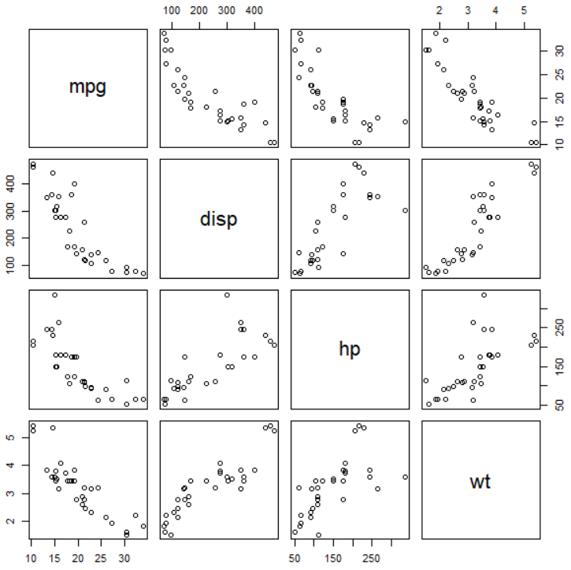
EXAMPLE 1 – mtcars responses are correlated
d1 = mtcars[,c("mpg","disp","hp","wt")]
pairs(d1)

Slide 16
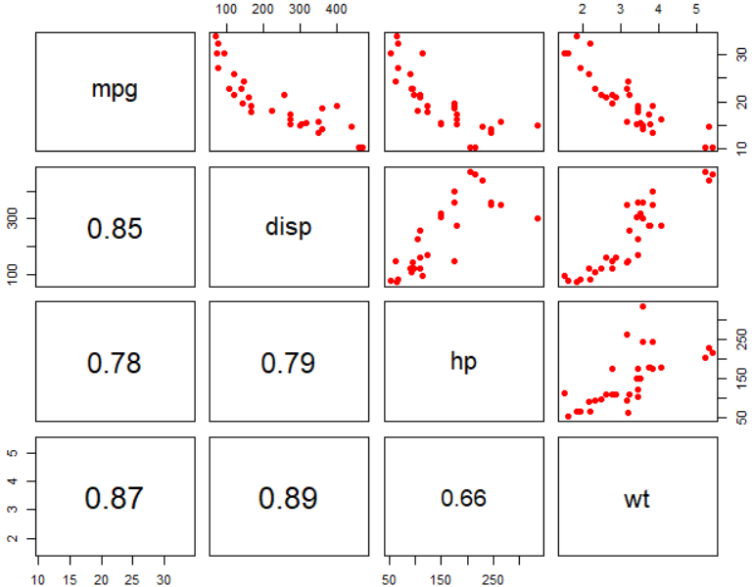
EXAMPLE 1 – mtcars responses are correlated
pairs(d1,lower.panel = panel.cor,
pch=19,col="red")

Slide 17
MRLR vs MLR
If the responses are correlated,
MRLR model will result in more accurate predictions

Slide 18
EXAMPLE 1 – mtcars building the model
y <- mtcars[,c("mpg","disp","hp","wt")]
y <- as.matrix(y)
mv1 <- lm(y ~ cyl + am + carb, mtcars)
mpg | disp | hp | wt
21 | 160 | 110 | 2.62
21 | 160 | 110 | 2.875
22.8 | 108 | 93 | 2.32
21.4 | 258 | 110 | 3.215
18.7 | 360 | 175 | 3.44
18.1 | 225 | 105 | 3.46
14.3 | 360 | 245 | 3.57
24.4 | 146.7 | 62 | 3.19
22.8 | 140.8 | 95 | 3.15
19.2 | 167.6 | 123 | 3.44
17.8 | 167.6 | 123 | 3.44

Slide 19
EXAMPLE 1 – mtcars building the model
y <- mtcars[,c("mpg","disp","hp","wt")]
y <- as.matrix(y)
mv1 <- lm(y ~ cyl + am + carb, mtcars)
summary(mv1)
mpg | disp | hp | wt
21 | 160 | 110 | 2.62
21 | 160 | 110 | 2.875
22.8 | 108 | 93 | 2.32
21.4 | 258 | 110 | 3.215
18.7 | 360 | 175 | 3.44
18.1 | 225 | 105 | 3.46
14.3 | 360 | 245 | 3.57
24.4 | 146.7 | 62 | 3.19
22.8 | 140.8 | 95 | 3.15
19.2 | 167.6 | 123 | 3.44
17.8 | 167.6 | 123 | 3.44

Slide 20
EXAMPLE 1 - mtcars
Response mpg
Coefficients:
Estimate Std. Error t value Pr(>|t|)
(Intercept) 25.3203 1.2238 20.690 < 2e-16 ***
cyl6 -3.5494 1.7296 -2.052 0.049959 *
cyl8 -6.9046 1.8078 -3.819 0.000712 ***
am 4.2268 1.3499 3.131 0.004156 **
carb -1.1199 0.4354 -2.572 0.015923 *
Residual standard error: 2.805 on 27 degrees of freedom
Multiple R-squared: 0.8113, Adjusted R-squared: 0.7834
F-statistic: 29.03 on 4 and 27 DF, p-value: 1.991e-09

Slide 21
EXAMPLE 1 - mtcars
Response disp
Coefficients:
Estimate Std. Error t value Pr(>|t|)
(Intercept) 134.325 21.836 6.152 1.42e-06 ***
cyl6 61.843 30.860 2.004 0.0552 .
cyl8 218.991 32.256 6.789 2.72e-07 ***
am -43.803 24.086 -1.819 0.0801 .
carb 1.726 7.768 0.222 0.8258
Residual standard error: 50.05 on 27 degrees of freedom
Multiple R-squared: 0.858, Adjusted R-squared: 0.8369
F-statistic: 40.78 on 4 and 27 DF, p-value: 4.537e-11

Slide 22
EXAMPLE 1 - mtcars
Response hp
Coefficients:
Estimate Std. Error t value Pr(>|t|)
(Intercept) 46.5201 10.4825 4.438 0.000138 ***
cyl6 0.9116 14.8146 0.062 0.951386
cyl8 87.5911 15.4851 5.656 5.25e-06 ***
am 4.4473 11.5629 0.385 0.703536
carb 21.2765 3.7291 5.706 4.61e-06 ***
Residual standard error: 24.03 on 27 degrees of freedom
Multiple R-squared: 0.893, Adjusted R-squared: 0.8772
F-statistic: 56.36 on 4 and 27 DF, p-value: 1.023e-12

Slide 23
EXAMPLE 1 - mtcars
coef(mv1)
mpg disp hp wt
(Intercept) 25.320303 134.32487 46.5201421 2.7612069
cyl6 -3.549419 61.84324 0.9116288 0.1957229
cyl8 -6.904637 218.99063 87.5910956 0.7723077
am 4.226774 -43.80256 4.4472569 -1.0254749
carb -1.119855 1.72629 21.2764930 0.1749132
m1 <- lm(mpg ~ cyl + am + carb, data = mtcars)
coef(m1)
(Intercept) cyl6 cyl8 am carb
25.320303 -3.549419 -6.904637 4.226774 -1.119855

Slide 24
EXAMPLE 1 - mtcars
coef(mv1)
mpg disp hp wt
(Intercept) 25.320303 134.32487 46.5201421 2.7612069
cyl6 -3.549419 61.84324 0.9116288 0.1957229
cyl8 -6.904637 218.99063 87.5910956 0.7723077
am 4.226774 -43.80256 4.4472569 -1.0254749
carb -1.119855 1.72629 21.2764930 0.1749132
m1 <- lm(mpg ~ cyl + am + carb, data = mtcars)
coef(m1)
(Intercept) cyl6 cyl8 am carb
25.320303 -3.549419 -6.904637 4.226774 -1.119855

Slide 25
EXAMPLE 1 - mtcars
coef(mv1)
mpg disp hp wt
(Intercept) 25.320303 134.32487 46.5201421 2.7612069
cyl6 -3.549419 61.84324 0.9116288 0.1957229
cyl8 -6.904637 218.99063 87.5910956 0.7723077
am 4.226774 -43.80256 4.4472569 -1.0254749
carb -1.119855 1.72629 21.2764930 0.1749132
m2 <- lm(disp ~ cyl + am + carb, data = mtcars)
coef(m2)
(Intercept) cyl6 cyl8 am carb
134.32487 61.84324 218.99063 -43.80256 1.72629

Slide 26
EXAMPLE 1 – prediction
Predict attributes (mpg, disp, hp, wt) of a car with
6 cylinders
4 carburetors
automatic transmission

Slide 27
EXAMPLE 1 – prediction
Predict attributes (mpg, disp, hp, wt) of a car with
6 cylinders
4 carburetors
automatic transmission
newdata <- data.frame(cyl=factor(6,levels=c(4,6,8)),am=1,carb=4)

Slide 28
EXAMPLE 1 – confidence and prediction intervals
# confidence interval
predict(mv1, newdata, interval="confidence")
# mpg disp hp wt
# 1 21.51824 159.2707 136.985 2.631108

Slide 29
EXAMPLE 1 – confidence and prediction intervals
# confidence interval
predict(mv1, newdata, interval="confidence")
# mpg disp hp wt
# 1 21.51824 159.2707 136.985 2.631108
# prediction interval
predict(mv1, newdata, interval="prediction")
# mpg disp hp wt
# 1 21.51824 159.2707 136.985 2.631108

Slide 30
EXAMPLE 1 – confidence and prediction intervals
# confidence interval
predict(mv1, newdata, interval="confidence")
# mpg disp hp wt
# 1 21.51824 159.2707 136.985 2.631108
# prediction interval
predict(mv1, newdata, interval="prediction")
# mpg disp hp wt
# 1 21.51824 159.2707 136.985 2.631108
No intervals

Slide 31
EXAMPLE 1 – confidence and prediction intervals
predictmlm <- function(object,newdata,level=0.95,
interval = c("confidence","prediction"))
{
form <- as.formula(paste("~",as.character(formula(object))[3]))
xnew <- model.matrix(form, newdata)
fit <- predict(object, newdata)
Y <- model.frame(object)[,1]
X <- model.matrix(object)
n <- nrow(Y)
m <- ncol(Y)
p <- ncol(X) – 1

Slide 32
EXAMPLE 1 – confidence and prediction intervals
# alpha correction
alpha = 1 - level
level = 1 - m*alpha
sigmas <- colSums((Y - object$fitted.values)^2) / (n - p - 1)
fit.var <- diag(xnew %*% tcrossprod(solve(crossprod(X)), xnew))
if(interval[1]=="prediction") fit.var <- fit.var + 1
const <- qf(level, df1=m, df2=n-p-m) * m * (n - p - 1) / (n - p - m)
vmat <- (n/(n-p-1)) * outer(fit.var, sigmas)
lwr <- fit - sqrt(const) * sqrt(vmat)
upr <- fit + sqrt(const) * sqrt(vmat)

Slide 33
EXAMPLE 1 – confidence and prediction intervals
if(nrow(xnew)==1) {
ci <- rbind(fit, lwr, upr)
rownames(ci) <- c("fit", "lwr", "upr") }
else {
ci <- array(0, dim=c(nrow(xnew), m, 3))
dimnames(ci) <- list(1:nrow(xnew), colnames(Y), c("fit", "lwr", "upr") )
ci[,,1] <- fit
ci[,,2] <- lwr
ci[,,3] <- upr}
ci
}

Slide 34
EXAMPLE 1 – confidence and prediction intervals
# confidence interval
predictmlm(mv1,newdata, interval="confidence")
# mpg disp hp wt
#fit 21.51824 159.27070 136.9850 2.631108
#lwr 17.79607 92.85711 105.1024 1.957935
#upr 25.24041 225.68430 168.8676 3.304281

Slide 35
EXAMPLE 1 – confidence and prediction intervals
# confidence interval
predictmlm(mv1,newdata, interval="confidence")
# mpg disp hp wt
#fit 21.51824 159.27070 136.9850 2.631108
#lwr 17.79607 92.85711 105.1024 1.957935
#upr 25.24041 225.68430 168.8676 3.304281

Slide 36
EXAMPLE 1 – confidence and prediction intervals
# prediction interval
predictmlm(mv1,newdata, interval="prediction")
# mpg disp hp wt
#fit 21.51824 159.270705 136.98500 2.631108
#lwr 12.45592 -2.425511 59.36086 0.992143
#upr 30.58056 320.966921 214.60914 4.270072

Slide 37
EXAMPLE 1 – prediction
Predict attributes (mpg, disp, hp, wt) of the following cars
mpg | disp | hp | wt | cyl | am | carb
 |  |  |  | 4 | no | 2
 |  |  |  | 6 | yes | 4
 |  |  |  | 8 | yes | 6

Slide 38
EXAMPLE 1 – prediction
Predict attributes (mpg, disp, hp, wt) of the following cars
newdata <- data.frame(cyl=factor(c(4,6,8), levels=c(4,6,8)),
am=c(0,1,1), carb=c(2,4,6))
mpg | disp | hp | wt | cyl | am | carb
 |  |  |  | 4 | no | 2
 |  |  |  | 6 | yes | 4
 |  |  |  | 8 | yes | 6

Slide 39
EXAMPLE 1 – confidence and prediction intervals
predictmlm(mv1, newdata, interval="prediction")
#, , fit
# mpg disp hp wt
#1 23.08059 137.7774 89.07313 3.111033
#2 21.51824 159.2707 136.98500 2.631108
#3 15.92331 319.8707 266.21745 3.557519
mpg | disp | hp | wt | cyl | am | carb
23.08 | 137.77 | 89.07 | 3.11 | 4 | no | 2
21.51 | 159.27 | 136.98 | 2.63 | 6 | yes | 4
15.92 | 319.87 | 266.21 | 3.55 | 8 | yes | 6

Slide 40
EXAMPLE 1 – prediction
predicted
mpg | disp | hp | wt | cyl | am | carb
23.08 | 137.77 | 89.07 | 3.11 | 4 | no | 2
21.51 | 159.27 | 136.98 | 2.63 | 6 | yes | 4
15.92 | 319.87 | 266.21 | 3.55 | 8 | yes | 6

Slide 41
EXAMPLE 1 – confidence and prediction intervals
predictmlm(mv1, newdata, interval="prediction")
, , lwr
mpg disp hp wt
1 13.871941 -26.529667 10.19560 1.445604
2 12.455915 -2.425511 59.36086 0.992143
3 6.728061 155.802679 187.45471 1.894514
, , upr
mpg disp hp wt
1 32.28925 302.0846 167.9507 4.776462
2 30.58056 320.9669 214.6091 4.270072
3 25.11856 483.9387 344.9802 5.220524

Slide 42
EXAMPLE 1 – confidence and prediction intervals
predictmlm(mv1, newdata, interval="prediction")
, , lwr
mpg disp hp wt
1 13.871941 -26.529667 10.19560 1.445604 lower
2 12.455915 -2.425511 59.36086 0.992143 boundaries
3 6.728061 155.802679 187.45471 1.894514
, , upr
mpg disp hp wt
1 32.28925 302.0846 167.9507 4.776462 upper
2 30.58056 320.9669 214.6091 4.270072 boundaries
3 25.11856 483.9387 344.9802 5.220524

Slide 43
EXAMPLE 1 – predictions
mpg | disp | hp | wt | cyl | am | carb
19.01 | 137.77 | 89.07 | 3.11 | 4 | no | 2
17.79 | 159.27 | 136.98 | 2.63 | 6 | yes | 4
11.88 | 319.87 | 266.21 | 3.55 | 8 | yes | 6
lower boundary
predicted
upper boundary
mpg | disp | hp | wt | cyl | am | carb
23.08 | 137.77 | 89.07 | 3.11 | 4 | no | 2
21.51 | 159.27 | 136.98 | 2.63 | 6 | yes | 4
15.92 | 319.87 | 266.21 | 3.55 | 8 | yes | 6
mpg | disp | hp | wt | cyl | am | carb
27.14 | 137.77 | 89.07 | 3.11 | 4 | no | 2
25.24 | 159.27 | 136.98 | 2.63 | 6 | yes | 4
19.95 | 319.87 | 266.21 | 3.55 | 8 | yes | 6

Slide 44
EXAMPLE 1 – new MRLR predict function
Function predictmlm()
can be found in our Github sites

Slide 45
EXAMPLE 2 – Health care data (Johnson, Wichern)
Drug, amitriptyline, is prescribed as an antidepressant.
Possible side effects
irregular heartbeat
abnormal blood pressure
irregular waves on the electrocardiogram
others
Data from patients who were admitted to the hospital ER after an overdose follow

Slide 46
EXAMPLE 2 – Health care data (Johnson, Wichern)
TOT | AMI | GEN | AMT | PR | DIAP | QRS
3389 | 3149 | 1 | 7500 | 220 | 0 | 140
1101 | 653 | 1 | 1975 | 200 | 0 | 100
1131 | 810 | 0 | 3600 | 205 | 60 | 111
596 | 448 | 1 | 675 | 160 | 60 | 120
896 | 844 | 1 | 750 | 185 | 70 | 83
1767 | 1450 | 1 | 2500 | 180 | 60 | 80
807 | 493 | 1 | 350 | 154 | 80 | 98
1111 | 941 | 0 | 1500 | 200 | 70 | 93
645 | 547 | 1 | 375 | 137 | 60 | 105
628 | 392 | 1 | 1050 | 167 | 60 | 74
1360 | 1283 | 1 | 3000 | 180 | 60 | 80
652 | 458 | 1 | 450 | 160 | 64 | 60
860 | 722 | 1 | 1750 | 135 | 90 | 79
500 | 384 | 0 | 2000 | 160 | 60 | 80
781 | 501 | 0 | 4500 | 180 | 0 | 100
1070 | 405 | 0 | 1500 | 170 | 90 | 120
1754 | 1520 | 1 | 3000 | 180 | 0 | 129
TOT Total TCAD plasma level
AMI Amount of amitriptyline
present in TCAD plasma level
GEN 1 female, 0 male
AMT Amount of antidepressant
at time of overdose
PR PR wave measurement
DIAP Diastolic blood pressure
QRS wave measurement

Slide 47
EXAMPLE 2 – Health care data (Johnson, Wichern)
TOT | AMI | GEN | AMT | PR | DIAP | QRS
3389 | 3149 | 1 | 7500 | 220 | 0 | 140
1101 | 653 | 1 | 1975 | 200 | 0 | 100
1131 | 810 | 0 | 3600 | 205 | 60 | 111
596 | 448 | 1 | 675 | 160 | 60 | 120
896 | 844 | 1 | 750 | 185 | 70 | 83
1767 | 1450 | 1 | 2500 | 180 | 60 | 80
807 | 493 | 1 | 350 | 154 | 80 | 98
1111 | 941 | 0 | 1500 | 200 | 70 | 93
645 | 547 | 1 | 375 | 137 | 60 | 105
628 | 392 | 1 | 1050 | 167 | 60 | 74
1360 | 1283 | 1 | 3000 | 180 | 60 | 80
652 | 458 | 1 | 450 | 160 | 64 | 60
860 | 722 | 1 | 1750 | 135 | 90 | 79
500 | 384 | 0 | 2000 | 160 | 60 | 80
781 | 501 | 0 | 4500 | 180 | 0 | 100
1070 | 405 | 0 | 1500 | 170 | 90 | 120
1754 | 1520 | 1 | 3000 | 180 | 0 | 129
TOT Total TCAD plasma level
AMI Amount of amitriptyline
present in TCAD plasma level
GEN 1 female, 0 male
AMT Amount of antidepressant
at time of overdose
PR PR wave measurement
DIAP Diastolic blood pressure
QRS wave measurement

Slide 48
EXAMPLE 2 – Health care data (Johnson, Wichern)
d1
TOT | AMI | GEN | AMT | PR | DIAP | QRS
3389 | 3149 | 1 | 7500 | 220 | 0 | 140
1101 | 653 | 1 | 1975 | 200 | 0 | 100
1131 | 810 | 0 | 3600 | 205 | 60 | 111
596 | 448 | 1 | 675 | 160 | 60 | 120
896 | 844 | 1 | 750 | 185 | 70 | 83
1767 | 1450 | 1 | 2500 | 180 | 60 | 80
807 | 493 | 1 | 350 | 154 | 80 | 98
1111 | 941 | 0 | 1500 | 200 | 70 | 93
645 | 547 | 1 | 375 | 137 | 60 | 105
628 | 392 | 1 | 1050 | 167 | 60 | 74
1360 | 1283 | 1 | 3000 | 180 | 60 | 80
652 | 458 | 1 | 450 | 160 | 64 | 60
860 | 722 | 1 | 1750 | 135 | 90 | 79
500 | 384 | 0 | 2000 | 160 | 60 | 80
781 | 501 | 0 | 4500 | 180 | 0 | 100
1070 | 405 | 0 | 1500 | 170 | 90 | 120
1754 | 1520 | 1 | 3000 | 180 | 0 | 129
TOT Total TCAD plasma level
AMI Amount of amitriptyline
present in TCAD plasma level
GEN 1 female, 0 male
AMT Amount of antidepressant
at time of overdose
PR PR wave measurement
DIAP Diastolic blood pressure
QRS wave measurement

Slide 49
EXAMPLE 2 – Health care data (Johnson, Wichern)
Model with two responses
mlm1 <- lm(cbind(TOT, AMI) ~ GEN + AMT + PR + DIAP + QRS,d1)
Models with one response
m11 <- lm(TOT ~ GEN + AMT + PR + DIAP + QRS,d1)
m22 <- lm(AMI ~ GEN + AMT + PR + DIAP + QRS,d1)

Slide 50
EXAMPLE 2 – Health care data (Johnson, Wichern)
Model with two responses
mlm1 <- lm(cbind(TOT, AMI) ~ GEN + AMT + PR + DIAP + QRS,d1)
Assumption: TOT, AMI are correlated
Models with one response
m11 <- lm(TOT ~ GEN + AMT + PR + DIAP + QRS,d1)
m22 <- lm(AMI ~ GEN + AMT + PR + DIAP + QRS,d1)
Assumption: TOT, AMI are not related

Slide 51
EXAMPLE 2 – Health care data (Johnson, Wichern)
Model with two responses
mlm1 <- lm(cbind(TOT, AMI) ~ GEN + AMT + PR + DIAP + QRS,d1)
Assumption: TOT, AMI are correlated
cor(d1[,1:2])
TOT AMI
TOT 1.0000000 0.9760717
AMI 0.9760717 1.0000000

Slide 52
EXAMPLE 2 – Health care data (Johnson, Wichern)
Jointly test predictors
Anova(mlm1)
#Type II MANOVA Tests: Pillai test statistic
# Df test stat approx F num Df den Df Pr(>F)
#GEN 1 0.65521 9.5015 2 10 0.004873 **
#AMT 1 0.69097 11.1795 2 10 0.002819 **
#PR 1 0.34649 2.6509 2 10 0.119200
#DIAP 1 0.32381 2.3944 2 10 0.141361
#QRS 1 0.29184 2.0606 2 10 0.178092

Slide 53
EXAMPLE 2 – Health care data (Johnson, Wichern)
Jointly test predictors
Anova(mlm1) library car
#Type II MANOVA Tests: Pillai test statistic
# Df test stat approx F num Df den Df Pr(>F)
#GEN 1 0.65521 9.5015 2 10 0.004873 **
#AMT 1 0.69097 11.1795 2 10 0.002819 **
#PR 1 0.34649 2.6509 2 10 0.119200
#DIAP 1 0.32381 2.3944 2 10 0.141361
#QRS 1 0.29184 2.0606 2 10 0.178092

Slide 54
EXAMPLE 2 – Health care data (Johnson, Wichern)
Jointly test predictors
Anova(mlm1) library car
#Type II MANOVA Tests: Pillai test statistic
# Df test stat approx F num Df den Df Pr(>F)
#GEN 1 0.65521 9.5015 2 10 0.004873 **
#AMT 1 0.69097 11.1795 2 10 0.002819 **
#PR 1 0.34649 2.6509 2 10 0.119200
#DIAP 1 0.32381 2.3944 2 10 0.141361
#QRS 1 0.29184 2.0606 2 10 0.178092

Slide 55
EXAMPLE 2 – Health care data (Johnson, Wichern)
m1 <- lm(TOT ~ GEN + AMT + PR + DIAP + QRS, data = d1)
Coefficients:
Estimate Std. Error t value Pr(>|t|)
(Intercept) -2.879e+03 8.933e+02 -3.224 0.008108 **
GEN 6.757e+02 1.621e+02 4.169 0.001565 **
AMT 2.848e-01 6.091e-02 4.677 0.000675 ***
PR 1.027e+01 4.255e+00 2.414 0.034358 *
DIAP 7.251e+00 3.225e+00 2.248 0.046026 *
QRS 7.598e+00 3.849e+00 1.974 0.074006 .

Slide 56
EXAMPLE 2 – Health care data (Johnson, Wichern)
Jointly test predictors
Anova(mlm1) library car
#Type II MANOVA Tests: Pillai test statistic
# Df test stat approx F num Df den Df Pr(>F)
#GEN 1 0.65521 9.5015 2 10 0.004873 **
#AMT 1 0.69097 11.1795 2 10 0.002819 **
#PR 1 0.34649 2.6509 2 10 0.119200
#DIAP 1 0.32381 2.3944 2 10 0.141361
#QRS 1 0.29184 2.0606 2 10 0.178092

Slide 57
EXAMPLE 2 – Health care data (Johnson, Wichern)
Simplify the model
mlm2 <- update(mlm1, . ~ . - PR - DIAP - QRS)
or
mlm2 <- lm(cbind(TOT, AMI) ~ GEN + AMT,d1)

Slide 58
EXAMPLE 2 – Health care data (Johnson, Wichern)
Predict TOT and AMI for a female with 1200 mg. of overdose
(consider two linear regression models)
newval <- data.frame(GEN = 1, AMT = 1200)
m11 <- lm(TOT ~ GEN + AMT,d1)
m22 <- lm(AMI ~ GEN + AMT,d1)

Slide 59
EXAMPLE 2 – Health care data (Johnson, Wichern)
Predict TOT and AMI for a female with 1200 mg. of overdose
(consider two linear regression models)
predict(m11,newval,level=0.90,interval="predict")
# fit lwr upr
#1 958.5473 297.8818 1619.213
predict(m22,newval,level=0.90,interval="predict")
# fit lwr upr
#1 754.0677 127.2403 1380.895

Slide 60
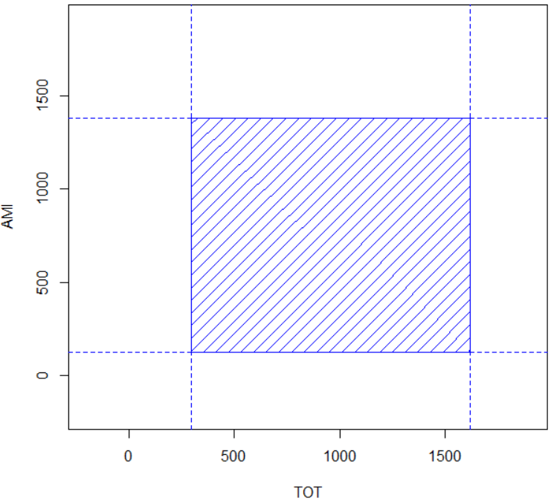
EXAMPLE 2 – Health care data (Johnson, Wichern)
predict(m11,newval,interval="predict")
# fit lwr upr
#1 958.5473 297.8818 1619.213
predict(m22,newval,interval="predict")
# fit lwr upr
#1 754.0677 127.2403 1380.895

Slide 61
EXAMPLE 2 – Health care data (Johnson, Wichern)
Predict TOT and AMI for a female with 1200 mg. of overdose
(use the multiple response regression model)
newval <- data.frame(GEN = 1, AMT = 1200)
predict(mlm2,newval,interval="predict")
# TOT AMI
#1 958.5473 754.0677
no prediction interval

Slide 62
EXAMPLE 2 – Health care data (Johnson, Wichern)
For two-response model
plotellipse <- function(mod,newdata,level = 0.95,
interval = c("confidence","prediction"))
{
.. .
}
plot prediction region
plotellipse(mlm2,newval,interval="prediction")

Slide 63
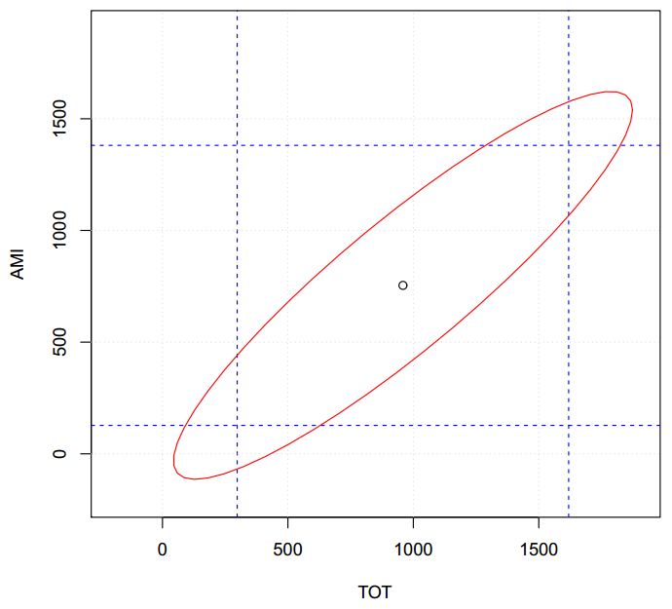
EXAMPLE 2 – Health care data (Johnson, Wichern)

Slide 64
EXAMPLE 2 – Health care data (Johnson, Wichern)
to plot the prediction region
plotellipse(mlm2, newval, level, interval="prediction")
To get individual prediction intervals
predictmlm(mlm2,newval,level=0.90,interval="prediction")
# TOT AMI
# fit 958.5473 754.06767
# lwr 138.7838 -23.70903
# upr 1778.3108 1531.84437

Slide 65
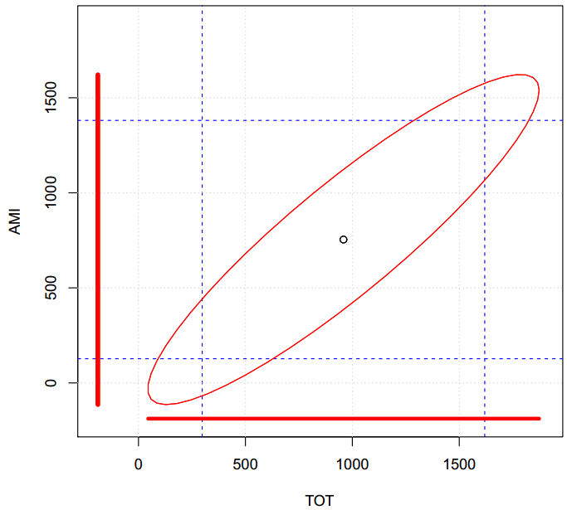
EXAMPLE 2 – Health care data (Johnson, Wichern)

Slide 66
EXAMPLE 2 – Health care data (Johnson, Wichern)

Slide 67
EXAMPLE 2 – Health care data (Johnson, Wichern)
For two responses, prediction region is an ellipse
plotellipse(mlm2, newval, level, interval="prediction")
To get individual prediction intervals
predictmlm(mlm2,newval,level=0.90,interval="prediction")
# TOT AMI
# fit 958.5473 754.06767
# lwr 138.7838 -23.70903
# upr 1778.3108 1531.84437

Slide 68
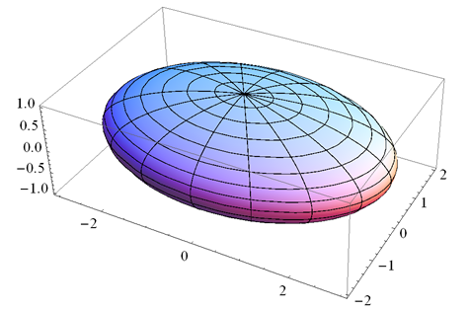
EXAMPLE 2 – Health care data (Johnson, Wichern)
For three responses - ellipsoid

Slide 69
EXAMPLE 2 – Health care data (Johnson, Wichern)
For three responses – prediction intervals

Slide 70
For more than two responses
do not plot the prediction region
but find prediction intervals

Slide 71
Conclusions

Slide 72
CONCLUSIONS
MRLR is a linear regression model with two
or more responses
Should be used when responses are correlated
and share same predictors
MRLRs do not provide prediction intervals
we provide predictmlm()

Slide 73
PERSONAL DATA
Cesar Acosta
acostame@usc.edu
Professor
University of Southern California
Department of Industrial and Systems Engineering
github.com/cesar-acosta

Slide 74
PERSONAL DATA
Qile Wang
qilewang@usc.edu
MS Analytics - student
University of Southern California
Department of Industrial and Systems Engineering

Slide 75
MULTIPLE RESPONSE REGRESSION MODELS
Thank you!

Slide 76
MULTIPLE RESPONSE REGRESSION MODELS
Questions?

