Slide 1

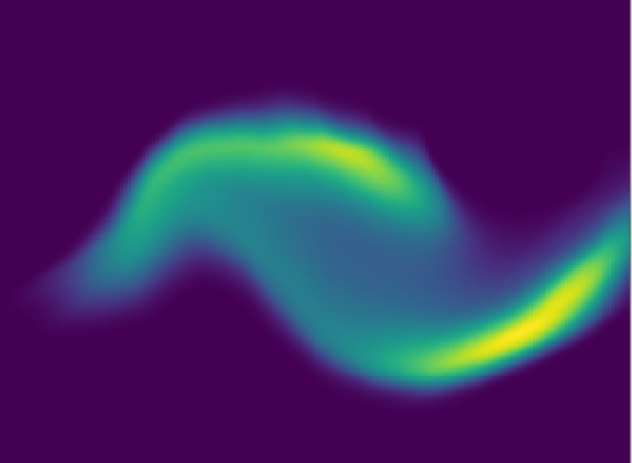
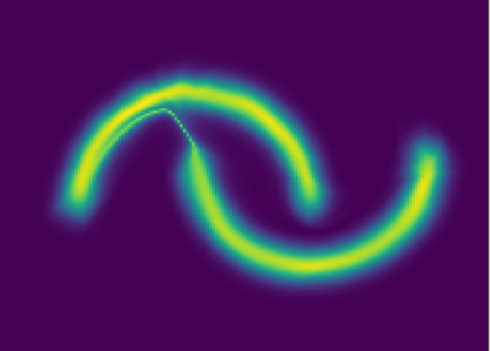
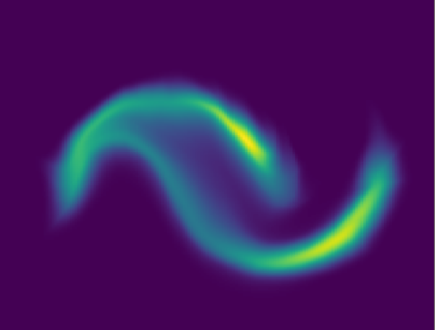




$$p_{x}\left(x|ω_{0}\right)$$
$$p_{x}\left(x|ω_{250}\right)$$
$$p_{x}\left(x|ω_{4000}\right)$$
$$p_{x}\left(x|ω_{500}\right)$$

