Slide 1
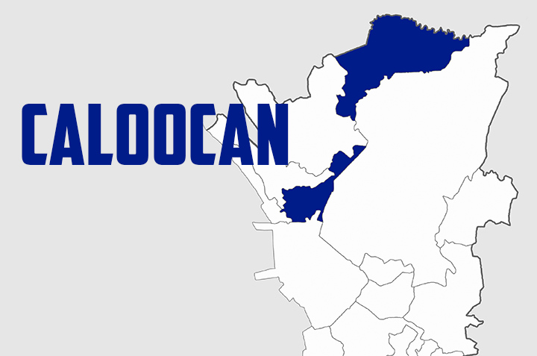
Some folks said that Caloocan got its name from a Tagalog word “lo-ok” (bay) because it is near to Manila Bay. Others insist that it was named after another Tagalog “sulok” (corner) because before, the place was located at the corner where the old towns
of Tondo and Malabon met. Therefore, the name of the place is a
mixture of the word
“kasuluk-sulokan” which
means“innermost area”.
Caloocan is known as the
Makasaysayang Lungsod (Historic City). Their claim of being
a historic city has a basis. This was the place of the Katipuneros, a secret militant society formed during the Spanish colonization in the country. The place served as their main meeting place and history also said that this was the place where the members of the Katipunan made their historic “Unang Sigaw” which served as the starting point for the early Filipinos to carry an arm against their oppressors.

Slide 2
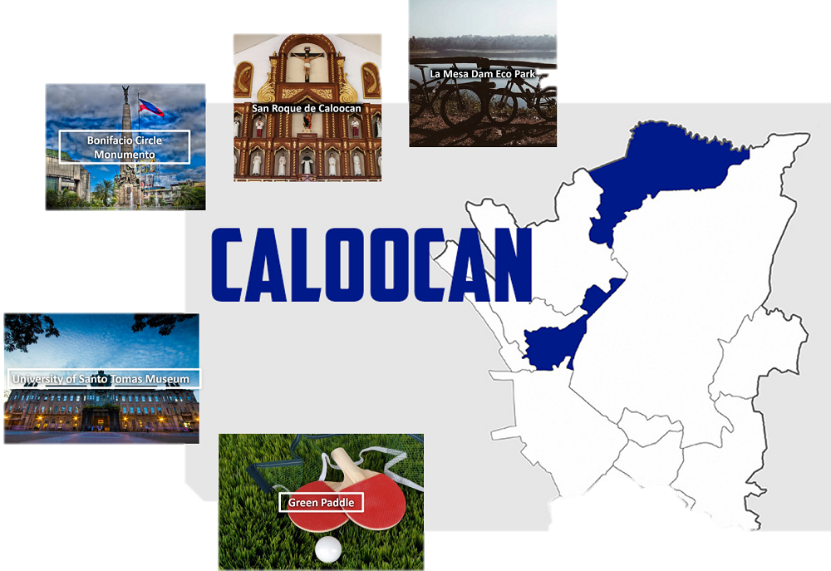

Slide 3
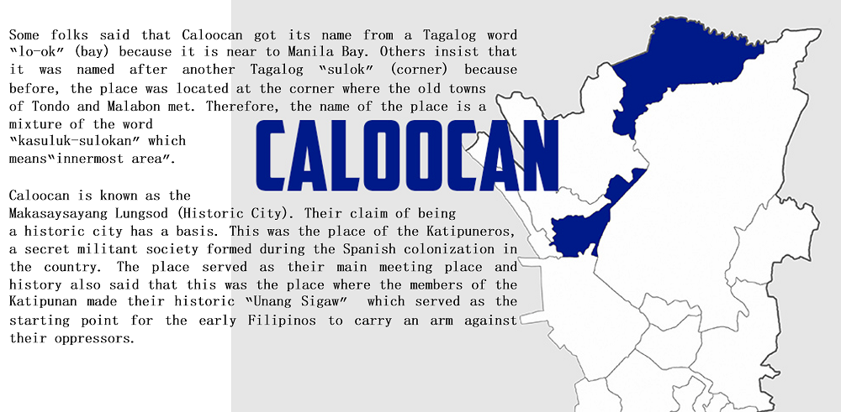
H I S T O R Y

Slide 4
The city limits of Caloocan borders La Mesa Watershed- 2,659 hectares of protected wetlands and Manila’s main source of water.
Visitors can come to take a tour of park paths where you’ll see fishermen with their polls in the water hoping to catch dinner. There are 50 miles of park paths within the watershed waiting to be explored; some of which are easily tackled wearing a pair of flip-flops.
Keep an eye out for exquisite wildlife with 4,400 acres of forest. La Mesa Watershed is a bird watcher’s heaven with a vast collection of colorful birds, big birds, and even some endangered birds.
A trip to Caloocan without visiting the watershed is not complete!

Slide 5
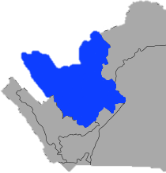
VALENZUELA
Valenzuela was named after Pio Valenzuela, a Filipino physician who was among the leaders of the Katipunan and served as the towns first presidente municipal who was appointed to serve as such.
Valenzuela’s long and colorful history dates back to the pre-colonial era, and traces the city’s evolution from a rural provincial town to a vibrant city, as well as its important role in the development of northern Metro Manila.
Prior to Spanish rule, and for centuries before Valenzuela’s urbanization, the city was located in a flourishing agricultural and fishing town, and part of a large land area that included parts of present-day Quezon City, Novaliches, and Obando, Bulacan.
Several bodies of water bound the area—the Tullahan River, which connects to the Pasig River on the south, and a number of connecting rivers, including the Rio Grande de Pampanga on the north. Because of the unique geography of the area, early inhabitants considered it as a separate island or "pulo", which became the area’s namesake until it was changed to the more Hispanic "Polo" during colonial rule.

Slide 6
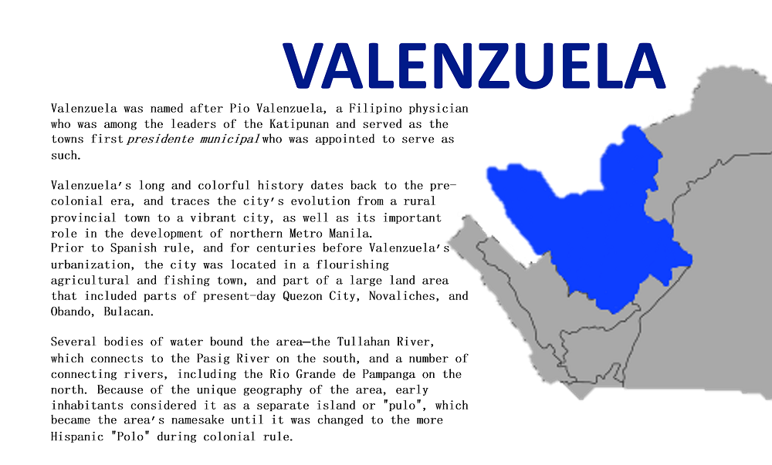
H I S T O R Y

Slide 7
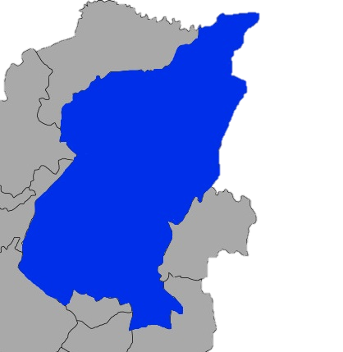
QUEZON CITY
Before Manila, Quezon was the capitol of the Philippines from 1948-1976? Named after Manuel L. Quezon, the second President of the Philippines, Quezon stands today as a metropolitan area full of entertainment, shopping, art, business, and nightlife.
With a population of nearly 2 million, Quezon is a city that keeps up with smooth-running public transportation like busses, Jeepneys, and soon to come, an underground MRT. You can be sure that when staying in Quezon as a tourist, you’ll have no troubles exploring.
You’ll find a nice balance of city life, wildlife, and marine life all within reach during your time in this bustling Philippine city. There is a range of accommodations from budget to luxury, as well as food to fit ever palate!
H I S T O R Y

Slide 8
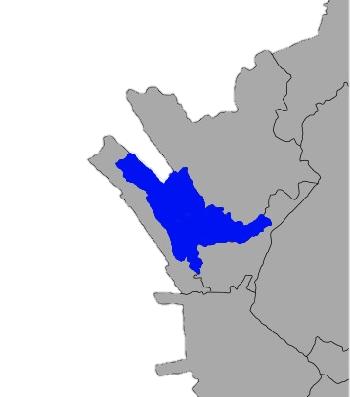
MALABON
According to legend, Malabon got its name from the words “maraming labong” (plenty of bamboo shoots). This was originally called as Tambobong and was founded by the Augustinian friars as a “Visita” of Tondo on May 21, 1599. It remained under this administrative jurisdiction from 1627 to 1688.
The place served as the literary center during the Spanish Colonization in 1896. In fact, “La Independencia”, a revolutionary publication, was printed here.
June 11, 1901, under the virtue of the Philippine Commission Act No. 137, Malabon was officially made a municipality under the then newly-created province of Rizal. 70 years passed, Malabon became a part of Metropolitan Manila or the National Capital Region. It became a city April 21, 2001 under Republic Act no. 9019 upon reaching its 407th years.
H I S T O R Y

Slide 9
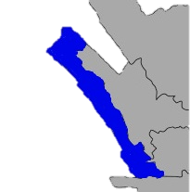
NAVOTAS
The whole Navotas was once part of Malabon. According to a legend, there was once a long and narrow delta extended unbroken from north to south along the seashore. The strip of land between the former district of Tondo and this town was eaten away by the sea until as opening was made. Water started to
flow through the opening. The change in the place made the residents to refer to the place as “butas”, “nayon ng butas” or “nabutas”, Tagalog words that mean breached or pierced through. In the next years, the place became known as “Nabotas”, then “Navotas”.
In 1904, the town was merged with Malabon with Bernardo Dagala as the elected municipal president. Two years after, Navotas became a separate and independent municipality with the enactment of Act No. 1442 which separated it from Malabon. And on June 24, 2007, the municipality became a city after a plebiscite was conducted.
H I S T O R Y

Slide 10
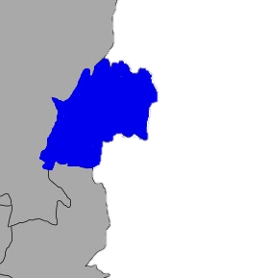
MARIKINA
The City of Marikina is one of the 17 cities that make up Metro Manila, one of the most populous metropolitan areas in the world. Marikina was the former capital of the province of Manila during the declaration of Philippine Independence. The city divided into two districts and composed of 16 barangays, located along the eastern border of Metro Manila, it is bordered on the west by Quezon City, to the south by Pasig City and Cainta, Rizal, to the east by Antipolo City, the capital of Rizal Province, and to the north by San Mateo also in Rizal Province. Marikina is one of the most populous cities and wealthiest local government unit in the country.
Marikina is noted as one of tourism and cultural hub in Metro Manila, it is also the home of Philippine Footwear Federation. Marikina is one of the wealthiest local government units in the Philippines. Aside the traditional shoe and leather industry, many places in Marikina are now recognized for its eco-friendly points, balance of industry, people and nature. Among this, the residents satisfy the basic services and transparent governance of the city. The city features typically many spacious parks, museums, tree-lined streets, bike-lanes, traffic signs, crossings, walkways, churches, antiquated houses and commercial establishments. Despite the latter, most of the city is classified as residential and industrial.
H I S T O R Y

Slide 11
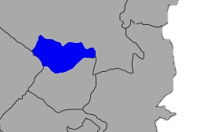
SAN JUAN
The city of San Juan or simply San Juan is a city in Metro Manila in the Philippines. Before the creation of Metro Manila, it was part of Rizal Province. Currently the smallest city in the region and the country in terms of area, San Juan is one of the smallest among the cities and municipalities in the metropolis, second only to Pateros. This was the site of the first battle of the Katipunan, the Filipino revolutionary organization, against the Spanish colonizers.
H I S T O R Y

Slide 12
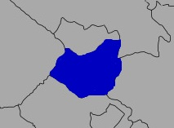
MANDALUYONG
H I S T O R Y
Mandaluyong City is referred to as “Tiger City of the Philippines”, “Metro Manila’s Heart”, and the “Shopping Mall Capital of the Philippines”. It is well developed that many of its infrastructures are owned and managed by the most successful business men in the country.
There are lots of sources of where this city got its name. Some claim that the place got its name from the Tagalog terms “mga” which means many and “daluy” which means flowing in the reference to the tall grasses that grow in the land many years ago. Another also claimed that it got its name from the incident when Acapulco, a navigator, saw that the rolling hills were frequently lashed at by “daluyong” or big waves from the sea.
Hence the residents gave an answer to those who inquired about the name of the place as “madaluyong”. Later, the Spaniards affixed a consonant “n” to it thus making it Mandaluyong.
Today, Mandaluyong is a bustling city with vibrant economic
activities and among many
other city accomplishments.

Slide 13
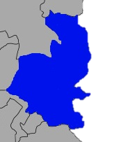
PASIG
H I S T O R Y
Even before the Spaniards came, there were already class of people living in Pasig. They were called Remontados who used to live in the mountains.
According to an American anthropologist named H. Otley Beyer, the first settlers in the city were groups of people of varied cultures and racial types who came to the Philippines in migratory waves during the long period of 25,000 to 30,000 years ago.
Pasig was a part before of Rizal province and served as its capital. However in 1975, it was carved out of Rizal and became part of Metro Manila when the Metro manila Commission was created by President Ferdinand Marcos through Presidential Decree 824.
At about 1450 A.D. the Pasig was a peaceful kingdom and was being ruled by Dayang Kalangitan, wife of Gat Lontok. It was also said that the people at that time were getting their foods at the river. There were also some who used to wash their clothes there. Others used the river for taking a bath.
Pasig continued to grow economically until it was converted into a highly urbanized city on January 21, 1995 through Republic Act 7829.

Slide 14
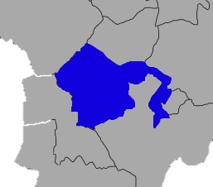
MAKATI
H I S T O R Y
Makati is the financial center of the Philippines where the Philippine Stock Exchange and the Makati Business Club is situated.
Notable for its multicultural lifestyle, Makati became known not only in the country but also abroad. The city is a home for many Makati hotels, shopping centers, condominiums, financial and entertainment hubs – most of them being owned, managed and frequently visited by the successful foreign businessmen – which is the major factor that made this city very prosperous.
All starts from low but Makati didn’t just begin from low, it really started as a swampland! Some said that during the Spanish colonization,
As years passed, many investors came to the municipality, putting businesses there that took the attentions of foreign neighbors. February 28, 1914, the Philippine Legislature passed Act 2390 thus shortening its name from San Pedro de Macati to simply Makati.
“From grass to class”, as what they call it, Makati City proved it throughout the years by being a great contributor to the development of the Philippine economy.

Slide 15
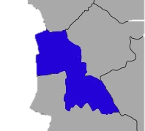
PASAY
H I S T O R Y
An explanation says that Pasay got its name from a princess named Dayang-dayang Pasay. She was a princess of the Namayan Kingdom that existed around year 1175. She owned the lands now comprising the territories of Culi-culi, Pasay and Baclaran.
The city of Pasay is one of the cities and municipalities that make up Metro Manila in the Philippines. It is bordered on the north by the country's capital, Manila, to the northeast by Makati City, to the east by Taguig City, and the Parañaque City to the south.
The city of Pasay has long been a great earner for Metropolitan Manila, even when it was only a town. The economic life of the town had steadily improved that its income
exceeded the limit set for an ordinary town, and thus it became a city.
Today, Roxas Boulevard is a recognized center for culture and the arts in the country. Found here is the Cultural Center of the Philippines, which was built to symbolize the country's national cultural development. The CCP is an institution mandated by law to preserve, promote, and enhance the Filipino people's cultural heritage. Not far from the Cultural Center of the Philippines stands the Folks Arts Theater. The work of Architect Leandro Locsin, the 10,000-capacity theater is used for popular performances which anticipate extensive audiences.

Slide 16
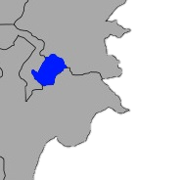
PATEROS
H I S T O R Y
This municipality is famous for its duck-raising industry and especially for producing balut, a Filipino delicacy, which is a boiled, fertilised duck egg. Pateros is also known for the production of red salty eggs and "inutak", a local rice cake. Moreover, the town is known for manufacturing of "alfombra", a locally-made footwear with a carpet-like fabric on its top surface. Pateros is bordered by the following highly urbanized cities of Pasig to the north, Makati to the west, and Taguig to the south.
Pateros is the only municipality and the smallest, both in population and in land area, in Metro Manila, but it is the second most densely populated at around 29,000 people per square kilometer after Manila.

Slide 17
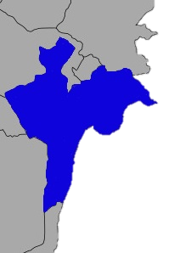
TAGUIG
H I S T O R Y
The City of Taguig, (formerly spelled as Tagig), is a highly urbanized city located in south-eastern portion of Metro Manila in the Philippines. From a thriving fishing community along the shores of Laguna de Bay, it is now an important residential, commercial and industrial center. The recent construction of the C-5 highway and the acquisition of the Fort Bonifacio Development Area has paved the way for the cityhood of the municipality. You can now access Taguig via C-6 Road.
Taguig City lies on the western shore of Laguna de Bay and is bordered by Muntinlupa City to the south, Parañaque to the southwest, Pasay to the west, Cainta and Taytay on the northeast and Makati, Pateros, and Pasig to the north. Taguig River, a tributary of the Pasig River,
cuts through the northern half of the municipality and Napindan River, also a tributary of the Pasig forms the common border of Taguig with Pasig City.
The city ranked first among Philippine cities in the Ease of Doing Business Index, conducted by the World Bank's International Finance Corporation.

Slide 18
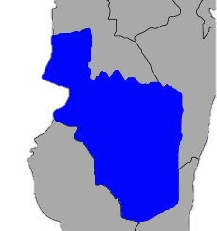
PARAÑAQUE
H I S T O R Y
The Parañaque City is one of the cities and municipalities that make up Metro Manila in the Philippines. It is located at 121’01” longitude and 14’30” latitude and is bordered to the north by Pasay, to the northeast by Taguig, to the Southeast by Muntinlupa, to the southwest by Las Piñas, and to the west of Manila Bay.
A historian believes the town’s name may have come from the term “palanas” which means a “broad flat plain,” the geographic description of Parañaque.
Other origins of the name Parañaque are “palanac” (with no special meaning), “palanyag” or contest for popularity, and “paranac”, a native term for the shell product that used to be the livelihood of the natives of the town at one time.
Today, Parañaque is a blossoming city. Due to its strategic location, it is an important centre for trade and business in Metro Manila. Baclaran, where a large number of dry goods stores are located, is one of the busiest markets in the country. Small fishing villages called “fisherman’s wharves” are also situated alongside Barangay La Huerta, where the famous DAMPA, a seaside market with numerous restaurants serving fresh seafood, is found. The country’s international airport as well as the Baclaran Church, one of the most active parishes in Manila, and the Duty Free, where one can buy imported goods,
can be found here.

Slide 19
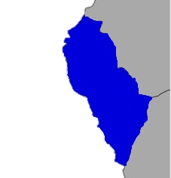
LAS PIÑAS
H I S T O R Y
Its proclamation into a town varies depending to the two historical records available. Cavada, a Spanish historian and Fr. Juan Medina state that it was proclaimed as a town year 1762, while Buzeta recorded the event at 1797.
The City of Las Piñas is one of the cities that can be found in the National Capital Region. The city has many nicknames such as Home of the Bamboo Organ, City of Love and Progress, Salt Center of Metro Manila, and the Lantern Capital of Metro Manila. It only proves that the city is one of the most improved and progressive cities in the region. Las Piñas is bounded on the north and northeast by Parañaque; on the east and southeast by Muntinlupa; on the south by Imus; on the
southwest and west by Bacoor; and on the northwest by the scenic Manila Bay. Half of its land area is residential and the remaining half is used for commercial, industrial and institutional purposes. The present physiography of Las Piñas consists of three zones: Manila Bay, coastal margin and Guadalupe Plateau.
Las Piñas currently bans Plastics and Styrofoam for packaging like its neighboring city, Muntinlupa.

Slide 20
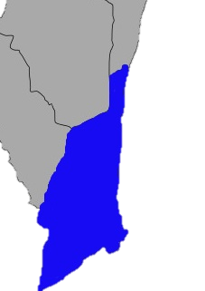
MUNTINLUPA
H I S T O R Y
The city of Muntinlupa is the southernmost city in the Philippine National Capital Region. It is bordered on the north by Taguig City; to the northwest by Parañaque City; by Las Piñas City to the west; to the southwest by the city of Bacoor; by the city of San Pedro, Laguna; and by Laguna de Bay to the east, the largest lake in the country. It is classified as a highly urbanized city with a population of more than 400,000 and is given the nickname "Emerald City of the Philippines" by the tourism establishment.
Muntinlupa is a home to some of the best commercial establishments in the metropolis and is the location of Ayala Alabang Village,
one of the country's biggest and most expensive residential communities, where many of the wealthy and famous live.
Muntinlupa is also the very first city in the Philippines to ban the use of plastic bags and styrofoam for packaging.

