Slide 1
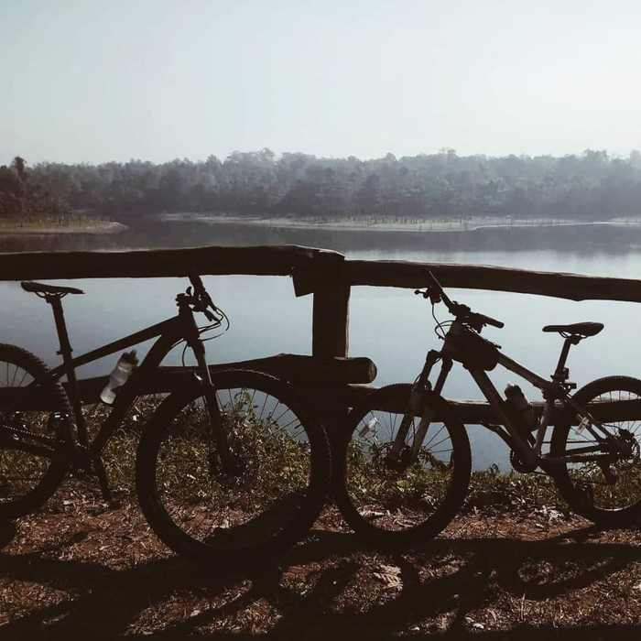
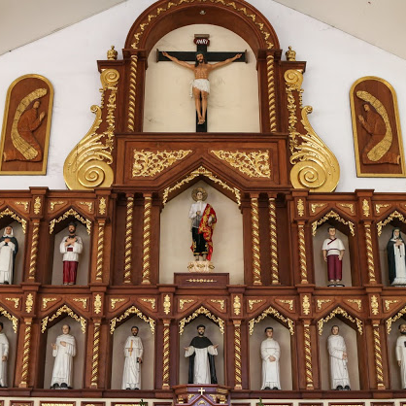
La Mesa Dam Eco Park
San Roque de Caloocan

Slide 2
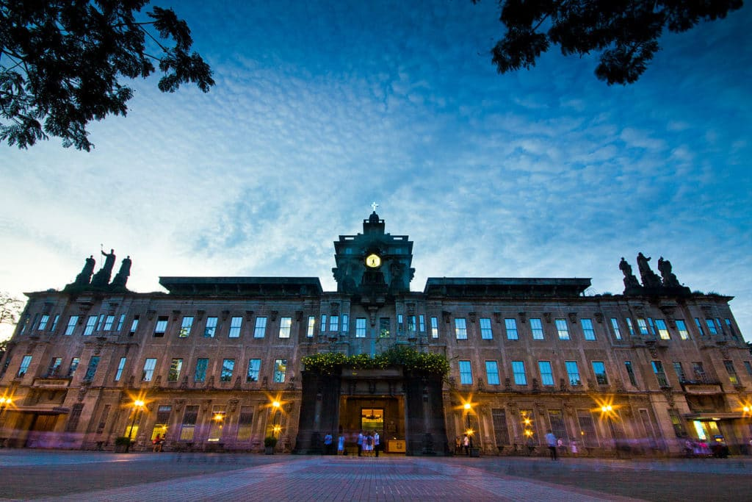
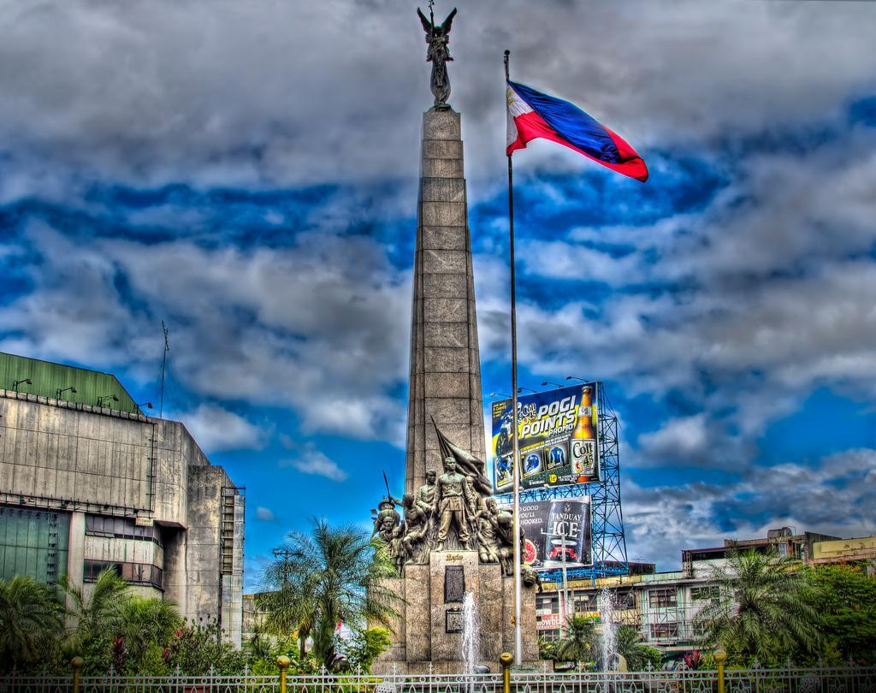
Bonifacio Circle
Monumento
University of Santo Tomas Museum

Slide 3
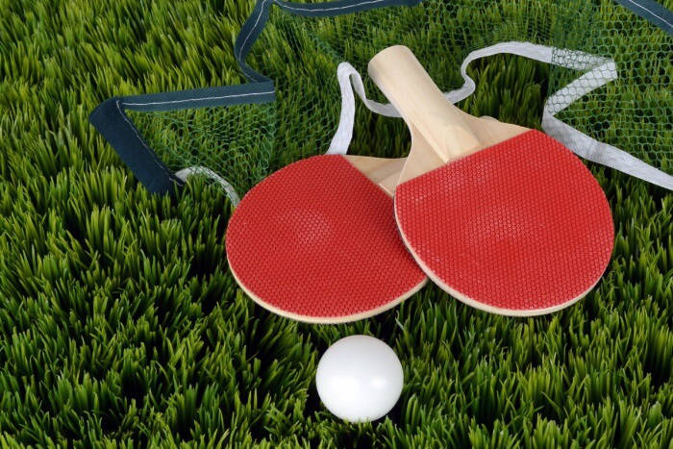
Green Paddle

Slide 4
