Slide 1
Finlatics Case Project
Harsh Varshney, CSE, IIT Dharwad

Slide 2
Introduction
Data analysis of a marketing campaign of a Portuguese bank (May, 2008 - Nov, 2010).
This aims to predict whether a client will subscribe to a term deposit.

Slide 3
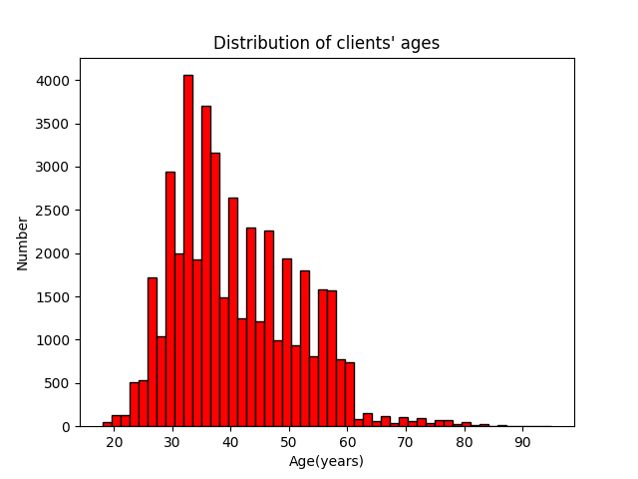
Distribution of Clients’ Ages
The minimum and maximum ages are 18 and 95 respectively.
The mean age is about 41 years, while the median age is 39 years.
Most clients are between 30 to 40 years of age, with very few being below 25 or above 60.

Slide 4
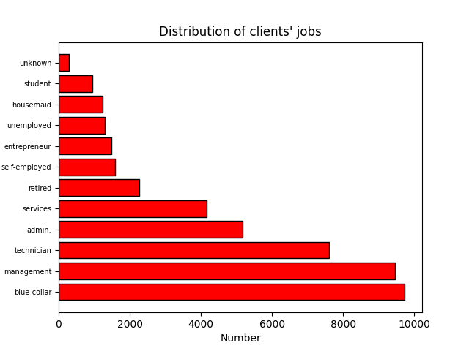
Distribution of Clients’ Jobs
9,732 clients have blue-collar jobs, the most out of any category, with management also having 9,460 clients.
288 clients have unknown jobs, while 937 are students.
The retirees make up 2,267 clients.

Slide 5
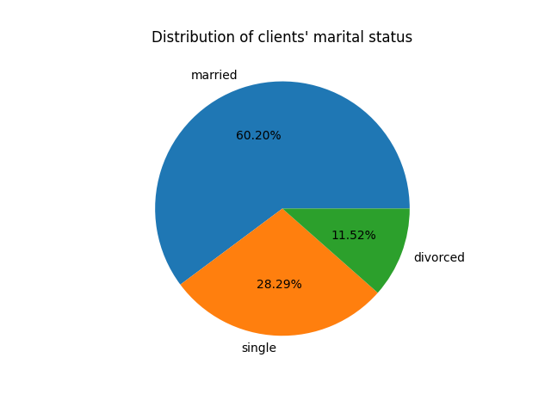
Marital Status of the Clients
60.20% of the clients, or 27, 220 clients, are married.
28.29% of the clients are single.
11.52% of the clients are divorced.

Slide 6
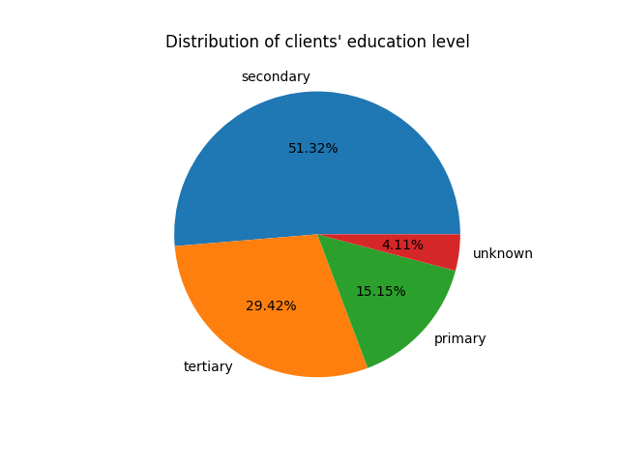
Education Level of the Clients
51.32% of clients have completed secondary education.
29.42% of clients have completed tertiary education.
15.15% of clients have completed primary education.
4.11% of clients have unknown education.

Slide 7
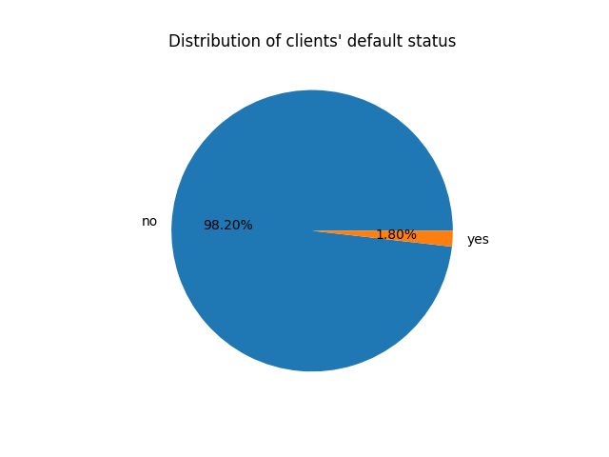
Proportion of Defaulter Clients
1.8% of clients are found to have credit in default.

Slide 8
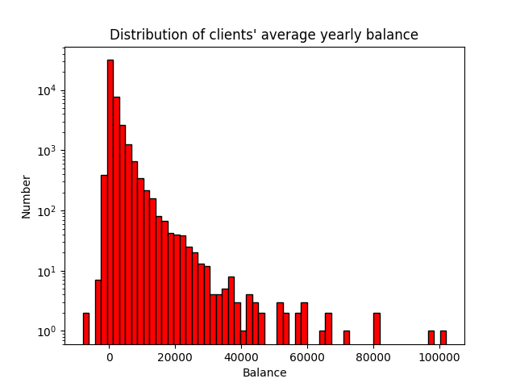
Distribution of Yearly Balance
Most clients have an average yearly balance of around 0 Euros, with a small portion having negative yearly balance.
A small percentage of clients have yearly balance of over a 1000 Euros.

Slide 9
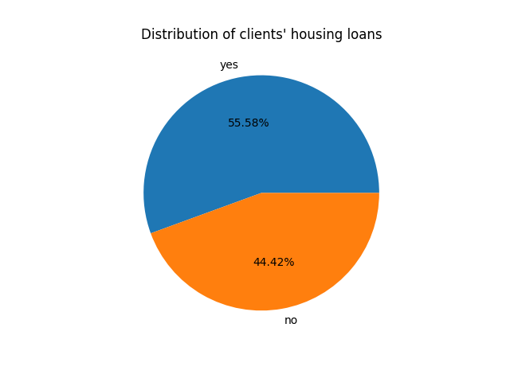
Clients with Housing Loans
55.58% of clients have housing loans, while 44.42% do not.

Slide 10
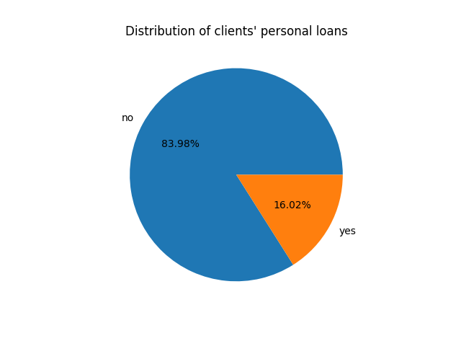
Clients with Personal Loans
16.02% of clients have personal loans, while 83.98% do not.

Slide 11
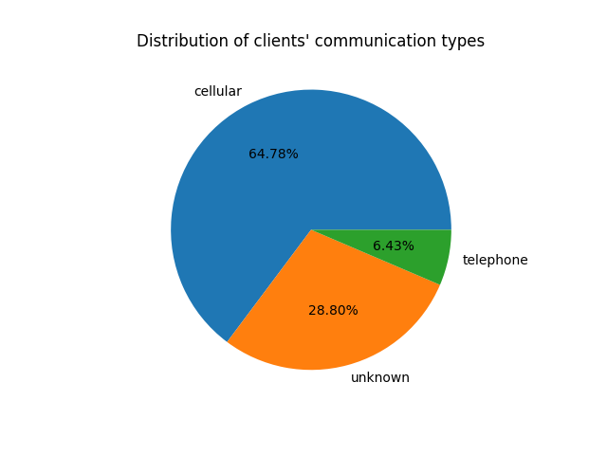
Communication Types used to Contact Clients
Majority of clients are contacted by cellular device, with 64.78%.
6.43% of clients are contacted using telephone, while remaining 28.80% of clients are contacted using unknown types of communication.

Slide 12
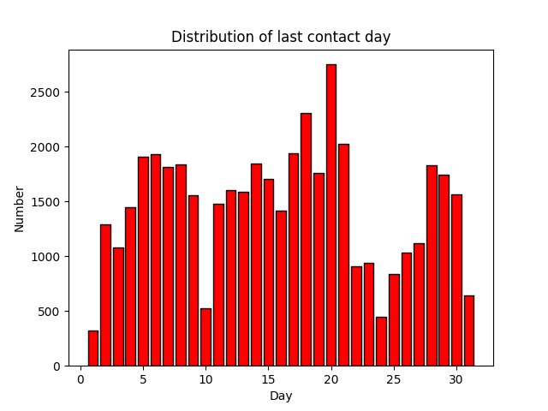
Distribution of Last Contact Day
Most clients are last contacted on the 20th of the month, with very few being contacted at the beginning or end of the month.

Slide 13
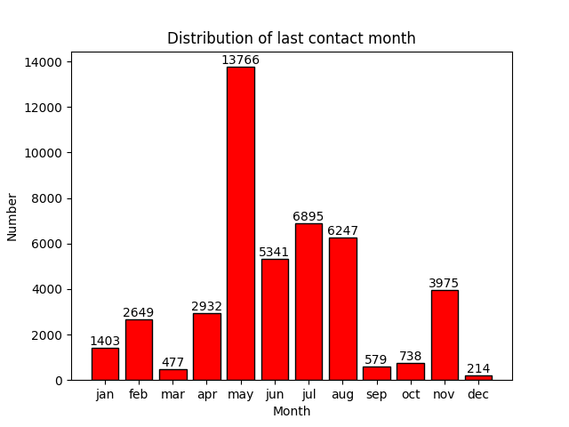
Distribution of Last Contact Month
Highest number of clients are contacted during the summer months, with the most being contacted in the month of May.
The months of March, September, October, and December have very few clients being contacted.

Slide 14
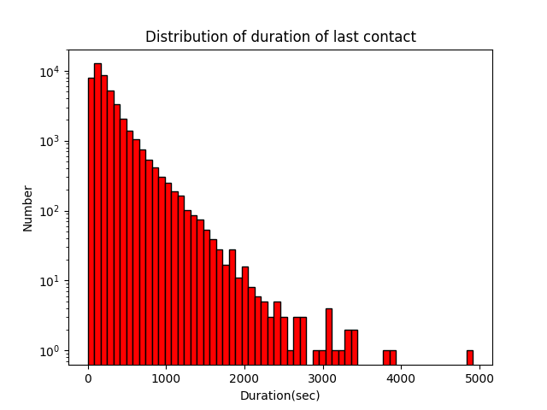
Duration of Last Contact
Most contacts have a relatively short duration while a handful of contacts last for very long duration.

Slide 15
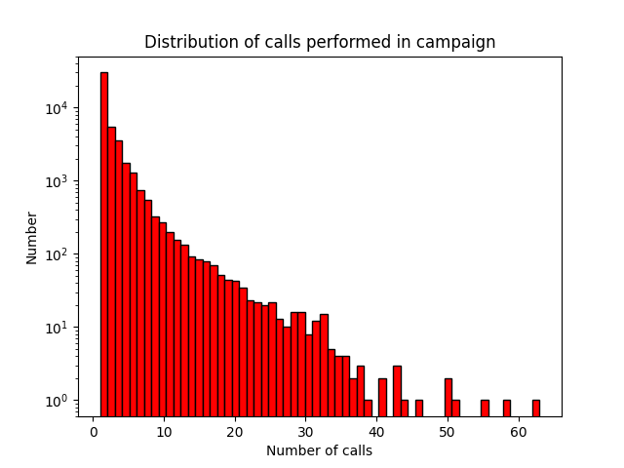
Contacts During Campaign of Each Client
Most clients were contacted less than 10 times during the campaign.
A small percentage of clients were contacted over 30 times.

Slide 16
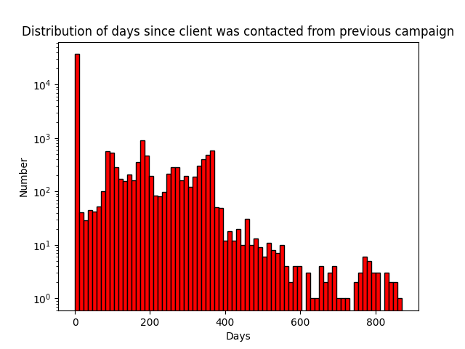
No. of Days since Client Contacted from Previous Campaign
A large portion of the clients were contacted for the first time.
A small portion of the clients were contacted after 1 to 1.5 years.
A very small portion of clients were contacted after 2 years.

Slide 17
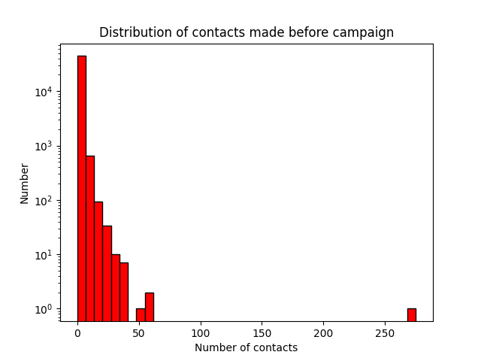
Contacts Performed before Current Campaign
As a large portion of clients were contacted for the first time, contacts made before the current campaign for most clients is 0. Very few clients had more than 10 previous contacts, with only one client who had over 250 previous contacts.

Slide 18
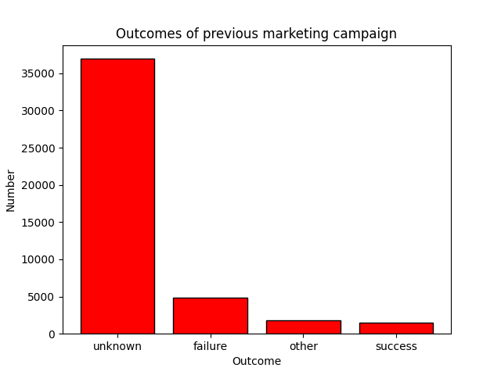
Outcomes of Previous Campaigns
The previous marketing campaign was a success for 3.34% of current clients.
It was a failure for 10.84% of current clients.
The vast majority of clients were contacted for the first time, so the previous marketing campaign had largely unknown outcomes.

Slide 19
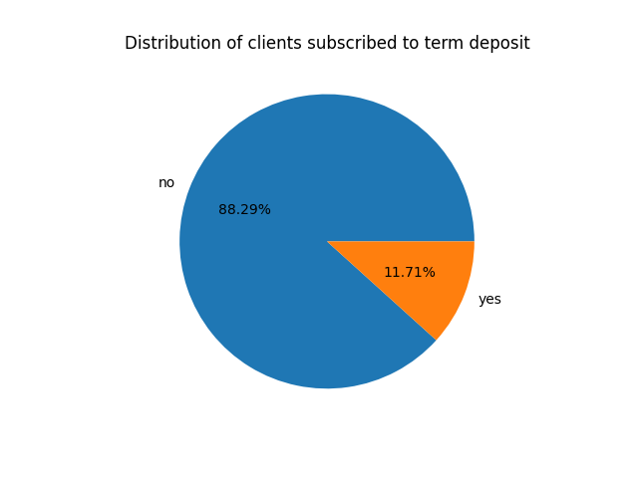
Distribution of Clients who Subscribed
11.71% of clients subscribed to the term deposit, while 88.29% did not.

Slide 20
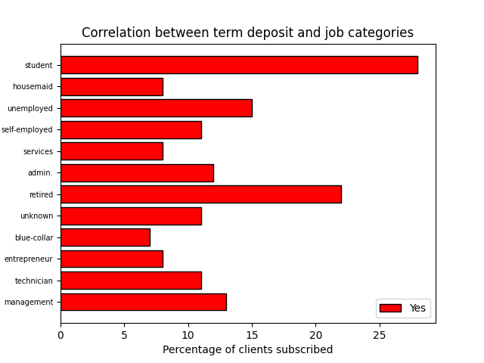
Correlation b/w Term Deposits and Jobs
Students were 15.67% more likely to subscribe than the average client.
Retirees were 9.17% more likely to subscribe than the average client.
Blue-collar workers were 5.83% less likely to subscribe than average.

Slide 21
THANK YOU !!

