Slide 1

Total Model cost = $\sum_{y}{AnnualCost(y)}$ for all years y in the model
AnnualCost(y) = AnnualCarrierCost(y) + AnnualECTCost(y) + AnnualStorageCost(y)
1
AnnualCarrierCost =
Σ_{ec} CostOfCarrier (ec, y) for all energy carriers ec.
AnnualECTCost = Σ_{ect} ECTFixedCost (ect, y) for all energy conversion technologies ect. Fixed cost incurred for all installations of technology ect existing in y [annualized payment over asset life]
AnnualStorageCost = Σ_{st} CostOfStorage (st, y) for all energy storage technologies st. Fixed cost incurred for all installations of storage st existing in y [annualized payment over asset life?]
2
CostOfCarrier(ec,y) = ECTInputVarCost(ec,y) + Σ_{ba,bt} (TotalECCostInBT_BA(ec,bt,ba) * ScaleFactor), where all “balancing areas” ba and “balancing time units” bt within y and ScaleFactor is a constant to scale up the cost when bt is a “representative” time unit standing for multiple “actual” time units
3
ECT-InputVarCost(ec,y) = The additional cost (beyond the cost of ec itself) of processing/using ec as an input to some ect in the year y. This accounts for costs such as the cost of storing, sizing and processing coal in a coal-based plant.
TotalECCostInBT_BA(ec,bt,ba) = ECCostInBT_BA(ec,bt,ba) + ECTransitCost(ec,bt,ba) + CostOfUnmetDemand (ec,bt,ba), where CostOfUnmetDemand is not a separate output but can be computed from the output UnmetDemand
ECCostInBT_BA(ec,bt,ba) = DomECCostInBT_BA(ec,bt,ba) + ImpECCostInBT_BA(ec,bt,ba) where ImpECCostInBT_BA(ec,bt,ba) is the cost of the imported ec including taxes etc., for both primary and derived carriers, where the quantity of ec is again that imported for any purpose (end-use, input to ect or for storage)
ECTransitCost (ec,bt,ba) = The cost of transferring ec to ba from any geography ba’ (including ba itself) in bt
4
DomECCostInBT_BA(ec,bt,ba) = The quantity of ec considered here is the ec produced domestically for any purpose – to meet end-use demand, as input to some ect, or to be stored in some storage. If ec is a primary energy carrier, it is the cost of the ec domestically produced in ba-bt including taxes etc. If ec is a derived energy carrier, the only cost is the fixed tax overheads of producing the ec, because the other costs are considered elsewhere

Slide 2
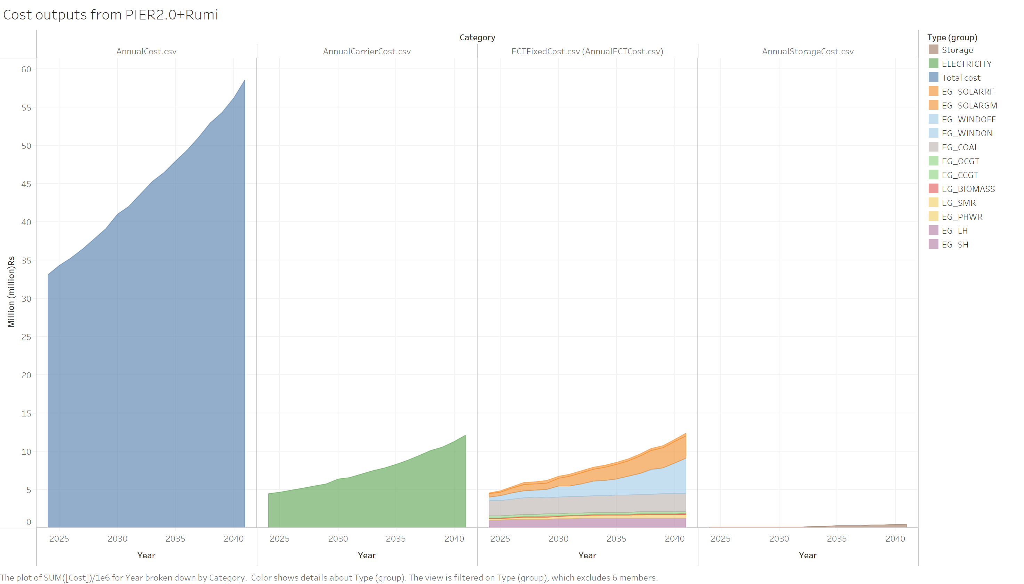
PIER2.0+Rumi costs – Electricity only, no electrolysis
~4.48 mmRs
~4.5 mmRs

